Slide 1



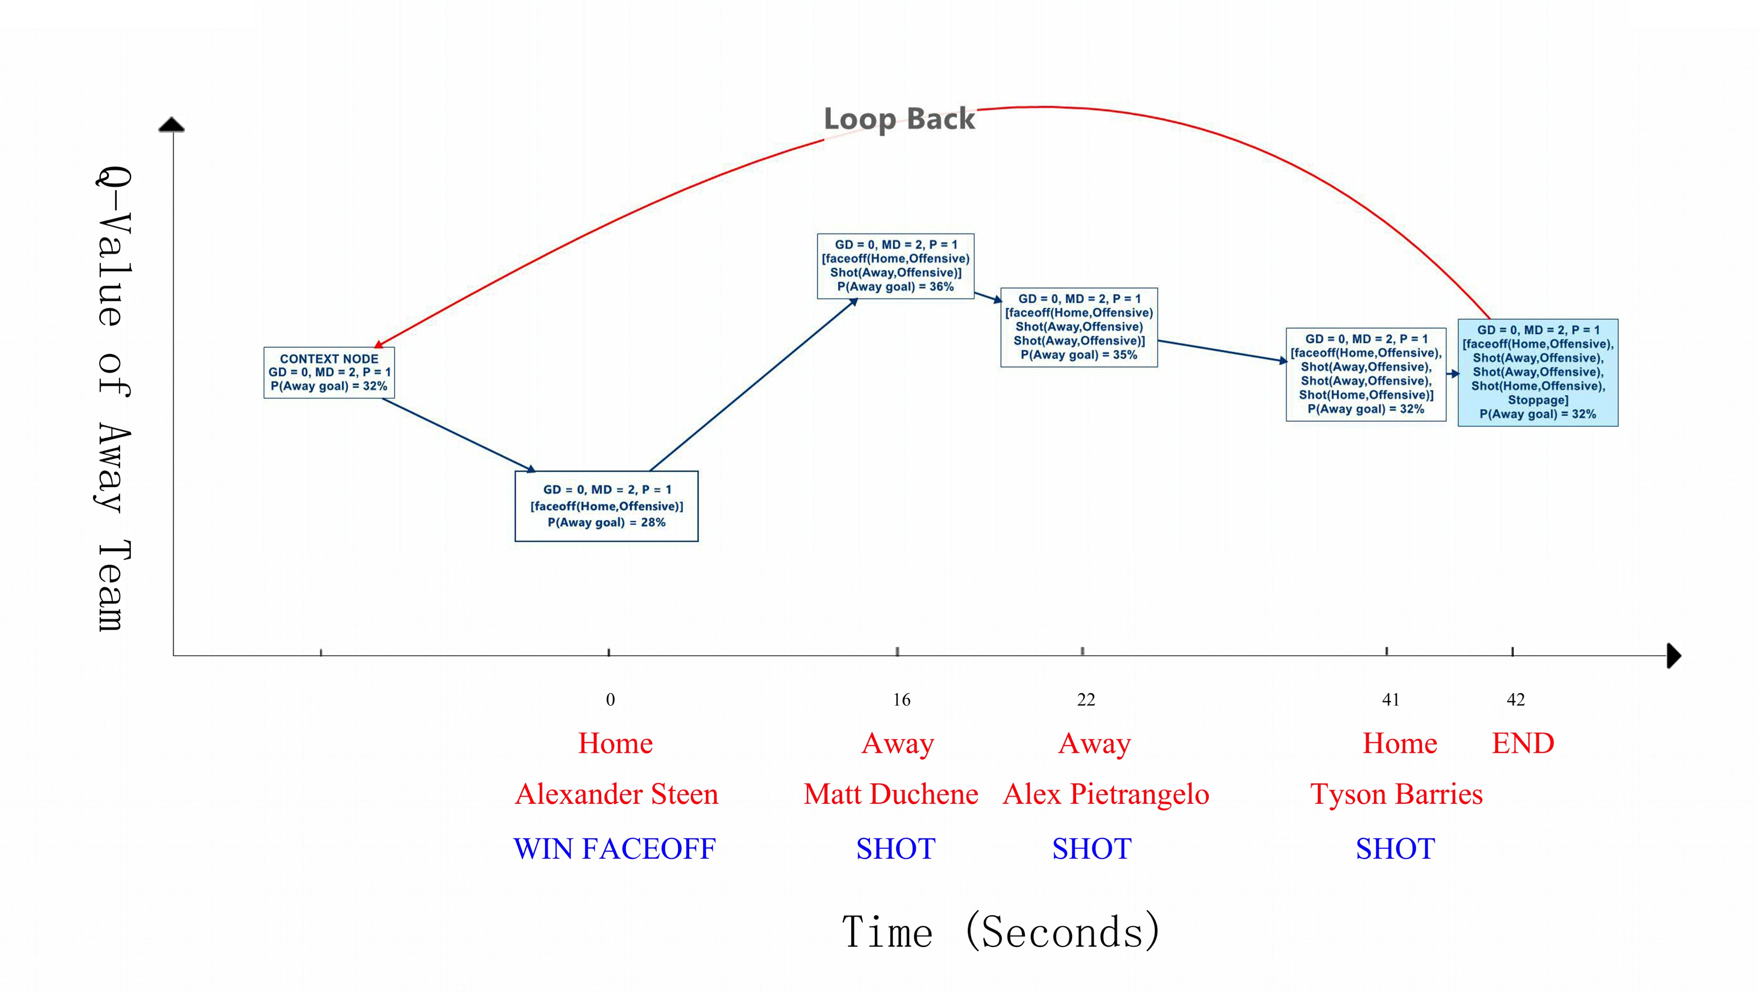
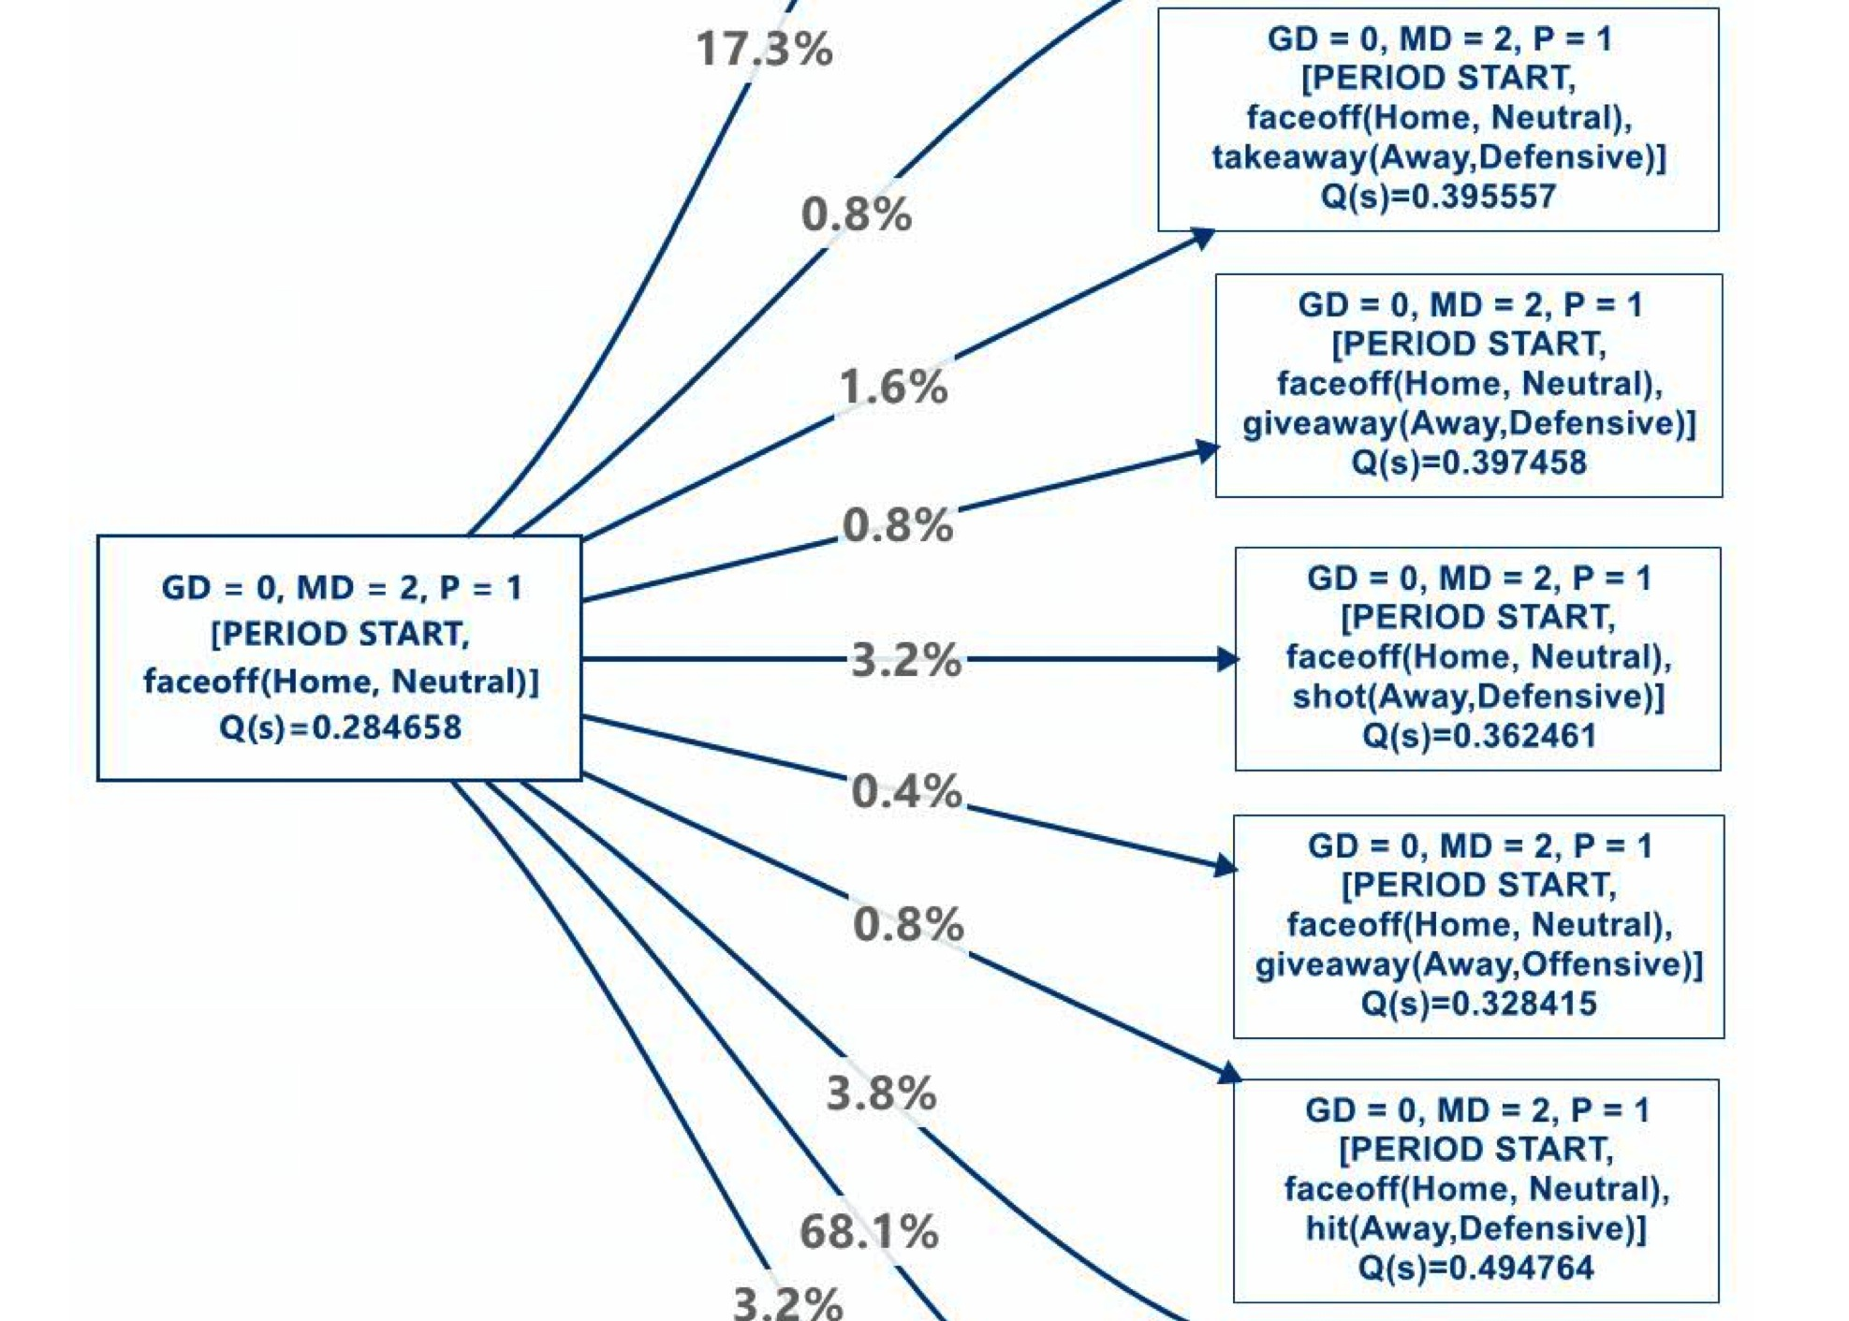
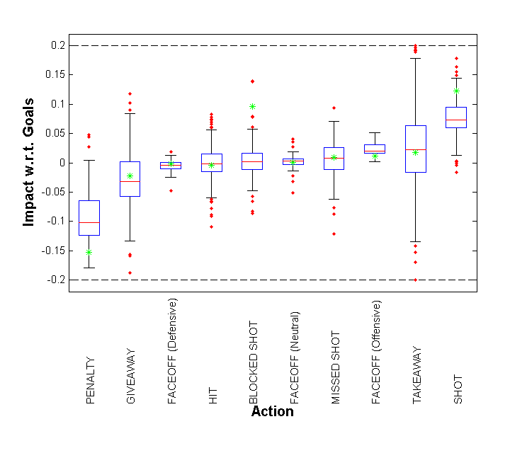
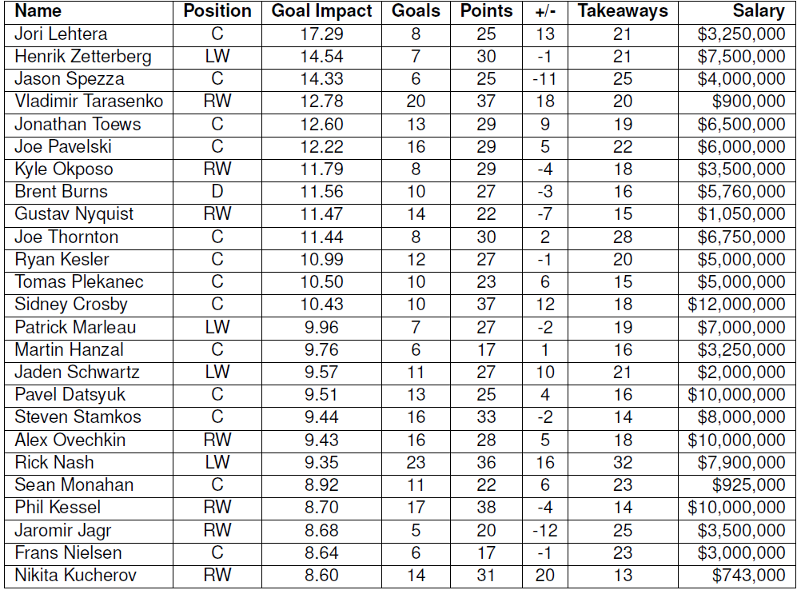
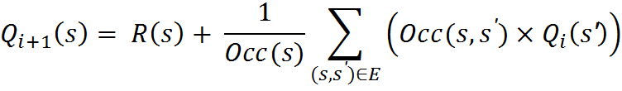
A Markov Game Model for
Valuing Player Actions in Ice Hockey
Kurt Routley, Oliver Schulte
School of Computing Science, Simon Fraser University,
Vancouver-Burnaby Canada
Introduction
Our vision: sports analytics = branch of reinforcement learning.
Fundamental question: which actions contribute to winning in what situation?
Answer: learn an action-value function or Q-function.
Markov Game Model
A Markov Game Model [1] consists of 4 components:
State Space, Transition Graph + Probabilities, Rewards
Players = Home, Away.
State = (Goal Differential, ManPower Differential, Period, Action History within play sequence)
Transition probababilities estimated from the number of observed occurrences.
>1.3 M states with >0 occurrences.
Player Impact Scores
The impact of an action in a state
is defined by
The Q-Value Ticker for Colorado vs. St. Louis
Motivation
Advantages over previous action-based analytics (plus-minus, Corsi, Fenwick).
Context-Awareness. Action values depends on context = state.
Example: Goals are worth more with tied scores than with a 2 goal lead.
Lookahead. Actions can have medium-term impact.
Example: Penalties can lead to goals but not immediately.
State Transition Examples.
Related Work
Expected Possession Value EPV: a Q-function for basketball [2]. Spatial-temporal model based on tracking data.
Total Hockey Rating (THoR) [3] assigns a value to all ice hockey player actions. No context, fixed look-ahead window (20 sec).
Action Goal Impact Depends on Context
Boxplot of action value for each state.
* = THoR Action Values [3].
Player Total Goal Impact (2014-2015 Season 1st half)
Jason Spezza has high goal impact, low plus-minus.
Data Set
2.8M events, > 600K play sequences.
Rewards/Costs
Score Goal/Incur Penalty.
Value Iteration for Q-Learning
Since states encode action histories, the expected value of states is equivalent to learning a Q-function (V = Q).
References
M. L. Littman. Markov games as a framework for multi-agent reinforcement learning. In ICML, pp. 157-163, 1994.
Cervone, D.; D’Amour, A.; Bornn, L. & Goldsberry, K. POINTWISE: Predicting points and valuing decisions in real time with nba optical tracking data. In MIT Sloan, 2014.
M. Schuckers and J.Curro. Total hockey rating (THoR): A comprehensive statistical rating of national hockey league forwards and defensement based upon all on-ice events. In MIT Sloan, 2013.
Conclusion
The Q-function is a powerful AI concept that captures much information about hockey dynamics (or other sports).
Novel player ranking method based on reinforcement learning.
The Q-impact of an action varies greatly with context, and medium-term ripple effects make a difference.
Goal Impact scores correlate with points.
Applications of the Q-function
Knowledge Discovery. Cervone et al. [2]: “We assert that most questions that coaches, players, and fans have ...can be phrased and answered in terms of EPV [i.e., the Q-function].”
Player ranking. Add up the total impact of a player’s actions.

