Slide 1

A Markov Game Model for Valuing Player Actions in Ice Hockey
Kurt Routley & Oliver Schulte, Simon Fraser University, Vancouver, Canada.
Reinforcement Learning
Sports
Analytics
We built Markov game model for NHL.
Big Data, Big Model:
2.8 M Events.
1.3 M States.
Learn Q-function (expected value of action in state).

Slide 2
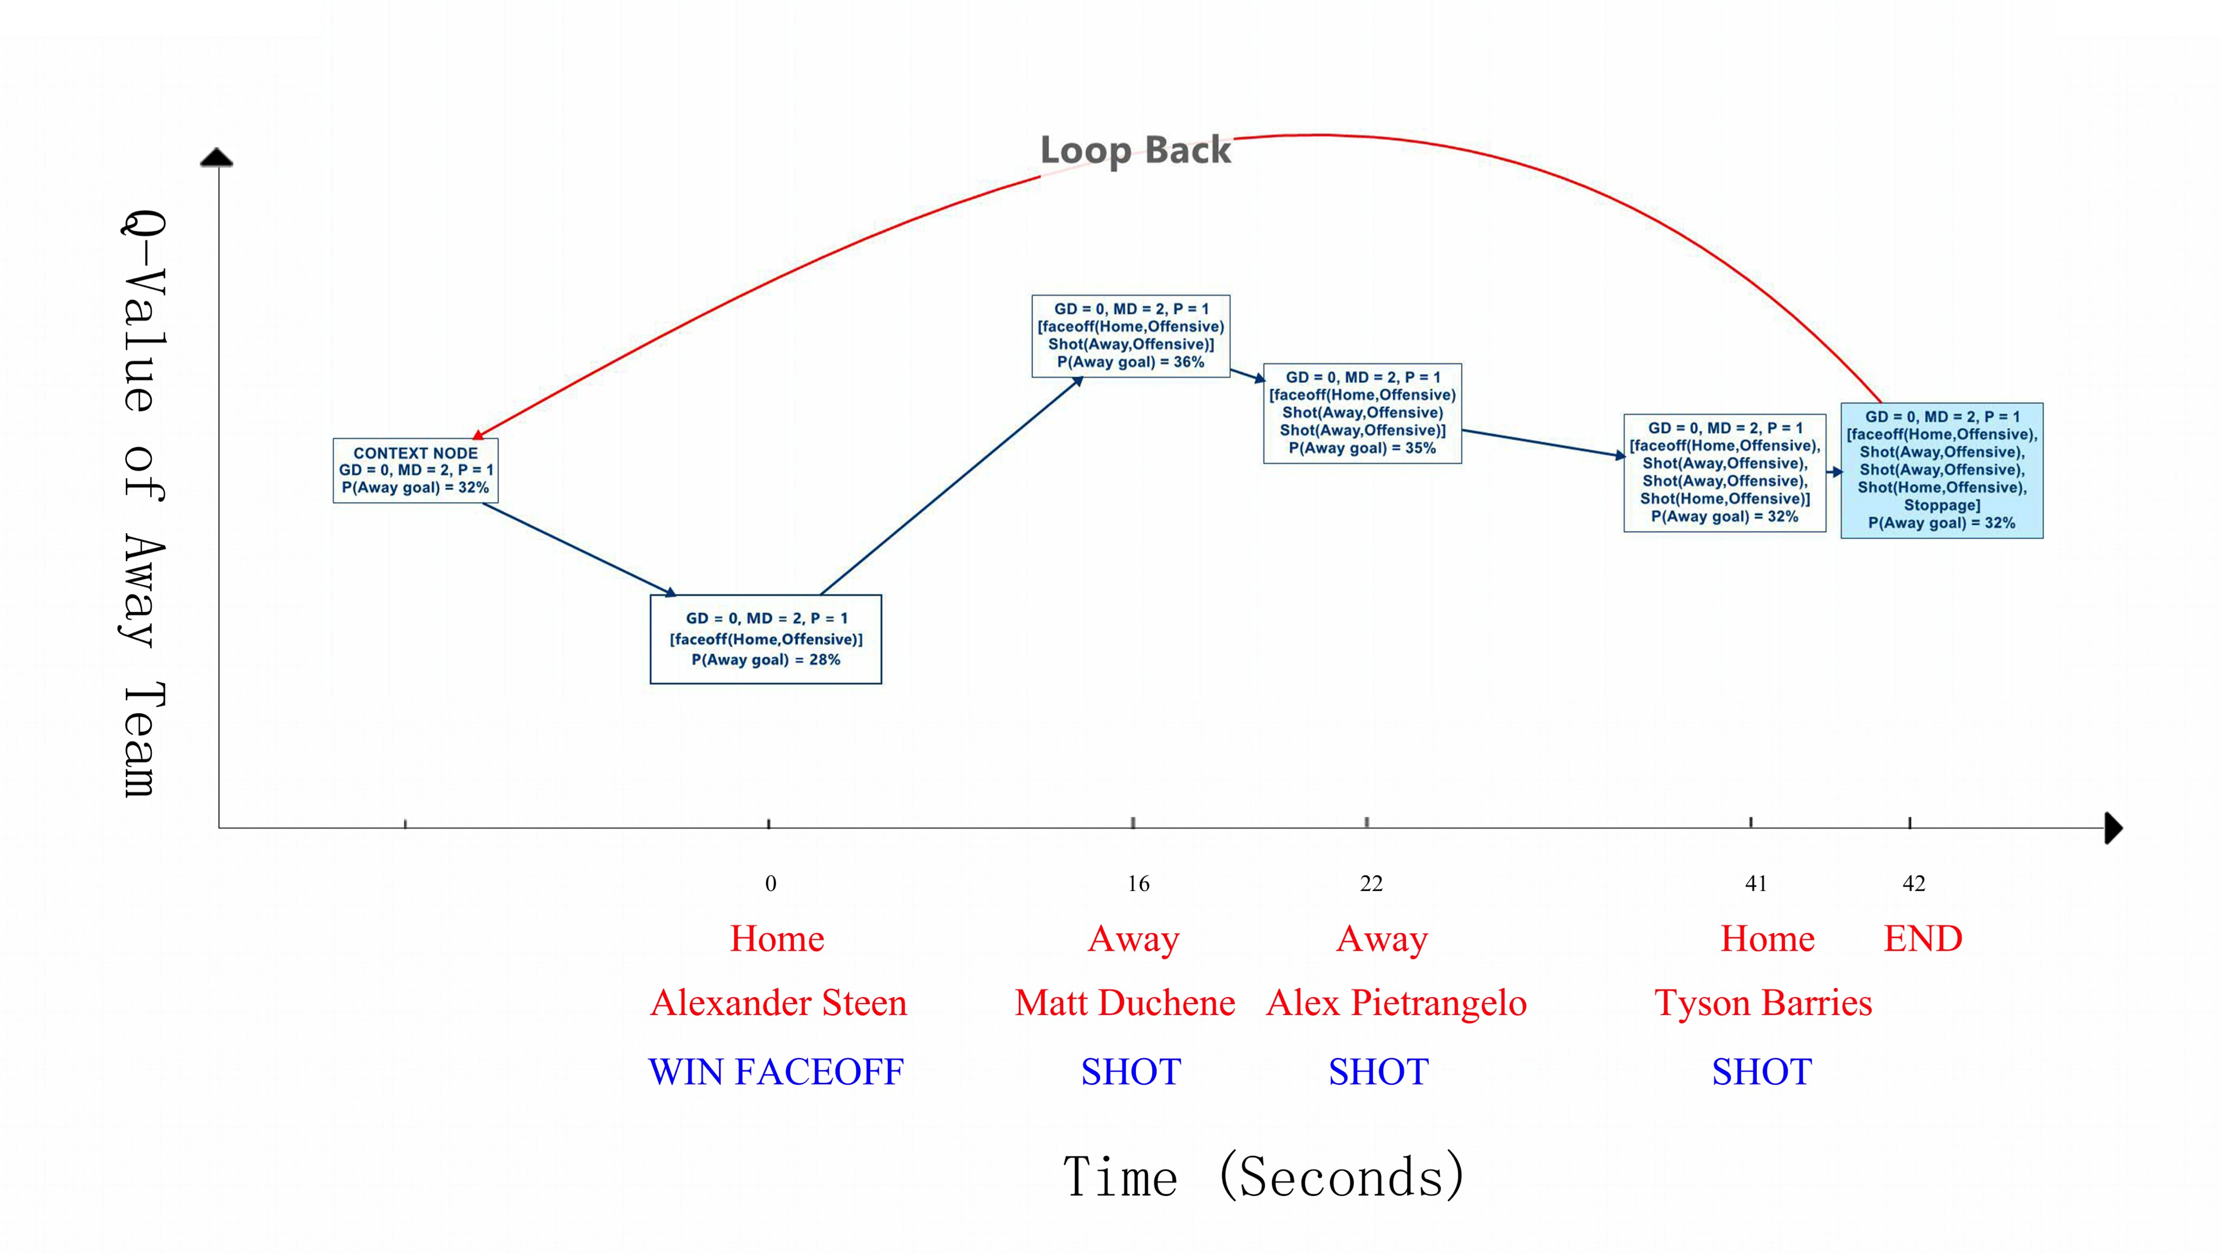
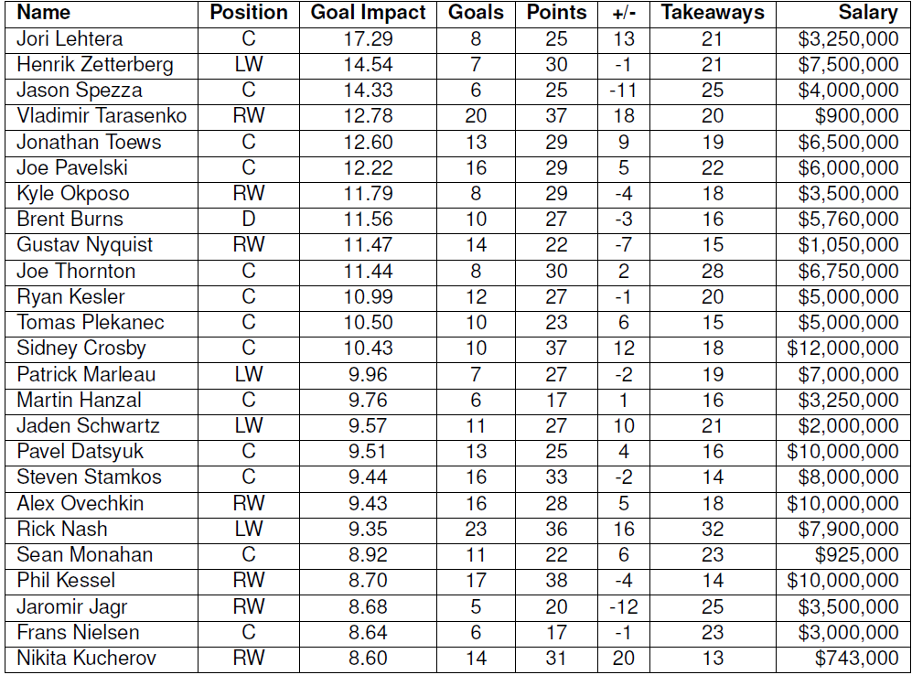
Player Ranking
Q-based Action Impact Score
Rank Players based on total action impact

