Slide 1
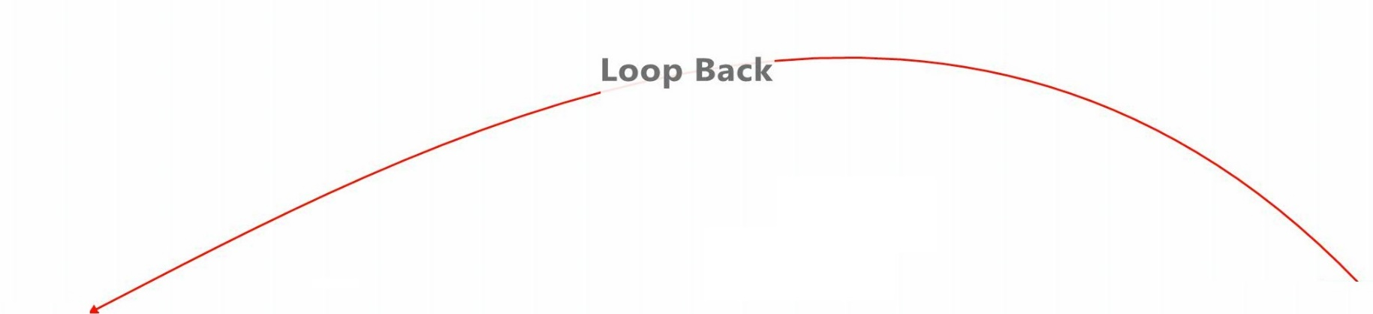
Q-value Ticker for ECML
Q-value = P(that away team scores next goal)
0,2,1
[face-off(Home,Off.)
Shot(Away,Off.)]
P(Away goal) = 36%
0,2,1
[face-off(Home,Off.)
Shot(Away,Off.)
Shot(Away,Off.)]
P(Away goal) = 35%
0,2,1
[face-off(Home,Offensive),
Shot(Away,Offensive),
Shot(Away,Offensive),
Shot(Home,Offensive)]
P(Away goal) = 32%
0,2,1
[face-off(Home,Off.),
Shot(Away,Off.),
Shot(Away,Off.),
Shot(Home,Off.),
Stoppage]
P(Away goal) = 32%
GD = 0, MD = 2, P = 1 P(Away goal) = 32%
0,2,1
[face-off(Home,Off.)]
P(Away goal) = 28%
Time (sec)
0 sec
Alexander Steen wins Face-off
16 sec
Matt Duchen shoots
22 sec
Alex Pientrangelo shoots
41 sec
Tyson Barries shoots
42 sec
sequence ends

Slide 2
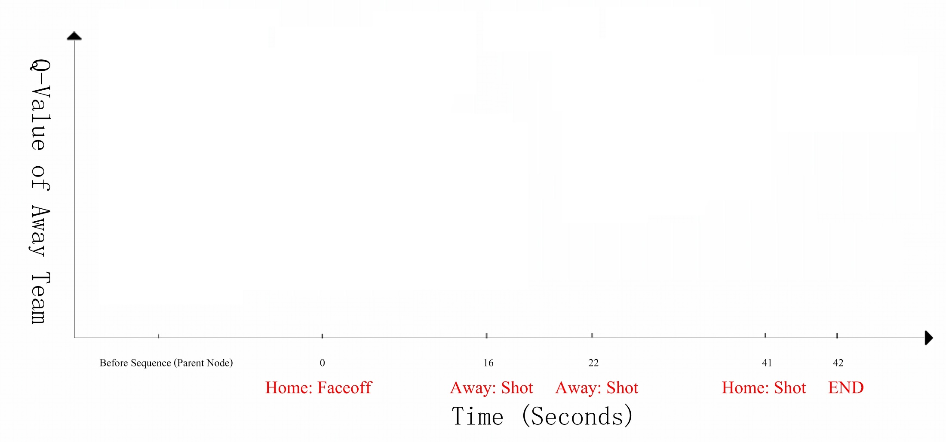
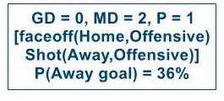
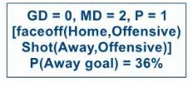
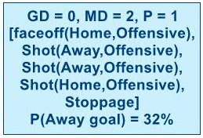
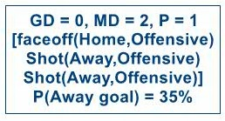
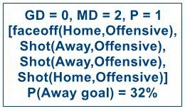

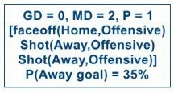
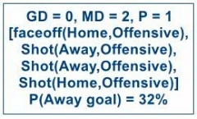
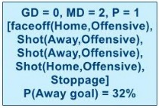

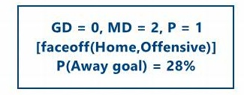





Slide 3
Editable Version (No Animation Here)
GD = 0, MD = 2, P = 1
[face-off(Home,Offensive)
Shot(Away,Offensive)]
P(Away goal) = 36%
GD = 0, MD = 2, P = 1
[face-off(Home,Offensive)
Shot(Away,Offensive)
Shot(Away,Offensive)]
P(Away goal) = 35%
GD = 0, MD = 2, P = 1
[face-off(Home,Offensive),
Shot(Away,Offensive),
Shot(Away,Offensive),
Shot(Home,Offensive)]
P(Away goal) = 32%
GD = 0, MD = 2, P = 1
[face-off(Home,Offensive),
Shot(Away,Offensive),
Shot(Away,Offensive),
Shot(Home,Offensive),
Stoppage]
P(Away goal) = 32%
CONTEXT NODE GD = 0, MD = 2, P = 1 P(Away goal) = 32%
GD = 0, MD = 2, P = 1
[face-off(Home,Offensive)]
P(Away goal) = 28%
Before Sequence (Parent Node) 0 16 22 41 42
Home:face-off Away:Shot Away:Shot Home:Shot END
Time (Seconds)

Slide 4
Editable Version (No Animation Here)
0,2,1
[face-off(Home,Off.)
Shot(Away,Off.)]
P(Away goal) = 36%
0,2,1
[face-off(Home,Off.)
Shot(Away,Off.)
Shot(Away,Off.)]
P(Away goal) = 35%
0,2,1
[face-off(Home,Offensive),
Shot(Away,Offensive),
Shot(Away,Offensive),
Shot(Home,Offensive)]
P(Away goal) = 32%
0,2,1
[face-off(Home,Off.),
Shot(Away,Off.),
Shot(Away,Off.),
Shot(Home,Off.),
Stoppage]
P(Away goal) = 32%
GD = 0, MD = 2, P = 1 P(Away goal) = 32%
0,2,1
[face-off(Home,Off.)]
P(Away goal) = 28%
0 16 22 41 42
Home:face-off Away:Shot Away:Shot Home:Shot END
Time (Seconds)
Notes:
put in pictures of actions from Kurt’s presentation

