Slide 1
Model-based Outlier Detection for Object-Relational Data
Ph.D. Dissertation Defence
Dec 6th, 2016
Senior Supervisor: Dr. Oliver Schulte
Supervisor: Dr. Jian Pei
Examiners: Dr. Christos Faloutsos, Dr. David Mitchell
Session Chair: Dr. Ramesh Krishnamurti
Notes:
Welcome everyone to my presentation. Today I am going to talk about my work on Modelbased Outlie
Dissertation Defence

Slide 2
Outline
Introduction
Outlier Definition
Problem Definition
Object-Relational Datasets: Synthetic and Real
Model-based Relational Outlier Detection
Propositionalization for outlier detection
Model-based outlier detection
Success and Outlierness
Conclusion
Notes:
In this presentation, first, I’ll provide a short introduction outlier detection work. Then, I will explain the limitations of current outlier detection methods and the necessity of developing methods for structured data. Then, I will introduce the datasets that we designed and developed in this research. I will shortly overview the model-based outlier detection methods that we developed for object relational data. I will end this presentation with our finding on relation between outlierness and success in our domain.

Slide 3
Introduction

Slide 4
Outlier Definition
Many definitions; no generally accepted one.
Observations that are generated by a different mechanism.
Rare graph objects that differ significantly from the majority of reference objects.
O1
O4
Sale Price
Expenditure
O2
O3
Lot Size
Income
(a)
(b)
Identification of Outliers, Hawkings, 1998
ODDBALL, Akoglu, 2010
Notes:
Many definitions have been proposed; observations that deviates from the rest of the data; or observation that makes us think it has been generated by different mechanism like the picture in the left ; or Objects that differ significantly from majority of reference objects. The second definition is the basis of our methods.

Slide 5
Problem Definition

Slide 6

Problem Definition
Most of outlier detection methods are designed for propositional data, not relational data
Information loss when using hand crafted features or aggregation-based features.
✗
Avg(ShotEff)=0.45
Avg(Goals)=0.5
ShotEff Goals | Venue=Home
PlayerID | MatchID | Venue | Shot_Eff | Goals
1123 | M1 | Home | 0.9 | 1
1123 | M2 | Away | 0 | 0
1123 | M3 | Home | 0.9 | 1
1123 | M4 | Away | 0 | 0
Aggregation
Image is from :
https://www.dreamstime.com/stock-illustration-business-concept-build-destroy-vector-cartoon-image44176241
Notes:
Most of outlier detection methods are designed for propositional data or single table data. These methods usually convert relational or instance based data into a single table by using aggregation. For example they aggregate over the features of a player in different matches; however aggregation tends to loose the information. For example in this data we can see team of this player plays at home, his shotEfficiency has high correlation with number of the goals that players scores. But this correlation doesn’t exists when venue is not home. But all this info will be destroyed when we aggregate over the features of the players.

Slide 7
Object Relational Data
One of the main data models for structured data is Object-relational data model.
Object Identity
Class Membership
Object Relationship
Object1: Player
Object1 Instance
PlayerID
1123
PlayerID | MatchID | Shot_Eff | Pass_Eff | TimePlayed
1123 | 2 | High | High | Low
1123 | 3 | Low | Low | High
1324 | 21 | Med. | Med. | Low
1324 | 16 | High | Low | Low
Object2: Team
Object2 Instance
TeamID
1
Object2: MatchID
Object2 Instance
MatchID
3
Notes:
In this WORK we addresses outlier detection For object-relational data which is one of the main data models for structured data. This model organizes data into different tables of entities and relationship . A difference between relational and vectorial data is therefore that an individual object is characterized not only by a list of attributes, but also by its links and by attributes of
the object linked to it.

Slide 8
Datasets

Slide 9
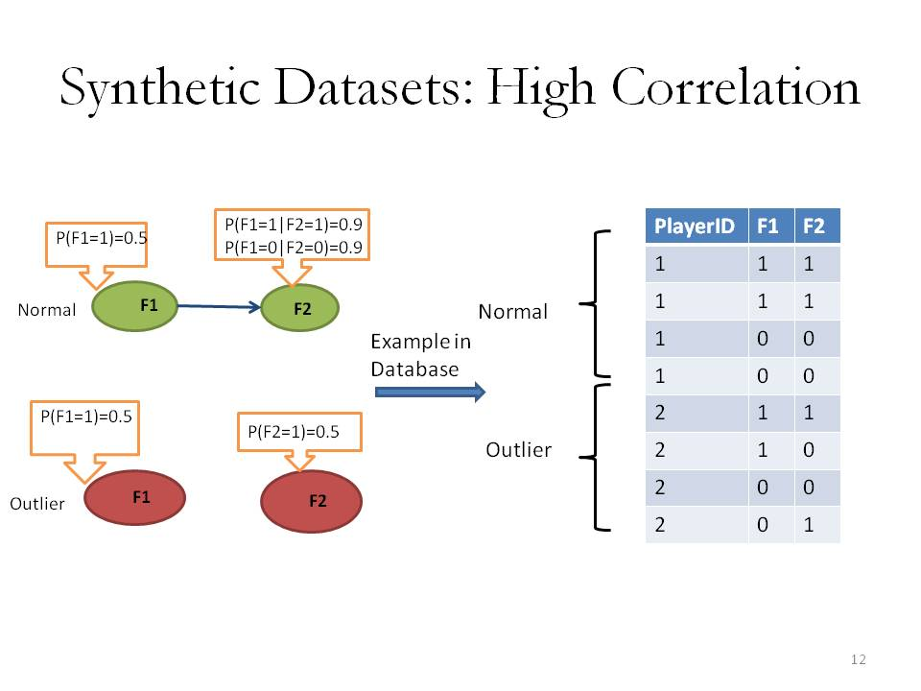
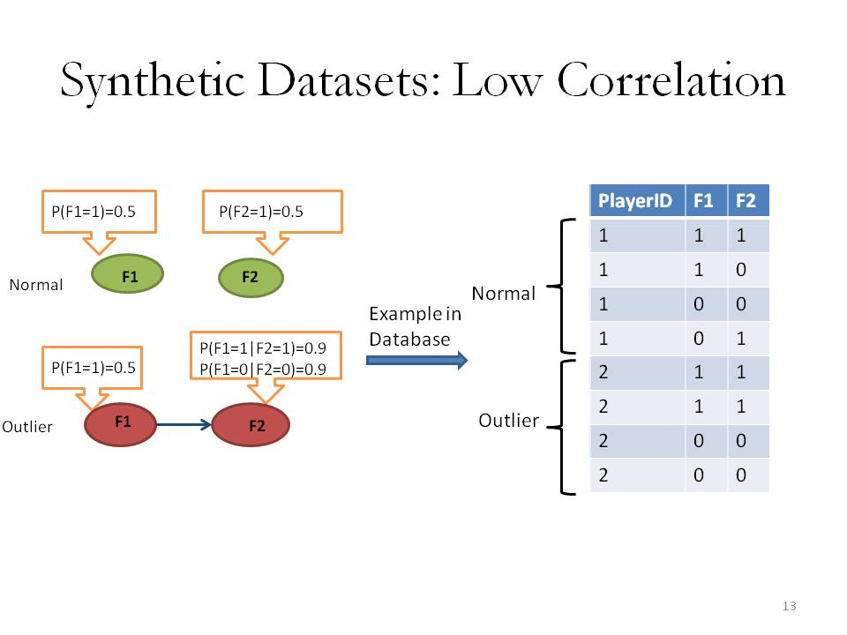
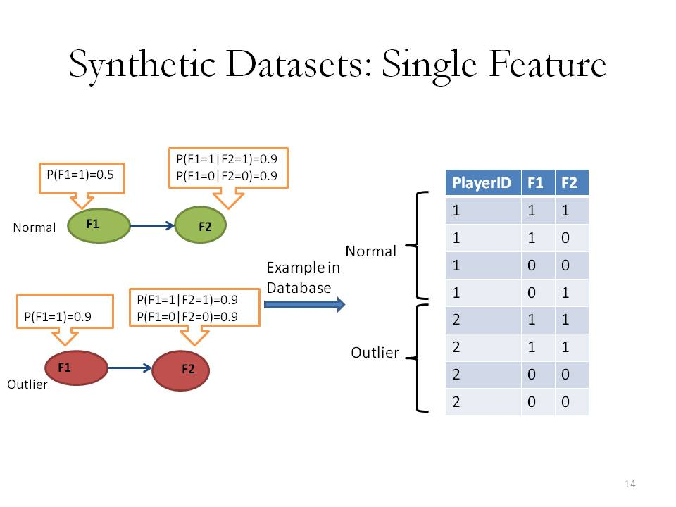
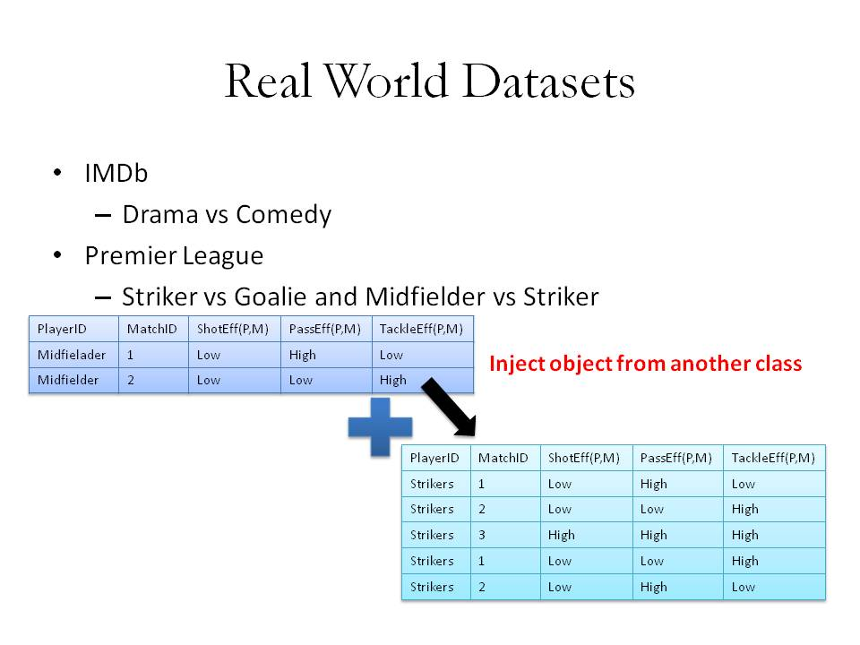
Datasets
Notes:
One of the many challenges we face in outlier detection research is that we don’t usually have ground truth or labeled instances. So in order to evaluate the methods that we have developed, we
generated three synthetic datasets with normal and outlier individuals using the distributions represented in the three Bayesian networks
High Correlation Normal individuals exhibit a strong association between their attributes, outliers no association. Low Correlation Normal individuals exhibit no association between their attributes, outliers have a strong association. Single attributes Both normal and outlier individuals exhibit a strong association between their attributes. In normal community, 50% of the time, attribute 1
has value 0. For outliers, attribute 1 has value 0 only 10% of the time.
For real world datasets, as we didn’t have ground truth we used outlier injection method, where we take individuals from one class such as midfielders in Soccer domain as normal class and added few individuals from another class such as strikers. And the goal was to see if we can identify the minority class as outliers.

Slide 10
First Model-based Approach: Propositionalization
Extract, Transform, Load Methodology
Propositionalization for Unsupervised Outlier Detection in Multi-relational data, In the Proceedings of Florida Association of Artificial Intelligence, 2016
Notes:
Propositionalization for Unsupervised Outlier Detection in Multi-relational data, In the proceeding of Florida Association of Artificial Intelligence, 2016

Slide 11

Propositionalization for Outlier Detection
Object-Relational Data
Feature Vector for
individuals based on
formulas
A single table with one row for each individual
Propositionalizer
Transform the object-relational representation of data into a propositional representation.
Construct features that capture relational properties.
Define features as conjunction of literals.
Target individuals (e.g. players) are represented as a feature-vectors of fixed size.
Apply previously developed propositional outlier detection methods to the constructed table.
Notes:
In this work we transform the object-relational representation of data into a propositional representation by constructing the features that capture relational properties of the data.
The input to a propositionalizer is a relational database, and the output is a set of conjunctive logical formulas we call query or templates.
We then use these templates to create a fix set of features and construct a single table so we can load this to any propositional outlier detection methods.

Slide 12
Use MLN to Generate Formulas
Markov Logic Network is a set where is a formula and is the weight of the formula.
Markov Logic Learning:
Input: A relational database.
Output: A set of conjunctive formulas that describe statistical patterns in the relational data.
For learning MLN, we use the learn-and-join algorithm, introduced by Khosravi et. al.
P. Domingos, Matthew Richardson, Markov Logic Network, Machine Learning Journal, 2006
P. Domingos, Matthew Richardson A Unifying Framework for Statistical Relational Learning, ICML, 2004
H. Khosravi, O. Schulte, Structure Learning for Markov Logic Networks with Many Descriptive Attributes, AAAI, 2010
Notes:
The propostinlizer that we use is Markov Logic network. MLN is a set of formulas and the weights that MLN learns from data for each formula. MLN produce a set of conjunctive formulas that describe patterns in the relational data

Slide 13
Example
MatchID | Team1 | Team2 | Result(T,M)
1 | ManU | Arsenal | Win
2 | ManU | Chelsea | Win
3 | ManU | ManC | Win
PlayerID | MatchID | ShotEff(P,M) | PassEff(P,M) | TackleEff(P,M)
Wayne Rooney | 1 | High | High | Low
Wayne Rooney | 2 | High | High | High
Wayne Rooney | 3 | Low | High | High
Javier Hernandez | 1 | Low | Low | High
Javier Hernandez | 2 | Low | High | Low
MLN
TeamID | PlayerID
Manchester United | Wayne Rooney
Manchester United | Javier Hernandez
Generate Formulas
Any Propositional Outlier Detection Method
Formula=template for network patterns
Wayne Rooney
Javier Hernandez
Load
MatchID=1
MatchID=2
MatchID=3
…
Extract a feature based on each formula for target individual
Apply feature functions
e.g. TF,TFIDF
PlayerID | f1 | f2 | f3 | f4
Wayne Rooney | 0 | 1 | 2 | 3
Javier Hernandez | 2 | 4 | 5 | 4
Manchester United
Notes:
This example is an overview of this work. As we said before we feed a relational db to a MLN learner. MLN generates formulas like f1 to f4. Formulas are the pattern that we later on look for in the information network of an individual. For example we see that pattern ShotEff=high PassEff=high Result=win happens for Rooney in the first and second match. We then have to decide on how to weight each pattern, we can use the frequency that pattern happens in the individual data or use a similar concept of TFIDF and measure how important a feature is to an individual in a collection of individuals. We then end up with a single data table with one row for each individual and columns representing the attributes that are actually templates learned using MLN. This single table can serve as an input to any propositional outlier detection methods.

Slide 14
Evaluation Result
Wordification: Using the concept of n-grams from NLP:
Unigram: All single literals.
Bigram: All conjunctions of two literals.
TreeLiker
Propositional Outlier Detection Method | MLN-TF |  | Bigram-IDF |  | Unigram-TF |  | Treeliker
 | Wins | AVG(AUC) | Wins | AVG(AUC) | Wins | AVG(AUC) | Wins | AVG(AUC)
OutRank | 2.50 | 0.79 | 2.50 | 0.70 | 1.00 | 0.64 | 0 | NA
KNN | 3.50 | 0.78 | 1.50 | 0.67 | 1.50 | 0.67 | 0 | 0.64
LOF | 4.00 | 0.63 | 1.00 | 0.55 | 1.00 | 0.61 | 1 | 0.61
Notes:
For baseline propositionlizers we have chosen Wordification and treeliker . Wordification method enumerates all conjunctive formulas up to a fixed length n as attributes for propositionalization. Treeliker is a supervised propositionlizer
For propositional-based outlier detection methods, we have chosen 3 well-known methods: Outrank KNN and LOF.
There is no single propositionalization method that always leads to the best accuracy for all three outlier analysis methods. We have summarized the performance of the methods for a fixed outlier detection algorithm. Average auc reports the average auc over different datasets. A propositionlizer method wins on a dataset if its AUC is greater than others and a tie if earns 0.5. Todal number of points is shown in win column. MLN is revealed to be best method in terms of average auc and number of wins
A propositionalization method is scored 1 point if it produces the best accuracy on a dataset, and 0.5 points if it ties. The table shows the total number of wins and average of AUC over all datasets.

Slide 15
Summary
Previous propositional outlier detection methods cannot be applied to relational databases.
AI-based solution: Discover informative features in the relational database, use them to construct a single-data table.
Efficient conjunctive feature discovery = Markov Logic Network structure learning.
Notes:
single-table data, but relational databases maintain multiple interrelated tables.
AI-based solution: Discover informative features in the relational database, use them to construct a single-data table.
Efficient conjunctive feature discovery = Markov Logic Network structure learning.
Works better than baselines with isolated attributes (unigrams) or enumerating all binary conjunctions of attributes (bigrams).
More results on comparing with supervised propositionalization (not in paper).
Other ways of generating unsupervised formula: WARMR
Use heuristic (partial) propositionalization instead of complete
Other ways of generating unsupervised formula: WARMR.
Use heuristic (partial) propositionalization instead of complete.

Slide 16
Second Model-based Approach: Outlierness metric
1- Model-based Outlier Detection for Object-relational data, in Computation Intelligence, IEEE Symposium Series, 2015
2- Identifying Important Nodes in Relational Data, AAAI Late Breaking Paper Track, 2013

Slide 17
Model-based Outlier Detection
Population Database
Individual Database
Class Bayesian network
Object Bayesian network
Outlierness Metric = Measure of dissimilarity between class and individual BN
Notes:
In this work the goal is to measure how different an individual is from a reference population?
A class-model Bayes net (BN) structure is learned with data for the entire population. Another Bayesian netwrok is learned from the individual data with the structured learned from population.
And then we have to come up with ways to compare these two model to measure similarity.

Slide 18
The Log-Likelihood Outliernes Metric
Standard Model-based method from previous work (Cansado and Soto 2008).
The generative model represents normal behavior.
If the model assigns a low likelihood to generating an individual data point ➔ outlier.
1 A. Cansado and Alvaro Soto, Unsupervised Anomaly Detection in Large Databases Using Bayesian Networks, 2008
Notes:
We learn a class model BN based on the entire population data and estimates
BN parameter .This generative model represents normal behaviour.
Given a set of parameter values and an input database, it is possible to compute a class model likelihood that quantifies how well the BN fits each individual data. This method has been previously used as an outlier score in iiid data by Cansado and we have extended to the case of relational data.
This likelihood serves as a baseline for our divergence-based metric.

Slide 19
Log Ratio Divergence
B_{c} models the class database distribution.
B_{o} model the individual database distribution D_{o}
The LR is equivalent to KL divergence and is the individual data log-likelihood ratio:
Notes:
While the class model likelihood is a good baseline score, it can be improved by comparing it to the object model likelihood, which estimates BN parameter values from the object data. The model log-likelihood ratio (LR) which is equivalent to KL divergence is the log-ratio of the object model likelihood to the
class model likelihood. This ratio quantifies how the probabilistic associations that hold in the general population deviate from the associations in the object
data substructure

Slide 20
LR Performance
LR performs very well on all three synthetic dataset. Not perfect though.
A problem with LR: some log ratios are positive, some negative ➔ cancelling of differences.
Can fix by taking log-distances:
Notes:
LR performs very well however what we noticed was for some logratio were positives some negatives and differences canceled out. So We improved it by taking log distances instead of differences. But there is still room for improvement

Slide 21
ELD: Mutual Information Decomposition
The interpretability of the metric can be increased by a mutual information decomposition of LR:
First sum measures single-variable distribution difference
The second sum measures difference in strength of associations
LR wrt marginal single-variable distributions
lift of parent condition in individual distribution
lift of parent condition
in class distribution
Notes:
While the likelihood ratio discriminates relational outliers better than the standard log-likelihood, it can be improved further for outlier
detection by applying two transformations: (1) a mutual information decomposition, and (2) replacing log-likelihood differences by log-likelihood distances.
We refer to the resulting score as the log-likelihood distance.

Slide 22


Example of Mutual Information
Confidence=0.50
Support=0.16
Confidence=0.38
Support=0.5
Images are from:
http://spanish.fansshare.com/gallery/photo
http://rexdl.com/android/striker-soccer-america-2015-apk.html/
Notes:
It is very important for outlier detection method to be interpretable. We should be able to make sense of detected outliers and reason why an individual was detected as outlier. In this slide we are showing an example of player that was found exceptional by our model. And this rule contributes to him being exceptional. Confidence of this rule which represents how often rules happens is 50% for Edin Zeko while it is 38% for the entire population and support which shows how frequent shot=high tackle eff high happens in data is very low.
A lift ratio larger than 1.0 implies that the relationship between the antecedent and the consequent is more significant than if the two sets were independent.
e show an example of a player that was discovered exceptional by ELD rule that contributes to a high ELD for Edin Zeko. And we compare the support and confidence of this rule for Edin and a random player in the network. The confidence of a rule is an indication of how often the rule has been found to be true which is 50% for Edin and 38% for a random player. However, the support of this rule which shows how frequent the ShotEfficiency=high and Tackle efficiency=medium occurs is 16% and for the random player is 0.5 percent so the lift which has been used as an indication of exception rule is higher than 1 for Edin while it is less than 1 for a random player.

Slide 23
Evaluation
Area Under Curve or AUC as evaluation metric.
Comparison of propositional methods and probabilistic methods.
Outlierness Metrics
Propositional Methods
Dataset | ELD | |LR| | LR | FD | LOG | LOF | OutRank | KNN
High Correlation | 1.00 | 0.99 | 0.97 | 0.88 | 0.98 | 0.68 | 0.99 | 0.97
Low Correlation | 1.00 | 0.99 | 0.98 | 0.35 | 0.81 | 0.58 | 0.83 | 0.97
Single Feature | 1.00 | 1.00 | 1.00 | 1.00 | 0.79 | 0.63 | 0.88 | 0.86
Striker vs Goalie | 0.89 | 0.77 | 0.65 | 0.71 | 0.61 | 0.61 | 0.60 | 0.63
Midfielder vs Striker | 0.66 | 0.62 | 0.55 | 0.59 | 0.54 | 0.76 | 0.71 | 0.58
Drama vs Comedy | 0.70 | 0.68 | 0.66 | 0.64 | 0.66 | 0.51 | 0.58 | 0.68
Notes:
We have used Area Under Curve to evaluate the performance of the metrics. ELD performs better than the other metrics/propositional methods except for one. For propositional methods; LOF, Outrank and KNN we have used the features we constructed in the pervious section to boost up their performance. If we were to use the traditional way of constructing features by aggregation then ELD non of the method could outperform the ELD. Explain why eld is not working on Midfielder and Striker

Slide 24
Summary
Bayesian network model:
computationally feasible
accurate
interpretable
Relational anomaly detection: how different is the feature distribution of an individual from the feature distribution of its class?
Basic idea: compare individual model likelihood of with class model likelihood of class features.
Key point: avoid cancellations in log-likelihood comparison; use distances, not differences.
Proposed a new divergence metrics, ELD.
Notes:
To summarize this work; we have introduced ways to compare and individuals with its class, by comparing the individual model likelihood of with class model likelihood of class features. We can justify and interpret why a method is good

Slide 25
Success and Outlierness

Slide 26
Can ELD Predict Success
Use ELD metric to compare individuals.
How accurate is the ranking within one class?
Compare it with independent ranking metric of the individuals, e.g. salary of players or rating of the movie.
What to expect? Both exceptionally good and exceptionally bad individuals should be on top.
Learn Class BN for entire population
Learn an Individual BN for object population
Compute ELD
Rank Individuals Based on ELD
Notes:
The aim of this part is to compare ELD metric with other meaningful metrics for comparing individuals.
Our reference metrics are success rankings of individuals selected for specific domain.
For doing so, we group individuals into categories. A class model BN is learned with data for entire category of individuals. An individual model BN is learned from the individual data. ELD metric is computed and used to rank the individuals.

Slide 27
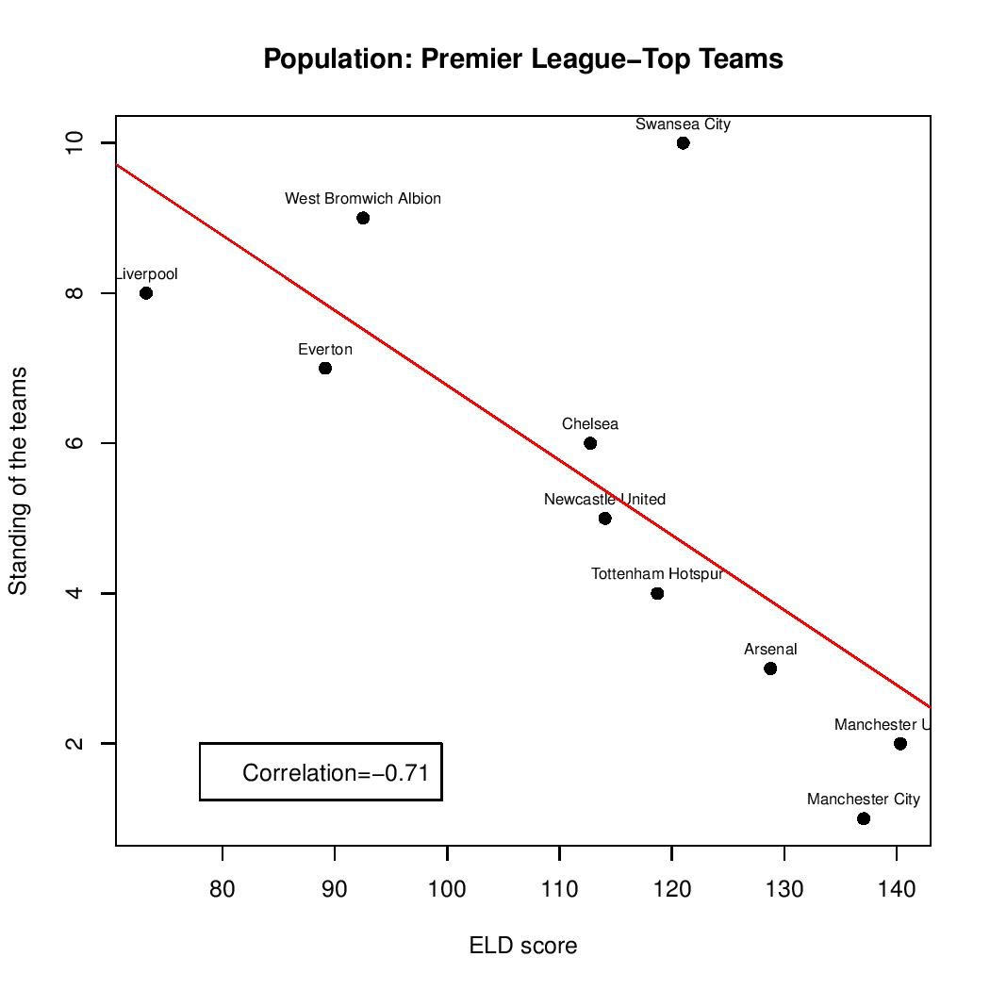
Correlation with Success
Teams and Standing:
All teams and Standing ➔ not a strong correlation
Top teams and Standing ➔ strong correlation
Strong correlation but not a power law
Notes:
Just an example: we show the correlation we found between team Standing and ELD. The most successful team has standing=1 and the least successful team has standing=20. For the top team there is a very strong negative correlation emerges between ELD and standing. Team with higher ELD achieve better standing. Other findings are explained in details in the thesis.

Slide 28
Midfielder salary doesn’t reflect their statistics
For Midfielder, ELD correlates less with success. e.g.
Stephane Sessegnon
Steven Gerrard (a famous player)
Midfielders salary doesn’t reflect their statistics
Stephane Sessegnon : an undervalued Player
2011 Sunderland
2013 signed a record breaking contract with West Brom.
Name | Team | Salary Ranking | ELD Ranking | TimePlayed | Unsuccessful Passes | Successful Passes | Successful Corners
Gerrard | Liverpool | 2 | 21 | 1212 | 244 | 52 | 25
Sessegnon | Sunderland | 22 | 2 | 3133 | 231 | 82 | 15
http://www.expressandstar.com/sport/west-bromwich-albion-fc/2013/09/02/west-brom-break-record-for-stephane-sessegnon/
Notes:
For one class of individual , midfielder ELD was less informative due to the weaker correlations. To investigate the reason for the weaker correlation we chose two midfielders
Stephane has been ranked second but doesn’t draw a large salary and Gerrard who is a very well known player and ranked second in the salary ranking.
But according to ELD he has been ranked 21. Based on domain knowledge we chose some of the features from the raw data relevant to midfielder performance and compared the feature statistics of these two player. Sessegnon scored higher in three out of four categories however his salary was much lower than Gerrard’s. And this is an example of an undervalued player, But he didn’t stayed for much longer as he signed a large contract with WestBroomwitch

Slide 29
Conclusion
Two Model-based outlier detection methods for relational data.
First one based on propositionalization.
Second one based on a novel outlierness metric.
difference between the feature distribution of an individual from the feature distribution of its class.
Proposed a new divergence metrics, ELD.
ELD correlates with success metrics to some degree.
Can be used to rank players.
Or to identify undervalued players.

Slide 30
Questions

