Slide 1


NGO Clustering Assignment
AGENDA: Identify countries based on social-economic and health attributes to provide investment aid
1
by
Raj Praveen Pradhan

Slide 2
Overview
Problem Statement: Our task was to categorize/segment the countries based on there socio-economic and health factors that determines the overall development of the country. Then identify top countries that are in direst need of aid.
Approach: For segmentation of k-means and hierarchical clustering algorithms were used. Then various social-economic attributes of the clusters were compared to determine the targeted countries.
Notes:
Ask this particularly in Non-Technical / Non-Experienced groups

Slide 3
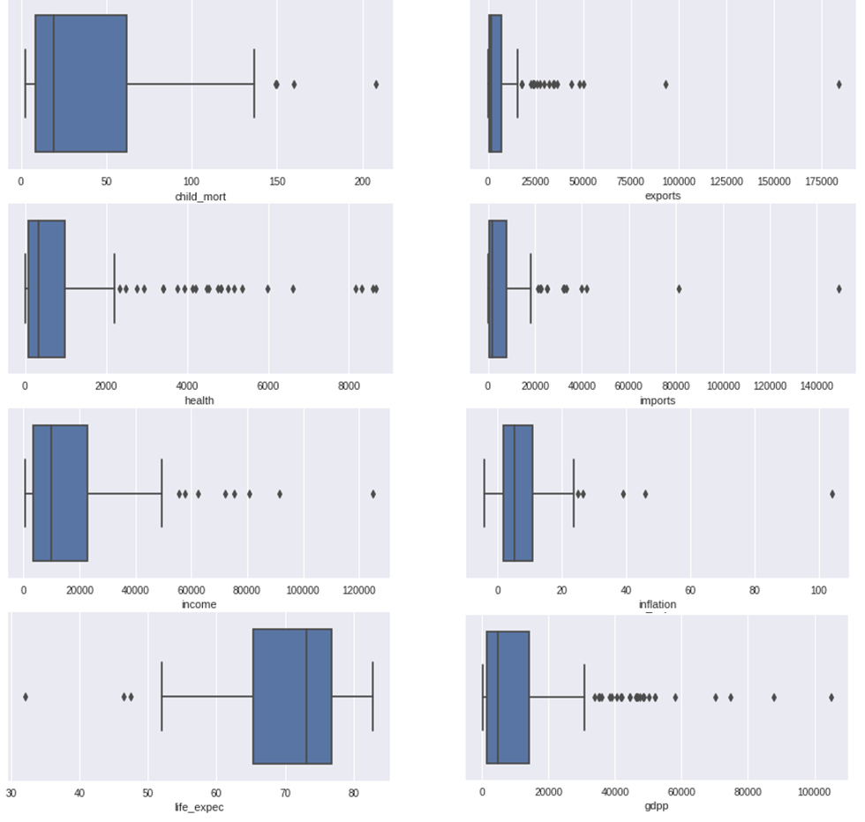
EDA : Univariate Analysis
Inferences:
Since health, import and export expenses are proportions of ‘gdpp’, all of them follow similar trend.
There couple of countries which have ‘child_mort’ greater than 150 and ‘life_excpec’ below 50. We will perform bivariate analysis later to find if there is any correlation.
Based on above plots 'health', 'imports', 'exports', 'income' & 'gdpp' are having outliers, which need to be treated. As outliers impact cluster formation.
Notes:
Ask this particularly in Non-Technical / Non-Experienced groups

Slide 4
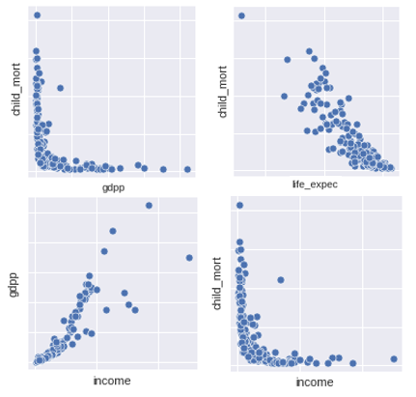
EDA : Bivariate Analysis
Inferences:
"child_mort" and "gdpp" are showing an inverse relationship, which is expected due to better healthcare service. As healthcare expenses are directly proportional to GDP.
As can be seen "life_expec" and "child_mort" are having an inverse linear relationship, as smaller value of "child_mort" leads to better "life_expec".
Usually countries with higher GDP have better standard of living, which explains the linear relationship between "income" and "gdpp".
Notes:
Ask this particularly in Non-Technical / Non-Experienced groups

Slide 5
k-means clustering
Notes:
Ask this particularly in Non-Technical / Non-Experienced groups

Slide 6
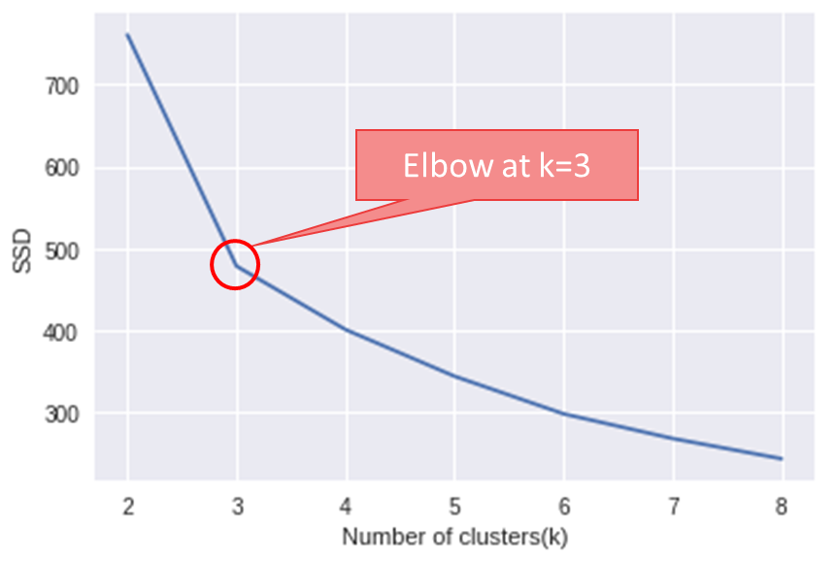
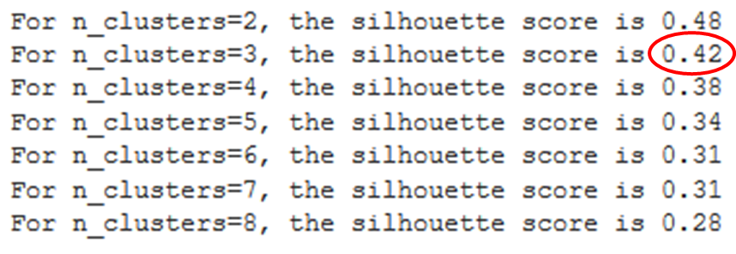
k-means: Optimal value of k
Elbow Curve
Silhouette Analysis
Using silhouette analysis k=2 seems to be the optimal number of clusters. However, as per business requirement having 3 clusters would make more sense. Since we can segment the countries into high, moderate and low based on their development.
Based on above "elbow" plot k=3 seems to be the optimal number of clusters.
Notes:
Ask this particularly in Non-Technical / Non-Experienced groups

Slide 7
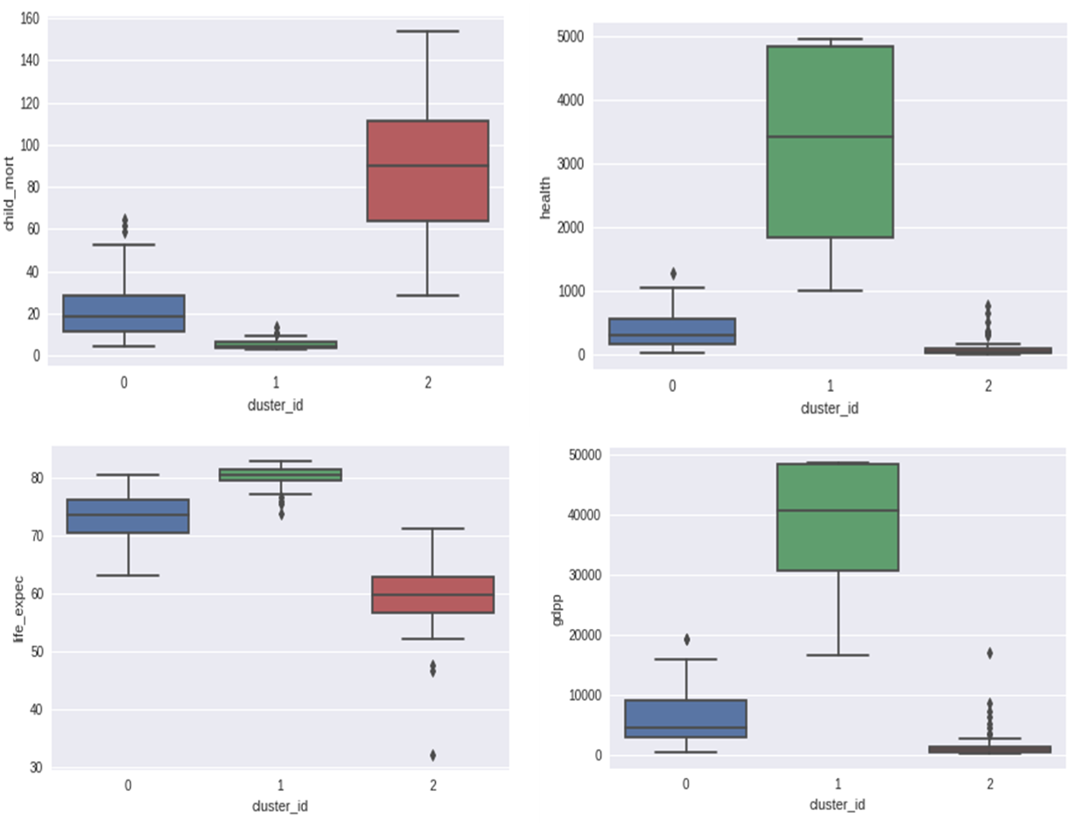

k-means: Visualizing Clusters
Cluster distribution:
Inferences:
These plots suggests that cluster_2 has lowest "life_expec", "income", "gdpp" and highest "child_mort" among all three clusters. Thus its clearly visible that countries which falls under cluster_2 are in need of aid the most. Meanwhile, cluster_0 and cluster_1 are moderately and highly self sufficient respectively.
Notes:
Ask this particularly in Non-Technical / Non-Experienced groups

Slide 8
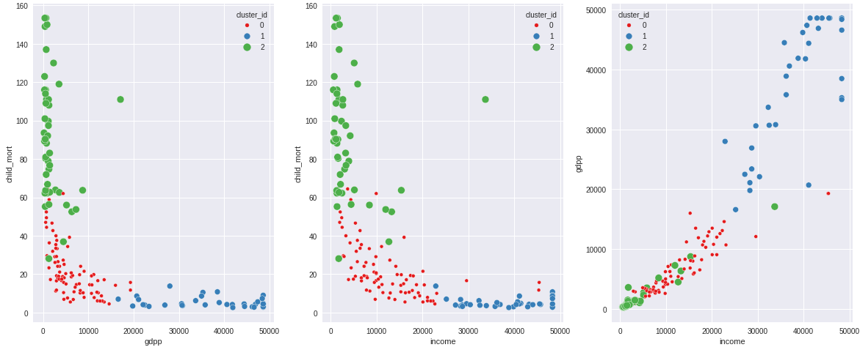
k-means: Cluster Profiling
Inferences:
Based on above cluster profile, three segments of countries are clearly visible i.e.
Cluster_0 : Moderately developed
Cluster_1 : Highly developed
Cluster_2 : Under developed
Notes:
Ask this particularly in Non-Technical / Non-Experienced groups

Slide 9
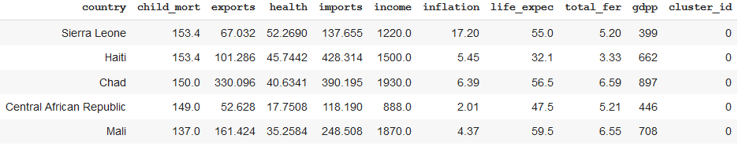
k-means: Top 5 Countries
Based on k-means clustering following are the countries which are in dire need of aid.
(ordered by "child_mort", "gdpp", "income")
Sierra Leone
Haiti
Chad
Central African Republic
Mali
Notes:
Ask this particularly in Non-Technical / Non-Experienced groups

Slide 10
Hierarchical clustering
Notes:
Ask this particularly in Non-Technical / Non-Experienced groups

Slide 11
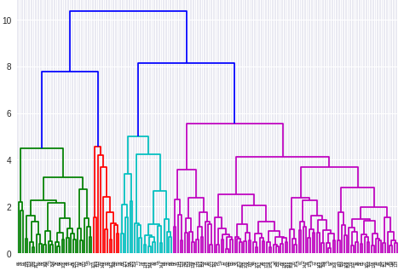

Hierarchical Clustering: Complete Linkage Dendrogram
Cluster distribution:
Unlike k-means, for hierarchical clustering k = 4 seems to provide better results.
Notes:
Ask this particularly in Non-Technical / Non-Experienced groups

Slide 12
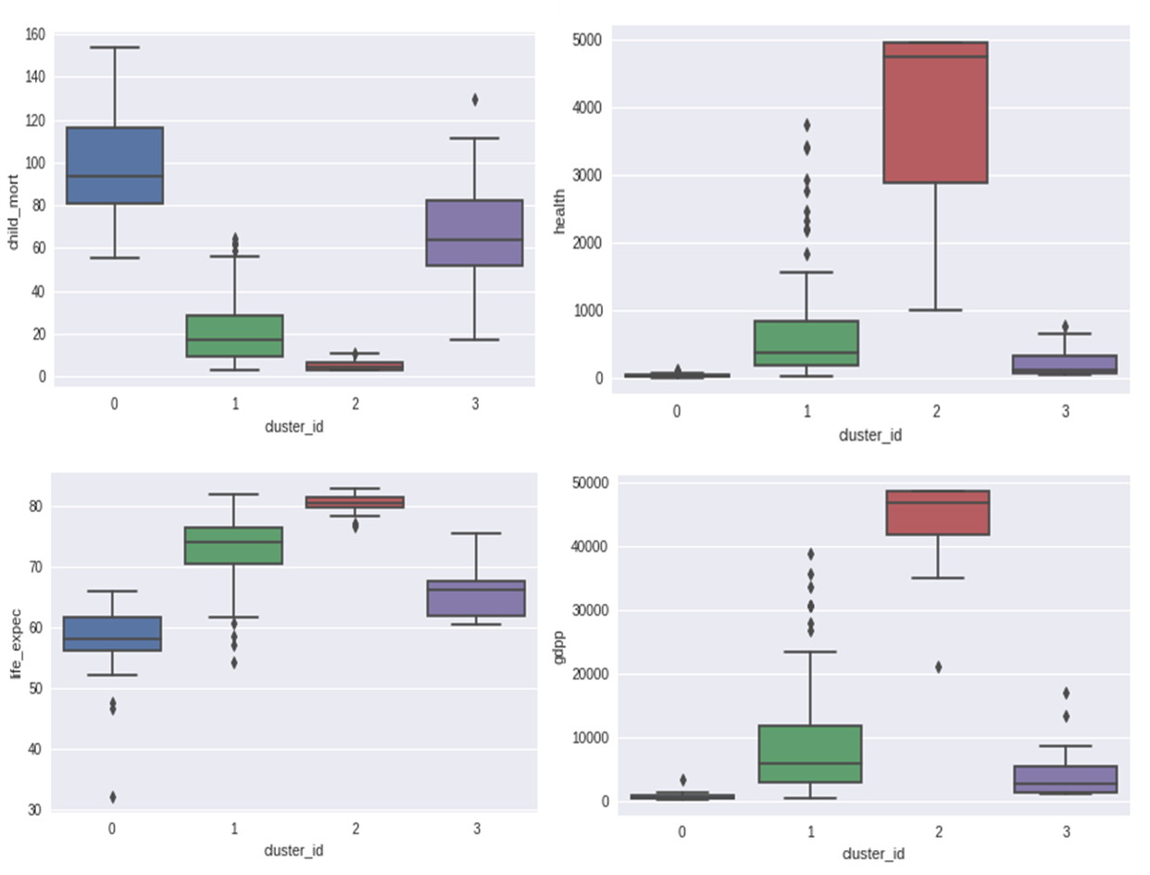
Hierarchical Clustering: Visualizing Clusters
Inferences:
Above plots suggests that cluster_0 has lowest "life_expec", "income", "gdpp" and highest "child_mort" among all four clusters. Thus its clearly visible that countries which falls under cluster_0 are in need of aid the most
Notes:
Ask this particularly in Non-Technical / Non-Experienced groups

Slide 13
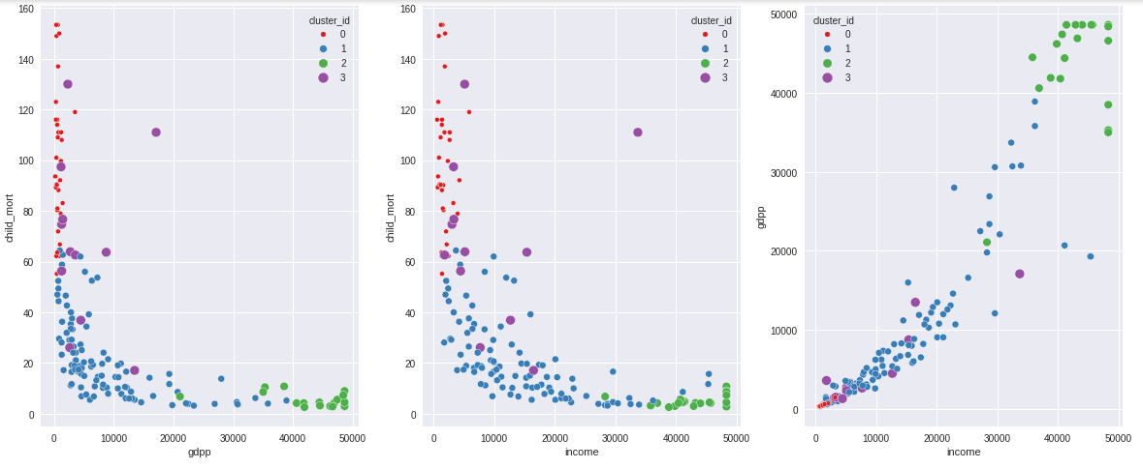
Hierarchical Clustering: Cluster Profiling
Inferences:
Based on above cluster profile, four segments of countries are clearly visible i.e.
Cluster_0 : Highly Under developed
Cluster_1 : Moderately developed
Cluster_2 : Highly developed
Cluster_3 : Under developed
Notes:
Ask this particularly in Non-Technical / Non-Experienced groups

Slide 14
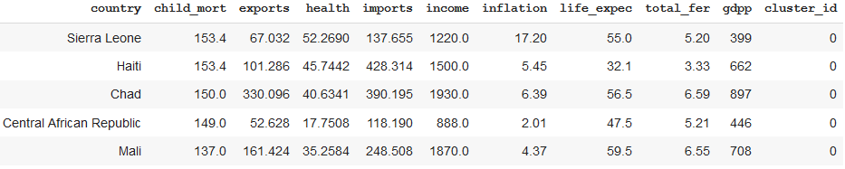
Hierarchical Clustering: Top 5 Countries
Based on hierarchical clustering following are the countries which are in dire need of aid.
(ordered by "child_mort", "gdpp", "income")
Sierra Leone
Haiti
Chad
Central African Republic
Mali
Notes:
Ask this particularly in Non-Technical / Non-Experienced groups

Slide 15
Final Recommendation of Countries
After performing k-means and hierarchical clustering list of top 5 countries ordered by "child_mort", "gdpp" & "income" came out to be same. Thus the countries which need financial aid are:
Sierra Leone
Haiti
Chad
Central African Republic
Mali
Notes:
Ask this particularly in Non-Technical / Non-Experienced groups

