Slide 1
MECH423 Final Project
FanFaceTracker
Ratthamnoon Prakitpong

Slide 2
Link:
https://github.com/rprakitpong/fanfacetracker
https://www.youtube.com/watch?v=s85OwPzjlDE

Slide 3
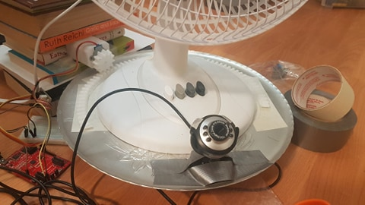
Mechanical
Motor shaft connected to pinion
Circular rack glued to turntable
Fan and camera sit on turntable
Jury rigged with home equipment and 3D printing

Slide 4
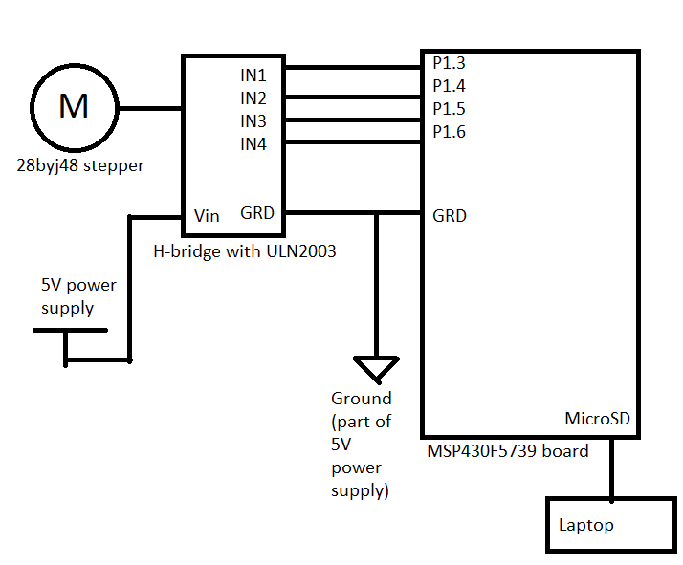
Electrical
Receives byte via UART
Difference between byte and 127 is used as step count and direction for motor movement
Similar to exercise 2 of lab 3

Slide 5
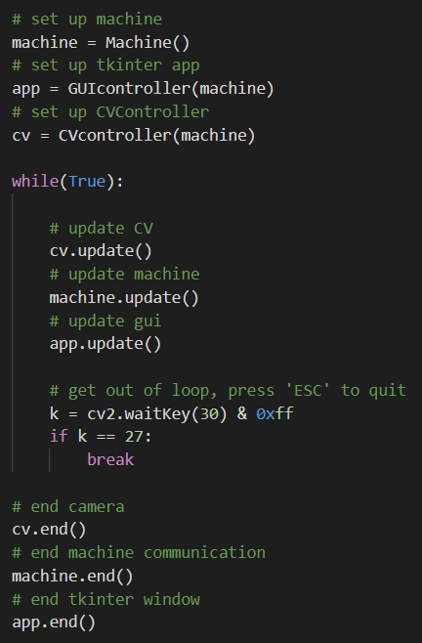
Software
Machine: serial communication class using serial with sendCommand(value) method to move motor
GUIcontroller: GUI class using tkinter displaying angular displacement and has buttons to move motor
Cvcontroller: CV class using cv2 getting image from camera and moves motor till face (if in frame) is centered in frame
Functionalities neatly encapsulated into classes

Slide 6
Interactions
Angular location of turntable
GUIcontroller:
- Display current location
- Button send displacement
Machine:
- Send displacement
to MCU via UART
- Receive flag when
movement is done
- Keep track of
location
MCU/motor:
- Takes value
and make
10n steps
Fan assembly:
- Pinion on
motor shaft
turns rack
on turntable
CVcontroller:
- Process image and get face
- Send displacement based
on how far face is from center
Image from camera

