Slide 1
Final Project
Pokemon Analysis

Slide 2
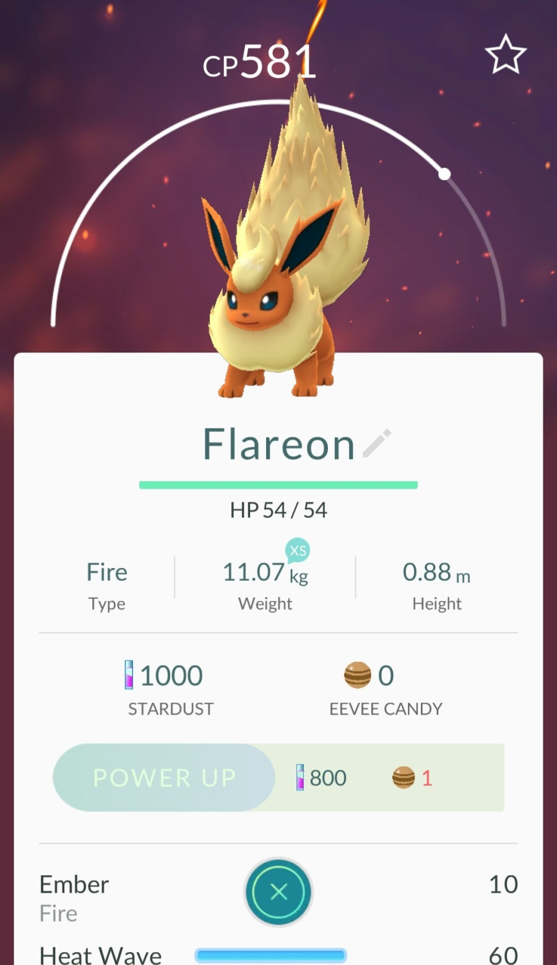
The type of this Pokemon
CP
HP
Stardust for power up
Level of Pokemon
Grading:
100 base + 100 ranking (top 10)

Slide 3
Function:
[ID, CP, HP, stardust, level] = pokemon_stats (image)
ID number
Pokemon Level
(Indicated by the point on the semi circle)

Slide 4
Creating Dataset
Get 20 extra credit by submitting images to help create dataset.
40 images from 20 different types of pokemon.
Image Name (ground truth label) Format:
136_CP581_HP54_SD800_8769_1.jpg
Required stardust
CP
1-40
136_CP581_HP54_SD800_8769_1.jpg
Pokemon ID
HP
Last 4 digits of your #800

Slide 5
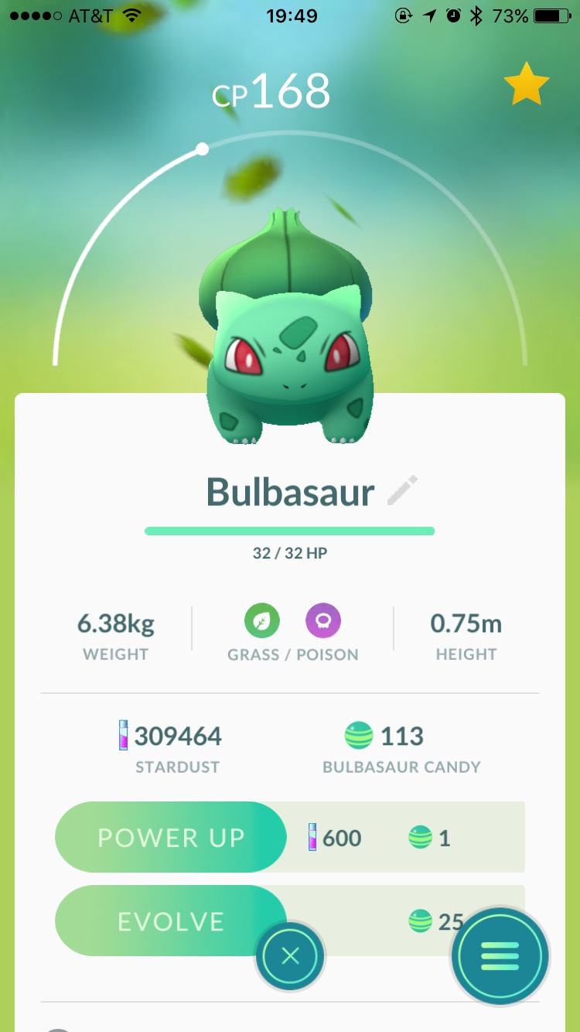
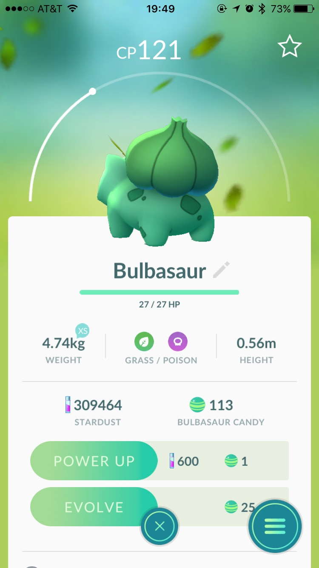
Examples
001_CP168_HP32_SD600_8769_1.jpg
001_CP121_HP27_SD600_8769_2.jpg

