Slide 1
Introduction to Machine Learning for Computer Vision
Slides adapted from James Hays, Lana Lazebnik, and Derek Hoeim

Slide 2
Machine Learning
Core Idea: Making predictions or decisions from data
This overview will not go in to depth about the statistical underpinnings of learning methods.

Slide 3
Exporting Machine Learning
Machine Learning is applied in many fields:
Bioinformatics
Genomics, Proteomics
High Energy Physics
OCR
High Energy Physics
Market Analysis
Text Categorization / Mining
Robotics
…

Slide 4
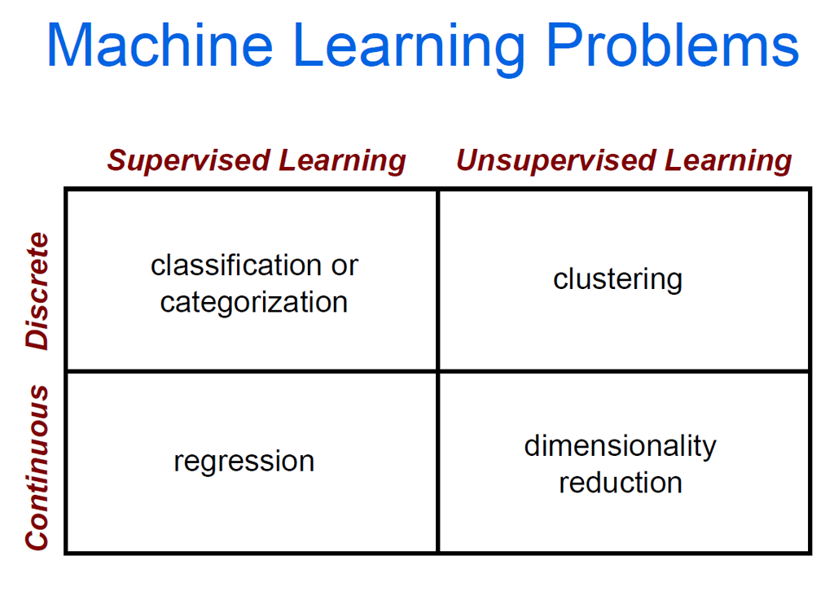

Slide 5
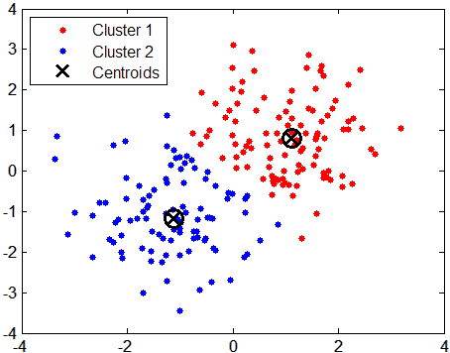
Unsupervised Learning: Clustering
We’ve seen this before
Segmentation
Vector Quantization
K-means
Divides input data into k groups
Most popular method
But there are *many* other algorithms

Slide 6



Supervised Learning: Classification
Apply a prediction function to a feature representation of the image to get the desired output:
f( ) = “apple”
f( ) = “tomato”
f( ) = “cow”

Slide 7
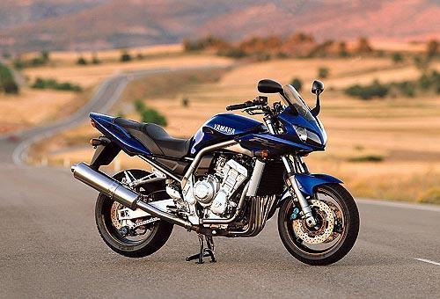
Recognition task and supervision
Images in the training set must be annotated with the “correct answer” that the model is expected to produce
“motorbike”

Slide 8
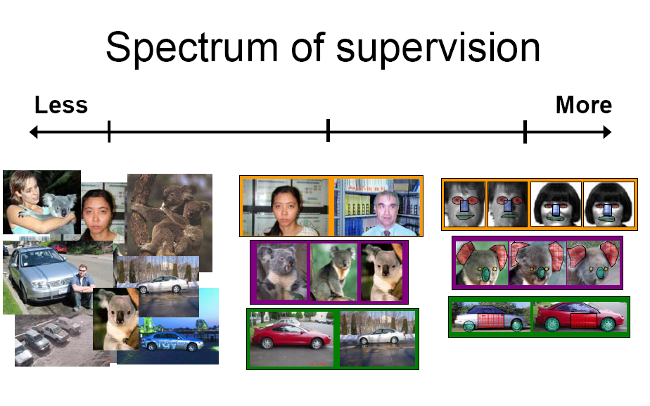
Unsupervised
“Weakly” supervised
Fully supervised
Definition depends on task

Slide 9
The machine learning framework
y = f(x)
Training: given a training set of labeled examples {(x₁,y₁), …, (x_{N},y_{N})}, estimate the prediction function f by minimizing the prediction error on the training set
Testing: apply f to a never before seen test example x and output the predicted value y = f(x)
output
prediction function
Image feature

Slide 10


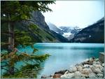

Image Categorization: Steps
Training
Training Labels
Training Images
Image Features
Classifier Training
Trained Classifier

Slide 11
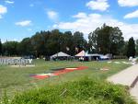
Image Categorization: Steps
Training
Training Labels
Training Images
Image Features
Classifier Training
Trained Classifier
Testing
Image Features
Trained Classifier
Prediction
Outdoor
Test Image

Slide 12
Image features
Training
Training Labels
Training Images
Image Features
Classifier Training
Trained Classifier

Slide 13
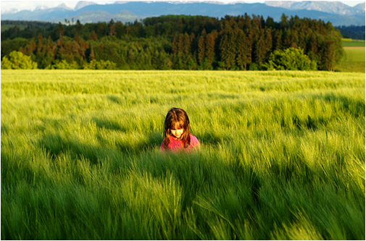
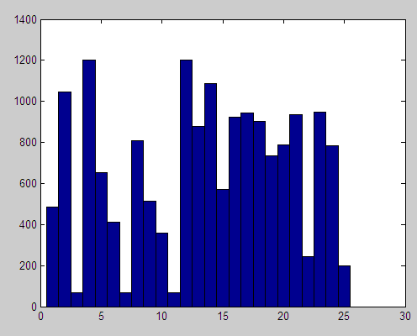
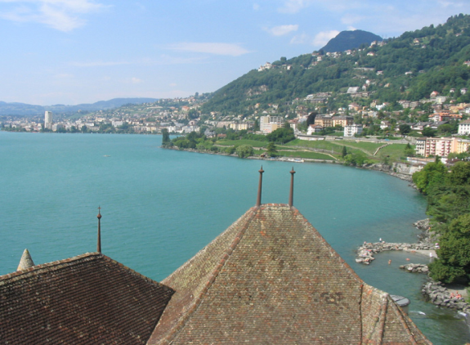
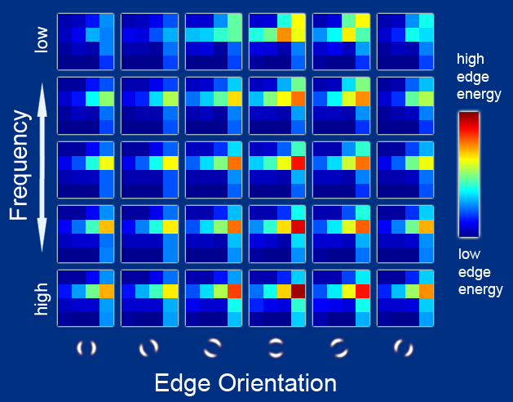
Features
Previous lectures covered different feature representations for images. Options include:
Raw pixels
Histograms
Intensity values
Visual words (e.g., SIFT)
Global image descriptors
E.g., GIST descriptors
…
How do you pick a feature representation?

Slide 14
General Principles of Representation
Coverage
Ensure that all relevant info is captured
Concision
Minimize number of features without sacrificing coverage
Directness
Ideal features are independently useful for prediction

Slide 15
Labels & Visual Similarity
Training labels dictate that two examples are the same or different, in some sense
“outdoor” “indoor”
Features and distance measures define visual similarity
Classifiers try to learn weights or parameters for features and distance measures so that visual similarity predicts label similarity

Slide 16
Classifiers
Training
Training Labels
Training Images
Image Features
Classifier Training
Trained Classifier

Slide 17
Classification
Assign input vector to one of two or more classes
Any decision rule divides input space into decision regions separated by decision boundaries

Slide 18
Many classifiers to choose from
SVM
Neural networks
Naïve Bayes
Bayesian network
Logistic regression
Randomized Forests
Boosted Decision Trees
K-nearest neighbor
RBMs
Etc.
Which is the best one?

Slide 19
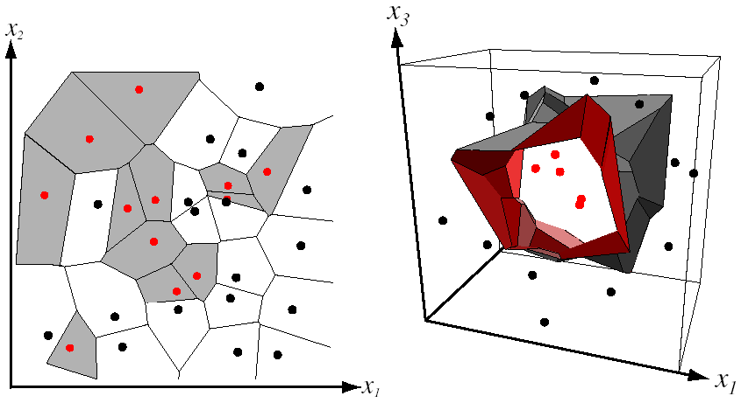
Nearest Neighbor Classifier
Assign label of nearest training data point to each test data point
from Duda et al.
Voronoi partitioning of feature space
for two-category 2D and 3D data

Slide 20
K-nearest neighbor
x
x
x
o
x
x
x
+
o
o
x
x
o
o
+
o
o
x2
x1

Slide 21
1-nearest neighbor
x
x
x
o
x
x
x
+
o
o
x
x
o
o
+
o
o
x2
x1

Slide 22
3-nearest neighbor
x
x
x
o
x
x
x
+
o
o
x
x
o
o
+
o
o
x2
x1

Slide 23
5-nearest neighbor
x
x
x
o
x
x
x
+
o
o
x
x
o
o
+
o
o
x2
x1

Slide 24
K-NN Classification: Summary
Pros:
Simple to implement
Work well
Easily can handle multi-class problems
Need tie-breaking procedure
Cons:
Must save all training examples
Need complex data structure to make testing fast

Slide 25
Linear Classification
Given some set of features with corresponding labels, learn a function to predict the labels from the features
There are *many* methods for linear classification. We will briefly cover one of the most popular methods: support vector machines (SVM)
x
x
x
x
x
x
o
x
x
o
o
o
o
x2
x1

Slide 26
Classifiers: Linear SVM
Which decision boundary is better?
x
x
x
x
x
x
o
x
x
o
o
o
o
x2
x1

Slide 27
Classifiers: Linear SVM
SVM finds the decision boundary that maximizes the margin
Margin: the distance between the examples and the decision boundary
Examples closest to the decision boundary are called support vectors
x
x
x
x
x
x
o
x
x
o
o
o
o
x2
x1
Notes:
Maximizes a margin

Slide 28
Classifiers: Linear SVM
SVM can handle a few outliers
In SVM packages, there is a parameter (usually C) that controls the trade-off between maximizing the margin and handling outliers
x
x
x
o
x
x
x
o
x
x
o
o
o
o
x2
x1

Slide 29
Nonlinear SVMs
General idea: the original input space can always be mapped to some higher-dimensional feature space where the training set is separable:
Φ: x → φ(x)

Slide 30
Nonlinear SVMs
The kernel trick: instead of explicitly computing the lifting transformation φ(x), define a kernel function K such that K(x_{i} , x_{j}) = φ(x_{i} ) · φ(x_{j})
This gives a nonlinear decision boundary in the original feature space

Slide 31
SVMs for Image Classification
Pick an image representation (in our case, bag of visual words represented as a histogram)
Pick a kernel function for that representation
Compute the matrix of pairwise kernel values between each training example (SVM packages with built-in kernel functions will do this for you.)
Train SVM solver to obtain model (support vectors and weights)
Testing: Using your trained model and a new example, SVM will predict value of the decision function

Slide 32
What about multi-class SVMs?
Unfortunately, there is no “definitive” multi-class SVM formulation. Two main strategies that use multiple two-class SVMs:
One vs. all (OVA)
Traning: learn an SVM for each class vs. mix of the others
Testing: apply each SVM to test example and assign to it the class of the SVM that returns the highest decision value
One vs. one (OVO)
Training: learn an SVM for each pair of classes
Testing: each learned SVM “votes” for a class to assign to the test example

Slide 33
SVMs: Pros and cons
Pros
Many publicly available SVM packages: http://www.kernel-machines.org/software
Kernel-based framework is very powerful, flexible
SVMs work very well in practice, even with very small training sample sizes
Cons
No “direct” multi-class SVM, must combine two-class SVMs
Computation, memory
During training time, must compute matrix of kernel values for every pair of examples
Learning can take a very long time for large-scale problems

Slide 34
Classification Methods
KNN and SVM are two example methods
Rather popular
There are many others
Neural networks, Naïve Bayes
Bayesian network, Logistic regression
Randomized Forests, Boosted Decision Trees
Etc.
There are issues to consider no matter which algorithm is selected…

Slide 35
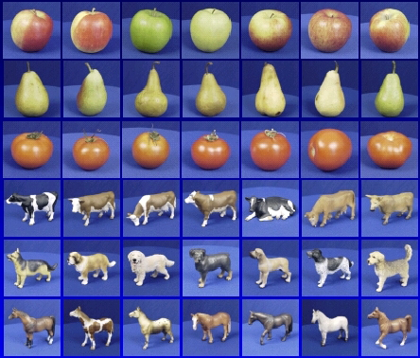

Generalization
Training set (labels known)
Test set (labels unknown)
How well does a learned model generalize from the data it was trained on to a new test set?

Slide 36
Generalization
Components of generalization error
Bias: how much the average model over all training sets differ from the true model?
Error due to inaccurate assumptions/simplifications made by the model
Variance: how much models estimated from different training sets differ from each other
Underfitting: model is too “simple” to represent all the relevant class characteristics
High bias and low variance
High training error and high test error
Overfitting: model is too “complex” and fits irrelevant characteristics (noise) in the data
Low bias and high variance
Low training error and high test error

Slide 37
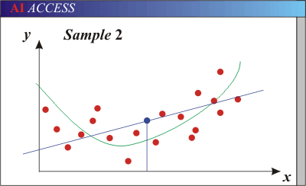
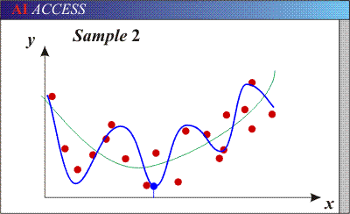
Bias-Variance Trade-off
Models with too few parameters are inaccurate because of a large bias (not enough flexibility).
Models with too many parameters are inaccurate because of a large variance (too much sensitivity to the sample).
Notes:
http://www.aiaccess.net/English/Glossaries/GlosMod/e_gm_bias_variance.htm

Slide 38
Bias-variance tradeoff
Underfitting
Overfitting
Error
Test error
Training error
High Bias
Low Variance
Complexity
Low Bias
High Variance

Slide 39
Bias-variance tradeoff
Few training examples
Test Error
Many training examples
High Bias
Low Variance
Complexity
Low Bias
High Variance
Slide credit: D. Hoiem
Notes:
Note: these figures don’t work in pdf

Slide 40
Effect of Training Size
Fixed prediction model
Error
Testing
Generalization Error
Training
Number of Training Examples

Slide 41
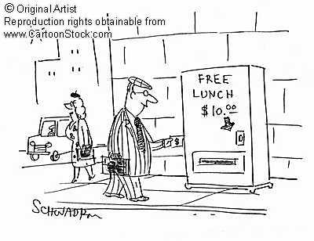
Remember…
No classifier is inherently better than any other: you need to make assumptions to generalize
Three kinds of error
Inherent: unavoidable
Bias: due to over-simplifications
Variance: due to inability to perfectly estimate parameters from limited data
Notes:
You can only get generalization through assumptions.

Slide 42
What to remember about classifiers
No free lunch: machine learning algorithms are tools, not dogmas
Try simple classifiers first
Better to have smart features and simple classifiers than simple features and smart classifiers
Use increasingly powerful classifiers with more training data (bias-variance tradeoff)

Slide 43
Some Machine Learning References
General
Tom Mitchell, Machine Learning, McGraw Hill, 1997
Christopher Bishop, Neural Networks for Pattern Recognition, Oxford University Press, 1995
SVMs
http://www.support-vector.net/icml-tutorial.pdf

