Slide 1
Intelligent Text Analyzer and Rating Identifier with Visualization
Team Heuristics
PRASANNA KUMAR| SANKALP | SENTHIL KUMAR

Slide 2
AGENDA
01
Objective
02
Data Extraction
03
Processing with NLP
04
Visualization

Slide 3

Objective
Integration of the building blocks of data analysis and predictive systems- Natural Language Processing, Artificial Intelligence, and Visual Analytics.
The inspiration behind this paper was the online Question and Answer based site – Quora.
This paper is a problem-solving strategy to visually display all the suggestions consolidated together.
Notes:
http://www.slideshare.net/Presentationsat24point0/corporate-social-responsibility-csr-powerpoint-templates

Slide 4
Data Extraction
Data is extracted by web scraping the Quora website.
To a given Question, the number of answers, up-votes for a given answer, person who has answered the question, related questions are extracted.
We plan to extract the data using Python with a module called BeautifulSoup
The data extracted after the web-scraping is stored in a DB.
This is used as input for the NLP Analytic processing.

Slide 5
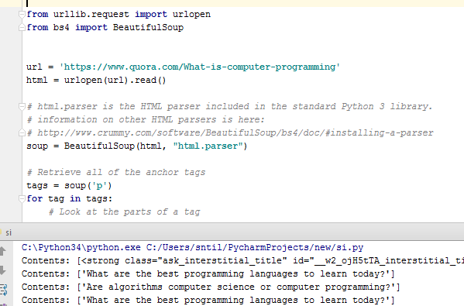
BeautifulSoup

Slide 6
NLP - Natural Language processing
The core processing unit, which fetches the extracted data from the Data Base and fed as Input to the NLP unit.
The text is processed using the below AI methods to get the overall idea about the answers.
Summarizer
AutoTag
Identify the type of entity extracted
Sentiment Analysis
Tokenizer

Slide 7
Algorithms – Word Analysis
Summarizer- It is an advanced AI algorithm for summarizing the text with the option of generating context-controlled summaries.
AutoTag- Extracting the important keywords from the text.
Named entity recognition - Segregates Name of Person, organization, Location.
Sentiment Analysis - To identify the sentiment of a string of text, from very negative to neutral to very positive.
Tokenizer – Used for break up text into tokens
Ranking Algorithm
AutoTag+ Named entity recognition + Tokenizer
Sentimental
Analysis
INPUT
From DB
Processing
Summarizer
DATA VISUALIZATION

Slide 8
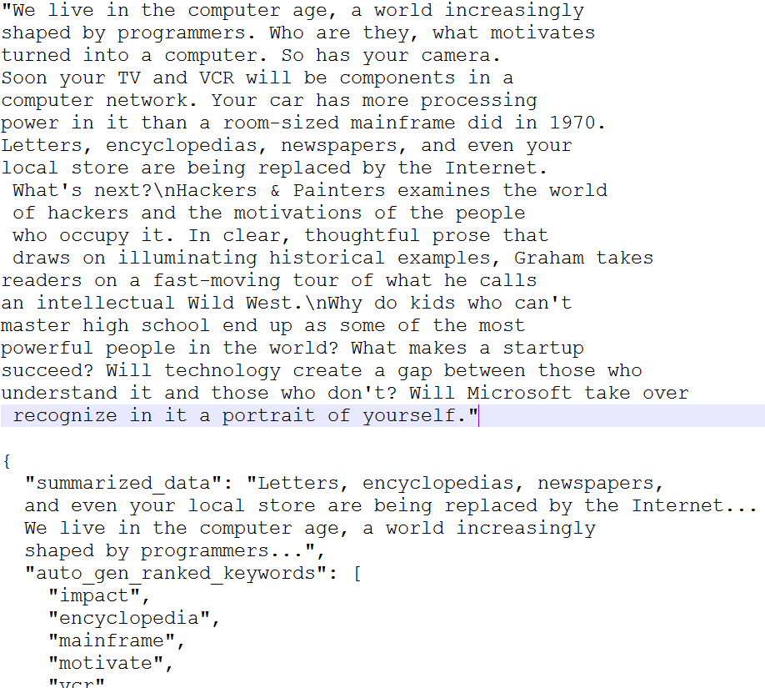
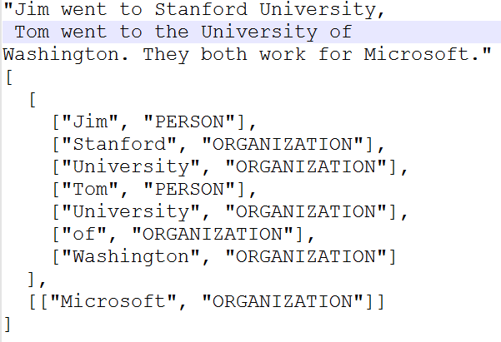
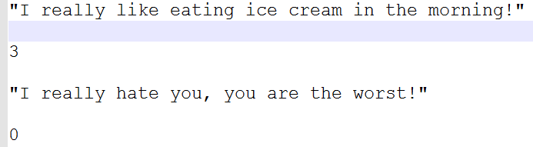
Sampled Output

Slide 9
Data Visualization
D3 is simple, robust and powerful visualization tool available for Web Applications
D3 uses HTML, SVG and CSS for customizing the required Visualizations.
D3.js
HTML
SVG
XML/JSON
You can make the data interaction through the use of D3.js data driven transformations and transitions.
Notes:
http://www.slideshare.net/Presentationsat24point0/corporate-social-responsibility-csr-powerpoint-templates

Slide 10
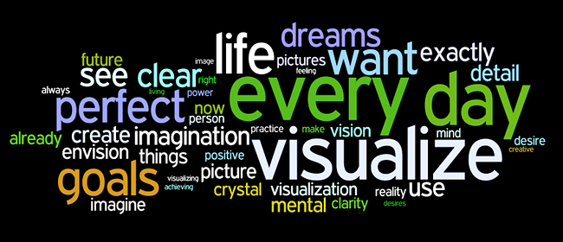
Data Visualization - Word Cloud
Output of NLP unit is in the form of JSON file, which is stored in the Database.
From this data, the more ranked word is displayed bigger in the word cloud.
Notes:
http://www.slideshare.net/Presentationsat24point0/corporate-social-responsibility-csr-powerpoint-templates

Slide 11
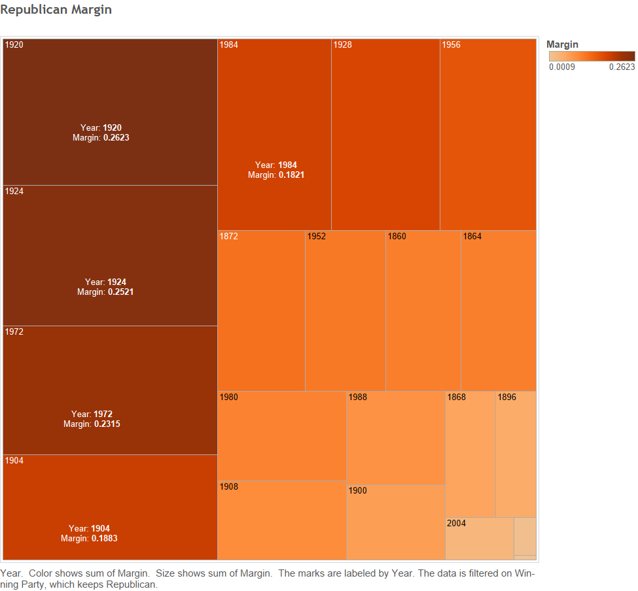
Data Visualization - Heat Map
Positives are brighter.
Negatives are dimmer.

Slide 12
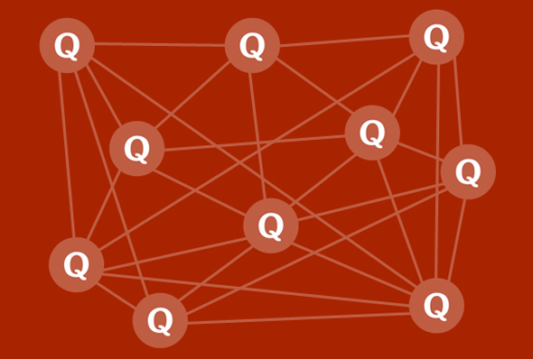
Data Visualization - Network Graph
The question suggestion are displayed in this way.
The more the connections, the more they are suggested.

Slide 13
References
James Clarke, Vivek Srikumar, Mark Sammons, and Dan Roth. 2012. An NLP Curator (or: How I learned to stop worrying and love NLP pipelines). In LREC 2012.
Christopher D. Manning, Mihai Surdeanu, Jenny Finkel, John Bauer. 2014 The Stanford CoreNLP Natural Language Processing Toolkit. http://nlp.stanford.edu/pubs/StanfordCoreNlp2014.pdf
https://d3js.org/
https://www.dashingd3js.com/why-build-with-d3js
https://pypi.python.org/pypi/beautifulsoup4
http://www.nltk.org/py-modindex.html

Slide 14
THANKS!
Any questions?

