Slide 1


COMPLETE RTOS
Author: Prashanth Rajasekar
Embedded Software Engineer
Intern @ CTI One Corporation

Slide 2
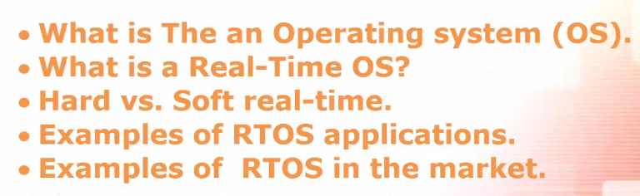
TOPICS TO BE COVERED
Chapter - 1

Slide 3
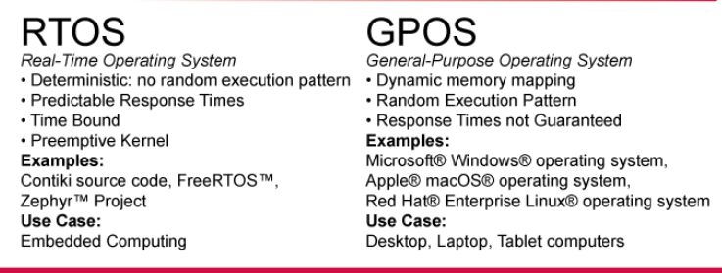
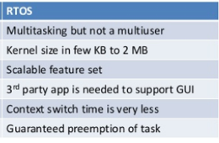
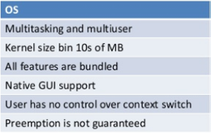
Basic Difference RTOS vs OS

Slide 4
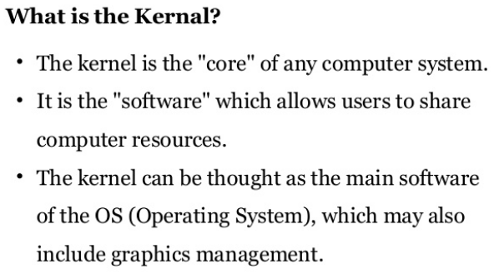
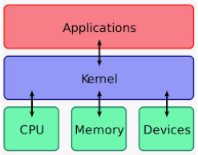
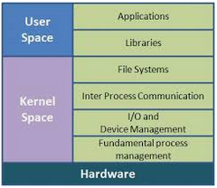
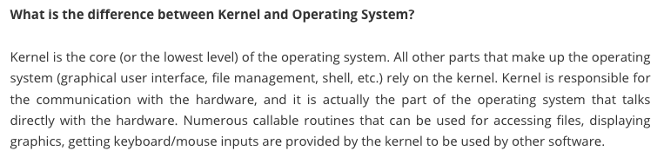
Basic Difference Kernel vs OS

Slide 5
Hard vs Soft Real Time
S.No | Hard Real Time | Soft Real time
1 | Timing constraint is hard if the failure to meet it is considered a fatal error. | A timing constraint is soft if a few misses of deadlines do no serious harm, only the system’s overall performance becomes poorer and poorer when more and more jobs with soft deadlines complete late.
2 | The usefulness of a result produced by hard real time job falls off abruptly and even become negative when the tardiness of the job becomes larger than zero. | The usefulness of a result produced by soft real time job decreases gradually as the tardiness of the job increases.
3 | User can obtain the validation as systems is to avoid hardware and software features that lead to non-determinism. Therefore, it is possible to verify the satisfaction of all hard timing constraint by exhaustive simulation and testing. | Less rigorous validation as more relaxed time constraint allow the developer to consider other performance metric equally seriously.
4 | Completion of task or job is deterministic. | Completion of task or job is probabilistic.
5 | Hard-required response time | Soft-required response time.
6 | Predictable peak load performance. | Degraded peak load performance.
7 | Controlled by environment. | Controlled by computer.
8 | Autonomous error detection. | User assisted error detection.
9 | Short-term data integrity | Long-term data integrity
10 | Small/medium size of data files | Large size of data files
11 | Example: Flight control, railway signaling, robot, anti missile system, inkjet printer etc. | Example: Dvd player, mobile phone, on-line transaction systems, telephone switches, electronic games, multimedia system, web browsing etc.

Slide 6
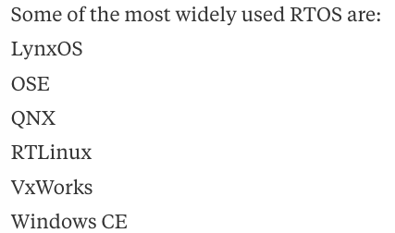
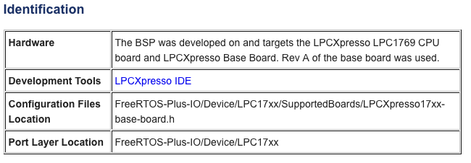
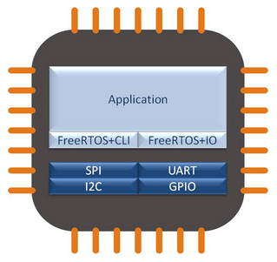
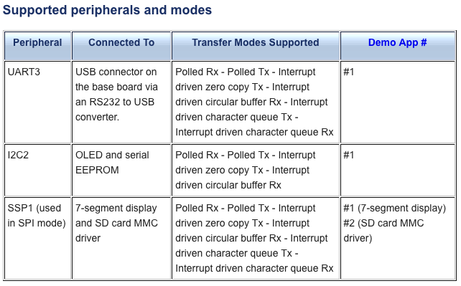
RTOS Application Example
LPC1769
FreeRTOS

