Slide 1


COMPLETE RTOS
Author: Prashanth Rajasekar
Embedded Software Engineer
Intern @ CTI One Corporation

Slide 2
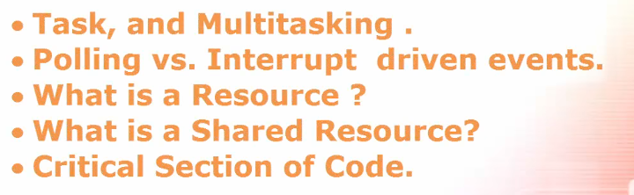
TOPICS TO BE COVERED
Chapter - 2

Slide 3
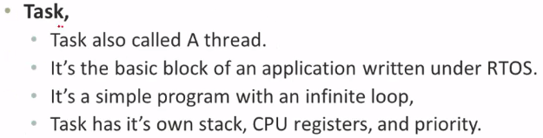
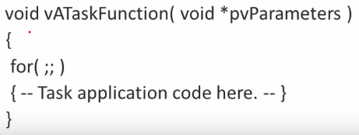
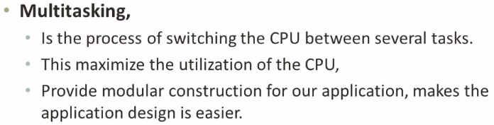
Tasks and MultiTasking
Example

Slide 4


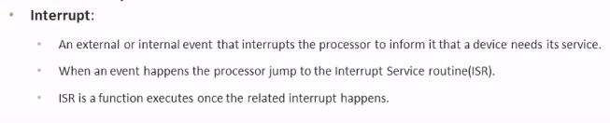
Polling vs Interrupt Driven Events
ISR – Interrupt Service Routine

Slide 5
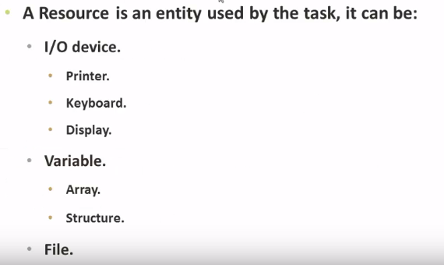
What is a Resource ?

Slide 6
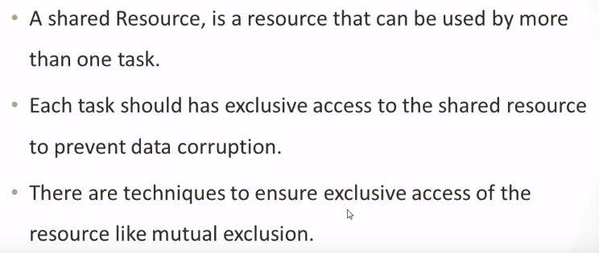
What is a Shared Resource ?

Slide 7
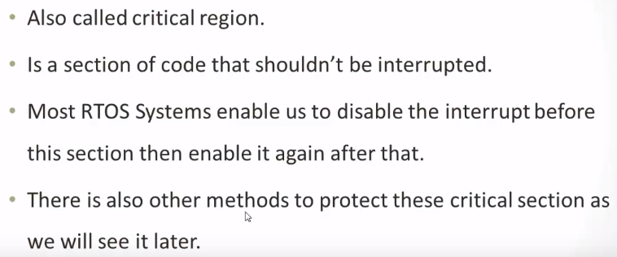
Critical Section of Code

