Slide 1


COMPLETE RTOS
Author: Prashanth Rajasekar
Embedded Software Engineer
Intern @ CTI One Corporation

Slide 2
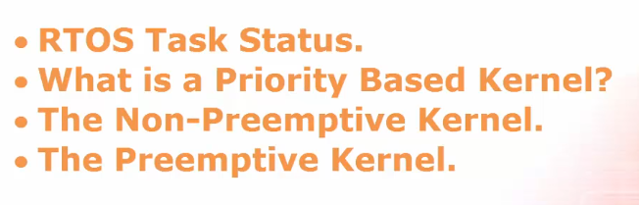
TOPICS TO BE COVERED
Chapter - 3
RTOS Kernels

Slide 3
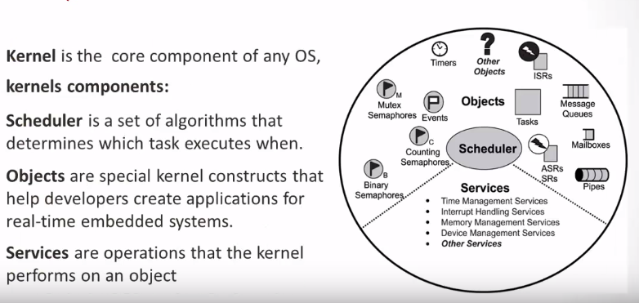
RTOS Kernels
1.
2.
3.

Slide 4
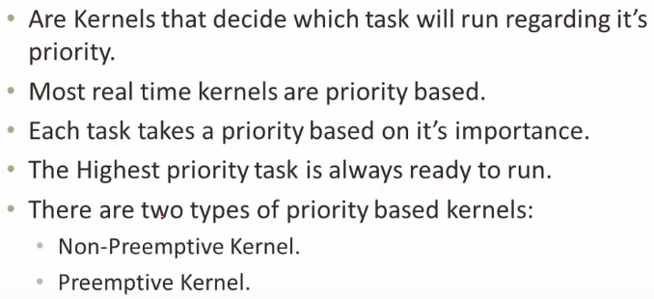
Priority based Kernels
Mutual Exclusion

Slide 5
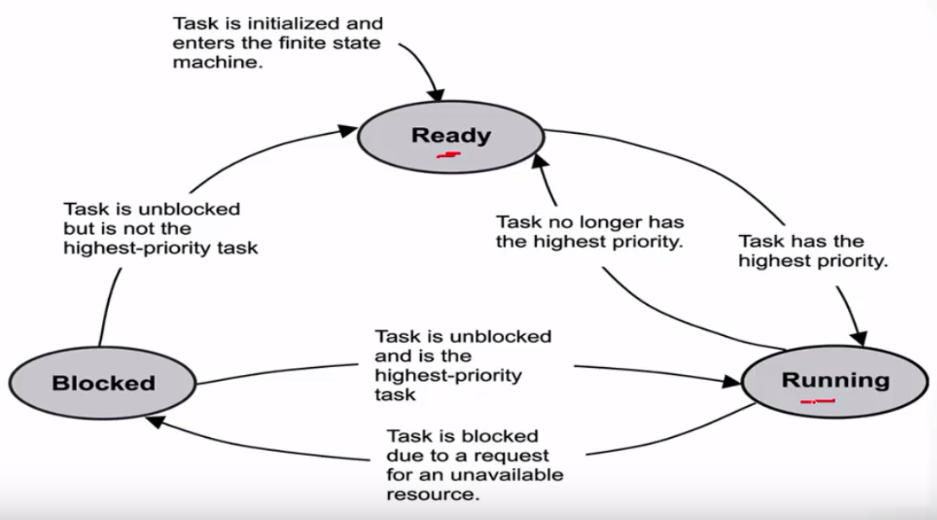
RTOS Task Status

Slide 6
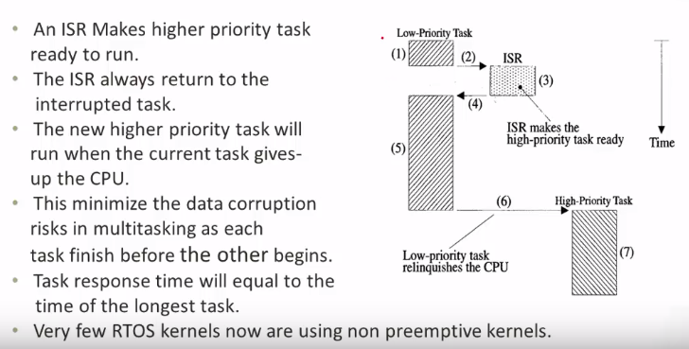
Non Pre-emptive Kernel
Makes it ready to run, but doesn’t execute it

Slide 7
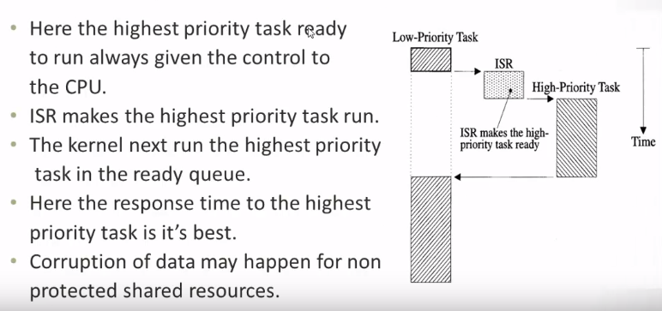
Pre-emptive Kernel
Transfers the CPU control to the high priority task

