Slide 1


COMPLETE RTOS
Author: Prashanth Rajasekar
Embedded Software Engineer
Intern @ CTI One Corporation

Slide 2
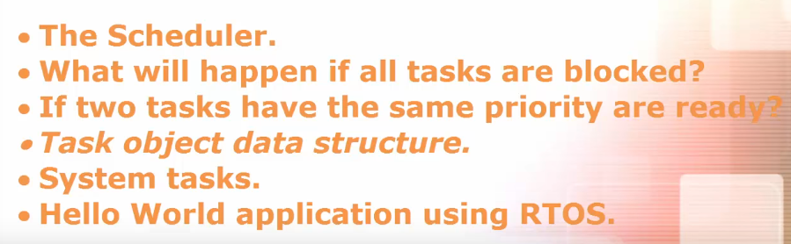
ROAD MAP
Chapter - 4

Slide 3
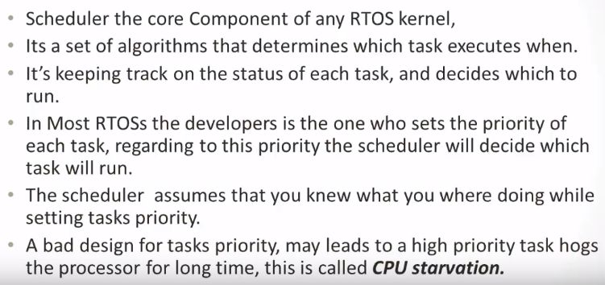
RTOS Scheduler

Slide 4
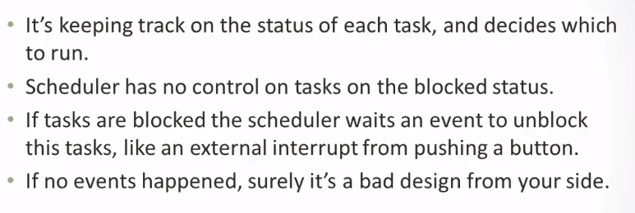
RTOS Scheduler

Slide 5
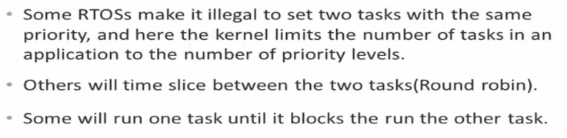
If the 2 tasks with the same priority are ready

Slide 6
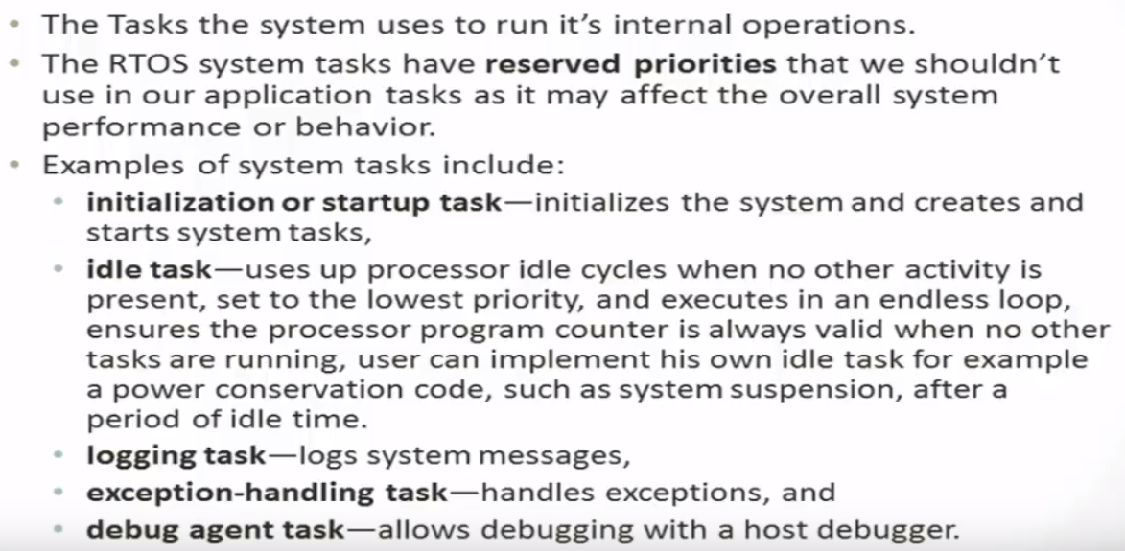
System Tasks

Slide 7
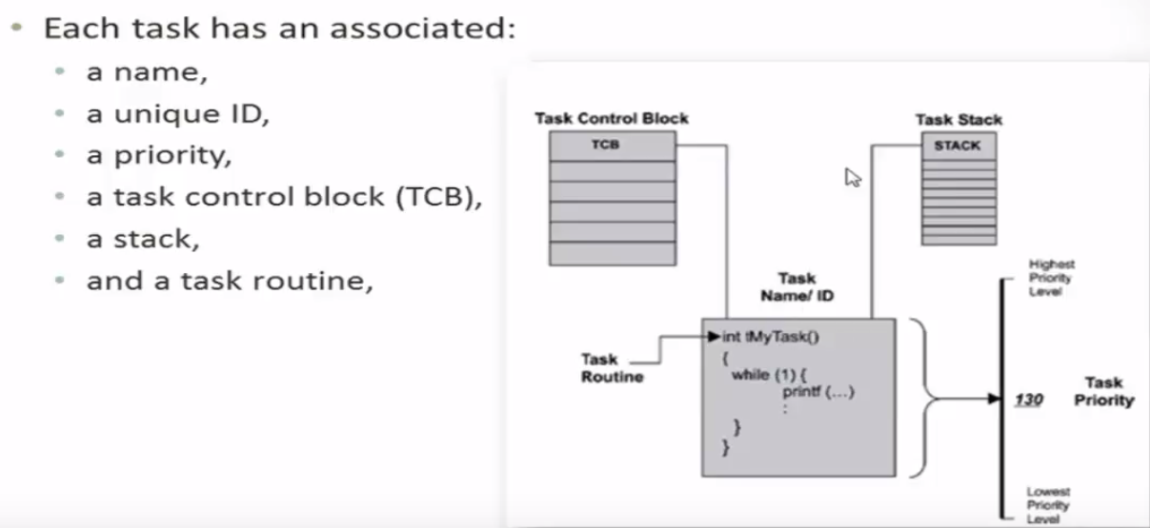
System Tasks

Slide 8
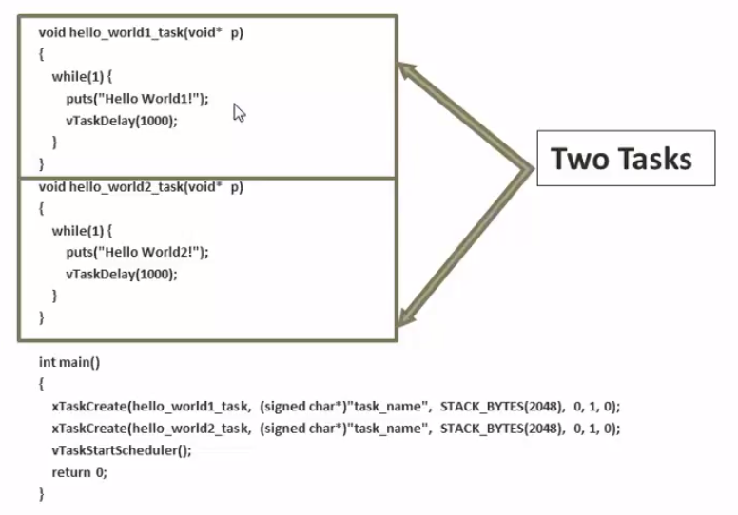
Hello World Application

