Slide 1


COMPLETE RTOS
Author: Prashanth Rajasekar
Embedded Software Engineer
Intern @ CTI One Corporation

Slide 2
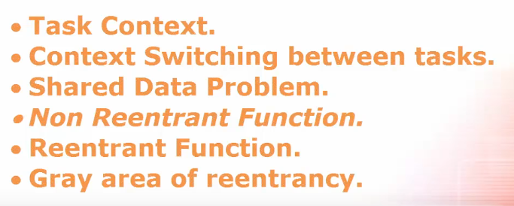
ROAD MAP
Chapter - 5
How to protect shared Data

Slide 3
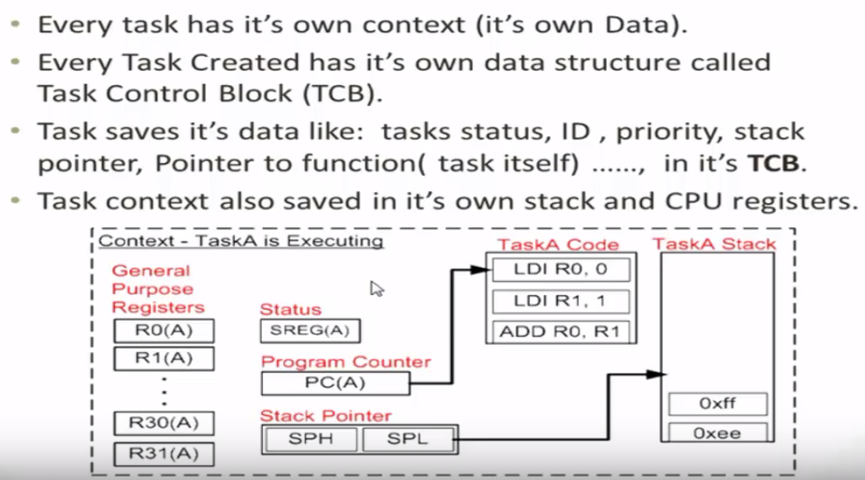
Task Context

Slide 4
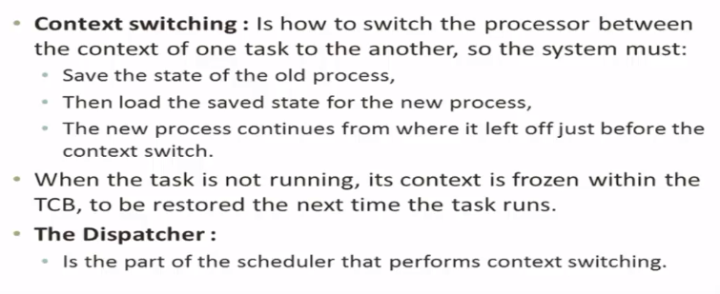
Context Switching

Slide 5
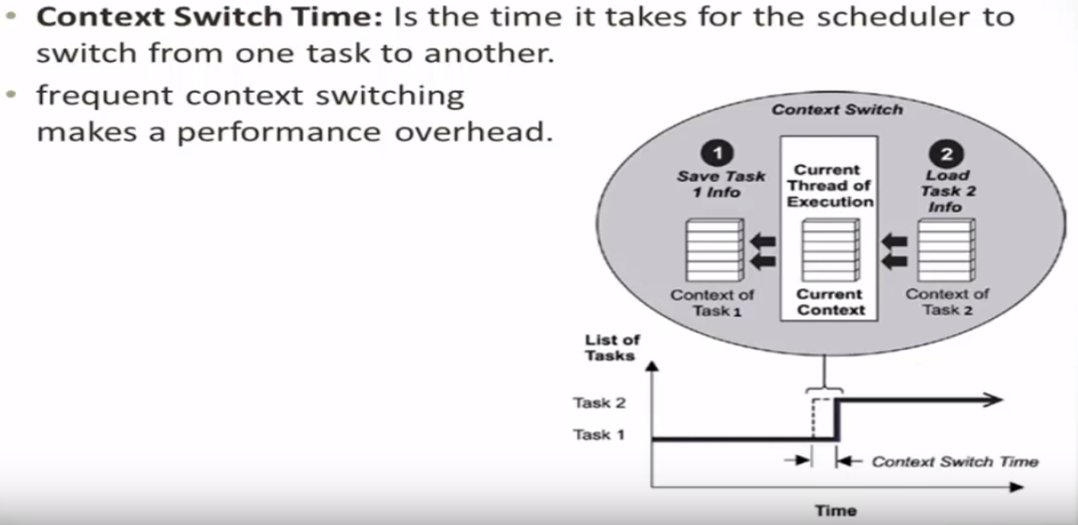
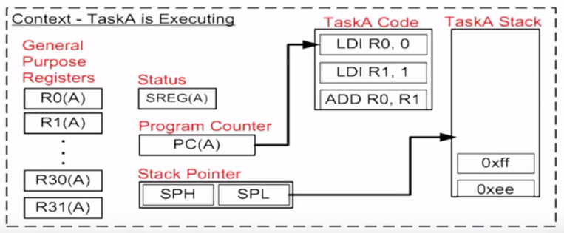
Context Switching

Slide 6
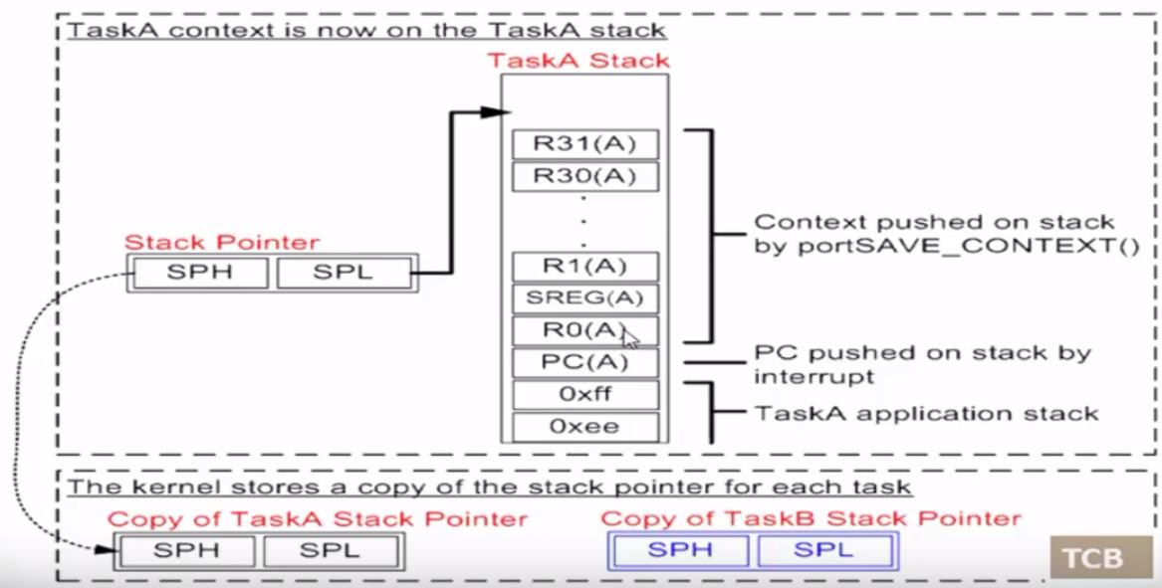
Context Switching

Slide 7
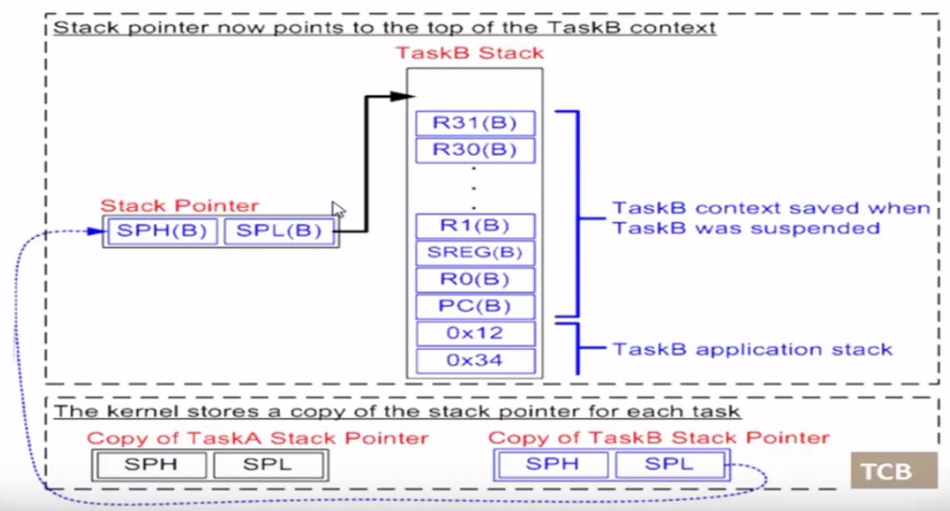
Context Switching

Slide 8
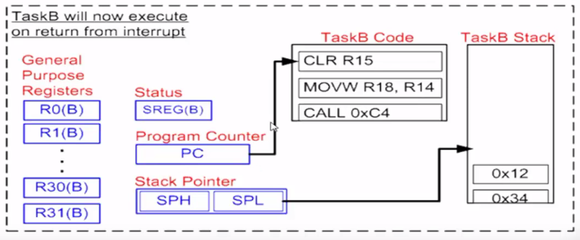
Context Switching

Slide 9
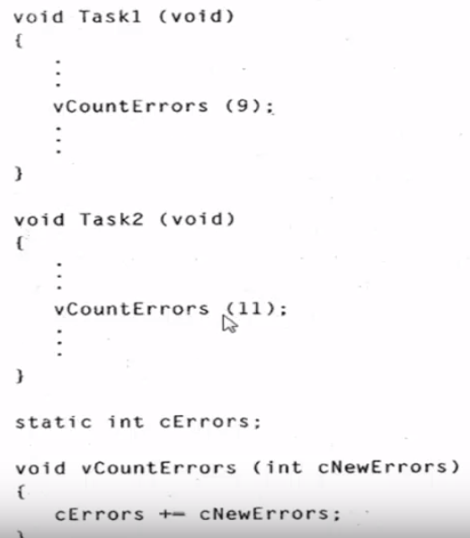
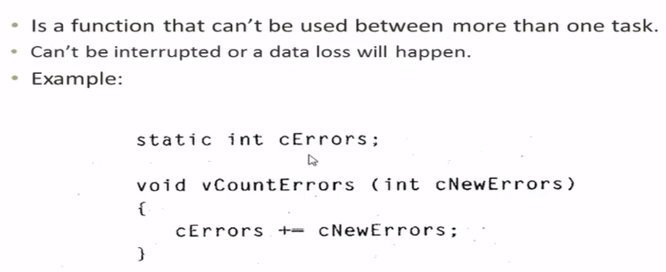
Shared Data Problem/ Non-Reentrant Func
We can see that the 2 functions keep on updating the value of int cErrors
Non Reentrant function

Slide 10
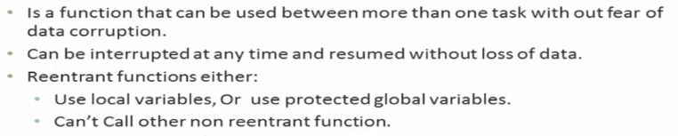
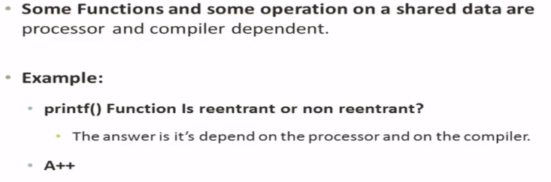
Reentrant Function
Gray area for Reentrancy

Slide 11
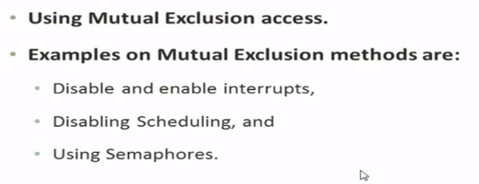
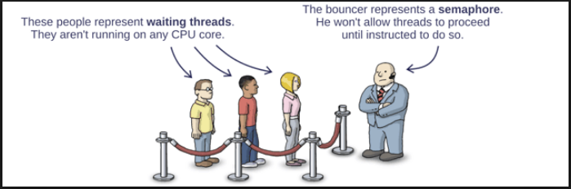
How to protect Shared Data

