Slide 1


COMPLETE RTOS
Author: Prashanth Rajasekar
Embedded Software Engineer
Intern @ CTI One Corporation

Slide 2
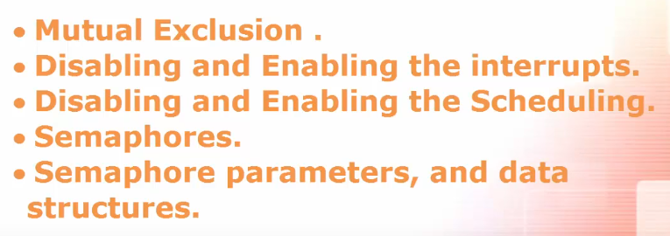
ROAD MAP
Chapter - 6
Semaphore types

Slide 3
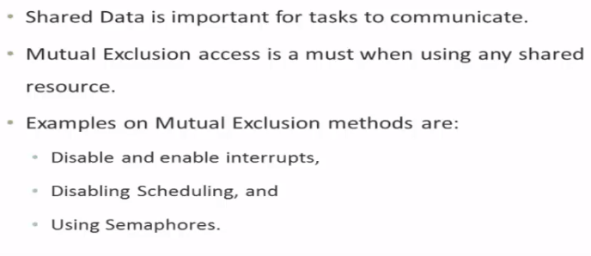
Mutual Exclusion

Slide 4
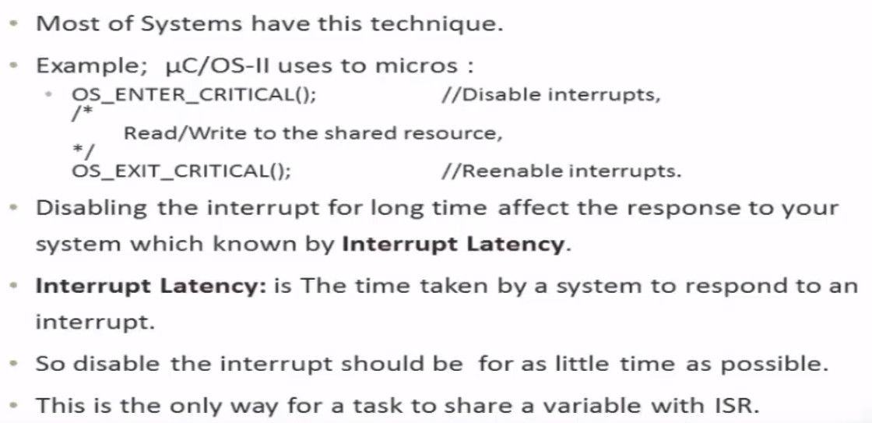
Disabling and Enabling the Interrupts
Interrupt Service Routine

Slide 5
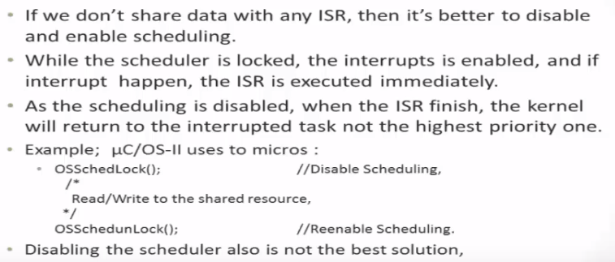
Disabling and Enabling the Scheduling
In this case the scheduling gets disturbed
Interrupt Service Routine

Slide 6

Semaphores

Slide 7
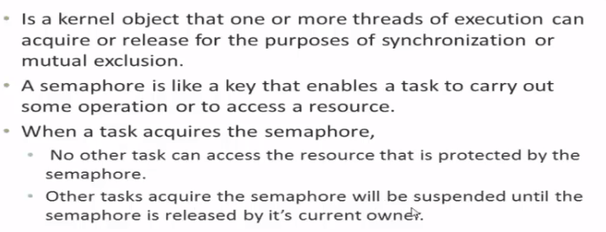
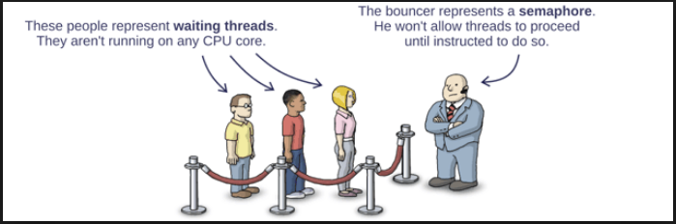
Semaphores

Slide 8
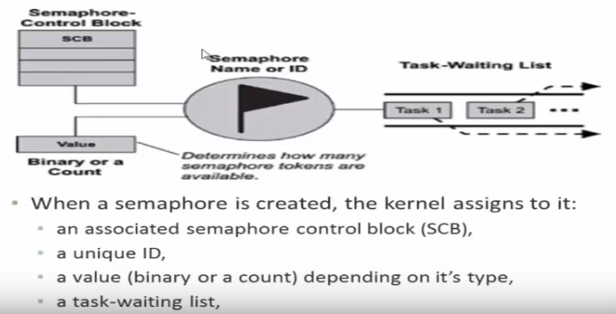
Semaphores parameter and Data Structure

Slide 9
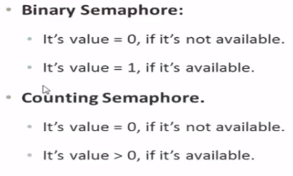
Semaphore types

