Slide 1


COMPLETE RTOS
Author: Prashanth Rajasekar
Embedded Software Engineer
Intern @ CTI One Corporation

Slide 2
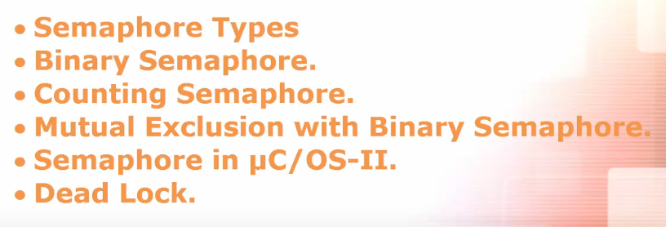
ROAD MAP
Chapter - 7
Avoid Deadlock

Slide 3
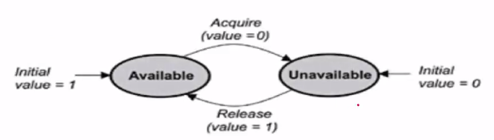
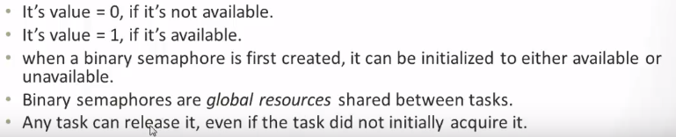
Semaphore types
Binary Semaphore

Slide 4
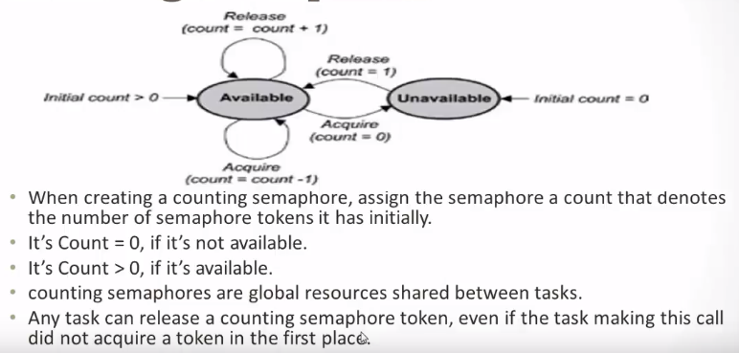
Semaphore types
Counting Semaphore

Slide 5
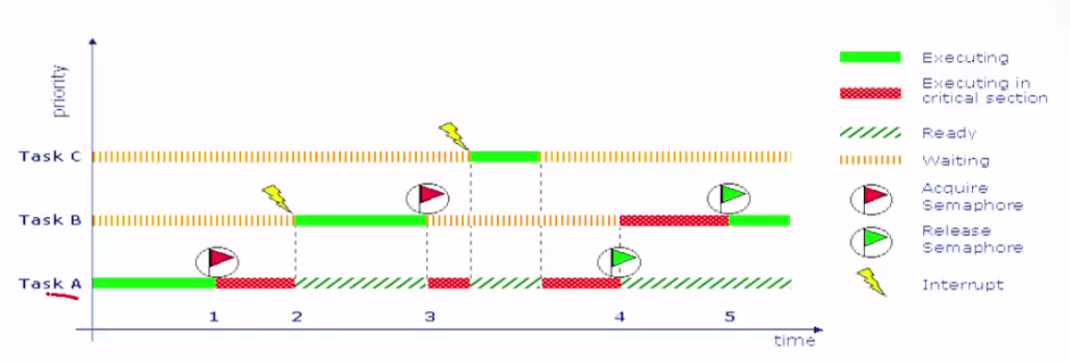

Mutual Exclusion with Binary Semaphore

Slide 6
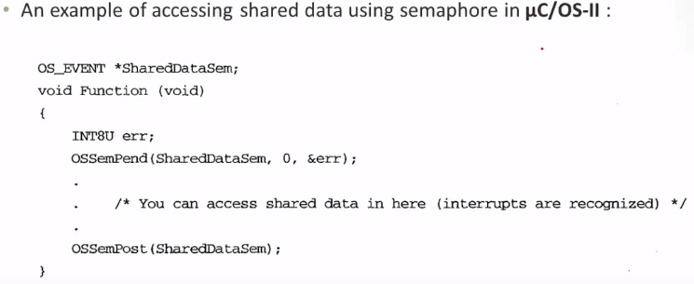
Semaphore in uC / OS-II

Slide 7
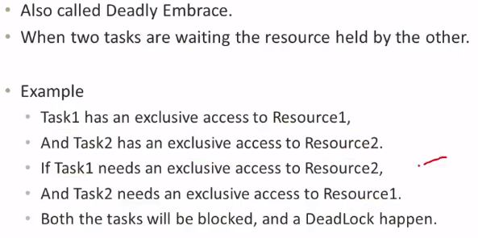
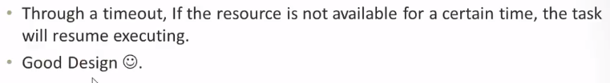
DeadLock
Avoid DeadLock

