Slide 1


COMPLETE RTOS
Author: Prashanth Rajasekar
Embedded Software Engineer
Intern @ CTI One Corporation

Slide 2
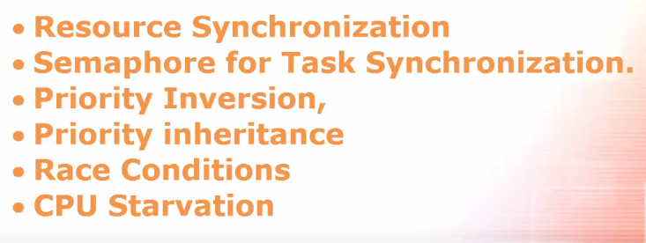
ROAD MAP
Chapter - 8

Slide 3
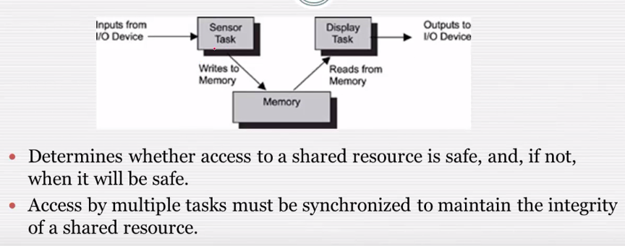
Resource Synchronisation

Slide 4
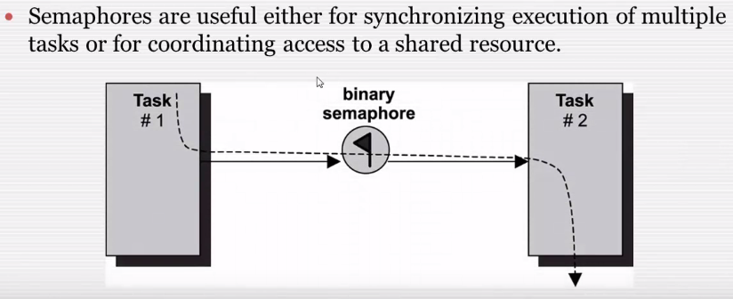
Semaphore for Task Sychronisation

Slide 5
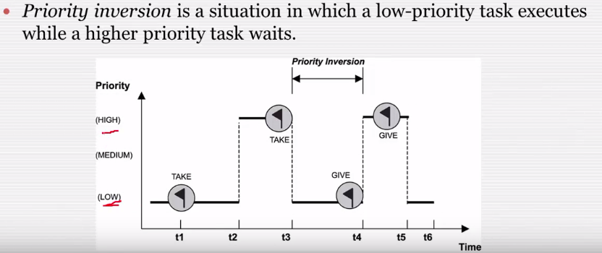
Priority Inversion

Slide 6
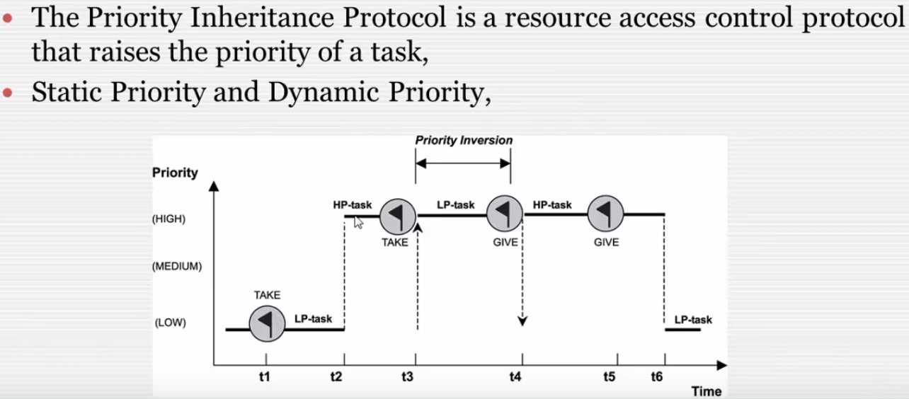
Priority Inheritance

Slide 7
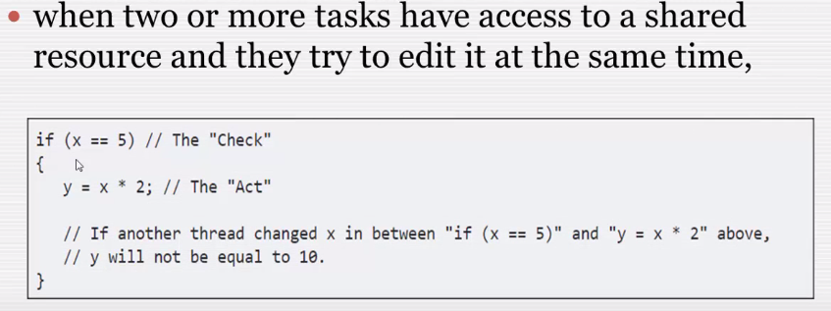
Race Condition

Slide 8
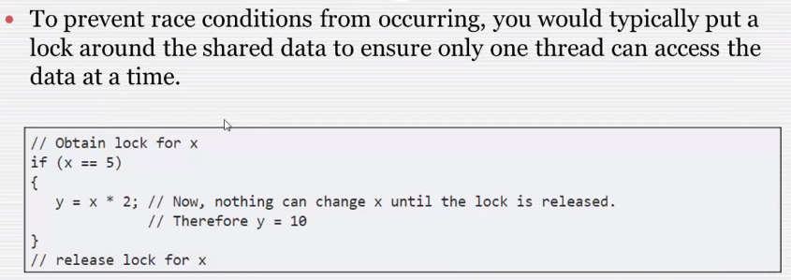
Race Condition

Slide 9
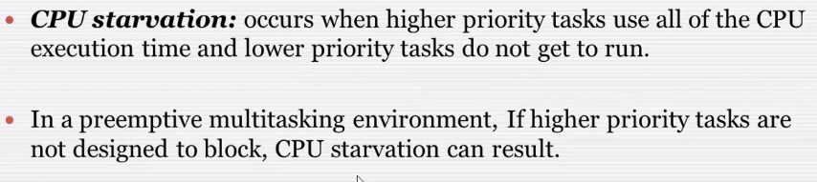
CPU Starvation
From Task point of View

