Slide 1


COMPLETE RTOS
Author: Prashanth Rajasekar
Embedded Software Engineer
Intern @ CTI One Corporation

Slide 2
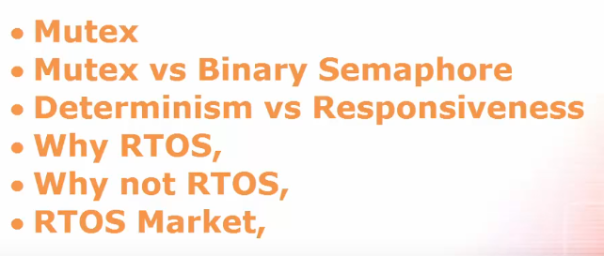
ROAD MAP
Chapter - 9

Slide 3
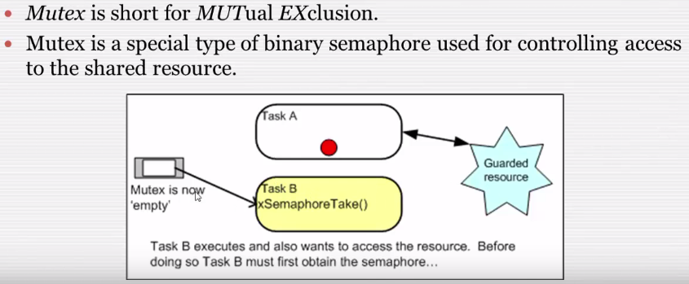
Mutex

Slide 4
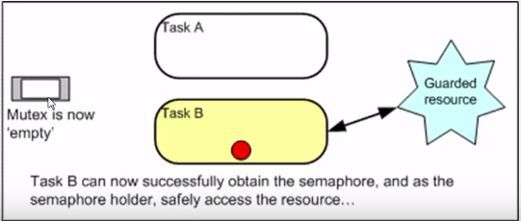
Mutex Cont..

Slide 5
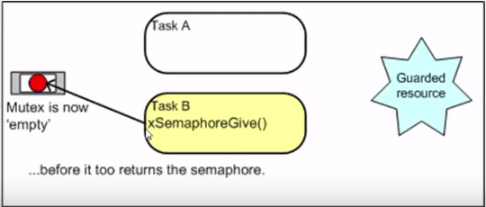
Mutex Cont..

Slide 6
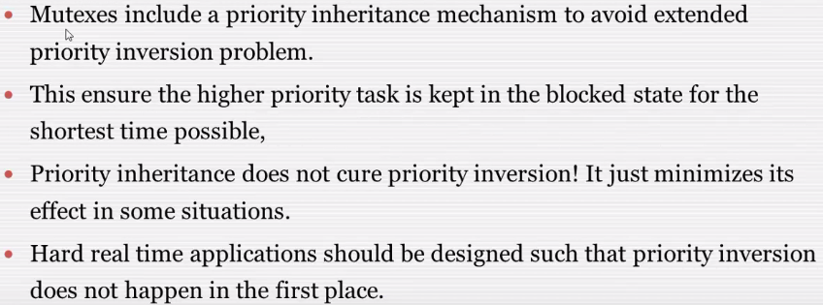
Mutex

Slide 7
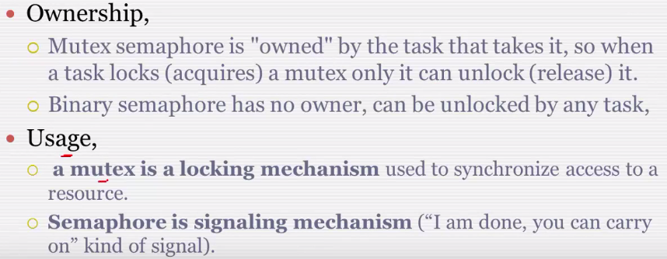
Mutex vs Binary Semaphore

Slide 8
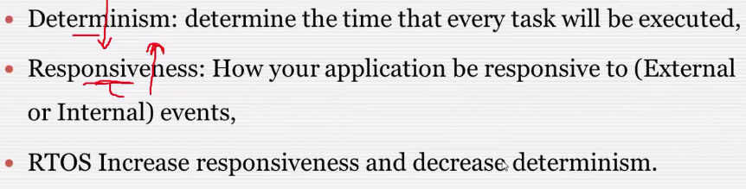
Deteriminism vs Responsiveness

Slide 9
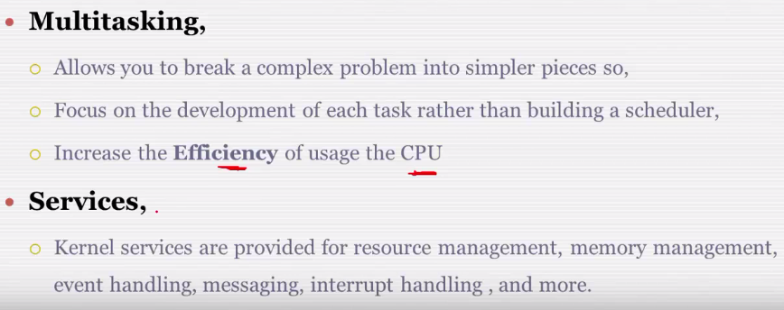
Why RTOS?

Slide 10
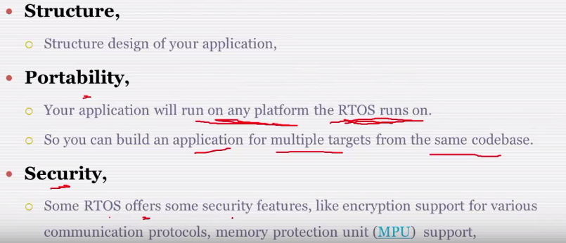
Why RTOS?

Slide 11
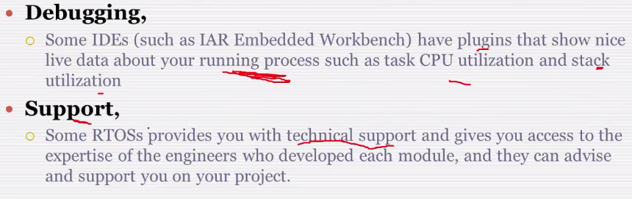
Why RTOS?

Slide 12
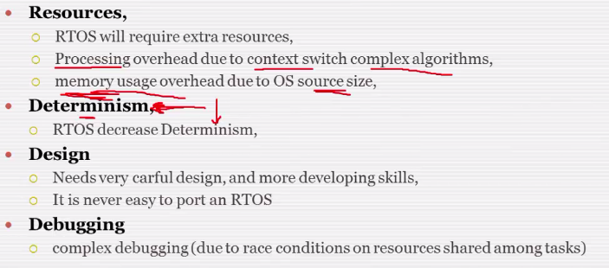
Why not RTOS?

Slide 13
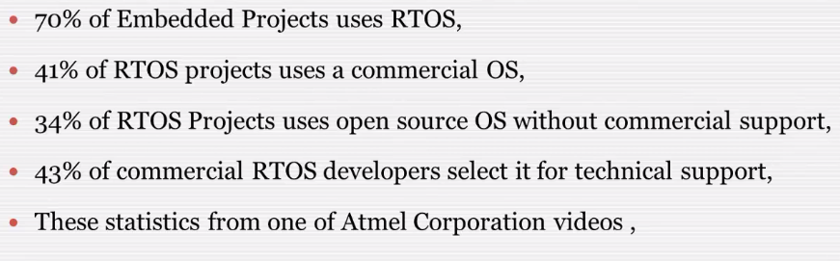
RTOS Market

