Slide 1

lec9-5-MagSEN_LPC-HL-PR-2018-9-12.ppt
Magnetic Sensors to LPC1769 Connection
CTI One Corporation
Version: x0.1
Date: September 2018
Project Lead: Harry Li, Ph.D.
Team members: Prashanth Rajasekar
Company confidential

Slide 2
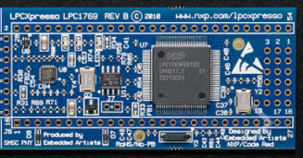
LPC1769 ADC pin Layout
6 ADC pins available
JTAG
Available ADC pins
AD0 | P0.23
AD1 | P0.24
AD2 | P0.25
AD3 | P0.26
AD4 | P1.30
AD5 | P1.31
GND
P0.23
P0.24
P0.25
P0.26
P1.30
P1.31

Slide 3
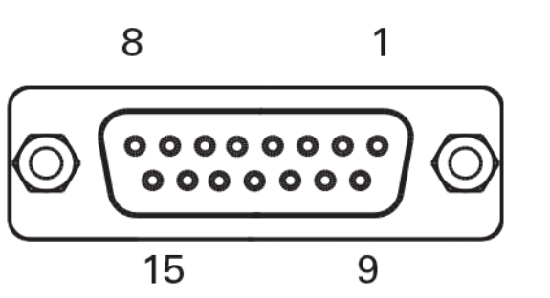
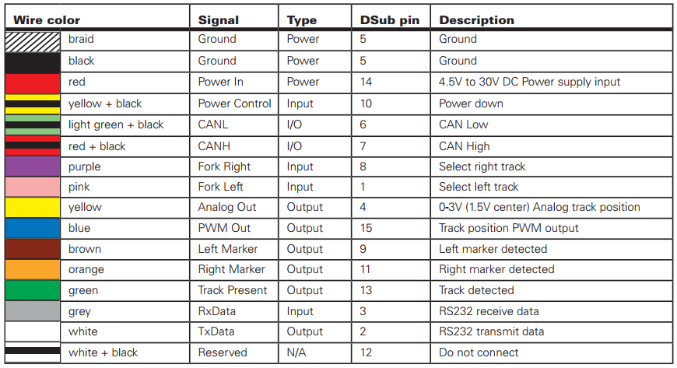
Magnetic Sensor Connector Pin Locations
Pins available: 1-15

Slide 4
Magnetic Sensor 1 Pin Connectivity Table
+
JTAG
-
MagSen1 Pins | LPC1769 Pins
Pin 5 | GND
Pin 14 | EXT_PWR
Pin 4 | P0.23
Pin 13 | P0.24
Pin 9 | P0.25
Pin 11 | P0.26
GND
P0.23
P0.24
P0.25
P0.26
Input Data from MagSen1： TrackDetected，Voltage 0V-3V，Left_Marker_detection, Right_Marker_detection

Slide 5


Magnetic Sensor 1 Physical connection
GND
P0.23 - LPC_ADC_INPUT (0V-3V)
EXT_PWR
1K
1K
1K
P0.24- Tape Detector
P0.25- Left Marker Detector
2K
2K
2K
P0.26- Right Marker Detector
GND

Slide 6
Magnetic Sensor 2 Pin Connectivity Table
+
JTAG
-
MagSen1 Pins | LPC1769 Pins
Pin 5 | GND
Pin 14 | EXT_PWR
Pin 4 | P1.30
Pin 13 | P1.31
GND
P1.30
P1.31
Input Data from MagSen2： TrackDetected，Voltage 1V-3V

Slide 7
Magnetic Sensor 2 Physical connection
GND
P1.30 - LPC_ADC_INPUT (0V-3V)
EXT_PWR 12V
1K
P1.31- Tape Detector
2K
GND

