Slide 1

Lec??? Deploy_VNC-PR-2018-10-35.ppt
Deploying VNC on PiNode and TX2SVR
CTI One Corporation
Version: x0.1
Date: October 2018
Project Lead: Harry Li, Ph.D.
Team members: Prashanth Rajasekar
Company confidential

Slide 2

VNC-Virtual Network Computing
Is a graphical desktop Sharing system.
It uses the Remote Frame Buffer Protocol (RFB) to remotely control another computer.
It transmits the Keyboard and mouse events from one computer to another.
It relays the UI Screen updates back to the remote computer over the network.
Has 2 parts : VNC Server and VNC Client.

Slide 3
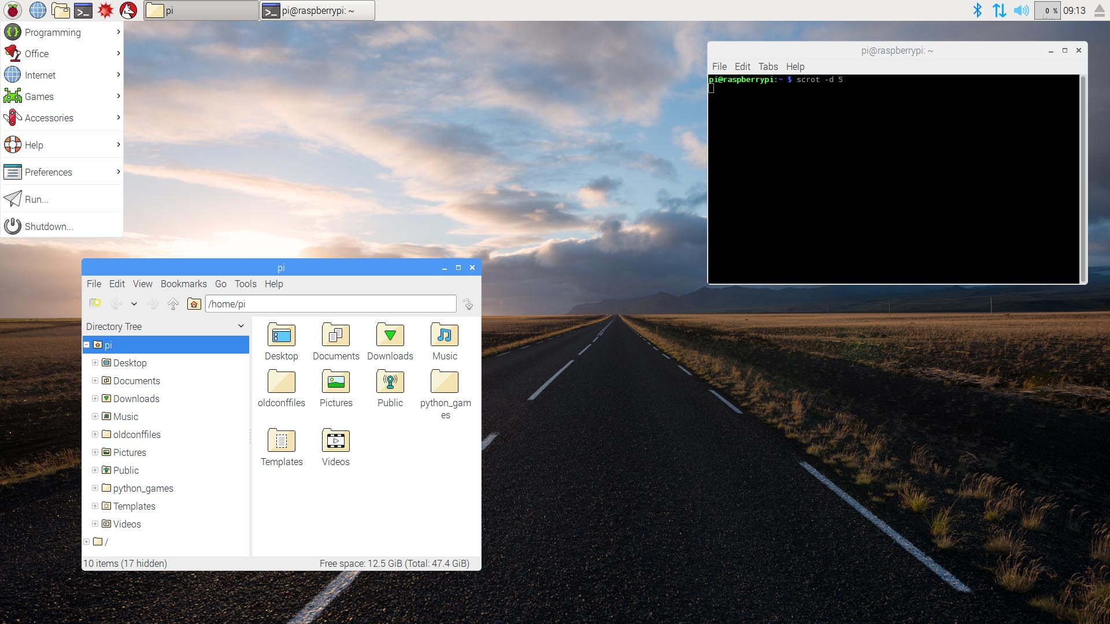
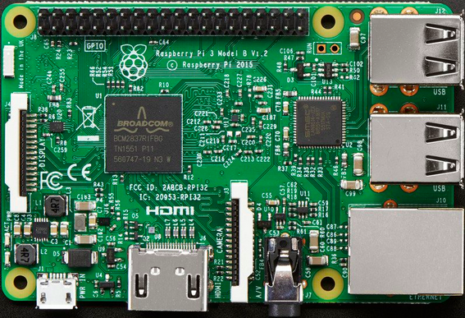
Deploying VNC on PiNode
VNC port: 5900
Steps:
1. Run these commands on the PiNode Terminal
$ sudo apt-get update
$ sudo apt-get install realvnc-server real-vnc-viewer
2. Enable VNC on PiNode
$ sudo raspi-config
Select interfacing options
Select VNC and click Yes.
3. View the Desktop from remote desktop (under same subnet)
a. Download VNC viewer from the below link
https://www.realvnc.com/en/connect/download/viewer/
b. Launch the application
c. Enter the IP address of PiNode and connect.
d. Enter the password of PiNode.
e. The screen will be shared successfully.
PiNode

Slide 4
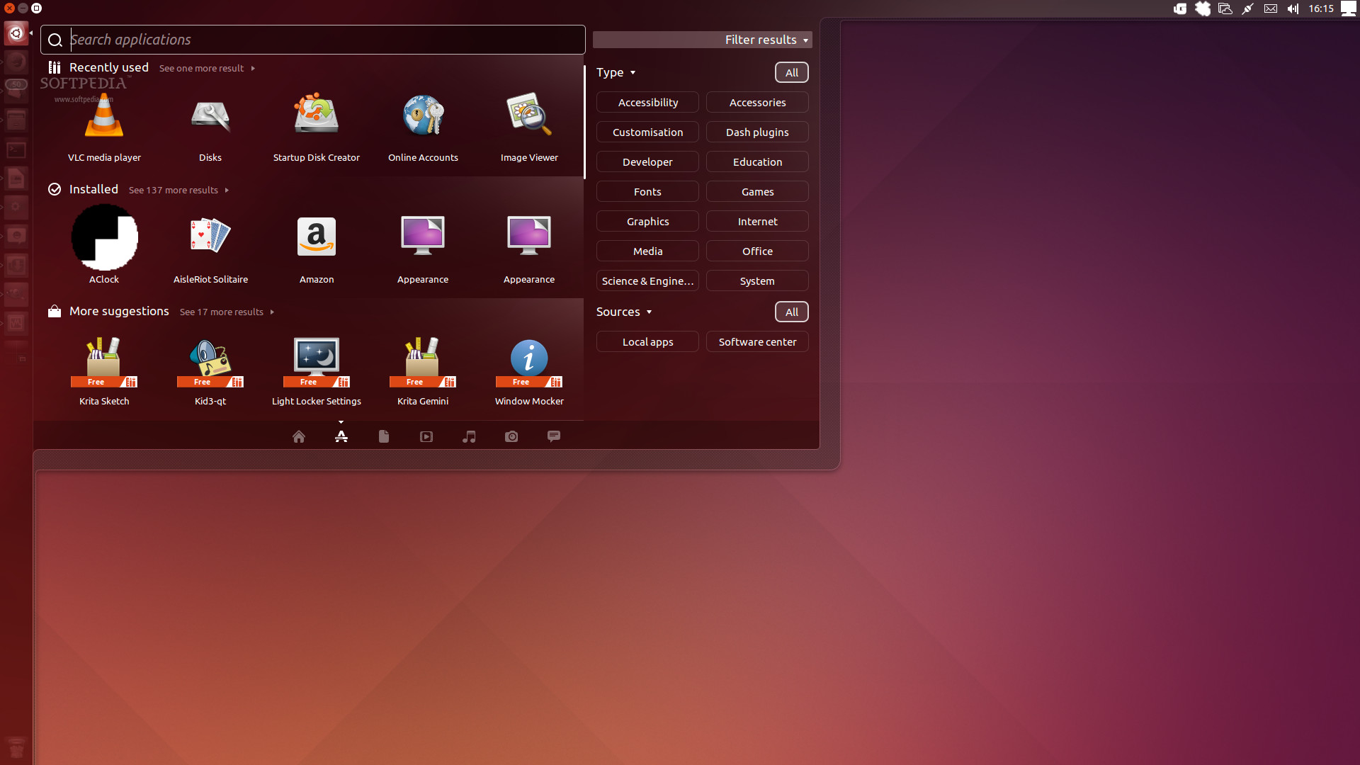
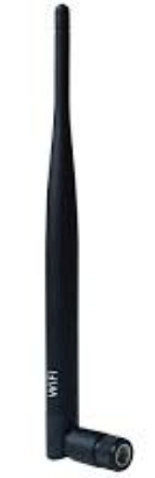
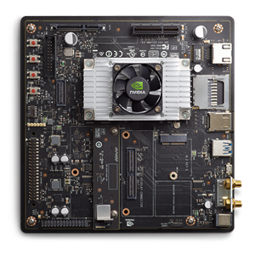
Deploying VNC on Linux System-1
VNC port: 5900
Steps:
Execute the following commands on the Tx2SVR.
$ sudo apt-get update
$ sudo apt-get install --no-install-recommends
ubuntu-desktop gnome-panel gnome-settings-
daemon metacity nautilus gnome-terminal
2. Select yes, is anything prompts.
*the above commands installs the dependencies for the Graphical Interface to work Properly.*
Install the VNC Server using the following command.
$ sudo apt-get install vnc4server
ssh to the TX2SVR using the following command.
$ ssh username@<IP_address>. *secure shell*
One got the access, execute the command.
$ vncserver :1 * starts the VNC Server @port 5901*
TX2SVR

Slide 5
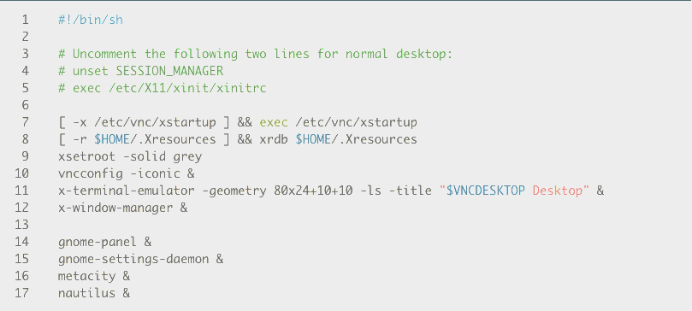
Deploying VNC on Linux System-2
6. Once the server successfully starts, kill the server, make changes to
the file as shown below.
$ vncserver –kill :1
$ vim ~/.vnc/xstartup
Make sure the file looks as shown above, save the file and exit (:wq!).
7. View the Desktop from remote desktop (under same subnet)
a. Download VNC viewer from the below link
https://www.realvnc.com/en/connect/download/viewer/
TX2SVR

Slide 6
Deploying VNC on Linux System-3
VNC port: 5900
8. Set the password for the vnc server like below.
$ vncpasswd *hit Enter*
password : *****
verify : *****
9. Start the Vnc Server using the command at TX2SVR.
$ vncserver :1 *vncserver @port5901*
10. On the remote computer open the Vnc viewer.
a. Enter the address as follows:
<TX2SVR ip_address>:1
11. Prompt will pop-up saying unencrypted connection. *hit continue*
12. Enter the password as entered in step 8.
13. The screen will be successfully shared.
TX2SVR

Slide 7
The End
Thank You

