Slide 1

Lec??-ULTSEN-RASPBRY-HL-PR-2018-9-12.ppt
ULTSEN to RASPBRY-PI Connection
CTI One Corporation
Version: x0.1
Date: September 2018
Project Lead: Harry Li, Ph.D.
Team member: Prashanth Rajasekar
Company confidential

Slide 2

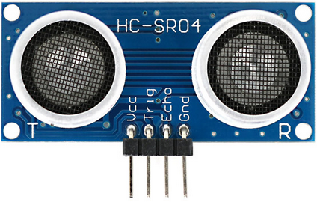
ULTRASOUND Sensor working details
TRANSMITTER
Original TRIGGER Wave
OBJECT
5V
GPIO#
GPIO#
GND
Reflected ECHO Wave
RECEIVER
sound wave frequency
greater than 20,000 Hz
Range : 2cm to 4m

Slide 3
Ultsen Raspberry_Pi Working Theory
Raspberry pi 3 Model B has a 4 core 1.2GHz CPU.
It is capable of performing 4 sensor tasks parallelly.
Currently we are connecting 3 Ultrasound sensors to Raspberry pi 3 B.
Raspberry pi 3 B will use its 3 cores to handle the 3 sensors.
Raspberry pi 3 B has sufficient RAM (1GB) to host the processes.
Multithreading concepts introduced to handle the 3 sensors parallelly.
Parallel data collection and conversion is done to calculate the distance wherever the sensor is being mounted.
According to the distance calculated, respective commands can be sent to the motor drive to take precautionary
steps.

Slide 4
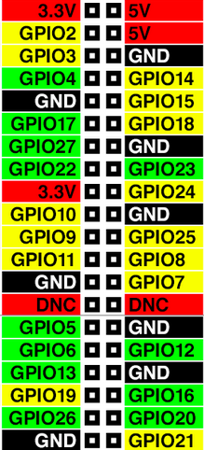
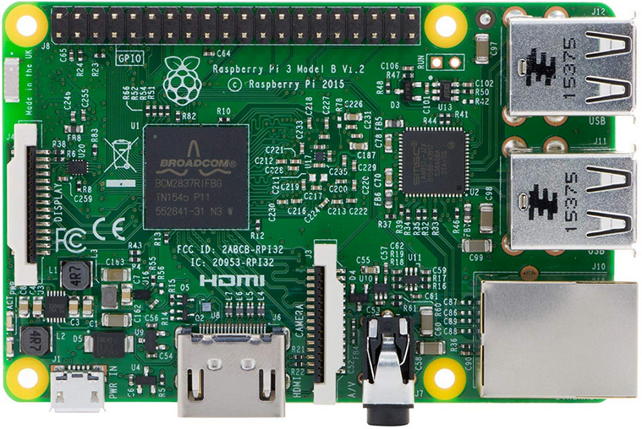

Raspberry Pi 3 System/Pin Details
Technical Specification
CPU : 4× ARM Cortex-A53,
1.2GHz.
CORES : 4
RAM : 1GB
GPIO : 40 Pin Headers
Storage : SD Card
Bluetooth : Bluetooth 4.1
No ADC Pins Available
26 GPIO Pins Available

Slide 5





Ultsen Raspberry_Pi Pin Connections/Table
S1
S2
S3
VCC
VCC
VCC
GPIO 4
GPIO 27
GPIO 5
GPIO 17
GPIO 22
GPIO 6
GND
GND
GND
S4
S5
S6
VCC
VCC
VCC
GPIO 19
GPIO 23
GPIO 20
GPIO 26
GPIO 24
GPIO 21
GND
GND
GND

Slide 6
Ultsen Raspberry_Pi Pin Connectivity Tables
ULTSEN 1 | RASP-PI
VCC | 5V
Trig | GPIO 4
Echo | GPIO 17
GND | GND
ULTSEN 2 | RASP-PI
VCC | 5V
Trig | GPIO 27
Echo | GPIO 22
GND | GND
ULTSEN 3 | RASP-PI
VCC | 5V
Trig | GPIO 5
Echo | GPIO 6
GND | GND
ULTSEN 4 | RASP-PI
VCC | 5V
Trig | GPIO 19
Echo | GPIO 26
GND | GND
ULTSEN 5 | RASP_PI
VCC | 5V
Trig | GPIO 23
Echo | GPIO 24
GND | GND
ULTSEN 6 | RASP-PI
VCC | 5V
Trig | GPIO 20
Echo | GPIO 21
GND | GND

Slide 7
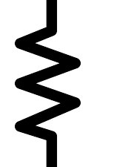

Ultsen Raspberry_Pi Circuit Diagram
VCC
TRIG
ECHO
GND
1.5K ohm
3.2 V
3K ohm
Max GPIO input voltage=3.3 V
GND

Slide 8
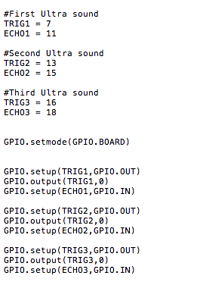
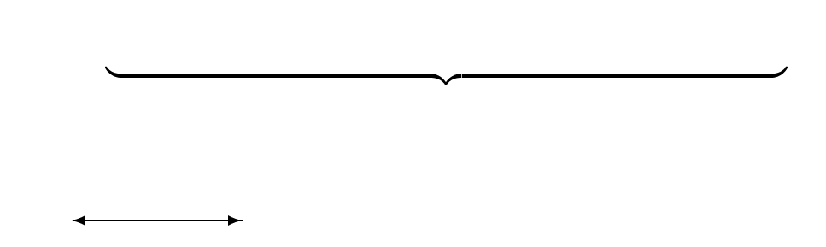
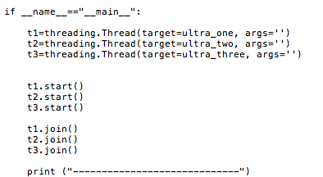
Ultsen Raspberry_Pi Code Snippet
. . . . . . . . . function definition here.
Pin Declaration done here.
……… Thread 1 starts here.
Pins Setup done here.
……… Thread 2 starts here.
……… Thread 3 starts here.

