Slide 1

Lec??? RTT_calc-PR-LIU-2018-10-35.ppt
RTT between PiNode and TX2SVR
CTI One Corporation
Version: x0.1
Date: October 2018
Project Lead: Harry Li, Ph.D.
Team members: Prashanth Rajasekar
Liuting
Company confidential

Slide 2
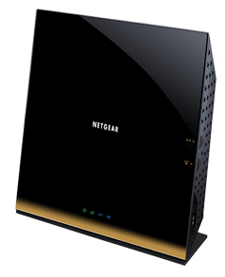

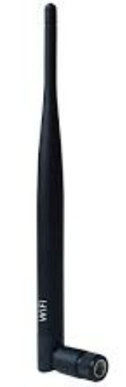
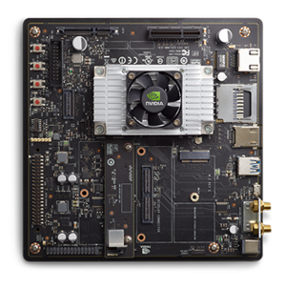
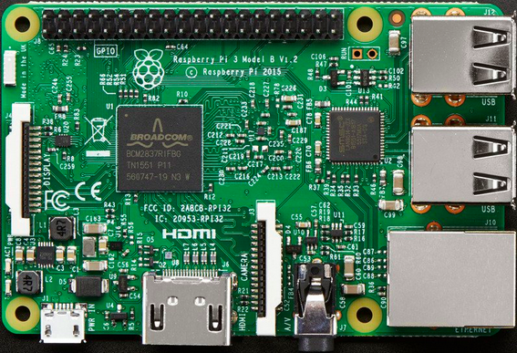
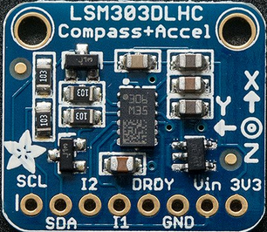
Testing Environment_1 Wifi
Router
Data_in
Data_out
Data_out
Data_in
IP : 192.168.1.25
IP : 192.168.1.1
IP : 192.168.1.27
LSM303
PiNode
TX2SVR

Slide 3
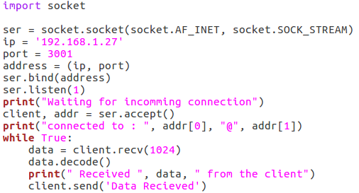
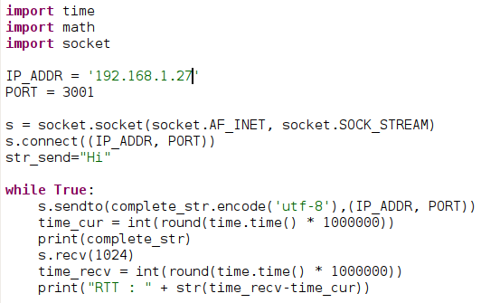
RTT Test Environment_1
TCP Server
RTT Table
9382
7617
3217
3048
3506
7432
8760
2651
7908
6875
Avg RTT: 6.039 ms
TCP Client
6039 μs

Slide 4

Testing Environment_2 Ethernet
Data in/out
LSM303
IP : 192.168.2.2
IP : 192.168.2.3
PiNode
TX2SVR

Slide 5
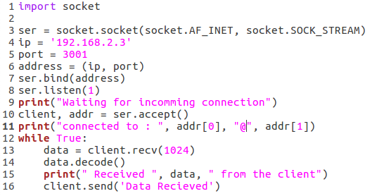
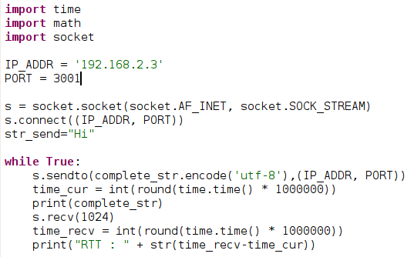
RTT Test Environment_2
TCP Server
RTT Table
638
745
734
744
649
616
656
639
630
615
Avg RTT: 0.666 ms
TCP Client
666.6 μs

Slide 6
The End
Thank You

