Slide 1
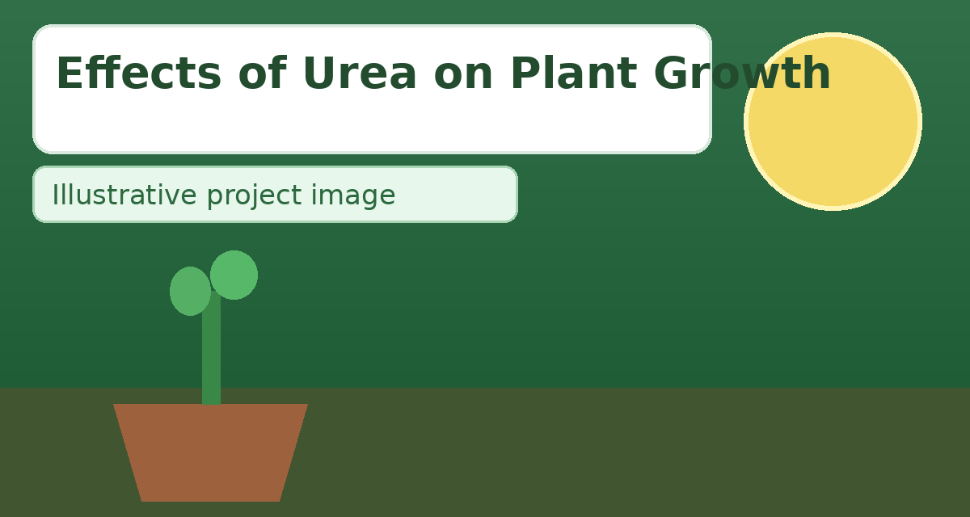
Effects of Urea on Plant Growth
• This presentation explains how urea fertilizer influences seed germination, vegetative growth, and final plant health under controlled conditions.
• It also compares the positive effects of balanced application with the risks caused by excess chemical fertilizer in soil and water systems.
• The project is designed as a school-ready scientific study with clear observations, inference, and conclusion.

Slide 2

Introduction
• Urea is one of the most widely used nitrogen fertilizers because it contains a high percentage of nitrogen and is relatively affordable for farmers.
• Nitrogen is essential for chlorophyll formation, protein synthesis, and leaf development, so urea can significantly improve visible plant vigor when used properly.
• However, incorrect dosage or repeated overuse can disturb soil chemistry, reduce microbial health, and lower long-term crop sustainability.

Slide 3

Aim of the Project
• To evaluate how different concentrations of urea affect germination rate, plant height, leaf color, and overall seedling quality.
• To identify a practical and safe application level that improves plant growth without causing fertilizer stress or nutrient imbalance.
• To build awareness about responsible fertilizer use in school-level agricultural science.

Slide 4

Hypothesis
• If urea is applied in an optimum and measured amount, then plants will exhibit faster growth, greener leaves, and better biomass accumulation.
• If urea is applied above the tolerance limit, then plants may show growth suppression, root injury, or leaf-tip burn due to osmotic and chemical stress.
• Therefore, plant response is expected to be dose-dependent rather than simply increasing with more fertilizer.

Slide 5

Germination of Seeds
• Germination starts when a dry seed absorbs water and activates enzymes that convert stored food into usable energy for the embryo.
• The radicle emerges first to form the root system, followed by shoot emergence that establishes early seedling growth.
• Uniform germination is a key indicator of seed quality and favorable environmental conditions.

Slide 6
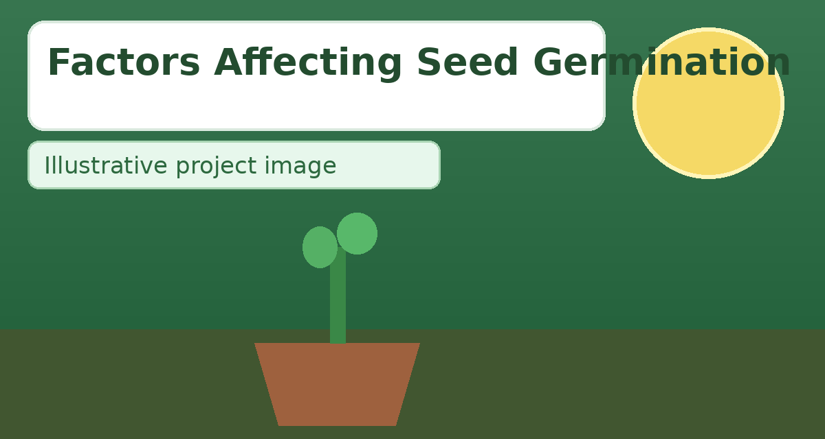
Factors Affecting Seed Germination
• Seed germination depends on both external environmental factors and internal biological conditions of the seed.
• External factors include water, oxygen, temperature, and light, while internal factors include vitality, viability, and dormancy.
• A deficiency in any essential factor can delay or prevent successful seed establishment.

Slide 7

External Factors
• External factors are the surrounding physical conditions that directly control germination speed and seedling success.
• Water enables metabolic activation, oxygen supports respiration, temperature regulates enzyme activity, and light affects specific seed types.
• Soil texture, pH, and moisture-holding capacity also influence germination outcomes in real field conditions.

Slide 8

Water
• Water is required for imbibition, enzyme activation, and the transport of nutrients to developing tissues in the embryo.
• Insufficient moisture causes delayed germination, while excessive water can create anaerobic conditions that reduce oxygen availability.
• Balanced and regular watering is essential for uniform sprouting and early root establishment.

Slide 9

Oxygen
• Germinating seeds use oxygen for aerobic respiration to generate ATP, the energy currency needed for growth and cell division.
• When soil is compacted or waterlogged, oxygen diffusion decreases and germination percentage may drop significantly.
• Adequate aeration around seeds helps maintain healthy root emergence and strong seedlings.

Slide 10

Temperature
• Temperature controls metabolic rate and enzyme efficiency, making it a major factor in how quickly seeds germinate.
• Each crop has a minimum, optimum, and maximum germination temperature range that must be respected for best results.
• Extreme temperatures may denature enzymes or slow metabolism, resulting in poor and uneven germination.

Slide 11

Light
• Certain seeds are light-sensitive and may require either light exposure or darkness to trigger germination mechanisms.
• After sprouting, adequate light intensity is crucial for chlorophyll development and sturdy shoot growth.
• Poor light management can produce weak, elongated seedlings with low survival potential.

Slide 12

Internal Factors
• Internal factors refer to biological properties of seeds that determine whether they can germinate under favorable conditions.
• Vitality influences seedling strength, viability represents lifespan of germination potential, and dormancy controls timing.
• These factors explain why two seed batches can perform differently under identical external conditions.

Slide 13

Vitality, Longevity, and Dormancy
• Vitality is the ability of a seed to produce a robust and healthy seedling under suitable conditions.
• Longevity or viability is the duration for which a seed remains alive and capable of germination during storage.
• Dormancy is a protective resting state in which a viable seed temporarily resists germination until specific triggers are met.

Slide 14
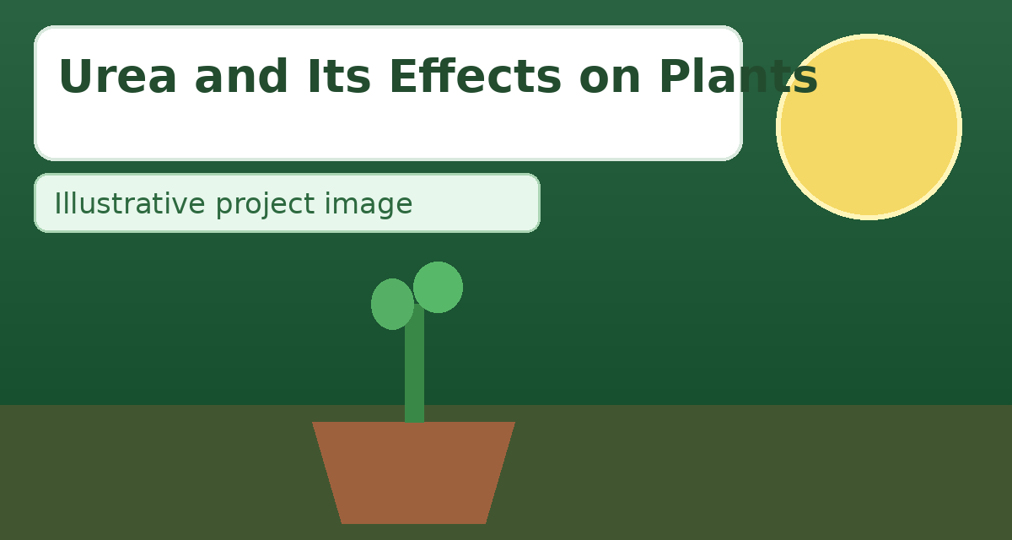
Urea and Its Effects on Plants
• Urea [CO(NH2)2] is transformed in soil into ammonium and later nitrate, both of which are usable nitrogen sources for plants.
• In moderate amounts, urea improves leaf area, chlorophyll concentration, and overall vegetative growth.
• In excess, it can increase salinity and ammonia stress, causing leaf scorch, weak roots, and reduced nutrient balance.

Slide 15

How to Use Urea
• Apply urea according to crop stage, soil condition, and recommended agronomic dosage rather than random estimation.
• Split application is often more effective than a single heavy dose because it reduces losses and improves nutrient uptake.
• Incorporate urea into moist soil and irrigate after application to minimize volatilization and maximize root access.

Slide 16

Advantages of Urea
• Urea contains high nitrogen concentration, making it efficient for correcting nitrogen deficiency and promoting rapid vegetative growth.
• It is comparatively economical, easy to store, and widely available, which supports large-scale agricultural use.
• When integrated with balanced nutrient management, urea can improve yield, leaf quality, and crop uniformity.

Slide 17
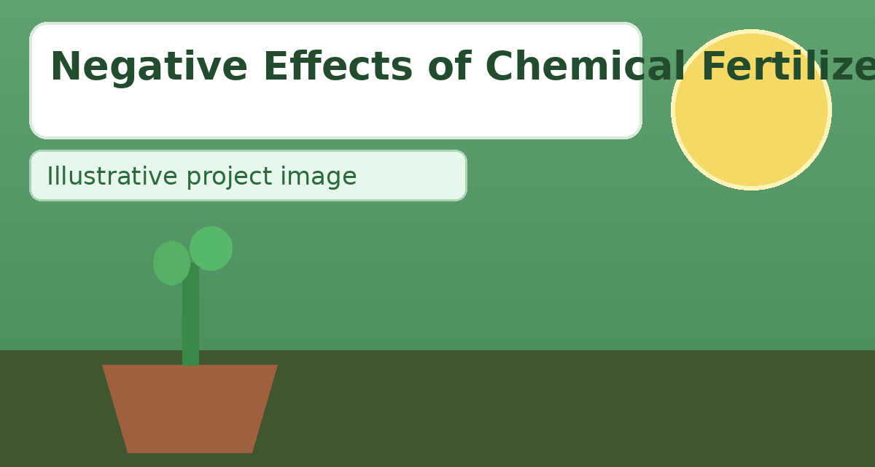
Negative Effects of Chemical Fertilizers
• Overuse of chemical fertilizers can degrade soil structure, reduce beneficial microbial populations, and create nutrient imbalance.
• Excess nitrate may leach into groundwater, while surface runoff can trigger eutrophication in ponds, lakes, and rivers.
• Long-term dependence on high doses can lower sustainability and increase environmental risk.

Slide 18

Apparatus Required
• Required materials include uniform seeds, equal-sized pots, measured soil, urea fertilizer, labels, and a watering can.
• Measurement tools such as a ruler, notebook, and weighing spoon are needed to maintain data accuracy and consistency.
• Protective gloves are recommended for safe fertilizer handling during the experiment.

Slide 19

Procedure
• Prepare equal pots with the same soil quantity and sow equal numbers of seeds from a single seed batch.
• Create one control group (without urea) and multiple treatment groups with increasing urea concentrations.
• Maintain equal water, light, and temperature, then record germination, plant height, leaf count, and visible health over time.

Slide 20

Observation
• The moderate-dose urea group showed improved greenness, stronger stems, and faster height increase compared with the control group.
• The zero-urea group displayed slower vegetative growth, while excessive-dose groups developed stress signs and inconsistent development.
• These outcomes indicate that response quality depends strongly on concentration and management practice.

Slide 21

Inference
• Balanced urea use enhances plant growth by supplying nitrogen for chlorophyll production, protein synthesis, and tissue development.
• Both under-application and over-application can reduce overall growth efficiency and quality.
• Therefore, fertilizer planning should focus on optimum dose, timing, and soil condition rather than maximum quantity.

Slide 22

Conclusion
• Urea is a useful and effective fertilizer when applied scientifically in the correct dose and at the proper growth stage.
• The project confirms that optimum application improves plant performance, while excessive application can damage plants and ecosystems.
• Responsible fertilizer management is essential for healthy crops, sustainable farming, and long-term soil productivity.

Slide 23

Thank You
• Thank you for reviewing this project on the effects of urea on plant growth.
• Questions and discussion are welcome.

