Slide 1




The art of Software Integration
Rafael Priego Porcuna
Online Engineering Offsite, September 2014
Moone Boy

Slide 2
The art of software integration
We all have to integrate systems in our day to day basis
Software integration is an “art” that requires knowledge, experience, intuition and creativeness

Slide 3
Contents
Strategies for integration
Integration techniques
Implementation
References, Q&A

Slide 4
Strategies for integration

Slide 5
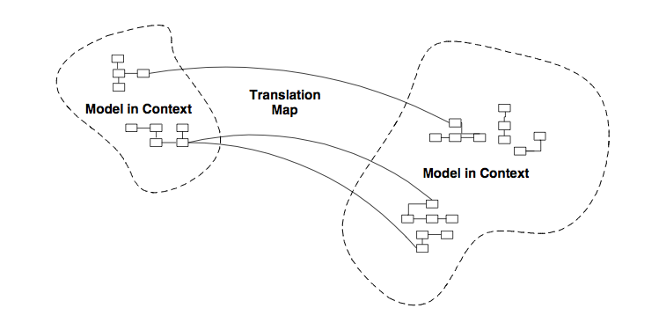
Choosing your strategy
Cooperation between teams
Overlap between models
Allow independent development
Cost of the integration

Slide 6
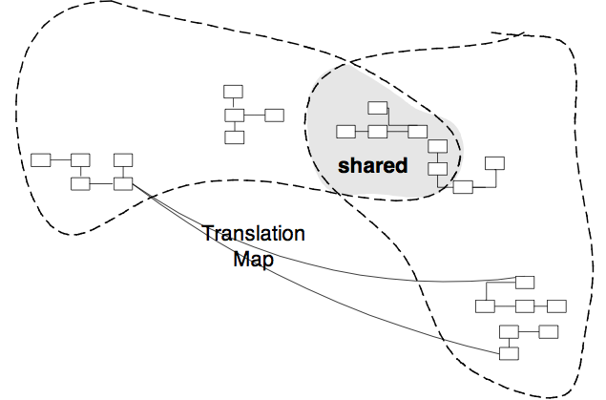
Shared Kernel
Intent/Problem: Split one team in multiple teams, creation of different domains in the same application
Applicability: Unidirectional and bidirectional communications, both teams report to the same management and ideally are located close to each other
Known use: Feature teams
Pros: Reduces overhead of Continuous Integration in big teams, shared model and domain language
Cons: Extra coordination required

Slide 7
Customer/Supplier
Intent/Problem: Handle unidirectional dependencies, when the downstream system needs data from upstream
Applicability: Unidirectional dependencies and both systems share the same goals
Known use: analytics systems
Related strategies: Conformist, Anti-corruption layer, Open host
Pros: Translation easier due to be unidirectional
Cons: Downstream system can be limited by the upstream system, difficult to take into practice when the supplier serves several customers

Slide 8
Conformist
Intent/Problem: Difficulty to follow customer/supplier approach when they follow different directions
Applicability: Dependencies are unidirectional and the models are not very distant
Related strategies: Customer/Supplier, Anti-corruption layer
Pros: Shared domain language between the teams, allow development independently
Cons: Limits the creativity of downstream system
Context 1
Context 2

Slide 9
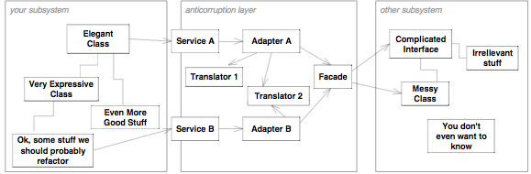
Anti-corruption layer
Intent/Problem: Difficulty to follow customer/supplier approach when they follow different directions
Applicability: Unidirectional and bidirectional communication. Interfaces are not really big.
Known use: Replacing legacy systems. Protection against constant interface changes
Related strategies: Customer/Supplier, Conformist
Pros: Allow development independently of the other system
Cons: Investment in translation required, changes in one model can lead to high cost in translation to the other

Slide 10
Open host services
Intent/Problem: System that will talk to multiple clients
Applicability: Unidirectional and bidirectional communications, multiple clients interact with a system
Known use: Banking
Related strategies: Customer/Supplier
Pros: Enables a published language, interaction with multiple clients without model alterations
Cons: Hard to design a protocol to be understood by multiple systems
CLIENT
CLIENT
CLIENT
PUBLISHED LANGUAGE

Slide 11
Separate ways
Intent/Problem: Integration cost is really high and doesn’t offer much value
Applicability: Integration is not needed or there is a work around
Known use: Links
Pros: Allow independent development and saves the cost of integration
Cons: If integration is needed, translation layers will be more complex
Context 1
Context 2

Slide 12
 | Collaboration | Bidirectional | Shared language | Integration cost
Shared Kernel | Yes | Yes | Yes | Low
Customer / Supplier | Yes | No | Yes | Low
Conformist | No | No | Yes | Medium
Anti-corruption layer | No | Yes | No | High
Open host | No | Yes | Yes | High
Separate ways | No | No | No | None

Slide 13
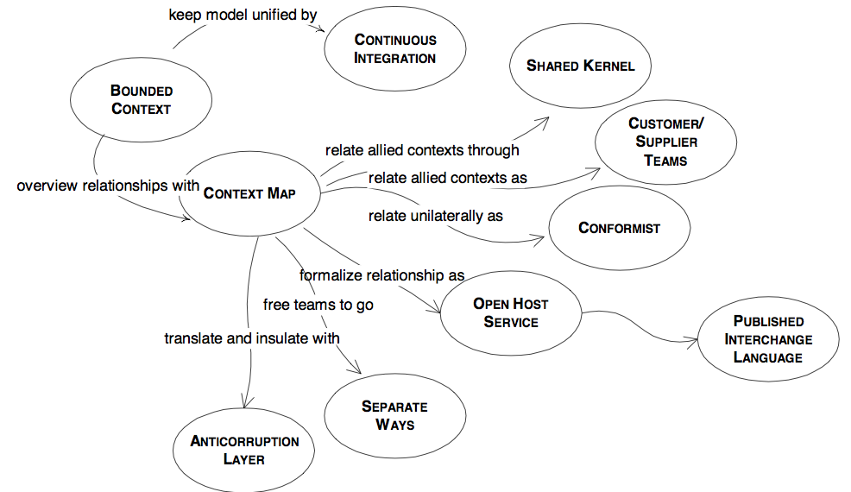
Strategies for integration

Slide 14
Integration techniques

Slide 15
REST endpoint
Read and write as separate services
Read
REST
Write

Slide 16
Client-server
Same protocol for read and write
Looks simple
Complex scalability (concurrency)
Read performance will decrease
Security
Business Objects Model
Business Objects Model
Write
Read

Slide 17
Segregating requests and commands
Different repository access to read and write
Domain objects will apply the business logic and will apply constraints
Command Query Responsibility Segregation: message driven integration, eventual consistency
Notification based integration: asynchronous
Feed based integration: asynchronous and batch

Slide 18
Segregating requests and commands
SQL
No SQL
Business Objects Model
Write
Read

Slide 19
 | Client-Server | CQRS | Notification based integration | Feed based integration
Synchronicity | Synchronous | Synchronous | Asynchronous | Asynchronous
Read/Write | R/W | R/W | RO | RO
Scalability | Coupled read and write | Decoupled | Decoupled of read not from write | Decoupled
Resilience | No | Read | Integrated | Integrated
Eventual consistency | No | Yes | Yes | Yes

Slide 20
Implementation

Slide 21
How much effort does it take you to implement the happy path of an interface with other system in comparison with the unhappy path?
50%-50%
80%-20%
20%-80%

Slide 22
Gateway pattern
LOGGING
MONITORING
Retry?
Logging
Monitoring
Error handling
Throttling
Timeouts
Testing: mocking, Chaos Monkey
TESTING
GATEWAY
THROTTLING
TIMEOUTS
ERROR HANDLING
RETRY

Slide 23
References

Slide 24

References

Slide 25
Any questions?

