Slide 1

Building AI based web scraper
A journey through the process of building one an AI based web scraper
Rohit Priyadarshi

Slide 2
Problem Statement
Purpose: design and implement an AI bot to scan through different websites (text, video, …) to capture the competitive analysis data for Intel latest CPU processor and other competitors’
Detailed Data to capture: the system information under testing, benchmarks and scores (please see the example tab in the excel file and watch the video)
What to send back to us: all the code of your AI bot and the filled-in excel file (we will run your code and check the excel file for data accuracy and completion)
Bonus: Auto-summarized the comparison across different benchmarks, give recommendations on where Intel is doing well and where competitors are doing well
Timeline: Ideally within one week
Note: the solution is not needed to be perfect. Just try the best that you can figure out
Follow-up: we will pick top 3 developers and follow up with more interviews on details of your implementations, then talk about roles, expectations, culture, compensation, etc.

Slide 3
Problem Statement (cont.)
Find the site and look for the new CPU reviews and find the review for13th Gen
Log the header information at the top of the sheet: Title, Author, URL, test system specs, etc.
Skim/read through the review to find the benchmark data. The primary data we are interested in are for:
Do not bother recording data for other processors.
Enter the data in columns E thru X noting there are columns for different memory configs. If there is not already a row that has the correct workload / benchmark, then copy and insert a new row and change the benchmark name (so the formulas copy). Make sure to note H/L for higher or lower is better. Take your best guess at category, etc., if unsure, highlight the cell in yellow to be checked later.
Collect any notable quotes on the Quotes tab, including the website, URL and author as well.
Select another publication that is available and repeat.
Notes:
Some sites do video reviews and you will need to watch the videos and pause the clips to record the numbers. Gamers Nexus, Linus Tech Tips, Hardware Canucks and Hardware Unboxed are likely to be reviews on YouTube.
Some sites will have slideshows embedded on the page and you will need to cycle through all of the images, each of which will have a graph to find all of the data.
Core i9-13900K
Ryzen 9 7950X
Core i7-13700K
Ryzen 7 7800X3D
Core i9-14900K
Ryzen 5 7600X
Core i5-14600K

Slide 4
Problem Breakdown
Based on the problem description, the solution space will have three main components:
Web scraping to extract data, especially since websites come in many different forms with embedded images, videos, reference pages etc.
Choose an AI engine and make sense of the data.
Presentation layer that showcases data and interacts with the user.

Slide 5
Web Scraping
Simple python-based scraping
Tried out several solutions to get data from URLs. It led to mostly dead-ends in presence of JavaScripts or pages that were rendered using scripts.
Scrapy: Scrapy | A Fast and Powerful Scraping and Web Crawling Framework
Pretty powerful framework where I added spiders. It was still missing key data.
Selenium: Selenium
Tried it out a simple script, but it continued to miss crucial data.

Slide 6
Web Scraping (cont.)
LangChain’s AsyncChromiumLoader, RecursiveUrlLoader etc.
This seemed to be the most logical way to include in AI.
AsyncChromiumLoader simulated a browser and executed scripts as a browser would.
Still continued to miss crucial data!
Inspected the benchmark tables that had led to a URL.
If the URL was scraped, got all relevant data
Data was still missing from the main page
Had missed the clue that the tables were actually infograms!
Implemented a custom infogram scraper.

Slide 7
AI Analytics
To keep implementation simple, decided to use OpenAI
This has its own trouble ~ gpt-4.0 is quite expensive, hence used gpt-3.5-turbo
Used LangChain for the implementation.
Used AsyncChromiumLoader for general web pages and BSHTMLLoader for extracted infograms.
Merged the loaders using MergedDataLoader
Created many prompts and queries to get relevant data which continued to be elusive

Slide 8
AI Analytics (cont.)
Tried both processed text and direct html to run the AI which continued to be elusive.
Added data extractors:
Used create_extraction_chain to directly extract JSON data. This continued to be unreliable and later noticed that it is now deprecated.
Used with_structured_output with mixed results.
Readjusted the prompts to make them more explicit in extracting data.
Started getting a bit more consistent response

Slide 9
Presentation Layer
To work with the AI and not have to constantly rerun the script, added a simple command-line user interface
This interface allows user to experiment with all the three options:
Direct communication with the chatbot
Invoke create_extraction_chain based extraction
Invoke with_structured_output based extraction
TBD: spreadsheet generation remains, but should be straightforward python play with good JSON file generated.
TBD: run the software to extract suggested processor data.

Slide 10
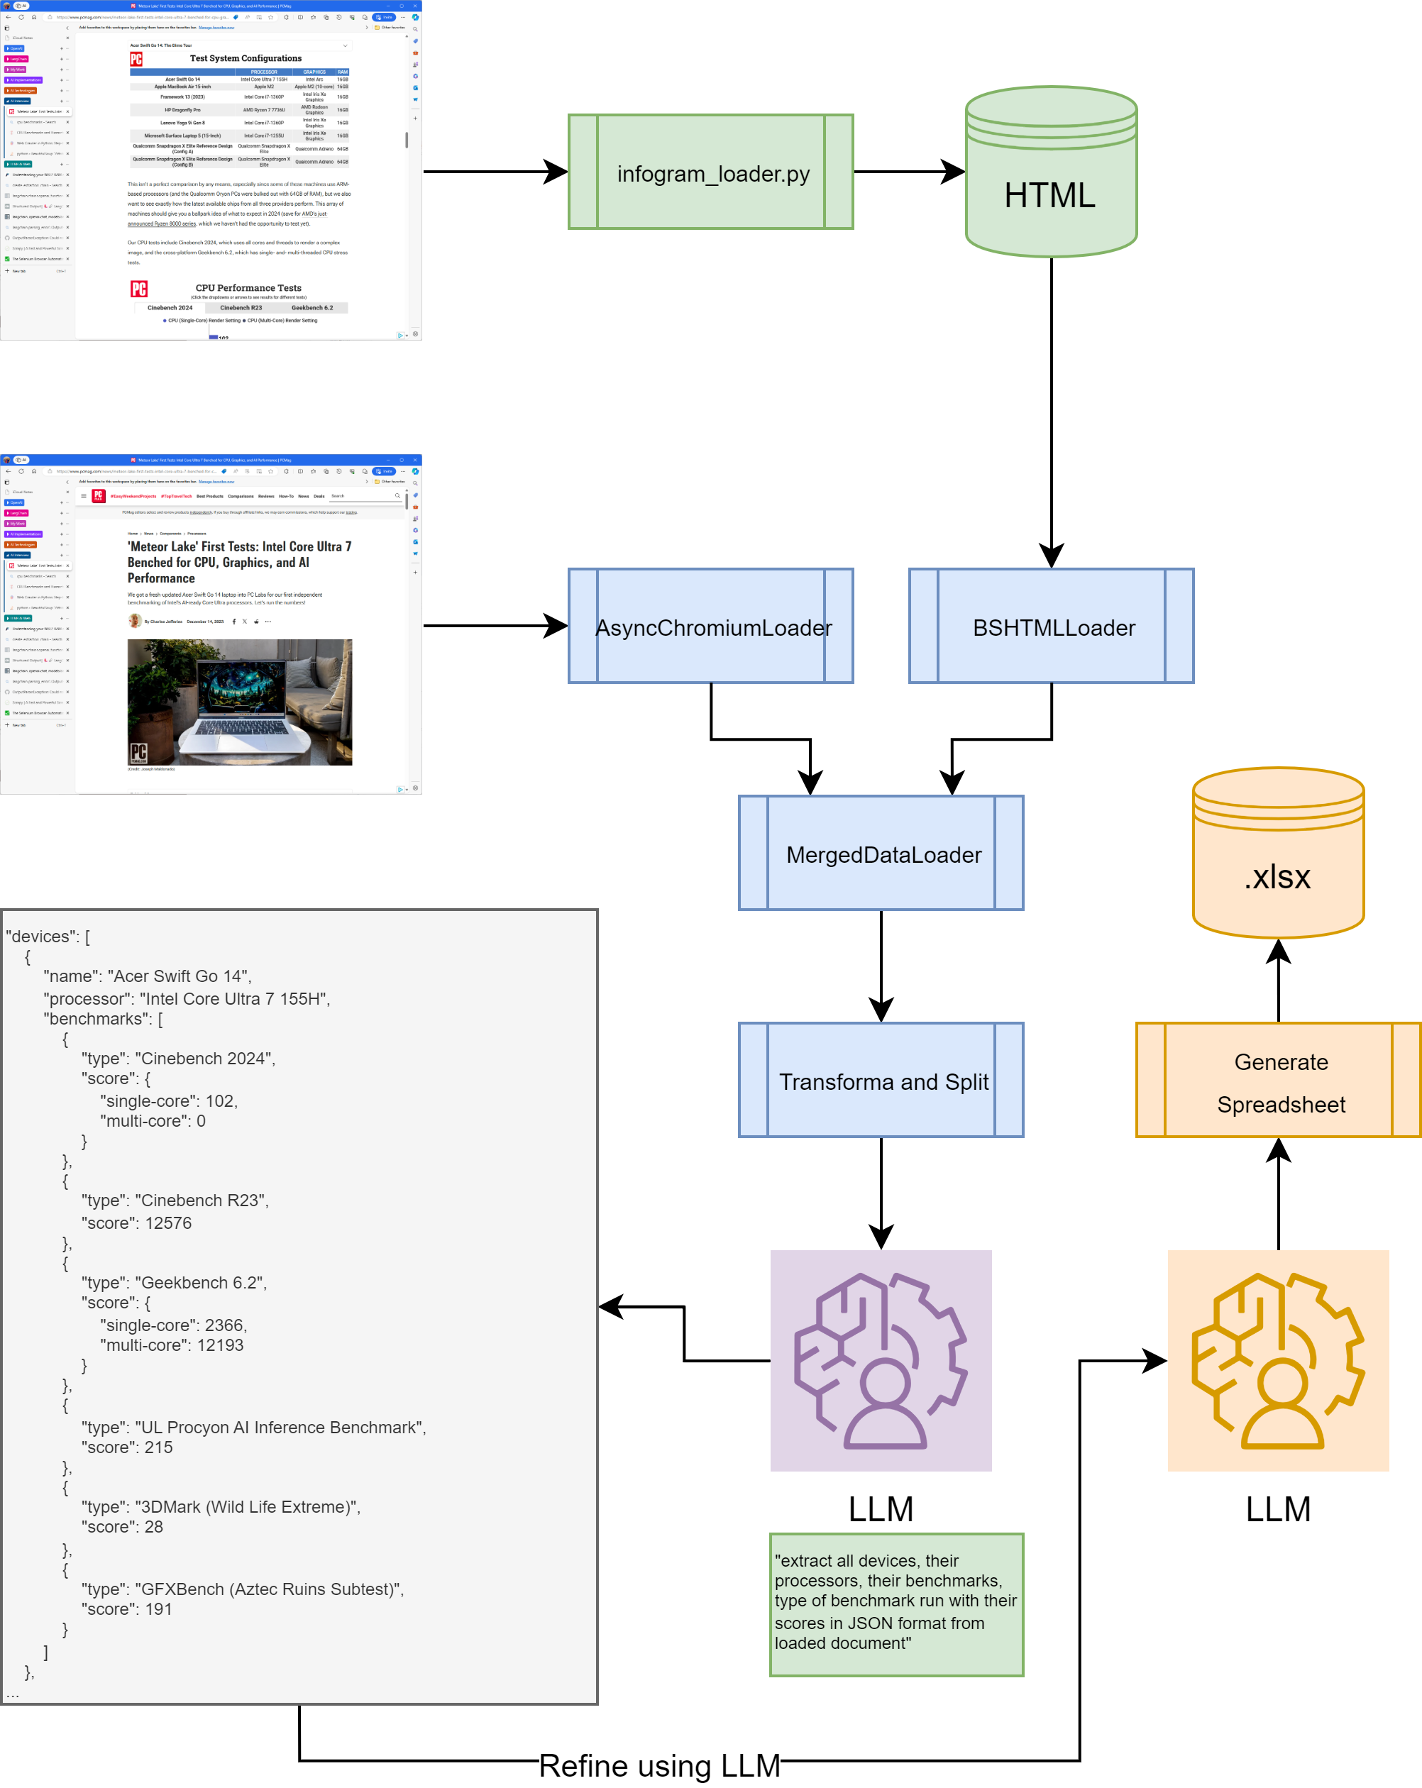
High-level Architecture
The diagram here shows high level overview of the AI web processor

Slide 11
Source Files
ai_crawler.py:
Implements most of the functionality in class AICrawler
infogram_loader.py:
Implements infogram extraction and abstracts out the data in class InfogramLoader
main.py:
Driver script that one should use to run ~ python main.py

Slide 12
Generated Files
output/
extracted_data.json: writes out JSON with deprecated create_extraction_chain.
htmldocs.json: HTML dump after the URLs are loaded.
infogram_groups.html: debug HTML dump to inspect infogram_groups.
infogram.html: dump of infogram data after processing.
response.json: most interesting file that is generated by AI with requested output.
cache/
The files here are snapshots of processed data after the loaders are done.
These were used to load data instead of web URL to get consistent pages.

