Slide 1



INFORMATION SECURITY IA2 Implementation of Metasploit
By:
UCHIT MODY - 16010120030
RAHIL PARIKH – 16010120037
JAI RAJANI – 16010120041
TY COMPS A

Slide 2
INTRODUCTION
Metasploit is an open-source framework that allows penetration testers and security researchers to exploit vulnerabilities in computer systems and networks. It was initially created by H.D. Moore in 2003 as a tool for testing and developing exploits. Metasploit can be used to test the security of networks and applications, as well as to create custom payloads and exploit code.
Metasploit is based on a modular architecture that allows users to build their own modules and plugins. The framework includes a vast library of pre-built modules that can be used to carry out attacks on vulnerable systems. These modules are designed to exploit specific vulnerabilities, and can be customized to suit the needs of the user.
The Metasploit Framework provides a command-line interface that allows users to interact with the framework and execute attacks. It also includes a graphical user interface (GUI) called Armitage, which provides a visual representation of the network and makes it easier to navigate and execute attacks.

Slide 3
FUNCTIONALITIES
Metasploit provides a variety of functionalities for penetration testing, vulnerability assessment, and exploitation. Some of the key functionalities of Metasploit are:
Exploitation: Metasploit can be used to exploit vulnerabilities in computer systems and networks. It includes a vast library of pre-built exploits for a variety of operating systems and applications.
Payloads: Metasploit provides a range of payloads that can be used to gain remote access to a target system, such as a reverse shell or a meterpreter session.
Post-exploitation: Once a system has been compromised, Metasploit can be used to perform post-exploitation activities such as privilege escalation, data exfiltration, and lateral movement.
Reconnaissance: Metasploit can be used to gather information about a target system or network, such as open ports, services, and operating system information.
Auxiliary modules: Metasploit includes a variety of auxiliary modules that can be used to perform tasks such as password cracking, scanning, and fuzzing.
Exploit development: Metasploit includes tools for developing custom exploits and payloads.
Integration: Metasploit can be integrated with other tools such as Nmap and Wireshark to provide a more comprehensive approach to penetration testing.
Reporting: Metasploit provides reporting capabilities that allow users to generate detailed reports on their testing activities and vulnerabilities found.

Slide 4
Advantages of Metasploit:
Open-source: Metasploit is an open-source tool, which means that it is free to use and can be customized according to the user's needs.
Comprehensive functionality: Metasploit provides a range of functionalities for penetration testing, vulnerability assessment, and exploitation, making it a versatile tool for security professionals.
Easy to use: Metasploit has a user-friendly interface and provides step-by-step guidance for executing attacks.
Large community: Metasploit has a large and active community of users and developers who provide support, updates, and new modules.
Integration with other tools: Metasploit can be easily integrated with other tools such as Nmap and Wireshark to provide a more comprehensive approach to penetration testing.

Slide 5
Disadvantages of Metasploit:
Potential for misuse: Metasploit is a powerful tool that can be used for malicious purposes. It is important to use Metasploit responsibly and only in authorized environments.
Detection by antivirus: Some payloads and exploits generated by Metasploit can be detected by antivirus software, which can limit their effectiveness.
Limited scope: Metasploit has a limited scope in terms of the types of vulnerabilities it can exploit. It may not be effective against complex or custom-built systems.
Skill and knowledge requirements: Metasploit requires a certain level of technical skill and knowledge to use effectively. Beginners may find it challenging to use and may need to undergo training.

Slide 6
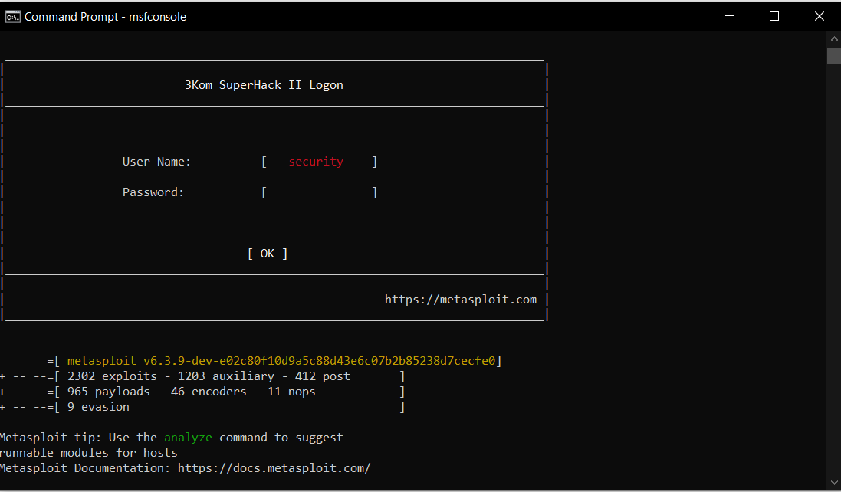
IMPLEMENTATION SCREENSHOTS
Start MetaSploit Console:

Slide 7
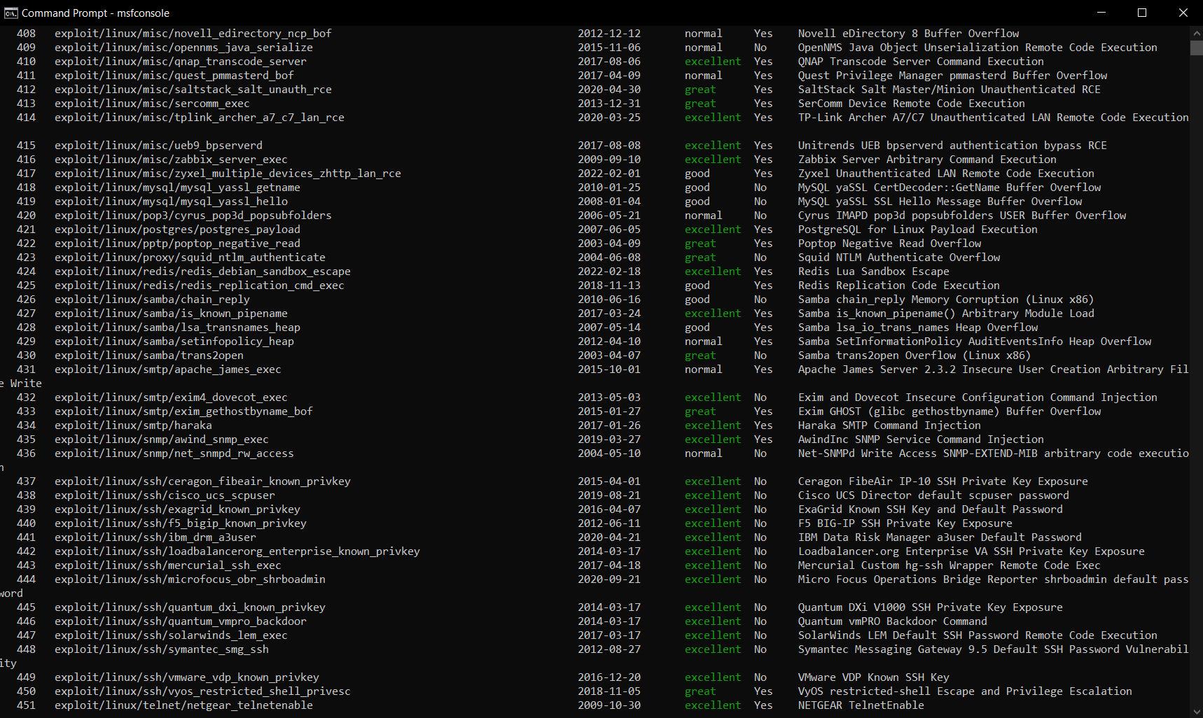
View all exploits

Slide 8
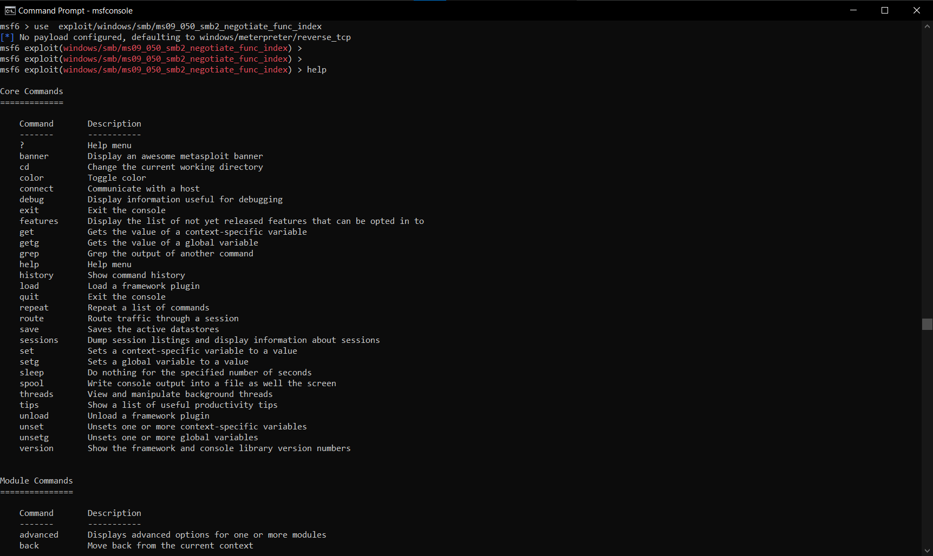
View exploit commands:

Slide 9
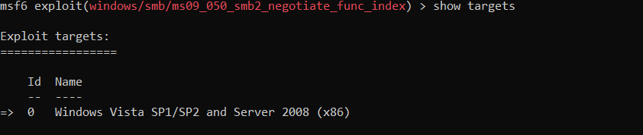
View exploit targets

Slide 10
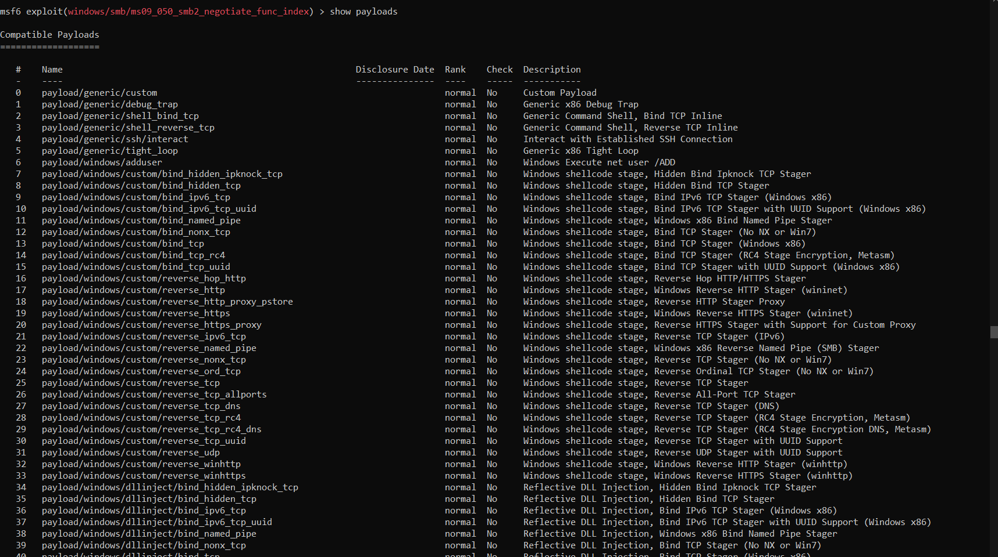
Show exploit payloads:

Slide 11
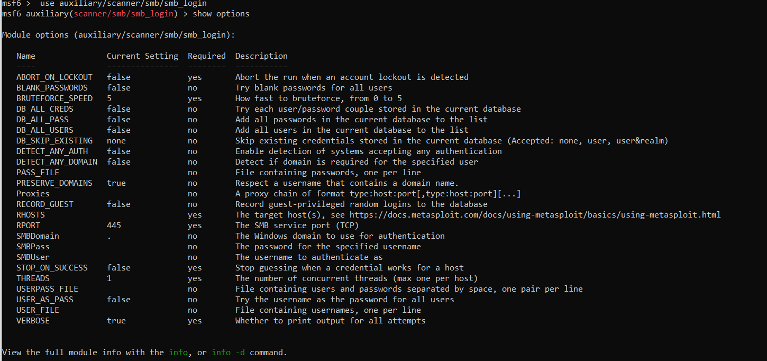
Show SMB exploit targets :

Slide 12
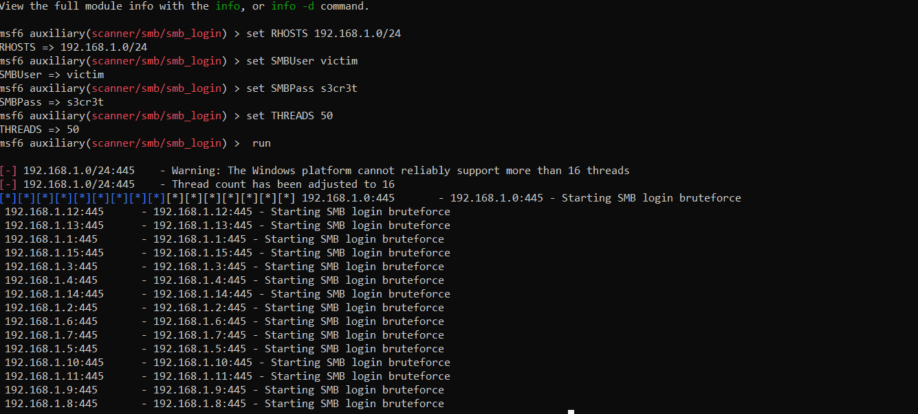
Apply SMB attack on a target:

Slide 13
THANK YOU

