Slide 1
ARIMA
Time Series: Autoregressive Integrated Moving Average
Capturing the temporal structure of time series data
Dr. Sparkle Malone
Florida International University
Malone Disturbance Ecology Lab

Slide 2
Objectives
At the end of this tutorial, you can expect to know how to:
Plot, examine, and prepare time series for modeling
Extract the seasonality component from the time series
Test for stationarity and apply appropriate transformations
Choose the order of an ARIMA model

Slide 3
Auto regressive: The use of past values in the regression equation for the series Y.
Differencing: Subtracting current and previous values d times to stabilize the series when the stationarity assumption is not met.
Moving Average: Represents the error of the model as a combination of previous error terms. The order q determines the number of terms to include in the model

Slide 4
ARIMA
Is specified by the parameters: p, d, q.
p: The number of lag observations included in the model (lag order).
d: The number of times that the raw observations are differenced (the degree of differencing).
q: The size of the moving average window (moving average)
The process of fitting an ARIMA model is sometimes referred to as the Box-Jenkins method.

Slide 5
ARIMA
Your goal is to account for the temporal trend and seasonal structures that violate assumptions of independence.
Differencing, autoregressive, and moving average components make up a nonseasonal ARIMA model
ARIMA models fit to time series data use AR and MA terms to describe the serial dependence, and use other time series data from independent variables to explain the dependence on outside factors.
The advantage is that the internal structure of the data (e.g., autocorrelation, seasonality) is explicitly accounted for by incorporating past values.

Slide 6
Assumptions
1. Data should be stationary –the properties of the series doesn’t depend on the time when it is captured. A white noise series and series with cyclic behavior can also be considered as stationary series.
2. Data should be univariate – ARIMA works on a single variable. Auto-regression is all about regression with the past values.

Slide 7
Limitations
Models directly rely on past values, and therefore work best on long and stable series.
ARIMA simply approximates historical patterns and therefore does not aim to explain the structure of the underlying data mechanism.

Slide 8
What can you do with this approach?
Explain temporal patterns.
Detect unusual events and estimate the magnitude of their effect.
Use explanatory series to improve time series models.

Slide 9
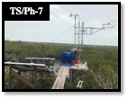
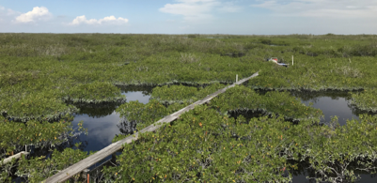
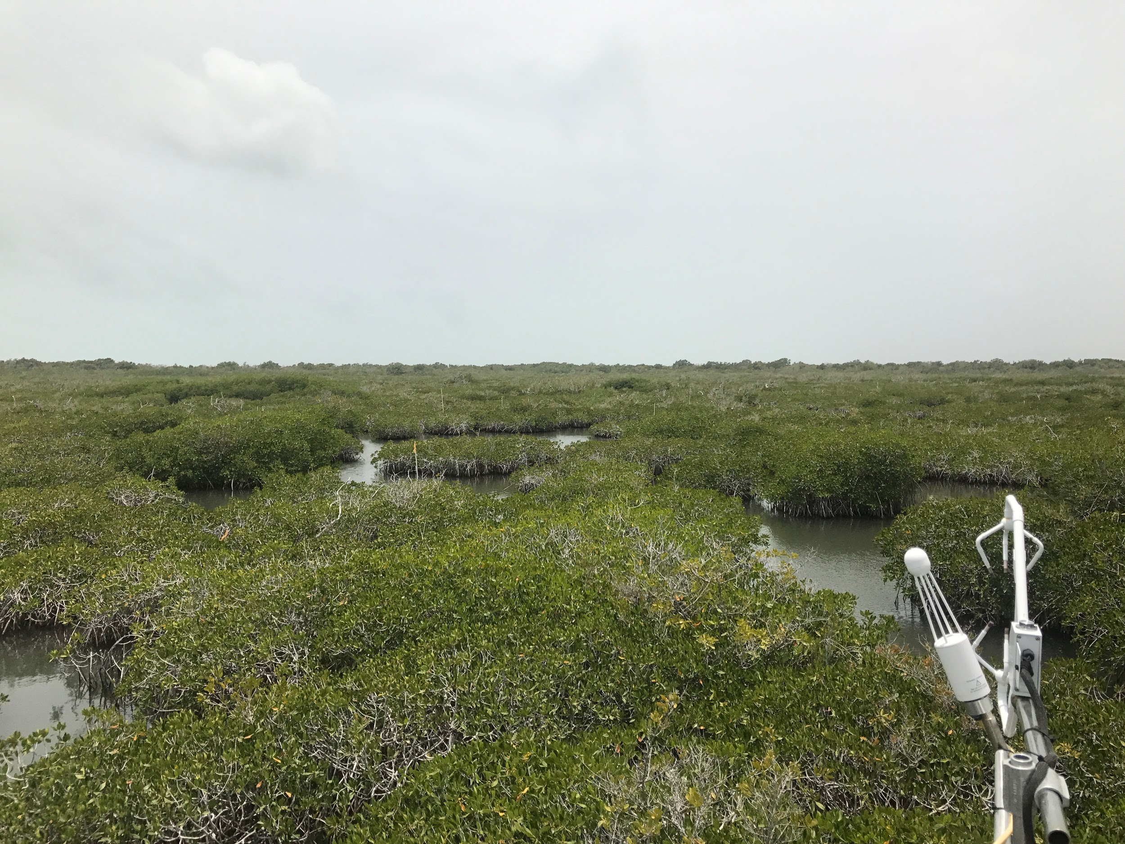
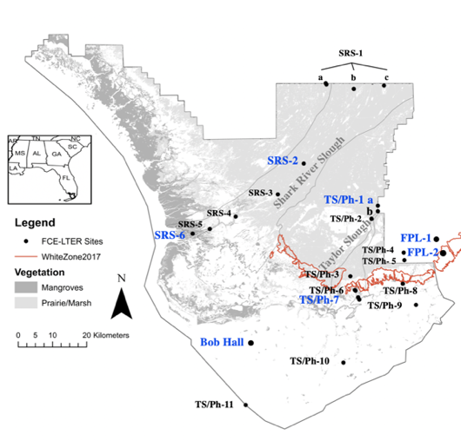
CASE:
p: lags
d: degree of differencing
q: size of the moving average window
Everglade Mangrove Scrub
TS/Ph-7

Slide 10
Additional information on Mangroves
https://fcelter.fiu.edu/research/key-findings-productivity-gradients-in-mangroves/index.html
https://pubs.er.usgs.gov/publication/70007382
https://www.fws.gov/verobeach/msrppdfs/mangroves.pdf

