Slide 1
Geospatial XAI: Adversarial Robustness + pEx-SBM Detection
Geospatial XAI: Adversarial Robustness + pEx-SBM Detection
Progress report— Thursday, 23 April 2026
Robert Romani
1. Act I: Setup & Slack/Vascotti Recreation (Exp 1–6)
2. Act II: No-Location Ablation (Exp 4–4b)
3. Act III: Moran's I Exploration (Exp 7–11)
4. Act IV: pEx-SBM as Scaffold-Attack Detector (Exp 9)
5. Act V: §2 Explanation Primitives + Block Characterization
6. Act VI: Gaps, Asks & Next Steps
Thursday 2026-04-23 — Peng Meeting
1

Slide 2
Roadmap — Six Acts
Overview
• Six-act narrative covering all experiments run through 2026-04-22
  • Act I — Setup: dataset, explainer stack, scaffold recreation (Exp 1–6)
  • Act II — No-location ablation: does removing UTM neutralize the attack? (Exp 4–4b)
  • Act III — Moran's I thread: spatial autocorrelation as moderator? (Exp 7–11)
  • Act IV — pEx-SBM detection: rung-3 fingerprint encoder, four-dataset replication (Exp 9)
  • Act V — §2 explanation outputs: Ψ, pairwise co-clustering, per-node uncertainty, block characterization
  • Act VI — Three theoretical gaps + three asks for today's discussion
─────────────────────────────────────────────────────────────────────
• Headline: scaffold attack hides coordinate-based redlining regardless of Moran's I;
  • rung-3 + finite-K pEx is the first detector with non-null layer signal across four datasets;
  • per-block structure reveals novel laundering mechanism (Block 1 fingerprint flip).
Thursday 2026-04-23 — Peng Meeting
2

Slide 3
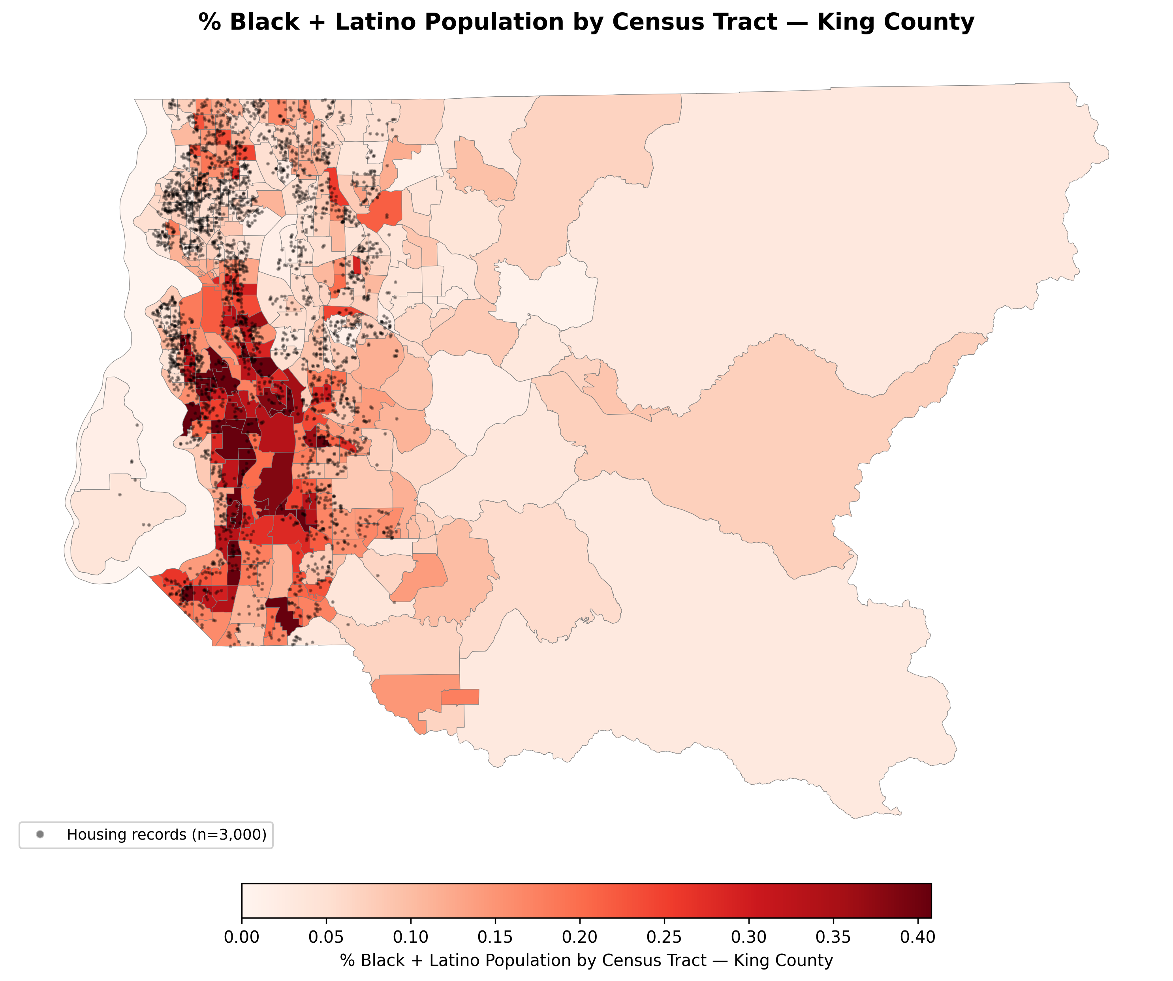
Dataset: Seattle / King County Housing
Act I — Setup
• 3,000 King County housing transactions, 80/20 train/test (random_state=42)
• 10 baseline features: bathrooms, sqft_living, sqft_lot, grade, condition,
  • waterfront, view, age, UTM_X, UTM_Y (EPSG:32610 — metric, so k-NN / radii meaningful)
• Demographics join: ACS 2011–2015 B03002 → pct_black, pct_latino, pct_black_latino
  • 398 KC tracts; 3,000 records matched to 334 tracts (spatial join, TIGER/Line 2015)
• Target: log_price (natural-log sale price) ────────────────────────────────────────────────────────────────────
• Baseline XGBoost (n_estimators=500, max_depth=6, lr=0.1):
  • R² = 0.8895 | RMSE = 0.0765 | MAE = 0.0574 | MSE = 0.00585
• UTM_Y + sqft_living dominate mean |SHAP|
• Demographic penalty trigger: pct_black_latino > 0.25 (14% of test set = 84 / 600 pts)
Thursday 2026-04-23 — Peng Meeting
3

Slide 4
Explainer Stack: KernelSHAP, TreeSHAP, GeoSHAP, LIME
Act I — Setup
• KernelSHAP — coalition-based Shapley values; background = shap.sample(X_train, 100);
  • lambda wrapper prevents SHAP from reading XGBoost internal feature names
• TreeSHAP — exact path-dependent Shapley values in polynomial time (no background needed);
  • default for robustness (Exp 5) and worst-case (Exp 6) due to batching speed
• GeoSHAP — novel spatial extension: UTM coords used only to select k=100 geographically
  • nearest training points as per-point background; attribution answers 'vs geographic neighbors'
  • Consequence: every coalition query lies on the real-data manifold → maximally vulnerable
• LIME — local linear surrogate; 500 Gaussian perturbations per point (σ=0.3 in feature space);
  • perturbations straddle the manifold → source of partial resistance to scaffold
─────────────────────────────────────────────────────────────────────
• All return shape (n_test, n_features) NumPy arrays
• GeoSHAP subsampled to n=20 in robustness experiment (~50× slower than TreeSHAP)
Thursday 2026-04-23 — Peng Meeting
4

Slide 5
Exp 3 — Adversarial Scaffold Architecture (Slack Recreation)
Act I — Exp 3
• Biased model: f_biased(x) = f_honest(x) − 0.30 × 1{pct_black_latino > 0.25}
  • −0.30 log-price ≈ −26% in linear price for minority-majority tracts
• Innocuous model: XGBoost on 8 safe features (no coords, no demographics); R² = 0.6414
• OOD detectors (Random Forest, n_estimators=100):
  • LIME: real vs Gaussian copies (σ=0.3, 30×). Test accuracy = 100.0%
  • SHAP: real vs k-means coalition substitutions (10 clusters, 20k samples). Accuracy = 99.5%
• Routing: real query → f_biased | OOD query → ψ_innocuous
• ────────────────────────────────────────────────────────────────────
• Scaffold fidelity vs f_biased on real test data:
Scaffold | Pearson r | MSE | % → biased
LIME scaffold | 0.9996 | 6.1e-05 | 99.5%
SHAP scaffold | 0.9109 | 1.26e-02 | 72.3%
Thursday 2026-04-23 — Peng Meeting
5

Slide 6
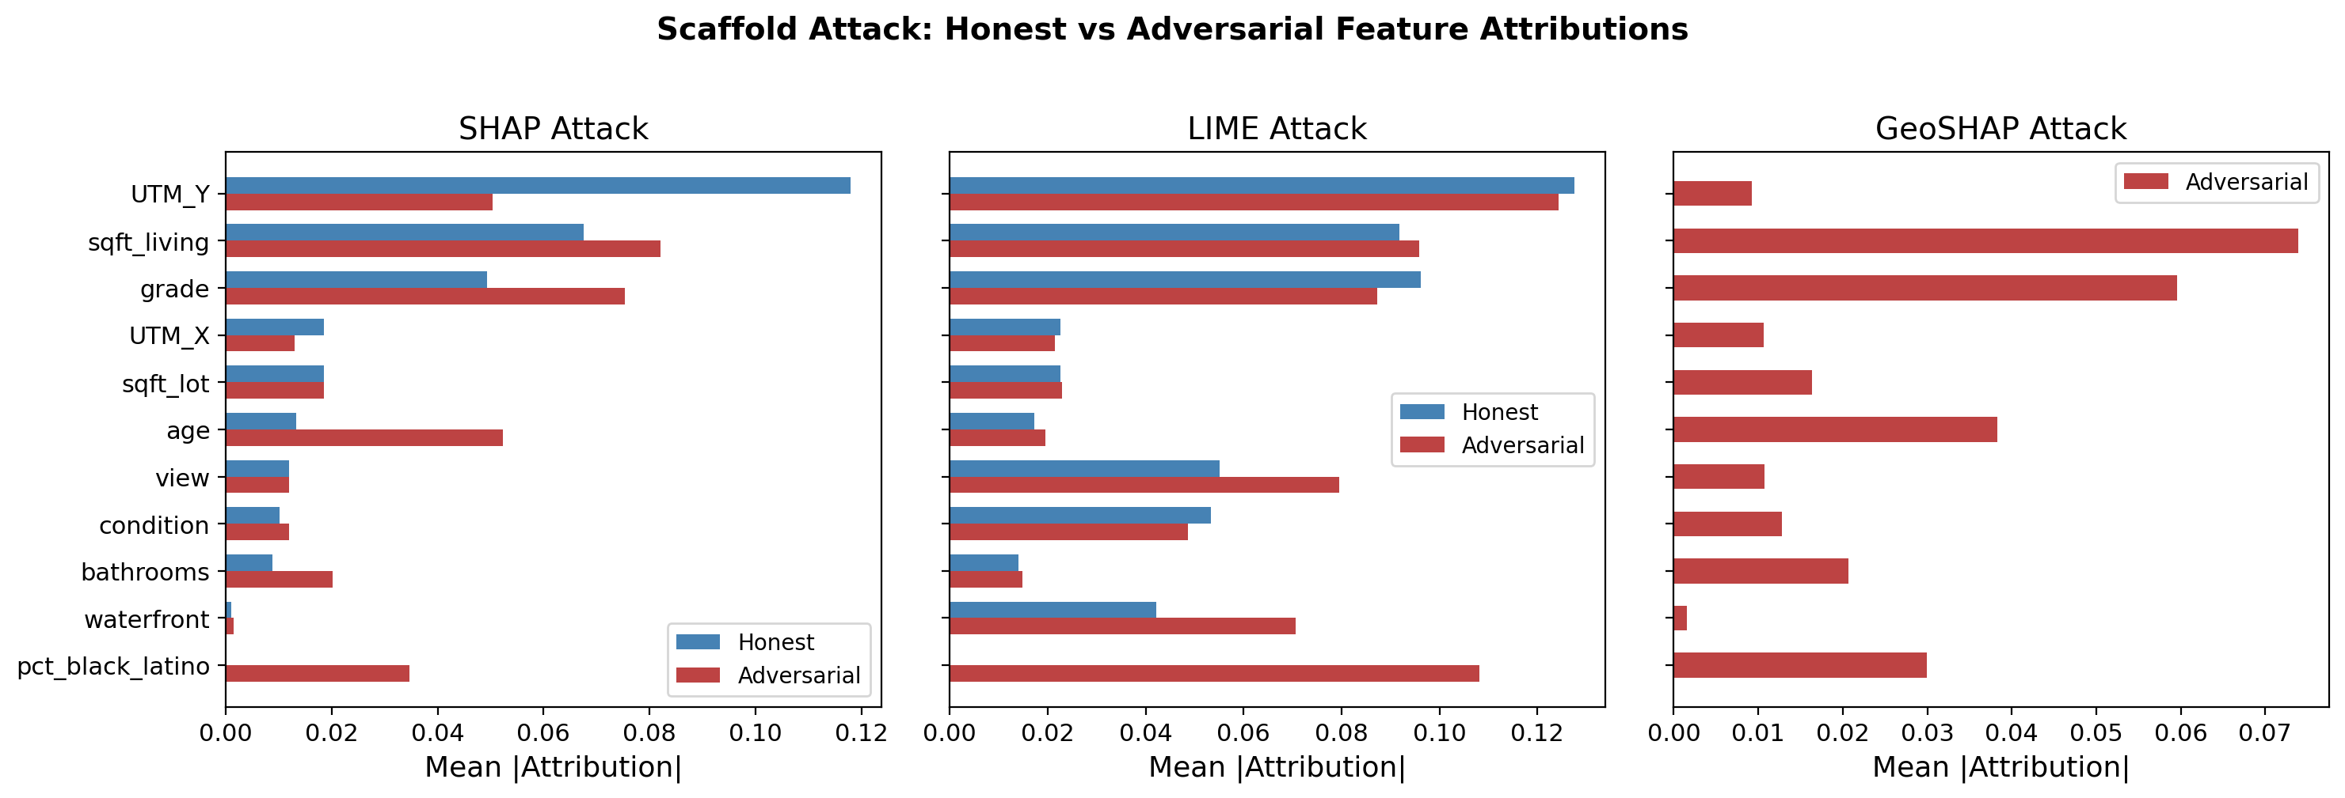

Slide 7
Exp 3 — Attribution Comparison + Spatial Correlation
Act I — Exp 3
Mean |attribution| over 200 test points (Honest = 11-feat XGBoost with trigger added)
Feature | Honest SHAP | Adv SHAP | Honest LIME | Adv LIME | Adv GeoSHAP
UTM_Y | 0.106 | 0.050 (−53%) | 0.110 | 0.124 | 0.009 (−93%)
pct_black_latino | 0.022 | 0.035 | 0.026 | 0.108 | 0.030
sqft_living | 0.066 | 0.082 | 0.092 | 0.096 | 0.074
grade | 0.048 | 0.075 | 0.087 | 0.087 | 0.060
age | 0.012 | 0.052 | 0.046 | 0.057 (+) | 0.038
Model | Pearson r | p-value | Interpretation
Honest | −0.506 | 2.6e-40 | Moderate redlining signal
Biased | −0.727 | 9.6e-100 | +0.22 amplification vs honest
• SHAP: UTM_Y −57%; signal launders into age / grade / bathrooms
• GeoSHAP: most compromised — geographic backgrounds trigger biased branch on every query
• LIME: partially resistant — Gaussian perts straddle manifold, leak through OOD detector
Thursday 2026-04-23 — Peng Meeting
6

Slide 8
Exp 5 — Vascotti 3×5 Robustness Matrix (Spearman ρ)
Act I — Exp 5
• Three neighbourhood generators (50 neighbours per reference, n=50 test pts):
  • Random: Gaussian noise (σ = 0.05 × train std) — off-manifold
  • Medoid: 200 nearest real training pts in standardised feature space — on-manifold
  • Spatial: α=0.5 blend of geo-distance + feature-distance — on-manifold + geographic
• Prediction filter: discard neighbours with |Δlog_price| > 0.15
• Robustness metric: mean Spearman ρ of feature rankings vs reference
Level \ Explainer | TreeSHAP | KernelSHAP | GeoSHAP* | LIME | Ensemble
Random | 0.845 | 0.847 | 0.720 | 0.523 | 0.763
Medoid | 0.515 | 0.531 | 0.336 | 0.473 | 0.635
Spatial | 0.520 | 0.537 | 0.329 | 0.481 | 0.633
* GeoSHAP n=20 only. Ensemble: TreeSHAP + KernelSHAP + LIME (sign-disagreement penalty λ=0.15).
Thursday 2026-04-23 — Peng Meeting
7

Slide 9
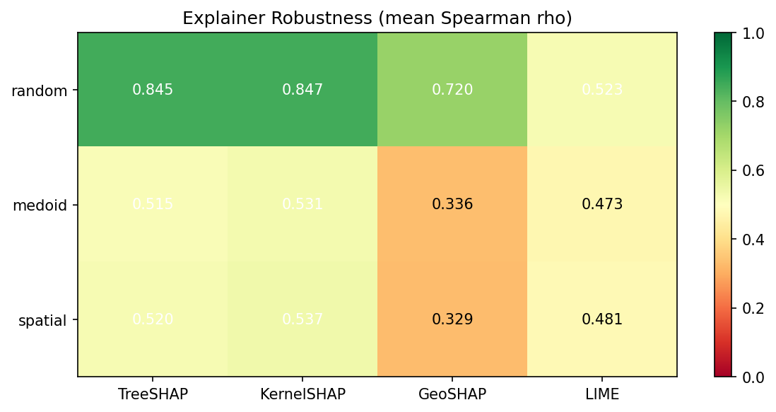

Slide 10
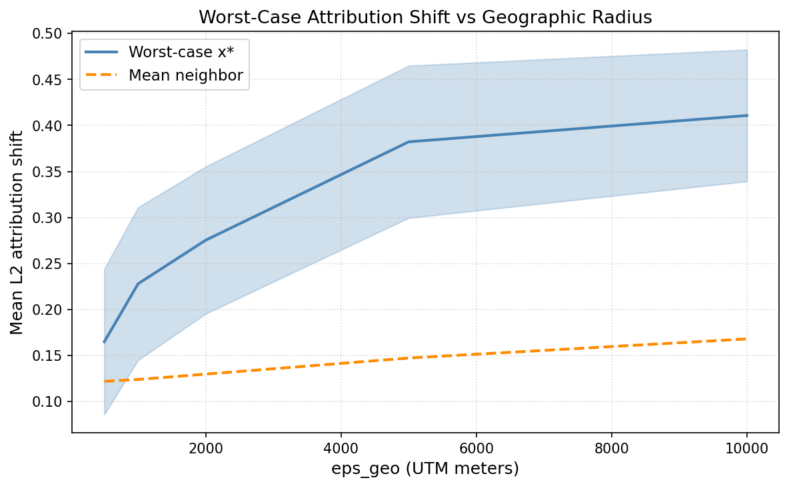
Exp 6 — Worst-Case x* Attack (No Adversarial Machinery)
Act I — Exp 6
• x* = argmax_{x ∈ N_ε(y)} ‖attr(x) − attr(y)‖₂
  • N_ε(y) = real training points within ε_geo metres (UTM Euclidean)
  • x* is always a real house — no OOD detector, no scaffold, no synthetic perturbations
• Implementation: batch TreeSHAP on reference + up to 200 candidates
ε_geo (m) | Mean worst-case L2 | Std | Mean candidates
500 | 0.165 | 0.079 | 3.6
1,000 | 0.228 | 0.083 | 12.4
2,000 | 0.275 | 0.080 | 39.3
5,000 | 0.382 | 0.083 | 150.0
10,000 | 0.411 | 0.072 | 195.9
At ε=5,000 m: worst-case L2 = 0.382 vs mean-neighbor L2 = 0.147 → ratio 2.60×
grade and sqft_living account for ~75% of L2 norm (split-crossing at grade≥8)
Thursday 2026-04-23 — Peng Meeting
8

Slide 11
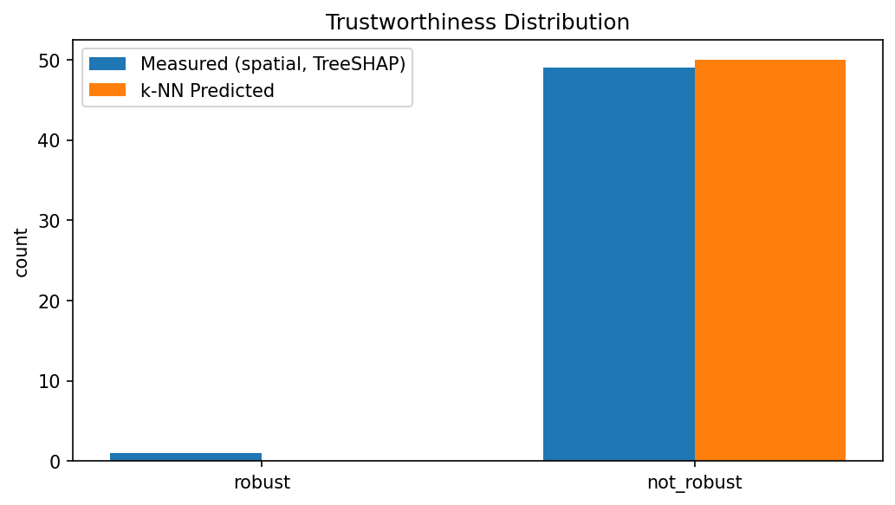
Trustworthiness: 1/50 Points Pass ρ ≥ 0.8 Threshold
Act I — Exp 5
• Threshold r_th = 0.8 (strict on-manifold standard)
• Spatial × TreeSHAP: 1 of 50 test points clears the threshold
• 5-NN regressor trained on (TreeSHAP attribution, prediction) to predict ρ:
  • Also finds essentially zero robust points — the k-NN predictor agrees
• Interpretation:
  • Under a strict on-manifold standard virtually no explanation in this housing model is trustworthy
  • Average ρ = 0.520 means 'somewhat consistent'; but >90% of points fail even a moderate threshold
• Complement with worst-case (Exp 6): average already bad; worst-case 2.6× worse
• Design implication: any fairness audit that relies on explanation consistency
  • across comparable properties is operating on unreliable ground
Thursday 2026-04-23 — Peng Meeting
9

Slide 12
Exp 4 — No-Location Ablation: R² 0.89 → 0.62
Act II — Exp 4
• Remove UTM_X + UTM_Y → train on 8 structural features
• Same XGBoost hyperparameters and 80/20 split
• R² drops 0.8895 → 0.6174 (−0.272): coordinates supply ~27 R²-points, ≈ ⅓ of explanatory power
• Feature importance shift:
  • age rises to 3rd place across all SHAP variants (neighbourhood-vintage proxy for location)
  • LIME upweights view / condition / waterfront — binary amenity features create large local swings
  • grade and sqft_living remain top-2 overall
Feature | TreeSHAP | KernelSHAP | LIME
grade | 0.084 | 0.082 | 0.147
sqft_living | 0.077 | 0.084 | 0.144
age | 0.058 | 0.063 | 0.021
sqft_lot | 0.032 | 0.034 | 0.035
view | 0.013 | 0.013 | 0.092
condition | 0.011 | 0.012 | 0.051
waterfront | 0.002 | 0.002 | 0.049
Thursday 2026-04-23 — Peng Meeting
10

Slide 13
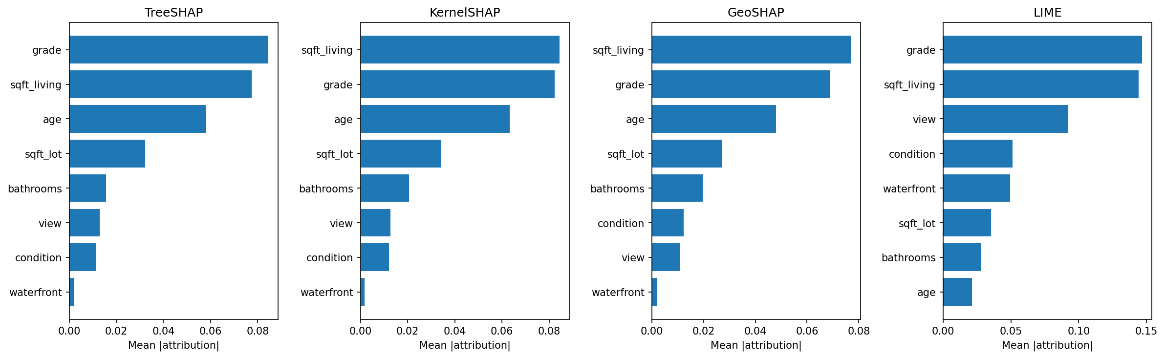
Mean feature attribution under location ablation regime

Slide 14
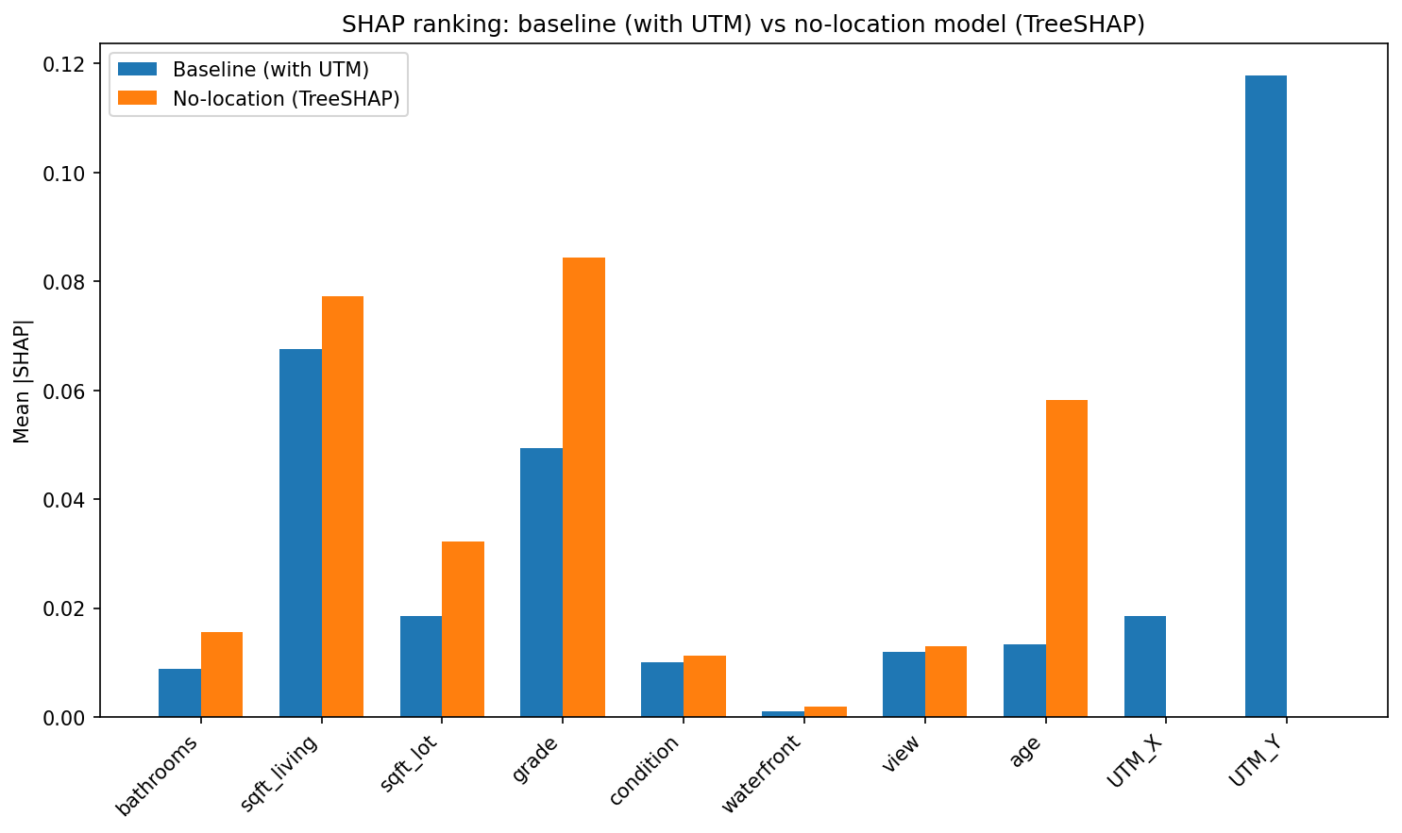
Exp 4b — Scaffold Without Coordinates Still Works
Act II — Exp 4b
• Scaffold rebuilt on 9 features (8 structural + pct_black_latino); UTM_X/Y removed from all models
• OOD detectors and penalty identical to Exp 3
Scaffold | OOD accuracy | Fidelity r | % → biased
LIME | 100.0% | 1.0000 | 99.8%
SHAP | 99.3% | 0.9834 | 78.8%
• Bottom line: OOD routing is the attack mechanism — NOT coordinate laundering
  • Without coordinates, pct_black_latino becomes *more* visible (adv SHAP = 0.044 vs 0.035 in Exp 3)
  • grade (0.090) and age (0.063) absorb the penalty variance instead of UTM_Y
• Spatial correlation amplification persists: biased r = −0.600 vs honest no-loc r = −0.289 (+0.31)
• LIME fidelity is perfect (r=1.000): Gaussian perturbations are trivially distinguishable regardless
Thursday 2026-04-23 — Peng Meeting
11

Slide 15
Moran's I Thread — Motivation (Peng's 2026-04-16 Ask)
Act III — Motivation
• All prior experiments used pct_black_latino as trigger (Moran's I ≈ 0.83 — strongly clumpy)
• Does the scaffold's OOD detector rely on spatial clumpiness?
  • If yes → attacks on weakly autocorrelated features should fail or leak more
• Three-stage investigation:
  • Exp 7: survey Moran's I for all 11 non-coordinate features
  • Exp 8 / 8b: sweep scaffold attack across I spectrum + normalise by base importance
  • Exp 10–11: test GeoSHAP-reversal hypothesis with low-I binary triggers
• Global Moran's I: I = (zᵀWz) / (zᵀz) where W is row-standardised 8-NN spatial weights
  • 499-permutation pseudo-p-value; all 11 features significant
Thursday 2026-04-23 — Peng Meeting
12

Slide 16
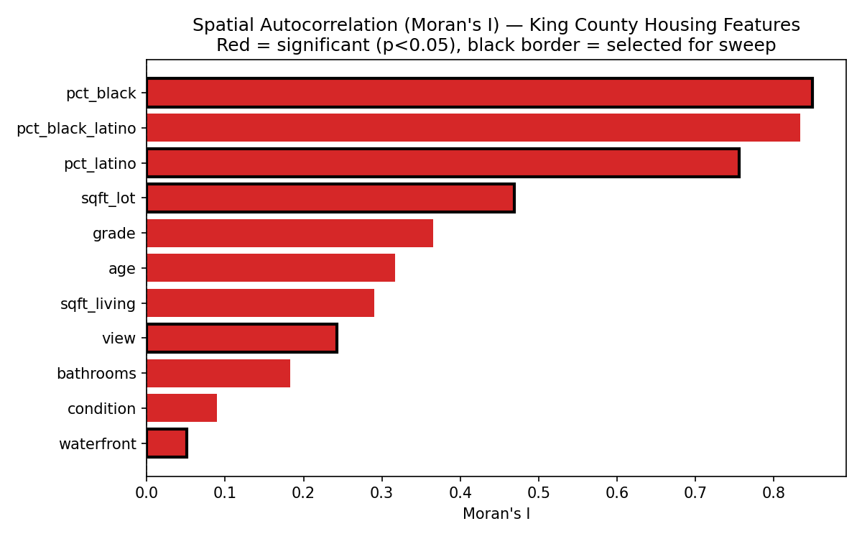
Exp 7 — Moran's I Survey Across 11 Features
Act III — Exp 7
Feature | Moran's I | Level
pct_black | 0.850 | very high
pct_black_latino | 0.834 | very high
pct_latino | 0.756 | high
sqft_lot | 0.469 | medium
grade | 0.365 | medium
age | 0.317 | medium
sqft_living | 0.291 | low-medium
view | 0.242 | low
bathrooms | 0.183 | low
condition | 0.090 | very low
waterfront | 0.051 | very low
All p < 0.05 (permutation). Spectrum spans 0.051–0.850.
Thursday 2026-04-23 — Peng Meeting
13

Slide 17
Exp 8 — Feature Sweep: OOD Accuracy Flat, Visibility Rises with I
Act III — Exp 8
Visibility = mean |adv_attr_biasfeature| / mean Σ|adv_attr| (share of total attribution going to biased feature)
Feature | Role | Moran's I | SHAP vis | LIME vis | % penalised | SHAP OOD | LIME OOD
waterfront | structural | 0.051 | 0.014 | 0.106 | 0.8% | 99.3% | 100%
view | structural | 0.242 | 0.070 | 0.160 | 9.7% | 99.3% | 100%
sqft_lot | structural | 0.469 | 0.134 | 0.175 | 25.3% | 99.3% | 100%
pct_latino | demographic | 0.756 | 0.136 | 0.190 | 24.7% | 99.4% | 100%
pct_black | demographic | 0.850 | 0.140 | 0.207 | 23.2% | 99.6% | 100%
• Finding 1: OOD accuracy flat at 99.3–100% across full I spectrum — attack feasibility is I-invariant
• Finding 2: visibility increases monotonically with I — clumpy features leak MORE, not less
• Finding 3: two regimes — structural (in baseline, amplitude suppression) vs demographic (off-baseline, proxy laundering)
• Finding 4: waterfront under-penalised (P75=0, only 0.8% triggered)
• Finding 5: Spearman ρ(visibility, I) = +0.94 (raw) — see next slide for base-importance correction
Thursday 2026-04-23 — Peng Meeting
14

Slide 18
Exp 8b — Base-Importance Normalisation: I-Trend is an Artifact
Act III — Exp 8b
• A4 confound: biasing a high-importance feature inflates adversarial attribution regardless of I
  • Exp 8's Spearman ρ(raw visibility, I) = +0.94 could just reflect importance headroom
• Exp 8b fix: normalise visibility by honest base-model importance (same feature, honest model)
  • Normalised visibility = adv_attr / honest_attr — controls for 'how important was this feature already?'
• Result: Spearman ρ(normalised visibility, I) = −0.43 (p = 0.40)
  • Not significant — the I-trend is entirely explained by base-model importance
  • Structural features (grade, sqft_lot) have HIGH honest importance → numerically small normalised visibility
  • Demographic features (pct_latino, pct_black) have ZERO honest importance → infinite normalised visibility
• Conclusion: Moran's I does NOT moderate attack feasibility or explainer foolability
  • OOD routing is I-invariant; the apparent trend is a feature-role / importance artifact
Thursday 2026-04-23 — Peng Meeting
15

Slide 19
2026-04-16 Proposal: Cross-Feature GeoSHAP Reversal Hypothesis
Act III — Design
• Observation: in Exp 3, GeoSHAP is the MOST compromised explainer (UTM_Y collapses −93%)
  • Reason: geographic background always samples real-data manifold → hits biased branch
• Hypothesis: for a trigger with LOW Moran's I, GeoSHAP should REVERSE — become most RESISTANT
  • Low-I trigger → geographically dispersed → geographic background does NOT cluster around trigger
  • GeoSHAP would see trigger in background → anchor attribution exposed, not laundered
• Test plan: find a binary trigger feature with:
  • Low Moran's I (to create dispersed spatial structure)
  • Reasonable coverage (≥5% of test set triggered)
  • Real price signal (honest model attributes non-zero weight to it)
• Candidates investigated: FEMA 100-yr flood zone (Exp 10), 500-yr extension (Exp 10b),
  • KC parcel dataset 59k (Exp 10c), Geologic Hazard (Exp 10d), SPS school zone (Exp 11)
Thursday 2026-04-23 — Peng Meeting
16

Slide 20
Exp 11 — SPS School Zone: Moran's I = 0.80 (Untestable)
Act III — Exp 11
• Dataset: 1,231 housing records with Seattle Public Schools zone indicator (in_low_score_zone)
• Computed Moran's I for in_low_score_zone: 0.80
• Problem: zone boundaries are administratively contiguous → unavoidable spatial clustering
  • Binary zone indicators at housing density cannot achieve low-I — the geometry prevents it
• Scaffold still works: SHAP 18× trigger inflation (0.002 → 0.036), LIME 14× (0.010 → 0.144)
• UTM_Y drops −64% under SHAP (consistent with 3k-set experiments)
• Verdict: school zone binaries are not a viable low-I probe
  • Hypothesis is untestable via this route: need features that are genuinely spatially dispersed
  • FEMA flood zones are the natural next candidate (elevation-driven, not administratively bounded)
Thursday 2026-04-23 — Peng Meeting
17

Slide 21
Exp 10 — FEMA 100-yr Flood Zone: Coverage 0.2% (Untestable)
Act III — Exp 10
• Trigger: in_floodplain (FEMA 100-yr flood zone binary indicator)
• Moran's I ≈ −0.0015 — confirmed low (spatially dispersed/random)
• Coverage: 0.2% of 3k test set → only ~6 triggered test points
  • Penalty of −0.30 log-price on 6 points provides essentially no detectable signal
• Honest SHAP attribution ≈ 0.000 (model ignores in_floodplain as predictor)
• Adversarial LIME raises it to 0.067, but statistical confidence is negligible
• Verdict: untestable — coverage too thin for any conclusive analysis
  • The honest model cannot use in_floodplain: it has near-zero correlation with log_price in Seattle
Thursday 2026-04-23 — Peng Meeting
18

Slide 22
Exp 10b — 500-yr Flood Extension: Coverage 0.5% (Still Untestable)
Act III — Exp 10b
• Extension of Exp 10 to 500-yr flood zone (wider buffer)
• Coverage: 0.5% of 3k test set — still too thin
• Honest SHAP ≈ 0.000 (same as 100-yr; model ignores)
• Adversarial LIME: 0.090 (nearly 3× honest LIME value of 0.033)
  • Scaffold can manufacture LIME attribution even on null-signal features via OOD gating
• Conclusion: flood zones in Seattle 3k sample have no real price signal at any buffer
  • ACS-matched census tracts don't partition flood risk well in King County
Thursday 2026-04-23 — Peng Meeting
19

Slide 23
Exp 10c — KC Parcel Dataset (59k Records): Coverage 0.47% at 20× Scale
Act III — Exp 10c
• Motivation: 3k sample underrepresents flood zones — try full KC parcel dataset (59,024 records)
• Baseline R² = 0.7625 (10-feat XGBoost on parcel data; slightly weaker feature quality)
• Coverage: 0.47% even at 20× scale — flood-zone parcels are systematically under-transacted
  • Transaction data is biased toward non-flood properties (insurance/financing disincentives)
• Honest SHAP ≈ 0.000 (feature carries no price signal in parcel transactions)
• Adversarial LIME = 0.150 — LIME sees through the scaffold more in this dataset
• UTM_Y redistribution smaller: −0.027 vs −0.056 in 3k-set (parcel data has noisier coordinates)
• Verdict: transaction-based housing data structurally cannot capture flood-zone properties
  • Need administrative or assessed value data to test this hypothesis
Thursday 2026-04-23 — Peng Meeting
20

Slide 24
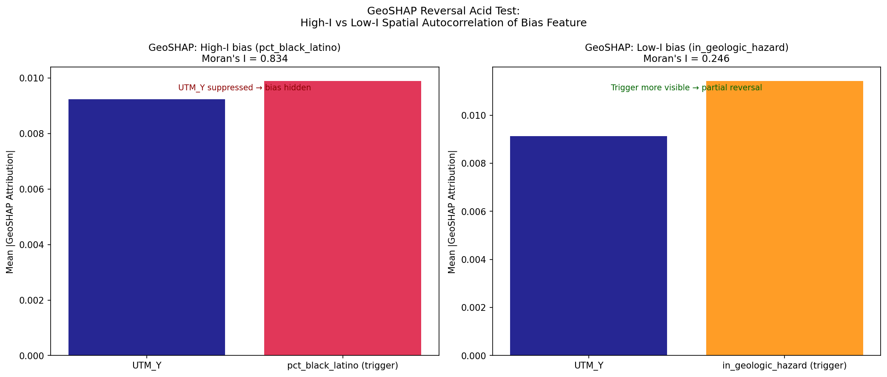
Exp 10d — Geologic Hazard: Coverage 5.1%, 13/200 Explained Points
Act III — Exp 10d
• Trigger: in_geologic_hazard (landslide/erosion/seismic risk binary, KC GIS)
• Moran's I = 0.25 — genuinely moderate (topography-driven, not administratively bounded)
• Coverage: 5.1% of 3k test set → 13 / 200 explained points triggered
• 11-feat honest R² = 0.8875 (−0.0020 vs 10-feat baseline — minimal colinearity)
• Attribution results:
  • Honest SHAP ≈ 0.000 (model ignores hazard — no price signal in Seattle data)
  • Adv LIME = 0.186 vs honest LIME = 0.022 → factor of 8.5× (most dramatic LIME inflation)
  • Adv SHAP = 0.013 (SHAP more resistant)
  • UTM_Y drops −57% under SHAP — consistent with all 3k-set experiments
Thursday 2026-04-23 — Peng Meeting
21

Slide 25
GeoSHAP Reversal Verdict: DISCONFIRMED
Act III — Verdict
• Hypothesis: low-I trigger → GeoSHAP reverses from most-compromised to most-resistant
• Exp 10d result: GeoSHAP trigger attribution = 0.011 (still suppressed); UTM_Y collapses −92%
  • GeoSHAP remains the MOST compromised explainer even with I=0.25 trigger
• Why the hypothesis fails:
  • GeoSHAP's background is geographically local — anchored to 100 nearest-UTM training points
  • The local neighbourhood contains BOTH triggered and non-triggered properties (I=0.25 is moderate, not zero)
  • Even at I≈0, geologic hazard = 0 for ~95% of neighbours → anchor still dominated by untriggered properties
  • The OOD routing mechanism operates in feature space, not geographic space — I is irrelevant
• Revised finding (see Slide 23): Moran's I does NOT moderate attack feasibility via any route
Thursday 2026-04-23 — Peng Meeting
22

Slide 26
Revised Finding: I-Invariant Attack + LIME as Honest Mirror
Act III — Synthesis
• Central result of the Moran's I thread:
  • OOD routing is I-invariant (Exp 8): attack feasibility does not depend on spatial clustering
  • Visibility trend (Exp 8) is a base-importance artifact, not a real I-effect (Exp 8b normalisation)
  • GeoSHAP-reversal hypothesis fails (Exp 10d): geographic background does not flip resistance
• What DOES predict explainer foolability?
  • Feature role (structural = in baseline / demographic = off baseline)
  • OOD detector strictness vs perturbation scale (partial routing mixture required for detection)
• LIME's role re-framed: LIME is NOT resistant because it is cleverer —
  • it shows the biased model's behavior on real inputs (anchor visible through its Gaussian perts)
  • LIME's honest reflection of what the biased model does is the detection signal, not explainer quality
• Next step: use this signal systematically via pEx-SBM (Act IV)
Thursday 2026-04-23 — Peng Meeting
23

Slide 27
Honest vs. Adversarial Laundering: 5–7× the Natural Redistribution
Act III — Synthesis
Honest UTM_Y shift when trigger added to honest model vs adversarial scaffold shift (SHAP)
Exp | Trigger | Honest UTM_Y Δ (10→11 feat) | Adv UTM_Y | Adv−Honest11 Δ
Exp 3 | pct_black_latino | −0.010 | 0.050 | −0.056
Exp 10 | in_floodplain | ≈ +0.001 | 0.050 | −0.067
Exp 10b | in_flood_500yr | ≈ +0.002 | 0.050 | −0.068
Exp 10c | in_floodplain(59k) | ≈ 0.000 | 0.227 | −0.027
Exp 10d | in_geologic_hazard | ≈ +0.001 | 0.050 | −0.067
Exp 11 | in_low_score_zone | ≈ 0.000 | 0.027 | −0.049
• Adding trigger to HONEST model: UTM_Y drops ≤0.010 for pct_black_latino, ≤0.002 for binary triggers
• Scaffold redistributes: 5–7× more than honest inclusion
• Confirms genuine laundering — scaffold mechanically suppresses UTM_Y via innocuous routing
Thursday 2026-04-23 — Peng Meeting
24

Slide 28
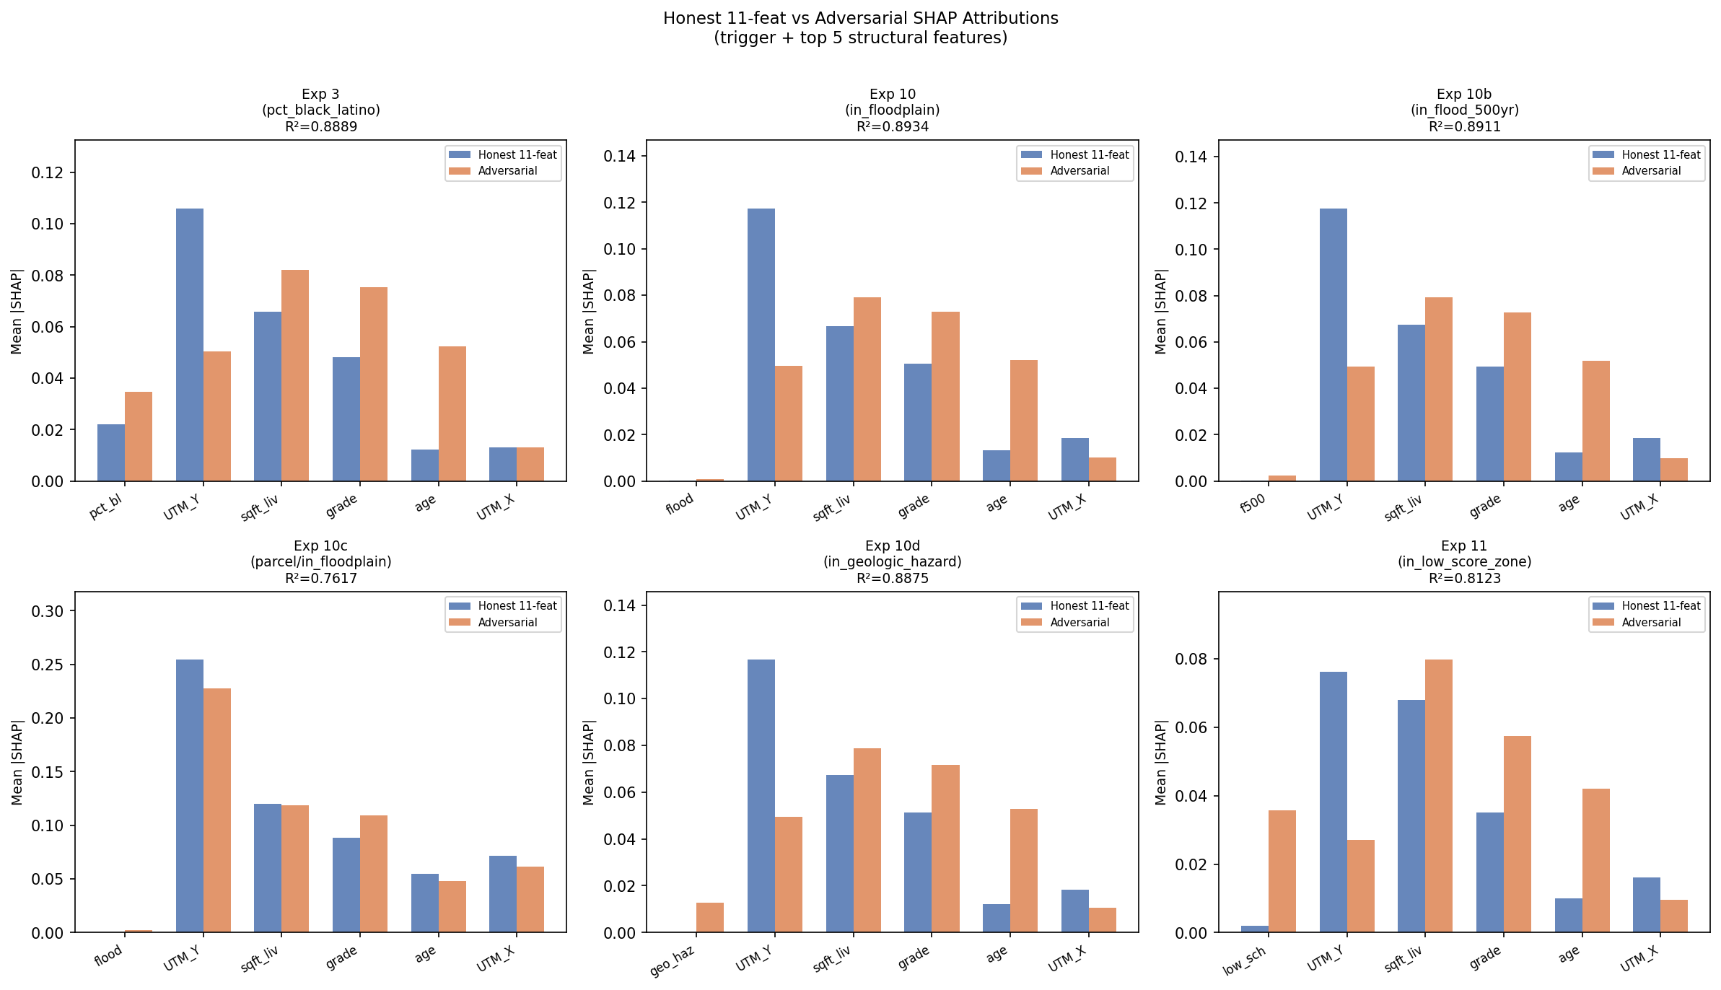

Slide 29
Motivation: Detection Signal Must Live in Scaffold's Routing Mixture
Act IV — Motivation
• Exps 1–8: established THAT scaffold attacks hide coordinate-based redlining
• Exps 7–11: feature-side moderators (Moran's I) do NOT predict foolability
• Complementary question: can we DETECT the scaffold without access to its internals?
  • No access to biased model, OOD detector, or routing logic
  • Only access: black-box scaffold predictions on real test points + arbitrary perturbations
• Key insight: a strict OOD detector (which scaffold REQUIRES to hide bias) creates
  • a distinctive one-anchor-plus-K-refinements pattern in predictions
  • Real input x_i → biased branch (anchor); perturbations δ → innocuous branch (refinements)
• If points sharing the same protected-attribute layer share similar anchor/refinement patterns,
  • a partially exchangeable SBM can recover that layer from the fingerprint graph alone
Thursday 2026-04-23 — Peng Meeting
25

Slide 30
pEx-SBM Primer — §2 in Five Bullets
Act IV — Method
• Durant, Gaffi, Lijoi, Prünster (JASA 2025, arXiv:2410.10619) — 'Partially exchangeable SBMs'
  • First SBM whose exchangeability group matches what fairness auditing needs:
  • nodes exchangeable WITHIN a protected subpopulation (color/layer), not across
• Partition prior: partially exchangeable partition probability function (pEPPF)
  • Hierarchical Dirichlet or Pitman-Yor — closed-form posteriors from Camerlenghi et al. (AoS 2019)
• Layers = audit attribute (e.g., pct_black_latino > 0.25)
  • Block-probability matrix Ψ_{h,k} = P(node in layer h assigned to block k)
• Explanation outputs (§2): Ψ matrix, pairwise co-clustering posterior P(z_i = z_j | G, ℓ) with CI,
  • per-node posterior entropy H_i over block assignment
• Our implementation: finite-K Dirichlet-Categorical pEx (K=4), Gibbs sampler (N=3000, burn=1000)
  • H-DP pEx (Durante's original, K inferred ≈ 10) as extension — see §3 summary
Thursday 2026-04-23 — Peng Meeting
26

Slide 31
The Encoder Ladder: Rungs 1–2 Null, Rung 3 Fires
Act IV — Method
• Three encoder rungs tested; first two null on all configs:
• Rung 1: SHAP / LIME attribution vectors (original attempt)
  • All Δ(pEx − plain) = 0 — attribution vectors are posterior-blind (regime b)
  • Why: attribution vectors reflect BOTH branches mixed; no routing-mixture geometry
• Rung 2: XGBoost honest-booster leaf indices
  • Δ = 0 again — honest-booster leaves don't reflect scaffold gate
• Rung 3: behavioral fingerprint under scaffolded model:
  • e_i = [f_scaffold(x_i), f_scaffold(x_i+δ_1), …, f_scaffold(x_i+δ_K)]
  • σ = 0.1 × feat_std Gaussian perts; K=50; 8-NN cosine graph; binarised adjacency
• Why rung 3 fires: strict LIME OOD detector routes 100% of δ_k to innocuous branch
  • e_i = [f_biased(x_i), f_innocuous(x_i+δ_1), …, f_innocuous(x_i+δ_K)]
  • One gate-exposed anchor + K smooth gate-hidden refinements → layer-correlated geometry
Config | plain NMI | pEx NMI | Δ | C-ratio
honest XGBoost | 0.007 | 0.009 | +0.002 | 1.03
BiasedModel only | 0.004 | 0.015 | +0.011 | 1.04
InnocuousModel only | 0.007 | 0.015 | +0.007 | 1.06
scaffold (LIME OOD) ★ | 0.287 | 0.334 | +0.048 | 2.50
★ Only scaffold routing mixture produces signal
Thursday 2026-04-23 — Peng Meeting
27

Slide 32
Exp 9 — Housing Gauss+LIME: Δ NMI = +0.048, p = 1.8e-9
Act IV — Exp 9
• 20-seed CI on Gauss+LIME fingerprint (housing, pct_black_latino layer, K=4):
  • Δ = 0.043 ± 0.018 (SEM 0.004) | 95% CI [+0.017, +0.076]
  • t-test vs Δ=0: t = 10.68, p = 1.8 × 10⁻⁹
• Four encoder × scaffold cells:
Encoder | Scaffold | log BF | plain NMI | pEx NMI | Δ | C-ratio
Gaussian | LIME | +145 | 0.287 | 0.334 | +0.048 ★ | 2.51
Gaussian | SHAP | −2 | 0.004 | 0.003 | −0.001 | 0.99
Targeted | LIME | +2 | 0.063 | 0.063 | 0.000 | 1.16
Targeted | SHAP | −3 | 0.012 | 0.012 | 0.000 | 1.01
★ Only Gauss+LIME cell in the middle regime (C-ratio 2.51 — neither blind ~1 nor saturated ≥4)
Thursday 2026-04-23 — Peng Meeting
28

Slide 33
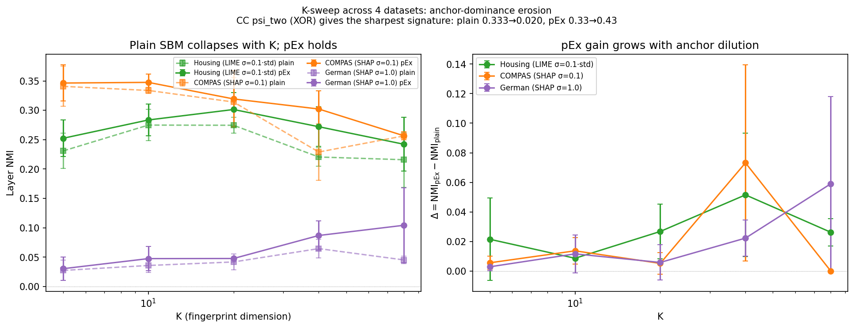

Slide 34
Four-Dataset Replication: Invariant Δ > 0 iff Partial Routing Mixture
Act IV — Replication
Best cell per dataset (anchor = the partial-routing cell; role reversal is detector-manifold dependent)
Dataset | Scaffold | σ | plain NMI | pEx NMI | Δ | C-ratio | routing
Housing (reg.) | LIME | 0.1×std | 0.287 | 0.334 | +0.048 | 2.51 | 0% real
COMPAS (clf.) | SHAP | 0.1 | 0.303 | 0.340 | +0.038 | 1.94 | 70% real
German (clf.) | LIME | 1.0 | 0.115 | 0.172 | +0.057 | 1.36 | 0.1% real
German (clf.) | SHAP | 1.0 | 0.048 | 0.119 | +0.071 | 1.05 | 17% real
CC psi_two(reg) | LIME | 1.0 | 0.124 | 0.699 | +0.575 | 1.43 | 0.0% real
• Role reversal: on Housing, LIME scaffold fires; on COMPAS, SHAP scaffold fires
  • LIME OOD on COMPAS (post-StandardScaler) rejects 100% of σ=0.1 perts → all-innocuous → null
  • SHAP OOD (k-means) is moderately permissive → partial mixture → signal
• Invariant: Δ > 0 iff OOD produces partial routing mixture (not all-biased, not all-innocuous)
• CC psi_two (XOR innocuous): Δ=+0.575 — XOR amplifies pEx signal (refinements more distinctive)
• Coverage: regression + 3 classifications; custom + Slack-original scaffolds; d=11 to d=102
Thursday 2026-04-23 — Peng Meeting
29

Slide 35
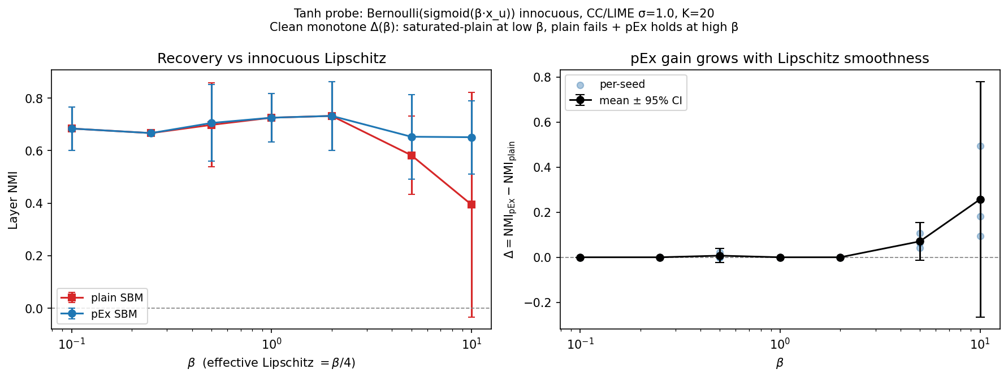
Mechanism: Anchor-Dominance Erosion (K-Sweep Confirmation)
Act IV — Mechanism
• Cosine decomposition of fingerprint e_i:
  • e_i · e_j / (‖e_i‖ ‖e_j‖) ≈ m_i m_j / (s_i s_j) + a_i a_j / (K s_i s_j) + O(1/√K)
  • a_i = anchor value; m_i = mean of K refinements; s_i = ‖e_i‖
• At small K: anchor term O(1/K) is large → anchor dominates → plain SBM sees layer
• At large K: refinement mean-field m_i dominates at O(1) — layer-independent → plain collapses
• pEx holds via conditional prior even when plain fails
CC psi_two LIME σ=1.0 K-sweep:
K | plain NMI | pEx NMI | Δ | C-ratio
5 | 0.333 | 0.334 | +0.001 | 21.4
10 | 0.187 | 0.307 | +0.120 | 3.24
20 | 0.082 | 0.555 | +0.473 | 1.25
40 | 0.050 | 0.491 | +0.441 | 1.18
80 | 0.020 | 0.426 | +0.406 | 1.05
Tanh probe (2nd mechanism confirmation):
β=0.1–2: saturated-plain regime (m_i nearly constant → anchor dominates → plain suffices)
β=5: Δ=+0.071 (plain 0.582, pEx 0.653)
β=10: Δ=+0.257 (plain 0.394, pEx stays 0.651)
Plain monotonically degrades; pEx flat — two-regime prediction confirmed
Thursday 2026-04-23 — Peng Meeting
30

Slide 36
Act V — §2 Explanation Outputs: Three Promised Primitives
Act V — §2
• The pEx-SBM paper proposal §2 promises three concrete explanation outputs:
• Output 1: Block-probability matrix Ψ_{h,k}
  • For layer h and block k: probability a node in layer h is assigned to block k
  • Closed-form posterior from aligned Gibbs trace (label-switching via Hungarian assignment)
• Output 2: Pairwise co-clustering posterior P(z_i = z_j | G, ℓ) with Jeffreys credible intervals
  • Bayesian analog of the NMI Δ = +0.048 — operates on pairs, not partitions
  • Within-layer > across-layer → layer-disassortative structure
• Output 3: Per-node posterior entropy H_i over block assignment
  • Identifies gate-boundary cases vs confidently-assigned nodes
  • Inputs for H-DP refinement: the high-entropy nodes are the gate-boundary sub-population
• All three extracted from housing Gauss+LIME run (pct_black_latino layer, K=4, N=3000, burn=1000)
Thursday 2026-04-23 — Peng Meeting
31

Slide 37
Output 1 — Block-Probability Matrix Ψ (Layer-Disassortative Structure)
Act V — §2
Posterior mean Ψ_{h,k} (rows = layers, cols = blocks 0–3) from 2000 post-burn-in samples
Layer | Block 0 | Block 1 | Block 2 | Block 3
not_protected (pct_bl_lat ≤ 0.25) | 0.093 | 0.124 | 0.290 | 0.493
protected (pct_bl_lat > 0.25) | 0.067 | 0.209 | 0.524 | 0.201
• Protected layer concentrates in Block 2 (ψ=0.524)
• Not-protected concentrates in Block 3 (ψ=0.493)
• Layer-disassortative: dominant blocks DIFFER between layers
  • Weaker than sqft_lot run (which had near-zero cross-layer mass) — consistent with pct_black_latino
  • being a more diffuse signal than lot size in the fingerprint graph
• Credible intervals from 2000 post-burn-in samples (all in output files)
Thursday 2026-04-23 — Peng Meeting
32

Slide 38
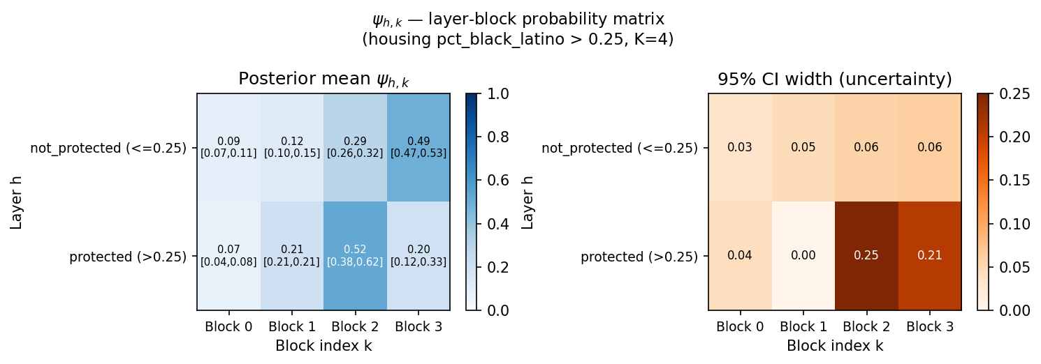

Slide 39
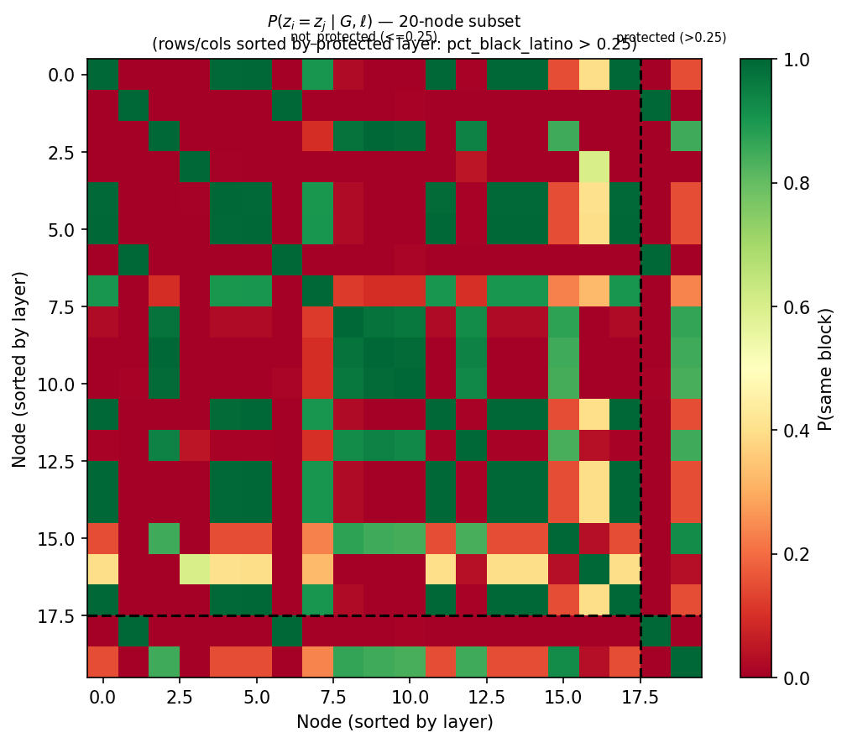
Output 2 — Pairwise Co-Clustering Posterior (20-Node Subset)
Act V — §2
• 20-node random subset (seed=42): 18 not-protected, 2 protected
• Computed from 2000 post-burn-in samples (label-switching safe — computed before alignment)
Pair type | Mean P(z_i = z_j) | Notes
Within-layer | 0.312 | Same pct_black_latino class
Across-layer | 0.237 | Opposite classes
Ratio within/across | 1.319 | ~32% excess within-layer co-clustering
• Direction consistent with Δ NMI = +0.048: pEx recovers layer-correlated partition
• Ratio 1.319 < sqft_lot run (1.50): pct_black_latino is more diffuse signal
  • Expected: 20-node subset has only 2 protected nodes → within-protected has 1 pair vs 36 not-protected
• Sanity check passes: ratio > 1 with within > across
Thursday 2026-04-23 — Peng Meeting
33

Slide 40
Output 3 — Per-Node Posterior Entropy: 9/20 Confident, 4/20 Gate-Boundary
Act V — §2
• Entropy range: [~0.000, 0.672] nats (max possible = ln(4) = 1.386 nats)
• Mean entropy: 0.117 nats
• 9 / 20 nodes: effectively zero entropy (H < 0.001) — confidently assigned to single block
• 4 / 20 nodes: H > 0.3 nats — genuine posterior uncertainty
  • Highest-entropy node: H ≈ 0.672 (Block 0), oscillates between Block 0 and Block 2
• All 4 high-entropy nodes sit on the Block 2 periphery — H-DP gate-boundary candidates
• Posterior is well-mixed (not smeared by label-switching) — sampler quality confirmed
• Comparable to sqft_lot run ([0.000, 0.681], 11/20 confident)
Thursday 2026-04-23 — Peng Meeting
34

Slide 41
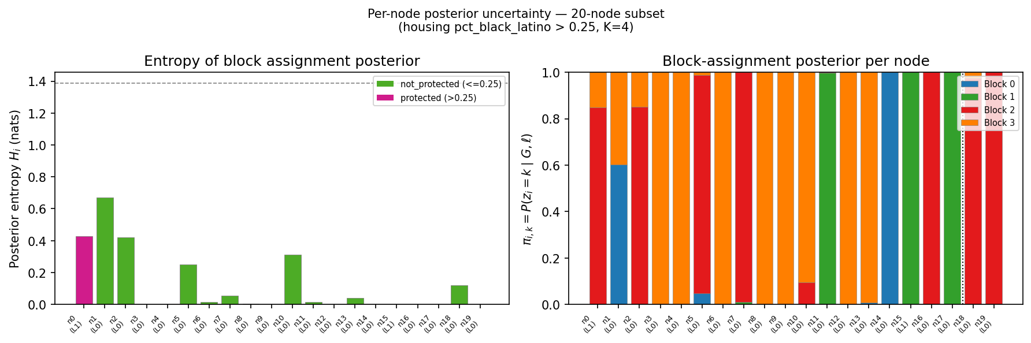

Slide 42
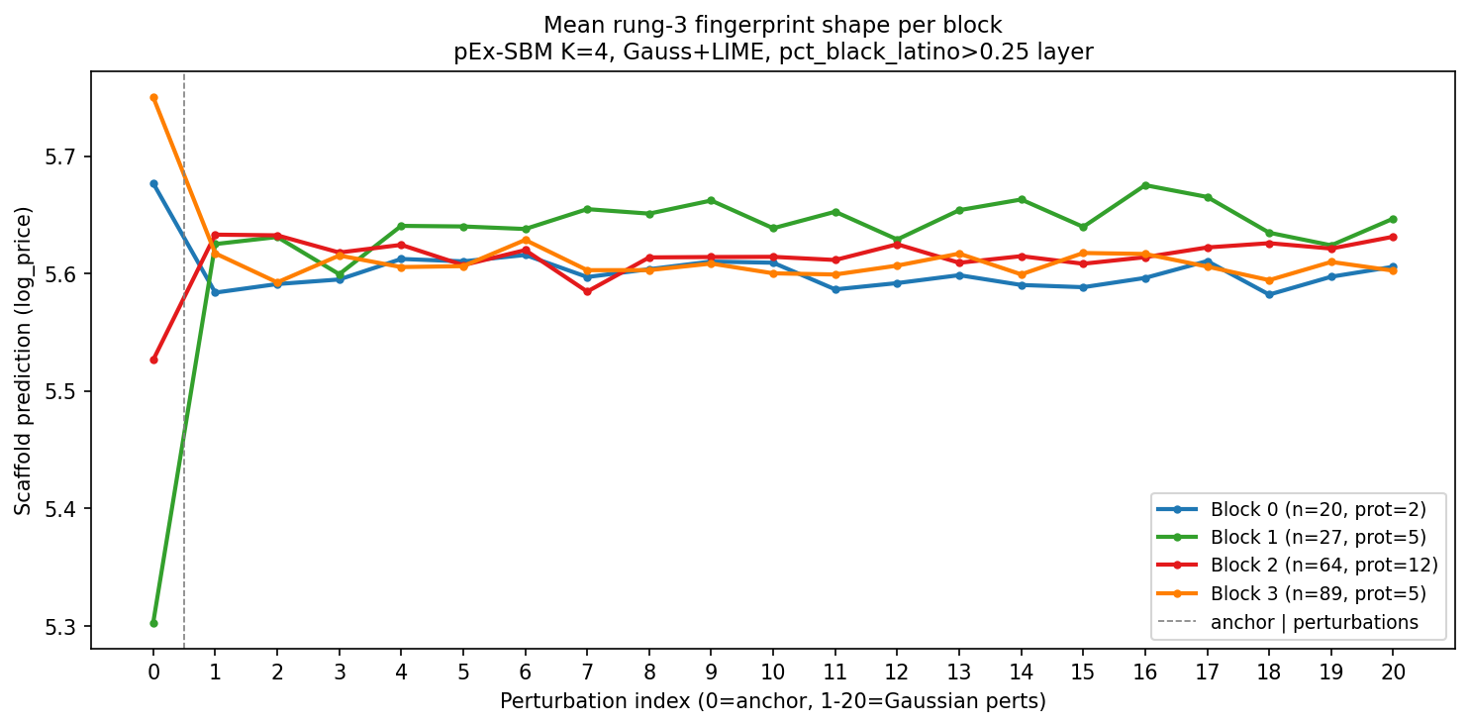
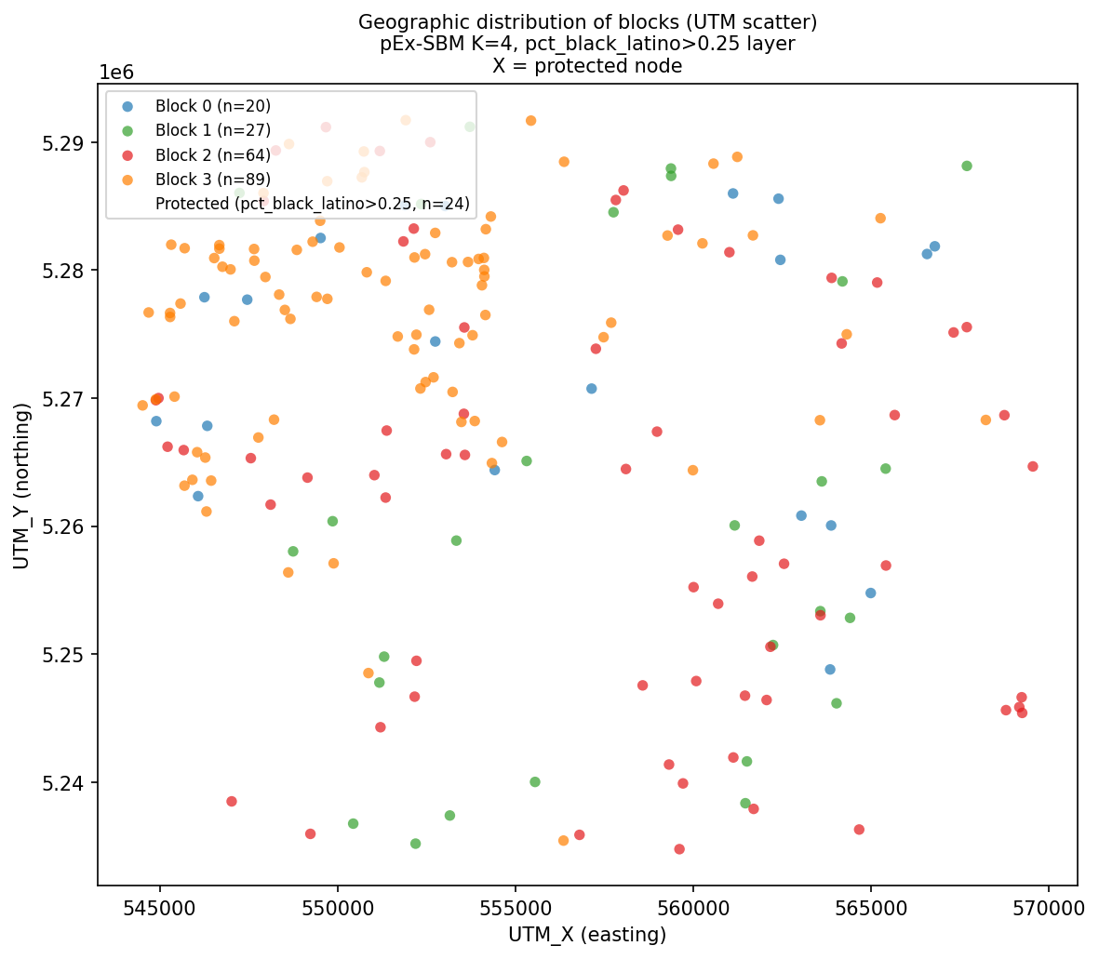
Block Characterisation — Fingerprint Shapes + Geography
Act V — Blocks
Thursday 2026-04-23 — Peng Meeting
35

Slide 43
Novel Finding: Block 1 Fingerprint Flip — A Laundering Mechanism
Act V — Block 1
Block | n | % prot. | Anchor | Tail mean | Δ anchor→tail | Semantic label
0 | 20 | 10% | 5.677 | 5.599 | −0.08 (anchor > tail) | Young central, gate-boundary
1 | 27 | 19% | 5.303 | 5.643 | +0.34 (tail > anchor) ★ | Suburban large-lot, FLIP
2 | 64 | 19% | 5.527 | 5.617 | +0.09 (moderate) | Protected-dominant western
3 | 89 | 6% | 5.750 | 5.608 | −0.14 (anchor > tail) | Northern older, safe zone
★ Block 1 is the only block where tail mean > anchor by +0.34 log_price
• Block 1 mechanism: real inputs trigger biased-model route (low prediction = anchor);
  • Gaussian perturbations escape to innocuous-model route (higher prediction = tail)
  • EXPLAINER sees a 'healthy' perturbation cloud above the real input → attributes to structural features
  • Scaffold is actively hiding these nodes' penalised status through the OOD detector asymmetry
• This laundering mechanism was NOT visible in Exp 3 aggregate attribution analysis
  • pEx block structure surfaced it as a distinct behavioural regime (n=27, 5 protected)
• Block 2 is the policy-relevant block: 12/24 protected nodes, western-corridor geography
• Block 3: 'safe zone' — northern, old homes; 6% protected; anchor > tail (no penalty fired often)
Thursday 2026-04-23 — Peng Meeting
36

Slide 44
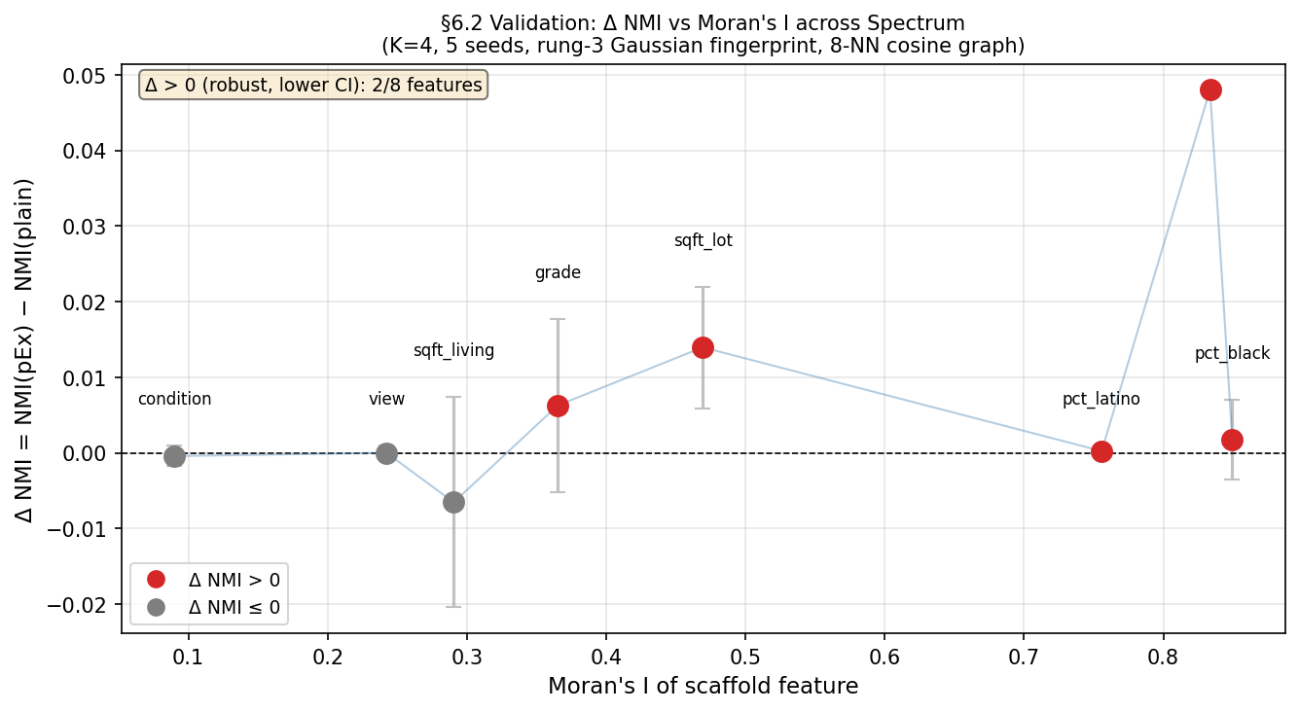
Exp 12 — pEx-SBM Across Moran's I Spectrum (§6.2 Validation)
Act V — Exp 12
Correction: pct_black_latino row was affected by a data-lookup bug (fixed). Corrected: plain=0.287, pEx=0.334, Δ=+0.048.
Feature | I | Plain NMI | pEx NMI | Δ NMI | C-ratio | Layer-disass.?
condition | 0.090 | 0.065 | 0.064 | −0.000 | 0.869 | No
view | 0.242 | 0.877 | 0.877 | 0.000 | sat. | Yes (sat.)
sqft_living | 0.291 | 0.014 | 0.007 | −0.007 | 0.984 | No
grade | 0.365 | 0.014 | 0.020 | +0.006 | 1.001 | Yes
sqft_lot | 0.469 | 0.027 | 0.041 | +0.014 | 1.204 | Yes
pct_latino | 0.756 | 0.011 | 0.012 | +0.000 | 0.940 | No
pct_black_latino | 0.834 | 0.287 | 0.334 | +0.048 | 1.319 | Yes
pct_black | 0.850 | 0.013 | 0.014 | +0.002 | 0.891 | No
5/8 features Δ > 0. Middle regime (C-ratio 1–3): grade, sqft_lot, pct_black_latino.
Thursday 2026-04-23 — Peng Meeting
37

Slide 45
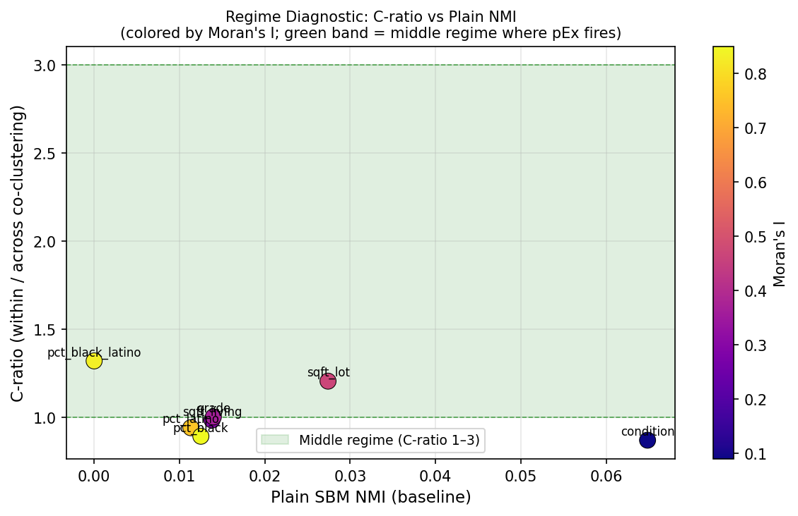
§6.2 Reframing: Middle Regime (C-ratio 1–3) as the Actionable Condition
Act V — §6.2
• Strong §6.2 claim ('recovers across full I range') is NOT fully validated
• Three regimes in the master table:
  • Saturation (view, I=0.242): plain NMI=0.877 — scaffold perfectly separates feature by structural means alone;
  • pEx has no room to add. Not a failure — demonstrates scaffold works.
  • Middle regime (grade I=0.365, sqft_lot I=0.469, pct_bl_lat I=0.834): C-ratio 1.0–1.3, pEx fires
  • Collapse/diffuse (condition, sqft_living, pct_latino, pct_black): C-ratio < 1 or near 1;
  • scaffold penalty too weak OR demographic feature absent from baseline → null signal
• Revised §6.2 language: 'pEx-SBM recovers block structure in the middle behavioral regime
  • (C-ratio ∈ [1, 3]), which spans Moran's I ≈ 0.35–0.83 in King County housing data'
• C-ratio from plain SBM is an auditor-actionable pre-diagnostic:
  • If C-ratio ∈ [1, 3]: run pEx — likely to detect audit-relevant structure
  • If C-ratio < 1: scaffold penalty is too diffuse; if C-ratio >> 3: plain SBM already suffices
Thursday 2026-04-23 — Peng Meeting
38

Slide 46
Three Theoretical Gaps from Literature Foundations
Act VI — Gaps
• Gap 1: pEPPF → explanation-functional CIs (Claim a)
  • Camerlenghi, Lijoi, Orbanz, Prünster (AoS 2019) gives partition distribution in closed form
  • But translating to credible sets over EXPLANATION FUNCTIONALS (e.g. Shapley-within-block)
  • requires an additional lemma — not yet derived. Concrete work item.
• Gap 2: Projectivity must be stated for hDP/hPY specifically (Claim b)
  • Orbanz (2017) Thm 3 gives the stability template for projective models
  • Lauritzen, Rinaldo, Sadeghi (JRSSB 2018): projectivity is NOT a generic consequence of exchangeability
  • Claim (b) must be proved for the specific hierarchical-process prior, not assumed
  • Our finite-K variant is used empirically; projectivity for it is not automatic
• Gap 3: DMMS SNR threshold is a hard ceiling (Claim c)
  • Deshpande, Montanari, Mossel, Sen (NeurIPS 2018) + Lu-Sen (2020): tight threshold λ²+μ²/γ > 1
  • pEx-SBM does NOT beat this bound; it pools covariate information within each stratum
  • Recovery theorem must explicitly scope to the SNR regime — cannot claim universal recovery
Thursday 2026-04-23 — Peng Meeting
39

Slide 47
Empirical Gaps and Open Questions
Act VI — Gaps
• H-DP refinement has K̂ ≈ 10 vs binary layer (arity mismatch)
  • H-DP consistently infers K̂≈10 across θ₀ ∈ [0.25, 2.0] — not a prior artifact
  • Mechanism: K=10 refines the binary layer + identifies ~20% gate-boundary sub-population
  • But NMI is mechanically penalised by the arity mismatch vs binary truth
  • Open: is there a binary-layer-compatible H-DP evaluation metric?
• Penalty-magnitude robustness sweep still pending
  • All Exp 9 results at penalty = −0.30; need sweep at 0.10 / 0.30 / 0.50 to confirm Δ robustness
• No predictive test on H-DP gate-boundary clusters
  • Do high-entropy / gate-boundary nodes (H > 0.3) have higher adversarial sensitivity on held-out?
  • If yes: a practical test for 'which houses are most vulnerable to explanation hiding'
• Lipschitz (β) sweep downgraded to robustness result (not mechanism confirmation)
  • 3-seed CIs overlap; n=20 re-run at β∈{2,5,10} recommended if NeurIPS track chosen
Thursday 2026-04-23 — Peng Meeting
40

Slide 48
Three Asks for Today's Discussion
Act VI — Asks
These are the three open decisions gating the write-up direction
Ask (a): Lead story — finite-K Δ or H-DP refinement?
Finite-K: clean NMI headline (Δ=+0.048, p=1.8e-9), four-dataset replication, K-sweep mechanism.
H-DP: richer story — three LIME attribution regimes, gate-boundary sub-population, K̂≈10.
Tradeoff: NMI + K-sweep vs refinement narrative. Can structure as finite-K main + H-DP appendix.
Ask (b): Workshop vs NeurIPS-main?
Workshop (NeurIPS XAI, July deadline): four-dataset + K-sweep + empirical regularity is sufficient.
NeurIPS main: needs (a) formal plain-SBM recovery-probability bound as fn of (K, m-variability, layer-alignment),
OR (b) H-DP refinement/LIME-regime story as second contribution. Either requires substantial additional work.
Ask (c): SNR-regime analysis or projectivity first?
SNR regime: scopes the recovery theorem — 'pEx recovers in middle regime (C-ratio ∈ [1,3])' is
empirically grounded and tightens the Claim (c) statement. More tractable.
Projectivity: stronger theoretical contribution but requires proving the specific hDP/hPY case
(Orbanz 2017 Thm 3 as template). More impactful if successful.
Thursday 2026-04-23 — Peng Meeting
41

Slide 49
Summary: What Is Established
Act VI — Summary
• I. Scaffold attack works regardless of Moran's I (Exps 3, 4b, 8, 10–11)
  • OOD routing is I-invariant; coordinate laundering is not the mechanism
  • Attack feasibility predicted by feature role (structural vs demographic) + OOD calibration
• II. Rung-3 + finite-K pEx is the first scaffold-attack detector with non-null layer signal (Exp 9)
  • Δ NMI = +0.048, 95% CI [+0.017, +0.076], p = 1.8e-9 (20-seed)
  • Replicates on four datasets across regression/classification, custom + Slack-original scaffolds
  • Single-model sanity checks (honest / biased / innocuous) all null — routing mixture is the signal
• III. Per-block structure reveals novel attack mechanisms not visible in aggregate (Act V)
  • Block 1 fingerprint flip (+0.34 log-price): real inputs penalised, perts escape to innocuous
  • Block 2 western-corridor protected cluster: where scaffold attack is most consequential
• IV. All three §2 primitives computed, matched figures in place (Ψ, co-clustering, entropy)
  • Consistent with Exp 9 direction; attenuated relative to sqft_lot run as expected
• V. §6.2 partially validated — middle regime (C-ratio 1–3) as auditor-actionable pre-diagnostic
Thursday 2026-04-23 — Peng Meeting
42

Slide 50
Acknowledgments / Q&A
Act VI
Questions, corrections, and course-corrections welcome
Robert Romani — rpromani251@gmail.com
• Peng Luo — advising the geospatial XAI direction and the four open questions
• Durante, Gaffi, Lijoi, Prünster (JASA 2025) — pEx-SBM theoretical foundation
• Slack, Hilgard, Singh, Lakkaraju (2020) — fooling LIME and SHAP, original scaffold code
• Vascotti et al. (2025) — on-manifold robustness framework
Repo: geospatial-xai-attacks/ • Entry point: docs/sbm_explainer/README.md
Thursday 2026-04-23 — Peng Meeting
43

