Slide 1
Rachel Promersberger
CS3080: Programming in Python
9 December 2025

Slide 2

Strong Password
Generator

Slide 3
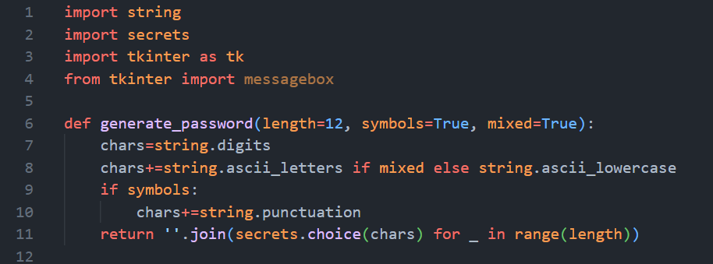
Generate Password Function

Slide 4
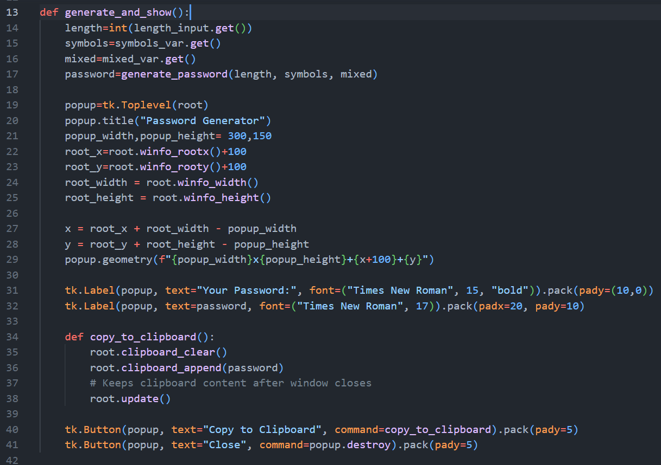
Parameterize Password with GUI input

Slide 5
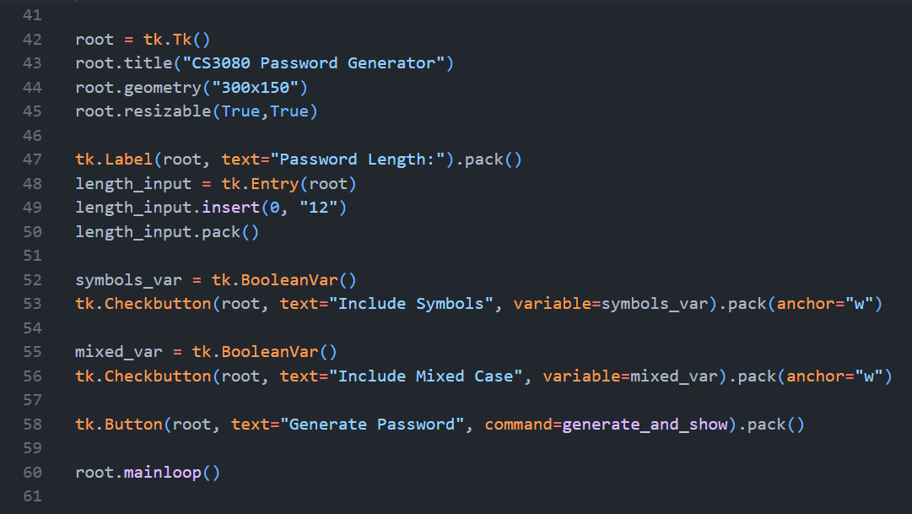
Launch Interface

Slide 6
Thank you
Rachel Promersberger
rpromers@uccs.edu

