Slide 1
FIELD TRAINING SERIES
Electrical Theory &
Energized-Line Safety
for Powerline Workers
A complete field-training program: theory → working hot → cover-up & tools → job planning & regulations
Lineworker Apprenticeship & Journeyman Refresher • Instructor Edition
Notes:
Welcome the crew and set the tone: this course builds from the science up to daily field discipline. Stress that every rule has a reason, and the only acceptable outcome of any job is everyone going home.

Slide 2
COURSE MAP
What This Course Covers
Six modules, building from first principles to the daily disciplines that keep crews alive.
■ Module 1 — Electrical theory: the science behind everything you touch
– Atomic charge, voltage, current, resistance, power, AC vs DC, the grid
■ Module 2 — Electricity and the human body
– Shock physiology, arc flash/blast, step & touch potential
■ Module 3 — Working around energized lines & equipment
– Minimum approach distance, the second point of contact, isolation, cover-up, grounding
■ Module 4 — Tools of the trade
– Rubber goods, live-line tools, grounds, testers, FR/arc-rated PPE — use, care, testing
■ Module 5 — Putting it to work in the field
– Hazard assessment, the tailboard/job brief, roles, communication, rescue
■ Module 6 — Regulations & standards that govern the work
– OSHA 1910.269 / 1926 Subpart V, NESC, ASTM/IEEE, recordkeeping
Course Overview
Powerline Electrical Theory & Safety | 02
Notes:
Walk the six modules so the crew sees the arc from theory to the tailboard. Emphasize that theory is not academic — it is why every later rule works.

Slide 3
OBJECTIVES
Learning Objectives & How to Use This Training
By the end you will be able to
How the material is structured
■ Explain voltage, current, resistance and power in plain terms
■ Describe how the grid moves power from plant to service
■ Identify what makes a circuit through the human body
■ Recognize and eliminate the second point of contact
■ Apply correct cover-up and minimum approach distances
■ Build an equipotential grounding zone
■ Lead a complete tailboard and hazard assessment
■ Cite the regulation behind each safe-work rule
■ Theory first — you cannot work safely on what you don't understand
■ Each hazard is paired with its control
– Recognize → isolate → protect → verify
■ DANGER / WARNING / BEST-PRACTICE call-outs flag the must-knows
■ Tables summarize numbers you will use on the job
■ Discuss every slide as a crew — this is a conversation, not a lecture
Course Overview
Powerline Electrical Theory & Safety | 03
Notes:
Set expectations: this is a conversation, not a lecture. Point out the DANGER / WARNING / BEST-PRACTICE call-outs and that the tables hold numbers they will use on the job.

Slide 4
THE STAKES
Why This Training Exists
Line work is among the most hazardous trades in the country — and almost every incident traces back to a missed fundamental.
#1
Electrocution is a leading cause of lineworker fatalities
50 V
Can be enough to be lethal under the right conditions
0.1 s
A fault can evolve to an arc-flash in a fraction of a second
100%
Of electrical contacts are preventable with the right controls
These numbers are not here to scare you — they are here to remind you that the disciplines in this course are written in other workers' experience. Every rule has a reason. The goal of this training is simple: everyone goes home, every day.
Course Overview
Powerline Electrical Theory & Safety | 04
Notes:
Ground the stakes without fear-mongering — these numbers come from real incidents. Reinforce that essentially every electrical contact is preventable with the controls we are about to cover.

Slide 5
MODULE
1
Electrical Theory Fundamentals
— What electricity actually is
— Voltage, current, resistance & power
— AC vs DC and three-phase systems
— Transformers and the grid
— Voltage classes you will encounter
Notes:
Transition: before we touch anything energized, we have to know what is moving in the wire and why it always wants to get back to its source through every available path.

Slide 6
1.1 FIRST PRINCIPLES
What Is Electricity?
Before any rule makes sense, you have to know what is moving in the wire — and why it wants to get to ground.
■ All matter is built from atoms; atoms contain protons (+), neutrons (0) and electrons (–)
■ Electricity is the movement of electrons — specifically the flow of electric charge
– In conductors, outer (“free”) electrons drift from atom to atom
– That organized drift, driven by a difference in charge, is electric current
■ Two ways to talk about flow direction:
– Conventional current: + to – (the convention used on prints and in formulas)
– Electron flow: – to + (the physical reality)
■ Electricity always seeks to return to its source and will take every available path to ground
– It does not “prefer” the easiest path — it uses ALL paths in proportion to their conductance
– Your body can be one of those paths
Module 1 — Electrical Theory
Powerline Electrical Theory & Safety | 06
Notes:
Keep it concrete: electricity is charge in motion, seeking its source, using every path in proportion to conductance. Drive home that the human body can be one of those paths.

Slide 7
1.2 MATERIALS
Conductors, Insulators & Semiconductors
Conductors (let electrons flow)
Insulators (resist electron flow)
■ Copper, aluminum — line and busbar metals
■ Steel — structures, ground rods, messenger
■ Water with impurities, wet wood, the human body
– Low resistance — current passes easily
■ Why we de-energize, isolate, and ground them
■ Rubber, dry wood, glass, porcelain, fiberglass
■ Air — but only at sufficient distance (it can break down!)
■ EPDM rubber — the basis of our gloves & cover-up
– High resistance — used to create separation
■ Semiconductors: silicon devices — reclosers, electronics, controls
Module 1 — Electrical Theory
Powerline Electrical Theory & Safety | 07
Notes:
Have the crew name conductors and insulators on a typical pole. Stress that the body and wet wood conduct, and that air only insulates at sufficient distance — it can break down.

Slide 8
1.3 VOLTAGE
Voltage — Electrical Pressure
■ Voltage (V) is the difference in electric potential between two points — the “pressure” that pushes current
■ Measured in volts; symbol E (electromotive force) or V
– Analogy: water pressure in a pipe — more pressure, more push
■ Voltage is always measured BETWEEN two points (a potential difference)
– A bird on one wire sits at one potential — no difference, no current
– Bridge two different potentials and current flows through you
■ Higher voltage can push current across larger air gaps — it can arc to you before you touch it
KEY CONCEPT
Why this matters
– Every safe-work distance exists because voltage can drive current across air.
– “Difference of potential” is the whole game — control it and you control the hazard.
Module 1 — Electrical Theory
Powerline Electrical Theory & Safety | 08
Notes:
Voltage is always measured BETWEEN two points. Use the bird-on-a-wire idea here as a teaser for the second point of contact in Module 3.

Slide 9
1.4 CURRENT
Current — The Flow That Hurts You
■ Current (I) is the rate of charge flow, measured in amperes (amps)
– Analogy: the volume of water flowing past a point
■ It is CURRENT through the body — not voltage — that injures and kills
– Voltage determines how much current will be pushed through your resistance
■ Even small currents across the chest can stop the heart
■ Fault current on distribution/transmission can be thousands of amps
– Enough to vaporize metal and create an arc-flash explosion
DANGER ⚠
Remember
– It takes surprisingly little current to be fatal.
– Milliamps through the heart — not amps — are deadly.
– Protect against the current by removing the path and the potential difference.
Module 1 — Electrical Theory
Powerline Electrical Theory & Safety | 09
Notes:
Hammer the key point of the whole course: current — not voltage — injures and kills. Voltage only decides how much current gets pushed through your resistance.

Slide 10
1.5 OHM'S LAW
Resistance, Ohm's Law & Power
Three quantities, one relationship — the most useful equation you will ever memorize.
■ Resistance (R) opposes current flow — measured in ohms (Ω)
– Conductors = low R; insulators = high R; your skin's R drops sharply when wet
■ Ohm's Law ties the three together: V = I × R
– Current I = V / R → same voltage + lower body resistance = MORE current through you
– This is why sweat, water, and broken skin make a shock far more dangerous
■ Power is the rate of doing work — measured in watts: P = V × I
– Also P = I² × R — heat in a fault rises with the SQUARE of current
– That heat is what drives burns and arc-flash energy
■ Utilities sell energy in kilowatt-hours (kWh): power used over time
Module 1 — Electrical Theory
Powerline Electrical Theory & Safety | 10
Notes:
Work an example. Emphasize that wet or broken skin drops resistance and raises current, and that heat and arc energy rise with the SQUARE of current (P = I²R).

Slide 11
1.5 REFERENCE
The Ohm's Law / Power Wheel — Quick Reference
To find | If you know | Use the formula | Units
Voltage (E) | Current & Resistance | E = I × R | Volts (V)
Current (I) | Voltage & Resistance | I = E ÷ R | Amperes (A)
Resistance (R) | Voltage & Current | R = E ÷ I | Ohms (Ω)
Power (P) | Voltage & Current | P = E × I | Watts (W)
Power (P) | Current & Resistance | P = I² × R | Watts (W)
Power (P) | Voltage & Resistance | P = E² ÷ R | Watts (W)
Tip: cover the value you want in the V / I / R triangle and the remaining two show you the operation. Power = the rate energy is delivered — and the source of heat and arc energy.
Module 1 — Electrical Theory
Powerline Electrical Theory & Safety | 11
Notes:
Show the triangle trick. This is the one relationship worth memorizing. Tie P = I²R back to why a small rise in fault current is a big rise in arc-flash energy.

Slide 12
1.6 WAVEFORMS
AC vs DC
Direct Current (DC)
Alternating Current (AC)
■ Electrons flow one direction only
■ Batteries, solar arrays, some traction & HVDC systems
■ Steady polarity — + and – stay fixed
■ Cannot be easily transformed up/down in voltage
■ DC can cause sustained muscle 'lock-on'
■ Electrons reverse direction cyclically
■ 60 Hz in North America = 60 cycles per second
■ Polarity and magnitude change continuously (a sine wave)
■ Easily stepped up/down by transformers — why the grid uses it
■ Crosses zero 120×/sec, but is still lethal — never assume 'off'
Module 1 — Electrical Theory
Powerline Electrical Theory & Safety | 12
Notes:
Contrast the two. Note that AC crosses zero 120 times a second but is still lethal — never let anyone think of it as momentarily 'off.'

Slide 13
1.6 AC BEHAVIOR
AC Details: Frequency, Peak & RMS
■ One full cycle = one complete positive + negative swing of the sine wave
■ Frequency = cycles per second, measured in hertz (Hz); 60 Hz in the U.S./Canada
■ Peak voltage is the maximum the wave reaches; the average useful value is the RMS
– RMS (root-mean-square) is the 'DC-equivalent' value — it does the same work
– When we say 120 V or 7,200 V, we mean RMS; peak is ~1.414× higher
■ Phase describes where two AC waveforms are in their cycle relative to each other
– Critical for three-phase systems and for paralleling sources
■ Inductance and capacitance on lines cause current and voltage to shift out of step
– This is the source of INDUCED voltage on de-energized parallel circuits (Module 3)
Module 1 — Electrical Theory
Powerline Electrical Theory & Safety | 13
Notes:
Clarify that nameplate voltages are RMS, peak is about 1.4× higher, and that line reactance is the seed of the induced voltage we will cover in Module 3.

Slide 14
1.7 PHASES
Single-Phase vs Three-Phase
Single-Phase
Three-Phase
■ One AC voltage waveform (with neutral)
■ Typical residential service: 120/240 V
■ Simple loads — lighting, receptacles, small motors
■ Power delivery pulses (crosses zero each half-cycle)
■ Three waveforms 120° apart — A, B, C phases
■ Backbone of transmission, distribution & industrial power
■ Smooth, continuous power — efficient for large motors
■ More power in less conductor than single-phase
■ Phase-to-phase voltage = √3 (1.732) × phase-to-neutral
Module 1 — Electrical Theory
Powerline Electrical Theory & Safety | 14
Notes:
Most services are single-phase; the system backbone is three-phase. Mention the √3 relationship between phase-to-phase and phase-to-neutral voltage.

Slide 15
1.8 TRANSFORMERS
Transformers — Stepping Voltage Up & Down
The single reason the grid runs on AC — voltage can be transformed efficiently.
■ A transformer changes AC voltage using two coils linked by a magnetic core
– No direct electrical connection — energy crosses by induction
■ Turns ratio sets the voltage ratio: more secondary turns → higher voltage
– Step UP: raise voltage for transmission (less current = less line loss)
– Step DOWN: lower voltage for distribution and the customer
■ Power in ≈ power out, so when voltage goes UP, current goes DOWN (and vice-versa)
– P = V × I — this is WHY we transmit at high voltage: to cut I²R losses
■ Distribution transformers on the pole/pad drop primary (e.g., 7,200 V) to 120/240 V
■ WARNING: a de-energized secondary can be BACK-FED from the customer side — generators!
Module 1 — Electrical Theory
Powerline Electrical Theory & Safety | 15
Notes:
Turns ratio sets the voltage ratio; power in ≈ power out. Flag back-feed hard: a customer's generator can re-energize a 'dead' secondary from the load side.

Slide 16
1.9 THE SYSTEM
The Grid: From Generation to Your Service
Know where you are on this chain — it tells you the voltage, the fault energy, and the controls you need.
1
1. Generation
Power plants (gas, hydro, nuclear, wind, solar) produce AC, typically at medium voltage.
2
2. Step-Up Substation
Transformers raise voltage to transmission levels (69 kV up to 765 kV) to move power far with low loss.
3
3. Transmission Lines
High-voltage lines on large towers carry bulk power across regions.
4
4. Step-Down / Distribution Substation
Voltage is reduced to distribution levels (typically 4 kV–35 kV).
5
5. Distribution Feeders
Primary lines on poles carry power through neighborhoods; reclosers & fuses protect them.
6
6. Service Transformer & Customer
Final step-down to 120/240 V (residential) or higher for commercial/industrial.
Module 1 — Electrical Theory
Powerline Electrical Theory & Safety | 16
Notes:
Have the crew place themselves on this chain — where you are tells you the voltage, the fault energy, and the controls you need.

Slide 17
1.10 VOLTAGE CLASSES
Voltage Classes You Will Work Around
Class | Typical Range | Where you see it | Note
Low voltage | < 600 V | Services, secondary, street light | Still deadly — most contacts happen here
Medium voltage (Distribution) | 600 V – 35 kV | Primary feeders, urban/rural lines | Common lineworker environment
High voltage (Sub-transmission/Transmission) | 35 kV – 230 kV | Towers, large substations | Larger MAD; arc & induction hazards grow
Extra-high voltage (EHV) | 230 kV – 765 kV | Bulk transmission | Specialized live-line methods, large clearances
Ultra-high voltage (UHV) | > 765 kV | Long-distance bulk corridors | Rare; highly specialized work
Exact class boundaries vary by utility and standard (NESC/IEEE). What never changes: higher voltage = larger required clearances and greater fault energy.
Module 1 — Electrical Theory
Powerline Electrical Theory & Safety | 17
Notes:
Most contacts happen at low voltage — it is not 'safe.' Higher classes mean bigger clearances and far greater fault energy.

Slide 18
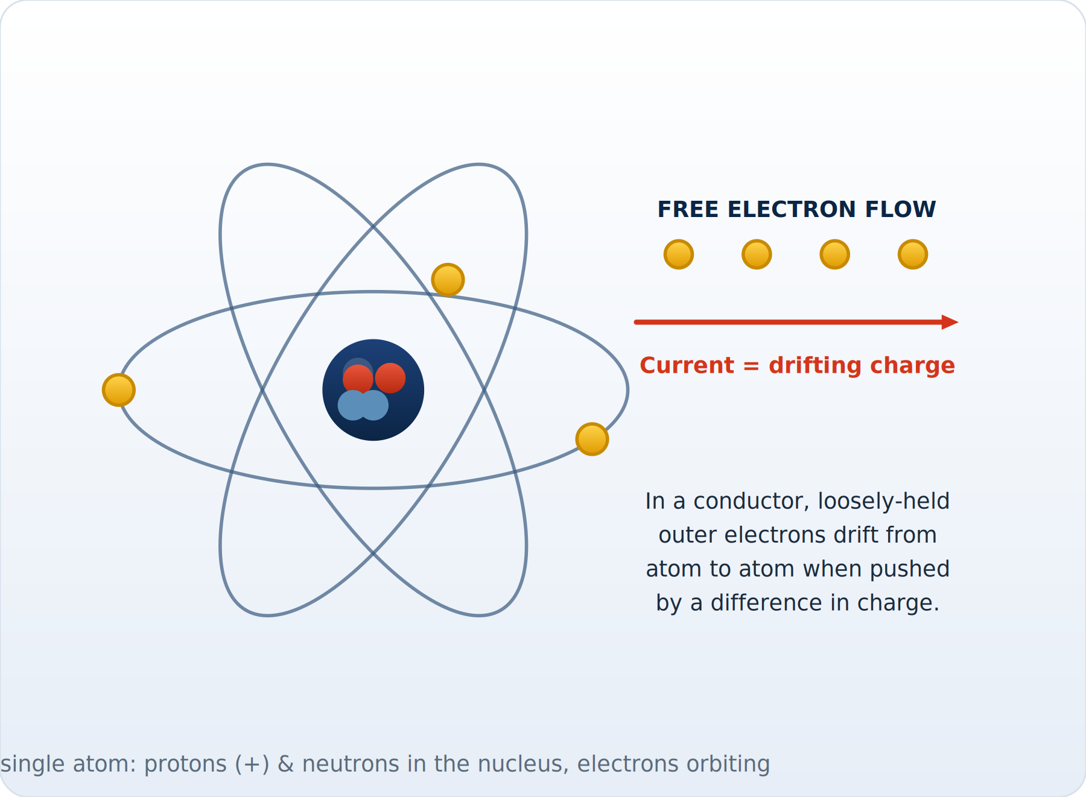
ILLUSTRATED
How Electricity Flows
Electrons drifting from atom to atom — driven by a difference in charge — are electric current.
Module 1 — Electrical Theory
Powerline Electrical Theory & Safety | 18
Notes:
Electrons drifting from atom to atom — driven by a difference in charge — are electric current.

Slide 19
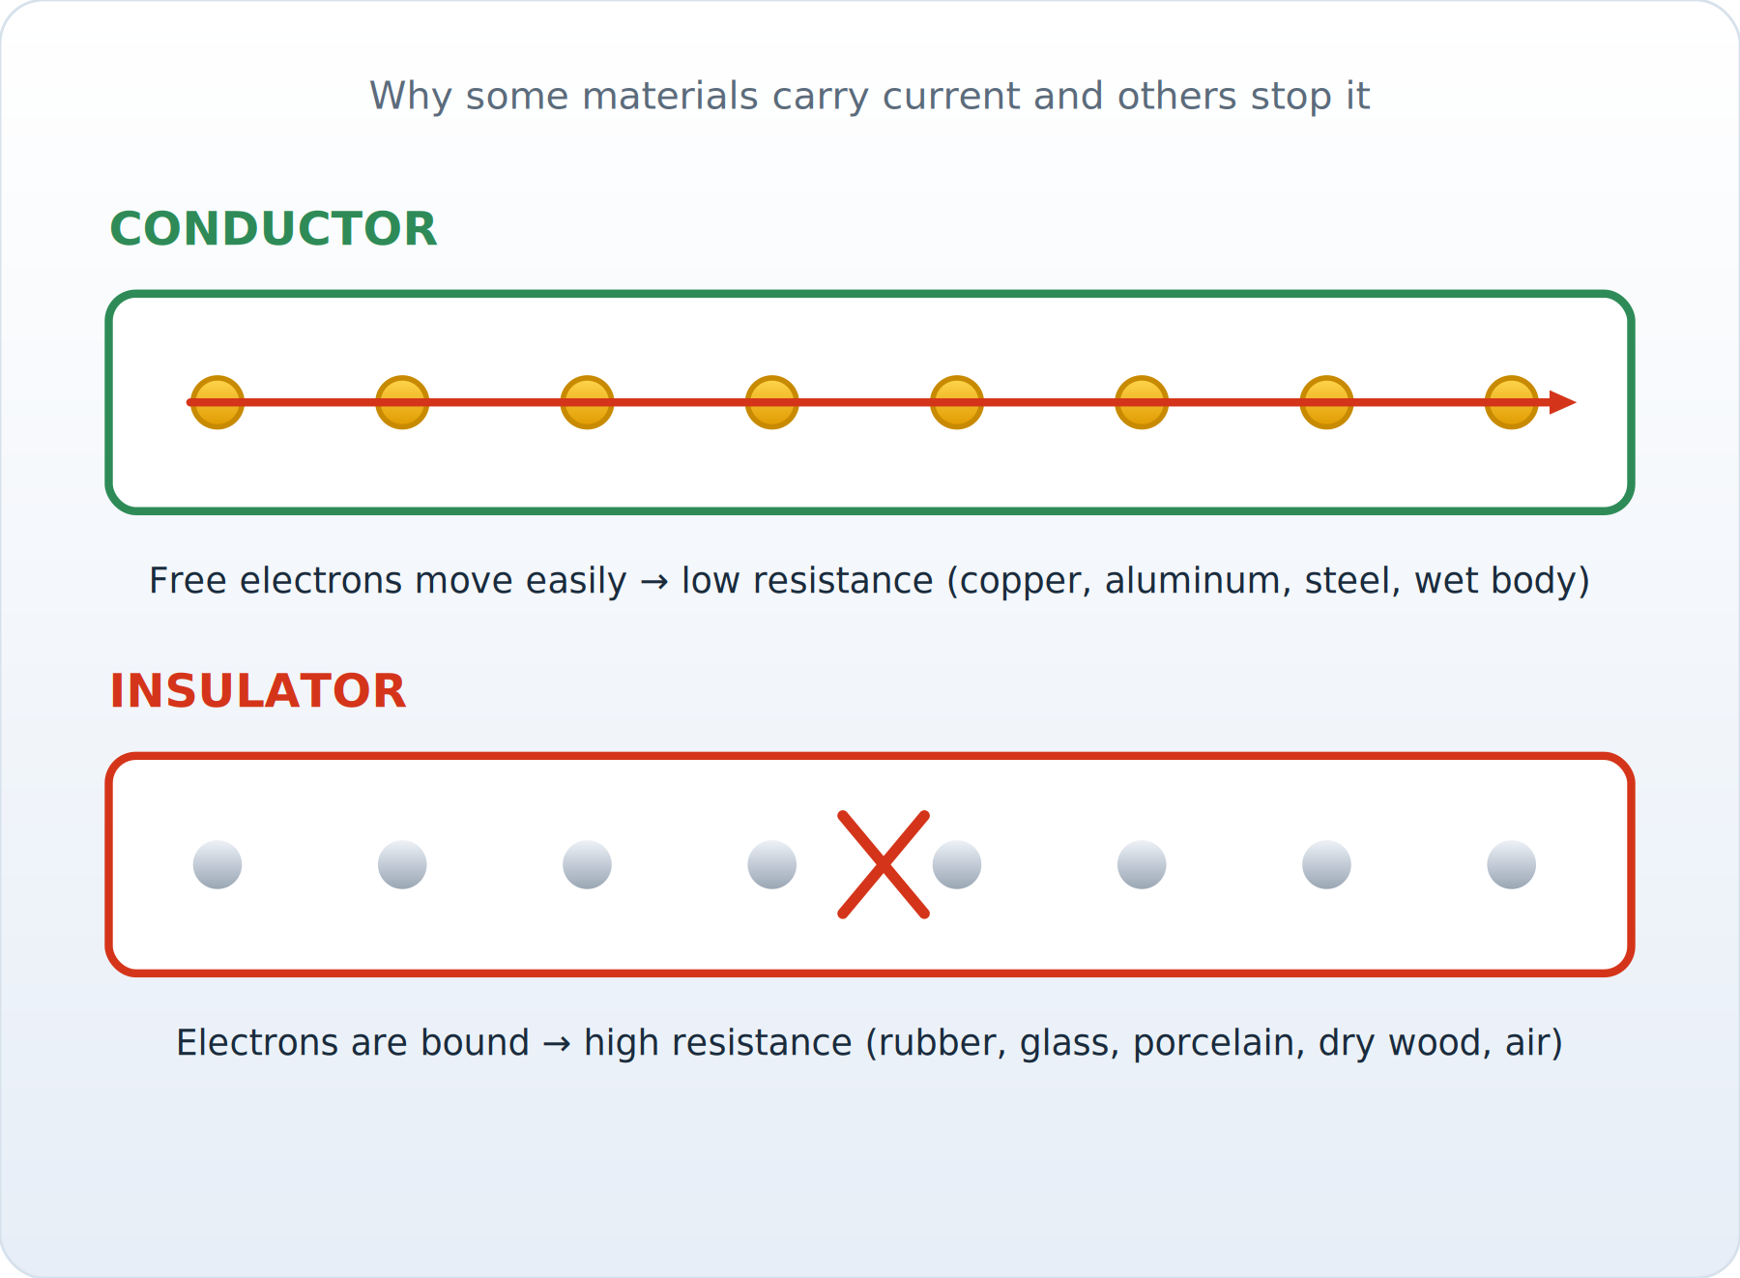
ILLUSTRATED
Conductors vs Insulators
Conductors let electrons pass (low resistance); insulators bind them (high resistance).
Module 1 — Electrical Theory
Powerline Electrical Theory & Safety | 19
Notes:
Conductors let electrons pass (low resistance); insulators bind them (high resistance).

Slide 20
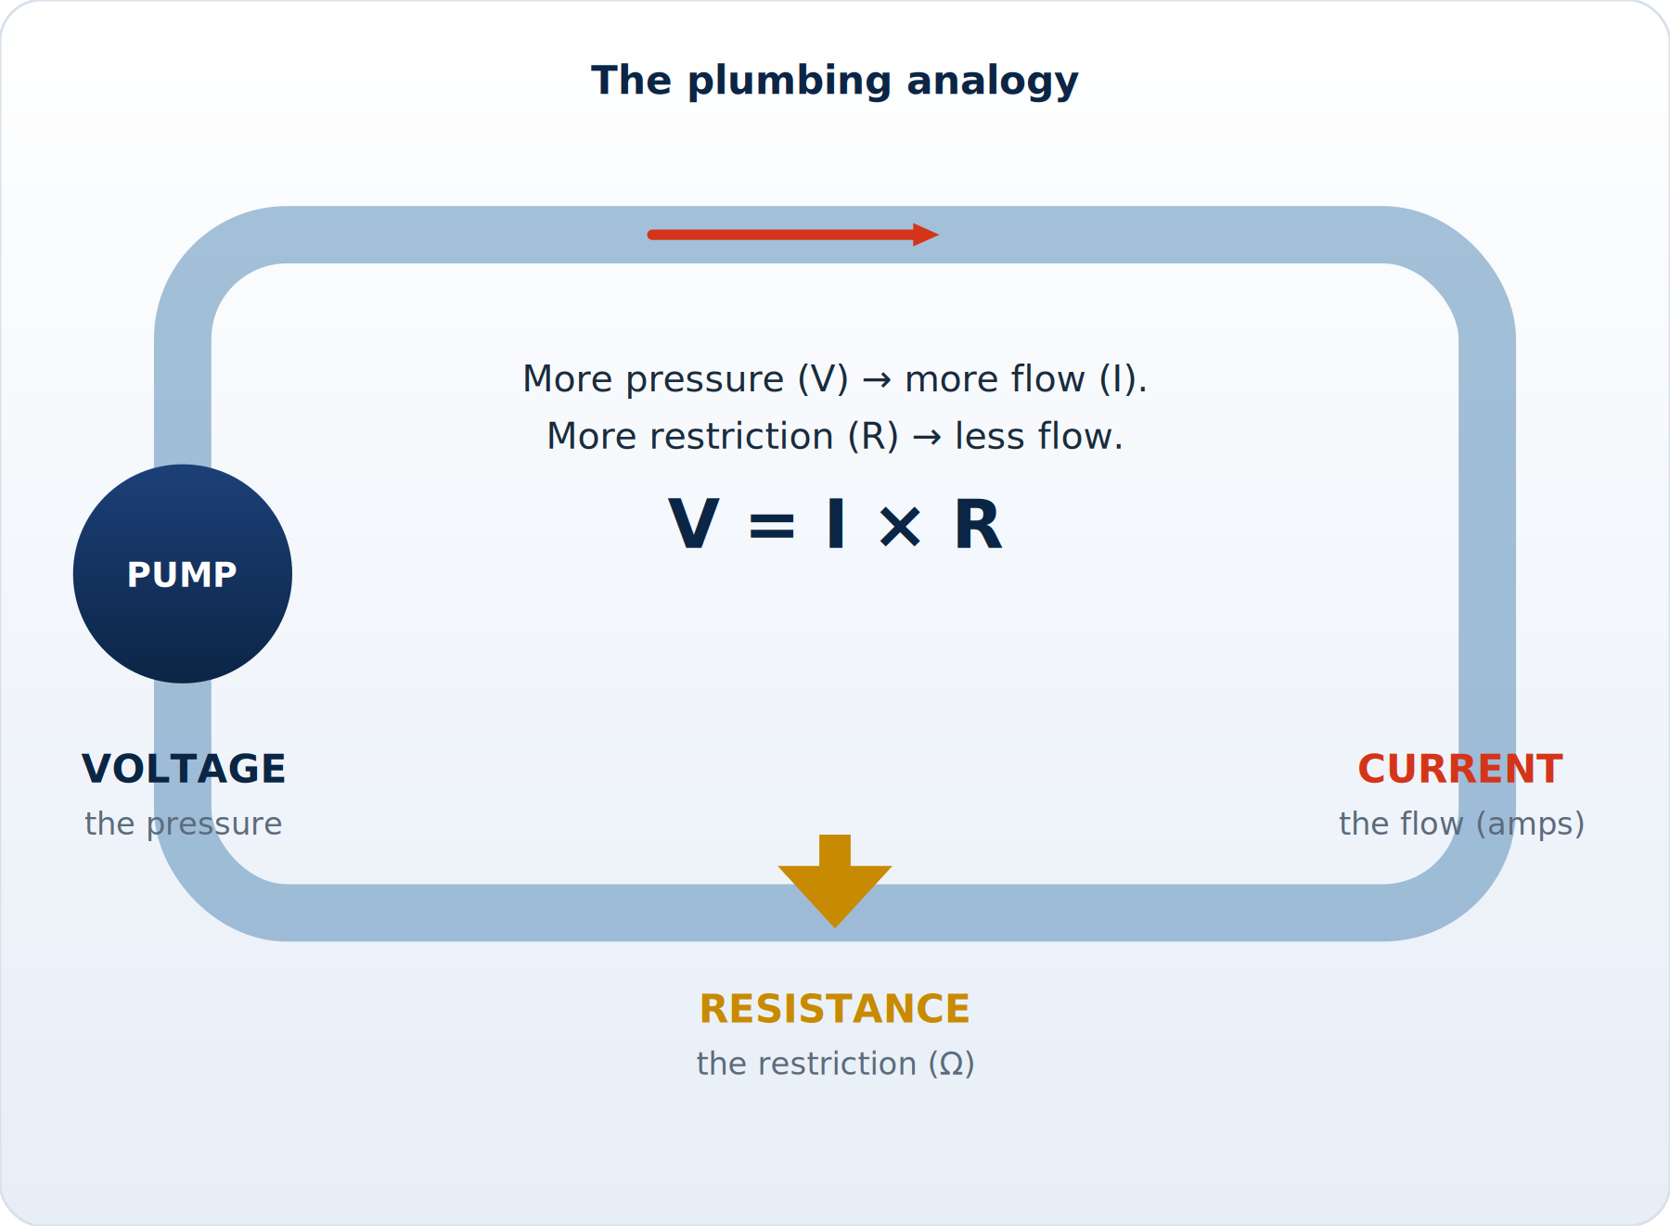
ILLUSTRATED
The Water Analogy
Voltage is pressure, current is flow, resistance is the restriction: I = V ÷ R.
Module 1 — Electrical Theory
Powerline Electrical Theory & Safety | 20
Notes:
Voltage is pressure, current is flow, resistance is the restriction: I = V ÷ R.

Slide 21
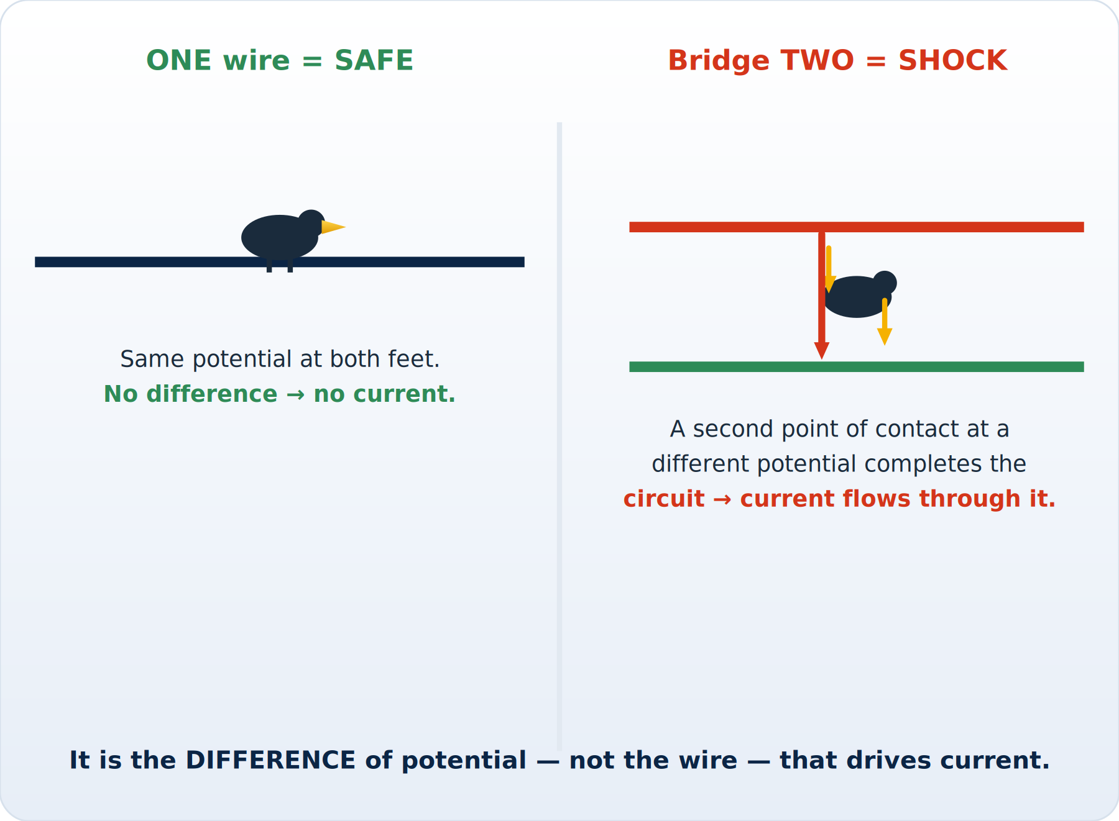
ILLUSTRATED
Why Voltage Needs Two Points
One potential is safe; bridging two different potentials drives current through you.
Module 1 — Electrical Theory
Powerline Electrical Theory & Safety | 21
Notes:
One potential is safe; bridging two different potentials drives current through you.

Slide 22
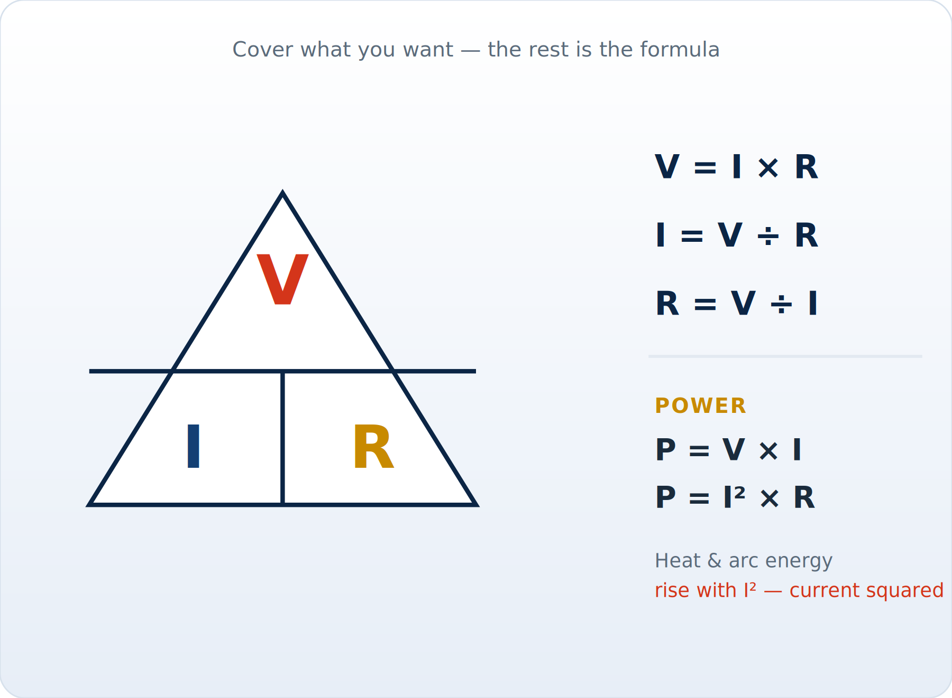
ILLUSTRATED
The Ohm's Law & Power Wheel
Cover the unknown in the V / I / R triangle. Power P = V×I = I²R — heat rises with current squared.
Module 1 — Electrical Theory
Powerline Electrical Theory & Safety | 22
Notes:
Cover the unknown in the V / I / R triangle. Power P = V×I = I²R — heat rises with current squared.

Slide 23
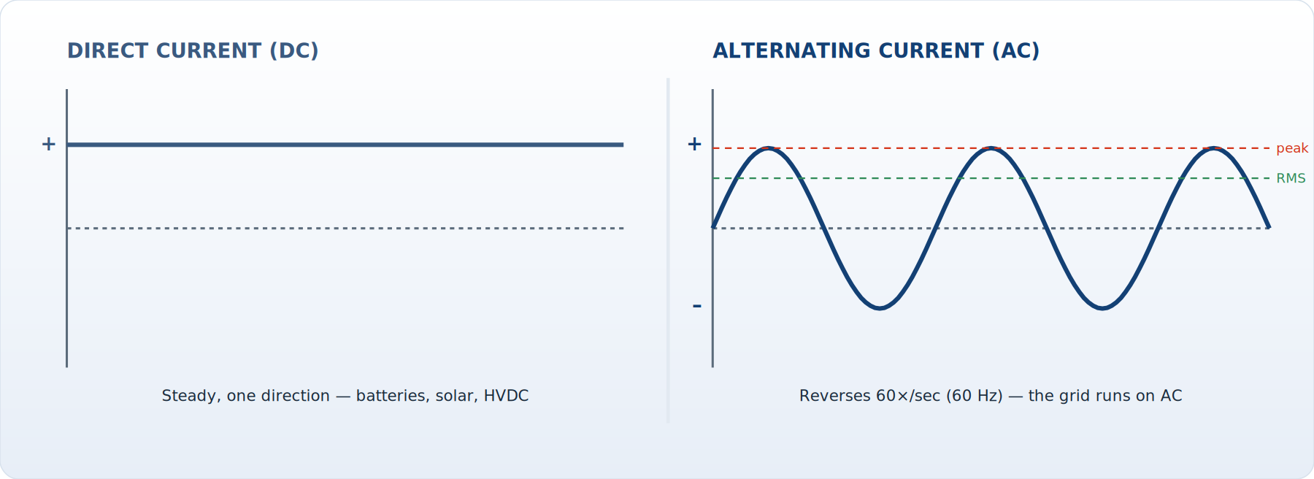
ILLUSTRATED
AC vs DC Waveforms
DC flows one way at a steady level; AC reverses 60×/sec, which lets transformers change its voltage.
Module 1 — Electrical Theory
Powerline Electrical Theory & Safety | 23
Notes:
DC flows one way at a steady level; AC reverses 60×/sec, which lets transformers change its voltage.

Slide 24
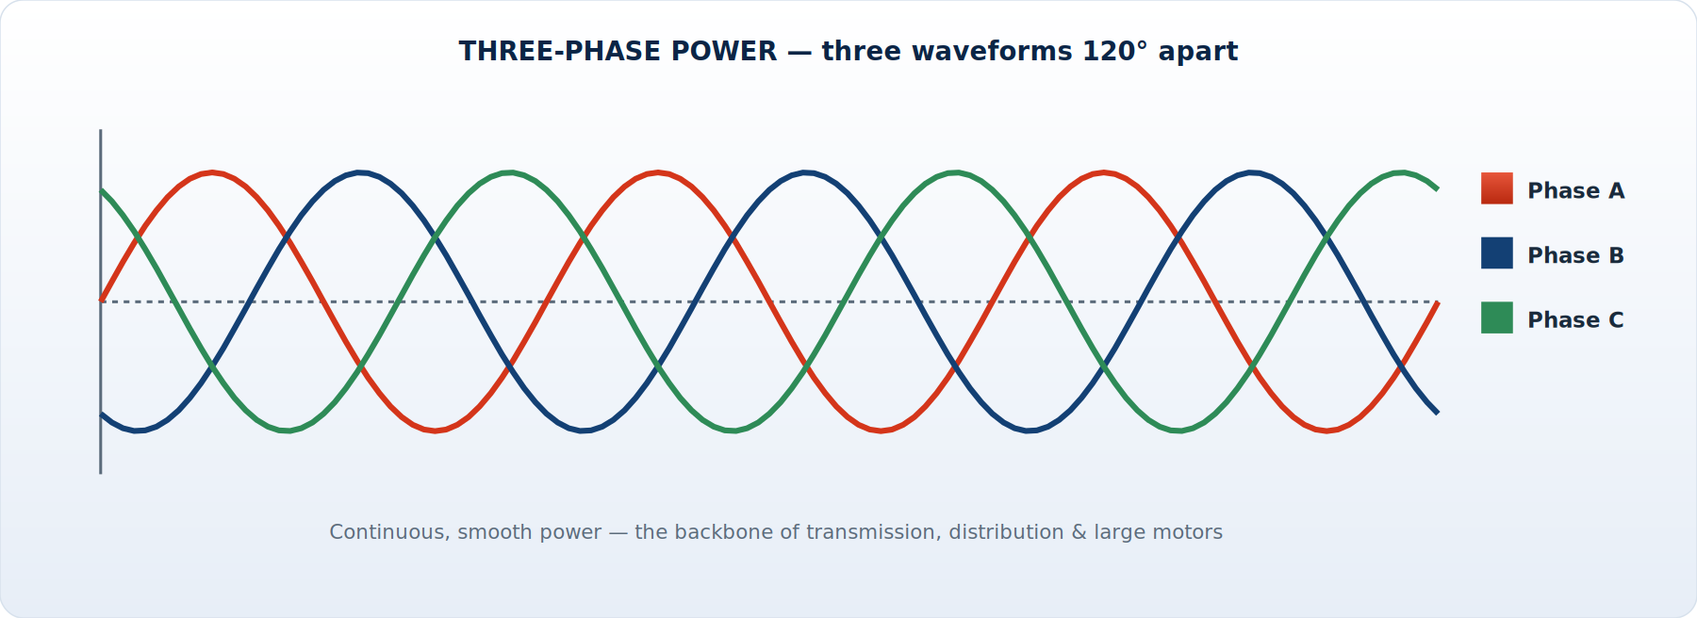
ILLUSTRATED
Three-Phase Power
Three waveforms 120° apart deliver smooth, continuous power — the backbone of the grid.
Module 1 — Electrical Theory
Powerline Electrical Theory & Safety | 24
Notes:
Three waveforms 120° apart deliver smooth, continuous power — the backbone of the grid.

Slide 25
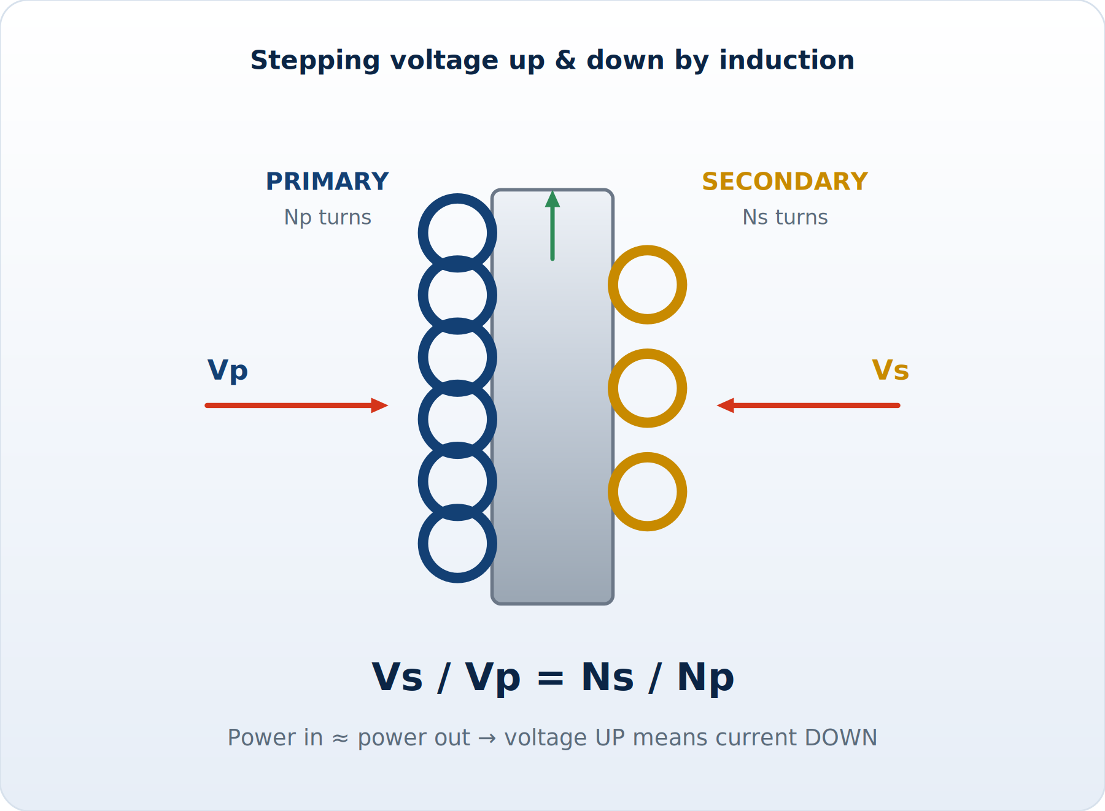
ILLUSTRATED
How a Transformer Works
Two coils on a magnetic core: the turns ratio sets the voltage ratio; power in ≈ power out.
Module 1 — Electrical Theory
Powerline Electrical Theory & Safety | 25
Notes:
Two coils on a magnetic core: the turns ratio sets the voltage ratio; power in ≈ power out.

Slide 26
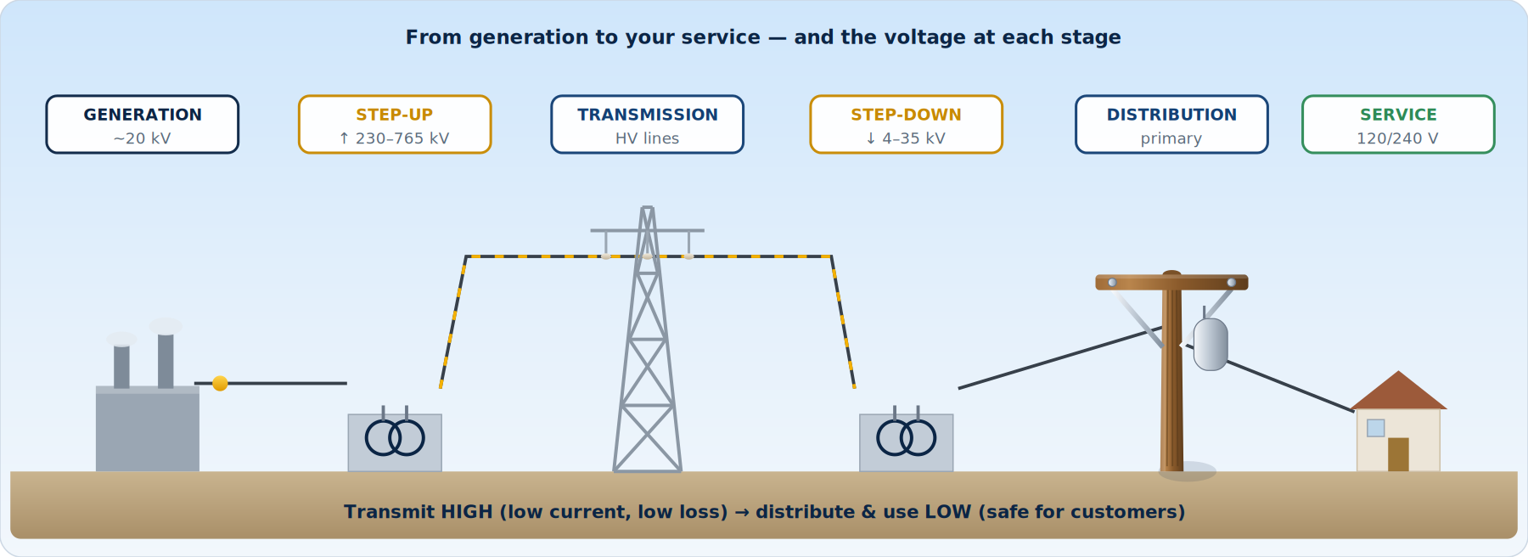
ILLUSTRATED
The Grid, End to End
Voltage is stepped up for transmission, then down in stages until it is safe for the customer.
Module 1 — Electrical Theory
Powerline Electrical Theory & Safety | 26
Notes:
Voltage is stepped up for transmission, then down in stages until it is safe for the customer.

Slide 27
MODULE 1 RECAP
Module 1 — Key Takeaways
■ Electricity is the flow of charge that always wants to return to its source via every path
■ Voltage pushes; current flows; resistance opposes — V = I × R ties them together
■ It is CURRENT through the body that kills, and low body resistance lets more through
■ AC dominates the grid because transformers let us change voltage efficiently
■ Transmit high (low current, low loss); distribute and use low (safe for customers)
■ Know your voltage class — it sets your clearances, fault energy, and controls
Module 1 — Electrical Theory
Powerline Electrical Theory & Safety | 27
Notes:
Recap and check for questions before we move from the energy itself to what it does to the body.

Slide 28
MODULE
2
Electricity & the Human Body
— How current injures and kills
— Shock thresholds & the heart
— Electrical burns
— Arc flash and arc blast
— Step, touch & ground-gradient potential
Notes:
Transition: now we make it personal — exactly what current does to a person, and why the controls later are non-negotiable.

Slide 29
2.1 SHOCK PHYSIOLOGY
How Current Affects the Body
■ The body is a conductor — nerves and muscles run on tiny electrical signals
■ External current overrides those signals: muscles clamp, nerves misfire, the heart can fibrillate
■ Severity depends on:
– Amount of current (the key factor) — set by voltage ÷ your resistance
– Path through the body — hand-to-hand or hand-to-foot crosses the heart
– Duration of contact — longer exposure, more damage
– Frequency — 60 Hz AC is especially effective at causing fibrillation
■ Skin resistance can be ~100,000 Ω dry, but drops to ~1,000 Ω or less when wet/broken
– Same voltage then drives far more current — wet conditions are a force multiplier
Module 2 — Electricity & the Body
Powerline Electrical Theory & Safety | 29
Notes:
List the four factors: amount, path, duration, and frequency. Stress that wet skin can drop resistance from ~100,000 Ω to ~1,000 Ω — a force multiplier.

Slide 30
2.2 THRESHOLDS
Approximate Effects of 60 Hz Current Across the Body
Current (through body) | Typical effect
~1 mA | Threshold of perception — a faint tingle
~5 mA | Slight shock; not painful but startling — can cause falls
6–16 mA | Painful shock; loss of muscular control begins (“let-go” threshold)
17–20 mA | Muscles clamp — CANNOT let go of the conductor; breathing labored
20–50 mA | Severe muscle contractions, breathing difficulty
50–100 mA | Possible ventricular fibrillation — the heart quivers, stops pumping
100 mA – 2 A | Likely fatal ventricular fibrillation; nerve damage
> 2 A | Cardiac arrest, severe internal burns, organ damage
Values are approximate and vary by body size, path, and conditions. The lesson: the dangerous range starts in the MILLIAMP region — far below what trips most circuits.
Module 2 — Electricity & the Body
Powerline Electrical Theory & Safety | 30
Notes:
Point out the dangerous range starts in milliamps — far below what trips a breaker. The values are approximate; the lesson is the scale.

Slide 31
2.3 THE HEART
The Heart, Let-Go & Fibrillation
■ “Let-go threshold”: above ~10–16 mA your flexor muscles clamp and you cannot release the conductor
– The longer you hold on, the more the contact heats and the more current flows
■ Ventricular fibrillation: current disrupts the heart's rhythm so it quivers instead of pumping
– Blood stops circulating — brain damage in minutes, death without intervention
– A defibrillator/AED and CPR may restart a coordinated rhythm — know where yours is
■ Even a 'minor' shock can throw you from a pole or bucket — the fall often does the damage
DANGER ⚠
Why we never rely on 'holding on'
– Above the let-go threshold your body works against you.
– The only safe contact with an energized conductor is NO direct contact — insulate and isolate.
Module 2 — Electricity & the Body
Powerline Electrical Theory & Safety | 31
Notes:
Explain why we never rely on letting go, and that even a 'minor' shock can cause a fatal fall from a pole or bucket. Make sure everyone knows where the AED is.

Slide 32
2.4 BURNS
Electrical Burns
How they happen
Why they are deceptive
■ Contact / true electrical burns: current flowing through tissue generates heat (I²R)
■ Arc burns: radiated heat from an arc — can exceed 35,000°F at the arc
■ Thermal-contact burns: ignited clothing or hot surfaces
■ Flash burns to eyes (welder's flash) from intense UV
■ Entry/exit wounds may look small but mask massive internal damage
■ Current cooks tissue along its whole path — nerves, muscle, organs
■ Delayed effects: kidney damage from tissue breakdown, cardiac issues
■ ALWAYS seek medical evaluation after any electrical contact — even if you feel fine
Module 2 — Electricity & the Body
Powerline Electrical Theory & Safety | 32
Notes:
Entry and exit wounds can hide massive internal damage. Anyone who takes a contact gets a medical evaluation — even if they feel fine.

Slide 33
2.5 ARC FLASH
Arc Flash & Arc Blast
■ An arc flash is an explosive release of energy when current jumps through ionized air
– Triggered by faults, dropped tools, animals, equipment failure, or getting too close
■ Arc FLASH = light & heat: temperatures up to ~35,000°F (hotter than the sun's surface)
■ Arc BLAST = pressure wave: vaporized metal expands violently
– Copper expands ~67,000 times when it vaporizes — like a small explosion
– Concussive force, shrapnel, molten metal spray, sound > 140 dB
■ Incident energy is measured in cal/cm² — it sets the arc rating of PPE you must wear
DANGER ⚠
Controlled by
– Distance (clearances), de-energizing, and arc-rated FR clothing/face protection.
– An arc flash can occur WITHOUT you touching anything — proximity alone can trigger it.
Module 2 — Electricity & the Body
Powerline Electrical Theory & Safety | 33
Notes:
Two hazards in one event: heat (flash) and pressure (blast). Stress it can happen WITHOUT contact — proximity alone can trigger it — so distance and arc-rated PPE matter.

Slide 34
2.6 GROUND GRADIENTS
Step Potential & Touch Potential
■ When current flows into the earth (e.g., a downed line, a fault to a ground rod), it spreads out
■ Voltage drops with distance from the contact point — forming a 'voltage gradient' across the ground
■ STEP POTENTIAL: the voltage difference between your two feet
– One foot sits at a higher potential than the other — current flows up one leg, down the other
– The wider your stride, the greater the difference — and the greater the shock
■ TOUCH POTENTIAL: difference between your hand (on an object) and your feet
– Touching a faulted structure while standing on ground at a different potential
DANGER ⚠
If you must leave an energized area
– Keep feet together and SHUFFLE or bunny-hop — never take a normal stride.
– Assume the ground around any downed line is energized out to a wide radius.
– Equipotential bonding & grounding (Module 3) eliminate these gradients in your work zone.
Module 2 — Electricity & the Body
Powerline Electrical Theory & Safety | 34
Notes:
Walk through the ground gradient and demonstrate the shuffle. Tie it forward to bonding and grounding, which eliminate the gradient inside the work zone.

Slide 35
2.7 DOWNED LINES
Downed Conductors & The Ground Around You
The most dangerous ground is the ground that looks perfectly normal.
■ A downed line may look dead — it is NOT until tested and grounded
– It may be re-energized automatically by reclosers, or back-fed by a customer's generator
■ Energized ground can extend many feet from the contact point — you cannot see it
■ Vehicles in contact with lines: occupants should STAY INSIDE unless fire forces evacuation
– If they must exit: JUMP clear without touching vehicle and ground at once, then shuffle away
■ Keep the public back — establish a wide barrier and treat everything as energized
■ Never approach within the established radius until the line is confirmed de-energized & grounded
Module 2 — Electricity & the Body
Powerline Electrical Theory & Safety | 35
Notes:
First-on-scene discipline: treat it as live, keep a wide radius, and occupants stay in the vehicle unless fire forces them out. Reclosers and back-feed can re-energize it.

Slide 36
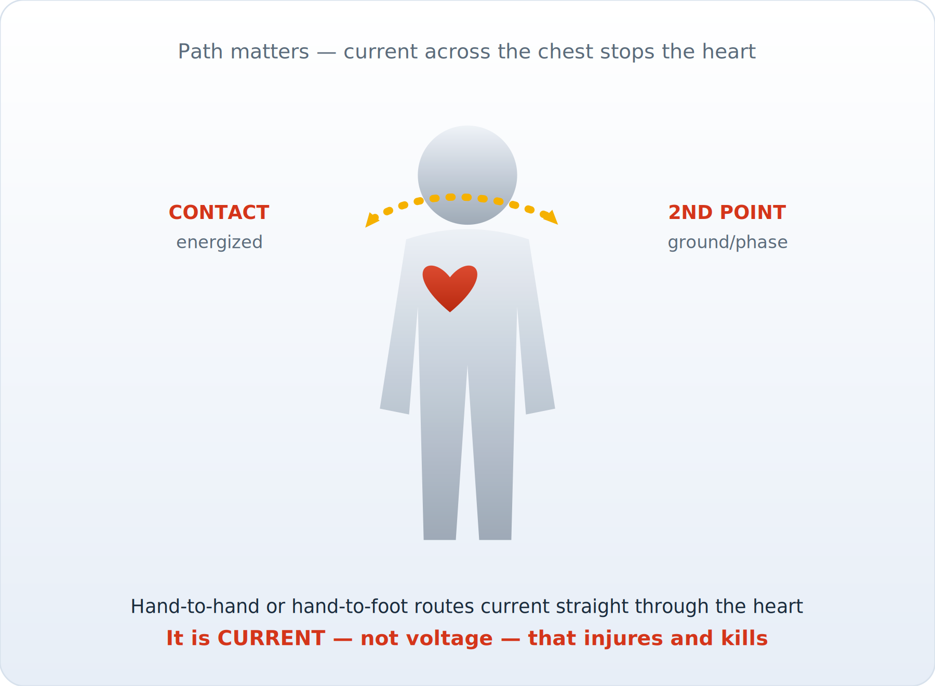
ILLUSTRATED
Current Path Through the Body
Current across the chest — hand-to-hand or hand-to-foot — can stop the heart. Control both contact points.
Module 2 — Electricity & the Body
Powerline Electrical Theory & Safety | 36
Notes:
Current across the chest — hand-to-hand or hand-to-foot — can stop the heart. Control both contact points.

Slide 37
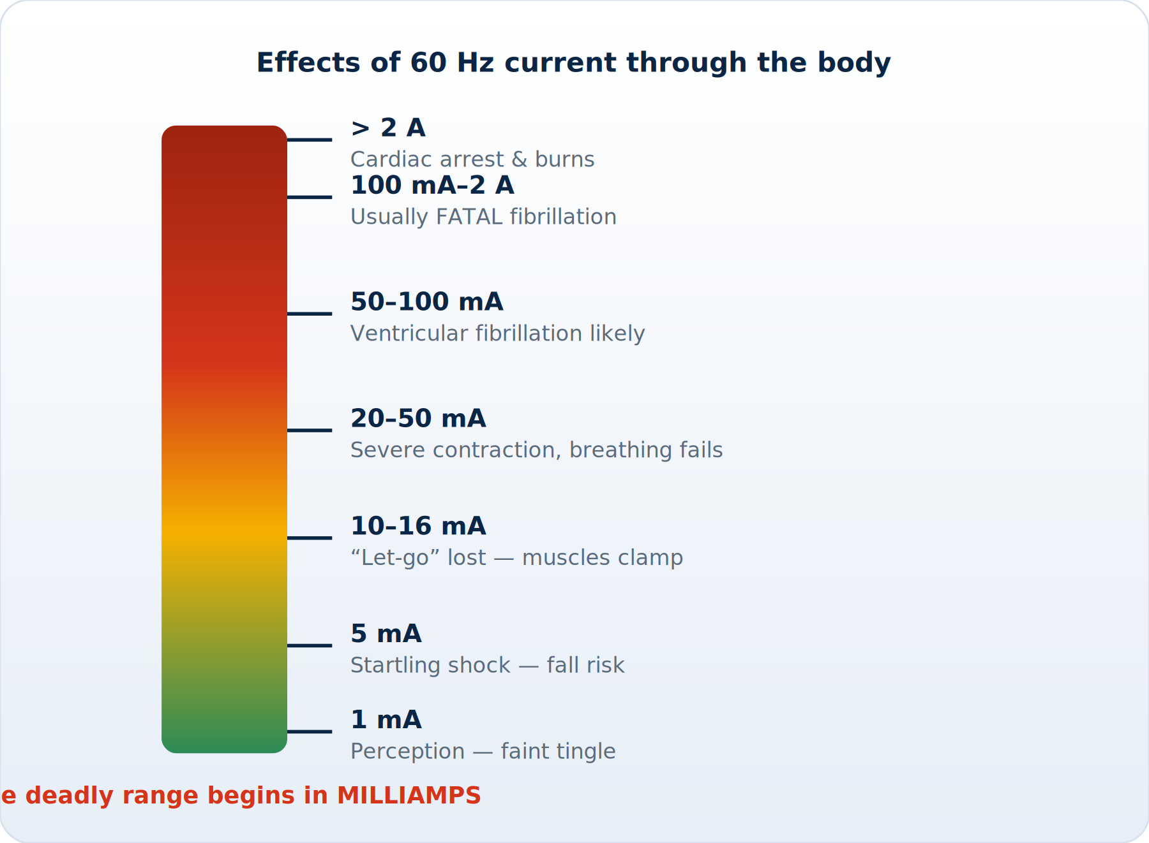
ILLUSTRATED
Shock Threshold Ladder
The dangerous range begins in milliamps — far below what trips a typical breaker.
Module 2 — Electricity & the Body
Powerline Electrical Theory & Safety | 37
Notes:
The dangerous range begins in milliamps — far below what trips a typical breaker.

Slide 38
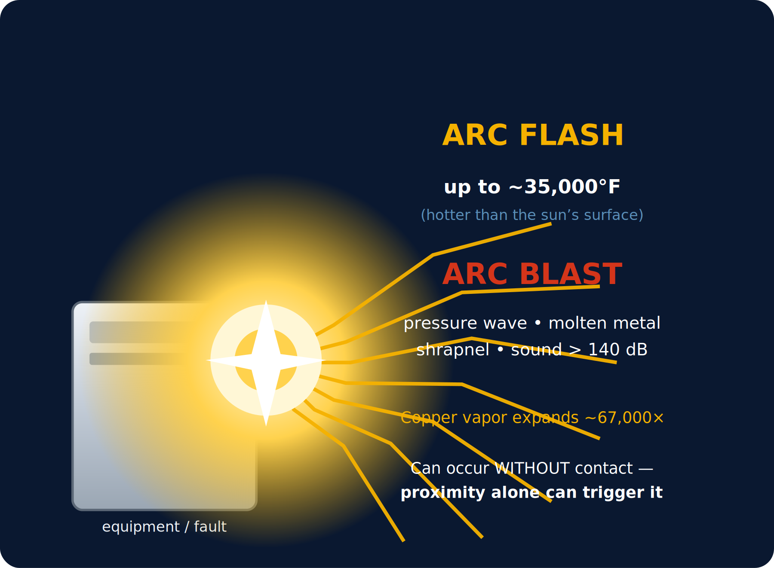
ILLUSTRATED
Arc Flash & Arc Blast
An arc can reach ~35,000°F with an explosive blast — and can be triggered by proximity alone.
Module 2 — Electricity & the Body
Powerline Electrical Theory & Safety | 38
Notes:
An arc can reach ~35,000°F with an explosive blast — and can be triggered by proximity alone.

Slide 39
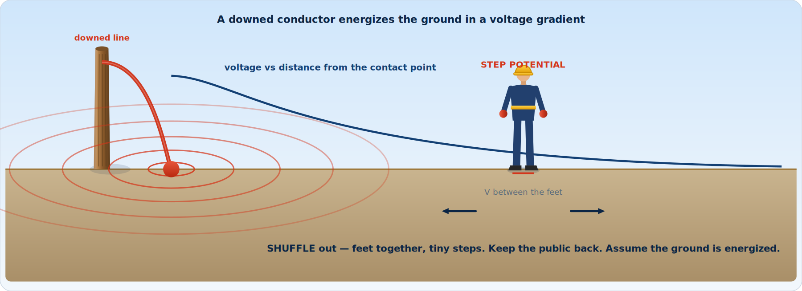
ILLUSTRATED
Step & Touch Potential
Current spreading from a downed line creates a ground gradient. Shuffle out with feet together.
Module 2 — Electricity & the Body
Powerline Electrical Theory & Safety | 39
Notes:
Current spreading from a downed line creates a ground gradient. Shuffle out with feet together.

Slide 40
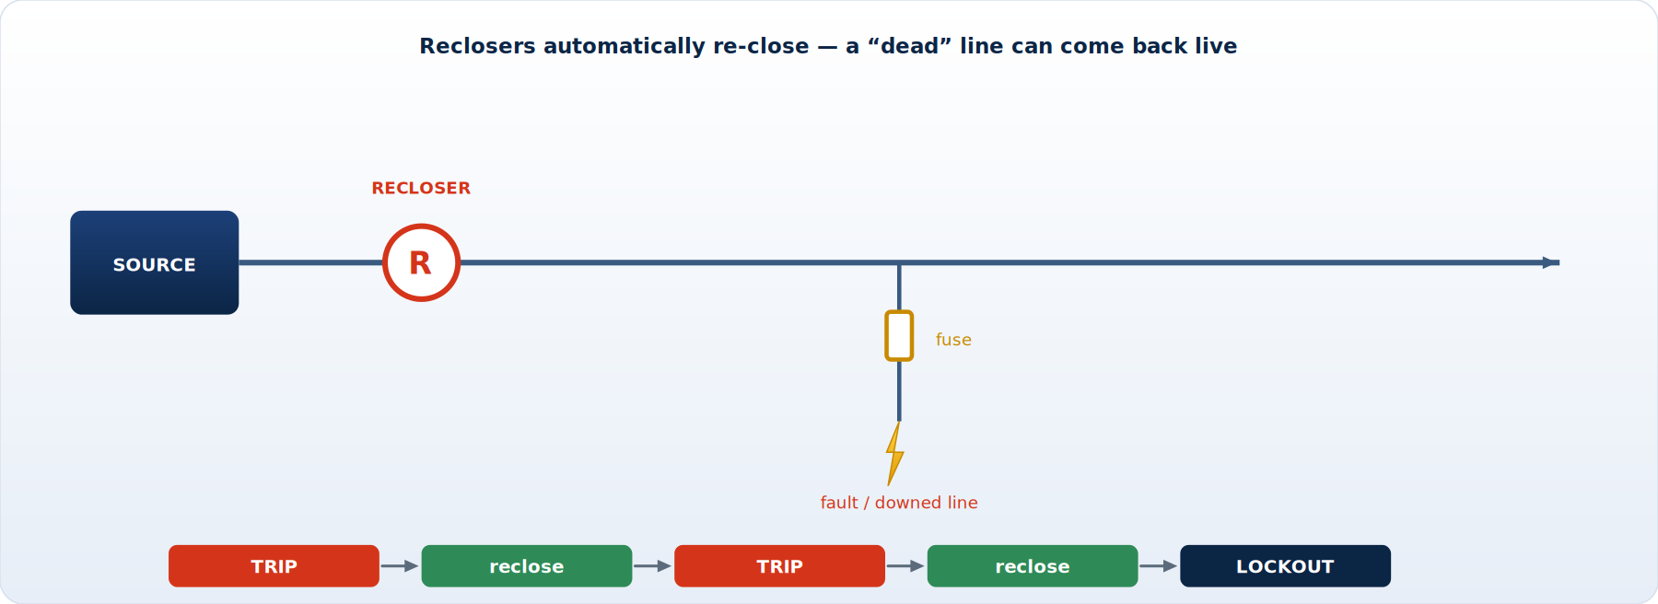
ILLUSTRATED
Reclosers — Why a Dead Line Bites Back
Reclosers trip then auto-reclose — a downed line can re-energize without warning.
Module 2 — Electricity & the Body
Powerline Electrical Theory & Safety | 40
Notes:
Reclosers trip then auto-reclose — a downed line can re-energize without warning.

Slide 41
MODULE 2 RECAP
Module 2 — Key Takeaways
■ Current — not voltage — injures; the dangerous range begins in milliamps
■ Path across the heart and 60 Hz AC make fibrillation likely; wet skin worsens everything
■ Above the let-go threshold you cannot release — so we never rely on letting go
■ Arc flash/blast can kill or maim WITHOUT contact — distance and FR PPE are your defense
■ Energized ground creates step & touch potential — shuffle out, bond and ground your zone
■ After any contact: get medical evaluation — internal damage hides
Module 2 — Electricity & the Body
Powerline Electrical Theory & Safety | 41
Notes:
Recap; confirm everyone has internalized 'current kills, and it does so in milliamps.'

Slide 42
MODULE
3
Working Around Energized Lines & Equipment
— Minimum approach distance
— The second point of contact — the core concept
— Isolate, insulate & cover-up
— Grounding & the equipotential zone
— De-energizing, LOTO & induced voltage
Notes:
Transition into the heart of the course: the disciplines that keep us out of the circuit when the line is hot.

Slide 43
3.1 CONTROLS
The Hierarchy of Controls for Electrical Work
Reach for the top of the hierarchy first; PPE alone is never the plan.
■ The safest energized work is work that isn't energized — always prefer de-energizing where feasible
■ Order of preference when planning a job:
– 1. Eliminate — de-energize, isolate, lock & tag, test dead, and ground
– 2. Substitute / engineer — reroute, switch load, use remote/robotic methods
– 3. Isolate the worker — insulate & isolate (rubber-glove or hot-stick / live-line bare-hand)
– 4. Administrative — procedures, job briefings, MAD, qualified workers only
– 5. PPE — FR clothing, rubber gloves/sleeves, face & head protection (last line, never the only line)
■ Energized work is permitted only when de-energizing is infeasible or creates greater hazard
Module 3 — Working Energized
Powerline Electrical Theory & Safety | 43
Notes:
Reinforce: reach for the top first. De-energizing beats everything below it; PPE is the last line, never the only line.

Slide 44
3.2 MAD
Minimum Approach Distance (MAD)
■ MAD = the closest a qualified worker (or conductive object) may come to an energized part
■ It protects against flashover — the air gap that voltage cannot jump
■ MAD increases with voltage and with altitude (thinner air insulates less)
■ It includes the phase-to-ground AND phase-to-phase exposure
■ Anything conductive counts: your body, tools, materials, the boom, a tape measure
– Unqualified employees must stay even farther back
■ If you cannot maintain MAD, the part must be de-energized OR covered/insulated
WARNING ⚠
Rule of thumb
– Know your utility's MAD table for the voltage you're on — BEFORE you leave the ground.
– When in doubt, cover up or back off. MAD is a minimum, not a target.
Module 3 — Working Energized
Powerline Electrical Theory & Safety | 44
Notes:
MAD protects against flashover across air. Everything conductive counts — body, tools, boom, materials. Know your utility's table before you leave the ground.

Slide 45
3.2 MAD TABLE
Illustrative Minimum Approach Distances (Phase-to-Ground)
Nominal Voltage (ph-ph) | Example MAD | Typical Setting
50 V – 300 V | Avoid contact | Service / secondary
301 V – 750 V | ~1 ft 1 in | Secondary / street light
751 V – 15 kV | ~2 ft 2 in | Distribution primary
15.1 kV – 36 kV | ~2 ft 7 in | Distribution / sub-transmission
36.1 kV – 46 kV | ~2 ft 9 in | Sub-transmission
46.1 kV – 72.5 kV | ~3 ft 3 in | Sub-transmission
72.6 kV – 121 kV | ~3 ft 4 in | Transmission
138 kV – 145 kV | ~3 ft 7 in | Transmission
230 kV | ~5 ft 3 in | Bulk transmission
ILLUSTRATIVE ONLY — distances vary with altitude, transient over-voltage factor, and the governing edition of OSHA 1910.269 Table R-3 / R-6. ALWAYS use your employer's current, approved MAD table.
Module 3 — Working Energized
Powerline Electrical Theory & Safety | 45
Notes:
Stress these are illustrative — always use your employer's approved table. Note that altitude and transient over-voltage change the numbers.

Slide 46
3.3 SECOND POINT OF CONTACT
The Second Point of Contact — The Concept That Saves Lives
■ Current can only flow when it has a complete path: a source, a load/body, and a return
■ Touching ONE energized conductor while perfectly insulated from everything else = no path
– This is why a bird sits on a wire unharmed — it is at one potential, with no second contact
■ The SECOND POINT OF CONTACT is what completes the circuit through you:
– A grounded neutral, a guy wire, a pole ground, a crossarm, the structure
– Another phase at a different potential (phase-to-phase — even more dangerous)
– A co-worker, a tool, the bucket, a wet rope, the truck
■ Eliminate the second point of contact and you eliminate the shock — every time
DANGER ⚠
The discipline
– Before you reach for ANY energized part, ask: 'Where is my second point of contact?'
– Cover it. Insulate it. Or remove yourself from it.
– Most electrocutions are NOT phase-to-phase — they are phase-to-GROUND through a missed second point.
Module 3 — Working Energized
Powerline Electrical Theory & Safety | 46
Notes:
This is the most important slide in the course. Have every worker say the question out loud: 'Where is my second point of contact?' Most electrocutions are phase-to-ground through a missed second point.

Slide 47
3.3 APPLICATION
Finding Your Second Point of Contact — Every Time
Rubber gloves alone are not the answer — you must also control what else you could touch.
■ Scan the whole work envelope, not just the conductor you're working
■ Common second points hiding in plain sight:
– Grounded neutral conductor (often the closest deadly path)
– The pole ground / ground wire, guy wires and down-guys
– Metal crossarm braces, bolts, staples, hardware
– Other phases above, below, or behind you
– Transformer cases, capacitor banks, riser/cable terminations
– The bucket lip, jib, winch line, hand line, or another worker
■ Work to keep yourself, your tools, and the energized part isolated from all of them
■ Glove AND cover: rubber gloves protect your hands; cover-up protects against the SECOND point
Module 3 — Working Energized
Powerline Electrical Theory & Safety | 47
Notes:
Drill the scan on a real pole top — have the crew name every second point. Glove AND cover: gloves protect your hands, cover-up removes the second point.

Slide 48
3.4 TWO METHODS
Insulate & Isolate — The Two Methods of Protection
■ INSULATE: place insulating barriers between the worker and energized/grounded parts
– Rubber gloves, sleeves, line hose, hoods, blankets — rated for the voltage
– Insulated tools and platforms; the dielectric boom of an aerial device
■ ISOLATE: create distance/separation so no path can form
– Maintain MAD; reposition the work; use live-line (hot-stick) tools to keep the worker back
■ Rubber-glove method: worker is insulated and works within reach — cover-up is mandatory
■ Hot-stick / live-line tool method: worker stays beyond MAD and works through tools
■ Bare-hand (live-line) method: worker is bonded TO the conductor at line potential — specialized, EHV
Module 3 — Working Energized
Powerline Electrical Theory & Safety | 48
Notes:
Differentiate the methods: rubber-glove (insulate, within reach, cover-up mandatory) versus hot-stick / live-line (isolate the worker by distance).

Slide 49
3.5 COVER-UP
Cover-Up: Purpose & Principles
Cover-up turns a cluttered, energized pole top into an isolated, defendable work zone.
■ Cover-up = installing insulating guards over energized AND grounded parts in the work zone
■ Purpose: protect against accidental contact and eliminate second points of contact
– It is secondary protection — it backs up your gloves, MAD, and positioning
■ Cover EVERYTHING within reach you could contact: phases, neutral, ground, hardware, guys
■ Cover-up must be rated for the system voltage and inspected before use
■ Install from a position of safety — nearest/most-accessible energized part first, working outward
– Use a hot stick or gloved hands per procedure; never let cover-up create a false sense of security
■ Remove in REVERSE order — last on, first off — keeping protection in place longest where you work
Module 3 — Working Energized
Powerline Electrical Theory & Safety | 49
Notes:
Cover-up is secondary protection that removes the second point of contact. Cover energized AND grounded parts within reach, rated for the voltage.

Slide 50
3.5 SEQUENCE
Cover-Up Sequence — Building the Protected Zone
1
1. Plan & inspect
Identify every energized & grounded part within reach. Inspect all cover-up for damage; verify voltage rating.
2
2. Establish footing
Position the bucket/yourself so you can reach with the conductor at a safe angle — from below where possible.
3
3. Cover the closest hazard first
Apply line hose/blankets to the nearest energized phase, then work outward to additional phases.
4
4. Cover the second points
Cover the neutral, ground wire, guys, crossarm hardware — anything that could be your second point of contact.
5
5. Work the job
With the zone insulated, perform the task maintaining gloves, MAD, and positioning throughout.
6
6. Remove in reverse
Strip cover-up last-on/first-off — keep protection nearest you in place until the end.
Module 3 — Working Energized
Powerline Electrical Theory & Safety | 50
Notes:
Walk the sequence: nearest hazard first, from a position of safety, working outward — then remove in reverse, last on / first off.

Slide 51
3.5 EQUIPMENT
Cover-Up Equipment
Types of cover-up
Selection & care
■ Line hose — tubular cover for conductors
■ Insulator hoods — cover pin/post insulators & tops
■ Conductor/line covers & connector covers
■ Insulating blankets — wrap irregular shapes, hardware
■ Dead-end & pole/crossarm covers, guy guards
■ Match the voltage rating to (or above) the system
■ Inspect for cuts, ozone cracks, embedded metal, swelling
■ Keep clean & dry; store properly — no sharp folds
■ Use approved clip pins/connectors so it stays put
■ Removed from service & retested per schedule if suspect
Module 3 — Working Energized
Powerline Electrical Theory & Safety | 51
Notes:
Name each item and where it goes. Stress voltage rating, pre-use inspection, and using approved clips so it stays put.

Slide 52
3.6 DE-ENERGIZE / LOTO
De-Energizing & Lockout/Tagout (LOTO)
■ When a line can be de-energized, follow the formal switching & clearance procedure
■ The classic verification sequence — do not skip a step:
– 1. Identify the correct circuit/section (right line, right structure)
– 2. Open the disconnects and render them visibly open
– 3. Lock and TAG the points of isolation — each worker's own lock
– 4. TEST for absence of voltage with a tested-good detector (test-before-touch)
– 5. Apply protective GROUNDS to create an equipotential, drained zone
■ Hold the clearance; only the holder releases it after all workers are clear
WARNING ⚠
Test your tester
– Prove the voltage detector works on a known source BEFORE and AFTER testing the line.
– Treat every conductor as energized until YOU have verified it dead and grounded.
Module 3 — Working Energized
Powerline Electrical Theory & Safety | 52
Notes:
Walk the verification sequence and do not skip a step. 'Test the tester' on a known source before and after testing the line.

Slide 53
3.7 GROUNDING & EPZ
Grounding & The Equipotential Zone
■ Protective grounding does NOT just 'drain' the line — it protects YOU if it is re-energized
■ If the line is accidentally energized, grounds provide a low-resistance path that trips protection fast
■ Equipotential zone (EPZ): bond everything you could touch to the SAME potential
– If everything around you is at the same voltage, no current flows through you — like the bird
■ Bonding: connect conductors, structures, and equipment together; ground that bonded system
■ Grounds must be sized for available fault current and connected in the correct order
– Connect to ground/structure FIRST, then to the conductor; remove in REVERSE
KEY CONCEPT
Why grounds save lives
– A worker inside a properly bonded EPZ rides the voltage up and down together — no difference of potential across the body.
– Grounds are sized to carry fault current long enough for the breaker/recloser to operate.
Module 3 — Working Energized
Powerline Electrical Theory & Safety | 53
Notes:
Grounds protect YOU if the line is re-energized; the equipotential zone removes any difference of potential across the body. Connect ground end first, line end last.

Slide 54
3.8 INDUCED VOLTAGE
Induced Voltage — The Hidden Hazard on 'Dead' Lines
“Dead” is not the same as “grounded.” Induction is why we ground at the work location.
■ A de-energized line running parallel to an energized one can pick up voltage by induction
– Magnetic (current) and electrostatic (voltage) coupling from the live circuit
■ The longer the parallel and the higher the live circuit's load, the greater the induced voltage
■ An ungrounded 'dead' line can hold enough induced potential to shock or kill
■ Control it by GROUNDING — and by working within a bonded equipotential zone
– Grounds at the work site (not just at the ends) keep induced potential off the worker
■ Switching, transmission, and parallel-circuit work demand extra attention to induction
Module 3 — Working Energized
Powerline Electrical Theory & Safety | 54
Notes:
'Dead' is not 'grounded.' Explain magnetic and electrostatic coupling from parallel circuits, and why we ground at the work site, not just the ends.

Slide 55
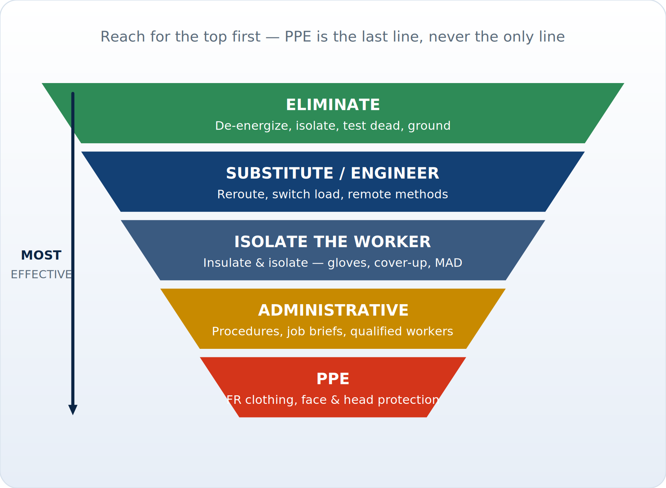
ILLUSTRATED
The Hierarchy of Controls
Work from the top down: de-energize first; PPE is the last line, never the only line.
Module 3 — Working Energized
Powerline Electrical Theory & Safety | 55
Notes:
Work from the top down: de-energize first; PPE is the last line, never the only line.

Slide 56
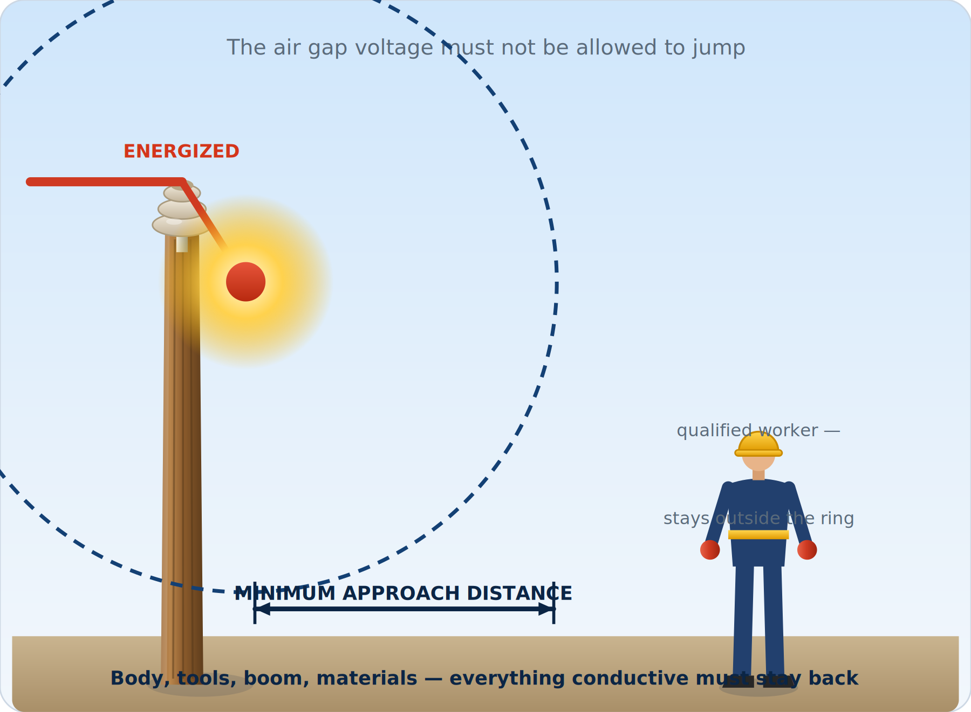
ILLUSTRATED
Minimum Approach Distance
Keep body, tools, and equipment outside the minimum approach distance for your voltage.
Module 3 — Working Energized
Powerline Electrical Theory & Safety | 56
Notes:
Keep body, tools, and equipment outside the minimum approach distance for your voltage.

Slide 57
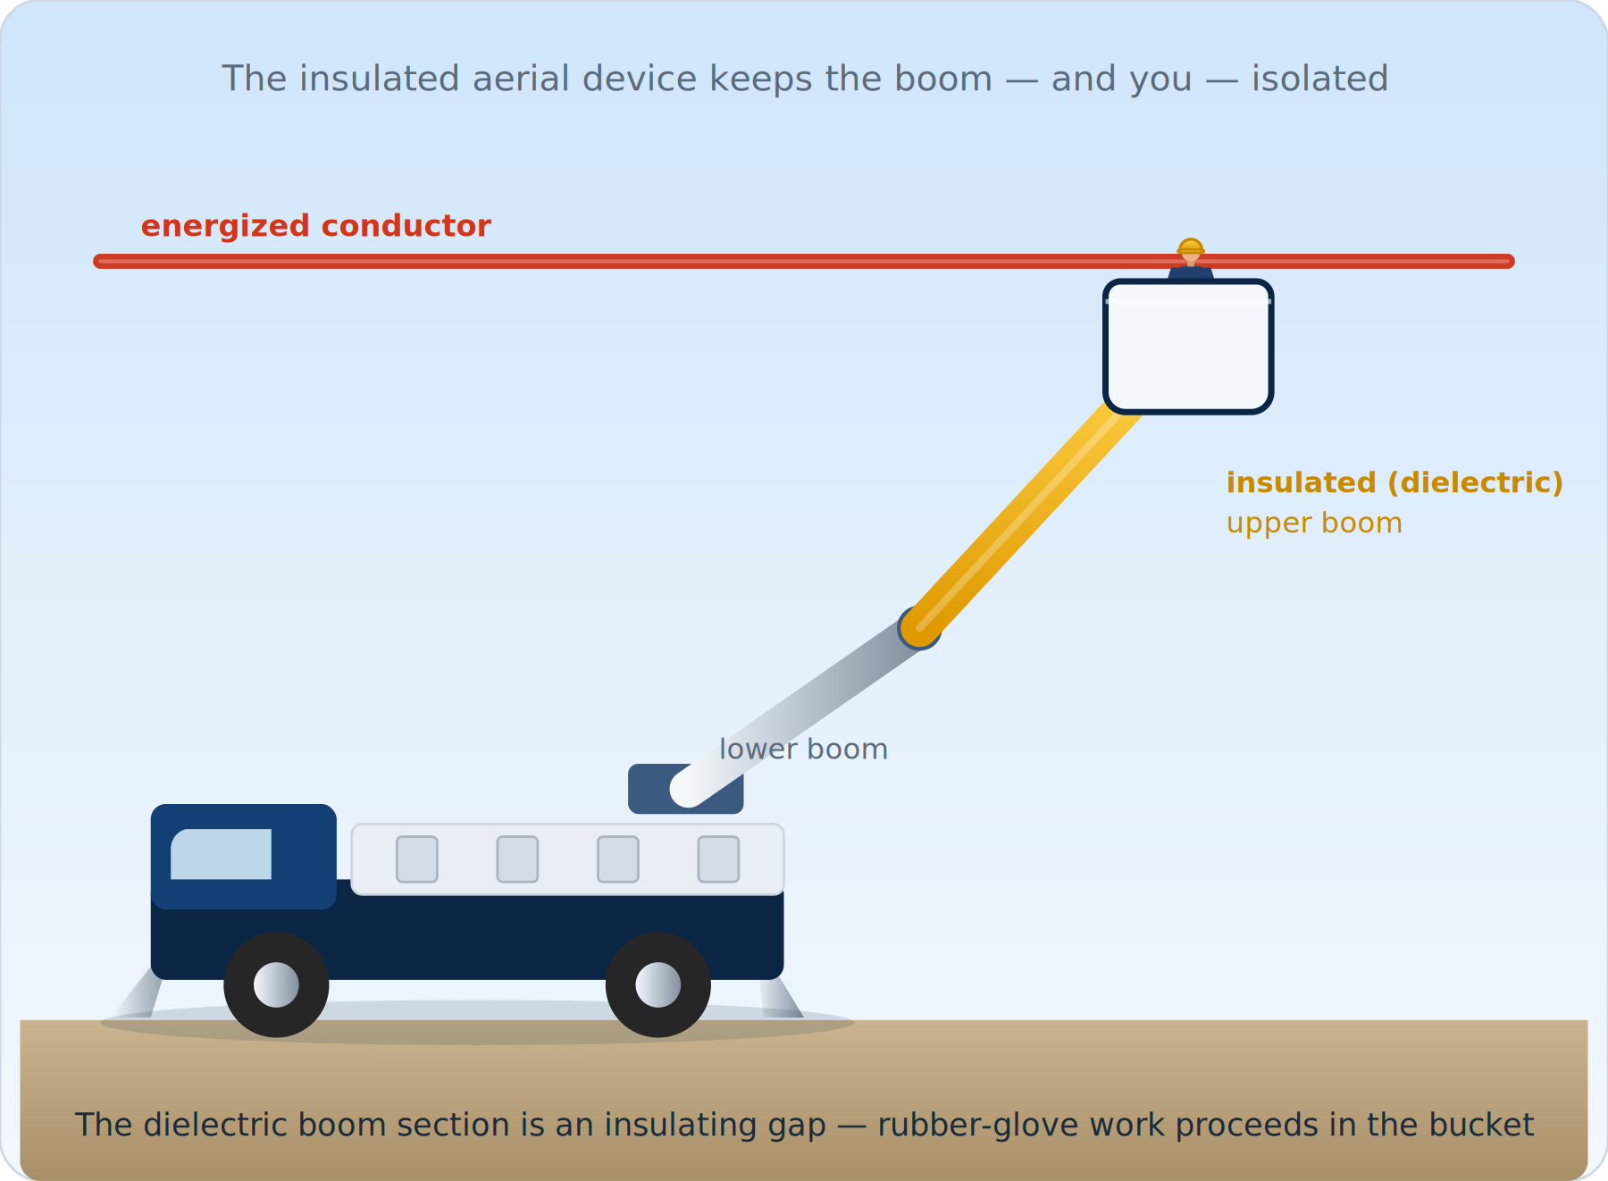
ILLUSTRATED
The Insulated Aerial Device
The fiberglass upper boom is a dielectric insulating gap between the bucket and ground.
Module 3 — Working Energized
Powerline Electrical Theory & Safety | 57
Notes:
The fiberglass upper boom is a dielectric insulating gap between the bucket and ground.

Slide 58
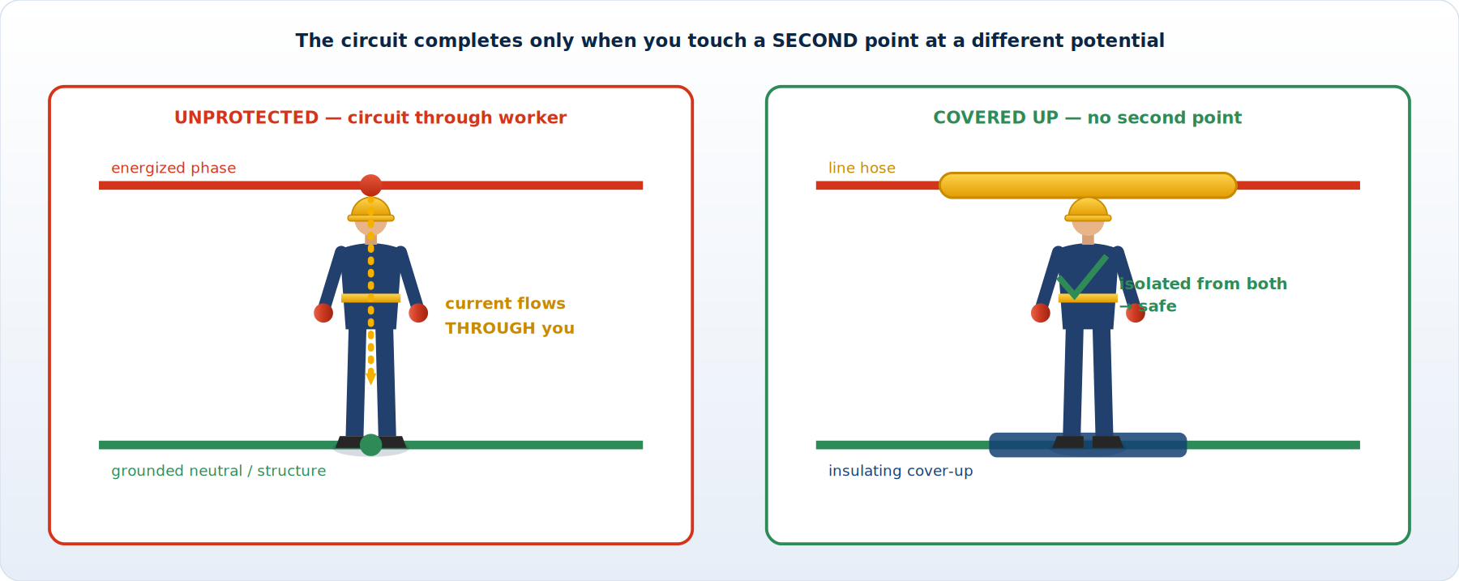
ILLUSTRATED
The Second Point of Contact
Eliminate the second point of contact — cover it or remove it — and the circuit can't close through you.
Module 3 — Working Energized
Powerline Electrical Theory & Safety | 58
Notes:
Eliminate the second point of contact — cover it or remove it — and the circuit can't close through you.

Slide 59
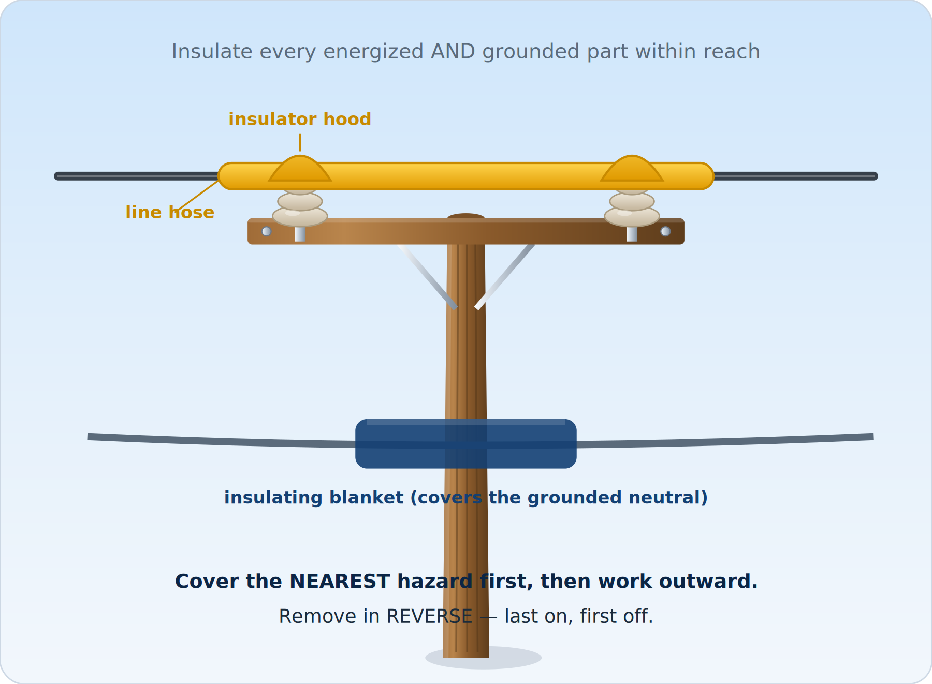
ILLUSTRATED
Cover-Up at the Pole Top
Insulate every energized and grounded part within reach: nearest first, remove in reverse.
Module 3 — Working Energized
Powerline Electrical Theory & Safety | 59
Notes:
Insulate every energized and grounded part within reach: nearest first, remove in reverse.

Slide 60
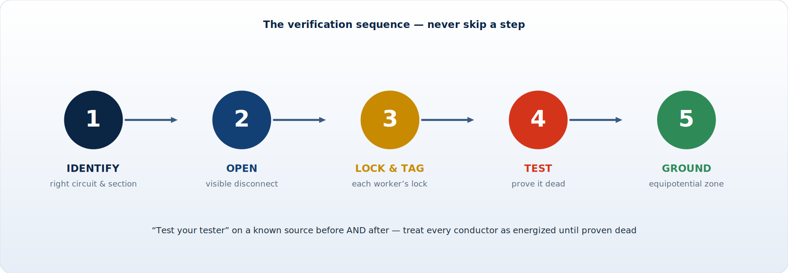
ILLUSTRATED
The De-Energize / LOTO Sequence
Identify → open → lock & tag → test → ground. Never skip a step.
Module 3 — Working Energized
Powerline Electrical Theory & Safety | 60
Notes:
Identify → open → lock & tag → test → ground. Never skip a step.

Slide 61
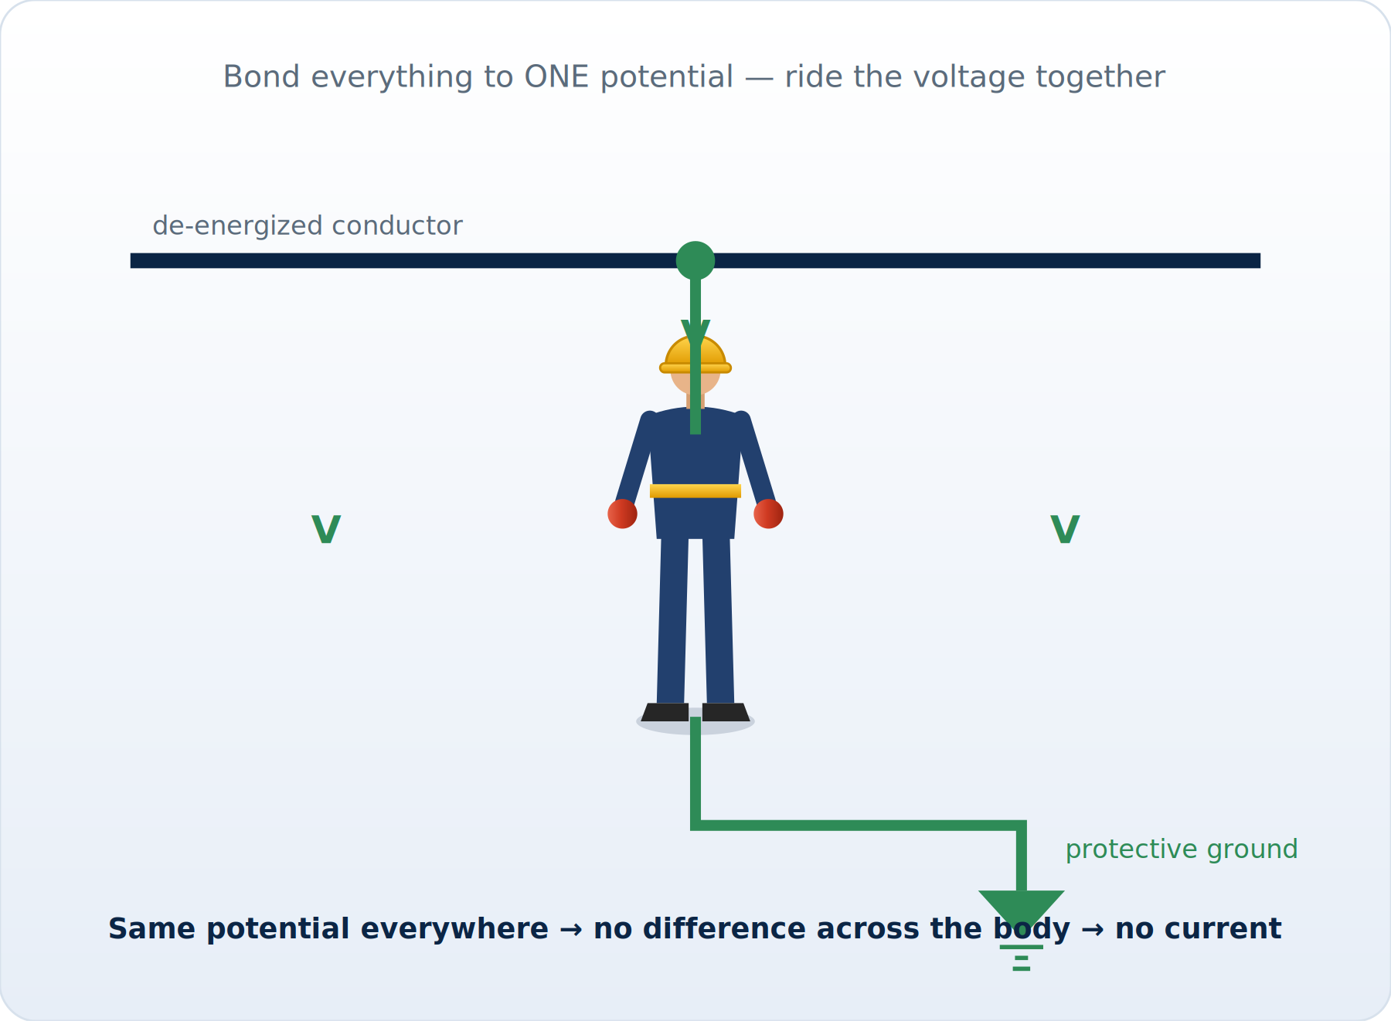
ILLUSTRATED
The Equipotential Zone
Bond and ground a work zone to one potential — no difference across the body means no current.
Module 3 — Working Energized
Powerline Electrical Theory & Safety | 61
Notes:
Bond and ground a work zone to one potential — no difference across the body means no current.

Slide 62
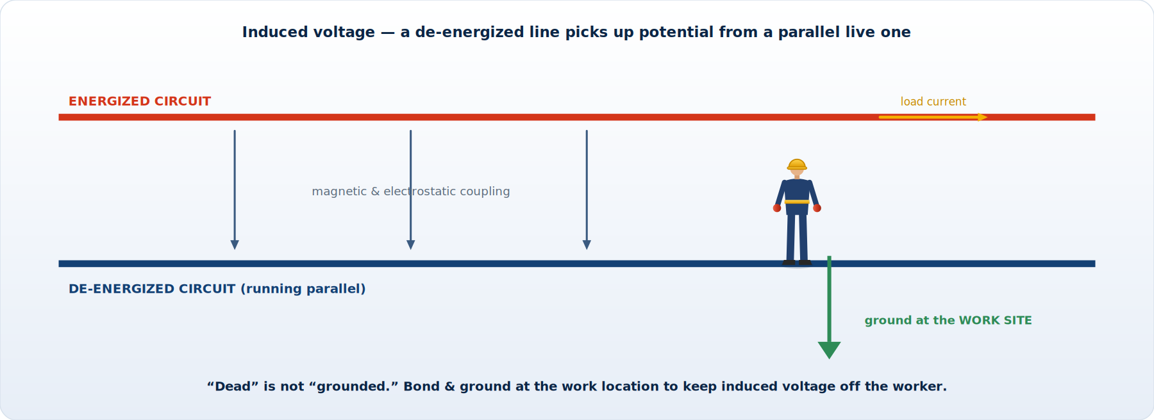
ILLUSTRATED
How Induced Voltage Appears
A parallel live line couples voltage onto a dead one — ground at the work site, not just the ends.
Module 3 — Working Energized
Powerline Electrical Theory & Safety | 62
Notes:
A parallel live line couples voltage onto a dead one — ground at the work site, not just the ends.

Slide 63
MODULE 3 RECAP
Module 3 — Key Takeaways
■ Prefer de-energizing; when working hot, isolate AND insulate — never rely on one control
■ Maintain MAD for your voltage; anything conductive counts toward the distance
■ THE SECOND POINT OF CONTACT completes the circuit — find it, cover it, remove it, every time
■ Cover-up backs up your gloves and MAD: nearest first, remove in reverse
■ De-energize properly: identify, open, lock/tag, TEST, then GROUND
■ Bond an equipotential zone and ground at the work site — it defeats re-energization AND induction
Module 3 — Working Energized
Powerline Electrical Theory & Safety | 63
Notes:
Recap the controls — this is the module the crew uses every single day.

Slide 64
MODULE
4
Tools of the Trade
— Rubber insulating gloves & sleeves
— Live-line (hot-stick) tools
— Protective grounds & testers
— Arc-rated FR clothing & PPE
— Inspection, testing & care
Notes:
Transition: the gear that makes insulate-and-isolate possible — and the discipline that keeps it trustworthy.

Slide 65
4.1 RUBBER GLOVES
Rubber Insulating Gloves — Your First Line of Defense
■ Rubber gloves insulate your hands from energized parts in the rubber-glove method
■ Always worn with leather protector gloves OVER them
– The leather shields the rubber from cuts, abrasion, and UV — the rubber does the insulating
■ Selected by VOLTAGE CLASS — each class has a max use voltage and proof-test voltage
■ Field-inspect before EVERY use:
– Air-test (roll/inflate) to find pinholes; check for cuts, cracks, swelling, embedded debris
– Inspect inside and out; check for chemical or ozone damage
■ Retest electrically on a schedule (typically every 6 months) at a certified lab
■ Store in a glove bag, fingers up, away from heat, ozone, sunlight, and sharp objects
Module 4 — Tools of the Trade
Powerline Electrical Theory & Safety | 65
Notes:
Always worn with leather protectors. Air-test and inspect before every use, honor retest dates, and store them properly in a glove bag.

Slide 66
4.1 GLOVE CLASSES
Rubber Glove Voltage Classes (ASTM D120 / IEC)
Class | Max Use Voltage (AC, ph-ph) | Color (label) | Proof Test
Class 00 | 500 V | Beige | 2,500 V
Class 0 | 1,000 V | Red | 5,000 V
Class 1 | 7,500 V | White | 10,000 V
Class 2 | 17,000 V | Yellow | 20,000 V
Class 3 | 26,500 V | Green | 30,000 V
Class 4 | 36,000 V | Orange | 40,000 V
Always select a class rated AT or ABOVE the maximum voltage you may contact. Label color aids quick identification; the printed rating governs. Same class system applies to insulating sleeves and many blankets.
Module 4 — Tools of the Trade
Powerline Electrical Theory & Safety | 66
Notes:
Select a class rated at or above the system voltage. Color helps quick ID, but the printed rating governs. Same system applies to sleeves and many blankets.

Slide 67
4.2 SLEEVES & COVER
Rubber Sleeves, Blankets & Line Hose
Sleeves
Blankets & line hose
■ Insulate the forearm, upper arm, and shoulder
■ Worn when the arm could contact an energized/grounded part
■ Same voltage-class system as gloves
■ Inspected & retested like gloves
■ Blankets: flexible cover for irregular shapes & hardware
■ Line hose: slips over conductors to insulate runs
■ Secured with approved pins/snaps/clamps
■ Voltage-rated; inspected for cuts, ozone & contamination
Module 4 — Tools of the Trade
Powerline Electrical Theory & Safety | 67
Notes:
Same voltage-class system. Sleeves when the arm is exposed; blankets and line hose for cover-up. Inspect for cuts, ozone cracks, and contamination.

Slide 68
4.3 HOT STICKS
Live-Line (Hot-Stick) Tools
A hot stick keeps the worker back while the work goes forward — isolation in tool form.
■ Hot sticks are insulating tools (usually fiberglass/epoxy) that extend your reach beyond MAD
■ Let qualified workers operate, test, install and remove equipment without closing the gap
■ Common types:
– Universal / shotgun (telescoping) sticks with interchangeable heads
– Switch sticks, disconnect sticks, fuse pullers
– Tie sticks, wire-holding & cleaning tools, measuring sticks
– Grounding sticks (clamp sticks) for applying protective grounds
■ Keep them CLEAN and DRY — contamination & moisture ruin the insulating surface
– Wipe down with an approved cleaner/wax; use a cradle, not the ground
■ Inspect for scratches, cracks, soft spots; periodic dielectric testing required
Module 4 — Tools of the Trade
Powerline Electrical Theory & Safety | 68
Notes:
The hot-stick method isolates the worker by distance. Keep tools clean and dry — contamination ruins the insulating surface — and dielectric-test on schedule.

Slide 69
4.4 GROUNDS
Protective Grounds & Grounding Equipment
■ Personal protective grounds = flexible copper cables with clamps (ferrules) and ground studs
■ Sized to carry the available fault current for the clearing time without failing
– Undersized grounds can fuse and fail under fault — use the correct cable size
■ Components: cable, clamps, ferrules, ground rods/cluster bars, EPZ jumpers
■ Apply correctly: clean contact points, tight clamps, ground end FIRST then line end
■ Use grounding sticks to install/remove — treat the line as energized until grounds are on
■ Inspect for broken strands, corroded clamps, loose ferrules; remove damaged sets from service
■ Remove grounds in REVERSE: line end first, ground end last
Module 4 — Tools of the Trade
Powerline Electrical Theory & Safety | 69
Notes:
Size grounds for the available fault current and clearing time. Ground end first, line end last; remove in reverse. Inspect for broken strands and corroded clamps.

Slide 70
4.5 TESTERS
Voltage Detectors & Testers
Types
Use it right
■ Contact voltage detectors (on a hot stick)
■ Non-contact / proximity testers (presence of field)
■ Phasing testers — verify phase relationships
■ Audible/visual indication of energized condition
■ TEST the tester on a known source before AND after
■ Match the detector's range to the system voltage
■ Test-before-touch on every conductor, every time
■ A 'no voltage' reading from an unproven tester proves NOTHING
Module 4 — Tools of the Trade
Powerline Electrical Theory & Safety | 70
Notes:
Match the detector range to the system voltage. Test the tester on a known source before AND after; test-before-touch on every conductor.

Slide 71
4.6 FR / PPE
Arc-Rated FR Clothing & Personal PPE
■ Flame-resistant (FR) / arc-rated (AR) clothing protects against arc-flash thermal energy
– Rated in cal/cm² (ATPV / arc rating) — must meet or exceed the job's incident energy
– Self-extinguishing; will not melt and drip like synthetics (no untreated nylon/poly next to skin)
■ Layering increases protection; outermost layer must be arc-rated
■ Head/face/eyes: hard hat (Class E, electrical), arc-rated face shield/hood, safety glasses
■ Hands: rubber gloves + leather protectors; feet: EH-rated footwear
■ Hearing protection for arc-blast environments; no exposed conductive jewelry
■ PPE is the LAST layer — it limits injury when other controls fail; it never replaces them
Module 4 — Tools of the Trade
Powerline Electrical Theory & Safety | 71
Notes:
Rated in cal/cm² — must meet or exceed the incident energy. The outer layer must be arc-rated, nothing meltable underneath. PPE is the last layer of defense.

Slide 72
4.7 INTERVALS
PPE & Tool Inspection / Test Intervals (Typical)
Item | Before each use | Periodic electrical test
Rubber gloves | Air & visual inspection | Retest ≈ every 6 months
Rubber sleeves | Visual inspection | Retest ≈ every 6 months
Insulating blankets | Visual inspection | Retest ≈ every 12 months
Line hose / covers | Visual inspection | When suspect / per program
Hot sticks / live-line tools | Wipe & visual inspection | Periodic dielectric test (e.g., every 2 yrs)
Protective grounds | Visual; check clamps/strands | Resistance/condition per program
Voltage detectors | Self-test before & after use | Per manufacturer schedule
FR clothing | Inspect for damage/contamination | Replace when worn/contaminated
Intervals are TYPICAL and governed by OSHA 1910.137, ASTM F496/F478, and your employer's program. If equipment is dropped, suspect, or out of test date — remove it from service.
Module 4 — Tools of the Trade
Powerline Electrical Theory & Safety | 72
Notes:
Intervals are typical — follow your program. If equipment is dropped, suspect, or out of test date, it comes out of service. No exceptions.

Slide 73
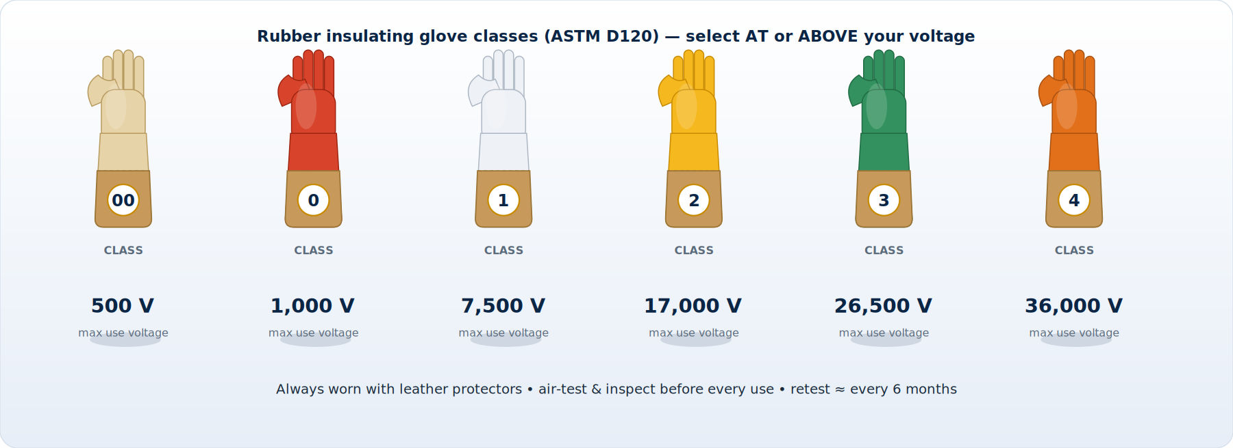
ILLUSTRATED
Rubber Glove Voltage Classes
Select a glove class rated at or above your system voltage; wear leather protectors over them.
Module 4 — Tools of the Trade
Powerline Electrical Theory & Safety | 73
Notes:
Select a glove class rated at or above your system voltage; wear leather protectors over them.

Slide 74
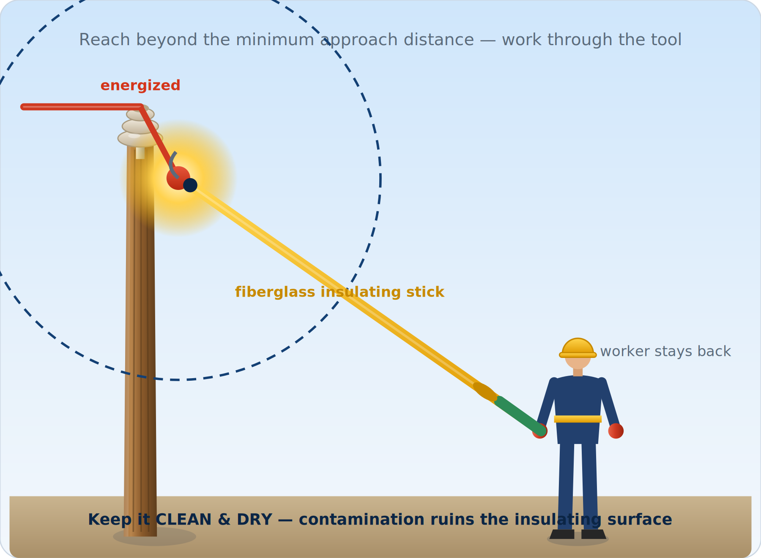
ILLUSTRATED
The Live-Line (Hot-Stick) Method
A fiberglass live-line tool extends reach beyond MAD — keep it clean and dry.
Module 4 — Tools of the Trade
Powerline Electrical Theory & Safety | 74
Notes:
A fiberglass live-line tool extends reach beyond MAD — keep it clean and dry.

Slide 75
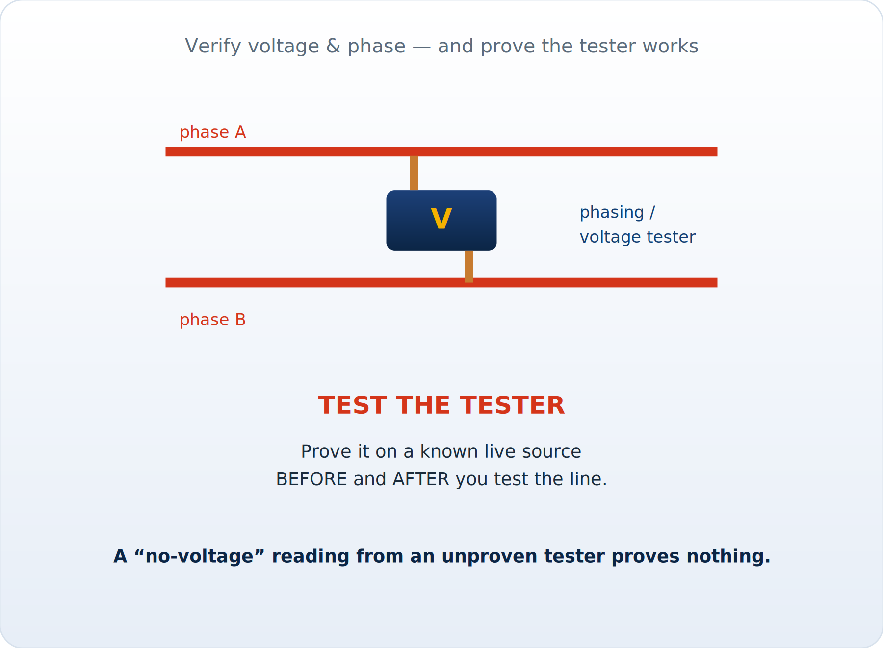
ILLUSTRATED
Phasing & Voltage Testing
Verify voltage and phase — and prove the tester on a known source before and after.
Module 4 — Tools of the Trade
Powerline Electrical Theory & Safety | 75
Notes:
Verify voltage and phase — and prove the tester on a known source before and after.

Slide 76
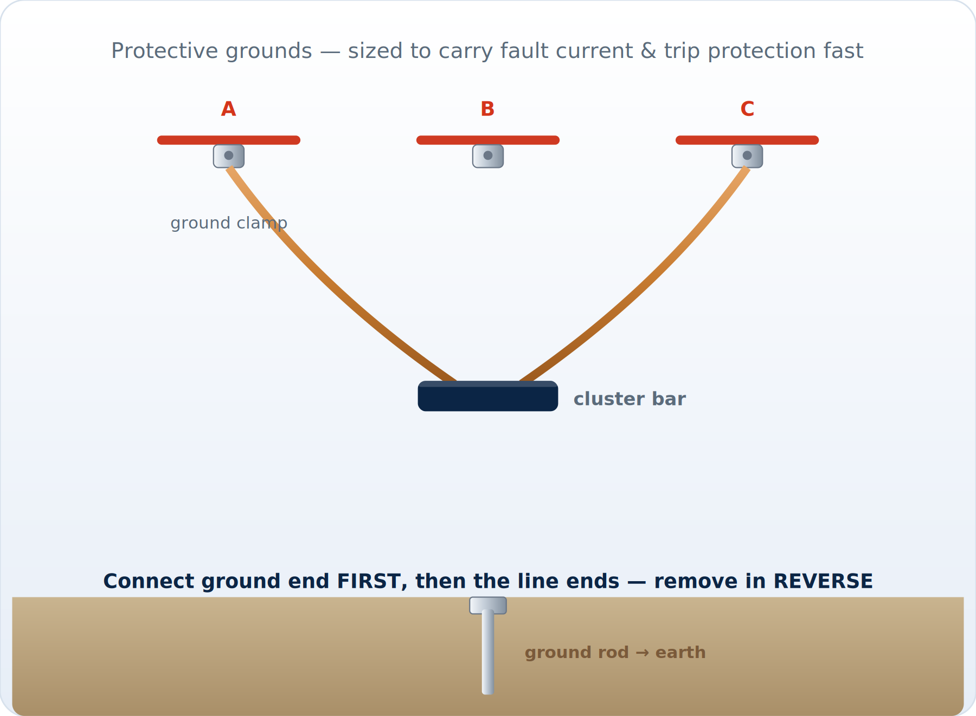
ILLUSTRATED
Protective Grounding Sets
Grounds carry fault current and trip protection fast: ground end first, line ends last.
Module 4 — Tools of the Trade
Powerline Electrical Theory & Safety | 76
Notes:
Grounds carry fault current and trip protection fast: ground end first, line ends last.

Slide 77
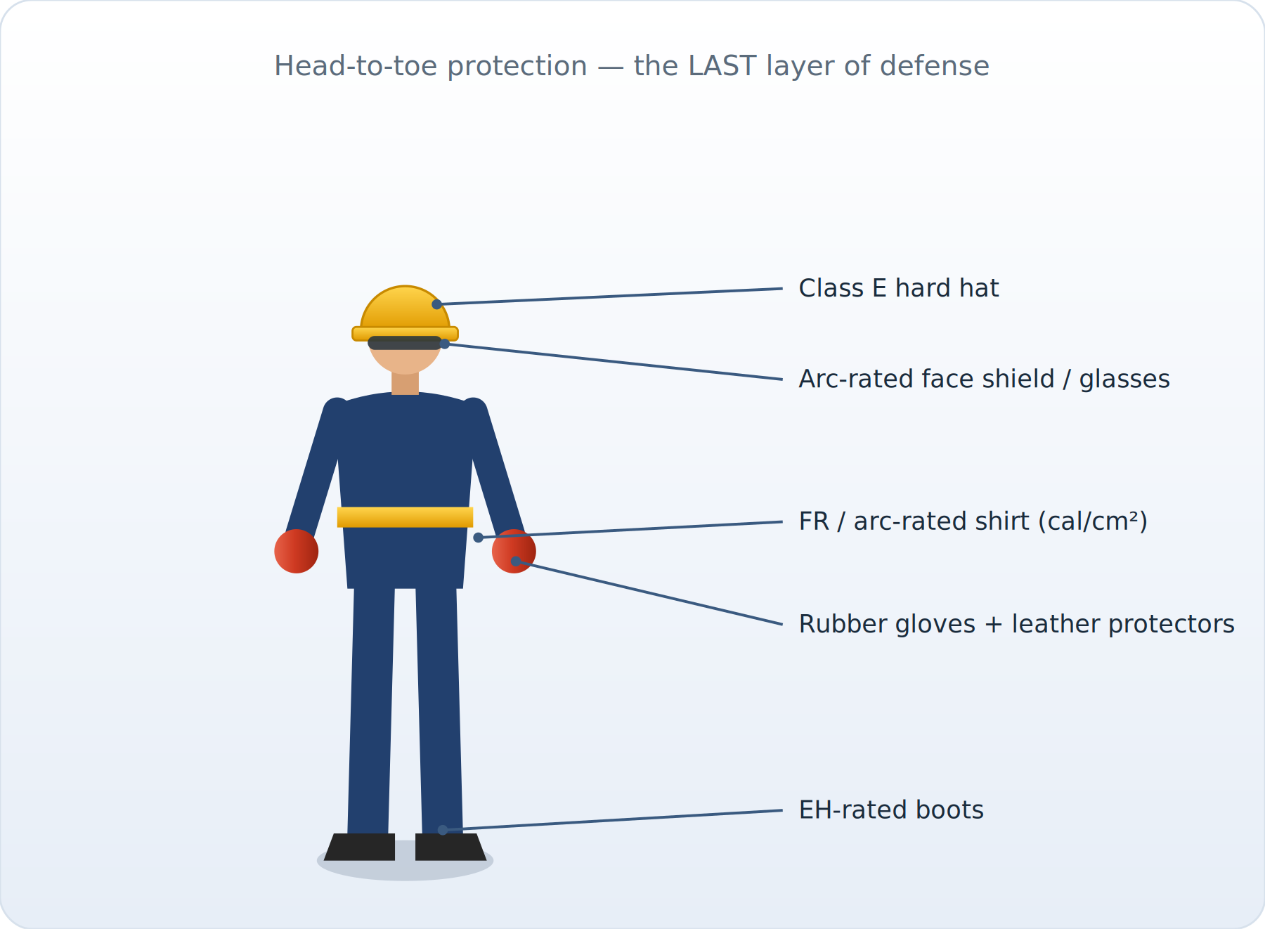
ILLUSTRATED
Head-to-Toe PPE
Arc-rated FR clothing, Class E hard hat, face shield, rubber gloves — the last layer of defense.
Module 4 — Tools of the Trade
Powerline Electrical Theory & Safety | 77
Notes:
Arc-rated FR clothing, Class E hard hat, face shield, rubber gloves — the last layer of defense.

Slide 78
MODULE 4 RECAP
Module 4 — Key Takeaways
■ Rubber gloves (with leather protectors) are first-line insulation — selected by voltage class
■ Air-test and inspect rubber goods before every use; honor retest dates
■ Hot sticks isolate the worker; grounds protect against re-energization — both must be tested & sized
■ Test your tester before AND after; test-before-touch every time
■ Arc-rated FR PPE must meet or exceed the incident energy — and it's the last layer, not the plan
■ Clean, dry, inspected, in-date — or out of service. No exceptions.
Module 4 — Tools of the Trade
Powerline Electrical Theory & Safety | 78
Notes:
Recap: clean, dry, inspected, in-date — or out of service.

Slide 79
MODULE
5
Putting It to Work in the Field
— Pre-job planning
— Hazard assessment / JSA
— The tailboard / job briefing
— Roles, responsibilities & communication
— Emergency response & rescue
Notes:
Transition: now we tie the theory and the tools into the daily disciplines that run a safe job.

Slide 80
5.1 PLANNING
Pre-Job Planning — Before Boots Leave the Truck
■ Understand the SCOPE: what work, on what equipment, at what voltage, energized or not
■ Review prints, switching orders, clearances, and the circuit map
■ Confirm the right crew, qualifications, and a competent person in charge
■ Verify tools, PPE, cover-up, grounds — right ratings, inspected, in test date
■ Check the weather: wind, lightning, heat, ice — conditions that stop or change the job
■ Identify the access, the work zone, traffic control, and the public exposure
■ Know the location: address, nearest cross-streets, gate codes — for emergency response
■ Plan the rescue BEFORE the work — not after the incident
Module 5 — In the Field
Powerline Electrical Theory & Safety | 80
Notes:
Plan scope, crew, tools, weather, access — and the rescue — before anyone leaves the truck. Know the location for emergency response.

Slide 81
5.2 HAZARD ASSESSMENT
Hazard Assessment / Job Safety Analysis (JSA)
■ Break the job into steps; for each step identify the hazards and the controls
■ Electrical hazards: energized parts, second points of contact, induced voltage, fault energy
■ Mechanical/physical: falls, dropped objects, pinch points, equipment, rigging, tension
■ Environmental: weather, traffic, terrain, wildlife, confined/excavation, public
■ For each hazard, select the control from the hierarchy — eliminate where you can
■ Reassess when ANYTHING changes: scope, weather, crew, equipment, the unexpected
KEY CONCEPT
The four questions
– What am I about to do? What can hurt me?
– How do I control it? What if the plan changes?
– A JSA is a living document — update it as the job evolves.
Module 5 — In the Field
Powerline Electrical Theory & Safety | 81
Notes:
Break the job into steps and pair each hazard with a control from the hierarchy. The JSA is a living document — reassess when anything changes.

Slide 82
5.3 TAILBOARD
The Tailboard / Job Briefing — What & Why
The tailboard is where the plan in your head becomes the plan in everyone's head.
■ A tailboard is the crew safety briefing held before work starts (and again when things change)
■ Required before each job; it aligns the whole crew on the plan and the hazards
■ OSHA 1910.269(c) requires a job briefing covering at minimum:
– Hazards associated with the job
– Work procedures involved
– Special precautions
– Energy-source controls (clearances, grounds, LOTO)
– Personal protective equipment requirements
■ More extensive briefing for complex/hazardous jobs; brief again after interruptions or changes
Module 5 — In the Field
Powerline Electrical Theory & Safety | 82
Notes:
Cite 1910.269(c) minimum content. The tailboard is where the plan in your head becomes the plan in everyone's head.

Slide 83
5.3 BRIEFING
Running an Effective Tailboard
1
1. Describe the job
What are we doing, where, on what equipment, energized or de-energized, at what voltage.
2
2. Walk the hazards
Go through the JSA: electrical (second points, MAD, induction), falls, traffic, weather, public.
3
3. State the controls
Cover-up plan, grounds/EPZ, LOTO/clearance, MAD, PPE, traffic control — specific, not generic.
4
4. Assign roles
Person in charge, who works, who tends, who grounds, who watches, who calls for help.
5
5. Confirm rescue & comms
Location/address, nearest hospital, rescue plan & equipment, radio/phone, hand signals.
6
6. Engage the crew
Ask questions, invite input, confirm understanding — everyone has stop-work authority.
Module 5 — In the Field
Powerline Electrical Theory & Safety | 83
Notes:
Walk the six steps. Engage the crew, invite input, and confirm understanding — everyone has stop-work authority.

Slide 84
5.4 ROLES
Roles & Responsibilities on the Crew
Key roles
Shared responsibilities
■ Person-in-Charge / Crew Leader — owns the plan & clearance
■ Qualified worker(s) — perform the energized/skilled tasks
■ Groundman / tender — supports, tends ropes, handles materials
■ Safety watch / second person — eyes on the worker, ready to act
■ Flagger / traffic control — protects the work zone & public
■ Everyone: know the plan and your part in it
■ Everyone: maintain situational awareness
■ Everyone has STOP-WORK authority — use it without fear
■ Speak up: a question now beats an incident later
■ No solo energized work — a qualified second person is present
Module 5 — In the Field
Powerline Electrical Theory & Safety | 84
Notes:
Define roles clearly so nothing falls through the cracks. No solo energized work — a qualified second person is present and watching.

Slide 85
5.5 COMMUNICATION
Communication — The Glue That Holds the Job Together
■ Use clear, standardized language for switching and clearances — no ambiguity
■ Three-way communication for critical commands: state → repeat back → confirm
■ Confirm clearances and grounds with the system operator before and after
■ Agree on hand signals for crane/bucket/rigging where radios are hard to hear
■ Announce movements: 'coming down', 'tension on', 'clear' — keep the crew in the loop
■ Re-brief after ANY interruption, crew change, or scope change
■ If you're not sure what was said, STOP and confirm — assumptions kill
Module 5 — In the Field
Powerline Electrical Theory & Safety | 85
Notes:
Use three-way communication for critical commands: state, repeat back, confirm. Re-brief after any interruption, crew change, or scope change.

Slide 86
5.6 RESCUE
Emergency Response & Rescue — Plan It Before You Need It
■ Every energized/elevated job needs a rescue plan briefed in the tailboard
■ Pole-top & bucket rescue: trained crew can lower an injured worker quickly
– Know the equipment (handline, rescue device) and practice the procedure
■ Do NOT become the second victim — ensure the source of contact is removed/de-energized first
■ Call for help early: know the address, cross-streets, and access
■ CPR + AED for electrical contact / cardiac arrest — minutes matter; know where the AED is
■ After contact, ALWAYS transport for medical evaluation — internal injury can be hidden
WARNING ⚠
The first rule of rescue
– Protect yourself first — a rescuer who gets electrocuted helps no one.
– De-energize / remove the source, then reach the patient.
– Speed saves lives, but only a SAFE rescue saves two.
Module 5 — In the Field
Powerline Electrical Theory & Safety | 86
Notes:
Brief the rescue plan every time. Protect yourself first — never become the second victim. Know where the AED is and how to do pole-top and bucket rescue.

Slide 87
5.7 ENVIRONMENT
Weather, Environment & Public Safety
■ Lightning / approaching storms: stop work and clear elevated/exposed positions
■ High wind: affects conductors, booms, rigging, and footing — know your limits
■ Wet conditions: drastically reduce body & equipment insulation — reassess hot work
■ Heat/cold: fatigue and impaired judgment are hazards in themselves — hydrate, rotate
■ Ice/snow loading: added conductor weight and slip hazards
■ Public protection: barricades, signage, traffic control; keep bystanders clear of downed lines
■ Wildlife & vegetation: animals cause faults; trees create clearance & contact hazards
Module 5 — In the Field
Powerline Electrical Theory & Safety | 87
Notes:
Weather can stop or change the job — lightning, wind, wet, ice. Protect the public with barriers and traffic control; keep bystanders clear of downed lines.

Slide 88
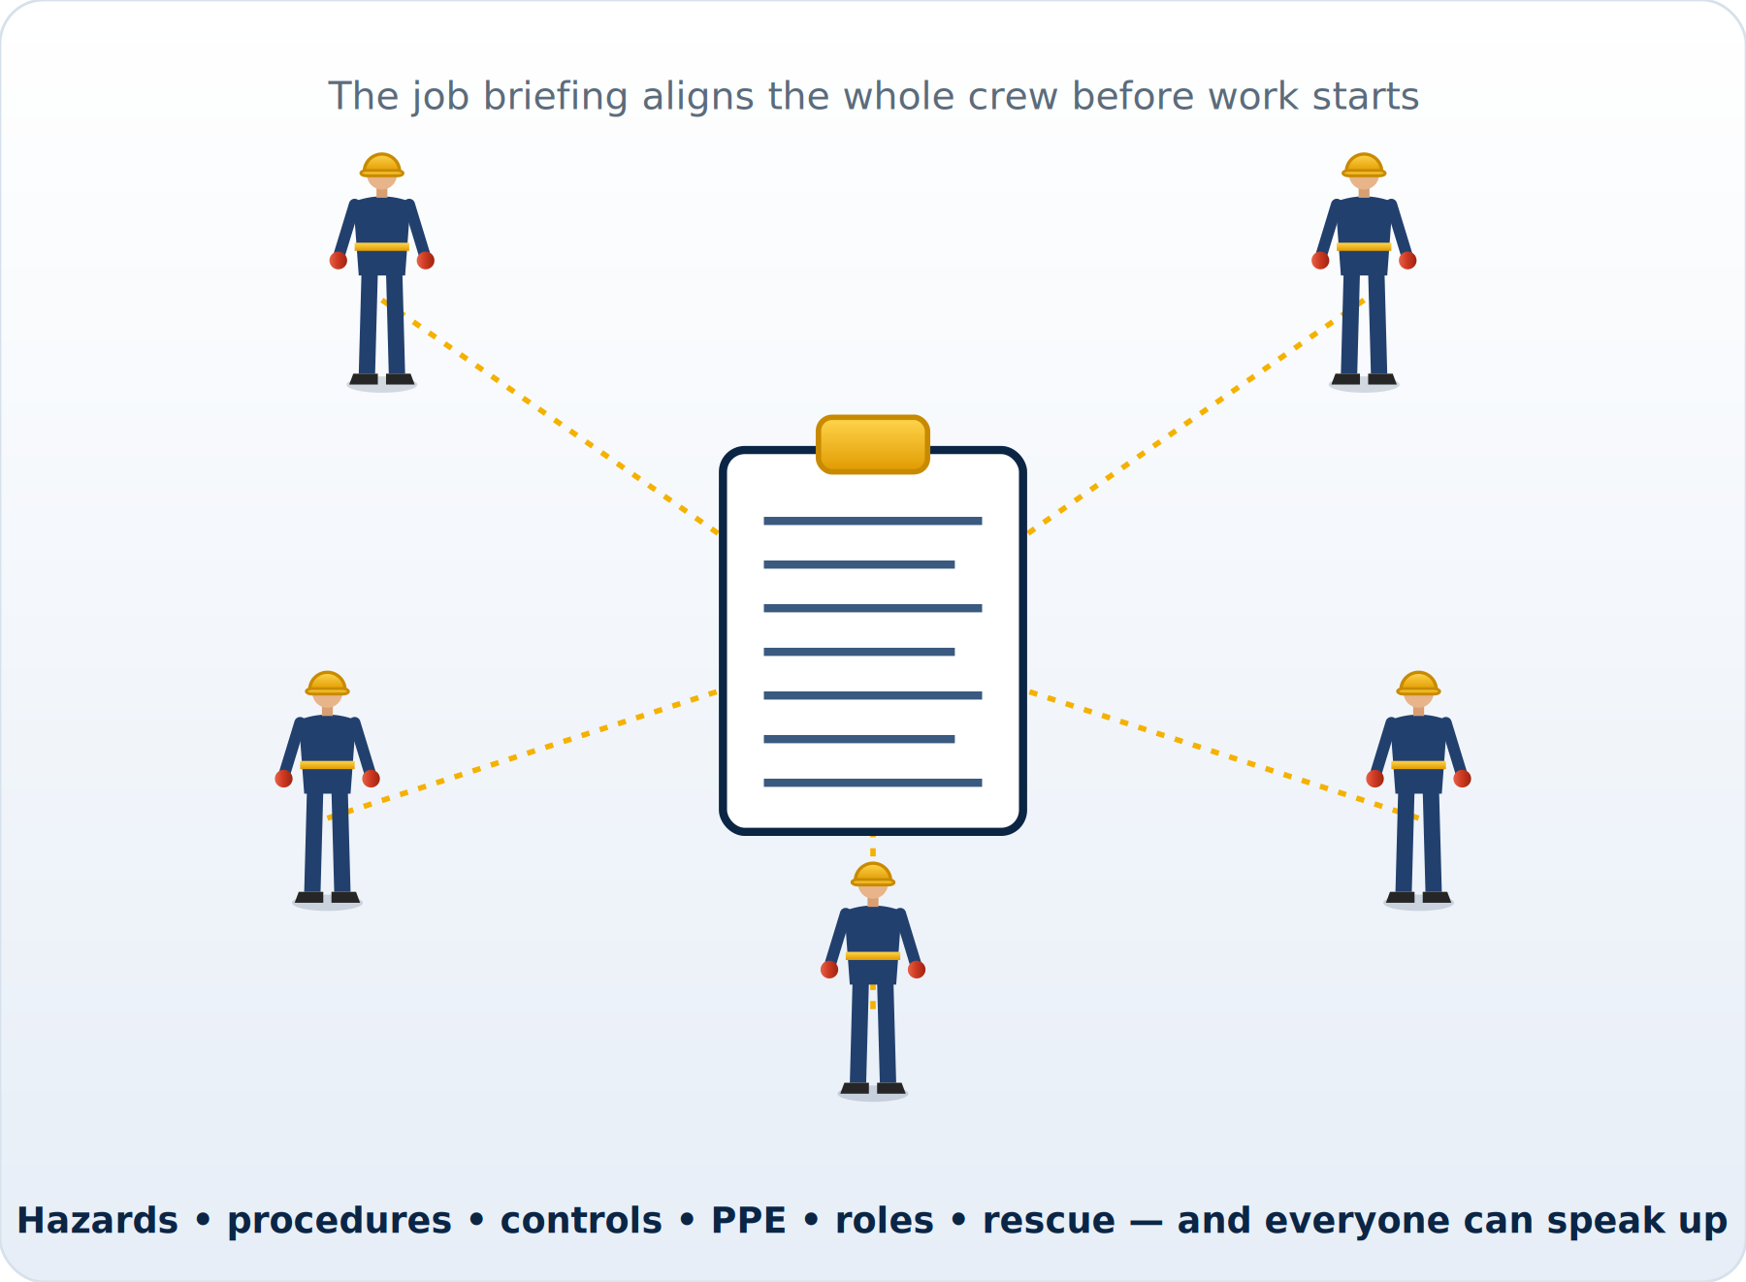
ILLUSTRATED
The Tailboard Briefing
The crew briefing aligns everyone: hazards, procedures, controls, PPE, roles, and rescue.
Module 5 — In the Field
Powerline Electrical Theory & Safety | 88
Notes:
The crew briefing aligns everyone: hazards, procedures, controls, PPE, roles, and rescue.

Slide 89
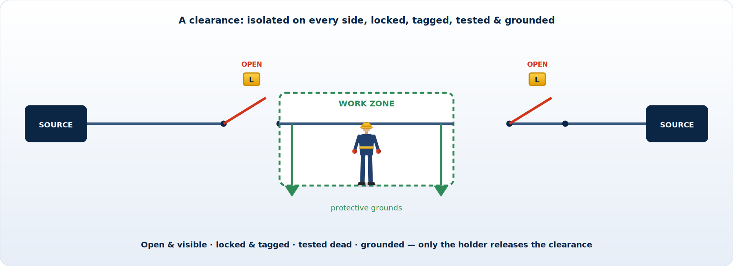
ILLUSTRATED
Switching & the Clearance
A clearance isolates the work zone: open, locked, tagged, tested dead, and grounded on every side.
Module 5 — In the Field
Powerline Electrical Theory & Safety | 89
Notes:
A clearance isolates the work zone: open, locked, tagged, tested dead, and grounded on every side.

Slide 90
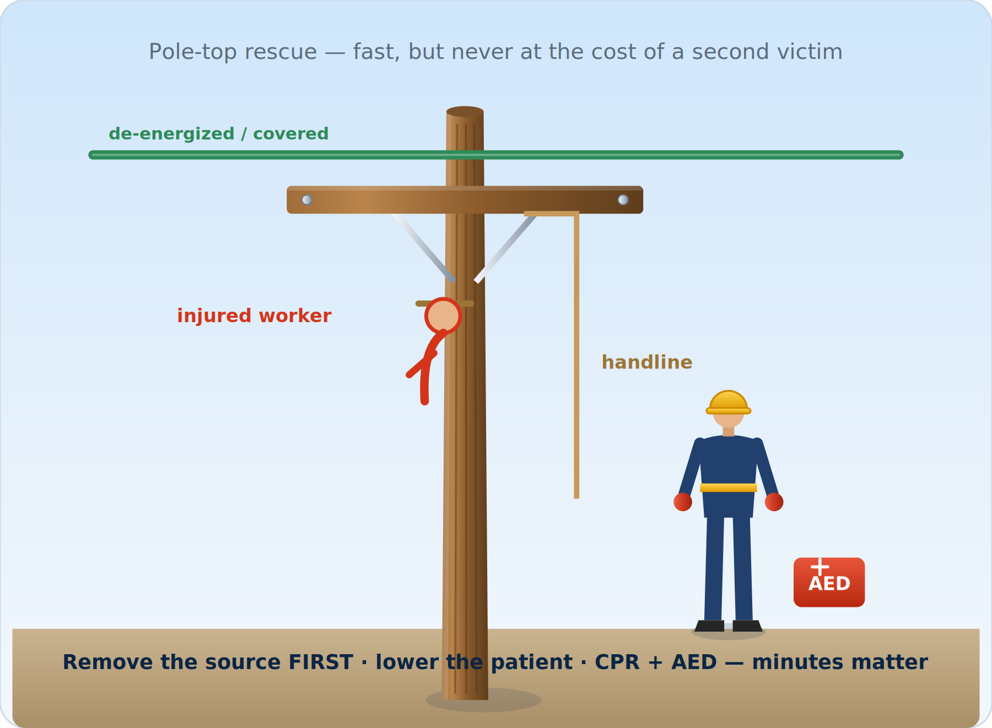
ILLUSTRATED
Pole-Top Rescue
Remove the source first, lower the patient, start CPR & AED — never become the second victim.
Module 5 — In the Field
Powerline Electrical Theory & Safety | 90
Notes:
Remove the source first, lower the patient, start CPR & AED — never become the second victim.

Slide 91
MODULE 5 RECAP
Module 5 — Key Takeaways
■ Plan the job — and the rescue — before boots leave the truck
■ A JSA pairs every step with its hazards and controls, and updates when things change
■ The tailboard puts the plan in everyone's head: hazards, procedures, controls, PPE, roles
■ Define roles and use disciplined, three-way communication
■ Everyone has stop-work authority — and the obligation to use it
■ Rescue first protects the rescuer; after any contact, get medical evaluation
Module 5 — In the Field
Powerline Electrical Theory & Safety | 91
Notes:
Recap the field disciplines and reinforce that stop-work authority is an obligation, not just a right.

Slide 92
MODULE
6
Regulations & Standards
— OSHA 1910.269 & 1926 Subpart V
— The National Electrical Safety Code (NESC)
— ASTM & IEEE equipment standards
— Qualification & apprenticeship
— Recordkeeping & program duties
Notes:
Transition: the 'why it is written' behind every rule we have covered — and where to find it.

Slide 93
6.1 WHY REGS
Why Regulations Exist — and Why You Should Know Them
■ Every safe-work rule in this course is backed by a regulation or consensus standard
■ Regulations set the MINIMUM — your employer's program may be stricter (follow the stricter)
■ Knowing the 'why' and the 'where it's written' makes you a better, safer, more credible worker
■ The big three for line work:
– OSHA — federal law: how the work must be done safely (enforceable)
– NESC (IEEE C2) — how the system is built, spaced, and maintained
– ASTM / IEEE / ANSI — how the tools and PPE are made, rated, and tested
■ Compliance is the floor; the goal is everyone home safe — which often means going beyond the floor
Module 6 — Regulations & Standards
Powerline Electrical Theory & Safety | 93
Notes:
Regulations set the minimum; your program may be stricter — always follow the stricter rule. Knowing the source makes you a more credible, safer worker.

Slide 94
6.2 OSHA 1910.269
OSHA 1910.269 — Electric Power Generation, Transmission & Distribution
If you read one regulation cover to cover, make it this one.
■ The primary OSHA standard for operating & maintaining electric power systems (general industry)
■ Key provisions every lineworker should know:
– (a) Training & qualified-employee requirements
– (c) Job briefings (the tailboard) — required content and frequency
– (l) Working on or near energized parts; minimum approach distances (Tables R-3 / R-6)
– (m) De-energizing lines & equipment
– (n) Grounding for the protection of employees
– Arc-flash hazard assessment and arc-rated apparel requirements
■ Companion construction standard: 29 CFR 1926 Subpart V (power transmission & distribution)
Module 6 — Regulations & Standards
Powerline Electrical Theory & Safety | 94
Notes:
The core standard for operating and maintaining power systems. Walk the key subsections — if a worker reads one regulation, make it this one.

Slide 95
6.2 SCOPE
OSHA 1910.269 vs 1926 Subpart V
1910.269 (General Industry)
1926 Subpart V (Construction)
■ Operation & MAINTENANCE of existing power systems
■ Day-to-day line & substation work
■ Job briefings, MAD, de-energizing, grounding
■ Harmonized with Subpart V on key requirements
■ CONSTRUCTION of power transmission & distribution
■ Building new lines and major rebuilds
■ Mirrors 1910.269 on MAD, briefings, grounding
■ Use the standard that matches the type of work
Module 6 — Regulations & Standards
Powerline Electrical Theory & Safety | 95
Notes:
Maintenance (1910.269) versus construction (1926 Subpart V), harmonized on the key requirements. Use the standard that matches the type of work.

Slide 96
6.3 NESC
The National Electrical Safety Code (NESC / IEEE C2)
■ NESC governs the safe installation, operation & maintenance of utility electric & communication systems
■ Distinct from the NEC (NFPA 70), which covers premises/building wiring
■ Sets rules for the SYSTEM that protect both workers and the public, including:
– Conductor clearances — ground, structures, other lines, and to the public
– Strength & loading of structures; grades of construction
– Grounding methods and worker safety rules (Part 4 covers work rules)
■ Updated on a multi-year cycle; the edition in force depends on jurisdiction
■ When clearances or construction look wrong in the field — NESC is the reference
Module 6 — Regulations & Standards
Powerline Electrical Theory & Safety | 96
Notes:
Governs the system — clearances, structure strength, grounding, and work rules. Distinct from the NEC (NFPA 70), which covers premises wiring.

Slide 97
6.4 ASTM/IEEE
Key ASTM / IEEE / ANSI Equipment Standards
Standard | Covers
ASTM D120 | Rubber insulating GLOVES — manufacture & rating
ASTM D1051 | Rubber insulating SLEEVES
ASTM D1048 | Rubber insulating BLANKETS
ASTM D1049 / D1050 | Insulating COVERS / LINE HOSE
ASTM F496 | In-service CARE of rubber gloves & sleeves (test intervals)
ASTM F478 | In-service care of insulating LINE HOSE & covers
ASTM F711 | Fiberglass rod & tube for LIVE-LINE TOOLS
ASTM F855 | Temporary protective GROUNDS (clamps & cables)
ASTM F1506 / NFPA 70E | Arc-rated FR CLOTHING & arc-flash protection
IEEE C2 (NESC) | Utility system safety code
ANSI Z89.1 | Hard hats (electrical Class E)
These standards define how your PPE and tools are built, rated, and re-tested — the numbers on your gloves and grounds trace back here.
Module 6 — Regulations & Standards
Powerline Electrical Theory & Safety | 97
Notes:
These define how your PPE and tools are built, rated, and re-tested. The numbers printed on your gloves and grounds trace back to here.

Slide 98
6.5 QUALIFICATION
Qualified Workers, Training & Apprenticeship
■ OSHA requires that only QUALIFIED employees work on or near energized parts
■ Qualified = trained AND able to demonstrate skills/knowledge for the construction & operation involved
– Knows how to distinguish energized parts, determine voltages, and maintain MAD
■ Lineworker apprenticeships (often ~3–4 years, thousands of OJT hours) build that qualification
– Classroom theory + supervised on-the-job training + skills verification
■ Ongoing training: refreshers, new procedures, CPR/AED & pole-top rescue, equipment-specific
■ Document training and re-qualification — it is both a legal requirement and proof of competence
Module 6 — Regulations & Standards
Powerline Electrical Theory & Safety | 98
Notes:
Only qualified employees work on or near energized parts. Qualification is earned through apprenticeship and verified skills — and documented.

Slide 99
6.6 RECORDS
Recordkeeping & Program Responsibilities
Records to keep
Employer program duties
■ Training & qualification records
■ PPE/tool inspection & electrical test dates
■ Job briefings / tailboards (per program)
■ Switching orders, clearances & grounding records
■ Incident & near-miss reports and investigations
■ Written safe-work & electrical safety program
■ Hazard/arc-flash assessments & MAD tables
■ Provide & maintain rated PPE and tools
■ Enforce procedures; support stop-work authority
■ Investigate, learn, and improve after every event
Module 6 — Regulations & Standards
Powerline Electrical Theory & Safety | 99
Notes:
What records to keep and the employer's program duties. Records are both a legal requirement and a tool for learning after every event.

Slide 100
MODULE 6 RECAP
Module 6 — Key Takeaways
■ Regulations set the minimum; your program may be stricter — always follow the stricter rule
■ OSHA 1910.269 (and 1926 Subpart V) govern how the work is done — briefings, MAD, LOTO, grounding
■ NESC (IEEE C2) governs how the system is built, spaced, and maintained
■ ASTM/IEEE/ANSI define how your PPE & tools are rated and tested
■ Only qualified workers do energized work — earned through apprenticeship & ongoing training
■ Keep records: training, test dates, briefings, clearances, incidents
Module 6 — Regulations & Standards
Powerline Electrical Theory & Safety | 100
Notes:
Recap; remember compliance is the floor, not the goal — the goal is everyone home safe.

Slide 101
MODULE
7
Arc-Flash Analysis, First Aid & Rescue
— What drives incident energy
— The arc-flash boundary & working distance
— PPE categories & the label
— Electrical injury & burns
— Scene control, CPR & AED
Notes:
Transition: two deeper safety topics the crew runs into — how the arc-flash numbers are derived, and what to do when someone is hurt.

Slide 102
7.1 INCIDENT ENERGY
Arc-Flash Analysis — What Drives Incident Energy
Why two jobs at the same voltage can carry wildly different arc-flash hazard.
■ Incident energy is the thermal energy reaching a surface a set distance from an arc — measured in cal/cm²
■ It rises with the available fault (bolted) current and with how long the arc lasts
– Clearing time is decisive: a faster-tripping device means far less energy
■ It falls with the SQUARE of the distance from the arc
■ An analysis (IEEE 1584 / NFPA 70E) calculates it for each location
– Inputs: fault current, electrode gap & configuration, equipment type, working distance
■ The result drives the required PPE arc rating and the arc-flash boundary
Module 7 — Arc-Flash, First Aid & Rescue
Powerline Electrical Theory & Safety | 102
Notes:
Make the physics usable: incident energy rises with fault current and clearing time and falls with the square of distance. Stress that a faster-tripping device dramatically cuts the energy.

Slide 103
7.2 BOUNDARY & DISTANCE
The Arc-Flash Boundary & Working Distance
■ Working distance: the arc-to-worker distance used in the calc (often 18 in for distribution)
– The incident energy at that distance sets the PPE arc rating you must wear
■ Arc-flash boundary: the distance where incident energy = 1.2 cal/cm²
– 1.2 cal/cm² is the onset of a second-degree burn to bare skin
■ Anyone inside the boundary must wear arc-rated PPE
■ Shock approach boundaries (limited / restricted) are separate and based on voltage
KEY CONCEPT
Two different boundaries
– Arc-flash boundary = thermal (cal/cm²).
– Shock approach boundaries = voltage-based (the MAD family).
– Respect both — they guard against different hazards.
Module 7 — Arc-Flash, First Aid & Rescue
Powerline Electrical Theory & Safety | 103
Notes:
Two distances do two jobs: the energy at the working distance sets your PPE rating; the arc-flash boundary (1.2 cal/cm²) is where a second-degree burn begins. Don't confuse these with the voltage-based shock boundaries.

Slide 104
7.3 PPE CATEGORIES
Arc-Flash PPE Categories (NFPA 70E)
Category | Min arc rating | Typical ensemble
CAT 1 | ≥ 4 cal/cm² | AR shirt & pants, hard hat, arc face shield, gloves
CAT 2 | ≥ 8 cal/cm² | Above + arc-rated hood or balaclava with face shield
CAT 3 | ≥ 25 cal/cm² | AR flash-suit jacket & trousers + arc-rated hood
CAT 4 | ≥ 40 cal/cm² | Heavy AR flash suit & hood — full ensemble
The category method is one approach; an incident-energy analysis is the other. Either way the garment's arc rating (ATPV) must meet or exceed the incident energy. Above ~40 cal/cm² the blast hazard alone may make energized work unacceptable — de-energize.
Module 7 — Arc-Flash, First Aid & Rescue
Powerline Electrical Theory & Safety | 104
Notes:
Walk the four categories. The key rule: the garment's arc rating must meet or exceed the incident energy. Above ~40 cal/cm² the blast itself may rule out energized work.

Slide 105
7.4 THE LABEL
Reading the Arc-Flash Label
The label turns the engineering study into a field decision.
■ Equipment should carry a label produced from the facility's arc-flash analysis
■ Typical fields:
– Nominal system voltage · arc-flash boundary · incident energy @ working distance
– Required PPE category · minimum glove class · shock approach boundaries
■ Use it to select PPE and set your boundaries BEFORE energizing or opening equipment
■ Missing, outdated, or illegible label → STOP and get the analysis
■ Labels change when the system changes — new transformer, settings, or fault current
Module 7 — Arc-Flash, First Aid & Rescue
Powerline Electrical Theory & Safety | 105
Notes:
Have the crew read a real label. It turns the study into a field decision — select PPE and set boundaries before opening the door. A missing or stale label means stop.

Slide 106
7.5 ELECTRICAL INJURY
Electrical Injury — What Happens to the Body
One contact can injure several body systems at once — which is why every contact gets evaluated.
■ Cardiac: ventricular fibrillation or arrest from current across the chest
■ Burns: surface arc burns AND internal burns along the current path
– Small entry/exit wounds can hide massive internal tissue damage
■ Respiratory: chest muscles lock — breathing can stop
■ Neurological: nerve damage, confusion, lasting deficits
■ Trauma: falls from the shock, blast-thrown objects and molten metal
■ Delayed effects: kidney injury from tissue breakdown; rhythm problems hours later
Module 7 — Arc-Flash, First Aid & Rescue
Powerline Electrical Theory & Safety | 106
Notes:
Make it concrete: one contact can hit the heart, lungs, nerves, and tissue, plus cause a fall — and effects can be delayed. This is why every contact gets a medical evaluation.

Slide 107
7.6 SCENE CONTROL
Emergency Response — Scene Control & the Rescuer
■ Protect yourself FIRST — a second victim helps no one
■ Do NOT touch the patient until the source is removed / de-energized and you know it
■ Treat downed conductors and the ground around them as energized — keep a wide barrier
■ Call for help early with a precise location; send someone for the AED
■ Decide who is in charge of the rescue and communicate clearly
WARNING ⚠
The order is fixed
– 1. Make the scene safe (remove the source).
– 2. Reach the patient.
– 3. Treat — CPR/AED, then burns.
– Never skip step 1 to save time.
Module 7 — Arc-Flash, First Aid & Rescue
Powerline Electrical Theory & Safety | 107
Notes:
Drill the fixed order: make the scene safe, then reach the patient, then treat. Do not touch the patient until the source is removed. Never become the second victim.

Slide 108
7.7 CPR & AED
CPR & AED for Electrical Contact
Push hard, push fast, minimize interruptions.
1
1. Scene safe
Confirm the source is removed / de-energized before you approach the patient.
2
2. Check & call
Check responsiveness and breathing; call 911 and send for the AED.
3
3. Compressions
Center of the chest, 100–120 per minute, about 2 inches deep, full recoil.
4
4. Apply the AED
Power on, attach pads, follow the voice prompts; clear for analysis and shock.
5
5. Continue
Resume compressions immediately; cycle until EMS takes over.
Module 7 — Arc-Flash, First Aid & Rescue
Powerline Electrical Theory & Safety | 108
Notes:
Walk the five steps once the scene is safe. Push hard, push fast, minimize interruptions; the AED can restart a coordinated rhythm. Practice it — know where the AED lives.

Slide 109
7.8 BURNS & CARE
Burns & Ongoing Care
■ Stop the burning; cool a thermal burn with clean water where appropriate
■ Cover with a clean, dry dressing — do not break blisters or apply ointments to severe burns
■ Treat for shock; keep the patient warm
■ Electrical burns are deceptive — internal damage far exceeds the visible wound
■ ALWAYS transport for medical evaluation after any contact, even if they feel fine
■ Report and investigate the contact — every event is a chance to prevent the next
Module 7 — Arc-Flash, First Aid & Rescue
Powerline Electrical Theory & Safety | 109
Notes:
Cover, don't break blisters, treat for shock, and transport every contact — internal damage hides. Report and investigate so the next crew benefits.

Slide 110
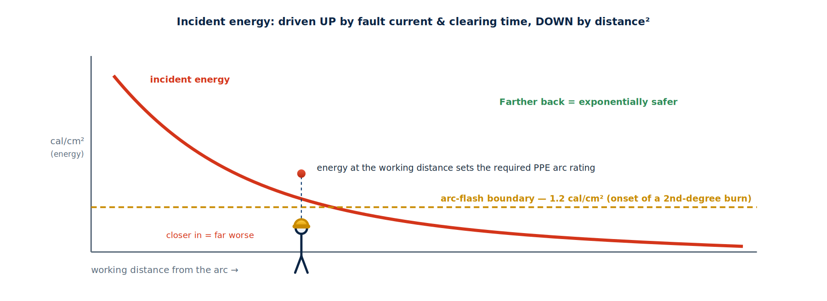
ILLUSTRATED
Incident Energy vs Working Distance
Energy falls with the square of distance; where it crosses 1.2 cal/cm² is the arc-flash boundary.
Module 7 — Arc-Flash, First Aid & Rescue
Powerline Electrical Theory & Safety | 110
Notes:
Energy falls with the square of distance; where it crosses 1.2 cal/cm² is the arc-flash boundary.

Slide 111
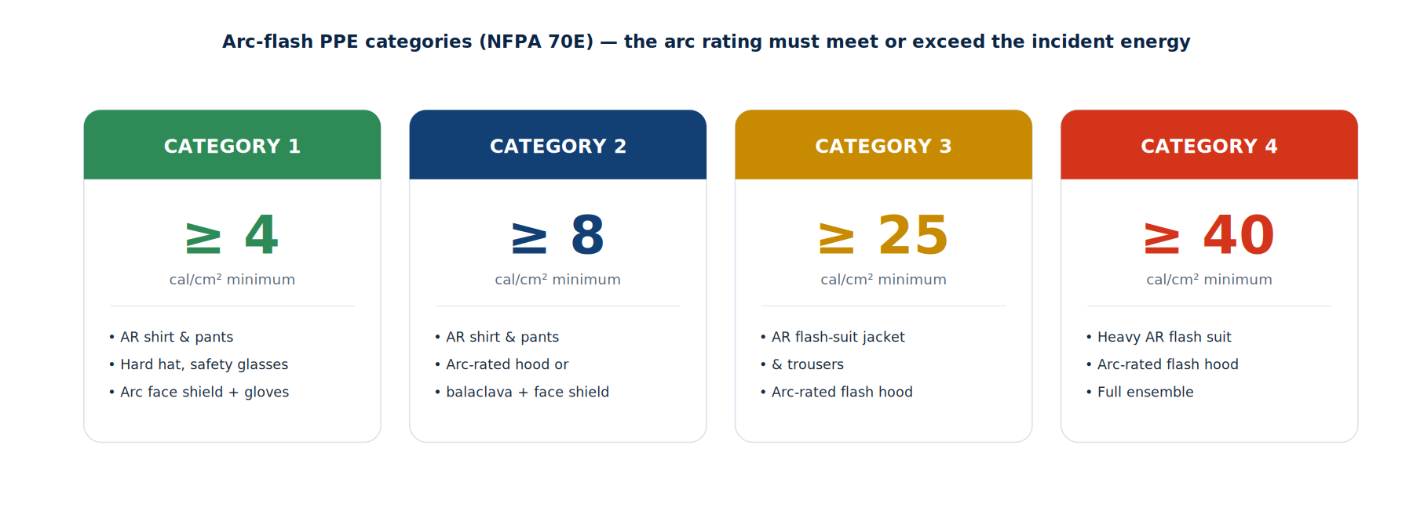
ILLUSTRATED
Arc-Flash PPE Categories
Four categories from ≥4 to ≥40 cal/cm². The garment's arc rating must meet or exceed the incident energy.
Module 7 — Arc-Flash, First Aid & Rescue
Powerline Electrical Theory & Safety | 111
Notes:
Four categories from ≥4 to ≥40 cal/cm². The garment's arc rating must meet or exceed the incident energy.

Slide 112
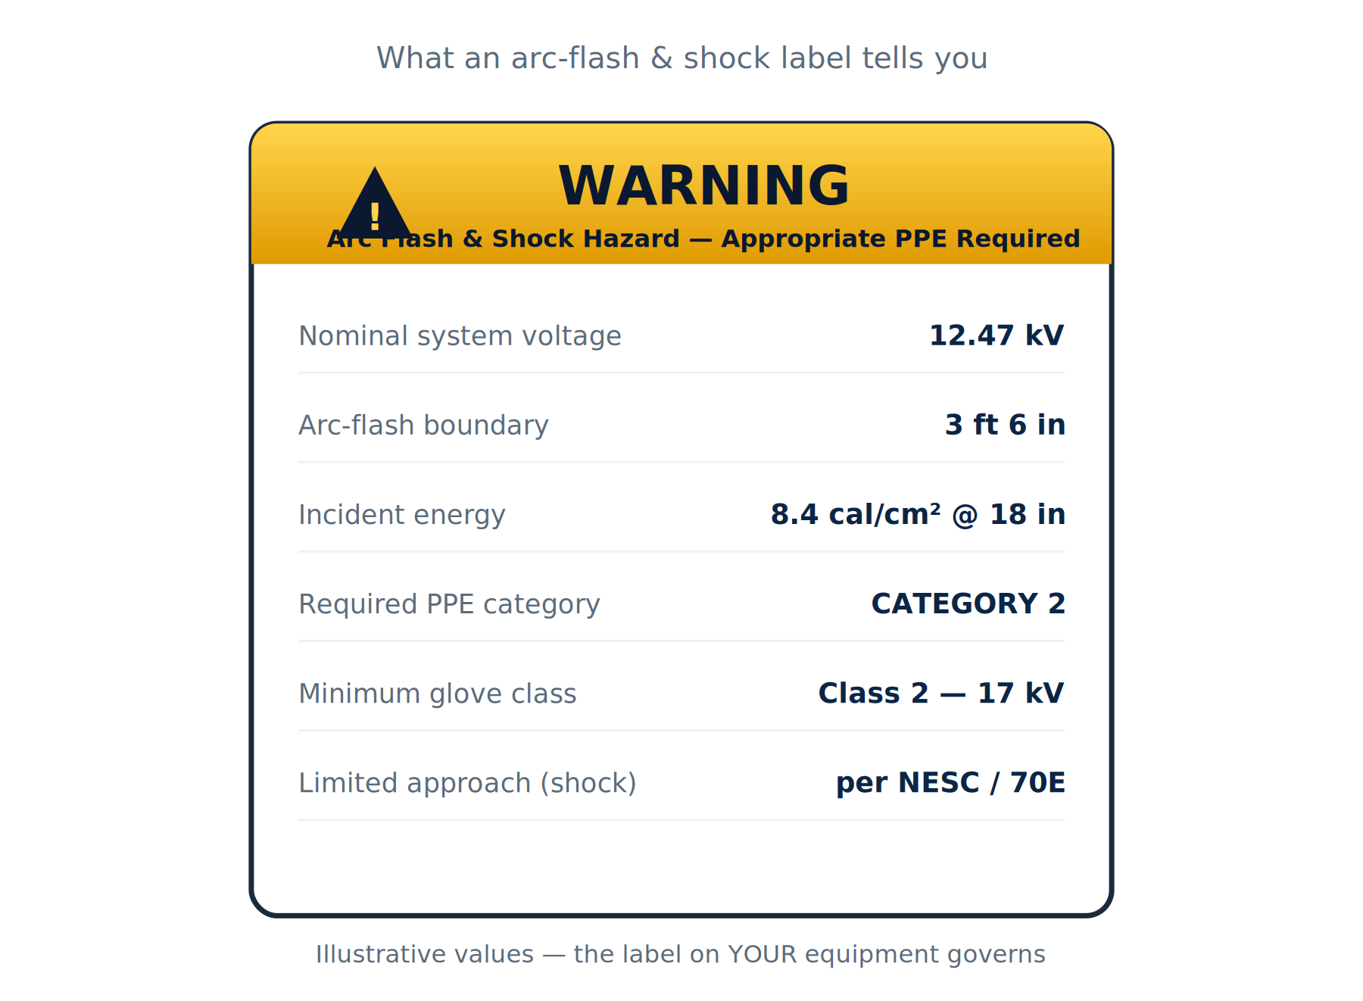
ILLUSTRATED
The Arc-Flash & Shock Label
Voltage, boundaries, incident energy, PPE category, and glove class — read it before you open the door.
Module 7 — Arc-Flash, First Aid & Rescue
Powerline Electrical Theory & Safety | 112
Notes:
Voltage, boundaries, incident energy, PPE category, and glove class — read it before you open the door.

Slide 113
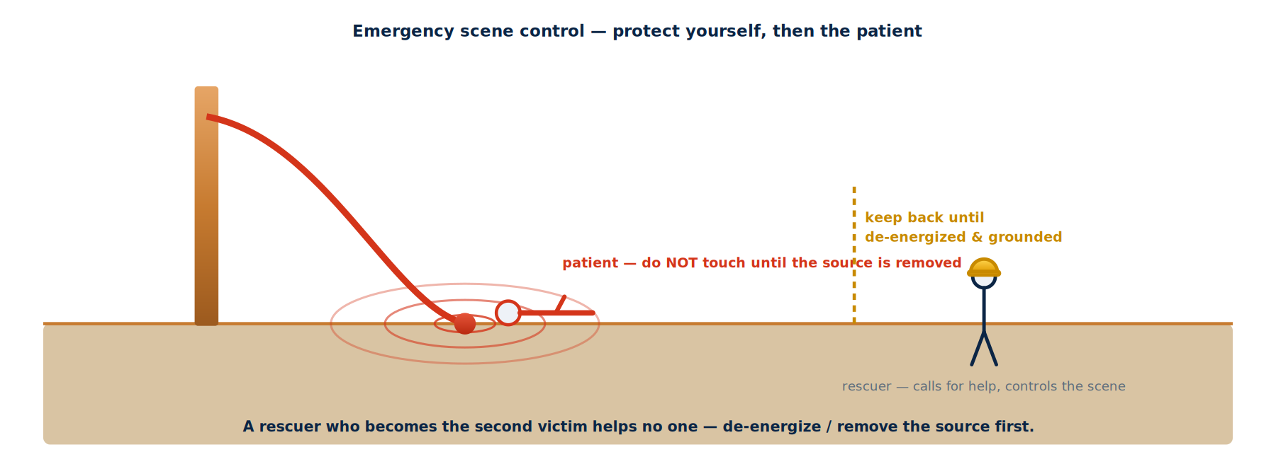
ILLUSTRATED
Emergency Scene Control
Treat the conductor and ground as energized; keep the patient untouched until the source is removed — then reach them.
Module 7 — Arc-Flash, First Aid & Rescue
Powerline Electrical Theory & Safety | 113
Notes:
Treat the conductor and ground as energized; keep the patient untouched until the source is removed — then reach them.

Slide 114
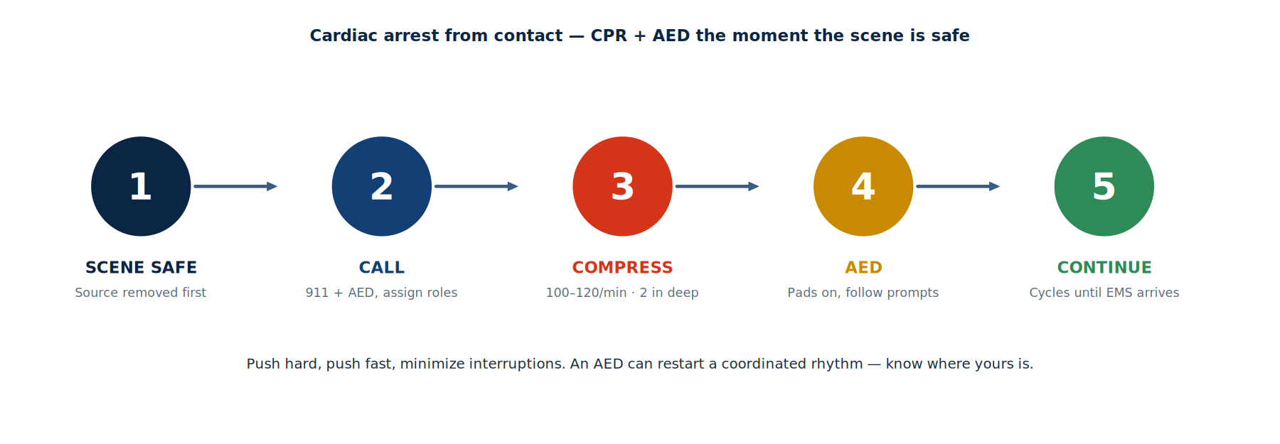
ILLUSTRATED
CPR & AED Sequence
Once the scene is safe: check & call, compress 100–120/min, apply the AED, continue until EMS arrives.
Module 7 — Arc-Flash, First Aid & Rescue
Powerline Electrical Theory & Safety | 114
Notes:
Once the scene is safe: check & call, compress 100–120/min, apply the AED, continue until EMS arrives.

Slide 115
MODULE 7 RECAP
Module 7 — Key Takeaways
■ Incident energy (cal/cm²) rises with fault current & clearing time, falls with distance²
■ The arc-flash boundary is where energy = 1.2 cal/cm²; PPE arc rating must meet or exceed the incident energy
■ Read the label and set your boundaries before opening equipment
■ One contact injures many systems — cardiac, burns, neuro, trauma; effects can be delayed
■ Rescue order is fixed: make the scene safe, reach the patient, then treat
■ CPR + AED for arrest; transport every contact for medical evaluation
Module 7 — Arc-Flash, First Aid & Rescue
Powerline Electrical Theory & Safety | 115
Notes:
Recap the arc-flash math and the fixed rescue order. Reinforce that every contact is transported and investigated.

Slide 116
MODULE
8
Current Paths, Grounding & the Bucket Truck
— It's all a circuit — completing the loop
— Why we ground: trip protection + equipotential
— The bucket truck — grounded vs isolated vs bonded
— Dangers in the air vs on the ground
— Flow through grounds & the zero-voltage idea
Notes:
The capstone: tie all the theory together around the current's path. This is where grounding, the bucket truck, and step/touch finally click into one mental model.

Slide 117
8.1 IT'S A CIRCUIT
It's All a Circuit — You Get Hurt by Completing It
Electricity does nothing until it has a complete loop across a difference in potential.
■ Current needs three things: a source, a complete path, and a difference in potential
■ No complete loop → no current flows — an open circuit is dead-ended
■ You are injured when your body BECOMES part of the loop — you turn into the load
– Touch one energized point AND a second point at a different potential → current flows through you
■ Two ways to stay safe: never complete the loop, or sit at ONE potential (no difference across you)
■ Every grounding and cover-up decision is really a question about where the current goes
Module 8 — Current Paths & Grounding
Powerline Electrical Theory & Safety | 117
Notes:
Anchor everything here: no complete loop, no current. Workers are hurt when they become the load. Two defenses — never complete the loop, or sit at one potential. Every later decision is a question about the path.

Slide 118
8.2 WHY WE GROUND
Why We Ground — Two Different Jobs
■ Job 1 — a low-impedance FAULT PATH: if a line is accidentally energized, large current flows to ground and trips the protection FAST
■ Job 2 — an EQUIPOTENTIAL ZONE: bond everything you can touch to one potential so there is little or no voltage ACROSS your body
– You can sit at thousands of volts to remote earth and be safe — if there is no difference across YOU
■ A protective ground must carry the available fault current without burning open
■ “Dead” is not “grounded” — induced voltage and accidental re-energizing are why we ground at the worksite
KEY CONCEPT
Ground = path + equipotential
– Trips protection (a path to the source).
– Flattens the voltage you stand in (equipotential).
– Both protect the worker — for different reasons.
Module 8 — Current Paths & Grounding
Powerline Electrical Theory & Safety | 118
Notes:
Separate the two jobs cleanly: grounding gives fault current a fast path to trip protection, AND it creates an equipotential zone so there's no voltage across the worker. People conflate these — keep them distinct.

Slide 119
8.3 TRUCK: GROUND OR ISOLATE?
The Bucket Truck: Ground It, Isolate It, or Bond It?
Three legitimate methods — the wrong mix of them is what kills.
■ GROUNDED: bond the truck to the system/earth so a contact faults and trips protection
■ ISOLATED: keep the truck off ground and rely on the insulated boom — treat the truck as energized
■ BONDED / at potential: bond the bucket to the conductor and work at line potential (bird-on-wire)
■ Which one you use is set by your employer's procedure, the system, and the task — never mix methods by accident
– The danger is a half-measure: a truck that is neither solidly grounded nor truly isolated
Module 8 — Current Paths & Grounding
Powerline Electrical Theory & Safety | 119
Notes:
Set up the three methods as deliberate choices. Stress that the killer is the half-measure — a truck that's neither solidly grounded nor truly isolated. The method is set by procedure, not preference.

Slide 120
8.4 GROUNDED TRUCK
Scenario A — The GROUNDED Truck
■ The truck is bonded to a driven ground / the system ground
■ If the boom contacts a line, fault current flows down the truck and into the earth
– Protection sees the fault and trips quickly — the upside of grounding
■ But the current entering the earth raises the ground potential around the truck
– Step & touch potential endangers the ground crew and the public near the truck
■ Anyone touching the truck while standing on the ground is across that voltage
WARNING ⚠
The trade-off
– Grounding buys you a fast trip.
– It also puts the ground crew in the fault path.
– Control the area: bond, barricade, keep people back.
Module 8 — Current Paths & Grounding
Powerline Electrical Theory & Safety | 120
Notes:
Walk the current: contact, down the truck, into the earth, breaker trips. Then the catch — the earth around the truck rises in potential, so the ground crew and public face step & touch. Grounding protects the circuit but loads the bystanders. Barricade and bond.

Slide 121
8.5 ISOLATED TRUCK
Scenario B — The ISOLATED (Ungrounded) Truck
■ The truck is NOT grounded; the insulated (dielectric) boom isolates the bucket worker
■ If the boom contacts a line, there is no path to complete — so the breaker does NOT trip
– The whole truck rises to line potential and stays energized
■ The bucket worker is safe at potential — but the TRUCK is now a live object
■ Anyone who bridges truck-to-ground (steps off, hands up a tool, touches the chassis) completes the circuit
■ Barricade the truck, keep ground workers clear, and treat it as energized
WARNING ⚠
No path, no trip
– The boom protects the worker aloft.
– The truck is energized with no warning trip.
– Never bridge the truck to ground.
Module 8 — Current Paths & Grounding
Powerline Electrical Theory & Safety | 121
Notes:
Opposite trade: no path means no trip, so the whole truck rises to line potential and stays live with no warning. The insulated boom protects the bucket worker. The danger is on the ground — anyone bridging truck-to-earth completes the circuit. Barricade; never touch from the ground.

Slide 122
8.6 BONDED / AT POTENTIAL
Working at Potential — Bonded (Bird on a Wire)
■ The bucket / worker is BONDED directly to the conductor with a jumper
■ Worker and conductor sit at the SAME potential — like the bird on one wire
– No difference across the body → no current through the worker, even at line potential
■ The rule that makes it safe: absolutely NO second point at a different potential
– Another phase, a grounded structure, or the boom touching earth would be fatal
■ This is a deliberate, procedure-driven method — not the same as accidental isolation
KEY CONCEPT
One potential only
– Bonded = you ride the wire's potential.
– Safe only while there is no second potential.
– Maintain isolation from everything else.
Module 8 — Current Paths & Grounding
Powerline Electrical Theory & Safety | 122
Notes:
The bird-on-wire method made deliberate: bond the bucket to the conductor and ride at line potential. Safe ONLY while there is no second point at a different potential — another phase, a ground, the boom touching earth. Emphasize it's procedure-driven, not accidental.

Slide 123
8.7 AIR VS GROUND
Dangers in the Air vs On the Ground
■ ALOFT: direct contact, second point of contact, phase-to-phase / phase-to-ground, MAD & arc-over, induced voltage, the boom bridging in
■ ON THE GROUND: step & touch potential, a downed conductor energizing the earth, the truck as a live object, ground gradient across the feet, the public
■ The same fault is two different problems depending on where you are standing
■ Aloft you control it with cover-up, MAD, isolation/bonding; on the ground with grounds, EPZ, barricades, and shuffling
DANGER ⚠
Two zones, two playbooks
– Aloft: isolate / bond / cover-up.
– Ground: equipotential / barricade / shuffle.
– Brief BOTH before the job.
Module 8 — Current Paths & Grounding
Powerline Electrical Theory & Safety | 123
Notes:
Make them see the same fault as two problems. Aloft: contact, second point, MAD, induced. On the ground: step/touch, downed conductor, the live truck, the public. Different zone, different controls — brief both.

Slide 124
8.8 FLOW & ZERO-VOLTAGE
Flow Through Grounds & the Zero-Voltage Idea
■ Fault current follows EVERY available path back to its source, in proportion to each path's impedance
■ Good grounds give it a fat, low-impedance path — so very little chooses to go through you
■ Equipotential bonding makes the voltage ACROSS your body near zero, even if you are at high potential to remote earth
– High potential is fine; a DIFFERENCE in potential across you is what hurts
■ Test dead, then ground — and remember “dead” is not “grounded” until you have bonded it at the worksite
BEST PRACTICE
Zero across you
– Current splits by impedance — make your body the worst path.
– Bond to kill the difference, not the potential.
– The grounds do the carrying; you stay at one level.
Module 8 — Current Paths & Grounding
Powerline Electrical Theory & Safety | 124
Notes:
Driving idea: current splits among all paths by impedance, so make your body the worst path with good grounds, and bond to drive the voltage ACROSS you to near zero. High potential doesn't hurt — a difference does. Reinforce 'dead isn't grounded.'

Slide 125
8.9 THE DECISION
Choosing & Controlling the Current Path
Before the boom goes up, decide where the current would go — and prove it can't go through a person.
■ Identify the source(s) and every path the current could take to get back
■ Pick the method on purpose — grounded, isolated, or bonded — per your procedure
■ Control the ground area: bond/EPZ, barricade, and keep the public and ground crew clear
■ Cover up aloft, hold MAD, and never create a second point at a different potential
■ Treat every conductor and the truck as energized until tested, grounded, or bonded
Module 8 — Current Paths & Grounding
Powerline Electrical Theory & Safety | 125
Notes:
The decision checklist: find the sources and return paths, pick the method on purpose, control the ground area, cover up aloft, and treat everything as energized until proven otherwise. This is the working synthesis of the whole course.

Slide 126
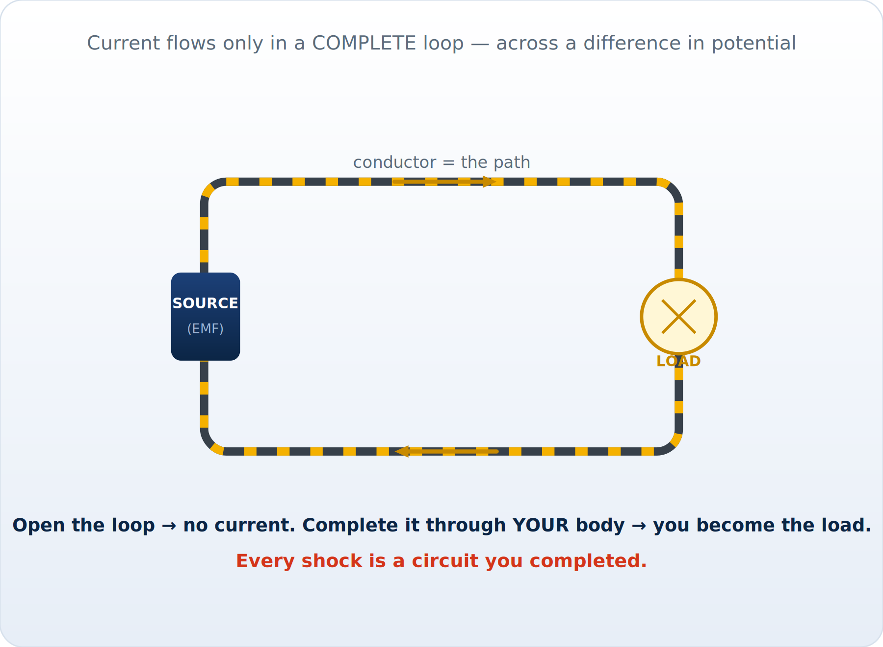
ILLUSTRATED
A Circuit Needs a Complete Loop
Source, a complete path, and a difference in potential — all three, or nothing flows. You become the load when you bridge two potentials.
Module 8 — Current Paths & Grounding
Powerline Electrical Theory & Safety | 126
Notes:
Source, a complete path, and a difference in potential — all three, or nothing flows. You become the load when you bridge two potentials.

Slide 127
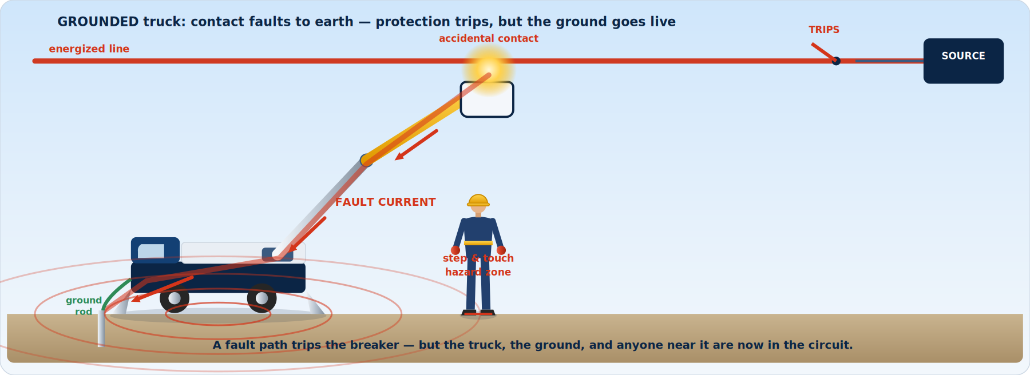
ILLUSTRATED
The Grounded Truck — Fault Path & Step/Touch
Grounding trips protection fast — but the current entering the earth raises the ground potential, putting the crew and public near the truck in the circuit.
Module 8 — Current Paths & Grounding
Powerline Electrical Theory & Safety | 127
Notes:
Grounding trips protection fast — but the current entering the earth raises the ground potential, putting the crew and public near the truck in the circuit.

Slide 128
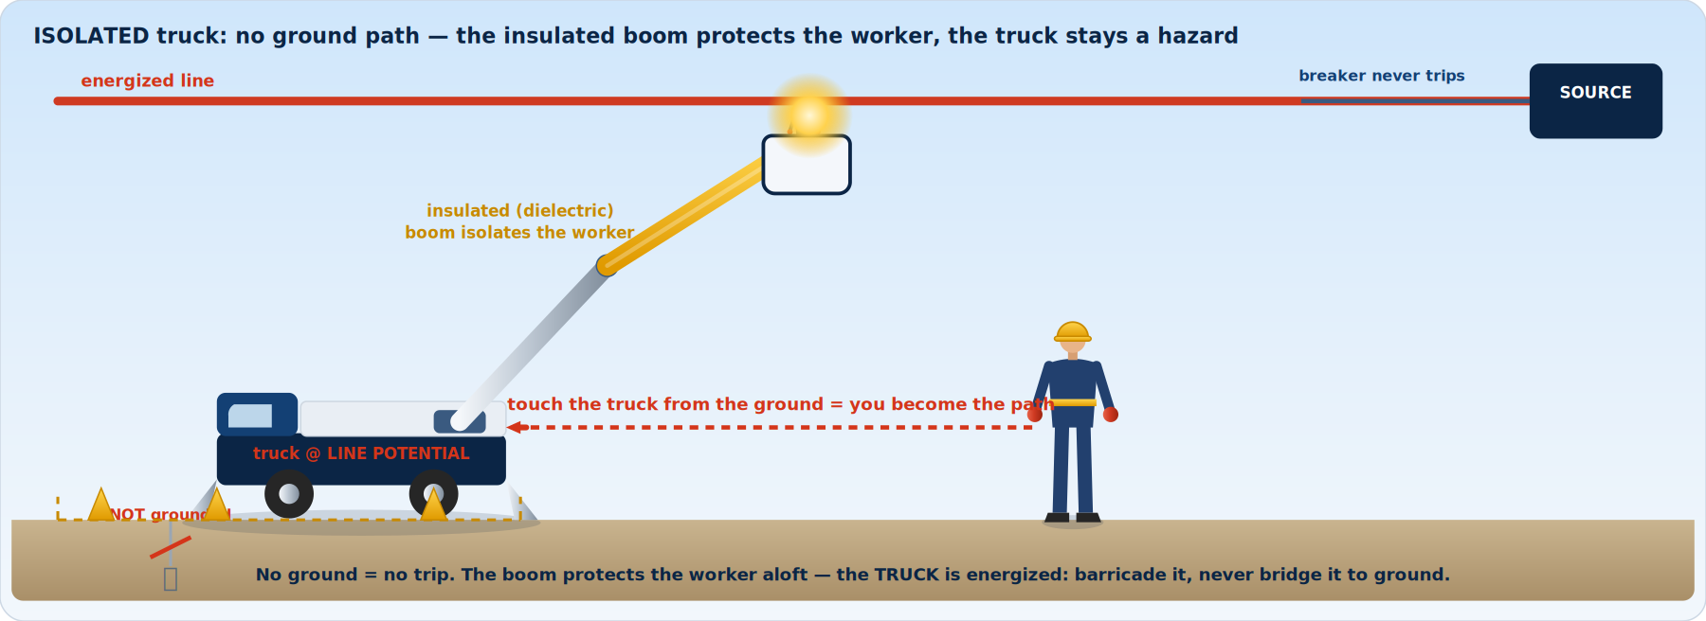
ILLUSTRATED
The Isolated Truck — No Path, No Trip
No ground path means the breaker never trips and the whole truck sits at line potential. The boom protects the worker; bridging the truck to ground completes the circuit.
Module 8 — Current Paths & Grounding
Powerline Electrical Theory & Safety | 128
Notes:
No ground path means the breaker never trips and the whole truck sits at line potential. The boom protects the worker; bridging the truck to ground completes the circuit.

Slide 129
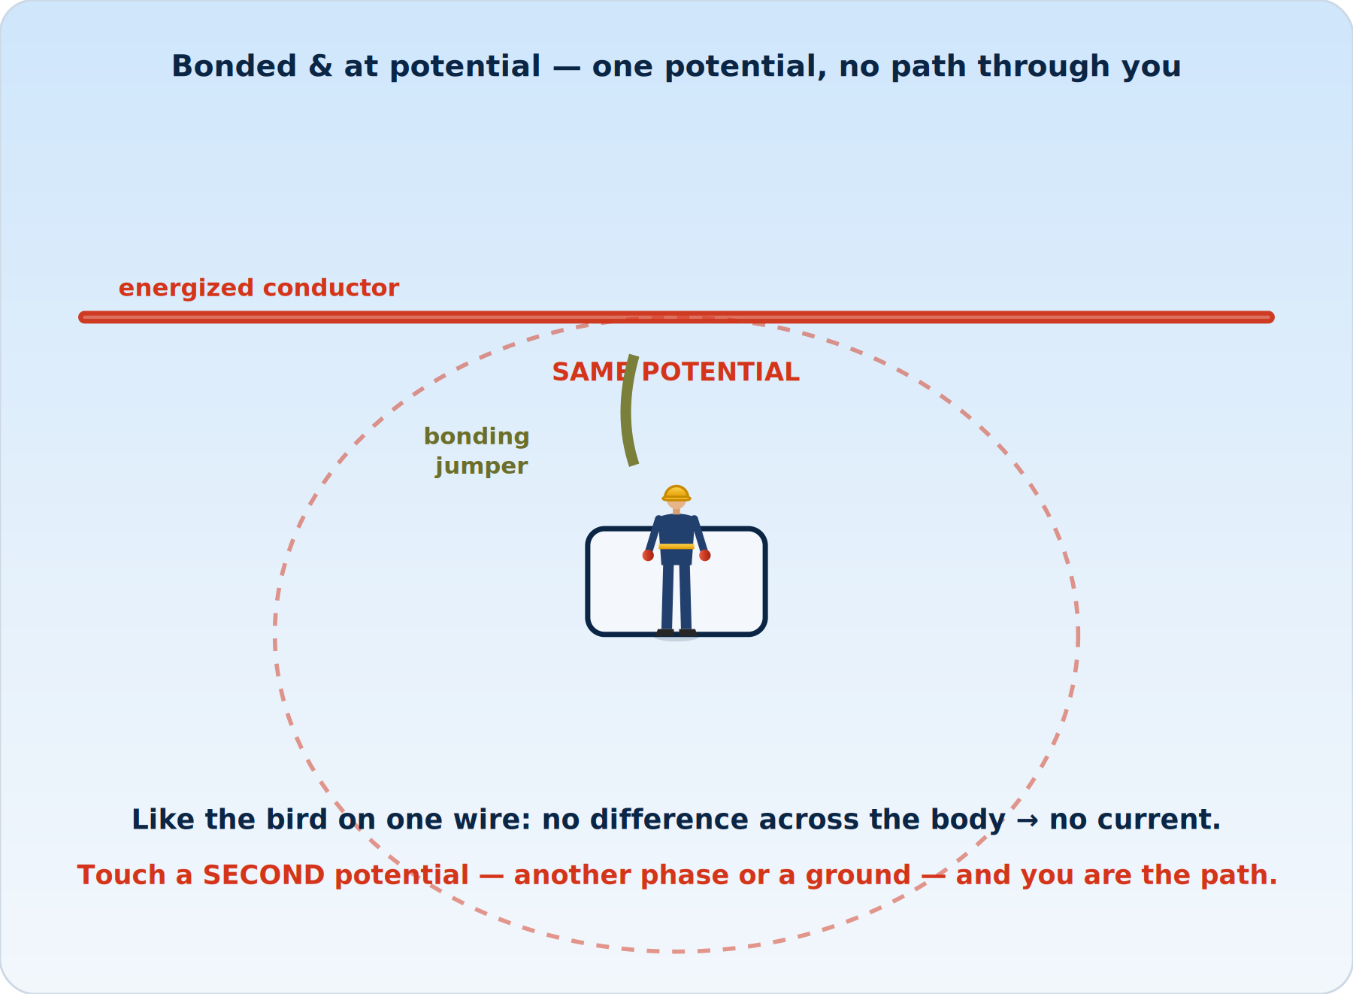
ILLUSTRATED
Bonded — Working at Line Potential
Bond the bucket to the conductor and ride at one potential, like the bird on a wire — fatal the instant a second potential is touched.
Module 8 — Current Paths & Grounding
Powerline Electrical Theory & Safety | 129
Notes:
Bond the bucket to the conductor and ride at one potential, like the bird on a wire — fatal the instant a second potential is touched.

Slide 130
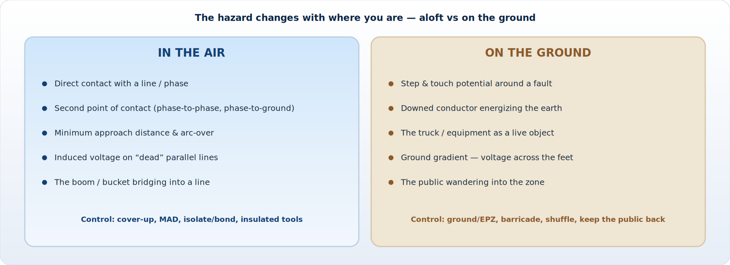
ILLUSTRATED
Air vs Ground — Two Zones, Two Playbooks
The same fault is a different problem depending on where you stand. Brief both the aloft hazards and the ground hazards before the job.
Module 8 — Current Paths & Grounding
Powerline Electrical Theory & Safety | 130
Notes:
The same fault is a different problem depending on where you stand. Brief both the aloft hazards and the ground hazards before the job.

Slide 131
MODULE 8 RECAP
Module 8 — Key Takeaways
■ Injury = your body completing a circuit; safety = no loop, or one potential across you
■ We ground for two reasons: a fault path to trip protection AND an equipotential zone
■ Grounded truck → trips fast but energizes the ground (step & touch); barricade it
■ Isolated truck → the boom protects the worker, but the truck is live and won't trip; never bridge it to ground
■ Bonded / at potential → safe at one potential only; no second point, ever
■ High potential doesn't hurt — a difference across you does; current splits by impedance
Module 8 — Current Paths & Grounding
Powerline Electrical Theory & Safety | 131
Notes:
Recap around the path: injury is completing a circuit; ground for path + equipotential; grounded vs isolated vs bonded trade-offs; a difference across you is what hurts.

Slide 132
MODULE
✓
Bringing It All Together
— The mental model from theory to the field
— Daily safe-work disciplines
— Final reminders
— Resources & references
Notes:
Transition to synthesis — turning everything into one mental model and a set of daily habits.

Slide 133
SYNTHESIS
From Theory to the Field — The Mental Model
1
Understand the energy
Voltage pushes current; current through you kills. Know your voltage class and fault energy.
2
Find the circuit
Where would current flow through ME? Locate the SECOND POINT OF CONTACT — every time.
3
Choose the control
De-energize if you can. If hot: isolate AND insulate — MAD, cover-up, gloves, grounds, EPZ.
4
Verify
Test the tester, test-before-touch, prove dead, apply grounds, inspect every piece of PPE.
5
Brief & assign
Tailboard the hazards, controls, roles, comms, and rescue. Everyone understands. Everyone can stop work.
6
Work & reassess
Maintain controls all the way through. When ANYTHING changes — stop, re-brief, re-assess.
Course Wrap-Up
Powerline Electrical Theory & Safety | 133
Notes:
Walk the six-step loop slowly: understand the energy, find the circuit, choose the control, verify, brief, work and reassess. This is the through-line of the whole course.

Slide 134
DAILY DISCIPLINE
Ten Disciplines That Keep Crews Alive
If you remember nothing else, remember these.
■ Treat every conductor as energized until YOU prove it dead and grounded
■ Always identify and eliminate the second point of contact
■ Maintain minimum approach distance — for your body, tools, and equipment
■ Cover up: nearest hazard first, remove in reverse
■ Test the tester before and after; test-before-touch
■ Ground and bond an equipotential zone at the work site
■ Inspect rubber goods and tools before every use; honor test dates
■ Hold a real tailboard — and re-brief when anything changes
■ Plan the rescue before the work; never become the second victim
■ Use your stop-work authority — no job is worth your life
Course Wrap-Up
Powerline Electrical Theory & Safety | 134
Notes:
Read these as a crew pledge. If they remember nothing else from the day, make it these ten.

Slide 135
CLOSING
Final Word
■ Electricity is invisible, silent, and unforgiving — but it is also entirely predictable
■ It follows the same laws every time, which means the hazard is always controllable
■ The theory in Module 1 is not academic — it is WHY every rule in Modules 3–6 works
■ Skills fade and complacency creeps in — that is why we train, brief, and reassess relentlessly
■ Look out for the worker next to you as carefully as you look out for yourself
BEST PRACTICE
The whole point
– Everyone goes home, every day.
– That is the only acceptable outcome of any job — and it is achievable on every job.
Course Wrap-Up
Powerline Electrical Theory & Safety | 135
Notes:
Close on the philosophy: electricity is invisible and unforgiving, but entirely predictable — which means the hazard is always controllable. Look out for each other.

Slide 136
REFERENCES
Resources & References
Regulations & codes
Standards & training
■ OSHA 29 CFR 1910.269 — GT&D (general industry)
■ OSHA 29 CFR 1926 Subpart V — construction
■ OSHA 1910.137 — electrical protective equipment
■ OSHA 1910.147 — control of hazardous energy (LOTO)
■ NESC — IEEE C2; NFPA 70E — arc-flash safety
■ ASTM F18 committee standards (D120, F496, F855, etc.)
■ IEEE standards for live-line work & grounding
■ Your employer's safe-work practices & MAD tables
■ Apprenticeship program materials & manufacturer manuals
■ First aid / CPR / AED & pole-top rescue certification
Course Wrap-Up
Powerline Electrical Theory & Safety | 136
Notes:
Point the crew to the standards and, most importantly, to their own employer's procedures and approved MAD tables.

Slide 137
Questions & Discussion
Review the hazards on YOUR system, with YOUR equipment, against YOUR procedures.
Stay sharp. Watch your second point of contact. Everyone goes home.
Notes:
Open the floor. Bring it back to their system, their equipment, and their procedures.

