Slide 1
Heroes of CSS
Day 3
June 25th, 2016
Afternoon Slides

Slide 2
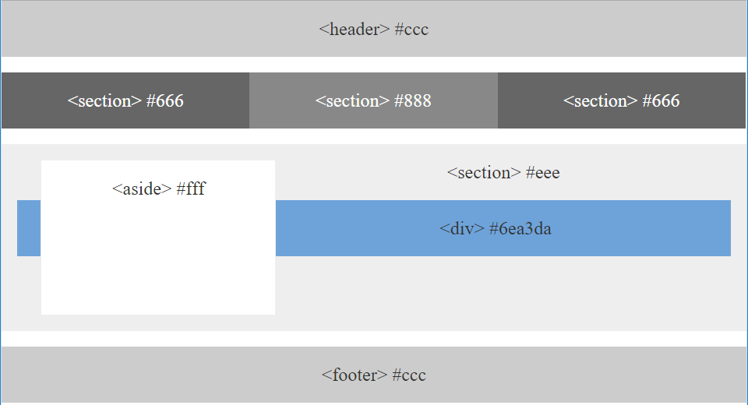
> YOUR TURN!!

Slide 3
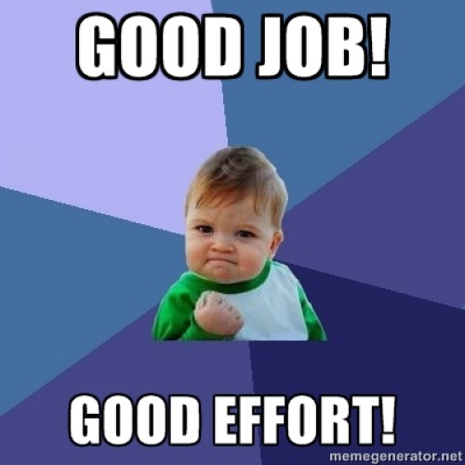
Good work!
Your Brain may rest now

Slide 4
CSS Positioning

Slide 5
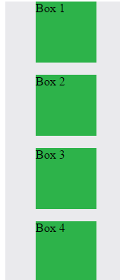
Position: Static (Default)
Four boxes placed statically (default)

Slide 6
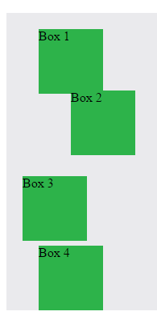
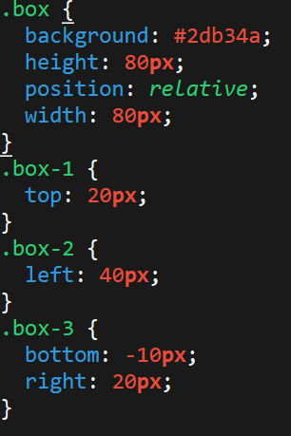
Position: Relative
Switching the boxes to relative nudges the boxes in relation to their “original” location.

Slide 7
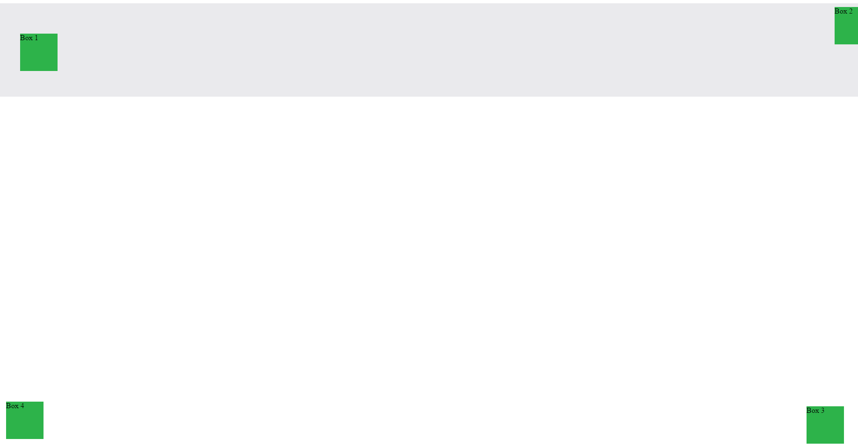
Position: Absolute
Position with location relevant to first “placed” element

Slide 8

Position: Fixed
Position with exact coordinates to the browser window

Slide 9
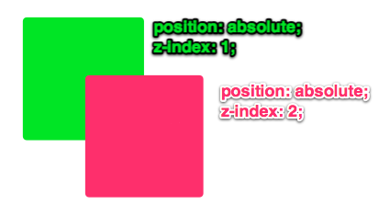
Layering with Z-Index
Z-Index allows you to layer elements on top of each other when placed in absolute coordinates

Slide 10
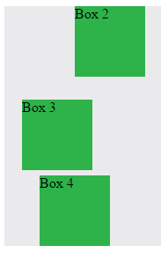
Hiding Things
Display none allows elements to be completely hidden from view.
This becomes useful because in later sections, we will be selectively activating and de-activating.

Slide 11
Quick Demo
Instructor: Demo
(5-CSS_PositionedLayout)

Slide 12
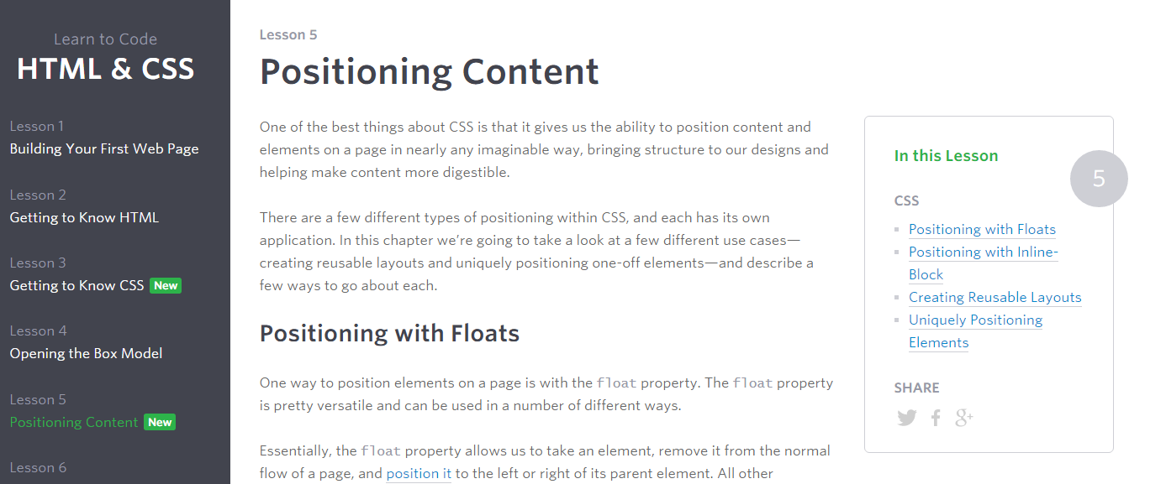
Great Resource
Another great read for front-end developers (and game designers): http://learn.shayhowe.com/html-css/positioning-content/

Slide 13
> YOUR TURN!!
6-CSS_Positioned_Activity | Suggested Time: 30 min
Assignment
In this activity, you will be flexing your newfound positioning skills to create another conceptual layout. Eyeball the design to your best ability.
Additional instructions, sent via Slack.

Slide 14
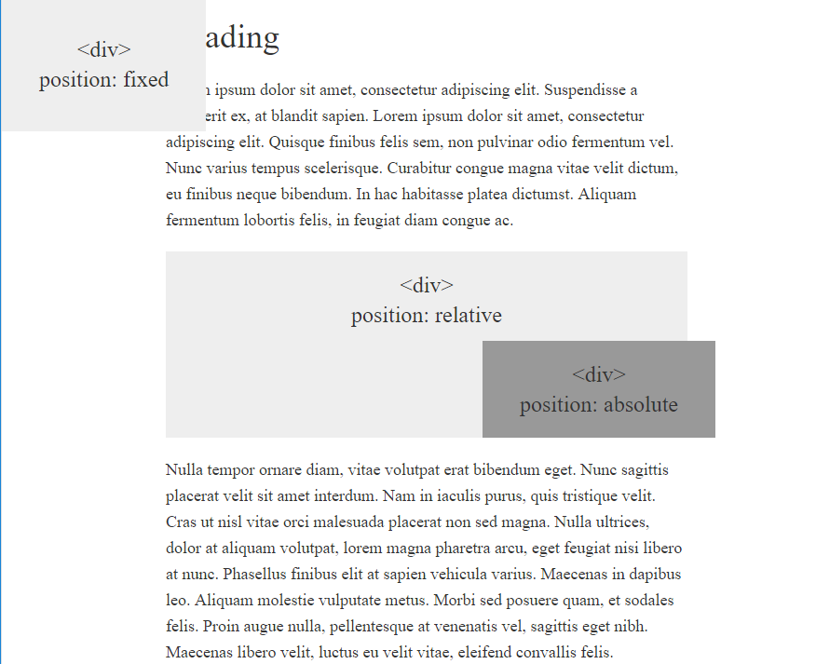
> YOUR TURN!!

Slide 15
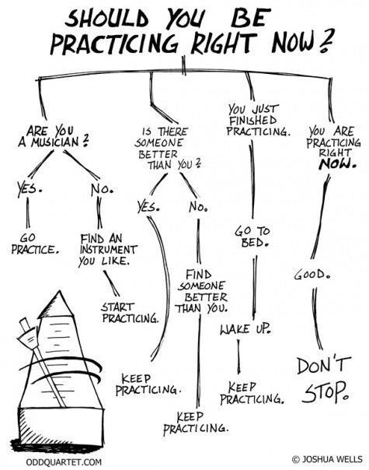
Advice
Re-do this at home. It’s a good one to firm up your HTML/CSS skills.
REMEMBER:
The best way to get good is to PRACTICE

Slide 16
Chrome Inspector

Slide 17
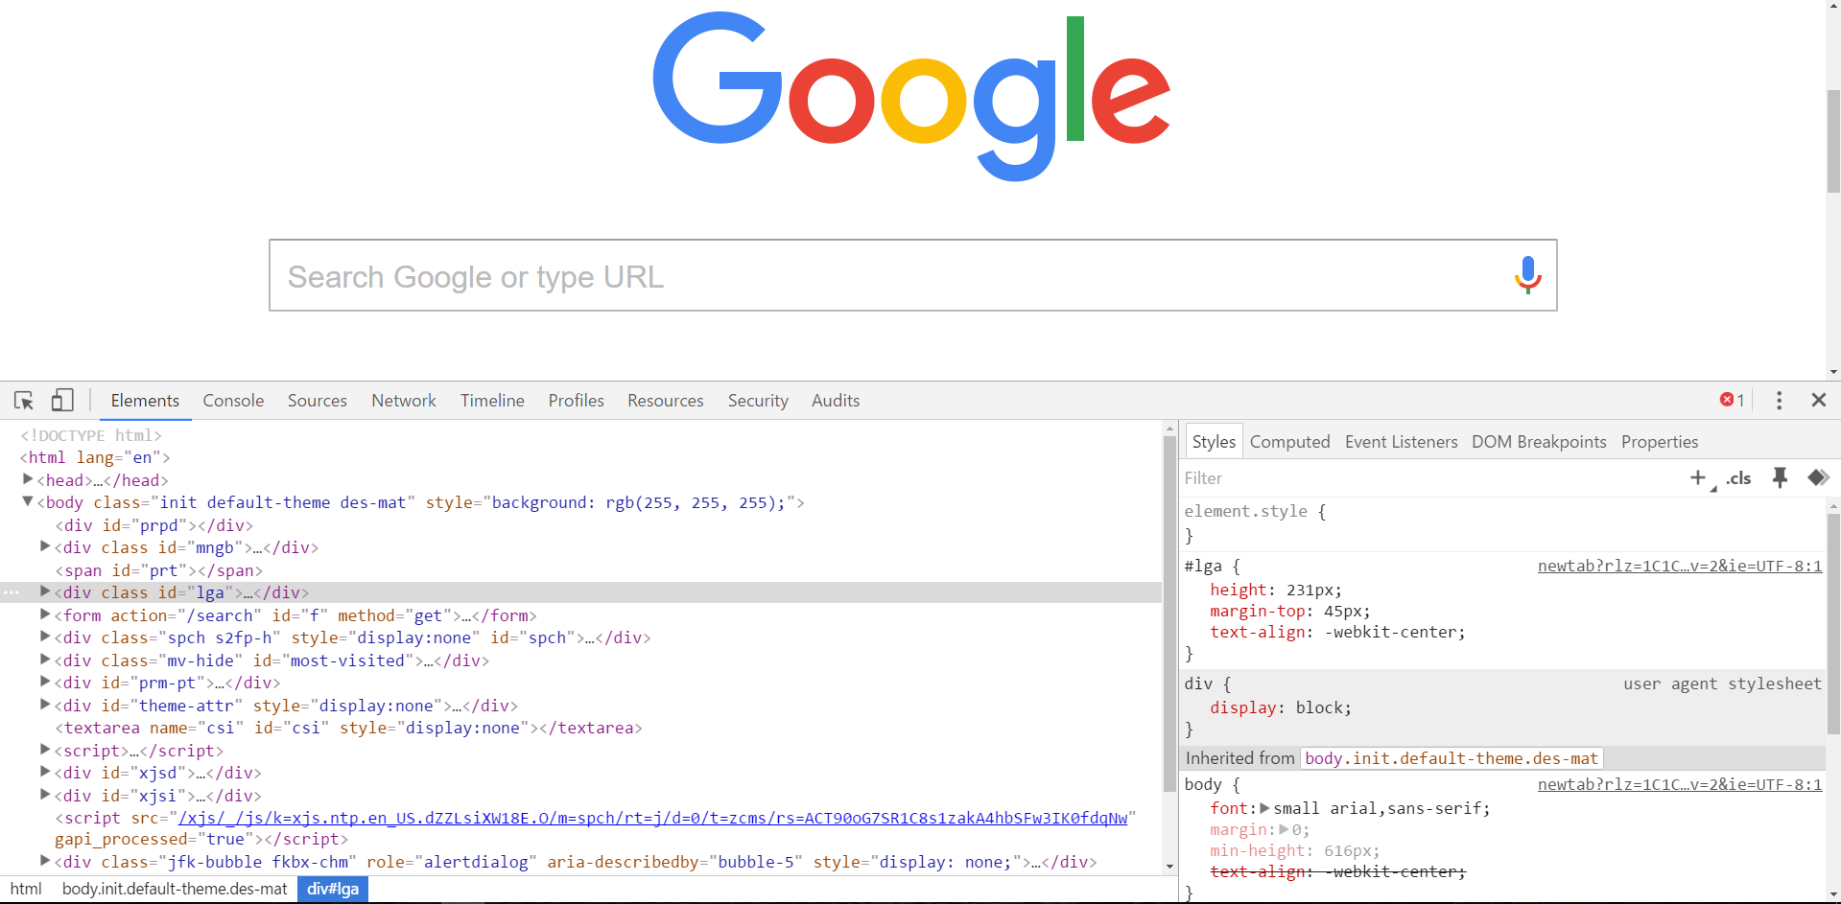
Chrome Inspector is Your Friend
To access chrome inspector: Right click on a page then hit “Inspect”
It will allow you to inspect the HTML, CSS, and more!

Slide 18
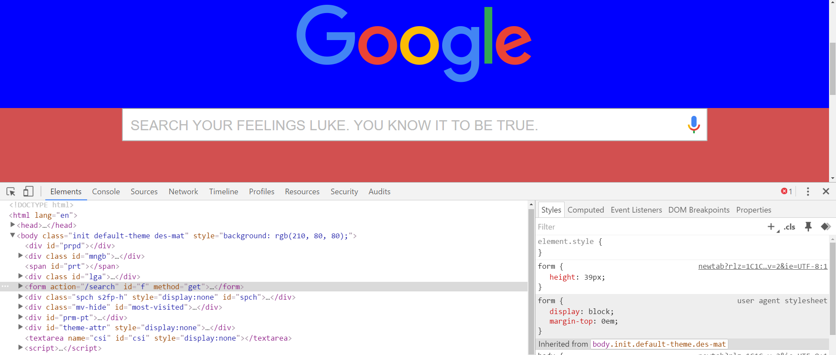
Chrome Inspector is Your Friend
Using Chrome Inspector you can readily edit any webpage (your own or otherwise) to see the immediate impact of HTML or CSS changes

Slide 19
> YOUR TURN!!
Assignment
For the next 15 minutes, take a website that you commonly use (Amazon, Google, Huff Po, etc.) and heavily modify it using the Google Developer Tools.
Be sure to at least modify:
Content (Change words)
Colors
Spacing
Etc.
Send a screenshot to the class’ slack profile when you’re done.

Slide 20
CSS Resets

Slide 21
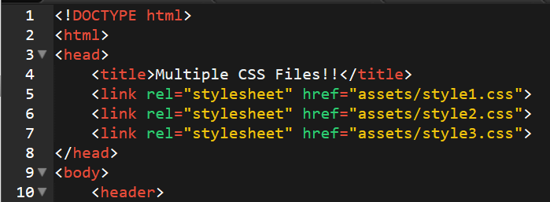
Loading Multiple CSS Files ***(Very Important!!!)***
One of the most powerful aspects of CSS is the ability to deploy multiple CSS files simultaneously.
This allows developers the ability to create complex designs – made up of multiple design elements.
Just remember the loading order matters!!!

Slide 22
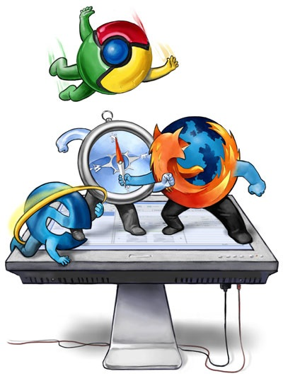
Battle of the Browsers
Under-the hood there are often significant differences between how browsers render webpages.
These differences in rendering agents can mean HTML/CSS gets displayed differently in each.
As designers/developers, creating cross-browser compatible websites is critical.

Slide 23
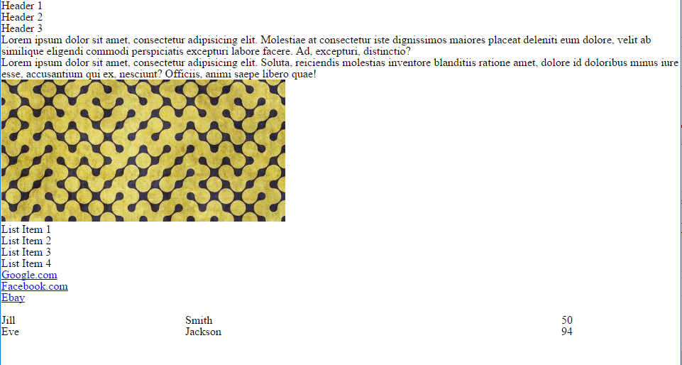
Reset.css (or Normalize.css)
Reset.css ensures that all browser-specific css has been reset, so it appears the same in all browsers.
This means you will have to re-style everything yourself

Slide 24
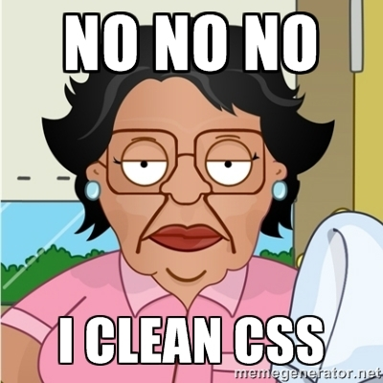
Why CSS Resets Matter
It’s important for creating browser-compatible websites
It’s an example of using someone else’s CSS in your website!!!
It’s a common Front-End Developer Interview question.

Slide 25
> YOUR TURN!!
Assignment
Follow the instructions given via slack to incorporate a reset.css file into a basic HTML file.
Note the impact the reset file makes after its inclusion.

Slide 26
Recap + Reassurances

Slide 27


