Slide 1
Break – Resume at 12:30 pm

Slide 2
> YOUR TURN!!
Activity: 9-RPS-Coded | Suggested Time: 1 hour 10 min
Code Creation: Coding out RPS
With groups of 4, begin the process of coding out the Rock-Paper-Scissors Game.
Do as much as you can, on your own but raise your hand regularly to ask a TA or Instructor to help.
Note: Don’t worry. We know this will be very challenging. We also know that you won’t know where to start. In fact, we haven’t shown you EVERYTHING you need yet. But that’s okay. Accepting the confusion is a HUGE first step in becoming a coder.
Note to Instructor/TAs: Use the files in RPS-Coded to help guide students through the process. Feel free to bits of code that are relevant on the projector.

Slide 3
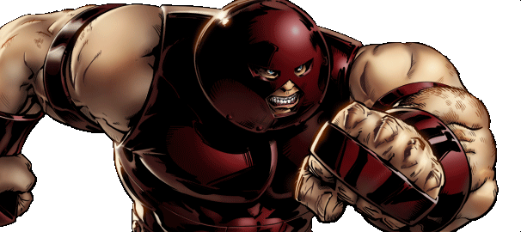
This will soon be you…
Javascript Juggernauts.

Slide 4
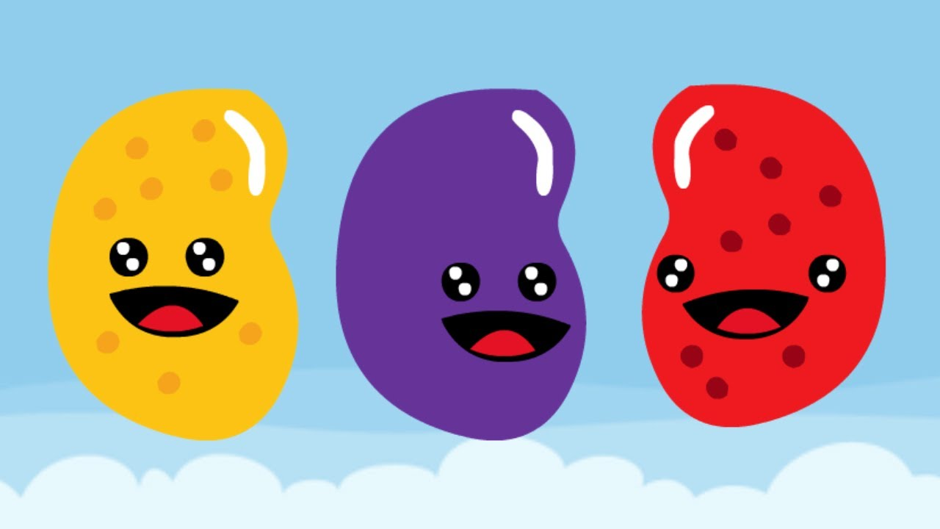
But right now…
Probably feeling like
Javascript Jellybeans.

Slide 5
Transformation to Come
HANG IN THERE!

