Slide 1
Javascript Juggernauts
Day 9
July 11th, 2016

Slide 2

This will soon be you…
Javascript Juggernauts.

Slide 3
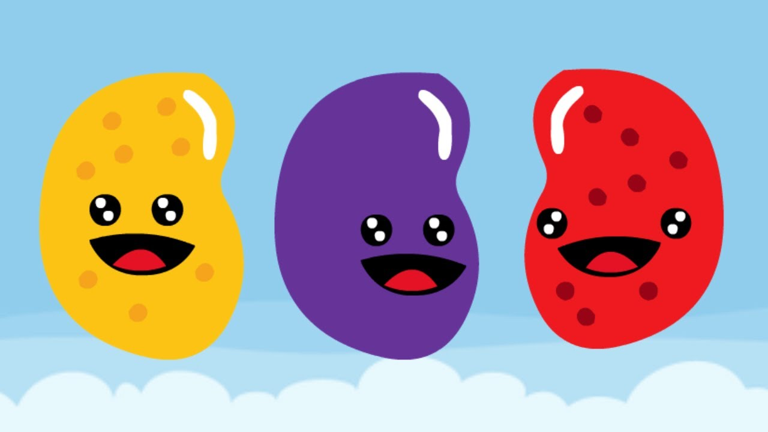
But right now…
Probably feeling like
Javascript Jellybeans.

Slide 4
Transformation to Come
HANG IN THERE!

Slide 5
Today’s Class First a little R.E.S.P.E.C.T

Slide 6
Objectives
In today’s class we’ll be covering:
Javascript Functions
Javascript Objects
Building Simple Javascript Applications
Homework timeline
Assigned Friday and due the following Saturday (8 days)
Make a goal to have it completed on Thursday so we can cover all issues during the Friday hangout – Submit early!
Then you can start looking at the next homework Friday and get a lot more out of the class on Saturday!

Slide 7
Juggernauts be Born
Let’s get straight to it!

Slide 8
Functions!

Slide 9
> YOUR TURN!!
Activity: 1-LoopTV | Suggested Time: 10 min
Code Dissection: Array Building
Open LoopTV_Unsolved.html in Chrome.
Then, with a partner fill in the missing comments for each line of code in your IDE (Sublime Text). In other words, replace the question marks - ???? with comments that explain what the following line of code accomplishes. Don’t miss the one in the for loop ☺
Make sure both of you can fully explain what each line means.
Be prepared to share! -- Round the room when fini

Slide 10
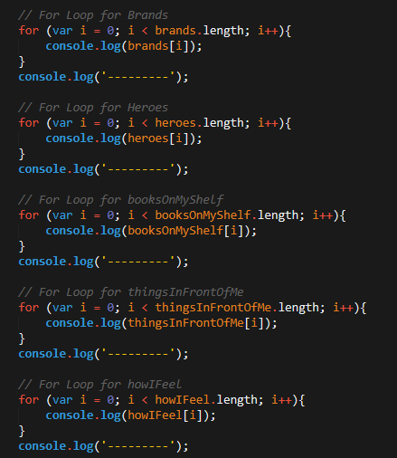
Mondo Repetitive…
Who wants to maintain this??
Hint: No one.

Slide 11
Let’s optimize some code! 15 Min
Interactive Build
(SuperHeroLogging_NoFunctions.html)
Group by table
2 minutes to review code
Round the room by table
You get to do this all by yourself next ☺
Sublime Text Tips:
Ctrl – Shift – L
Alt – F3

Slide 12
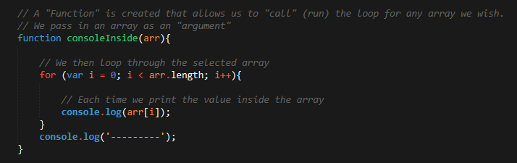
Much Better with Functions!
Squeaky Clean Code.
With very minimal repetition
WHO CARES? WHY? - - to -+

Slide 13
> YOUR TURN!!
Activity: 3-MyFirstFunctions | Suggested Time: 20 min
Code Creation: Function Building
Working in pairs, use MyFirstFunctions_Unsolved.html and fill in the missing functions and function calls.
Note: Try to finish all four functions if you can. But don’t beat yourself if you only get 1 or 2. The important thing is that you get at least one function fully done.
Hint: Look back the example just slacked to you.
Another Hint: https://developer.mozilla.org/en-US/docs/Web/JavaScript/Reference/Statements/function
function logArrays(someArray) {
for (var i = 0; i < someArray.length; i++){
alert(someArray[i]);
}
}

Slide 14
Break. Resume at 8:23

Slide 15
Objects!

Slide 16
Demo Time
Instructor: Demo
(GoodArray.html)

Slide 17
Demo Time
Instructor: Demo
(JoanofArcArrays.html)
Doable? Yes
Easy to understand & Maintain? No

Slide 18
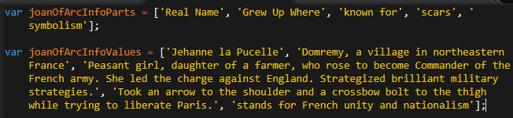
Associated Data ==/== Arrays
Relating two separate arrays is not fun.

Slide 19
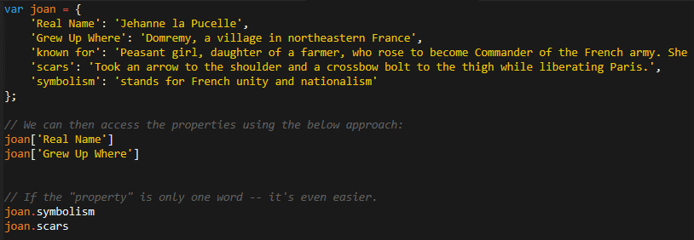
Joan of Arc – The Maid of Le’Objects
Now, Joan’s “properties” and “values are associated in object form. Making it easy to recall specific data

Slide 20
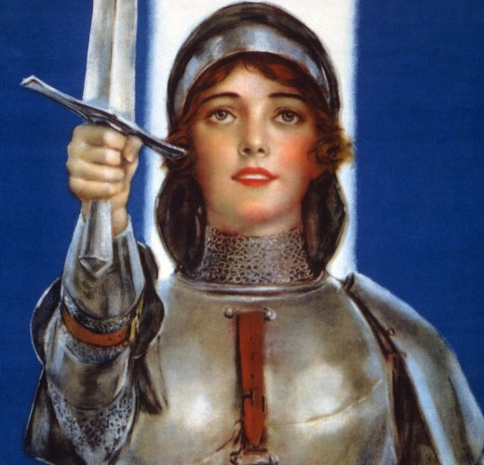
Objects Visualized
var joan
=
{
“Real Name”
:
“Jehane La Pucelle”
,
“scars”
:
“Took an arrow to shoulder…”
,
“symbolism”
:
“Stands up for French Unity..”
}
This is Joan. According to code… Joan is an Object

Slide 21
Objects Visualized
var joan
=
{
“Real Name”
:
“Jehane La Pucelle”
,
“scars”
:
“Took an arrow to shoulder…”
,
“symbolism”
:
“Stands up for French Unity..”
}
These are Joan’s properties (like descriptors)

Slide 22
Objects Visualized
var joan
=
{
“Real Name”
:
“Jehane La Pucelle”
,
“scars”
:
“Took an arrow to shoulder…”
,
“symbolism”
:
“Stands up for French Unity..”
}
These are the “values” of Joan’s Properties

Slide 23
Objects Visualized
var joan
=
{
“Real Name”
:
“Jehane La Pucelle”
,
“scars”
:
“Took an arrow to shoulder…”
,
“symbolism”
:
“Stands up for French Unity..”
}
Thus: Joan.scars = “took an arrow to shoulder”

Slide 24
Fun with objects…
Instructor: Demo
(JoanofArcObjects.js)
In Console
JSFiddle

Slide 25
> YOUR TURN!!
Activity: 7-MyFirstObject | Suggested Time: 15 min
Code Dissection / Creation: Basic Objects
With a partner, spend the next few moments studying carObject_Unsolved.html
Then add code to log the relevant information about the provided `car` object for each question asked in the comments at the bottom of the file after `// How would I log....`
Bonus: If you finish early, begin creating an object of your own in HTML. Slack out a snippet of the code to the class when you are done. Be Creative!
Questions on this? https://developer.mozilla.org/en-US/docs/Web/JavaScript/Reference/Operators/this `As an Object Method` section… You need to know THIS ☺

Slide 26
Demo Time
Instructor: Show in Browser
(carGame_Solved.html)

Slide 27
> YOUR TURN!!
Activity: 8-CarGame | Suggested Time: 30 min
Code Creation: Run that Car!
Using carGame_Unsolved.html, create a complete application such that:
Users can enter keyboard input (letters) – {Hint – get keyboard input the same as we did for RPS Saturday}
These letters then trigger the car’s functions to get run
These letters also trigger a global function called reWriteStats() that logs the car’s make, model, color, mileage, and isWorking status to the console.

Slide 28
> YOUR TURN!!
Activity: 9-TriviaGame | Suggested Time: 45 min
Extra Activity: Trivia Game
With whatever class time remains, complete the following activity in pairs.
Starting from a blank HTML file:
Create an object with 10 questions. The object should be structured like this: q1: [“QUESTION”, “ANSWER”] q2: [“QUESTION”, “ANSWER”]
Then create code that goes through the questions one by one and asks users each question. Users must hit t (for true) or f (for false).
Check the user’s answer against the correct answer and provide the user an alert of some sort if they are right or wrong.
Bonus: Keep track of the number of questions the user gets right or wrong.
Hint:
Don’t worry about having DRY code to start with. Just focus on getting working code first.

Slide 29
Questions {Homework?}

