Slide 1
JS and jQuery Jubilee
12:45p Start Time
Day 11
July 16th, 2016
The {yawn} after lunch part….

Slide 2
Lexical Scope

Slide 3

Shh… Just Between Us.
WARNING:
This next section is heavy on theory.
Disclaimer:
It’s not the end of the world if its confusing and/or you’re completely lost.

Slide 4
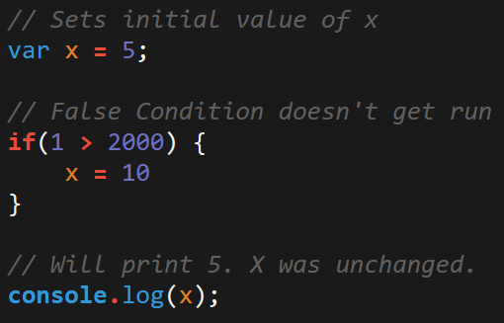
Javascript Scope
In Javascript curly brackets { } indicate blocks of code.
In order for the code inside the curly brackets to be executed, it must meet the condition or it must be called (example: functions).
These blocks of code have the power to affect variables outside the curly brackets if those variables were declared outside – so be careful!

Slide 5
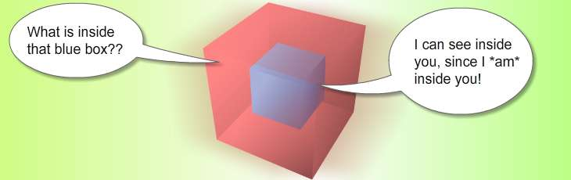
Scope = Boxes in Boxes
Scope impacts which variables can be accessed by which function.

Slide 6
Scope = Boxes in Boxes
function global()
function inner()
function eveninner()
function innest()

Slide 7
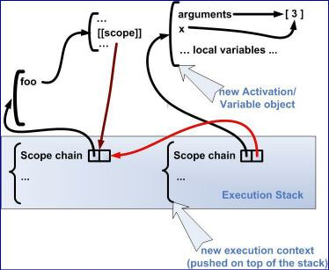

Javascript’s Odd Relationship with Scope
For those who have programmed in other languages, Javascript seemingly behaves in unpredictable ways.

Slide 8
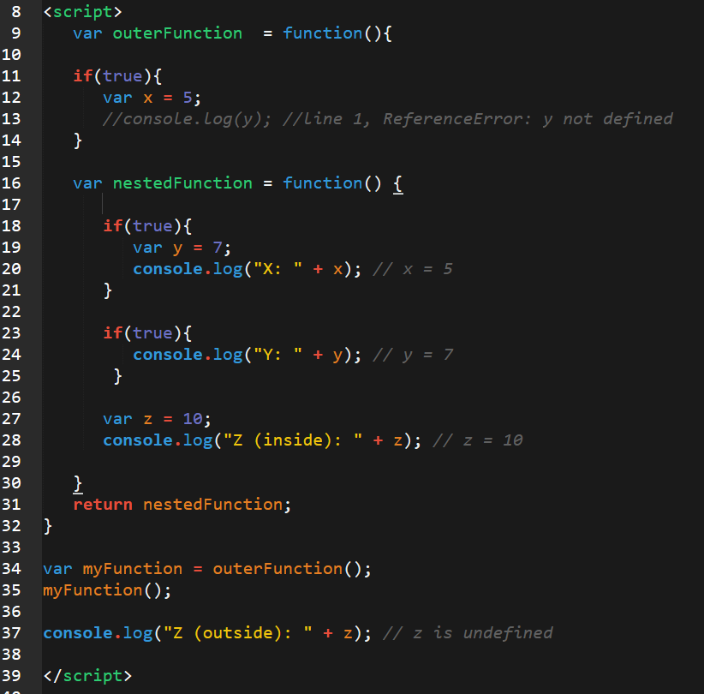
Javascript Scope Example (Tricky)
Here nested function is clearly able to access the variables of their parent function.
Whereas outer function has no idea what the variable z is because it was declared in a child function.

Slide 9
> YOUR TURN!!
Activity: LexicalScope1.html (5 min)
Take a few moments dissecting what I just said.
Look at LexcialScope1.html and explain to the person next to you what is meant by:
The terms parent function and child function
The concept that child functions can access parent variables but not vice versa.
Be prepared to share!

Slide 10
> YOUR TURN!!
Activity: LexicalScope2.html (7 Min)
Take a few moments to dissect LexicalScope2.html
Try to predict what will be printed in each of the examples.
Be prepared to share!
Note: Pay attention to the unusual use of the keyword: ‘this”

Slide 11
> YOUR TURN!!
Activity: 6-ScopeThree | Suggested Time: 7 min
Take a few moments to dissect LexicalScope3.html
Try to predict what will be printed in each of the examples.
Be prepared to share!
Note: Pay attention to the unusual use of the keyword: ‘this”

Slide 12

You Probably…

Slide 13
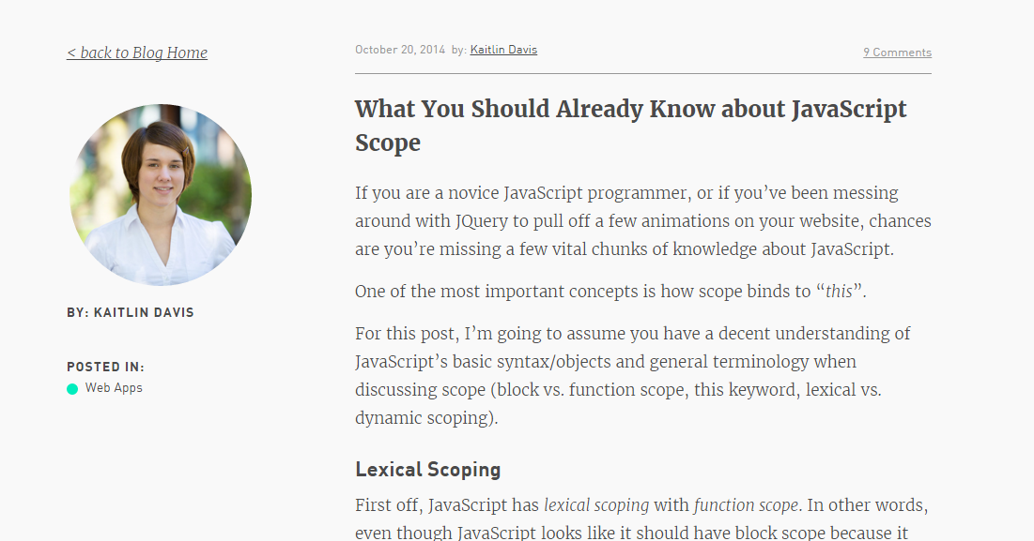
Helpful Article (If you’d like to learn more…)

Slide 14
Build a Brain Teaser

Slide 15
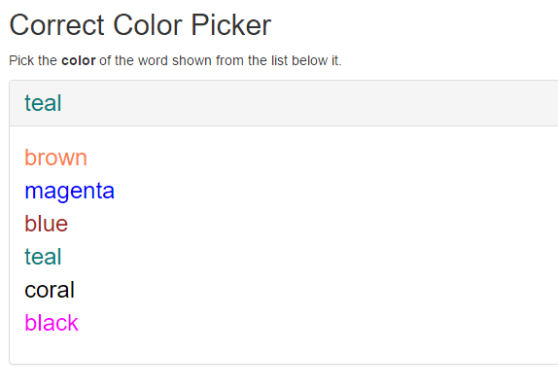
Color Picker – Brain Teaser -- Show in browser

Slide 16
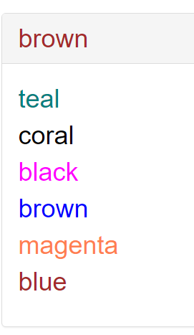
> YOUR TURN!!
Activity: 7-ColorCorrector | Suggested Time: 20 min
Using the files sent to you as a starting point, add the missing code such that the Color Corrector game works correctly.
To win, you should be picking the “word” that matches the color of the text at the top.
Ex:

Slide 17
Build a Person
Person Object
Methods {verbs}
Make Noise
Move
.
Properties {nouns}
Name
Age
.
About that pseudocode…
Create a person
Prompt for name, age, …
Person canMove ( age < 3 = crawl, age < 90 walk)
What else??

Slide 18
Questions

