Slide 1

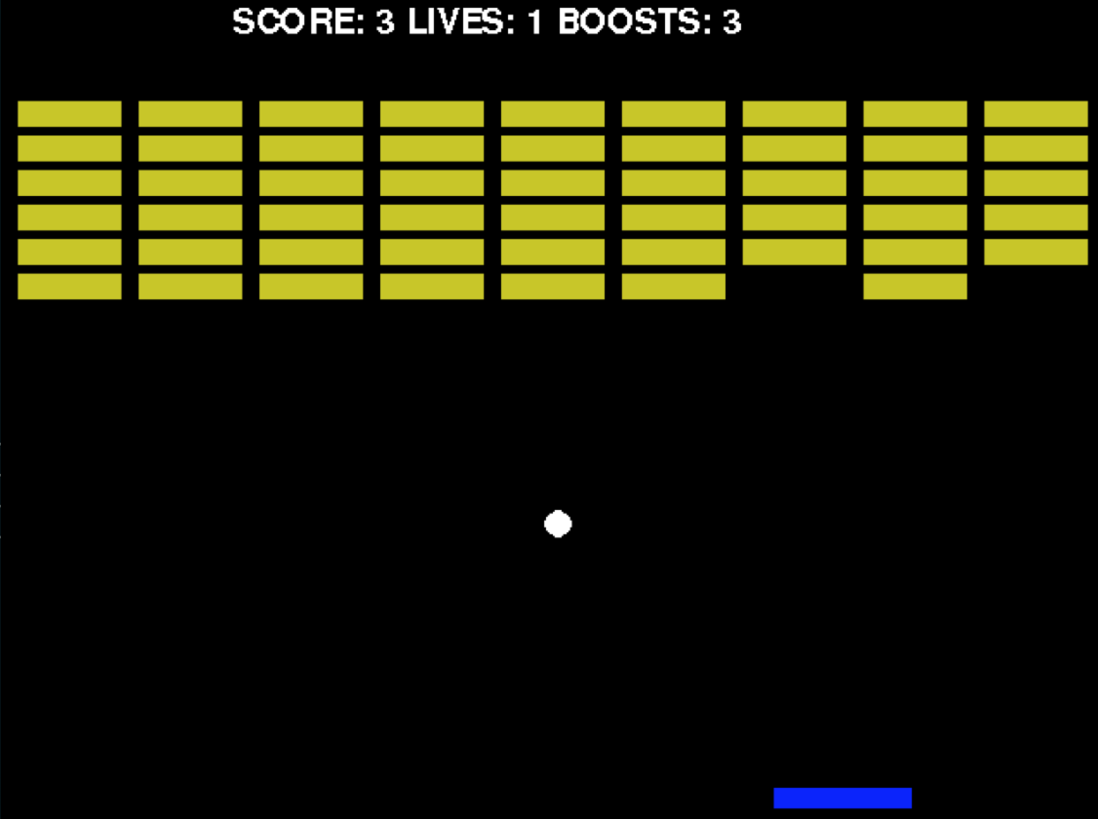
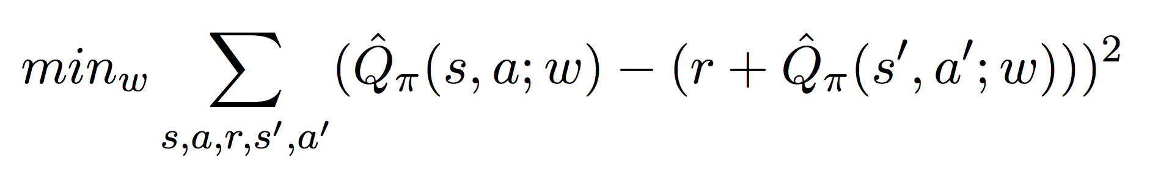
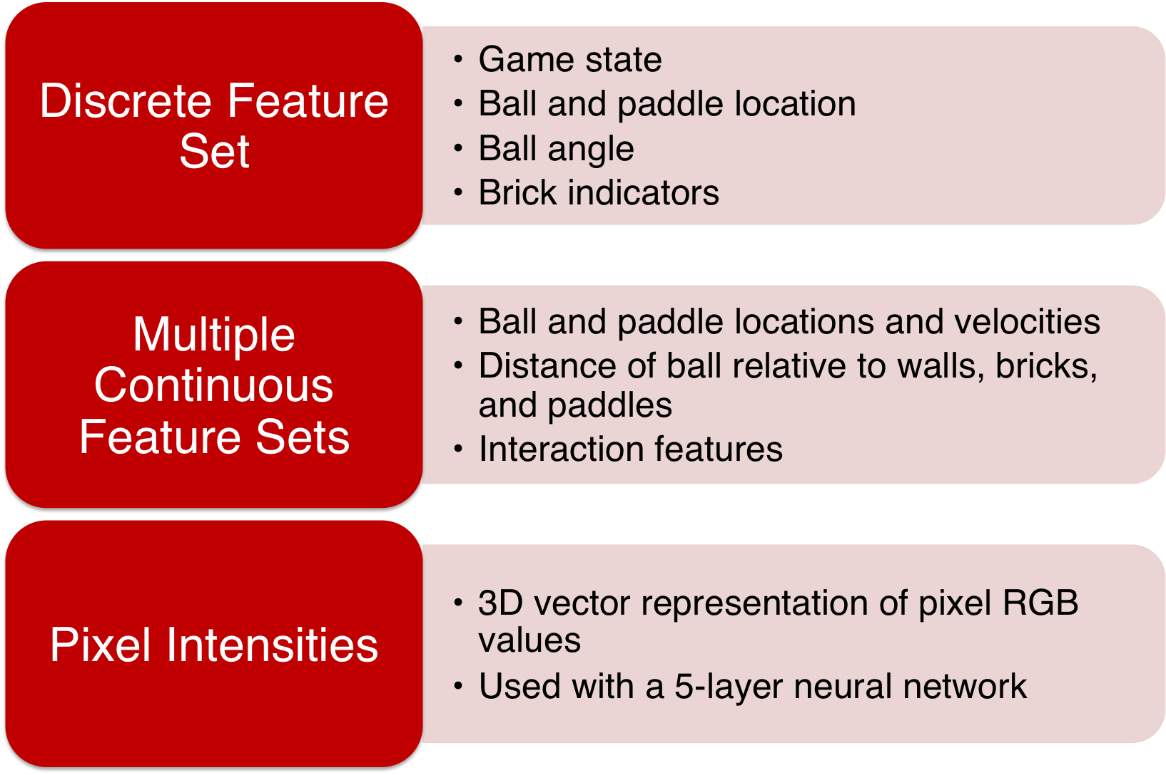
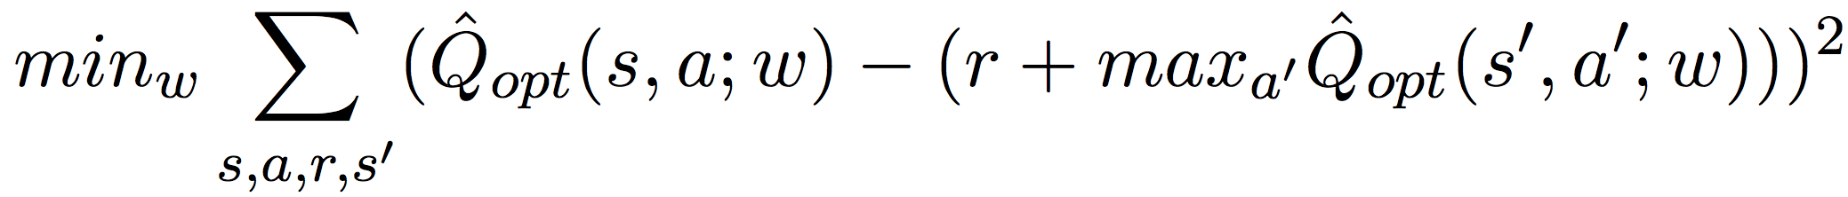
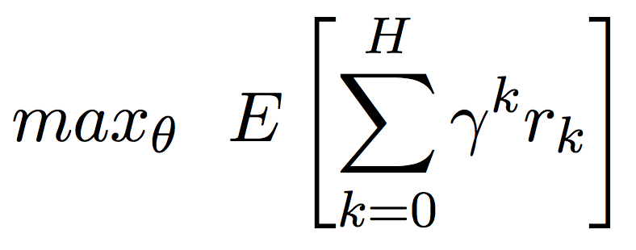
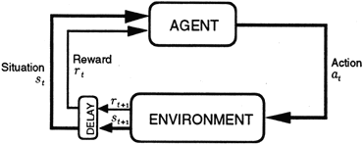
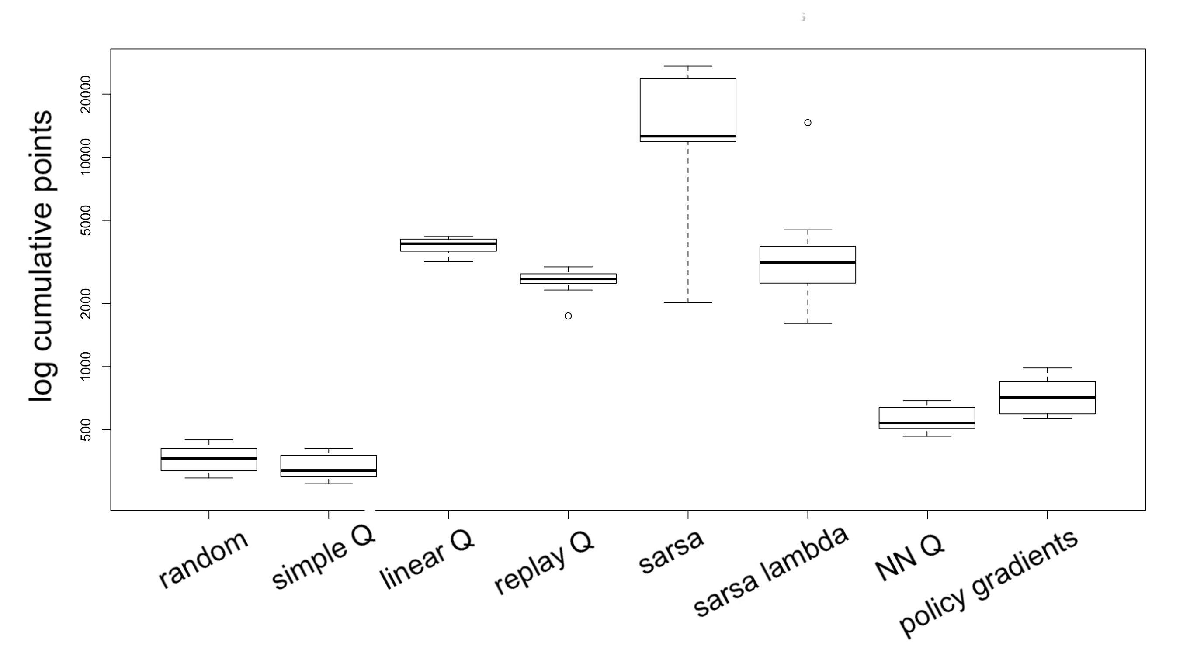
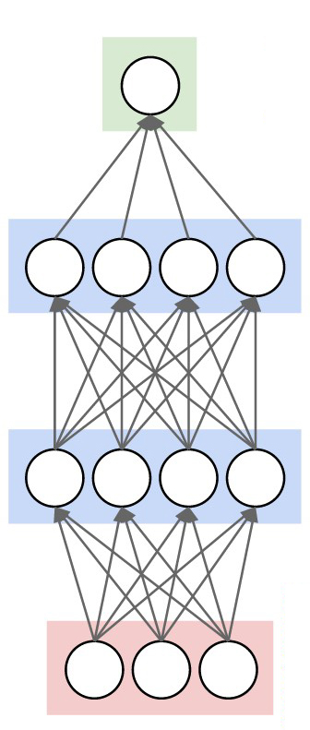
Reinforcement Learning Approaches for Atari Breakout
Vincent Pierre Berges, Reid Pryzant, Priyanka Rao
CS 221 Final Project
Motivation
Algorithms
Analysis
How do different RL approaches compare in a custom implementation of Atari Breakout?
Baseline | Follows a random policy
SARSA(λ) | Maps (s, a) to Q values of current policy Combine past rewards, more recent = more important Maintain an eligibility trace to assign blame to parameters
Q-learning with Replay Memory | Maps (s,a) to Q-values of optimal policy Estimate Q(s,a) with linear and neural network function approximators Bootstrap estimate of future value by sampling from experience Cache parameters of target function for stable updates
Policy Gradients | Directly learn parameters θ of a policy π_{θ} (vs ε-greedy) Use a neural network for the policy, but wait to fill in gradients until eventual reward is received
Almost all algorithms outperformed baseline by 2x
Q learning w/out function approximation struggled because large state space was inadequately explored
Replay memory added no benefit – for Breakout, correlations between adjacent game states sometimes help agent performance. Delays between actions (ex. returning a ball) correlate to delays in rewards (ex. breaking a brick).
Model
Agents leveraging nonlinear policy & value networks generally underperformed.
Neural network did not help despite hyperparameter tuning and different network structures – too little info captured in feature sets
Future work: investigate each model (especially the more opaque ones) to understand their performance in Breakout vs other games
Challenges
Results
Contact Information
Featurizing a huge
state space
Delayed rewards
Exploration vs exploitation
Determining relevance of hyperparameters
Learning from losing vs from hitting bricks
Highly correlated states
Experience replay vs SARSA(λ)
Training neural network
rpryzant@stanford.edu, vpberges@stanford.edu, prao96@stanford.edu
References
[1] Mnih, Volodymyr, et al. "Asynchronous methods for deep
reinforcement learning." arXiv preprint arXiv:
1602.01783 (2016).
[2] Mnih, Volodymyr, et al. "Human-level control through deep
reinforcement learning." Nature 518.7540 (2015): 529-533.
[3] Mnih, Volodymyr, et al. "Playing atari with deep reinforcement
learning." arXiv preprint arXiv:1312.5602 (2013).
[4] Silver, David. “COMPGI13: Reinforcement Learning”.
University College London online course. London, UK. 2015.
Lecture Series.
Cumulative points over multiple runs of 250 test games (ε = 0) after 2000 training games (ε = 0.5). 3 points are awarded per broken brick and 1000 points for winning. Experiments were conducted with γ = 0.993, η = (1 / x), |memory| = 5000, update cycle = 750, eligibility trace threshold = 0.1, trace decay = 0.98. The SARSA agent won 46 games.

