Slide 1

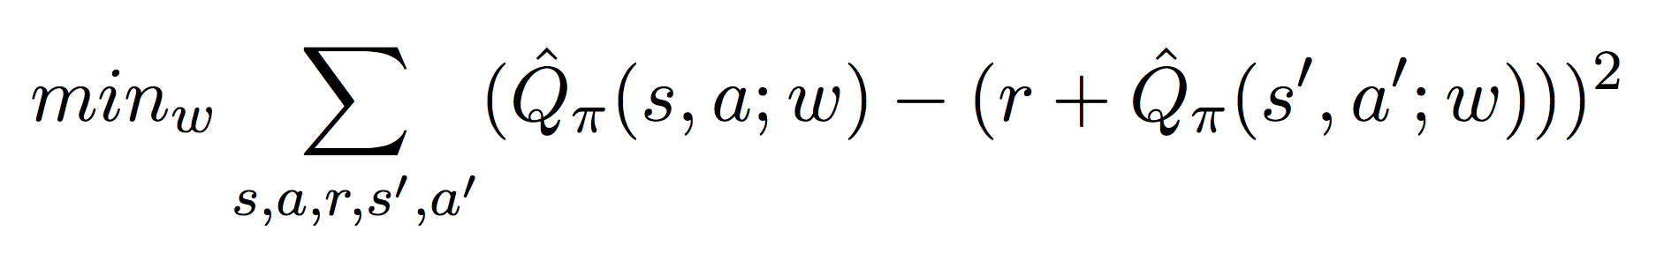
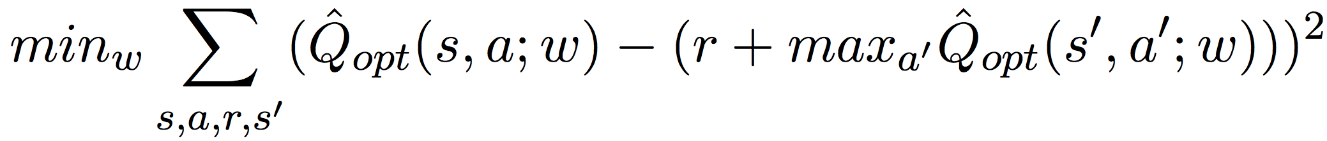
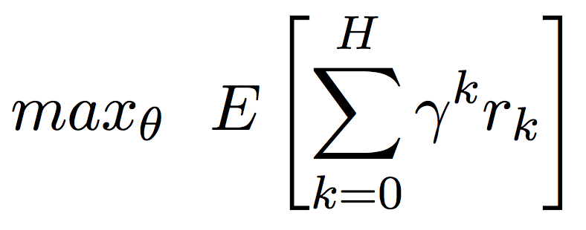
Reinforcement Learning Approaches for Atari Breakout
Vincent Pierre Bagues, Reid Pryzant, Priyanka Rao
CS 221 Final Project
Motivation
Approaches
Analysis
How do different RL approaches compare in performance for Atari games?
Baseline | Follows a random policy
SARSA(λ) | Learns mapping between (s, a) and Q values of current policy Combine past rewards, more recent = more important Maintain an eligibility trace to assign blame to parameters
Q-learning + replay memory | Learns mapping between (s,a) and Q-values of optimal policy Estimate Q(s,a) with linear and NN function approximators Update towards a bootstrap estimate of future value, obtained by sampling from a record of agent experience Cache parameters of target function for more stable updates
Policy Gradients | Directly learn parameters θ of a policy π_{θ} (vs ε-greedy) Use a NN for the policy, but wait to fill in gradients until eventual reward is received
Problem Definition
Contact Information
Challenges
Results
References

