Slide 1


Defining model scope:
Combining automation and user input
Dr. Robert Sheehan
Sorger Lab Group Meeting
September 24, 2018

Slide 2
What goes in a model?
Build a model to answer open ended questions
How does a drug treatment induce a downstream effect?
Defining model scope is critical
Often want to minimize inclusions
Improves simulation time
Easier to calibrate
Easier to interpret
Need right mechanisms

Slide 3
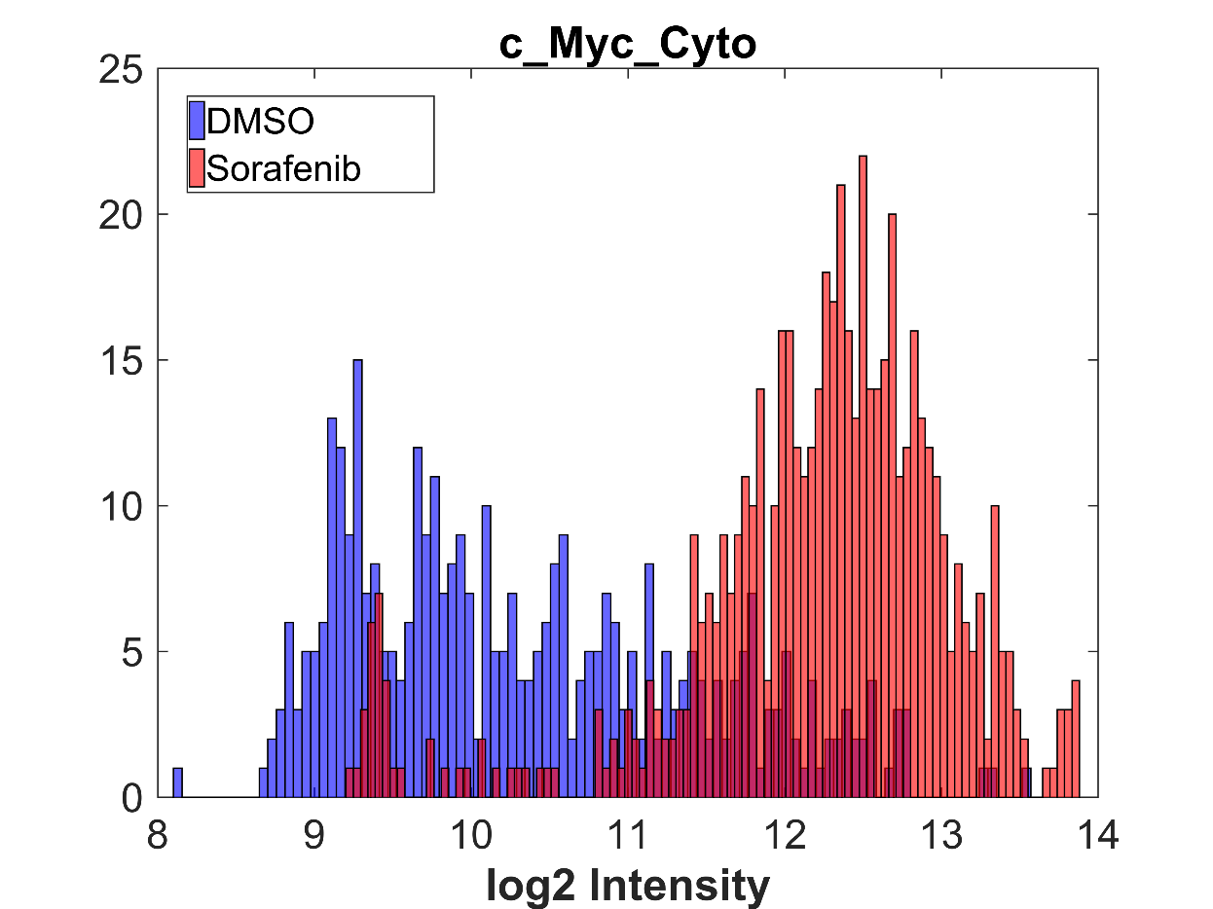
Automating model scope definition – path finding
Drug Targets
c-Myc Abundance
Experimental Variables
Modeling outputs

Slide 4
How do we do it
Input:
List of known drug targets
List of specific proteins of interest
List of experimental observations
Build a prior mining Pathway Commons, BEL, Signor database
Optionally include statements from automated reading
Iteratively build a model
Check model to see if experimental observations is matched
If not, search INDRA DB for a new mechanism to fill in gaps
Repeat, building model up from downstream nodes to drug targets

Slide 5
Iterative model building
A (Drug Target)
?
D (Modified Protein)
Iteratively build a model
Check model to see if experimental observations is matched
If not, search INDRA DB for a new mechanism to fill in gaps
Repeat, building model up from downstream nodes to drug targets

Slide 6
Iterative model building
A (Drug Target)
C (What modifies D?)
D (Modified Protein)
Iteratively build a model
Check model to see if experimental observations is matched
If not, search INDRA DB for a new mechanism to fill in gaps
Repeat, building model up from downstream nodes to drug targets

Slide 7
Iterative model building
A (Drug Target)
B (What modifies C?)
C (What modifies D?)
D (Modified Protein)
Iteratively build a model
Check model to see if experimental observations is matched
If not, search INDRA DB for a new mechanism to fill in gaps
Repeat, building model up from downstream nodes to drug targets

Slide 8
Use case - DARPA Evaluation
Build a model to explain drug-treatment data
Fallahi-Sichani, M et al., 2015, Mol Syst Biol
RAF inhibitor applied to multiple cell lines
ERK phosphorylation decreases in one cell line
ERK phosphorylation increases at low doses in one cell line
Want a single model that can explain both phenomena
Same model structure and rate constants
Differences in expression levels
Notes:
AZ628

Slide 9
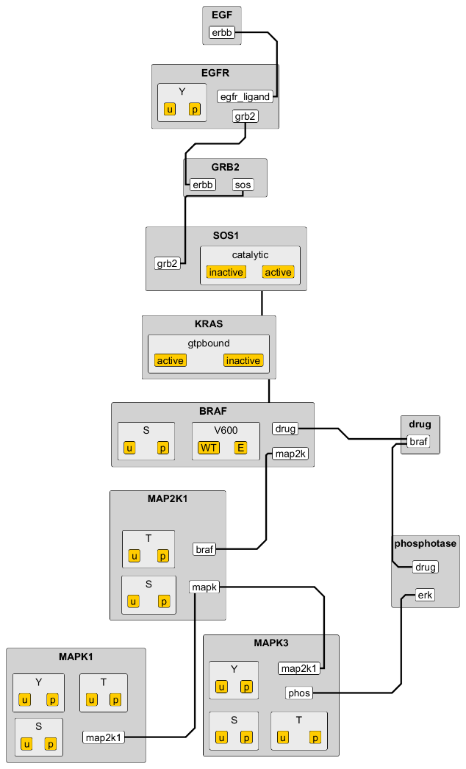
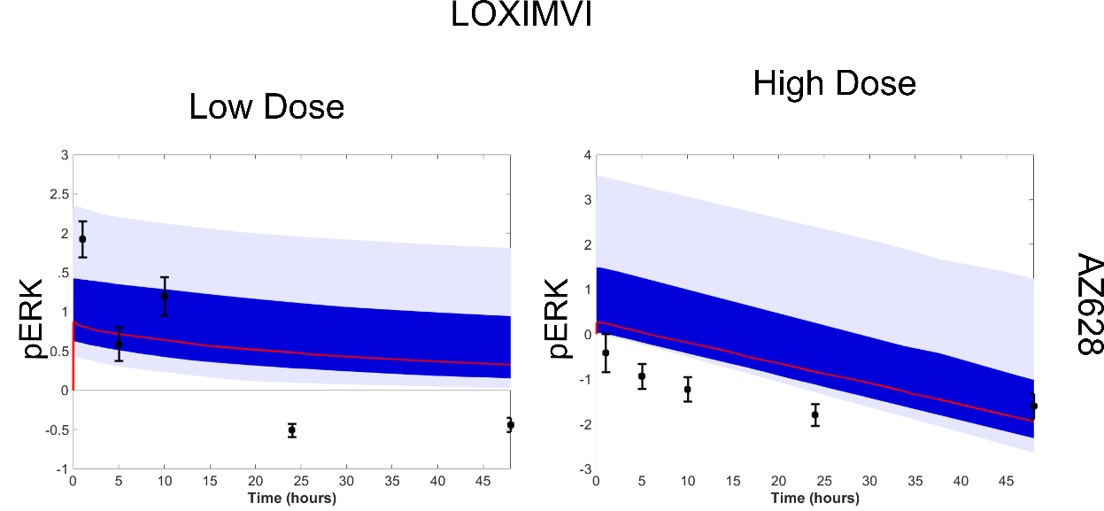
Mechanisms matter - can’t always fit an elephant
Notes:
AZ628

Slide 10
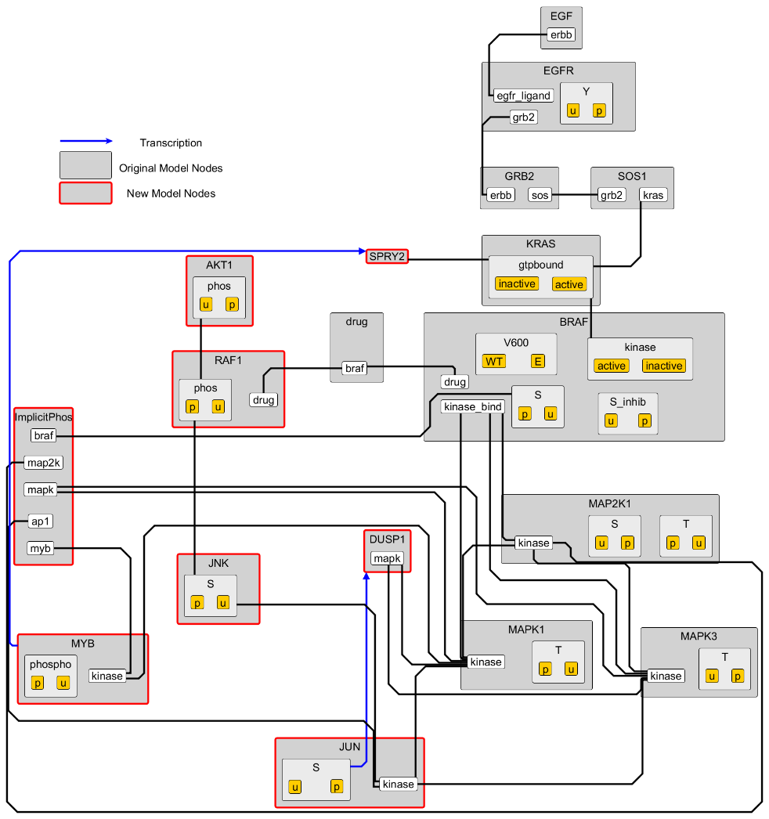
Model needs to be expanded – transcription of phosphatase DUSP1
Notes:
AZ628

Slide 11
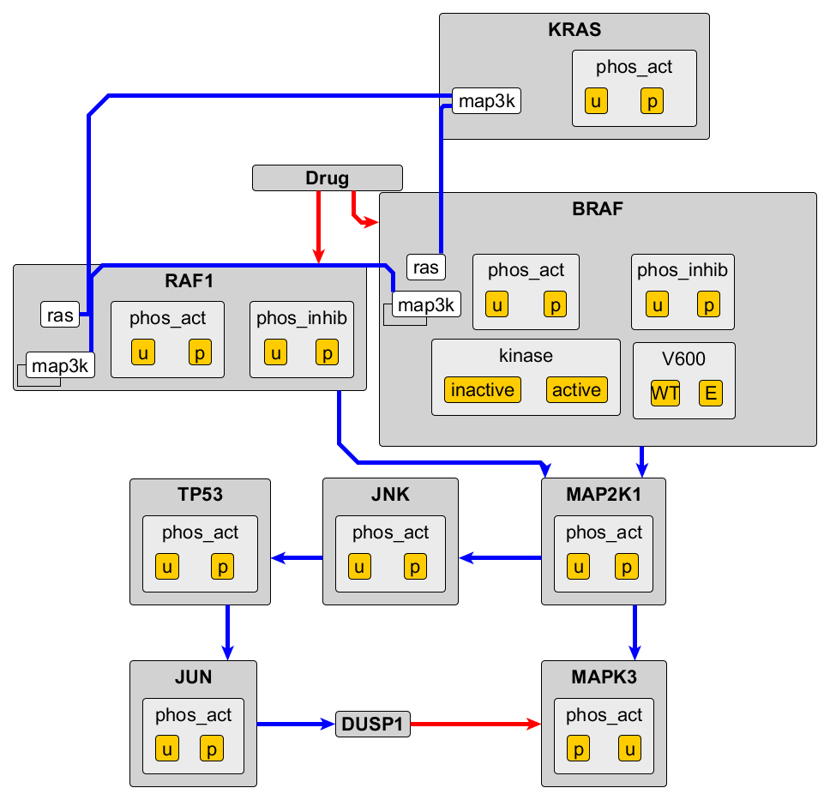
Automated construction of a similar model
Notes:
AZ628

Slide 12
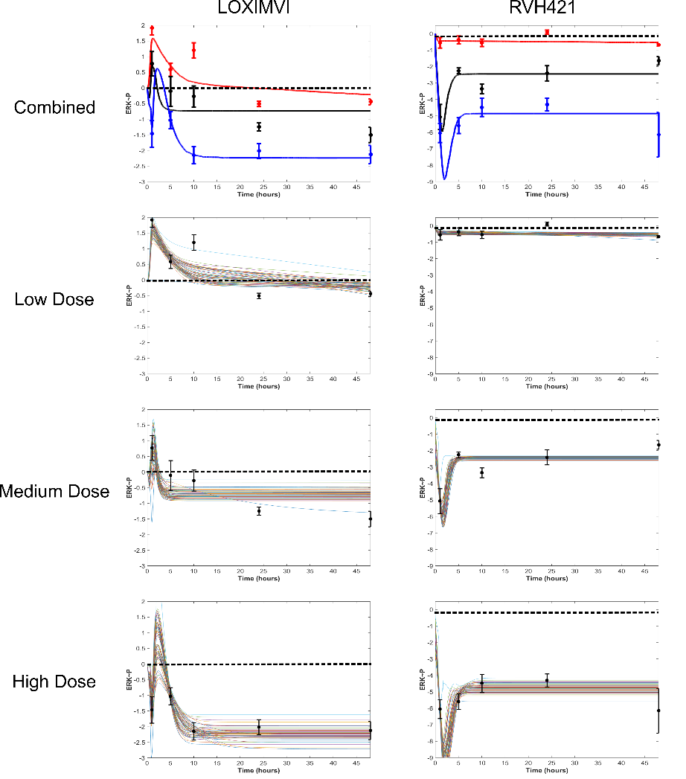
Model can now fit data across doses and cell lines
Notes:
AZ628

Slide 13
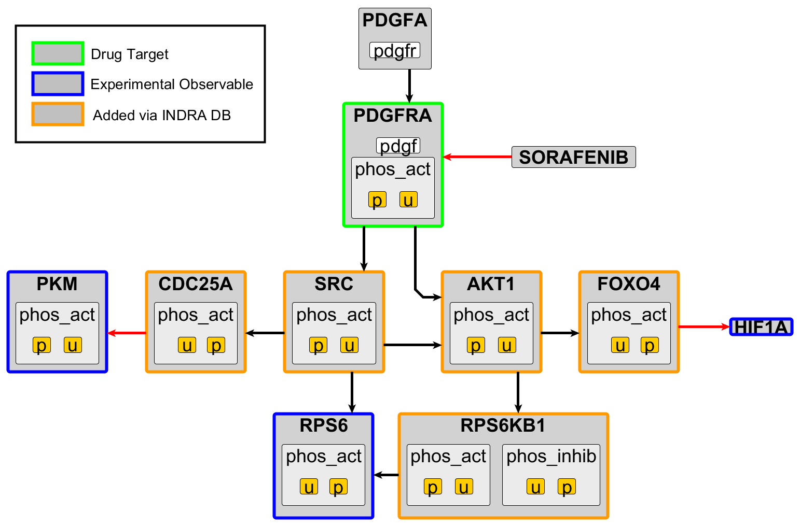
Model of cardiomyocyte response to Sorafenib

Slide 14
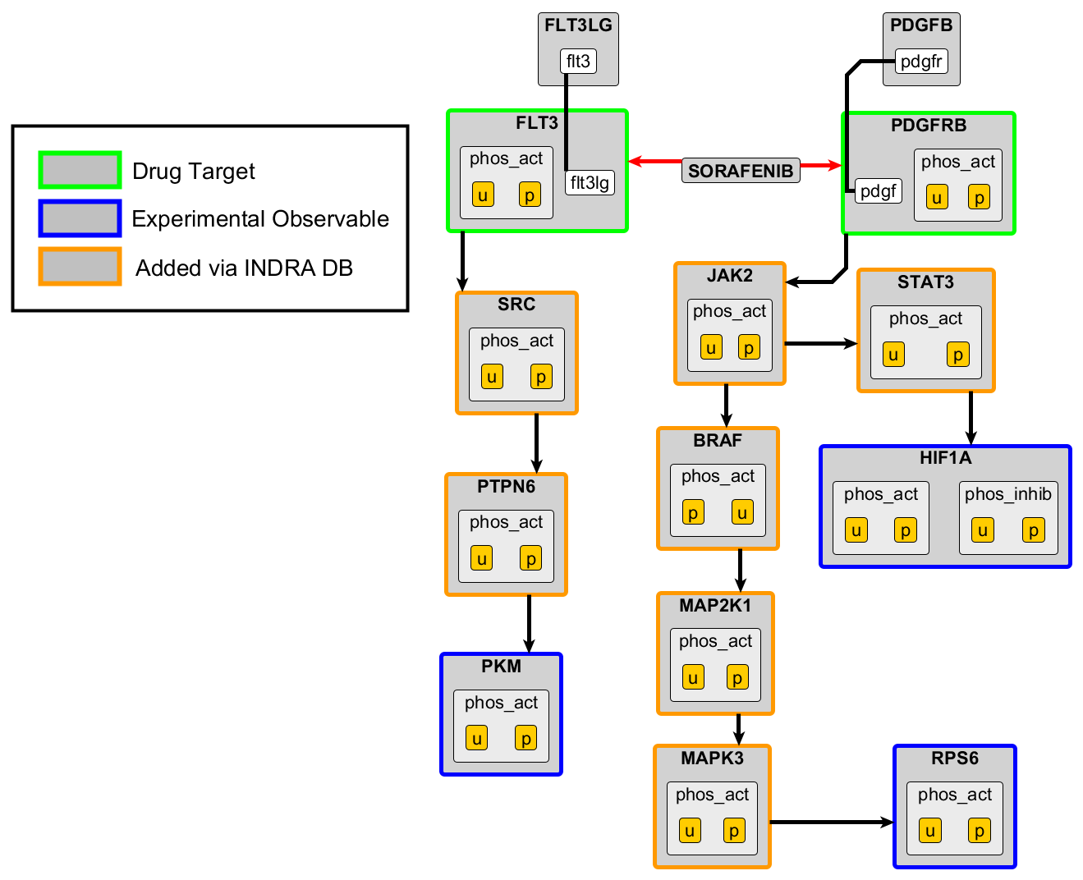
A completely different model can satisfy our constraints

Slide 15
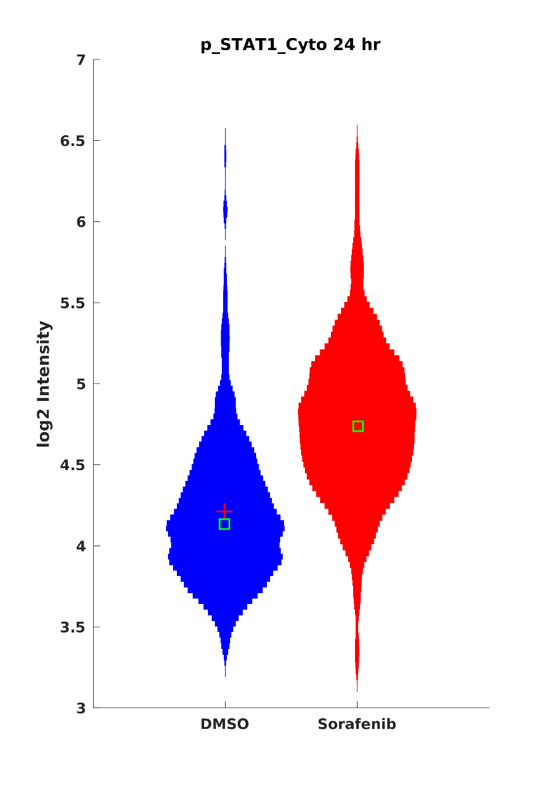
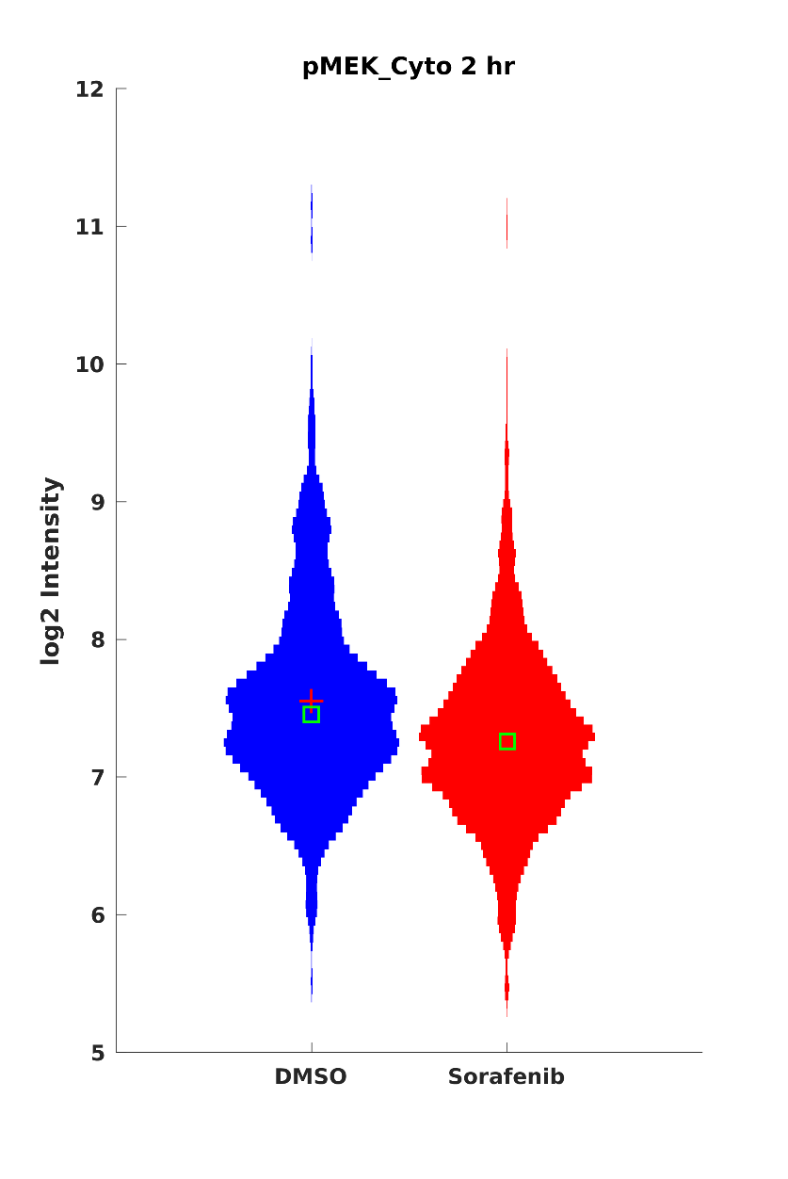
Additional experimental data can constrain the model
p-STAT3 2 hr
p-MEK 2 hr

Slide 16
Model selection
As we gather more data we can constrain model structure
-omics data can be used to filter out nodes not expressed in experimental context
Changes (or lack thereof) in key model nodes can help rule in or out pathways
Identify experiments that can differentiate between two models
Get the most bang for your buck with new experiments

Slide 17



Acknowledgments
Peter Sorger
Experimental Work:
Huan Wang
Jia-Ren Lin
Zoltan Maliga
Connor Jacobson
Clarence Yapp
INDRA Team:
Benjamin Gyori
John Bachman
Patrick Greene

Slide 18
One model can satisfy increase and decrease in ERK phosphorylation following treatment
Decrease in ERK phosphorylation
Vemurafenib inhibits BRAF
BRAF phosphorylation of MAP2K1 is reduced
MAP2K1 phosphorylation of ERK is reduced
Decrease in ERK phosphorylation
Vemurafenib inhibits BRAF
BRAF phosphorylation of MAP2K1 is reduced
MAP2K1 phosphorylation of JNK is reduced
JNK phosphorylation of TP53 is reduced
TP53 activation of JUN is reduced
JUN transcription of DUSP1 is reduced
DUSP1 dephosphorylation of ERK is reduced

