Slide 1
Ethos-ML Challenge
Solution By: Rajan Pratap SINGH & Aditya Shankar

Slide 2
Problem Statement
The goal is to develop an advanced machine learning solution capable of accurately reconstructing human faces from low-quality CCTV footage. By leveraging state-of-the-art computer vision and machine learning techniques, the solution should enhance blurry or distorted images, enabling investigators to identify suspects with greater accuracy.

Slide 3
Proposed Solution (Basic Facial Reconstruction)
Architecture: This model uses a multi-scale convolutional neural network with residual blocks. This architecture is well-suited for image restoration tasks, including facial reconstruction.
Multi-scale Processing: This model processes the image at multiple scales (3 levels), which helps in capturing both fine details and larger structures. This is crucial for facial reconstruction, as it needs to handle both fine facial features and overall face structure.
LSTM Option: This model includes an option to use ConvLSTM cells, which can be beneficial for handling temporal information in video sequences. This could be useful for reconstructing faces from CCTV footage with motion blur.
Flexible Input: This model can handle both color and grayscale images, making it adaptable to various types of CCTV footage.

Slide 4
Image Enhancement Techniques
The code implements several image enhancement techniques that are relevant to improving facial image quality from low-quality CCTV footage:
Deblurring: The primary focus of this model is image deblurring. It uses a deep learning approach to remove motion blur and out-of-focus blur, which are common issues in CCTV footage.
Multi-scale Processing: By processing the image at multiple scales, the model can effectively handle different levels of blur and detail, which is crucial for enhancing facial features of various sizes.
Residual Learning: The use of ResnetBlocks (residual blocks) allows the model to learn the residual between blurred and sharp images, which is an effective technique for image restoration.
Color Processing: The model can handle both color and grayscale images, allowing for enhancement of different types of CCTV footage.

Slide 5
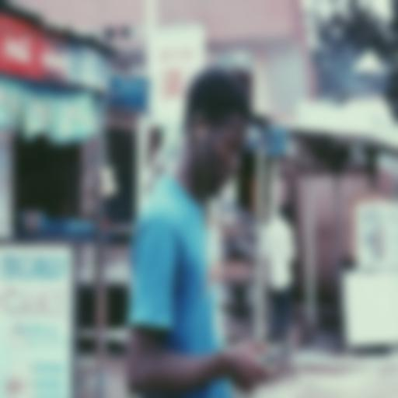

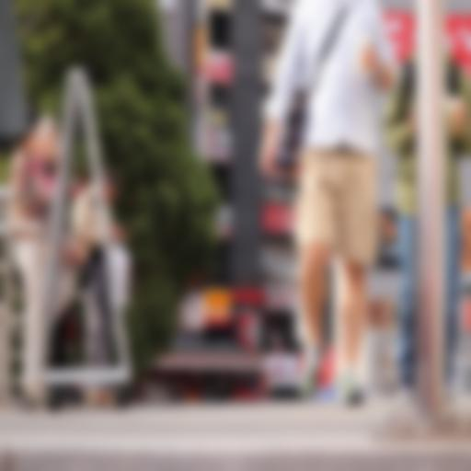
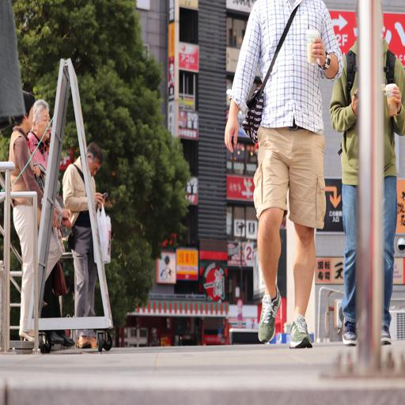
Basic Prototype results
Old(Blurred)
New(Unblurred)
Old(Blurred)
New(Unblurred)

Slide 6
References
Deblurring by Realistic Blurring, https://ieeexplore.ieee.org/document/9156306
Image Deblurring using GAN, https://arxiv.org/abs/2312.09496
DeblurGAN: Blind Motion Deblurring Using Conditional Adversarial Networks,
https://paperswithcode.com/paper/deblurgan-blind-motion-deblurring-using

