Slide 1
ITI105 Final Project Presentation
Financial Fraud Detection using Machine Learning
Adelene Ng

Slide 2
Problem Statement
Objective: To predict if a financial transaction is fraudulent or not
Binary Classification problem
Ideal outcome: To correctly predict a transaction which is fraudulent as actually fraudulent
Datasets
From Kaggle, generated by the PaySim mobile generator
Based on a sample of real transactions extracted from one month of financial logs from a mobile money service

Slide 3
Dataset Features

Slide 4
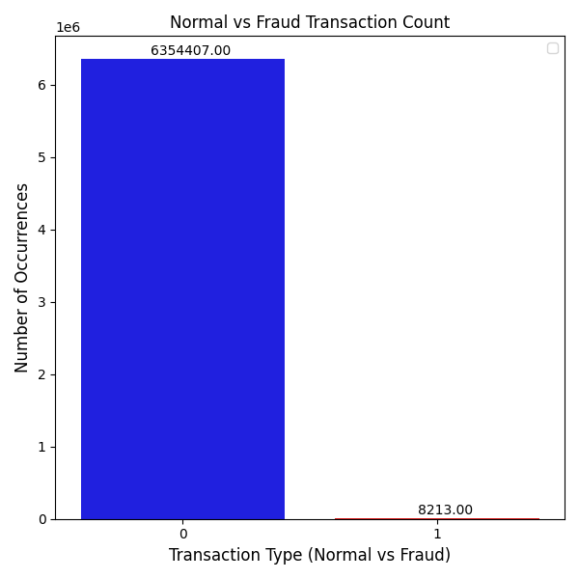
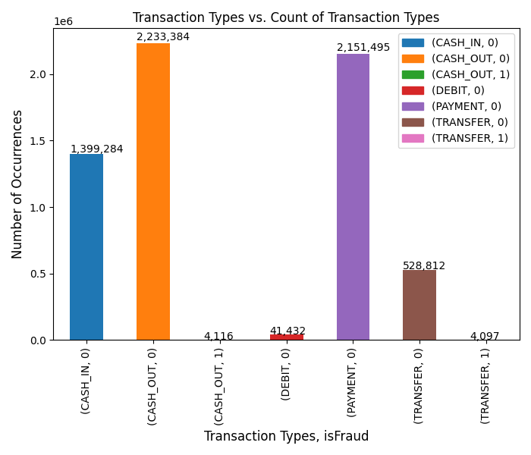
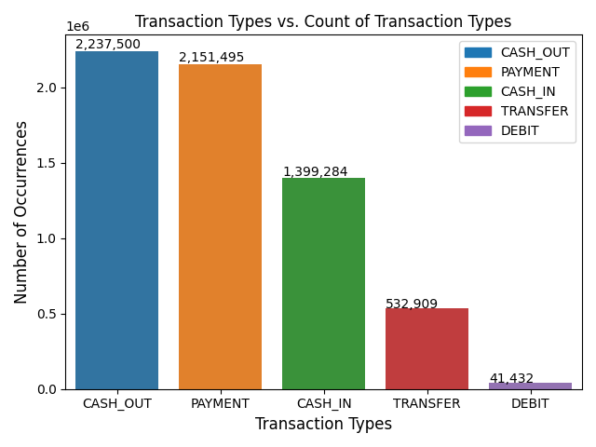
Exploratory Data Analysis

Slide 5
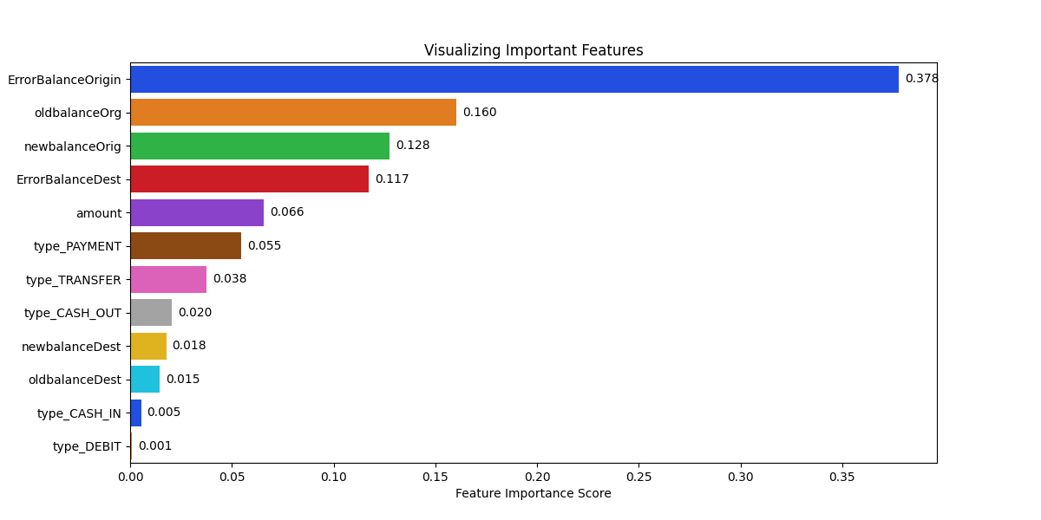
Feature Importance

Slide 6
Experiments
Algorithms | recall | precision | f1 | balanced accuracy
lr | 0.943 | 0.023 | 0.044 | 0.945
xgb | 0.996 | 0.826 | 0.903 | 0.998
gnb | 0.993 | 0.003 | 0.006 | 0.783
dt | 0.995 | 0.975 | 0.985 | 0.997
rfc | 0.995 | 0.867 | 0.927 | 0.997
cb | 0.996 | 0.984 | 0.99 | 0.998
lgbm | 0.998 | 0.808 | 0.893 | 0.999
bg | 0.995 | 0.858 | 0.921 | 0.997
Maximum | 0.998 | 0.984 | 0.99 | 0.999
LightGBM has a recall of 0.998 compared to CatBoost, whose recall is 0.996.
CatBoost has a higher precision 0.984 compared to LightGBM 0.808.
The F1-score for CatBoost is 0.99 whilst that of LightGBM is 0.893.
We can conclude that CatBoost is the better classifier.
Notes:
0 ≤F1 Score ≤1: It tells you how precise your classifier is (how many instances it classifies correctly), as well as how robust it is (it does not miss a significant number of instances). The F1-score does not care at all about how many negative examples you classified or how many negative examples are in the dataset at all; instead, the balanced accuracy metric gives half its weight to how many positives you labeled correctly and how many negatives you labeled correctly.
Balanced accuracy is a better metric to use with imbalanced data. It accounts for both the positive and negative outcome classes and doesn’t mislead with imbalanced data. It is the average of sensitivity and specificity. Balanced accuracy is a good measure when you have imbalanced data and you are indifferent between correctly predicting the negative and positive classes.
Recall: Model recall score represents the model’s ability to correctly predict the positives out of actual positives. This is unlike precision which measures as to how many predictions made by models are actually positive out of all positive predictions made. For all the transactions that are actually fraudulent, recall tells us how many we correctly identified as fraudulent. Recall says how often the system detects an instance which belongs to the minority class (this is usually the hardest part with imbalanced data)
Precision: Model precision score represents the model’s ability to correctly predict the positives out of all the positive prediction it made. This is the measure of transactions that we correctly identify as fraudulent out of all the transactions that are actually fraudulent. Precision says how often the system is correct when predicting an instance in the minority class.

Slide 7
Hyper-parameter Tuning: Important – Controls Overfitting
CatBoost | Values |  | LightGBM | Values
Learning Rate (This determines how fast or slow the model will learn. The default is usually 0.03) | 0.001, 0.01, 0.5 | 0.01 | Learning Rate (Default: 0.1) | 0.001, 0.01, 0.5 | 0.01
Depth (up to 16) (tree depth) | 4, 6, 10 | 10 | Max depth (Controls the max depth of each trained tree; If you use a large value of max_depth, your model will likely be over fit to the train set) | 10, 50 | 10
L2-leaf-reg (Coefficient at the L2 regularization term of the cost function. The default is 3.0) | 10, 15, 25 | 10 | Min Data in Leaf: the minimum number of data/sample/count per leaf (default is 20; lower min_data_in_leaf means less conservative/control, potentially overfitting). | 500, 1000 | 1000
Notes:
CatBoost: iterations = 25, random_state=88
LightGBM: num_iterations=25, random_state=88

Slide 8
Results before/after hyper-parameter tuning
Score Type | CatBoost (Old Hyper Parameters) | CatBoost | Light GBM (Old Hyper Parameters) | Light GBM
Precision Score | 0.984 | 0.993 | 0.808 | 0.888
Recall Score | 0.996 | 0.996 | 0.998 | 0.997
F1 Score | 0.99 | 0.995 | 0.893 | 0.939
Balanced Accuracy | 0.998 | 0.998 | 0.999 | 0.998
AUC ROC Score | 0.998 | 0.998 | 0.999 | 0.998
LightGBM has a recall of 0.997 compared to CatBoost, whose recall is 0.996.
CatBoost has a new higher precision 0.993 compared to LightGBM’s new precision score of 0.888.
The new F1-score for CatBoost is 0.995 whilst the new F1-score for LightGBM is 0.939.
We conclude that CatBoost is the better classifier.

Slide 9
CatBoost and LightGBM Classification Reports
CatBoost
precision recall f1-score support
0 1.00 1.00 1.00 1270881
1 0.99 1.00 0.99 1643
accuracy 1.00 1272524
macro avg 1.00 1.00 1.00 1272524
weighted avg 1.00 1.00 1.00 1272524
LightGBM
precision recall f1-score support
0 1.00 1.00 1.00 1270881
1 0.89 1.00 0.94 1643
accuracy 1.00 1272524
macro avg 0.94 1.00 0.97 1272524
weighted avg 1.00 1.00 1.00 1272524

Slide 10
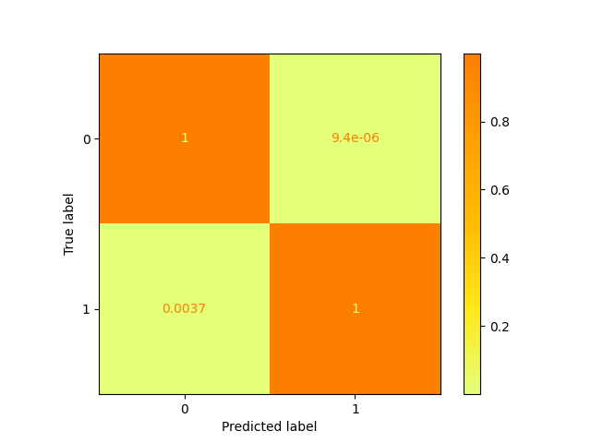
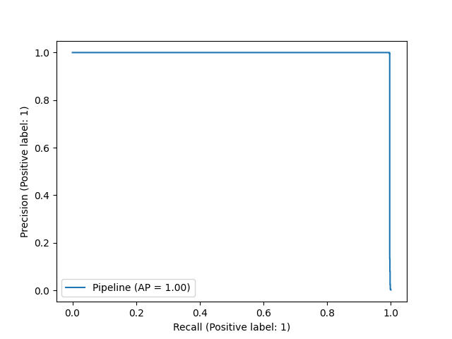
CatBoost

Slide 11
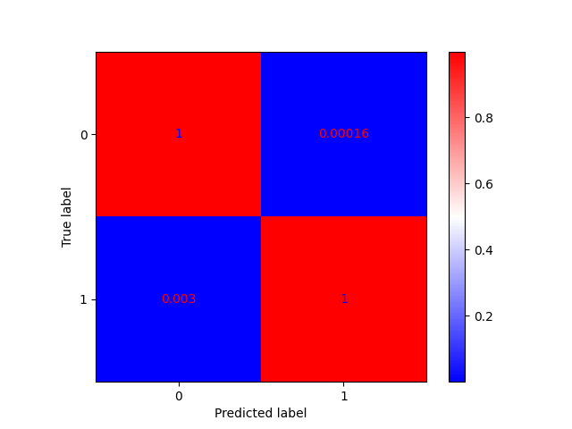
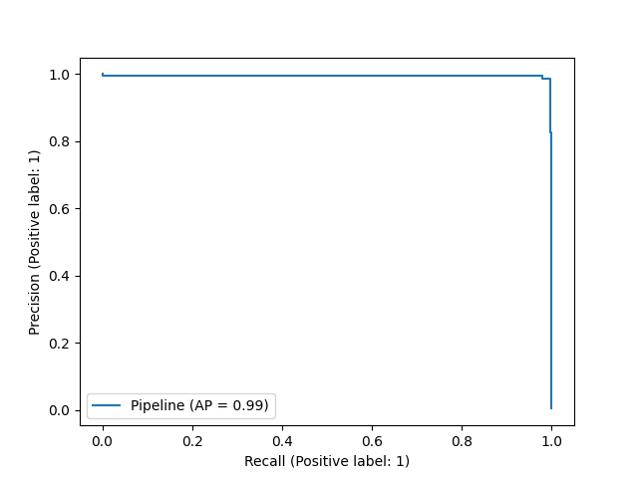
LightGBM

Slide 12
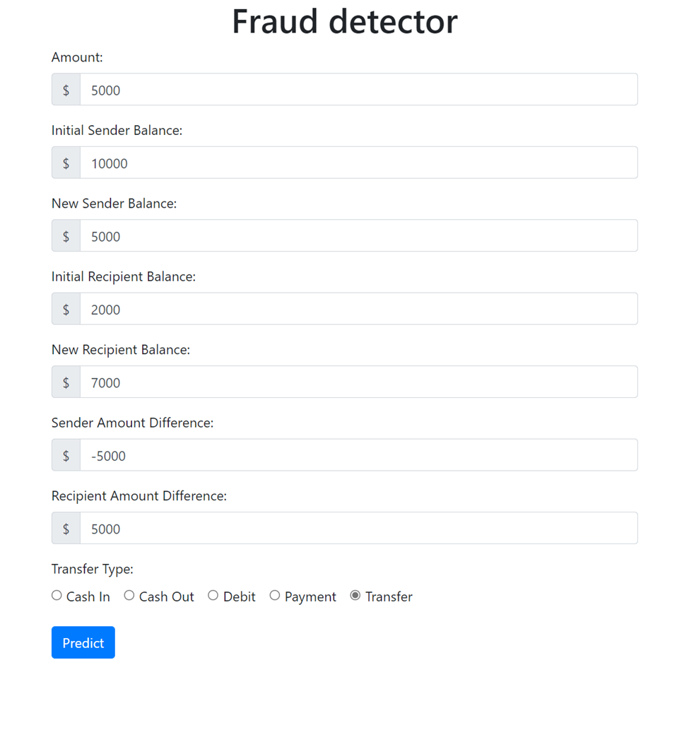
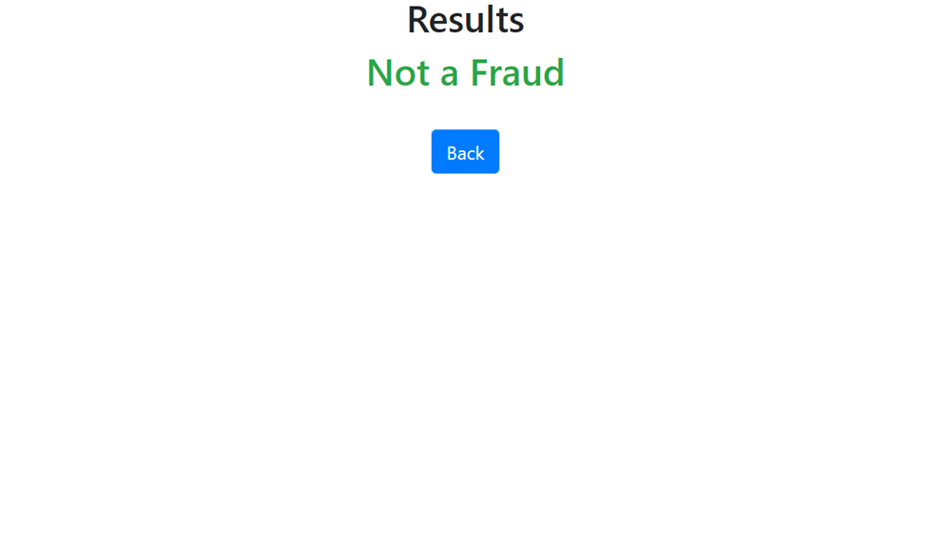
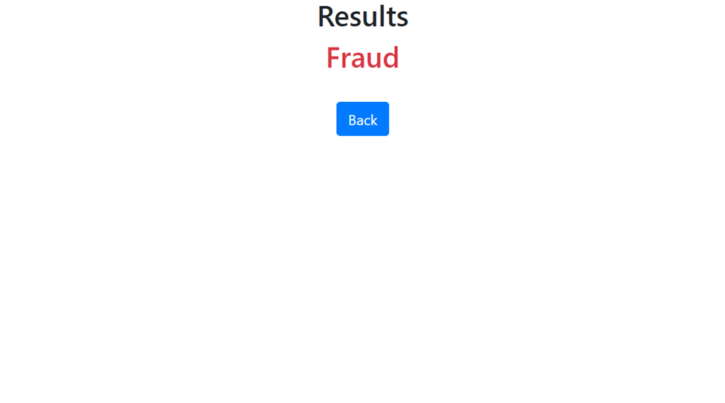
Web Application UI

Slide 13
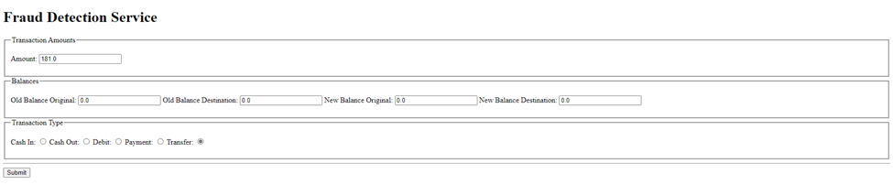
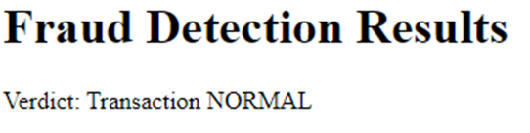
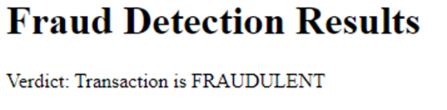
Web Application UI

