Slide 1
Sequence of steps for AvgRg optimization using Bayesian Optimization
/home/tpatra/Praneeth/ N100_sample_1110/mean_block

Slide 2
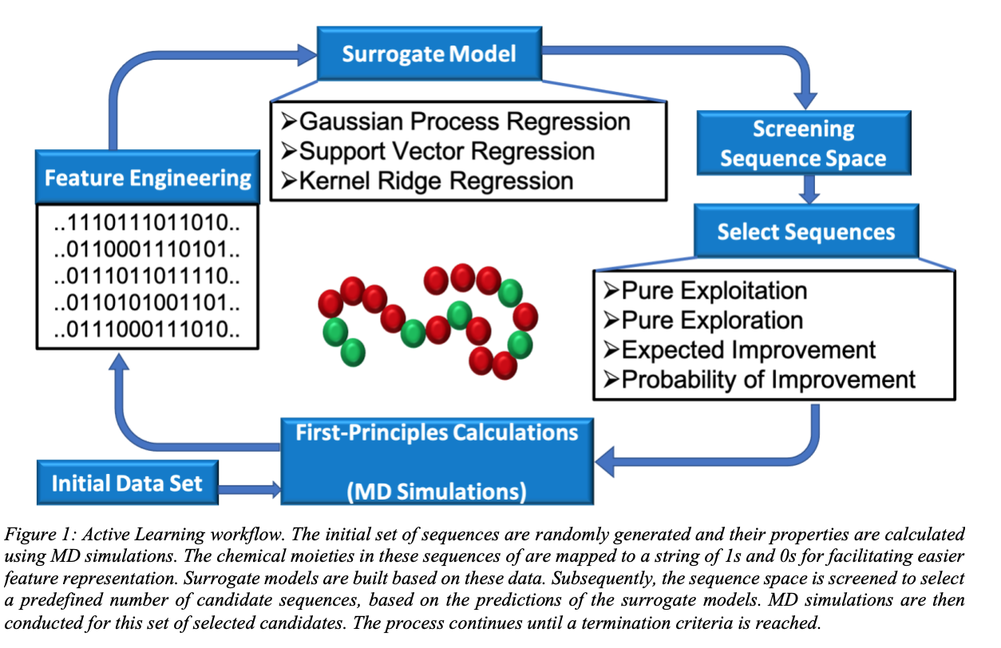
Schematic
P.S. Ramesh and Patra, Tarak K (2023), “Polymer sequence design via molecular simulation‐based active learning”, Soft Matter, 19, pp. 282‐294. DOI:10.1039/D2SM01193J

Slide 3
Sets of python files
bo_GPR_script.py
bo_functions.py (with two functions)
training_fitness(X_initial,n_initial,num_weights) – for initial training data
y_query_max_sm(X_input,iter_count, num_weights)– for computation over each iteration (for AvgRg minimization)
apply_single_mutation(oned_array_initial, num_weights) – for performining the swapping of As and Bs at a particular location
calc_cand_sm(X_initial, num_weights) – for book-keeping purposes pertaining to the candidate pool

Slide 4
Step 1: Initializing the hyper-parameters
num_weights = 100 (size of A-B 100-mer polymer sequence)
n_initial = 112 (number of polymers in the initial training set)
#Sampling
n_sm = 32 (number of candidates sampled by single-mutation)
n_dm = 0 (number of candidates sampled by mutation at two locations)
n_sixm = 0 (number of candidates sampled by mutation at six locations)
#Active learning loop
n_queries_max = 75
n_iterations = 75
iter_count_max = 0

Slide 5
Step 2: Defining Initial training set of datapoints of N_initial
N_initial = 112
X_initial (randomly picked collection of N_initial sequences)
y_initial (the computed Rg value)

Slide 6
Step 3 – Computation of y_initial n_initial fitness values to be computed parallely
y_initial = bo_functions.y_query_max_sm(X_initial, n_initial, num_weights)
3.1) Storing the genes of n_initial points of X_initial in separate text files
3.2) Creating n_initial copies of .cpp files
-for transformation of polymer1.data to new polymer2. data files
3.3) Creating n_initial number of in.lammps files
3.4) Running the in.lammps files to generate n_initial Avg_Rg files and dump files
- using the new polymer2.data files
3.5) Reading the Avg_Rg files to obtain the fitness value.
Thus the training data X_initial and y_initial would be ready.

Slide 7
Step 4 – Initializing the Bayesian Optimizer
Gaussian process Regression is initialized with (X_initial, y_initial)
optimizer = BayesianOptimizer( estimator=GaussianProcessRegressor(kernel=Matern(length_scale=1.0)), X_training=X_initial_sofar_max, y_training=y_initial_sofar_max, query_strategy=max_PI)

Slide 8
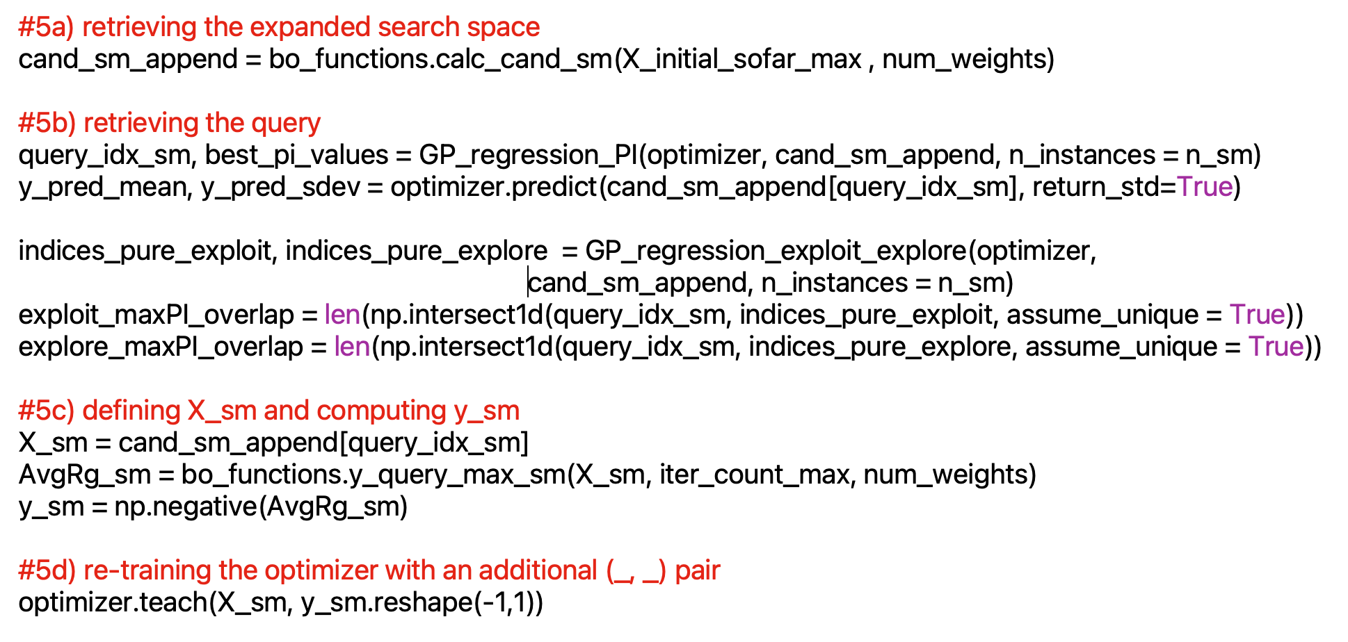
Step 5 Iterations during the Active Learning

Slide 9
Zooming into a particular step in the loop
AvgRg_sm = bo_functions.y_query_max_sm(X_sm, iter_count_max, num_weights)
(1) Storing the sequence of X_sm in separate text files
(2) Creating a datatoData1.cpp file
For polymer1.data to polymer2.data conversion
(3) Creating a copy of in.lammps file
(4) Running the in.lammps file to generate Avg_Rg file and dump file
- using the polymer2.data files
(5) Reading the Avg_Rg file to obtain the fitness value.
Thus the training data y_sm would be ready.

Slide 10
Step 6 Printing the fitness values obtained over 75 iterations
The fitness values computed over all the iterations are ready to be plotted in a graph.

