Slide 1
Smart Wireless controlled Pick-N-Place Line Following Robot
PREPARED BY:
Arpit Shrivastava (T150393199)
Durgesh Vitore (T150393219)
Tejas Shinde (T150393196)

Slide 2
Introduction
Aims to reduce manpower needed at Online selling site Warehouses or Human Intervention in toxic or hazardous places.
Makes use of Bluetooth module to take directions from user in order to reach Source & Destination point.
Detect the Object with the help of proximity sensors mounted on the robot.
When object is detected, microcontroller gives command to servo motor for pick up the object.
Bot takes U-turn and places the object to the Destination.

Slide 3
OBJECTIVE
The main objective of pick and place robot is picking the object form source location and place it to desired destination.
Robots can work in hazardous environments where working by Humans can cause fatal long term physical or mental conditions.
Reduces efforts of human work, safety of Humans and speeds up the process of picking and placing objects.

Slide 4

BLOCK DIAGRAM
IR Receiver
(I/P: 5V, 20mA)
Battery Source
3S-1P
(O/P: 4.2V [max], 2.2A)/cell
To: Motor driver
IR Receiver Array
(I/P: 5V, 100mA)
ATMEGA 328P
-PU
(I/P: 7-12V, 250mA)
Motor Driver
(I/P: 12V,)
Motor (2)
(I/P: 0-12V, 150-650mA)
Wireless Module (HC09)
(I/P: 5V, 250mA)
Mobile
GUI
Window
Servo Motor
(I/P: 5V,550mA)
Arm Gripper Mechanism

Slide 5
COMPONENTS
Bluetooth Module
IR Sensor Array
proximity Sensor
Microcontroller
Motor Driver & DC Motor
Servo Motor

Slide 6
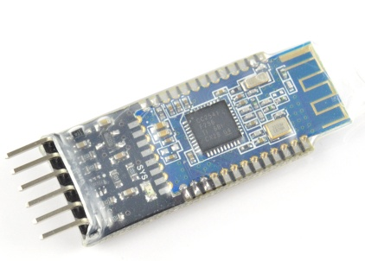
BLUETOOTH MODULE
Bluetooth is a wireless technology standard for exchanging data between fixed and mobile devices over short distances.
Bluetooth module provides wireless interface between user mobile and robot.
It acts as a bridge between user mobile and robot.

Slide 7
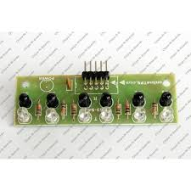
INFRARED SENSOR ARRAY
IR sensor array for line sensing.
It is array of five IR sensors with 5 digital outputs.
It gives 0 & 1 signals for black and white colour respectively.
By interfacing the IR array to Arduino Uno board, we transmitted the signal on serial terminal of pc

Slide 8
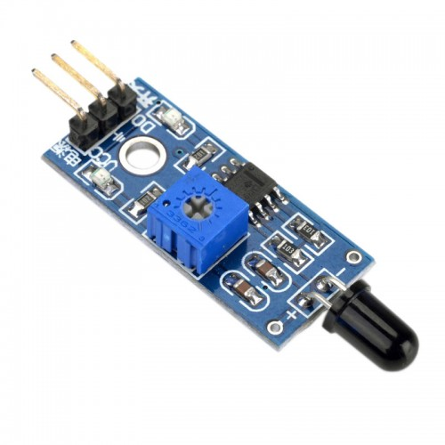
PROXIMITY SENSOR
Detects Object
wavelength in the range of
760nm-1100nm.
Detection angle: 60
Adjustable sensitivity
Operating voltage: 3.3-5.2v DC

Slide 9
MICROCONTROLLER- ATMEGA 328P PU
Read data provided by all sensors and provide instructions to the whole system.
Control movement of robot in the direction provided by user with the help of Bluetooth module.
If the sensor output values are found crossing the preset values, it turns on the water pump mechanism.

Slide 10
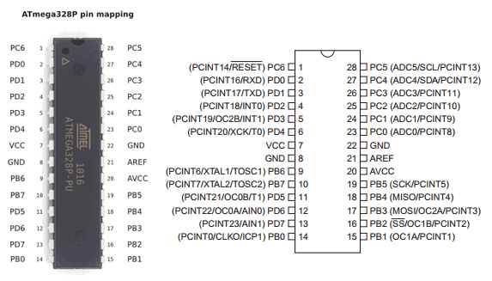
MICROCONTROLLER- ATMEGA 328P PU
Features:
28 pin package
14 digital input output
pins
6 analog input output
pins

Slide 11
MOTOR DRIVER (L298N)
Provides an interface between microcontroller and the high current, high voltage motor.
Motor is an electromechanical device which converts electrical energy into mechanical energy.
In this application, WRF-530TC-12560 DC motor is used.

Slide 12
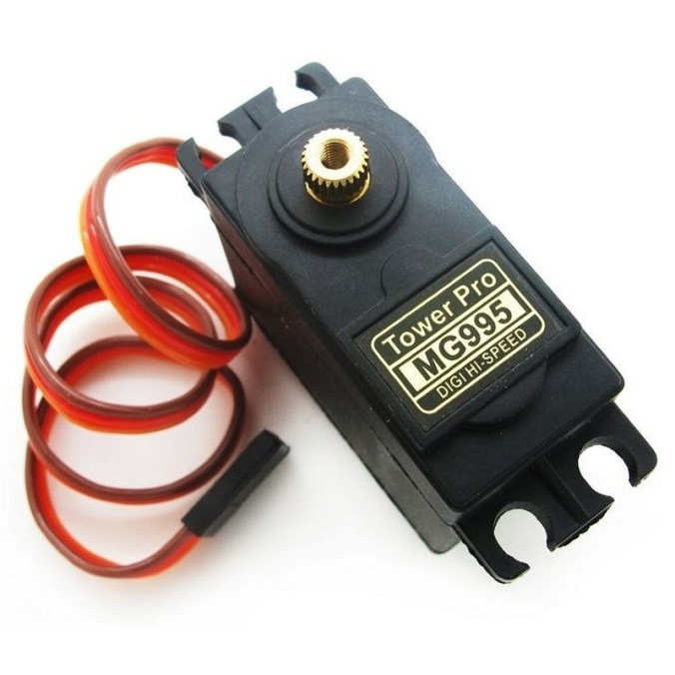
SERVO MOTOR
Servo Motor is used to Control the motion of arm
in precise 1° steps.
MG995 can turn between 0 ° to 180 ° when
provided a signal between 1 - 2ms of 20ms Time Period.
MG995 have Stall torque:of 8.5 kgf·cm at 4.8 V and 10 kgf·cm at 6 V.

Slide 13
Battery source (18650 cells)
Lithium ion batteries have high energy density
and cost less than lithium polymer.
As Lithium-ion batteries are rechargeable batteries
and portable
One cell will provide nearly 6Amperes of current.
We are using 3 cells in series (3s) configuration.

Slide 14
WORKING
The BOT is on its home position initially.
User connects to Bluetooth and sets the Source and Destination targets.
If the received targets were correct the Bot acknowledges.
Bot reaches the Source target and detects the objects triggers the servo motor which controls the arm mechanism, picking up the object.
Bot takes a U-turn and reaches the Destination places/releases the object.
And then finally acknowledges the User that the Job is completed.

Slide 15
POWER BUDGET
Approximate power Budget: 16.95 W
Component | Power calculation | Total Power
Atmega 328P-PU | (5V*200mA all active mode) | 1W
L298N | (5V*35mA) | 0.175W
Motor(2) | (12V*200mA*2 at max efiiciency ) | 4.8W
Line Sensor Array | (5V*160mA) | 0.8W
Bluetooth Module | (5V*100mA)
Servo | (5V*300mA) | 1.5W
TOTAL

Slide 16
FEATURES
Reduce human effort.
Reliable and economical.
Speeds up the work.
Helps Humans to avoid working in hazardous condition.

Slide 17
Incapabilities for now
The Load carrying capacity ranges between few 200-400gms only.
The batteries are needed to be charged.
Cannot pick-up objects which are higher than the Arm.
Line Tracing have a Speed Limit.

Slide 18
APPLICATION
Can be used at Industry.
Can be used at Warehouse.
Can be used at Construction Sides.
Can be used at Hazardous Sites such as Nuclear Power Plants.

Slide 19
FUTURE SCOPE
Automation of robot by making use of Bar Code Readers to read the code printed on the object and Cameras to just be sure that the object is picked and placed.
Live Job Monitoring can be added.
Improve weight capability of robot
Improvement in Arm Design and Speed of Bot.

Slide 20
CONCLUSION
This system would make it easier for human beings to pick and place the risk of handling suspicious objects
Movement of this robot is controlled by microcontroller as per the program
This Robot is useful in industrial activities and hazardous operations can be done easily and safely in a short span of time.
If object is detected with the help of proximity sensors, microcontroller operates and object pick up through servo motor using Arm.

Slide 21
THANK YOU

