Slide 1

COMPSCI 714 · GROUP PROJECT · S2 2026
Inventory Optimisation Agent
Zava Inventory Advisor: a read-only AI agent that turns inventory data into Data-driven recommendations
TEAM BLUEBIRD
Sateesh · Navneet · Ankur · Ranjith · Ruthvik
University of Auckland
Notes:
PRESENTER: Sateesh (Project Lead)
Welcome everyone. We are Team BlueBird and we chose the Inventory Optimisation Agent use case for Zava DIY. Our proof of concept is the Zava Inventory Advisor: a chat-based, read-only agent that answers inventory questions from the Zava database, checks every figure before the user sees it, and presents every recommendation as a draft for a person to approve. Each of us will present the part we owned.
[Sources] Visual on this slide was generated with Microsoft Copilot.

Slide 2





Who presents what
Sateesh
Project Lead
Each team member presents the part of the project they owned
PROJECT LEAD
DATA & PROBLEM ANALYST
SOLUTION ARCHITECT
IMPLEMENTATION LEAD
AI GOVERNANCE LEAD
Sateesh Kumar Puletipalle
Ruthvik Kodimela
Navneet Kumar Gupta
Ranjith Kumar Pulluri
Ankur Sharma
Problem, use case and success criteria; next steps
Evidence in the data; assumptions tested
Why an agent; architecture; services and design changes
How it works; evaluation results; delivery timeline
Governance controls; risks; privacy, limits and GenAI use
Slides 3–4, 18–19
Slides 5–6
Slides 7–10
Slides 11–13
Slides 14–17
Team BlueBird · COMPSCI 714
2
Notes:
PRESENTER: Sateesh (Project Lead)
Quick running order. I cover the problem and how we measured success. Ruthvik shows the evidence in the data and what our testing taught us about our assumptions. Navneet explains why we chose an agent and walks through the architecture. Ranjith shows how a question is answered end to end and our evaluation results. Ankur closes with governance, risks and responsible use. I will finish with next steps and questions.

Slide 3





The problem: Inventory Allocation Misaligned with Demand
Problem
Zava DIY faces challenges in aligning inventory levels with actual demand across its stores. Differences in customer demand, seasonal trends, and sales patterns lead to excess stock and inefficient inventory allocation. Currently, store managers spend considerable time manually analysing inventory and sales data to identify stock imbalances and make informed decisions about stock allocation and replenishment.
Users
The Super Manager sees all 8 stores; Store Managers see only their own. The agent knows who is asking from the sign-in.
Decision
Daily/weekly/on-need basis: Agent can help managers with right stock level recommendations across the stores on daily, weekly, need basis or with real-time numbers.
Consequence
Lost sales, higher holding and transport costs, and unsold seasonal stock, which hit profit, cash flow and customer satisfaction.
Team BlueBird · COMPSCI 714
3
Notes:
PRESENTER: Sateesh (Project Lead)
Zava DIY runs multiple stores. Demand, seasonal trends and availability differ by store, so some stores sit on excess stock while others could run short. Our users are the Super Manager, who sees all eight stores, and Store Managers, who see only their own. The decision they make is what to stop buying, move or clear first. Getting it wrong costs sales, storage and transport, and can leave seasonal stock unsold. For example, if Seattle runs out of a popular product while Everett has excess, Zava loses sales despite having enough stock overall.
[Sources] Visual on this slide was generated with Microsoft Copilot.

Slide 4
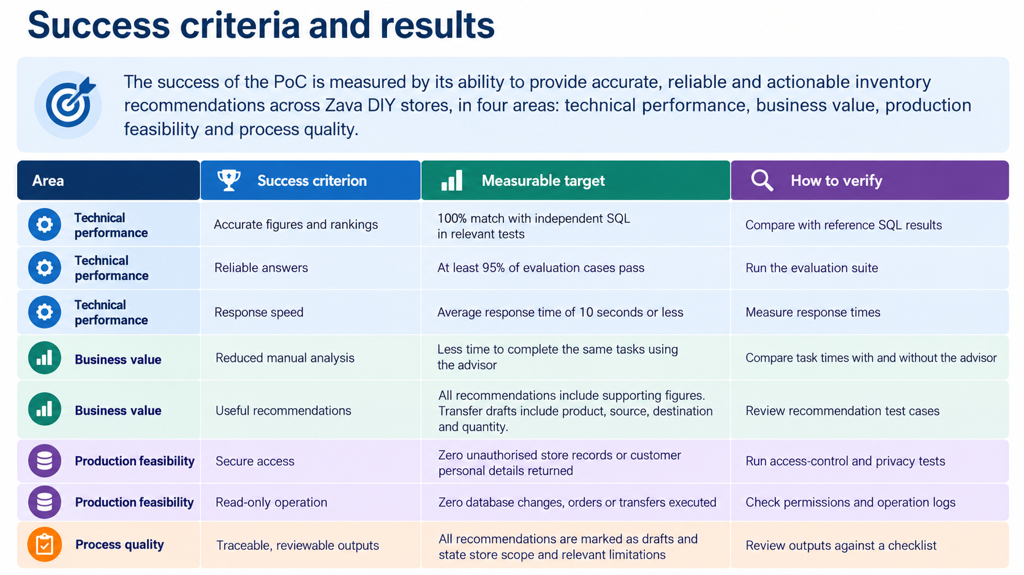
Sateesh
Project Lead
97.3%
Team BlueBird · COMPSCI 714
4
Notes:
PRESENTER: Sateesh (Project Lead)
We set six success criteria at the start. Four are met. The headline is 73 of 75 test cases passed, 97.3% against a 90% target; the two misses were wording differences, not wrong figures. The excess-stock ranking matches independent SQL. The transfer tool works, but no store is short in this data, so the agent honestly says no transfer is needed. Two are open: we did not run a timing study with real users to prove the 50% effort reduction, and the final demo and presentation are in progress. A typical answer takes about 10.5 seconds and costs about US$0.007.

Slide 5
Delivery timeline
Sateesh
Project Lead
Weeks 6 to 8 were planned milestones; weeks 10 to 13 record what was delivered
Wk 6
Wk 8
Wk 11
Wk 13
20/09
30/09
19–23/10
25-29/10
Use case and project plan
Architecture and AI governance practices
Charts and exports; grounded lookup; role sign-in; scope gate
Technical report and final presentation
Wk 7
Wk 10
Wk 12
27/09
13–14/10
25/10
Data exploration; scope; success criteria
Working agent, 20+ tests; per-person identity and RLS
Prompt review; privacy and read-only guards; 75-case evaluation
Owners: plan and success criteria (Sateesh, Ankur) · data (Ruthvik, Sateesh, Ranjith) · architecture (Navneet) · governance (Ankur) · build, evaluation and fixes (Team/Peer Programming), Technical and Final reports (Team)
Team BlueBird · COMPSCI 714
13
Notes:
PRESENTER: Ranjith (Implementation Lead)
Weeks 6 to 8 were planning: use case and plan, data exploration and success criteria, then architecture and governance practices. Build started in week 10 with a working agent and per-person row-level security. Week 11 added charts and exports, grounded product lookup, role sign-in, saved chats and the scope gate. Week 12 was the team prompt review, privacy and read-only guards and the 75-case evaluation. The report and this presentation are the final step. I will hand over to Ankur for governance.

Slide 6
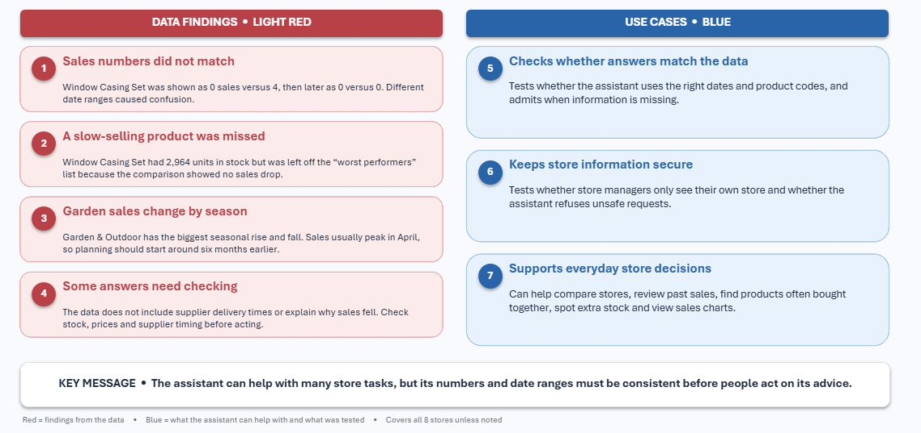
Ruthvik
Data & Problem Analyst
Data findings Snapshot
Team BlueBird · COMPSCI 714
4

Slide 7


The evidence: the problem exists in the data
Ruthvik
Data & Problem Analyst
Phase 2 queries on the Zava PostgreSQL dataset, checked against independent SQL
3,997,159
units in stock
$193.7M
stock value at cost
99%
Seasonal peaks are reliable
of product-store records hold > 5 years of stock
Garden & Outdoor peaks in April every year from 2020 to 2026, so clearing just before a peak would be a mistake.
Some stores are short today
Identified lowest stock stores are in Zava Retail Kirkland, Redmond and Everett.
Team BlueBird · COMPSCI 714
5
Notes:
PRESENTER: Ruthvik (Data & Problem Analyst)
We first confirmed the problem is real in the data. Zava holds 3,997,159 units, worth $193,657,843.57 at cost, against roughly 116,600 units sold in the last 12 months. Stock above six months of cover is worth $190,839,018.92 at cost, and 99% of product-store records hold more than five years of stock. The largest single excess is the Sliding Miter Saw 12-inch, at $4,431,750.00. Two more findings shaped the agent: seasonal peaks are reliable, for example Garden & Outdoor peaks every April from 2020 to 2026, and no store is short today, with the lowest stock cover about 375 days. The dataset is synthetic, so these sizes show the shape of the problem, not a real financial loss. Source: data/database/all_7_analysis_db.ipynb, questions 5 and 6.

Slide 8



Why do we need an agent? why not a chatbot?
Navneet
Solution Architect
A Passive Chatbot / SQL Report
The Inventory Optimisation Agent
Static & Reactive: Can only answer pre-scripted questions or return raw SQL query tables when asked.
No Multi-Tool Reasoning: Cannot independently chain actions (e.g., it cannot check inventory, look up freight costs, and verify warehouse capacity together).
Blind to Context: Pulls data without evaluating real-world business constraints like seasonal demand peaks.
Requires Manual Action: Merely outputs data and leaves humans to manually calculate and execute transfers or clearances.
Proactive & Goal-Driven: Automatically monitors stock levels, flags overstock risks, and initiates workflows unprompted.
Multi-Tool Chaining: Dynamically decides which tool to call next based on intermediate findings.
Context-Aware Reasoning: Cross-references stock excess with seasonal calendars before recommending clearance.
Autonomous Draft & Review: Drafts precise store transfer and clearance plans with hard figures for human sign-off.
Example: The database shows massive excess in Power Tools, but the agent checks the seasonal calendar, sees a peak coming in two months, and reasons: "Do not clear; hold stock for seasonal demand".
Team BlueBird · COMPSCI 714
7
Notes:
PRESENTER: Navneet (Solution Architect)
A SQL query can list stores with excess stock, but it cannot decide what to look at next or judge whether the evidence supports an action, and the user needs technical skills to write it. The agent goes beyond reporting: it chooses its tools and their order, checks the category seasonal peak before recommending a clearance, reads the results and drafts a recommendation with the figures behind it. A concrete example: the largest excess is in power tools, but the Electrical peak is two months away, so the agent says do not clear. And where no store is short, it says so instead of inventing a transfer.

Slide 9
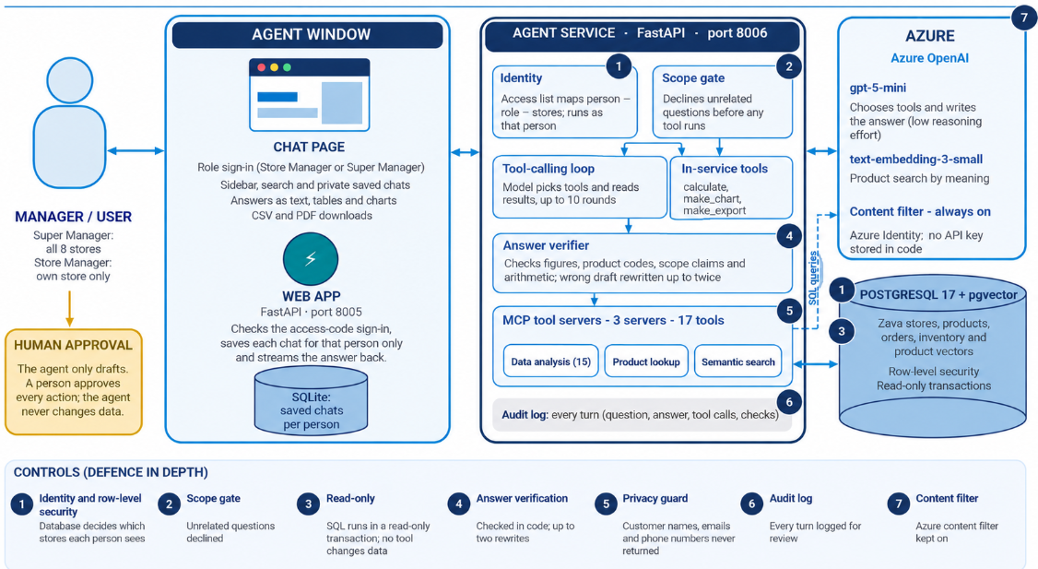
Implemented architecture
Navneet
Solution Architect
One agent with tools · read-only · every figure checked in code before the user sees it
Chat page
Web app :8005
Role sign-in; text, tables, charts, CSV and PDF
Checks sign-in; private saved chats
Agent service :8006
MCP tool servers
Scope gate → tool loop (≤10 rounds) → answer verifier
3 servers, 17 tools, querying as that person
Azure OpenAI
PostgreSQL + pgvector
gpt-5-mini; text-embedding-3-small
Row-level security; read-only transactions
Team BlueBird · COMPSCI 714
8
Notes:
PRESENTER: Navneet (Solution Architect)
This is the implemented design. A manager signs in on the chat page. The web app on port 8005 checks the sign-in, saves the chat for that person and passes the question to the agent service on port 8006. The service looks up which stores the person may see and runs the question as that person. A scope gate declines unrelated questions; gpt-5-mini then picks tools for up to ten rounds. Tools sit on three MCP servers that query PostgreSQL with the person's identity, so row-level security decides which stores are visible. Before an answer is shown, code checks every figure, product code, scope claim and calculation; a failing draft is rewritten up to twice. The seven numbered controls along the bottom are what Ankur will cover in governance.

Slide 10





Services, tools and key design decisions
Navneet
Solution Architect
PostgreSQL 17 + pgvector
KEY DESIGN DECISIONS
Data, product vectors, row-level security
Azure OpenAI gpt-5-mini
One agent with tools, not a multi-agent fleet
Rules enforced in code, not prompts
Access control inside the database
All arithmetic through a calculate tool
Data access through the MCP open standard
Tools take store names, so ids cannot be guessed
Read-only by design
Small, low-latency model
text-embedding-3-small
Python MCP SDK
Product search by meaning
3 servers, 17 tested SQL tools
FastAPI + Uvicorn
SQLite + vanilla JS
Agent service and web app; streams answers
Private saved chats; safe Markdown chat page
Answer verifier
Checks figures, codes, scope and arithmetic
Team BlueBird · COMPSCI 714
10
Notes:
PRESENTER: Navneet (Solution Architect)
On the left is the stack. PostgreSQL with pgvector holds the data and enforces row-level security. Azure OpenAI gpt-5-mini chooses tools and writes answers, and text-embedding-3-small powers search by meaning. Three MCP servers built with the Python SDK expose 17 tested SQL tools. FastAPI runs the agent service and the web app. Azure Identity means no key is stored in code. On the right are the decisions that matter most: one agent, rules in code, access control in the database, arithmetic in a tool, MCP for data access, store names not ids, read-only by design, and a small fast model. Over to Ranjith for how it runs.

Slide 11







How one question is answered
Ranjith
Implementation Lead
Every stage has its own control
01
02
03
04
Sign in
Identity
Scope gate
Tool loop
Role and access code; chat saved privately
Access list → stores; runs as that person
Unrelated questions declined first
Model picks tools, ≤10 rounds; read-only SQL
08
07
06
05
Audit
Deliver
Verify
Draft
Question, answer, tools and checks logged
Text, tables, charts, CSV / PDF; drafts only
Figures, codes, scope, maths; ≤2 rewrites
Starts with a Scope line: stores, metric, dates
Team BlueBird · COMPSCI 714
11
Notes:
PRESENTER: Ranjith (Implementation Lead)
Here is the journey of one question, top row left to right, then bottom row right to left. One: the manager signs in by role. Two: the service maps the person to their stores and runs as that person, so row-level security applies. Three: a scope gate declines unrelated questions before any tool runs; we checked it on 38 unrelated messages. Four: gpt-5-mini calls tools for up to ten rounds; SQL is read-only and personal-detail columns are refused. Five: the draft starts with a Scope line naming the stores, metric and dates. Six, the key step: code verifies every figure, product code, scope claim and calculation, with up to two rewrites, otherwise a visible verification note. Seven: the answer streams back as text, tables, charts or downloads, as a draft. Eight: the turn is logged for audit.

Slide 12
Evaluation results
Ranjith
Implementation Lead
Final run 25/10/2026 · rerun after every change
0
0
~10.5 s
invented products or SKUs
unsupported large figures
median time per answer
29-answer grounding audit
same audit
gpt-5-mini, low reasoning effort
73 / 75
~$0.007
38
75
97.3% passed
cost per question
unrelated messages
evaluation cases
under one US cent
used to check the scope gate
plus grounding audit, repeat-run check
Defect found by testing and fixed: on 25/10/2026 the agent returned customer names, emails and phones when asked. It now refuses, rejects those columns and strips them (case T8).
Team BlueBird · COMPSCI 714
12
Notes:
PRESENTER: Ranjith (Implementation Lead)
We built 75 evaluation cases and rerun them after every change. 73 passed, 97.3%; the two misses were wording in answers about the agent itself. A grounding audit of 29 answers found zero invented product names, zero invented SKUs and zero unsupported large figures. Median response is about 10.5 seconds at about US$0.007 per question. Testing also caught a real defect on 25 October: the agent would return customers' names, emails and phone numbers when asked. We fixed it in three places, refusing the request, rejecting queries that name those columns and stripping them from results, and added case T8 so it stays fixed.

Slide 13
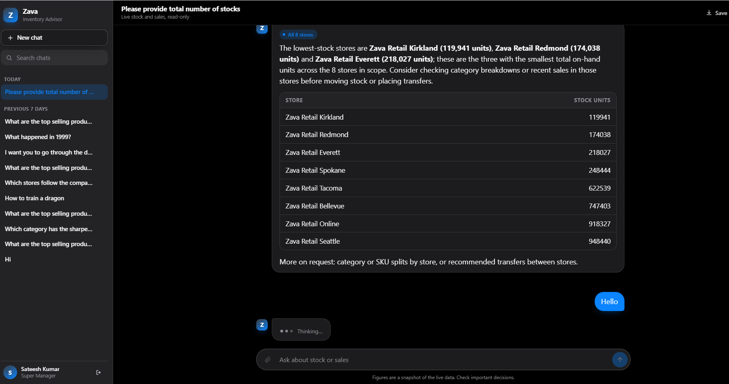
Agent Portal – Super user
Ranjith
Implementation Lead
Team BlueBird · COMPSCI 714
12
Notes:
PRESENTER: Ranjith (Implementation Lead)
We built 75 evaluation cases and rerun them after every change. 73 passed, 97.3%; the two misses were wording in answers about the agent itself. A grounding audit of 29 answers found zero invented product names, zero invented SKUs and zero unsupported large figures. Median response is about 10.5 seconds at about US$0.007 per question. Testing also caught a real defect on 25 October: the agent would return customers' names, emails and phone numbers when asked. We fixed it in three places, refusing the request, rejecting queries that name those columns and stripping them from results, and added case T8 so it stays fixed.

Slide 14
Ranjith
Implementation Lead
Team BlueBird · COMPSCI 714
12
Notes:
PRESENTER: Ranjith (Implementation Lead)
We built 75 evaluation cases and rerun them after every change. 73 passed, 97.3%; the two misses were wording in answers about the agent itself. A grounding audit of 29 answers found zero invented product names, zero invented SKUs and zero unsupported large figures. Median response is about 10.5 seconds at about US$0.007 per question. Testing also caught a real defect on 25 October: the agent would return customers' names, emails and phone numbers when asked. We fixed it in three places, refusing the request, rejecting queries that name those columns and stripping them from results, and added case T8 so it stays fixed.

Slide 15





Governance: defence in depth
Ankur
AI Governance Lead
No single control is relied on · every rule is enforced in code and tested
1
2
3
4
Row-level security
Scope gate
Read-only transaction
Answer verifier
Who sees what
What is asked
What can change
What is claimed
Cases A1–A6, V1
38-message gate check
V3, O1, O8, T6
29-answer audit; H1–H3
5
6
7
Privacy guard
Audit log
Azure content filter
Human approval
No customer personal details
What happened
What is generated
The agent only drafts. A manager stays accountable for every decision.
Tool test; T8
Reviewed in audit
Always on
Team BlueBird · COMPSCI 714
14
Notes:
PRESENTER: Ankur (AI Governance Lead)
Our governance principle is defence in depth: no single control is relied on. Identity and row-level security decide who sees what. The scope gate decides what is asked. The read-only transaction decides what can change. The answer verifier decides what is claimed. The privacy guard keeps customer personal details out. The audit log records what happened, and the Azure content filter covers what is generated. Above all of these, a person approves every action; the agent only drafts. Each control has its own test evidence, shown on each card.

Slide 16
Risk management
Ankur
AI Governance Lead
Main risks found during the project, rated Low / Medium / High
RISK
LIKELIHOOD
IMPACT
MITIGATION
Hallucinated figure or product
MEDIUM
HIGH
Every figure and code checked; calculate tool; audit and 75 cases rerun
Person sees stores they should not
LOW
HIGH
Row-level security, one identity per person; A1–A6, V1
Prompt injection or request to change data
MEDIUM
HIGH
Read-only SQL; tool output treated as data; content filter; scope gate
Customer personal details exposed
MEDIUM
HIGH
Columns refused and removed; prompt rule; test and case T8
Synthetic or incomplete data misleads
HIGH
MEDIUM
Limits stated; "within this dataset"; cost as upper bound; no forecasts
Inconsistent answers or wrong self-explanation
HIGH
MEDIUM
Fixed procedures in code; repeat-run check; W1–W3
Slow or unavailable model, or cost overrun
MEDIUM
MEDIUM
Timeouts and retries; ~10.5 s, ~$0.007; fallback video planned
Team BlueBird · COMPSCI 714
15
Notes:
PRESENTER: Ankur (AI Governance Lead)
These are the seven main risks. The four high-impact risks are hallucination, seeing the wrong stores, prompt injection or write requests, and exposing customer personal details. Each is mitigated in code or the database, and each has test cases. The two high-likelihood risks are that synthetic data misleads, which we handle by stating limits every time, and inconsistent answers, found by a tester on 25 October, which we handle with fixed procedures in tools and a repeat-run check. Model latency and cost are medium and managed with timeouts, retries and a planned fallback demo video.

Slide 17
Privacy, limitations and ethics
Ankur
AI Governance Lead
Data privacy
Limitations we state
Bias and ethics
Dataset is synthetic
Store access enforced in the database; a claim of more access changes nothing
Customer names, emails and phones never returned (defect found 25/10/2026, fixed)
Saved chats private to each person
Synthetic data shows the method, not real savings
Words such as "highest" or "fell" are not checked by code
The model sometimes adds general-knowledge remarks
Not yet tested with real managers or timed
Rankings use units sold unless revenue is asked, so the metric is always stated
No profiling of individual customers
Seasons are northern hemisphere
Users reminded not to over-rely; managers stay accountable
Team BlueBird · COMPSCI 714
16
Notes:
PRESENTER: Ankur (AI Governance Lead)
On privacy: the data is synthetic, store access is enforced in the database, and after the defect we found on 25 October customer personal details are never returned. Saved chats belong to the signed-in person only. We are open about limitations: synthetic data shows the method, not real savings; some wording like highest or fell is not checked by code; the model occasionally adds general-knowledge remarks; and we have not yet tested with real managers. On bias: rankings default to units sold, which favours cheap fast-moving items, so the metric is always stated; we never profile individual customers; seasons are northern hemisphere; and managers remain accountable for every decision.

Slide 18

Where we are and what comes next
Sateesh
Project Lead
Delivered in the proof of concept
Next steps toward production
Chat page with role sign-in, private saved chats, charts and CSV / PDF downloads
Excess-stock ranking with a seasonal clearance guard
Store coverage, transfer, sales, seasonal and stock-cover analysis
Product lookup and search by meaning
Answer verification, scope gate and refusals
Read-only, human-approved drafts
75-case evaluation, grounding audit and decision log
Demand forecasting once lead times, safety stock and receipts are available
Execute transfers, orders or clearances with an approval workflow
Hosted deployment in Azure AI Foundry with Microsoft Entra sign-in
Scheduled reviews and threshold alerts
ERP, point-of-sale and supplier integration
Cost modelling for transfers and clearance prices
Timing study with real managers to prove effort saved
Team BlueBird · COMPSCI 714
18
Notes:
PRESENTER: Sateesh (Project Lead)
To wrap up: the proof of concept delivers a working, read-only advisor with verified answers, seasonal awareness, role-based access and a strong evaluation. The path to production is clear: forecasting once lead times and safety stock exist, executing actions through an approval workflow, hosting in Azure AI Foundry with Entra sign-in, scheduled alerts, integration with ERP, POS and supplier systems, cost modelling, and a timing study with real managers to prove the 50% effort target.

Slide 19

Thank you
Questions and live demo
Verified
Safe
Proven
Every figure is checked in code before the user sees it
Read-only, role-based, privacy-guarded, human-approved
Agent answers defined use cases as per the user role and meets the expected criteria.
Team BlueBird · Sateesh · Navneet · Ankur · Ranjith · Ruthvik
Notes:
PRESENTER: Sateesh (Project Lead), whole team for Q&A
Three takeaways: the agent is verified, because every figure is checked in code; it is safe, because it is read-only, role-based, privacy-guarded and human-approved; and it is proven, with 73 of 75 cases passing. Thank you. We are happy to take questions or run the live demo (guide in docs/demo.md).
Suggested Q&A owners: data questions to Ruthvik; architecture to Navneet; code and evaluation to Ranjith; privacy and risk to Ankur; scope and plan to Sateesh.
[Sources] Visual on this slide was generated with Microsoft Copilot.

