Slide 1

The RPwD Act 2016
Easy Read Guide · All 102 Sections
Your rights, in plain words — with the law still attached.
A complete reference for persons with intellectual and learning disabilities.
Section titles verified against the official RPwD Act 2016 (Ministry of Law and Justice).
vidyasagar.co.in
RPwD Act 2016 · Easy Read Guide · All 102 Sections
Page 1 of 127
Notes:
Cover. Title: The RPwD Act 2016 — Easy Read Guide. All 102 sections. Section titles verified against the official Ministry of Law and Justice text. Supported by Vidyasagar.

Slide 2
About this guide
• This guide explains all 102 sections of India's Rights of Persons with Disabilities Act 2016.
• It is written in plain words for people who find legal language hard.
• Every page keeps the official Section number and title from the Act. The plain words sit below.
• Some sections give you rights you can claim. Others explain how the system works — those say “For reference” in the Use this when box.
• Each chapter has its own colour, so you can tell at a glance which chapter you are in.
• Section titles in this guide were verified against the official Act text from the Ministry of Law and Justice.
• This guide is not legal advice. For court matters, please ask a lawyer or your State Commissioner.
WHY THE LEGAL HEADINGS STAY
When you raise a complaint, citing the Section number gives your case real power. We never strip it out.
RPwD Act 2016 · Easy Read Guide · All 102 Sections
Page 2 of 127
Notes:
About this guide. Plain explanation of all 102 sections of the RPwD Act 2016. Section titles verified against the official Act text. Not legal advice.

Slide 3
How to use this guide
Every Section page in this guide has the same five parts:
1
Chapter and Section number
Tells you exactly where in the Act you are.
2
Official Section title
The exact name from the Act. Use this in complaints.
3
Picture
A simple drawing to help you remember the idea.
4
Plain words
The same idea in easy English.
5
Use this when…
Real-life examples of when this section helps you.
RPwD Act 2016 · Easy Read Guide · All 102 Sections
Page 3 of 127
Notes:
How to use this guide. The five-part anatomy of every Section page. Legal anchors stay so the reader can cite them in complaints.

Slide 4
Map of your rights
All 17 chapters and 102 sections — each chapter has its own colour:
CH I
The basics
1, 2
CH X
Certification
56 – 59
CH II
Your rights
3 – 15
CH XI
Advisory boards
60 – 73
CH III
Education
16 – 18
CH XII
Commissioners
74 – 83
CH IV
Skill and work
19 – 23
CH XIII
Special Court
84, 85
CH V
Health and support
24 – 30
CH XIV
National Fund
86, 87
CH VI
Benchmark disabilities
31 – 37
CH XV
State Fund
88
CH VII
High support needs
38
CH XVI
Penalties
89 – 95
CH VIII
Government duties
39 – 48
CH XVII
Miscellaneous
96 – 102
CH IX
Disability institutions
49 – 55
Plus: How to file a complaint · Who can help you · Your rights in one page
RPwD Act 2016 · Easy Read Guide · All 102 Sections
Page 4 of 127
Notes:
Map of your rights. All 17 chapters and 102 sections of the RPwD Act 2016, with the section number range and the chapter colour for each.

Slide 5
CHAPTER I
Preliminary
The basics: who is covered and what the words mean
RPwD Act 2016 · Easy Read Guide · All 102 Sections
Page 5 of 127
Notes:
CHAPTER I: Preliminary. The basics: who is covered and what the words mean

Slide 6

CHAPTER I · THE BASICS
1
Section 1 — Short title and commencement
This section gives the Act its name and tells when it started. The Act began on 19 April 2017 and applies to all of India.
★ USE THIS WHEN
(For reference. This section is the Act's name plate.)
RPwD Act 2016 · Easy Read Guide · All 102 Sections
Page 6 of 127
Notes:
Section 1 — Short title and commencement. Plain meaning: This section gives the Act its name and tells when it started. The Act began on 19 April 2017 and applies to all of India. Use when: (For reference. This section is the Act's name plate.)

Slide 7
CHAPTER I · THE BASICS
2
Section 2 — Definitions
The Act lists 21 disabilities. If you have one of them, you are covered. If your disability is 40% or more, you are called a person with benchmark disability — you get extra rights.
★ USE THIS WHEN
You are not sure if the Act covers you, or whether you have a benchmark disability. Look at the list of 21 disabilities and the 40% rule.
RPwD Act 2016 · Easy Read Guide · All 102 Sections
Page 7 of 127
Notes:
Section 2 — Definitions. Plain meaning: The Act lists 21 disabilities. If you have one of them, you are covered. If your disability is 40% or more, you are called a person with benchmark disability — you get extra rights. Use when: You are not sure if the Act covers you, or whether you have a benchmark disability. Look at the list of 21 disabilities and the 40% rule.

Slide 8
CHAPTER II
Rights and Entitlements
What you can claim, and what is wrong
RPwD Act 2016 · Easy Read Guide · All 102 Sections
Page 8 of 127
Notes:
CHAPTER II: Rights and Entitlements. What you can claim, and what is wrong

Slide 9

CHAPTER II · YOUR RIGHTS
3
Section 3 — Equality and non-discrimination
You have the right to be treated equally. No one can treat you badly because you have a disability.
★ USE THIS WHEN
Someone refused you a service, a job, or a place because of your disability. Cite Section 3 in your complaint.
RPwD Act 2016 · Easy Read Guide · All 102 Sections
Page 9 of 127
Notes:
Section 3 — Equality and non-discrimination. Plain meaning: You have the right to be treated equally. No one can treat you badly because you have a disability. Use when: Someone refused you a service, a job, or a place because of your disability. Cite Section 3 in your complaint.

Slide 10

CHAPTER II · YOUR RIGHTS
4
Section 4 — Women and children with disabilities
Women and children with disabilities have the same rights as everyone else. The government must protect them from extra harm.
★ USE THIS WHEN
A girl or woman is denied school, work, or safety because of her disability. Or a child is being kept out of school.
RPwD Act 2016 · Easy Read Guide · All 102 Sections
Page 10 of 127
Notes:
Section 4 — Women and children with disabilities. Plain meaning: Women and children with disabilities have the same rights as everyone else. The government must protect them from extra harm. Use when: A girl or woman is denied school, work, or safety because of her disability. Or a child is being kept out of school.

Slide 11

CHAPTER II · YOUR RIGHTS
5
Section 5 — Community life
You have the right to live in your own home and your own community. No one can force you into an institution against your will.
★ USE THIS WHEN
Someone is forcing a person with a disability to live in a hostel or institution they do not want to live in.
RPwD Act 2016 · Easy Read Guide · All 102 Sections
Page 11 of 127
Notes:
Section 5 — Community life. Plain meaning: You have the right to live in your own home and your own community. No one can force you into an institution against your will. Use when: Someone is forcing a person with a disability to live in a hostel or institution they do not want to live in.

Slide 12

CHAPTER II · YOUR RIGHTS
6
Section 6 — Protection from cruelty and inhuman treatment
No one can hurt you or treat you in a cruel way. The government must keep you safe.
★ USE THIS WHEN
A person with a disability is being treated cruelly at home, in school, in a hospital, or in care.
RPwD Act 2016 · Easy Read Guide · All 102 Sections
Page 12 of 127
Notes:
Section 6 — Protection from cruelty and inhuman treatment. Plain meaning: No one can hurt you or treat you in a cruel way. The government must keep you safe. Use when: A person with a disability is being treated cruelly at home, in school, in a hospital, or in care.

Slide 13
CHAPTER II · YOUR RIGHTS
7
Section 7 — Protection from abuse, violence and exploitation
No one can hit you, hurt you, or use you for their gain. You can tell the police. They must help. You can also ask a magistrate for protection.
★ USE THIS WHEN
Someone is hurting, abusing, or exploiting a person with a disability.
RPwD Act 2016 · Easy Read Guide · All 102 Sections
Page 13 of 127
Notes:
Section 7 — Protection from abuse, violence and exploitation. Plain meaning: No one can hit you, hurt you, or use you for their gain. You can tell the police. They must help. You can also ask a magistrate for protection. Use when: Someone is hurting, abusing, or exploiting a person with a disability.

Slide 14
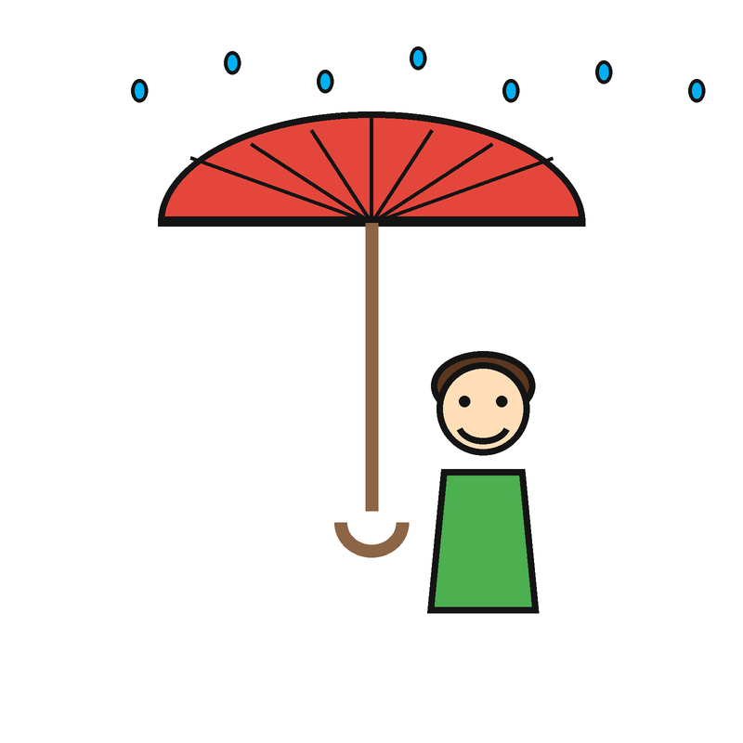
CHAPTER II · YOUR RIGHTS
8
Section 8 — Protection and safety
The government must keep persons with disabilities safe in disasters, fires, floods, armed conflict, and other emergencies.
★ USE THIS WHEN
A relief camp, shelter, or evacuation plan does not include or is not safe for persons with disabilities.
RPwD Act 2016 · Easy Read Guide · All 102 Sections
Page 14 of 127
Notes:
Section 8 — Protection and safety. Plain meaning: The government must keep persons with disabilities safe in disasters, fires, floods, armed conflict, and other emergencies. Use when: A relief camp, shelter, or evacuation plan does not include or is not safe for persons with disabilities.

Slide 15
CHAPTER II · YOUR RIGHTS
9
Section 9 — Home and family
Persons with disabilities have the right to a home and a family. No child can be taken from a parent only because the parent has a disability.
★ USE THIS WHEN
A child welfare worker tries to take your child away because of your disability.
RPwD Act 2016 · Easy Read Guide · All 102 Sections
Page 15 of 127
Notes:
Section 9 — Home and family. Plain meaning: Persons with disabilities have the right to a home and a family. No child can be taken from a parent only because the parent has a disability. Use when: A child welfare worker tries to take your child away because of your disability.

Slide 16

CHAPTER II · YOUR RIGHTS
10
Section 10 — Reproductive rights
Persons with disabilities have the right to decide about marriage and children. No one can force you to have an operation that stops you from having children.
★ USE THIS WHEN
A doctor, family member, or institution wants to sterilise a person with a disability without their full free consent.
RPwD Act 2016 · Easy Read Guide · All 102 Sections
Page 16 of 127
Notes:
Section 10 — Reproductive rights. Plain meaning: Persons with disabilities have the right to decide about marriage and children. No one can force you to have an operation that stops you from having children. Use when: A doctor, family member, or institution wants to sterilise a person with a disability without their full free consent.

Slide 17

CHAPTER II · YOUR RIGHTS
11
Section 11 — Accessibility in voting
You have the right to vote in private. Polling stations must have ramps, easy ballots, and help if you need it.
★ USE THIS WHEN
A polling station has no ramp, no Braille ballot, or no help for voters with disabilities.
RPwD Act 2016 · Easy Read Guide · All 102 Sections
Page 17 of 127
Notes:
Section 11 — Accessibility in voting. Plain meaning: You have the right to vote in private. Polling stations must have ramps, easy ballots, and help if you need it. Use when: A polling station has no ramp, no Braille ballot, or no help for voters with disabilities.

Slide 18

CHAPTER II · YOUR RIGHTS
12
Section 12 — Access to justice
You have the right to go to court. Courts must let you take part. They must give you a sign language interpreter or a support person if you need one.
★ USE THIS WHEN
A court, police station, or tribunal does not let you take part because of your disability.
RPwD Act 2016 · Easy Read Guide · All 102 Sections
Page 18 of 127
Notes:
Section 12 — Access to justice. Plain meaning: You have the right to go to court. Courts must let you take part. They must give you a sign language interpreter or a support person if you need one. Use when: A court, police station, or tribunal does not let you take part because of your disability.

Slide 19

CHAPTER II · YOUR RIGHTS
13
Section 13 — Legal capacity
You can make your own decisions. You can own things. You can run a bank account. No one can take that away because of your disability.
★ USE THIS WHEN
Someone says you cannot sign a document, open a bank account, or own property because of your disability.
RPwD Act 2016 · Easy Read Guide · All 102 Sections
Page 19 of 127
Notes:
Section 13 — Legal capacity. Plain meaning: You can make your own decisions. You can own things. You can run a bank account. No one can take that away because of your disability. Use when: Someone says you cannot sign a document, open a bank account, or own property because of your disability.

Slide 20

CHAPTER II · YOUR RIGHTS
14
Section 14 — Provision for guardianship
Guardianship can only be a last step. It must be limited and end when you can decide for yourself again. You always have the right to support to make your own choices.
★ USE THIS WHEN
Someone wants to put a person with a disability under full guardianship without trying support first.
RPwD Act 2016 · Easy Read Guide · All 102 Sections
Page 20 of 127
Notes:
Section 14 — Provision for guardianship. Plain meaning: Guardianship can only be a last step. It must be limited and end when you can decide for yourself again. You always have the right to support to make your own choices. Use when: Someone wants to put a person with a disability under full guardianship without trying support first.

Slide 21

CHAPTER II · YOUR RIGHTS
15
Section 15 — Designation of authorities to support
The government must name offices that help persons with disabilities make their own decisions.
★ USE THIS WHEN
(For reference. This section sets up the support system for decision-making.)
RPwD Act 2016 · Easy Read Guide · All 102 Sections
Page 21 of 127
Notes:
Section 15 — Designation of authorities to support. Plain meaning: The government must name offices that help persons with disabilities make their own decisions. Use when: (For reference. This section sets up the support system for decision-making.)

Slide 22
CHAPTER III
Education
Schools, colleges, and learning
RPwD Act 2016 · Easy Read Guide · All 102 Sections
Page 22 of 127
Notes:
CHAPTER III: Education. Schools, colleges, and learning

Slide 23
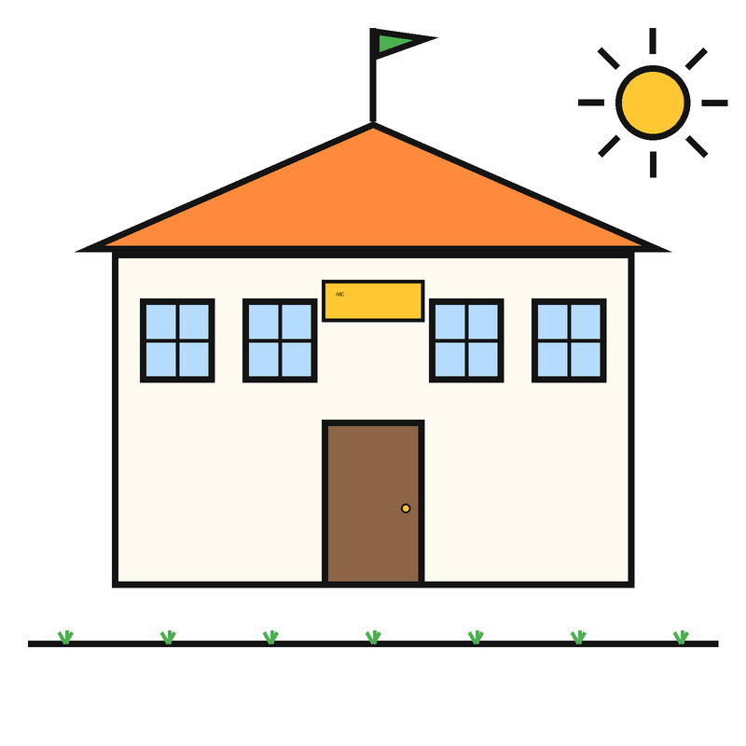
CHAPTER III · EDUCATION
16
Section 16 — Duty of educational institutions
All schools must welcome children with disabilities. Schools must give the help each child needs to learn.
★ USE THIS WHEN
A school refused to take a child because of disability, or refuses to give support.
RPwD Act 2016 · Easy Read Guide · All 102 Sections
Page 23 of 127
Notes:
Section 16 — Duty of educational institutions. Plain meaning: All schools must welcome children with disabilities. Schools must give the help each child needs to learn. Use when: A school refused to take a child because of disability, or refuses to give support.

Slide 24

CHAPTER III · EDUCATION
17
Section 17 — Specific measures to promote and facilitate inclusive education
The government must train teachers, make books in accessible formats, and make schools easy to enter and use.
★ USE THIS WHEN
A school does not have ramps, accessible books, sign language support, or trained teachers.
RPwD Act 2016 · Easy Read Guide · All 102 Sections
Page 24 of 127
Notes:
Section 17 — Specific measures to promote and facilitate inclusive education. Plain meaning: The government must train teachers, make books in accessible formats, and make schools easy to enter and use. Use when: A school does not have ramps, accessible books, sign language support, or trained teachers.

Slide 25

CHAPTER III · EDUCATION
18
Section 18 — Adult education
The government must run adult education programmes that include adults with disabilities.
★ USE THIS WHEN
An adult literacy or skills programme has no place for persons with disabilities.
RPwD Act 2016 · Easy Read Guide · All 102 Sections
Page 25 of 127
Notes:
Section 18 — Adult education. Plain meaning: The government must run adult education programmes that include adults with disabilities. Use when: An adult literacy or skills programme has no place for persons with disabilities.

Slide 26
CHAPTER IV
Skill Development and Employment
Training, jobs, and fair treatment at work
RPwD Act 2016 · Easy Read Guide · All 102 Sections
Page 26 of 127
Notes:
CHAPTER IV: Skill Development and Employment. Training, jobs, and fair treatment at work

Slide 27

CHAPTER IV · SKILL & WORK
19
Section 19 — Vocational training and self-employment
The government must run job training programmes and help persons with disabilities start their own work.
★ USE THIS WHEN
A skill training programme refused you, or did not have an accessible course.
RPwD Act 2016 · Easy Read Guide · All 102 Sections
Page 27 of 127
Notes:
Section 19 — Vocational training and self-employment. Plain meaning: The government must run job training programmes and help persons with disabilities start their own work. Use when: A skill training programme refused you, or did not have an accessible course.

Slide 28
CHAPTER IV · SKILL & WORK
20
Section 20 — Non-discrimination in employment
A government job cannot say no to you because you have a disability. You must be treated fairly at work.
★ USE THIS WHEN
You did not get a job, a promotion, or a fair review because of your disability.
RPwD Act 2016 · Easy Read Guide · All 102 Sections
Page 28 of 127
Notes:
Section 20 — Non-discrimination in employment. Plain meaning: A government job cannot say no to you because you have a disability. You must be treated fairly at work. Use when: You did not get a job, a promotion, or a fair review because of your disability.

Slide 29
CHAPTER IV · SKILL & WORK
21
Section 21 — Equal opportunity policy
Every workplace with 20 or more workers must write down how they will treat workers with disabilities fairly. They must show this paper if you ask.
★ USE THIS WHEN
You want to know your workplace's rules for disability support. Ask to see the equal opportunity policy.
RPwD Act 2016 · Easy Read Guide · All 102 Sections
Page 29 of 127
Notes:
Section 21 — Equal opportunity policy. Plain meaning: Every workplace with 20 or more workers must write down how they will treat workers with disabilities fairly. They must show this paper if you ask. Use when: You want to know your workplace's rules for disability support. Ask to see the equal opportunity policy.

Slide 30

CHAPTER IV · SKILL & WORK
22
Section 22 — Maintenance of records
Every workplace must keep records of how many workers with disabilities they have, and what support each one needs.
★ USE THIS WHEN
You ask your workplace for these records and they refuse, or they say no records are kept.
RPwD Act 2016 · Easy Read Guide · All 102 Sections
Page 30 of 127
Notes:
Section 22 — Maintenance of records. Plain meaning: Every workplace must keep records of how many workers with disabilities they have, and what support each one needs. Use when: You ask your workplace for these records and they refuse, or they say no records are kept.

Slide 31

CHAPTER IV · SKILL & WORK
23
Section 23 — Appointment of Grievance Redressal Officer
Every government workplace must name an officer to handle complaints from workers with disabilities.
★ USE THIS WHEN
Your workplace has no Grievance Redressal Officer, or the officer is not doing the job.
RPwD Act 2016 · Easy Read Guide · All 102 Sections
Page 31 of 127
Notes:
Section 23 — Appointment of Grievance Redressal Officer. Plain meaning: Every government workplace must name an officer to handle complaints from workers with disabilities. Use when: Your workplace has no Grievance Redressal Officer, or the officer is not doing the job.

Slide 32
CHAPTER V
Social Security, Health, Rehabilitation and Recreation
Help to live with dignity, stay well, and take part
RPwD Act 2016 · Easy Read Guide · All 102 Sections
Page 32 of 127
Notes:
CHAPTER V: Social Security, Health, Rehabilitation and Recreation. Help to live with dignity, stay well, and take part

Slide 33
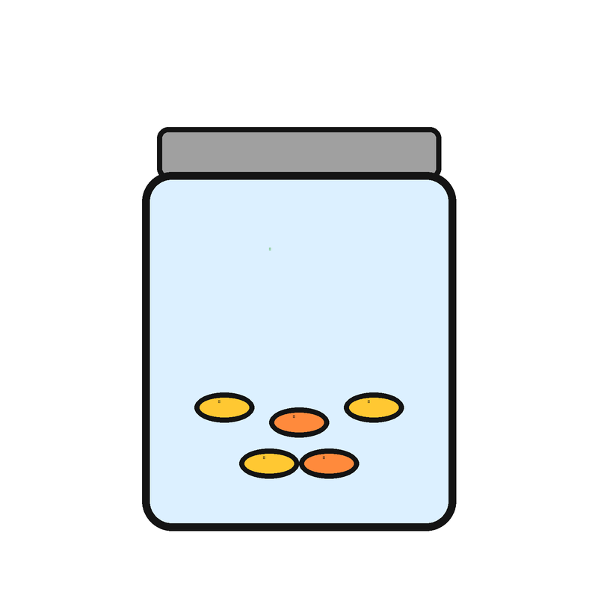
CHAPTER V · HEALTH AND SUPPORT
24
Section 24 — Social security
The government must help you with food, clothes, a home, and other support if you need it to live.
★ USE THIS WHEN
You need a disability pension, ration card, or housing scheme but were turned away.
RPwD Act 2016 · Easy Read Guide · All 102 Sections
Page 33 of 127
Notes:
Section 24 — Social security. Plain meaning: The government must help you with food, clothes, a home, and other support if you need it to live. Use when: You need a disability pension, ration card, or housing scheme but were turned away.

Slide 34

CHAPTER V · HEALTH AND SUPPORT
25
Section 25 — Healthcare
You should get free healthcare close to where you live. Healthcare must work for people with disabilities too.
★ USE THIS WHEN
A government hospital or clinic refused you, charged you, or had no accessible service.
RPwD Act 2016 · Easy Read Guide · All 102 Sections
Page 34 of 127
Notes:
Section 25 — Healthcare. Plain meaning: You should get free healthcare close to where you live. Healthcare must work for people with disabilities too. Use when: A government hospital or clinic refused you, charged you, or had no accessible service.

Slide 35
CHAPTER V · HEALTH AND SUPPORT
26
Section 26 — Insurance schemes
The government must run insurance schemes for persons with disabilities.
★ USE THIS WHEN
An insurance company refused you because of your disability, or you cannot find any disability insurance.
RPwD Act 2016 · Easy Read Guide · All 102 Sections
Page 35 of 127
Notes:
Section 26 — Insurance schemes. Plain meaning: The government must run insurance schemes for persons with disabilities. Use when: An insurance company refused you because of your disability, or you cannot find any disability insurance.

Slide 36
CHAPTER V · HEALTH AND SUPPORT
27
Section 27 — Rehabilitation
The government must run rehabilitation programmes covering health, mind, social skills, and work.
★ USE THIS WHEN
A government rehab centre is not available, is too far, or refused to take you.
RPwD Act 2016 · Easy Read Guide · All 102 Sections
Page 36 of 127
Notes:
Section 27 — Rehabilitation. Plain meaning: The government must run rehabilitation programmes covering health, mind, social skills, and work. Use when: A government rehab centre is not available, is too far, or refused to take you.

Slide 37
CHAPTER V · HEALTH AND SUPPORT
28
Section 28 — Research and development
The government must support research on disability, including new tools and treatments.
★ USE THIS WHEN
(For reference. This section funds research on assistive technology and disability services.)
RPwD Act 2016 · Easy Read Guide · All 102 Sections
Page 37 of 127
Notes:
Section 28 — Research and development. Plain meaning: The government must support research on disability, including new tools and treatments. Use when: (For reference. This section funds research on assistive technology and disability services.)

Slide 38
CHAPTER V · HEALTH AND SUPPORT
29
Section 29 — Culture and recreation
Persons with disabilities have the right to take part in art, music, films, libraries, and leisure.
★ USE THIS WHEN
A museum, cinema, library, or cultural event refused you or had no accessible entry.
RPwD Act 2016 · Easy Read Guide · All 102 Sections
Page 38 of 127
Notes:
Section 29 — Culture and recreation. Plain meaning: Persons with disabilities have the right to take part in art, music, films, libraries, and leisure. Use when: A museum, cinema, library, or cultural event refused you or had no accessible entry.

Slide 39

CHAPTER V · HEALTH AND SUPPORT
30
Section 30 — Sporting activities
The government must support sports for persons with disabilities.
★ USE THIS WHEN
A sports facility, training programme, or competition refused to include persons with disabilities.
RPwD Act 2016 · Easy Read Guide · All 102 Sections
Page 39 of 127
Notes:
Section 30 — Sporting activities. Plain meaning: The government must support sports for persons with disabilities. Use when: A sports facility, training programme, or competition refused to include persons with disabilities.

Slide 40
CHAPTER VI
Special Provisions for Persons with Benchmark Disabilities
Extra rights when your disability is 40% or more
RPwD Act 2016 · Easy Read Guide · All 102 Sections
Page 40 of 127
Notes:
CHAPTER VI: Special Provisions for Persons with Benchmark Disabilities. Extra rights when your disability is 40% or more

Slide 41
CHAPTER VI · BENCHMARK DISABILITIES
31
Section 31 — Free education for children with benchmark disabilities
Children with benchmark disabilities aged 6 to 18 have the right to free education in any government or government-aided school.
★ USE THIS WHEN
A government school asked a child with benchmark disability to pay fees, or refused to admit them.
RPwD Act 2016 · Easy Read Guide · All 102 Sections
Page 41 of 127
Notes:
Section 31 — Free education for children with benchmark disabilities. Plain meaning: Children with benchmark disabilities aged 6 to 18 have the right to free education in any government or government-aided school. Use when: A government school asked a child with benchmark disability to pay fees, or refused to admit them.

Slide 42
CHAPTER VI · BENCHMARK DISABILITIES
32
Section 32 — Reservation in higher educational institutions
Government colleges and universities must keep 5 seats out of every 100 for students with benchmark disabilities.
★ USE THIS WHEN
A college denied you a reserved seat or did not have a 5% disability quota in admissions.
RPwD Act 2016 · Easy Read Guide · All 102 Sections
Page 42 of 127
Notes:
Section 32 — Reservation in higher educational institutions. Plain meaning: Government colleges and universities must keep 5 seats out of every 100 for students with benchmark disabilities. Use when: A college denied you a reserved seat or did not have a 5% disability quota in admissions.

Slide 43
CHAPTER VI · BENCHMARK DISABILITIES
33
Section 33 — Identification of posts for reservation
The government must list out which jobs are open to persons with benchmark disabilities under the reservation.
★ USE THIS WHEN
(For reference. This section is the basis for the 4% reservation in Section 34.)
RPwD Act 2016 · Easy Read Guide · All 102 Sections
Page 43 of 127
Notes:
Section 33 — Identification of posts for reservation. Plain meaning: The government must list out which jobs are open to persons with benchmark disabilities under the reservation. Use when: (For reference. This section is the basis for the 4% reservation in Section 34.)

Slide 44

CHAPTER VI · BENCHMARK DISABILITIES
34
Section 34 — Reservation
The government must keep 4 jobs out of every 100 for persons with benchmark disabilities. The 4% is split across categories of disability.
★ USE THIS WHEN
A government office did not follow the 4% job quota, or did not let you apply under the disability category.
RPwD Act 2016 · Easy Read Guide · All 102 Sections
Page 44 of 127
Notes:
Section 34 — Reservation. Plain meaning: The government must keep 4 jobs out of every 100 for persons with benchmark disabilities. The 4% is split across categories of disability. Use when: A government office did not follow the 4% job quota, or did not let you apply under the disability category.

Slide 45
CHAPTER VI · BENCHMARK DISABILITIES
35
Section 35 — Incentives to employers in private sector
The government can give private companies incentives like grants and tax breaks if they hire workers with disabilities.
★ USE THIS WHEN
(For reference. This section encourages private sector hiring of persons with disabilities.)
RPwD Act 2016 · Easy Read Guide · All 102 Sections
Page 45 of 127
Notes:
Section 35 — Incentives to employers in private sector. Plain meaning: The government can give private companies incentives like grants and tax breaks if they hire workers with disabilities. Use when: (For reference. This section encourages private sector hiring of persons with disabilities.)

Slide 46
CHAPTER VI · BENCHMARK DISABILITIES
36
Section 36 — Special employment exchange
The government must set up special job centres that help persons with disabilities find work.
★ USE THIS WHEN
You cannot find a special employment exchange in your district, or the one you found is not helping you.
RPwD Act 2016 · Easy Read Guide · All 102 Sections
Page 46 of 127
Notes:
Section 36 — Special employment exchange. Plain meaning: The government must set up special job centres that help persons with disabilities find work. Use when: You cannot find a special employment exchange in your district, or the one you found is not helping you.

Slide 47
CHAPTER VI · BENCHMARK DISABILITIES
37
Section 37 — Special schemes and development programmes
The government must run schemes that help persons with benchmark disabilities live, study, and work.
★ USE THIS WHEN
(For reference. This section is the basis for many disability welfare schemes.)
RPwD Act 2016 · Easy Read Guide · All 102 Sections
Page 47 of 127
Notes:
Section 37 — Special schemes and development programmes. Plain meaning: The government must run schemes that help persons with benchmark disabilities live, study, and work. Use when: (For reference. This section is the basis for many disability welfare schemes.)

Slide 48
CHAPTER VII
Persons with Disabilities with High Support Needs
Extra support for those who need it most
RPwD Act 2016 · Easy Read Guide · All 102 Sections
Page 48 of 127
Notes:
CHAPTER VII: Persons with Disabilities with High Support Needs. Extra support for those who need it most

Slide 49

CHAPTER VII · HIGH SUPPORT NEEDS
38
Section 38 — Special provisions for persons with disabilities with high support
Persons with disabilities who need a lot of support get extra help. They have the right to ask for support, and the help must be reviewed often.
★ USE THIS WHEN
A person needs daily personal support but is not getting it from any government scheme.
RPwD Act 2016 · Easy Read Guide · All 102 Sections
Page 49 of 127
Notes:
Section 38 — Special provisions for persons with disabilities with high support. Plain meaning: Persons with disabilities who need a lot of support get extra help. They have the right to ask for support, and the help must be reviewed often. Use when: A person needs daily personal support but is not getting it from any government scheme.

Slide 50
CHAPTER VIII
Duties and Responsibilities of Appropriate Governments
Awareness, accessibility, and what governments must build
RPwD Act 2016 · Easy Read Guide · All 102 Sections
Page 50 of 127
Notes:
CHAPTER VIII: Duties and Responsibilities of Appropriate Governments. Awareness, accessibility, and what governments must build

Slide 51

CHAPTER VIII · GOVERNMENT DUTIES
39
Section 39 — Awareness campaigns
The government must run programmes to teach people about disability rights and accessibility.
★ USE THIS WHEN
(For reference. This section requires public awareness of the Act.)
RPwD Act 2016 · Easy Read Guide · All 102 Sections
Page 51 of 127
Notes:
Section 39 — Awareness campaigns. Plain meaning: The government must run programmes to teach people about disability rights and accessibility. Use when: (For reference. This section requires public awareness of the Act.)

Slide 52
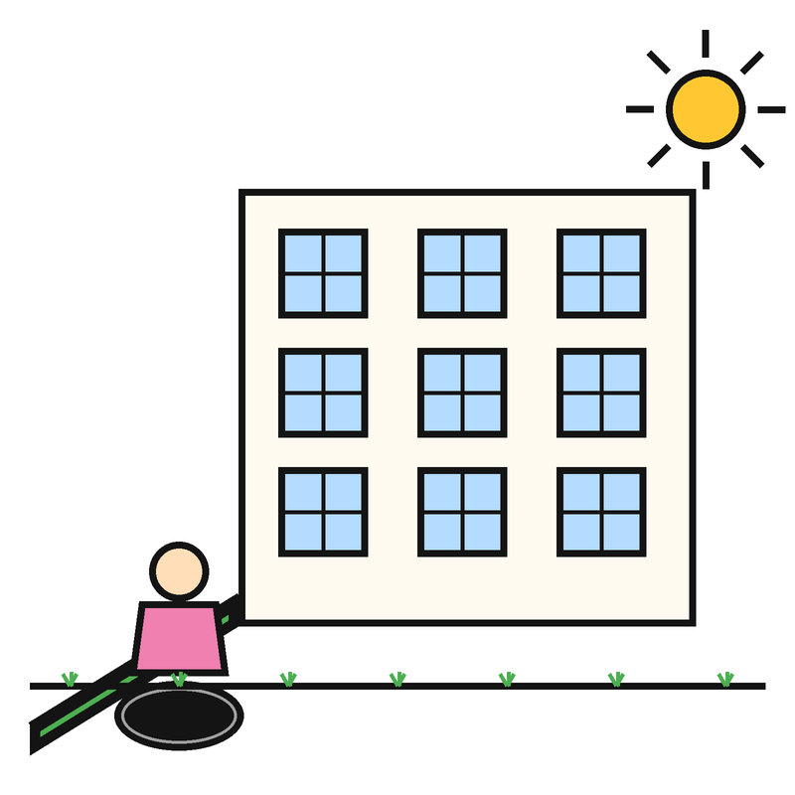
CHAPTER VIII · GOVERNMENT DUTIES
40
Section 40 — Accessibility
Buildings, places, transport, and information must be made easy to use for everyone, including persons with disabilities.
★ USE THIS WHEN
A public building has no ramp, no lift, no accessible toilet, or no clear signs.
RPwD Act 2016 · Easy Read Guide · All 102 Sections
Page 52 of 127
Notes:
Section 40 — Accessibility. Plain meaning: Buildings, places, transport, and information must be made easy to use for everyone, including persons with disabilities. Use when: A public building has no ramp, no lift, no accessible toilet, or no clear signs.

Slide 53

CHAPTER VIII · GOVERNMENT DUTIES
41
Section 41 — Access to transport
Buses, trains, stations, and airports must have ramps, accessible signs, and trained staff to help.
★ USE THIS WHEN
A bus, train, or station did not let you board, had no ramp or lift, or had no accessible toilet.
RPwD Act 2016 · Easy Read Guide · All 102 Sections
Page 53 of 127
Notes:
Section 41 — Access to transport. Plain meaning: Buses, trains, stations, and airports must have ramps, accessible signs, and trained staff to help. Use when: A bus, train, or station did not let you board, had no ramp or lift, or had no accessible toilet.

Slide 54

CHAPTER VIII · GOVERNMENT DUTIES
42
Section 42 — Access to information and communication technology
Websites, apps, TV, and phones must work for people with disabilities. Books, forms, and notices must come in accessible formats too.
★ USE THIS WHEN
A government website, app, TV news, or printed form is not accessible to you.
RPwD Act 2016 · Easy Read Guide · All 102 Sections
Page 54 of 127
Notes:
Section 42 — Access to information and communication technology. Plain meaning: Websites, apps, TV, and phones must work for people with disabilities. Books, forms, and notices must come in accessible formats too. Use when: A government website, app, TV news, or printed form is not accessible to you.

Slide 55
CHAPTER VIII · GOVERNMENT DUTIES
43
Section 43 — Consumer goods
Things sold in shops — like phones, TVs, and household goods — should be made so that persons with disabilities can use them.
★ USE THIS WHEN
A product you bought is not usable because of your disability and the maker did not provide an accessible version.
RPwD Act 2016 · Easy Read Guide · All 102 Sections
Page 55 of 127
Notes:
Section 43 — Consumer goods. Plain meaning: Things sold in shops — like phones, TVs, and household goods — should be made so that persons with disabilities can use them. Use when: A product you bought is not usable because of your disability and the maker did not provide an accessible version.

Slide 56
CHAPTER VIII · GOVERNMENT DUTIES
44
Section 44 — Mandatory observance of accessibility norms
No new building, transport, or service can get a permit unless it follows the accessibility rules.
★ USE THIS WHEN
A new building or service has been approved but does not meet the accessibility standards.
RPwD Act 2016 · Easy Read Guide · All 102 Sections
Page 56 of 127
Notes:
Section 44 — Mandatory observance of accessibility norms. Plain meaning: No new building, transport, or service can get a permit unless it follows the accessibility rules. Use when: A new building or service has been approved but does not meet the accessibility standards.

Slide 57

CHAPTER VIII · GOVERNMENT DUTIES
45
Section 45 — Time limit for making existing infrastructure and premises accessible and action for that purpose
Old buildings and services must be made accessible within five years. This is the law, not a request.
★ USE THIS WHEN
A public building or service is still inaccessible long after the law required it to be fixed.
RPwD Act 2016 · Easy Read Guide · All 102 Sections
Page 57 of 127
Notes:
Section 45 — Time limit for making existing infrastructure and premises accessible and action for that purpose. Plain meaning: Old buildings and services must be made accessible within five years. This is the law, not a request. Use when: A public building or service is still inaccessible long after the law required it to be fixed.

Slide 58
CHAPTER VIII · GOVERNMENT DUTIES
46
Section 46 — Time limit for accessibility by service providers
Service providers — like banks, hospitals, and shops — must make their services accessible within a fixed time set by the government.
★ USE THIS WHEN
A service provider has not made its service accessible within the time the government set.
RPwD Act 2016 · Easy Read Guide · All 102 Sections
Page 58 of 127
Notes:
Section 46 — Time limit for accessibility by service providers. Plain meaning: Service providers — like banks, hospitals, and shops — must make their services accessible within a fixed time set by the government. Use when: A service provider has not made its service accessible within the time the government set.

Slide 59
CHAPTER VIII · GOVERNMENT DUTIES
47
Section 47 — Human resource development
The government must train enough teachers, doctors, and other staff to support persons with disabilities.
★ USE THIS WHEN
There are no trained special educators, sign language interpreters, or rehab workers in your area.
RPwD Act 2016 · Easy Read Guide · All 102 Sections
Page 59 of 127
Notes:
Section 47 — Human resource development. Plain meaning: The government must train enough teachers, doctors, and other staff to support persons with disabilities. Use when: There are no trained special educators, sign language interpreters, or rehab workers in your area.

Slide 60
CHAPTER VIII · GOVERNMENT DUTIES
48
Section 48 — Social audit
The government must check, at least every five years, if the schemes for persons with disabilities are working — and persons with disabilities themselves should be part of that check.
★ USE THIS WHEN
A scheme is not being audited, or persons with disabilities were not part of the audit.
RPwD Act 2016 · Easy Read Guide · All 102 Sections
Page 60 of 127
Notes:
Section 48 — Social audit. Plain meaning: The government must check, at least every five years, if the schemes for persons with disabilities are working — and persons with disabilities themselves should be part of that check. Use when: A scheme is not being audited, or persons with disabilities were not part of the audit.

Slide 61
CHAPTER IX
Registration of Disability Institutions
Rules for organisations that work with persons with disabilities
RPwD Act 2016 · Easy Read Guide · All 102 Sections
Page 61 of 127
Notes:
CHAPTER IX: Registration of Disability Institutions. Rules for organisations that work with persons with disabilities

Slide 62
CHAPTER IX · DISABILITY INSTITUTIONS
49
Section 49 — Competent authority
The government must name the office that handles registration of organisations working with persons with disabilities.
★ USE THIS WHEN
(For reference. This sets up the registration system for disability organisations.)
RPwD Act 2016 · Easy Read Guide · All 102 Sections
Page 62 of 127
Notes:
Section 49 — Competent authority. Plain meaning: The government must name the office that handles registration of organisations working with persons with disabilities. Use when: (For reference. This sets up the registration system for disability organisations.)

Slide 63
CHAPTER IX · DISABILITY INSTITUTIONS
50
Section 50 — Registration
Any institution that wants to work with persons with disabilities must be registered. Without registration, they cannot legally provide services.
★ USE THIS WHEN
An institution is offering disability services without being registered.
RPwD Act 2016 · Easy Read Guide · All 102 Sections
Page 63 of 127
Notes:
Section 50 — Registration. Plain meaning: Any institution that wants to work with persons with disabilities must be registered. Without registration, they cannot legally provide services. Use when: An institution is offering disability services without being registered.

Slide 64
CHAPTER IX · DISABILITY INSTITUTIONS
51
Section 51 — Application and grant of certificate of registration
An institution must apply for a registration certificate. The competent authority gives the certificate after checking that the rules are met.
★ USE THIS WHEN
Your application for a registration certificate is taking too long, or was unfairly refused.
RPwD Act 2016 · Easy Read Guide · All 102 Sections
Page 64 of 127
Notes:
Section 51 — Application and grant of certificate of registration. Plain meaning: An institution must apply for a registration certificate. The competent authority gives the certificate after checking that the rules are met. Use when: Your application for a registration certificate is taking too long, or was unfairly refused.

Slide 65

CHAPTER IX · DISABILITY INSTITUTIONS
52
Section 52 — Revocation of registration
If a registered institution breaks the rules or harms persons with disabilities, its registration can be cancelled.
★ USE THIS WHEN
A registered institution is treating persons with disabilities badly. You can ask the authority to cancel its registration.
RPwD Act 2016 · Easy Read Guide · All 102 Sections
Page 65 of 127
Notes:
Section 52 — Revocation of registration. Plain meaning: If a registered institution breaks the rules or harms persons with disabilities, its registration can be cancelled. Use when: A registered institution is treating persons with disabilities badly. You can ask the authority to cancel its registration.

Slide 66
CHAPTER IX · DISABILITY INSTITUTIONS
53
Section 53 — Appeal
If your registration is refused or cancelled, you have the right to appeal to a higher authority.
★ USE THIS WHEN
Your institution's registration was refused or cancelled and you want to challenge that decision.
RPwD Act 2016 · Easy Read Guide · All 102 Sections
Page 66 of 127
Notes:
Section 53 — Appeal. Plain meaning: If your registration is refused or cancelled, you have the right to appeal to a higher authority. Use when: Your institution's registration was refused or cancelled and you want to challenge that decision.

Slide 67
CHAPTER IX · DISABILITY INSTITUTIONS
54
Section 54 — Act not to apply to institutions established or maintained by Central or State Government
Government-run institutions for persons with disabilities do not need to register under this chapter — different rules apply to them.
★ USE THIS WHEN
(For reference. Government institutions are exempt from this registration requirement.)
RPwD Act 2016 · Easy Read Guide · All 102 Sections
Page 67 of 127
Notes:
Section 54 — Act not to apply to institutions established or maintained by Central or State Government. Plain meaning: Government-run institutions for persons with disabilities do not need to register under this chapter — different rules apply to them. Use when: (For reference. Government institutions are exempt from this registration requirement.)

Slide 68
CHAPTER IX · DISABILITY INSTITUTIONS
55
Section 55 — Assistance to registered institutions
The government can give grants and other help to registered organisations that serve persons with disabilities.
★ USE THIS WHEN
(For reference. This section is the basis for funding disability organisations.)
RPwD Act 2016 · Easy Read Guide · All 102 Sections
Page 68 of 127
Notes:
Section 55 — Assistance to registered institutions. Plain meaning: The government can give grants and other help to registered organisations that serve persons with disabilities. Use when: (For reference. This section is the basis for funding disability organisations.)

Slide 69
CHAPTER X
Certification of Specified Disabilities
How to assess and certify a disability
RPwD Act 2016 · Easy Read Guide · All 102 Sections
Page 69 of 127
Notes:
CHAPTER X: Certification of Specified Disabilities. How to assess and certify a disability

Slide 70
CHAPTER X · CERTIFICATION
56
Section 56 — Guidelines for assessment of specified disabilities
The government must publish clear guidelines on how to assess each of the 21 specified disabilities.
★ USE THIS WHEN
(For reference. The assessment guidelines are issued by the central government.)
RPwD Act 2016 · Easy Read Guide · All 102 Sections
Page 70 of 127
Notes:
Section 56 — Guidelines for assessment of specified disabilities. Plain meaning: The government must publish clear guidelines on how to assess each of the 21 specified disabilities. Use when: (For reference. The assessment guidelines are issued by the central government.)

Slide 71
CHAPTER X · CERTIFICATION
57
Section 57 — Designation of certifying authorities
The government must name the doctors and offices that can issue a disability certificate.
★ USE THIS WHEN
(For reference. This sets up the disability certification system.)
RPwD Act 2016 · Easy Read Guide · All 102 Sections
Page 71 of 127
Notes:
Section 57 — Designation of certifying authorities. Plain meaning: The government must name the doctors and offices that can issue a disability certificate. Use when: (For reference. This sets up the disability certification system.)

Slide 72
CHAPTER X · CERTIFICATION
58
Section 58 — Procedure for certification
There must be a clear, fair process to get a disability certificate. The certificate is valid all over India.
★ USE THIS WHEN
A doctor or office is making the certificate process hard, slow, or unclear.
RPwD Act 2016 · Easy Read Guide · All 102 Sections
Page 72 of 127
Notes:
Section 58 — Procedure for certification. Plain meaning: There must be a clear, fair process to get a disability certificate. The certificate is valid all over India. Use when: A doctor or office is making the certificate process hard, slow, or unclear.

Slide 73
CHAPTER X · CERTIFICATION
59
Section 59 — Appeal against a decision of certifying authority
If you are refused a disability certificate or get the wrong one, you can appeal.
★ USE THIS WHEN
Your application for a disability certificate was refused, or the percentage was wrong.
RPwD Act 2016 · Easy Read Guide · All 102 Sections
Page 73 of 127
Notes:
Section 59 — Appeal against a decision of certifying authority. Plain meaning: If you are refused a disability certificate or get the wrong one, you can appeal. Use when: Your application for a disability certificate was refused, or the percentage was wrong.

Slide 74
CHAPTER XI
Advisory Boards on Disability
Central, state, and district advisory bodies
RPwD Act 2016 · Easy Read Guide · All 102 Sections
Page 74 of 127
Notes:
CHAPTER XI: Advisory Boards on Disability. Central, state, and district advisory bodies

Slide 75
CHAPTER XI · ADVISORY BOARDS
60
Section 60 — Constitution of Central Advisory Board on Disability
The central government must set up a Central Advisory Board on Disability to advise on disability matters.
★ USE THIS WHEN
(For reference. This sets up the national disability advisory body.)
RPwD Act 2016 · Easy Read Guide · All 102 Sections
Page 75 of 127
Notes:
Section 60 — Constitution of Central Advisory Board on Disability. Plain meaning: The central government must set up a Central Advisory Board on Disability to advise on disability matters. Use when: (For reference. This sets up the national disability advisory body.)

Slide 76
CHAPTER XI · ADVISORY BOARDS
61
Section 61 — Terms and conditions of service of members
The rules say how Central Advisory Board members are paid and how long they serve.
★ USE THIS WHEN
(For reference. Administrative rule for Central Advisory Board members.)
RPwD Act 2016 · Easy Read Guide · All 102 Sections
Page 76 of 127
Notes:
Section 61 — Terms and conditions of service of members. Plain meaning: The rules say how Central Advisory Board members are paid and how long they serve. Use when: (For reference. Administrative rule for Central Advisory Board members.)

Slide 77
CHAPTER XI · ADVISORY BOARDS
62
Section 62 — Disqualifications
Some people cannot be members of the Central Advisory Board — for example, people convicted of serious crimes.
★ USE THIS WHEN
(For reference. Lists who cannot be a Central Advisory Board member.)
RPwD Act 2016 · Easy Read Guide · All 102 Sections
Page 77 of 127
Notes:
Section 62 — Disqualifications. Plain meaning: Some people cannot be members of the Central Advisory Board — for example, people convicted of serious crimes. Use when: (For reference. Lists who cannot be a Central Advisory Board member.)

Slide 78
CHAPTER XI · ADVISORY BOARDS
63
Section 63 — Vacation of seats by Members
If a Central Advisory Board member misses too many meetings or breaks the rules, they lose their seat.
★ USE THIS WHEN
(For reference. Administrative rule for Central Advisory Board.)
RPwD Act 2016 · Easy Read Guide · All 102 Sections
Page 78 of 127
Notes:
Section 63 — Vacation of seats by Members. Plain meaning: If a Central Advisory Board member misses too many meetings or breaks the rules, they lose their seat. Use when: (For reference. Administrative rule for Central Advisory Board.)

Slide 79
CHAPTER XI · ADVISORY BOARDS
64
Section 64 — Meetings of the Central Advisory Board on disability
The Central Advisory Board must meet at least once every six months.
★ USE THIS WHEN
(For reference. The Central Advisory Board has not met in over six months.)
RPwD Act 2016 · Easy Read Guide · All 102 Sections
Page 79 of 127
Notes:
Section 64 — Meetings of the Central Advisory Board on disability. Plain meaning: The Central Advisory Board must meet at least once every six months. Use when: (For reference. The Central Advisory Board has not met in over six months.)

Slide 80
CHAPTER XI · ADVISORY BOARDS
65
Section 65 — Functions of Central Advisory Board on disability
The Central Advisory Board advises the central government on disability rules, schemes, and reports.
★ USE THIS WHEN
(For reference. Lists what the Central Advisory Board does.)
RPwD Act 2016 · Easy Read Guide · All 102 Sections
Page 80 of 127
Notes:
Section 65 — Functions of Central Advisory Board on disability. Plain meaning: The Central Advisory Board advises the central government on disability rules, schemes, and reports. Use when: (For reference. Lists what the Central Advisory Board does.)

Slide 81
CHAPTER XI · ADVISORY BOARDS
66
Section 66 — State Advisory Board on disability
Every state must set up its own State Advisory Board on Disability.
★ USE THIS WHEN
Your state does not have a State Advisory Board on Disability.
RPwD Act 2016 · Easy Read Guide · All 102 Sections
Page 81 of 127
Notes:
Section 66 — State Advisory Board on disability. Plain meaning: Every state must set up its own State Advisory Board on Disability. Use when: Your state does not have a State Advisory Board on Disability.

Slide 82
CHAPTER XI · ADVISORY BOARDS
67
Section 67 — Terms and conditions of service of Members
Rules for State Advisory Board members — pay, term, and conditions.
★ USE THIS WHEN
(For reference. Administrative rule for State Advisory Board members.)
RPwD Act 2016 · Easy Read Guide · All 102 Sections
Page 82 of 127
Notes:
Section 67 — Terms and conditions of service of Members. Plain meaning: Rules for State Advisory Board members — pay, term, and conditions. Use when: (For reference. Administrative rule for State Advisory Board members.)

Slide 83
CHAPTER XI · ADVISORY BOARDS
68
Section 68 — Disqualification
Same kind of rules as the Central Board: who cannot be a State Advisory Board member.
★ USE THIS WHEN
(For reference. Administrative rule for State Advisory Board.)
RPwD Act 2016 · Easy Read Guide · All 102 Sections
Page 83 of 127
Notes:
Section 68 — Disqualification. Plain meaning: Same kind of rules as the Central Board: who cannot be a State Advisory Board member. Use when: (For reference. Administrative rule for State Advisory Board.)

Slide 84
CHAPTER XI · ADVISORY BOARDS
69
Section 69 — Vacation of seats
When a State Advisory Board member loses their seat — missed meetings, broken rules, etc.
★ USE THIS WHEN
(For reference. Administrative rule for State Advisory Board.)
RPwD Act 2016 · Easy Read Guide · All 102 Sections
Page 84 of 127
Notes:
Section 69 — Vacation of seats. Plain meaning: When a State Advisory Board member loses their seat — missed meetings, broken rules, etc. Use when: (For reference. Administrative rule for State Advisory Board.)

Slide 85
CHAPTER XI · ADVISORY BOARDS
70
Section 70 — Meetings of State Advisory Board on disability
The State Advisory Board must meet at least once every six months.
★ USE THIS WHEN
Your State Advisory Board has not met in over six months.
RPwD Act 2016 · Easy Read Guide · All 102 Sections
Page 85 of 127
Notes:
Section 70 — Meetings of State Advisory Board on disability. Plain meaning: The State Advisory Board must meet at least once every six months. Use when: Your State Advisory Board has not met in over six months.

Slide 86
CHAPTER XI · ADVISORY BOARDS
71
Section 71 — Functions of State Advisory Board on disability
The State Advisory Board advises the state government on disability rules, schemes, and reports.
★ USE THIS WHEN
(For reference. Lists what the State Advisory Board does.)
RPwD Act 2016 · Easy Read Guide · All 102 Sections
Page 86 of 127
Notes:
Section 71 — Functions of State Advisory Board on disability. Plain meaning: The State Advisory Board advises the state government on disability rules, schemes, and reports. Use when: (For reference. Lists what the State Advisory Board does.)

Slide 87
CHAPTER XI · ADVISORY BOARDS
72
Section 72 — District-level Committee on disability
Every district must have a committee that handles disability matters at the district level.
★ USE THIS WHEN
Your district has no disability committee, or the committee is not working.
RPwD Act 2016 · Easy Read Guide · All 102 Sections
Page 87 of 127
Notes:
Section 72 — District-level Committee on disability. Plain meaning: Every district must have a committee that handles disability matters at the district level. Use when: Your district has no disability committee, or the committee is not working.

Slide 88
CHAPTER XI · ADVISORY BOARDS
73
Section 73 — Vacancies not to invalidate proceedings
Even if some seats on the Boards or committees are empty, their decisions are still valid.
★ USE THIS WHEN
(For reference. Administrative rule.)
RPwD Act 2016 · Easy Read Guide · All 102 Sections
Page 88 of 127
Notes:
Section 73 — Vacancies not to invalidate proceedings. Plain meaning: Even if some seats on the Boards or committees are empty, their decisions are still valid. Use when: (For reference. Administrative rule.)

Slide 89
CHAPTER XII
Chief Commissioner and State Commissioners
The offices that handle your complaints
RPwD Act 2016 · Easy Read Guide · All 102 Sections
Page 89 of 127
Notes:
CHAPTER XII: Chief Commissioner and State Commissioners. The offices that handle your complaints

Slide 90

CHAPTER XII · COMMISSIONERS
74
Section 74 — Appointment of Chief Commissioner and Commissioners
The central government appoints a Chief Commissioner for Persons with Disabilities and two Commissioners under the Chief Commissioner.
★ USE THIS WHEN
(For reference. This sets up the national disability complaints office.)
RPwD Act 2016 · Easy Read Guide · All 102 Sections
Page 90 of 127
Notes:
Section 74 — Appointment of Chief Commissioner and Commissioners. Plain meaning: The central government appoints a Chief Commissioner for Persons with Disabilities and two Commissioners under the Chief Commissioner. Use when: (For reference. This sets up the national disability complaints office.)

Slide 91
CHAPTER XII · COMMISSIONERS
75
Section 75 — Functions of Chief Commissioner
The Chief Commissioner watches over how the Act is being followed across India and takes action when rights are broken.
★ USE THIS WHEN
(For reference. The Chief Commissioner is who you escalate to after the State Commissioner.)
RPwD Act 2016 · Easy Read Guide · All 102 Sections
Page 91 of 127
Notes:
Section 75 — Functions of Chief Commissioner. Plain meaning: The Chief Commissioner watches over how the Act is being followed across India and takes action when rights are broken. Use when: (For reference. The Chief Commissioner is who you escalate to after the State Commissioner.)

Slide 92
CHAPTER XII · COMMISSIONERS
76
Section 76 — Action of appropriate authorities on recommendation of Chief Commissioner
When the Chief Commissioner makes a recommendation, the government office must act on it within a fixed time and report back.
★ USE THIS WHEN
The Chief Commissioner gave a recommendation and the office did not act on it.
RPwD Act 2016 · Easy Read Guide · All 102 Sections
Page 92 of 127
Notes:
Section 76 — Action of appropriate authorities on recommendation of Chief Commissioner. Plain meaning: When the Chief Commissioner makes a recommendation, the government office must act on it within a fixed time and report back. Use when: The Chief Commissioner gave a recommendation and the office did not act on it.

Slide 93
CHAPTER XII · COMMISSIONERS
77
Section 77 — Powers of Chief Commissioner
The Chief Commissioner can call witnesses, ask for documents, and act like a civil court when looking into a complaint.
★ USE THIS WHEN
You filed a complaint with the Chief Commissioner and they have not used their powers.
RPwD Act 2016 · Easy Read Guide · All 102 Sections
Page 93 of 127
Notes:
Section 77 — Powers of Chief Commissioner. Plain meaning: The Chief Commissioner can call witnesses, ask for documents, and act like a civil court when looking into a complaint. Use when: You filed a complaint with the Chief Commissioner and they have not used their powers.

Slide 94
CHAPTER XII · COMMISSIONERS
78
Section 78 — Annual and special reports by Chief Commissioner
The Chief Commissioner must publish a yearly report. The report goes to Parliament.
★ USE THIS WHEN
The Chief Commissioner has not published a yearly report.
RPwD Act 2016 · Easy Read Guide · All 102 Sections
Page 94 of 127
Notes:
Section 78 — Annual and special reports by Chief Commissioner. Plain meaning: The Chief Commissioner must publish a yearly report. The report goes to Parliament. Use when: The Chief Commissioner has not published a yearly report.

Slide 95
CHAPTER XII · COMMISSIONERS
79
Section 79 — Appointment of State Commissioner in States
Every state must appoint a State Commissioner for Persons with Disabilities.
★ USE THIS WHEN
Your state does not have a State Commissioner for Persons with Disabilities.
RPwD Act 2016 · Easy Read Guide · All 102 Sections
Page 95 of 127
Notes:
Section 79 — Appointment of State Commissioner in States. Plain meaning: Every state must appoint a State Commissioner for Persons with Disabilities. Use when: Your state does not have a State Commissioner for Persons with Disabilities.

Slide 96
CHAPTER XII · COMMISSIONERS
80
Section 80 — Functions of State Commissioner
The State Commissioner handles complaints in the state and watches over the Act in the state.
★ USE THIS WHEN
Use the State Commissioner as your first stop for complaints inside your state.
RPwD Act 2016 · Easy Read Guide · All 102 Sections
Page 96 of 127
Notes:
Section 80 — Functions of State Commissioner. Plain meaning: The State Commissioner handles complaints in the state and watches over the Act in the state. Use when: Use the State Commissioner as your first stop for complaints inside your state.

Slide 97
CHAPTER XII · COMMISSIONERS
81
Section 81 — Action by appropriate authorities on recommendation of State Commissioner
When the State Commissioner makes a recommendation, the office must act on it and report back within a fixed time.
★ USE THIS WHEN
The State Commissioner gave a recommendation and the office did not act on it.
RPwD Act 2016 · Easy Read Guide · All 102 Sections
Page 97 of 127
Notes:
Section 81 — Action by appropriate authorities on recommendation of State Commissioner. Plain meaning: When the State Commissioner makes a recommendation, the office must act on it and report back within a fixed time. Use when: The State Commissioner gave a recommendation and the office did not act on it.

Slide 98
CHAPTER XII · COMMISSIONERS
82
Section 82 — Powers of State Commissioner
The State Commissioner can call witnesses, ask for documents, and act like a civil court when looking into a complaint.
★ USE THIS WHEN
You filed a complaint and the State Commissioner has not used their powers.
RPwD Act 2016 · Easy Read Guide · All 102 Sections
Page 98 of 127
Notes:
Section 82 — Powers of State Commissioner. Plain meaning: The State Commissioner can call witnesses, ask for documents, and act like a civil court when looking into a complaint. Use when: You filed a complaint and the State Commissioner has not used their powers.

Slide 99
CHAPTER XII · COMMISSIONERS
83
Section 83 — Annual and special reports by State Commissioner
The State Commissioner must publish a yearly report. The report goes to the state government.
★ USE THIS WHEN
The State Commissioner in your state has not published a yearly report.
RPwD Act 2016 · Easy Read Guide · All 102 Sections
Page 99 of 127
Notes:
Section 83 — Annual and special reports by State Commissioner. Plain meaning: The State Commissioner must publish a yearly report. The report goes to the state government. Use when: The State Commissioner in your state has not published a yearly report.

Slide 100
CHAPTER XIII
Special Court
Where serious cases under this Act are heard
RPwD Act 2016 · Easy Read Guide · All 102 Sections
Page 100 of 127
Notes:
CHAPTER XIII: Special Court. Where serious cases under this Act are heard

Slide 101

CHAPTER XIII · SPECIAL COURT
84
Section 84 — Special Court
Each state must have a Special Court to handle serious offences against persons with disabilities under this Act.
★ USE THIS WHEN
A serious case under this Act is not being heard in a Special Court.
RPwD Act 2016 · Easy Read Guide · All 102 Sections
Page 101 of 127
Notes:
Section 84 — Special Court. Plain meaning: Each state must have a Special Court to handle serious offences against persons with disabilities under this Act. Use when: A serious case under this Act is not being heard in a Special Court.

Slide 102
CHAPTER XIII · SPECIAL COURT
85
Section 85 — Special Public Prosecutor
Each Special Court must have a Special Public Prosecutor to argue the case for the victim.
★ USE THIS WHEN
A case is being heard in the Special Court without a Special Public Prosecutor.
RPwD Act 2016 · Easy Read Guide · All 102 Sections
Page 102 of 127
Notes:
Section 85 — Special Public Prosecutor. Plain meaning: Each Special Court must have a Special Public Prosecutor to argue the case for the victim. Use when: A case is being heard in the Special Court without a Special Public Prosecutor.

Slide 103
CHAPTER XIV
National Fund for Persons with Disabilities
The national pot of money that pays for support
RPwD Act 2016 · Easy Read Guide · All 102 Sections
Page 103 of 127
Notes:
CHAPTER XIV: National Fund for Persons with Disabilities. The national pot of money that pays for support

Slide 104
CHAPTER XIV · NATIONAL FUND
86
Section 86 — National Fund for persons with disabilities
There is a National Fund for Persons with Disabilities. The Fund pays for schemes, support, and grants.
★ USE THIS WHEN
(For reference. The Fund pays for many disability programmes.)
RPwD Act 2016 · Easy Read Guide · All 102 Sections
Page 104 of 127
Notes:
Section 86 — National Fund for persons with disabilities. Plain meaning: There is a National Fund for Persons with Disabilities. The Fund pays for schemes, support, and grants. Use when: (For reference. The Fund pays for many disability programmes.)

Slide 105
CHAPTER XIV · NATIONAL FUND
87
Section 87 — Accounts and audit
The National Fund must keep clear accounts. The accounts must be audited every year.
★ USE THIS WHEN
(For reference. Audit rule for the National Fund.)
RPwD Act 2016 · Easy Read Guide · All 102 Sections
Page 105 of 127
Notes:
Section 87 — Accounts and audit. Plain meaning: The National Fund must keep clear accounts. The accounts must be audited every year. Use when: (For reference. Audit rule for the National Fund.)

Slide 106
CHAPTER XV
State Fund for Persons with Disabilities
Each state's own disability fund
RPwD Act 2016 · Easy Read Guide · All 102 Sections
Page 106 of 127
Notes:
CHAPTER XV: State Fund for Persons with Disabilities. Each state's own disability fund

Slide 107
CHAPTER XV · STATE FUND
88
Section 88 — State Fund for persons with disabilities
Every state must set up a State Fund for Persons with Disabilities, like the National Fund.
★ USE THIS WHEN
Your state has no State Fund, or the State Fund is not being used for persons with disabilities.
RPwD Act 2016 · Easy Read Guide · All 102 Sections
Page 107 of 127
Notes:
Section 88 — State Fund for persons with disabilities. Plain meaning: Every state must set up a State Fund for Persons with Disabilities, like the National Fund. Use when: Your state has no State Fund, or the State Fund is not being used for persons with disabilities.

Slide 108
CHAPTER XVI
Offences and Penalties
If someone breaks these rules
RPwD Act 2016 · Easy Read Guide · All 102 Sections
Page 108 of 127
Notes:
CHAPTER XVI: Offences and Penalties. If someone breaks these rules

Slide 109
CHAPTER XVI · PENALTIES
89
Section 89 — Punishment for contravention of provisions of Act or rules or regulations made thereunder
If anyone breaks the rules of this Act, they can be fined. The first time: up to Rs 10,000. The next time: Rs 50,000 to Rs 5 lakh.
★ USE THIS WHEN
Someone or some office is breaking the rules of this Act and you want them to be punished.
RPwD Act 2016 · Easy Read Guide · All 102 Sections
Page 109 of 127
Notes:
Section 89 — Punishment for contravention of provisions of Act or rules or regulations made thereunder. Plain meaning: If anyone breaks the rules of this Act, they can be fined. The first time: up to Rs 10,000. The next time: Rs 50,000 to Rs 5 lakh. Use when: Someone or some office is breaking the rules of this Act and you want them to be punished.

Slide 110
CHAPTER XVI · PENALTIES
90
Section 90 — Offences by companies
If a company breaks the rules of this Act, the people running the company can also be punished.
★ USE THIS WHEN
A company has broken the rules and you want the managers to be held responsible too.
RPwD Act 2016 · Easy Read Guide · All 102 Sections
Page 110 of 127
Notes:
Section 90 — Offences by companies. Plain meaning: If a company breaks the rules of this Act, the people running the company can also be punished. Use when: A company has broken the rules and you want the managers to be held responsible too.

Slide 111
CHAPTER XVI · PENALTIES
91
Section 91 — Punishment for fraudulently availing any benefit meant for persons with benchmark disabilities
If a person fakes a disability to get benefits meant for persons with benchmark disabilities, they can be jailed for up to 2 years and fined up to Rs 1 lakh.
★ USE THIS WHEN
Someone is faking a disability certificate to get a job, seat, or benefit reserved for persons with disabilities.
RPwD Act 2016 · Easy Read Guide · All 102 Sections
Page 111 of 127
Notes:
Section 91 — Punishment for fraudulently availing any benefit meant for persons with benchmark disabilities. Plain meaning: If a person fakes a disability to get benefits meant for persons with benchmark disabilities, they can be jailed for up to 2 years and fined up to Rs 1 lakh. Use when: Someone is faking a disability certificate to get a job, seat, or benefit reserved for persons with disabilities.

Slide 112
CHAPTER XVI · PENALTIES
92
Section 92 — Punishment for offences of atrocities
If someone insults you, hurts you, or humiliates you because of your disability, they can go to jail for 6 months to 5 years.
★ USE THIS WHEN
Someone publicly insults, beats, denies food, or sexually abuses a person with a disability because of their disability.
RPwD Act 2016 · Easy Read Guide · All 102 Sections
Page 112 of 127
Notes:
Section 92 — Punishment for offences of atrocities. Plain meaning: If someone insults you, hurts you, or humiliates you because of your disability, they can go to jail for 6 months to 5 years. Use when: Someone publicly insults, beats, denies food, or sexually abuses a person with a disability because of their disability.

Slide 113
CHAPTER XVI · PENALTIES
93
Section 93 — Punishment for failure to furnish information
If anyone refuses to give information that the Chief Commissioner or State Commissioner asks for, they can be fined.
★ USE THIS WHEN
An office refused to send information to the Chief Commissioner or State Commissioner.
RPwD Act 2016 · Easy Read Guide · All 102 Sections
Page 113 of 127
Notes:
Section 93 — Punishment for failure to furnish information. Plain meaning: If anyone refuses to give information that the Chief Commissioner or State Commissioner asks for, they can be fined. Use when: An office refused to send information to the Chief Commissioner or State Commissioner.

Slide 114
CHAPTER XVI · PENALTIES
94
Section 94 — Previous sanction of appropriate Government
Some cases under this Act need permission from the government before they can be filed in court.
★ USE THIS WHEN
(For reference. Procedural rule for filing certain cases.)
RPwD Act 2016 · Easy Read Guide · All 102 Sections
Page 114 of 127
Notes:
Section 94 — Previous sanction of appropriate Government. Plain meaning: Some cases under this Act need permission from the government before they can be filed in court. Use when: (For reference. Procedural rule for filing certain cases.)

Slide 115
CHAPTER XVI · PENALTIES
95
Section 95 — Alternative punishments
The court can give other punishments — like community service or training — instead of fine or jail in some cases.
★ USE THIS WHEN
(For reference. Court has flexibility on punishment in some cases.)
RPwD Act 2016 · Easy Read Guide · All 102 Sections
Page 115 of 127
Notes:
Section 95 — Alternative punishments. Plain meaning: The court can give other punishments — like community service or training — instead of fine or jail in some cases. Use when: (For reference. Court has flexibility on punishment in some cases.)

Slide 116
CHAPTER XVII
Miscellaneous
The closing rules of the Act
RPwD Act 2016 · Easy Read Guide · All 102 Sections
Page 116 of 127
Notes:
CHAPTER XVII: Miscellaneous. The closing rules of the Act

Slide 117
CHAPTER XVII · MISCELLANEOUS
96
Section 96 — Application of other laws not barred
This Act does not stop you from using other laws too. You can use this Act and other laws together.
★ USE THIS WHEN
(For reference. You can use multiple legal protections at once.)
RPwD Act 2016 · Easy Read Guide · All 102 Sections
Page 117 of 127
Notes:
Section 96 — Application of other laws not barred. Plain meaning: This Act does not stop you from using other laws too. You can use this Act and other laws together. Use when: (For reference. You can use multiple legal protections at once.)

Slide 118
CHAPTER XVII · MISCELLANEOUS
97
Section 97 — Protection of action taken in good faith
Government officers and others cannot be sued for actions they take honestly under this Act.
★ USE THIS WHEN
(For reference. Protects officers acting in good faith.)
RPwD Act 2016 · Easy Read Guide · All 102 Sections
Page 118 of 127
Notes:
Section 97 — Protection of action taken in good faith. Plain meaning: Government officers and others cannot be sued for actions they take honestly under this Act. Use when: (For reference. Protects officers acting in good faith.)

Slide 119
CHAPTER XVII · MISCELLANEOUS
98
Section 98 — Power to remove difficulties
If something in this Act is unclear or hard to do, the central government can issue an order to fix it within three years of the Act starting.
★ USE THIS WHEN
(For reference. Allows the central government to issue clarifications.)
RPwD Act 2016 · Easy Read Guide · All 102 Sections
Page 119 of 127
Notes:
Section 98 — Power to remove difficulties. Plain meaning: If something in this Act is unclear or hard to do, the central government can issue an order to fix it within three years of the Act starting. Use when: (For reference. Allows the central government to issue clarifications.)

Slide 120
CHAPTER XVII · MISCELLANEOUS
99
Section 99 — Power to amend Schedule
The central government can change the list of 21 specified disabilities — add, remove, or change them.
★ USE THIS WHEN
(For reference. The list of disabilities can be updated by the central government.)
RPwD Act 2016 · Easy Read Guide · All 102 Sections
Page 120 of 127
Notes:
Section 99 — Power to amend Schedule. Plain meaning: The central government can change the list of 21 specified disabilities — add, remove, or change them. Use when: (For reference. The list of disabilities can be updated by the central government.)

Slide 121
CHAPTER XVII · MISCELLANEOUS
100
Section 100 — Power of Central Government to make rules
The central government can make rules to put this Act into action.
★ USE THIS WHEN
(For reference. Many parts of the Act work through rules made under Section 100.)
RPwD Act 2016 · Easy Read Guide · All 102 Sections
Page 121 of 127
Notes:
Section 100 — Power of Central Government to make rules. Plain meaning: The central government can make rules to put this Act into action. Use when: (For reference. Many parts of the Act work through rules made under Section 100.)

Slide 122
CHAPTER XVII · MISCELLANEOUS
101
Section 101 — Power of State Government to make rules
Each state government can make its own rules to put this Act into action in the state.
★ USE THIS WHEN
(For reference. State governments make their own rules under Section 101.)
RPwD Act 2016 · Easy Read Guide · All 102 Sections
Page 122 of 127
Notes:
Section 101 — Power of State Government to make rules. Plain meaning: Each state government can make its own rules to put this Act into action in the state. Use when: (For reference. State governments make their own rules under Section 101.)

Slide 123
CHAPTER XVII · MISCELLANEOUS
102
Section 102 — Repeal and savings
This Act replaces the older 1995 Persons with Disabilities Act, but actions already taken under the old Act are still valid.
★ USE THIS WHEN
(For reference. The 1995 PWD Act is repealed and replaced by this 2016 Act.)
RPwD Act 2016 · Easy Read Guide · All 102 Sections
Page 123 of 127
Notes:
Section 102 — Repeal and savings. Plain meaning: This Act replaces the older 1995 Persons with Disabilities Act, but actions already taken under the old Act are still valid. Use when: (For reference. The 1995 PWD Act is repealed and replaced by this 2016 Act.)

Slide 124
How to file a complaint
Five steps to raise a complaint under the RPwD Act:
1
Write down what happened.
Date, place, names if you know them. Two or three lines is fine.
2
Find the right Section number.
Use this guide to pick the Section that fits your problem. Write it on your complaint.
3
Send your complaint.
Send it to the State Commissioner for Persons with Disabilities in your state. By email or by post.
4
Keep proof.
Save a copy. Get a receipt, an email reply, or a stamp showing they got your complaint.
5
Wait 60 days.
If nothing happens in 60 days, you can take it to the Chief Commissioner or to court.
RPwD Act 2016 · Easy Read Guide · All 102 Sections
Page 124 of 127
Notes:
How to file a complaint: 5 steps from writing it down to escalating to the Chief Commissioner if no response in 60 days.

Slide 125
Who can help you
If your rights are not respected, these offices can help:
State Commissioner for Persons with Disabilities
Chief Commissioner for Persons with Disabilities
Every state in India has one. They handle complaints inside the state. Look up your state's office or ask the state social welfare department.
A national office for cases that go beyond one state, or when the State Commissioner has not helped within 60 days.
First place to go for most complaints.
Office of the Chief Commissioner, New Delhi.
National Human Rights Commission
Disabled People's Organisations
For very serious cases — cruelty, abuse, denial of basic rights.
Local groups led by persons with disabilities. They can help you write your complaint and stand with you.
Especially under Sections 6, 7, and 92.
Vidyasagar in Chennai is one such organisation.
RPwD Act 2016 · Easy Read Guide · All 102 Sections
Page 125 of 127
Notes:
Who can help you: State Commissioner, Chief Commissioner, NHRC, and Disabled People's Organisations. Four main avenues for raising a disability rights complaint in India.

Slide 126
Remember: your rights in one page
You are equal.
No one can treat you badly.
Section 3
You can live with your family.
Not in an institution against your will.
Section 5
No one can hurt or use you.
You can call the police.
Sections 6, 7
You can go to school.
Schools must make space for you.
Sections 16, 17
You can work.
4 in 100 government jobs are reserved.
Sections 20, 34
You can have healthcare and a pension.
Free, close to home.
Sections 24, 25
Buildings and information must work for you.
Ramps. Lifts. Easy formats.
Sections 40, 42
If anyone breaks these rules,
they can be fined or jailed.
Sections 89, 92
Always write the Section number when you raise a complaint. That is what makes it powerful.
RPwD Act 2016 · Easy Read Guide · All 102 Sections
Page 126 of 127
Notes:
Your rights in one page. Eight-line summary of the most-cited sections. Closing reminder: always write the Section number when raising a complaint.

Slide 127
“Nothing about us without us”
Capacity, not dependency.
RPwD Act 2016 — Easy Read Guide
All 102 Sections · April 2026
Prepared for the Document Equity Initiative · EquitableDocs
vidyasagar.co.in
Section titles verified against the official Ministry of Law and Justice text. Not legal advice.
RPwD Act 2016 · Easy Read Guide · All 102 Sections
Page 127 of 127
Notes:
Back cover. Nothing about us without us. Capacity not dependency. All 102 sections. April 2026. Prepared for the Document Equity Initiative, EquitableDocs. Supported by Vidyasagar.

