Slide 1
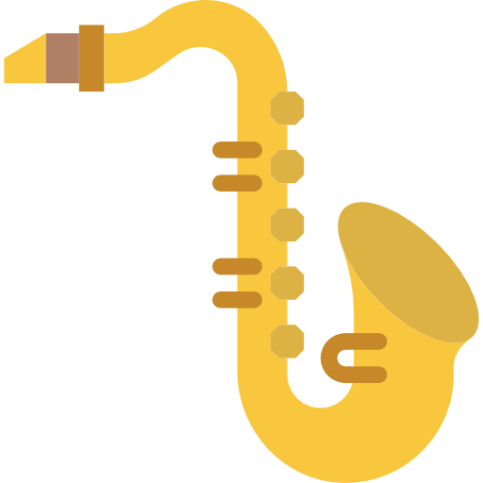




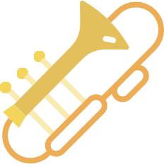
Search Radius
Alameda County Community Band
Filter by Type
Dublin, CA
Contact
Filter by State
John Smith, Director
VISIT WEBSITE
Jmoney@bandrulez.com
Filter by Country
Ba Ba Booie Community Band
Ba Ba Booie, CA
Contact
John Smith II, Director
VISIT WEBSITE
JmoneyLee@bandrulez.com

Slide 2
Alameda County Community Band
Dublin, CA
Contact
John Smith, Director
Jmoney@bandrulez.com
VISIT WEBSITE

