Slide 1

Improved Approximations for Ultrametric Violation Distance
Ruiquan Gao
Stanford University
based on joint work with Moses Charikar

Slide 2



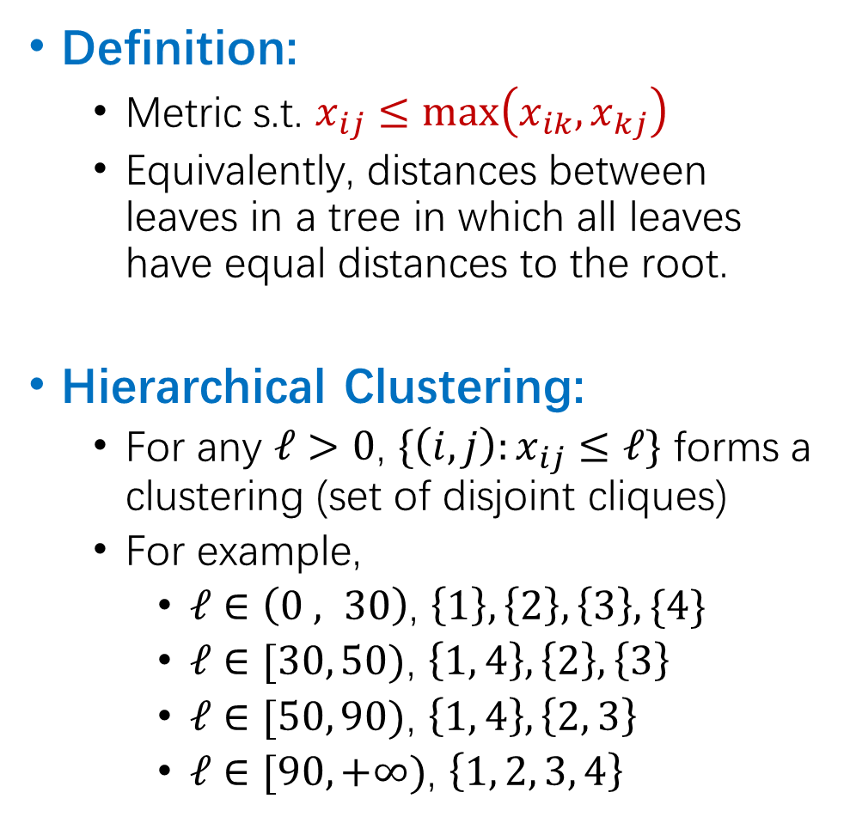



Ultrametrics
root
$$ℓ=100$$
Definition:
Metric s.t. $x_{ij}≤\max\left(x_{ik},x_{kj}\right)$
Equivalently, distances between leaves in a tree in which all leaves have equal distances to the root.
Hierarchical Clustering:
For any $ℓ>0$, $\{\left(i,j\right):x_{ij}≤ℓ\}$ forms a clustering (set of disjoint cliques)
For example,
$ℓ∈\left(0 , 30\right)$, $\left\{1\right\}, \left\{2\right\}, \left\{3\right\}, \{4\}$
$ℓ∈[30, 50)$, $\left\{1, 4\right\}, \left\{2\right\}, \left\{3\right\}$
$ℓ∈[50, 90)$, $\left\{1, 4\right\},\left\{2, 3\right\}$
$ℓ∈[90, +∞)$, $\left\{1, 2, 3, 4\right\}$
5
5
20
$$ℓ=60$$
30
3
3
$$ℓ=40$$
25
5
25
$$ℓ=20$$
15
3
15
1
4
3
2
 | 1 | 2 | 3 | 4
1 |  | 90 | 90 | 30
2 | 90 |  | 50 | 90
3 | 90 | 50 |  | 90
4 | 30 | 90 | 90

Slide 3
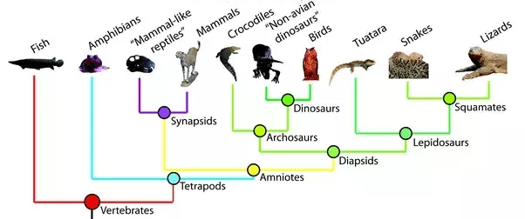
Ultrametrics in Practice
How to adjust imperfect inputs to satisfy ultrametric conditions?
phylogenetic trees

Slide 4
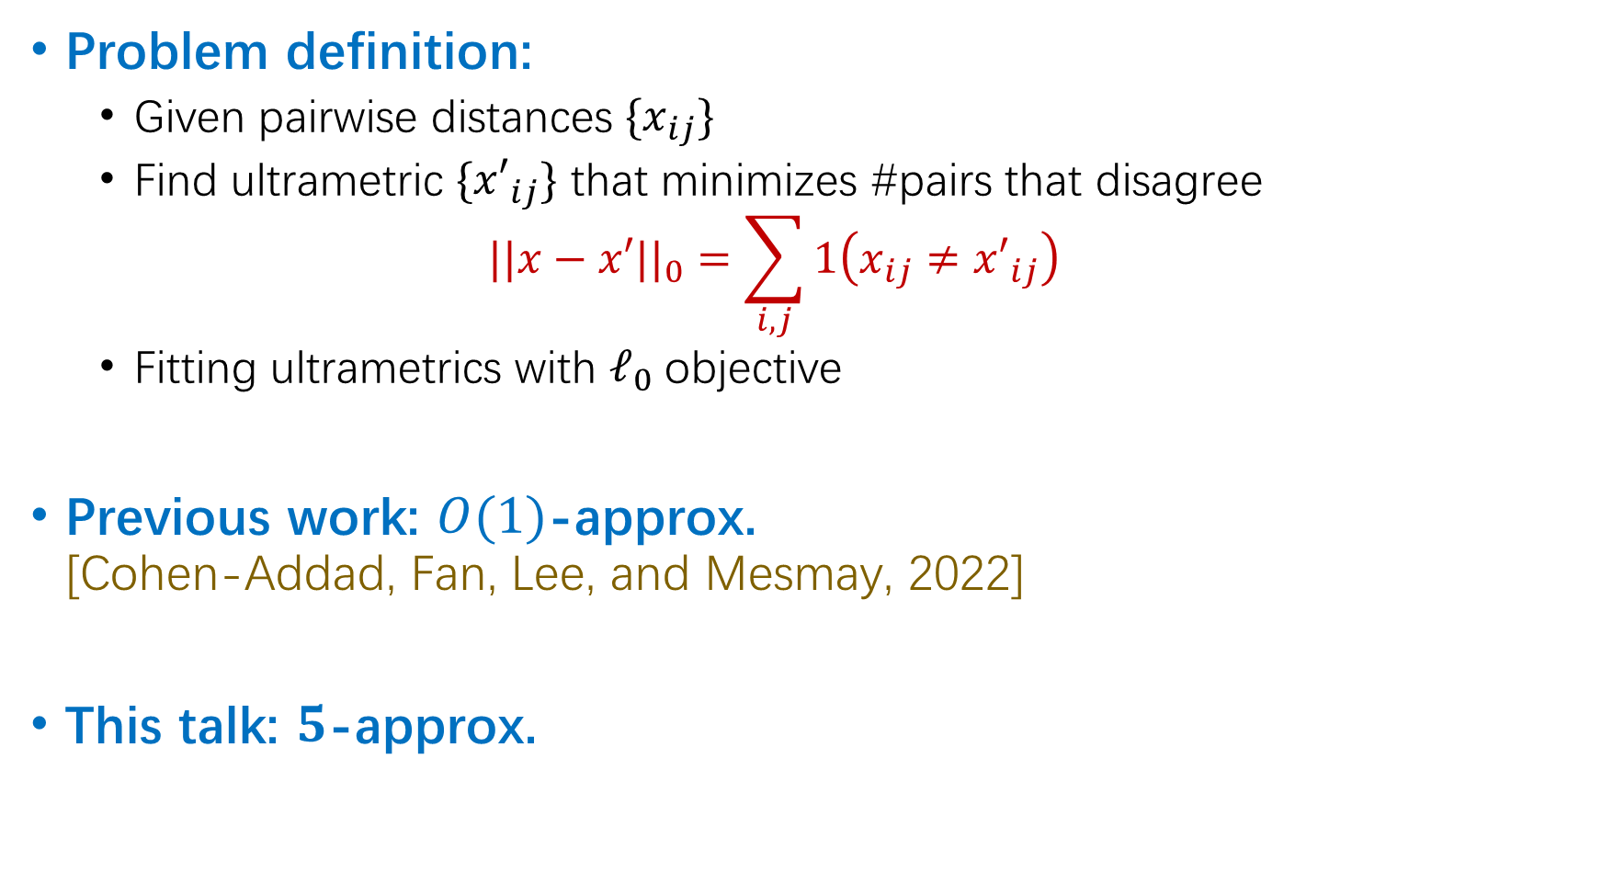
Ultrametric Violation Distance (UMVD)
Problem definition:
Given pairwise distances $\{x_{ij}\}$
Find ultrametric ${\{x′}_{ij}\}$ that minimizes #pairs that disagree $||x−x′||_{0}=\sum_{i,j}{1\left(x_{ij}≠{x′}_{ij}\right)}$
Fitting ultrametrics with $ℓ_{0}$objective
Previous work: $O(1)$-approx. [Cohen-Addad, Fan, Lee, and Mesmay, 2022]
This talk: $5$-approx.

Slide 5
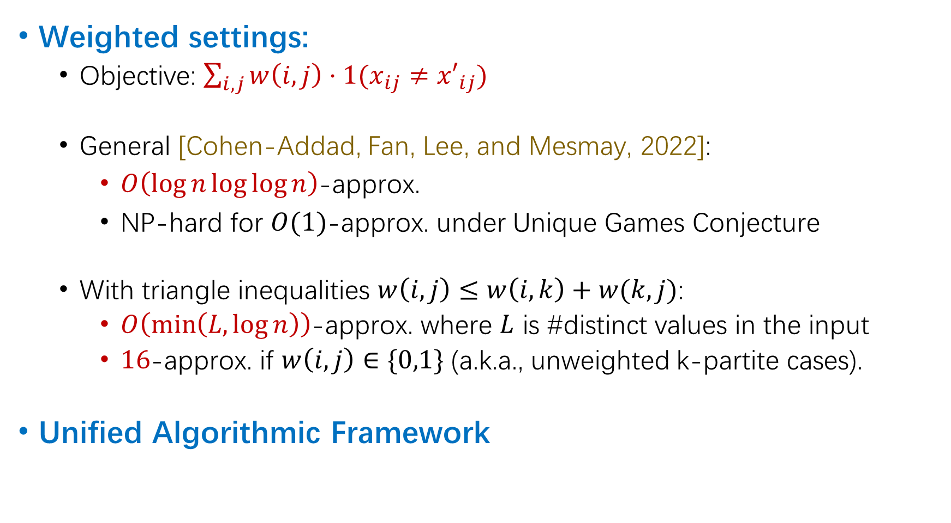
Ultrametric Violation Distance (UMVD)
Weighted settings:
Objective: $\sum_{i,j}{w\left(i,j\right)⋅1(x_{ij}≠{x′}_{ij})}$
General [Cohen-Addad, Fan, Lee, and Mesmay, 2022]:
$O\left(\log{n}\log{\log{n}}\right)$-approx.
NP-hard for $O(1)$-approx. under Unique Games Conjecture
With triangle inequalities $w\left(i,j\right)≤w\left(i,k\right)+w(k,j)$:
$O\left(\min\left(L,\log{n}\right)\right)$-approx. where $L$ is #distinct values in the input
$16$-approx. if $w\left(i,j\right)∈\{0,1\}$ (a.k.a., unweighted k-partite cases).
Unified Algorithmic Framework

Slide 6
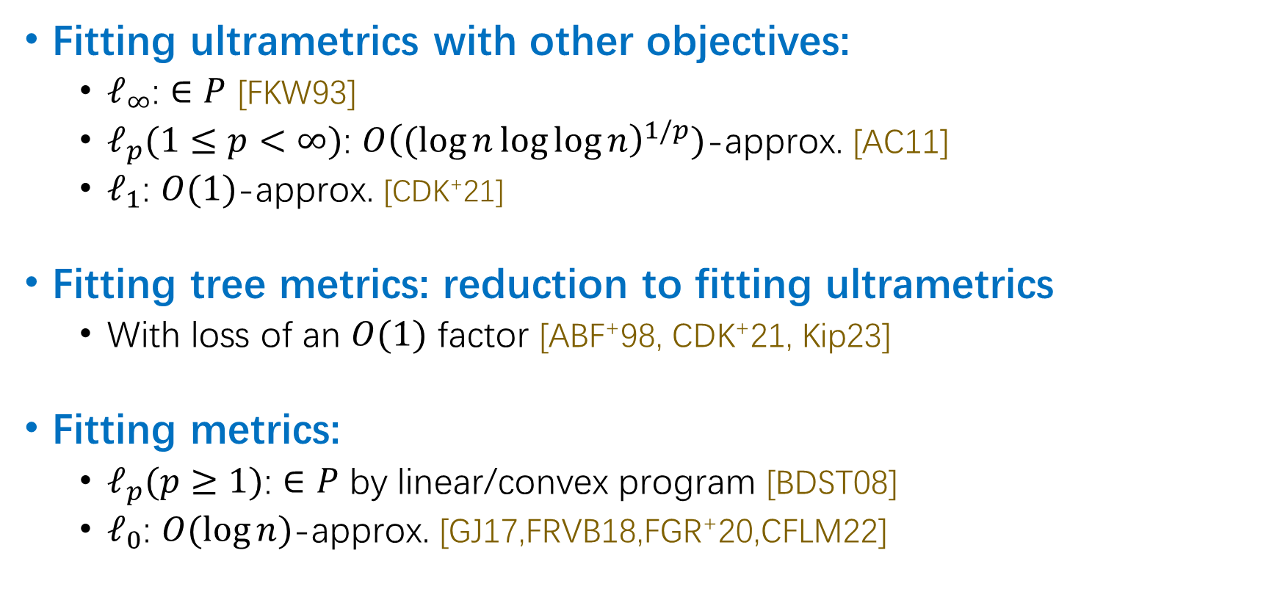
Related Works
Fitting ultrametrics with other objectives:
$ℓ_{∞}$: $∈P$ [FKW93]
$ℓ_{p}(1≤p<∞)$: $O{\left((log{n}\log{\log{n}}\right)}^{1/p})$-approx. [AC11]
$ℓ_{1}$: $O(1)$-approx. [CDK⁺21]
Fitting tree metrics: reduction to fitting ultrametrics
With loss of an $O(1)$ factor [ABF⁺98, CDK⁺21, Kip23]
Fitting metrics:
$ℓ_{p}(p≥1)$: $∈P$ by linear/convex program [BDST08]
$ℓ_{0}$: $O(\log{n})$-approx. [GJ17,FRVB18,FGR⁺20,CFLM22]

Slide 7
Techniques

Slide 8
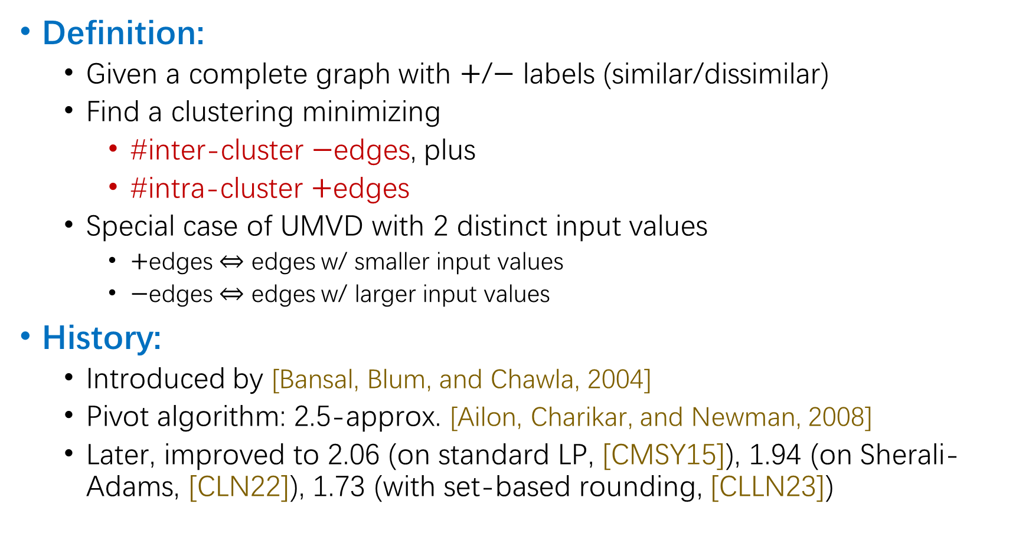
Correlation Clustering
Definition:
Given a complete graph with $+$/$−$ labels (similar/dissimilar)
Find a clustering minimizing
#inter-cluster $−$edges, plus
#intra-cluster $+$edges
Special case of UMVD with 2 distinct input values
$+$edges $⇔$ edges w/ smaller input values
$−$edges $⇔$ edges w/ larger input values
History:
Introduced by [Bansal, Blum, and Chawla, 2004]
Pivot algorithm: 2.5-approx. [Ailon, Charikar, and Newman, 2008]
Later, improved to 2.06 (on standard LP, [CMSY15]), 1.94 (on Sherali-Adams, [CLN22]), 1.73 (with set-based rounding, [CLLN23])

Slide 9
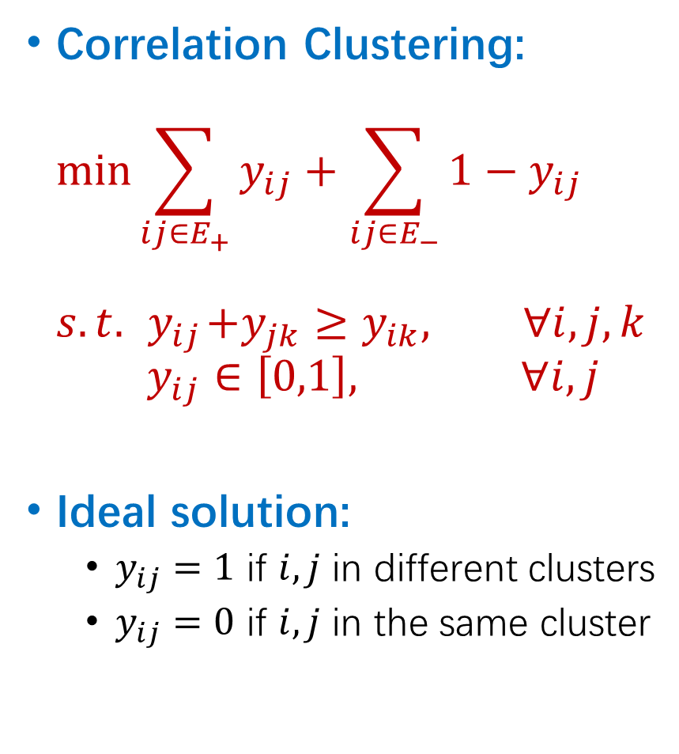
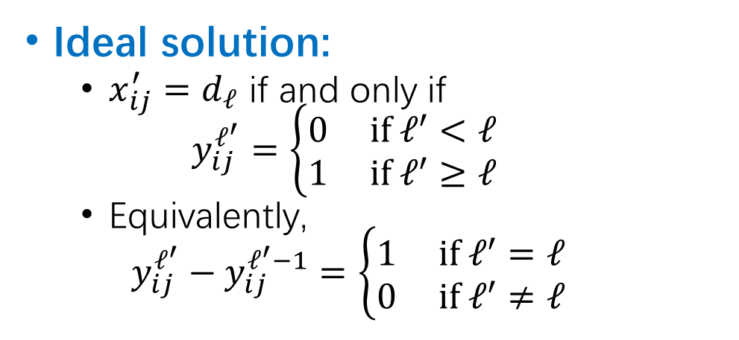
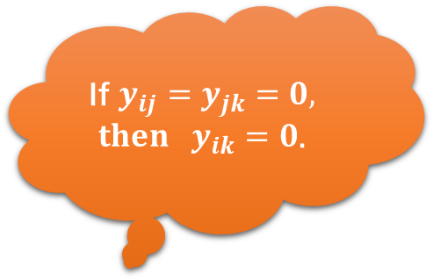

Standard LP Relaxations
Correlation Clustering: $\min{\sum_{ij∈E_{+}}{y_{ij}}+\sum_{ij∈E_{−}}{1−y_{ij}}}$ $s.t. { y}_{ij}+y_{jk}≥y_{ik}, ∀i,j,k$ $y_{ij}∈\left[0,1\right], ∀i,j$
Ideal solution:
$y_{ij}=1$ if $i,j$ in different clusters
$y_{ij}=0$ if $i,j$ in the same cluster
UMVD: $\min{\sum_{ij}{1−y_{ij}^{ℓ\left(i,j\right)}+y_{ij}^{ℓ\left(i,j\right)−1}}}$ $s.t. y_{ij}^{ℓ}+y_{jk}^{ℓ}≥y_{ik}^{ℓ}, ∀i,j,k,ℓ$ $y_{ij}^{ℓ}≥y_{ij}^{ℓ−1} , ∀i,j,ℓ$ $y_{ij}^{ℓ}∈\left[0,1\right] , ∀i,j,ℓ$
$d_{1}>d_{2}>…>d_{L}$: distinct values in the inputs
$ℓ\left(i,j\right)$: satisfy $d_{ℓ\left(i,j\right)}=x_{ij}$
If $y_{ij}=y_{jk}=0, then y_{ik}=0$.
Ideal solution:
$x_{ij}^{′}=d_{ℓ}$ if and only if $y_{ij}^{ℓ^{′}}=\left\{\begin{aligned}0 if ℓ^{′}<ℓ \\ 1 if ℓ^{′}≥ℓ\end{aligned}\right.$
Equivalently, $y_{ij}^{ℓ^{′}}−y_{ij}^{ℓ^{′}−1}=\left\{\begin{aligned}1 if ℓ^{′}=ℓ \\ 0 if ℓ^{′}≠ℓ\end{aligned}\right.$
30
20
25
25
15
15
1
4
3
2

Slide 10

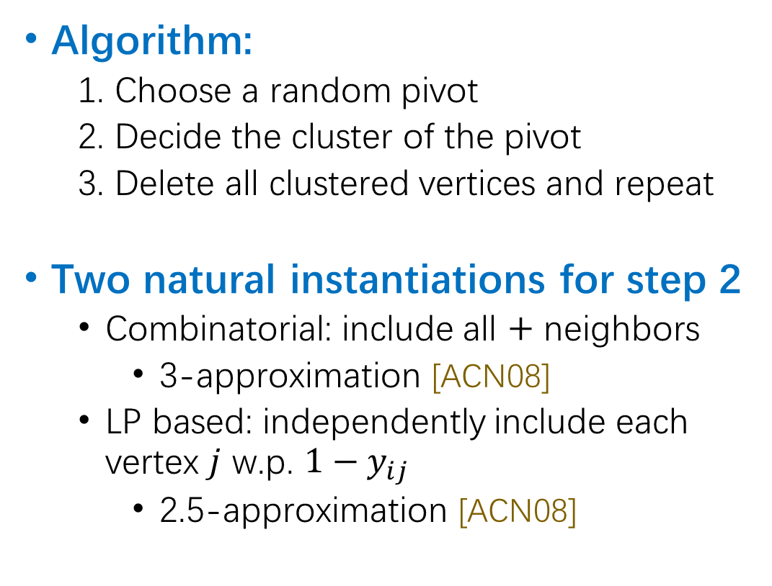





Pivot Algorithms for Correlation Clustering
Algorithm:
1. Choose a random pivot
2. Decide the cluster of the pivot
3. Delete all clustered vertices and repeat
Two natural instantiations for step 2
Combinatorial: include all $+$ neighbors
3-approximation [ACN08]
LP based: independently include each vertex $j$ w.p. $1−y_{ij}$
2.5-approximation [ACN08]
$+$edges
$−$edges
$$y_{1}$$
$$y_{4}$$
$$y_{2}$$
$$y_{3}$$
1
4
2
3

Slide 11
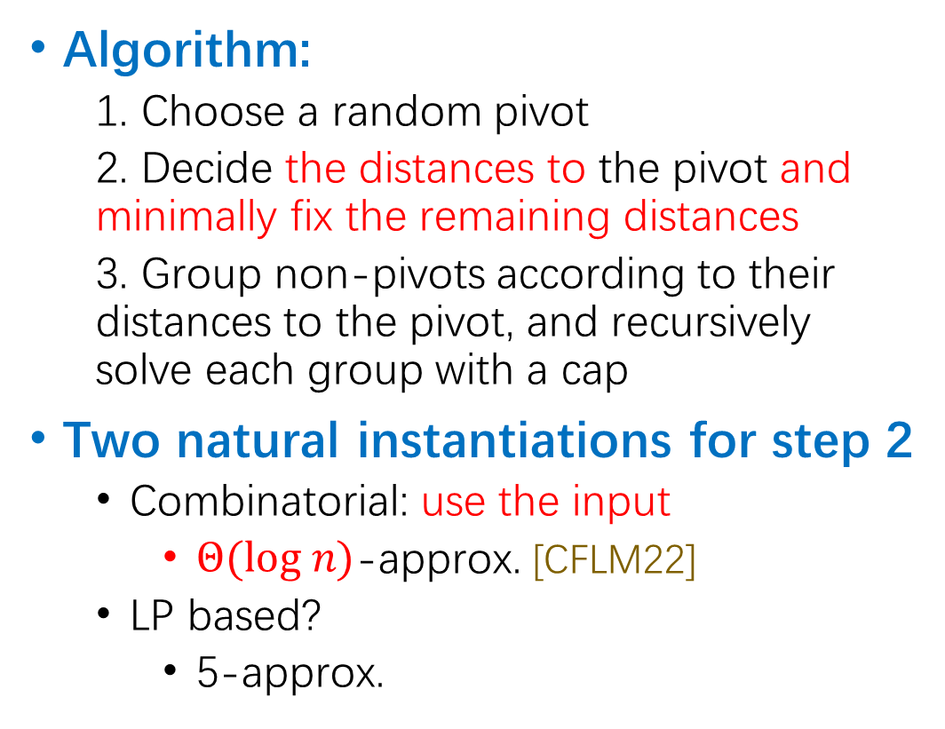



Pivot Algorithms for UMVD
Algorithm:
1. Choose a random pivot
2. Decide the distances to the pivot and minimally fix the remaining distances
3. Group non-pivots according to their distances to the pivot, and recursively solve each group with a cap
Two natural instantiations for step 2
Combinatorial: use the input
$Θ(log n)$-approx. [CFLM22]
LP based?
5-approx.
5
3
5
3
1
4
2
3
4
3
5
4
4
Cap: $x′≤5$
Cap: $x′≤3$
Ultrametric inequality: $$x_{ij}≤\max\left(x_{ik}, x_{kj}\right)$$

Slide 12
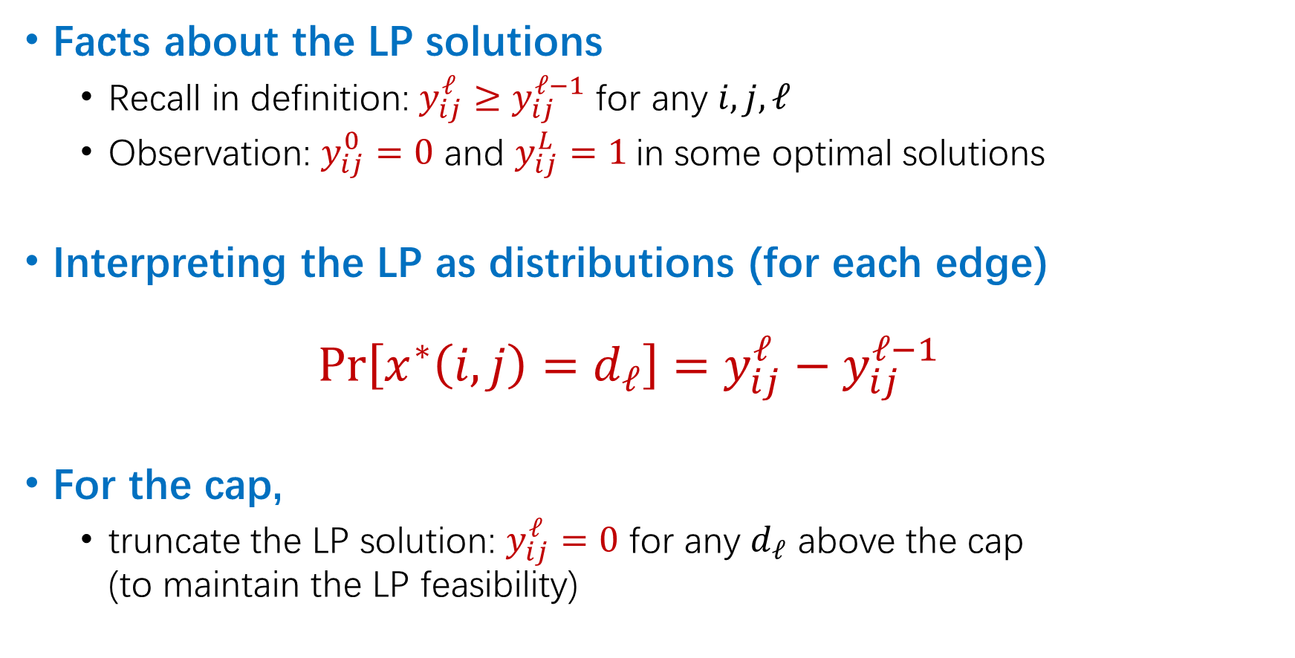

LP-based Pivot Algorithm: Candidate 1
Facts about the LP solutions
Recall in definition: $y_{ij}^{ℓ}≥y_{ij}^{ℓ−1}$ for any $i,j,ℓ$
Observation: $y_{ij}^{0}=0$ and $y_{ij}^{L}=1$ in some optimal solutions
Interpreting the LP as distributions (for each edge) $\operatorname{Pr}\left[x^{∗}\left(i,j\right)=d_{ℓ}\right]=y_{ij}^{ℓ}−y_{ij}^{ℓ−1}$
For the cap,
truncate the LP solution: $y_{ij}^{ℓ}=0$ for any $d_{ℓ}$ above the cap (to maintain the LP feasibility)
We assume
$$ℓ\left(i,j\right)=\underset{ℓ}{argmax}{ y_{ij}^{ℓ}−y_{ij}^{ℓ−1}}$$

Slide 13
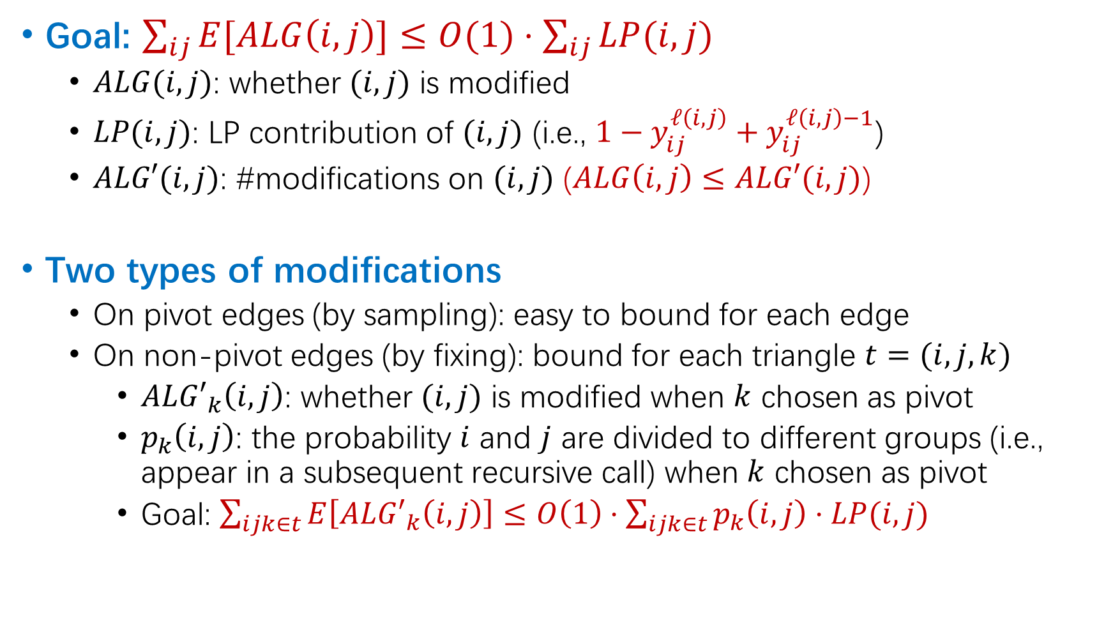
Triangle-based Analysis - Preliminaries
Goal: $\sum_{ij}{E[ALG\left(i,j\right)]≤O(1)⋅\sum_{ij}{LP(i,j)}}$
$ALG(i,j)$: whether $(i,j)$ is modified
$LP(i,j)$: LP contribution of $(i,j)$ (i.e., $1−y_{ij}^{ℓ\left(i,j\right)}+y_{ij}^{ℓ\left(i,j\right)−1}$)
$ALG′(i,j)$: #modifications on $(i,j)$ ($ALG\left(i,j\right)≤ALG′(i,j)$)
Two types of modifications
On pivot edges (by sampling): easy to bound for each edge
On non-pivot edges (by fixing): bound for each triangle $t=(i,j,k)$
$AL{G′}_{k}\left(i,j\right)$: whether $(i,j)$ is modified when $k$ chosen as pivot
$p_{k}\left(i,j\right)$: the probability $i$ and $j$ are divided to different groups (i.e., appear in a subsequent recursive call) when $k$ chosen as pivot
Goal: $\sum_{ijk∈t}{E\left[AL{G′}_{k}\left(i,j\right)\right]≤O\left(1\right)⋅\sum_{ijk∈t}{p_{k}\left(i,j\right)⋅LP(i,j)}}$

Slide 14






Triangle-based Analysis for UMVD
Issue for UMVD: $\frac{\sum_{ij∈t}{E\left[ALG_{k}^{′}(i,j)\right]}}{\sum_{ij∈t}{p_{k}\left(i,j\right)⋅LP\left(i,j\right)}}$ can be unbounded.
Possible bad triangles
Low-cost/high-cost edges: $LP\left(i,j\right)<θ or LP\left(i,j\right)≥θ$
$p_{k}(i,j)$ can be too low: only when 2 low-cost edges share the same input
key observation: when $θ≤1/3$, the inputs satisfy ultrametric inequality for these triangles.
$$i$$
$$j$$
$$i$$
$$j$$
The third one is low-cost
The third one is high-cost

Slide 15







LP-based Pivot Algorithm: Candidate 2
This property is extremely crucial in the weighted cases we considered.
Combining two rounding schemes
A threshold $θ$ (e.g., $1/3$)
If $LP\left(i,j\right)≥θ$, sample the distance
If $LP\left(i,j\right)<θ$, fix the distance to the input
Property: no modifications in triangles w/ 3 low-cost edges
$$y_{ij}^{1}$$
$$y_{ij}^{2}$$
$$y_{ij}^{2}−y_{ij}^{1}>1−θ⇒x\left(i,j\right)←d_{2}$$
$$y_{ij}^{1}$$
$$y_{ij}^{2}$$
$$y_{ij}^{2}−y_{ij}^{1}≤1−θ⇒x\left(i,j\right)∼x^{∗}\left(i,j\right)$$

Slide 16

Triangle-based Analysis for UMVD (cont’d)
Issue for UMVD: $\frac{\sum_{ij∈t}{E\left[ALG_{k}^{′}(i,j)\right]}}{\sum_{ij∈t}{p_{k}\left(i,j\right)⋅LP\left(i,j\right)}}$ can be unbounded.
Possible bad triangles
Low-cost/high-cost edges: $LP\left(i,j\right)<θ or LP\left(i,j\right)≥θ$
$p_{k}(i,j)$ can be too low: only when 2 low-cost edges share the same input
key observation: though $ALG′\left(i,j\right)$ can be big, $ALG\left(i,j\right)≤1$
$$i$$
$$j$$
The third one is high-cost

Slide 17
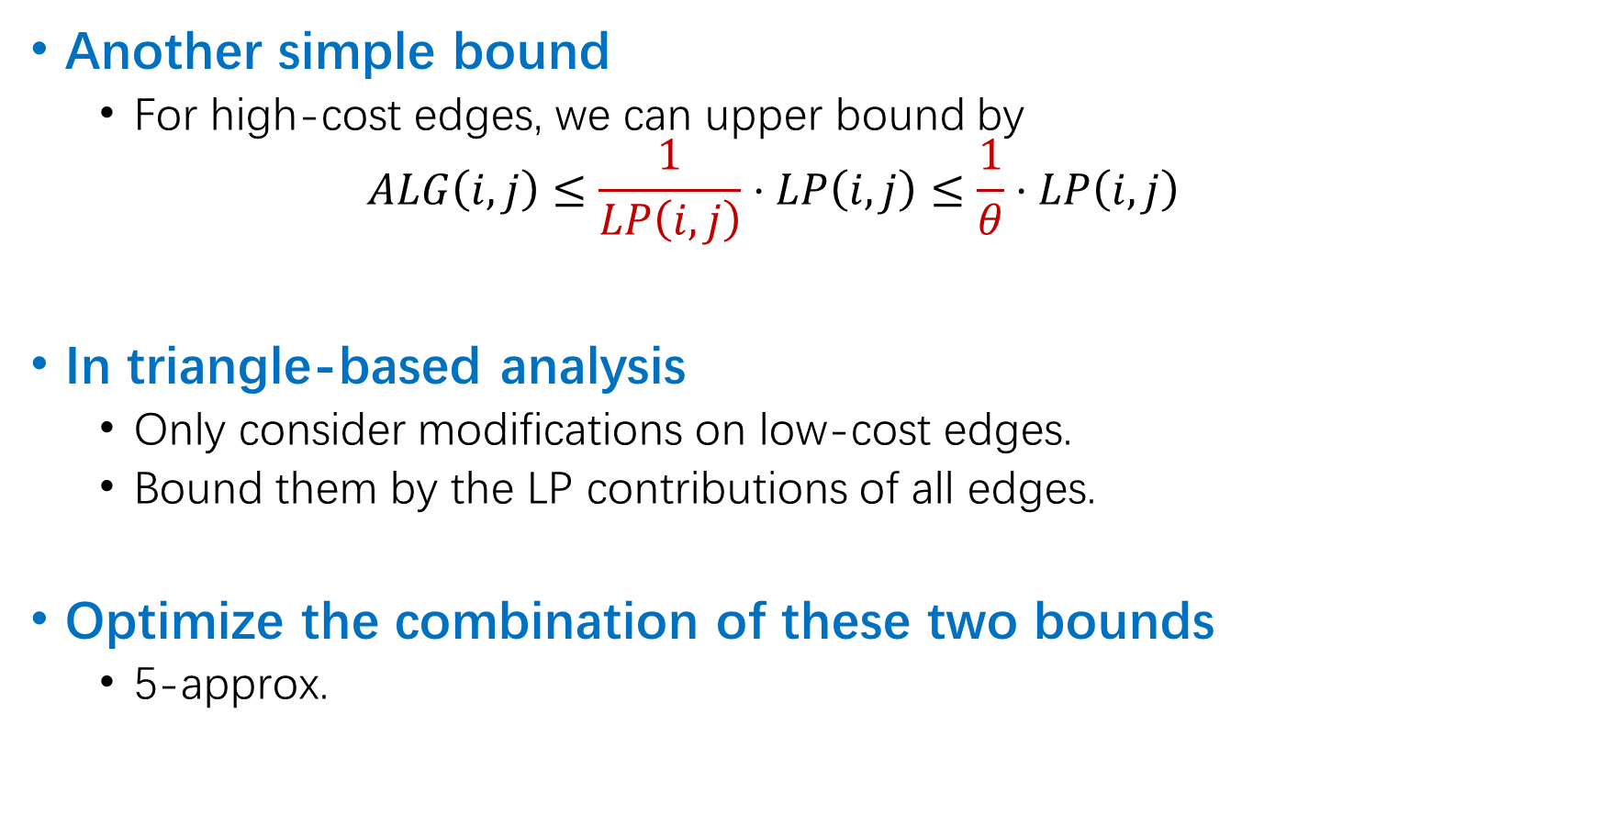
Triangle-based Analysis for UMVD (cont’d)
Another simple bound
For high-cost edges, we can upper bound by $ALG\left(i,j\right)≤\frac{1}{LP\left(i,j\right)}⋅LP\left(i,j\right)≤\frac{1}{θ}⋅LP\left(i,j\right)$
In triangle-based analysis
Only consider modifications on low-cost edges.
Bound them by the LP contributions of all edges.
Optimize the combination of these two bounds
5-approx.

Slide 18
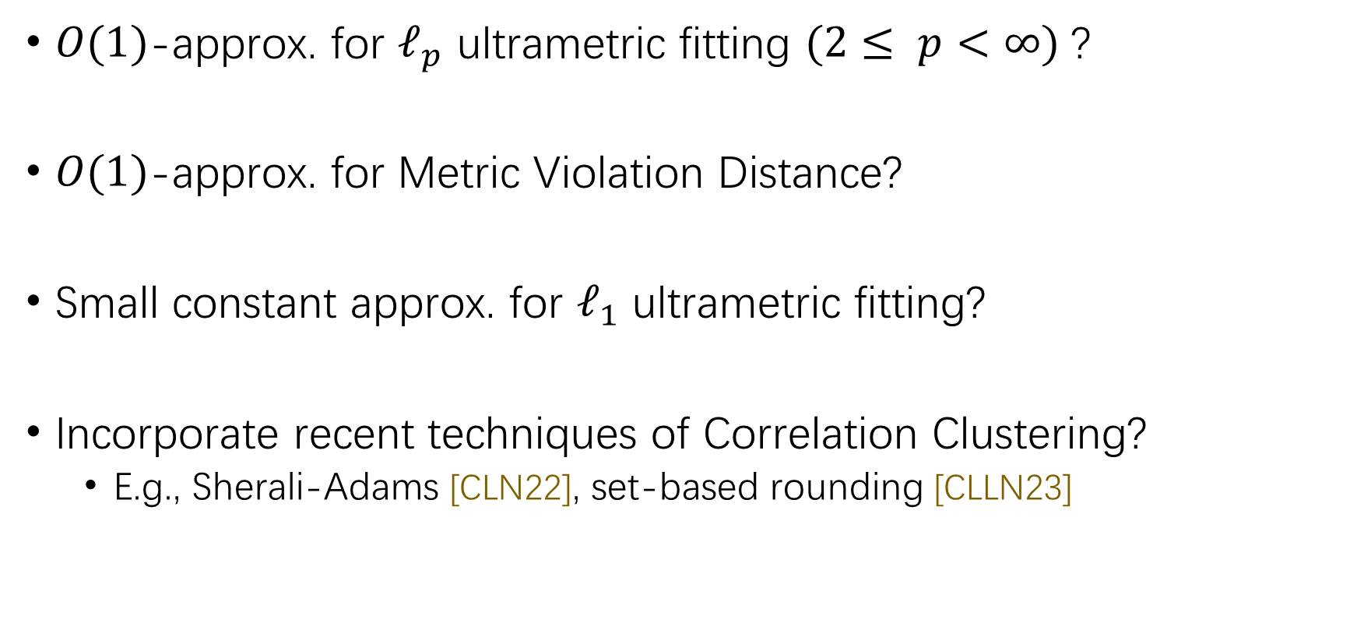
Open Problems
$O(1)$-approx. for $ℓ_{p}$ ultrametric fitting $(2≤ p<∞)$?
$O(1)$-approx. for Metric Violation Distance?
Small constant approx. for $ℓ_{1}$ ultrametric fitting?
Incorporate recent techniques of Correlation Clustering?
E.g., Sherali-Adams [CLN22], set-based rounding [CLLN23]

Slide 19
Thank you!

