Slide 1
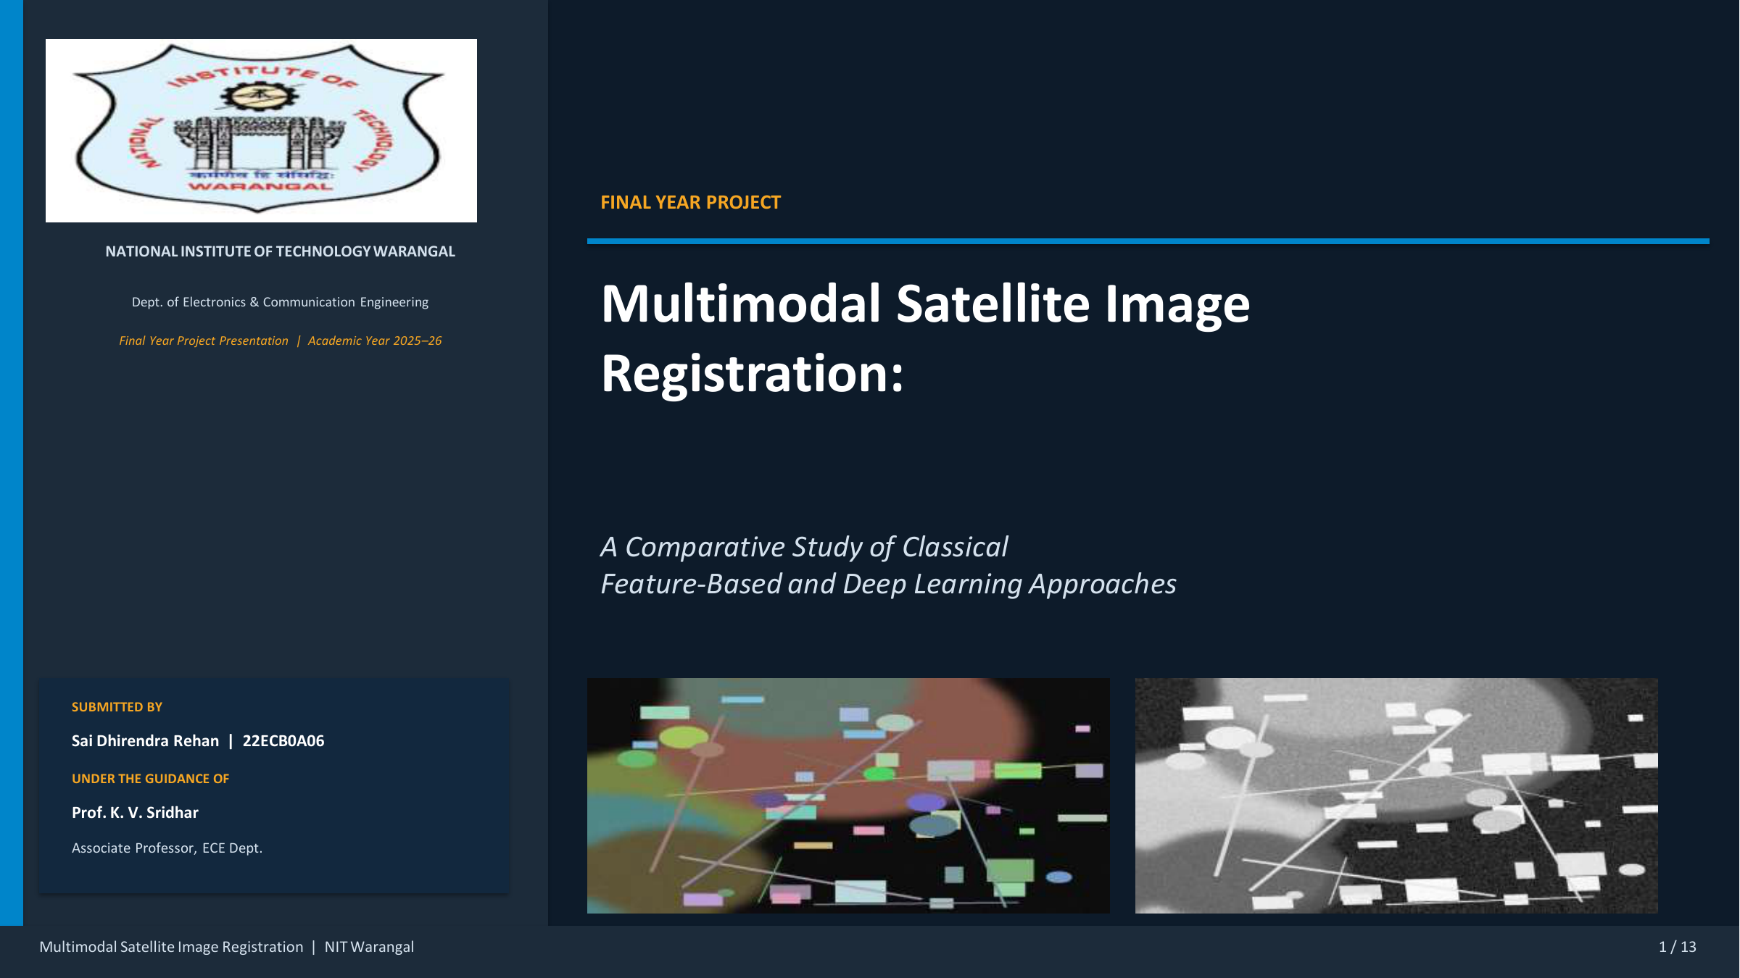
B.TECH FINAL PROJECT
Multimodal Satellite Image Registration
A comparative study of classical feature-based methods and deep learning for EO versus SAR or NIR alignment.
NN-DISK reached 98.19% CMR and 0.87 px RMSE.
Source visuals are preserved from the original project PDF; text hierarchy and layout are rebuilt for clearer presentation.
Notes:
Open by stating the real problem: multimodal registration fails when the same object has very different radiometric appearance across sensors.
[Sources]
- Rhan final-year project PDF, NIT Warangal, Academic Year 2025-26.

Slide 2
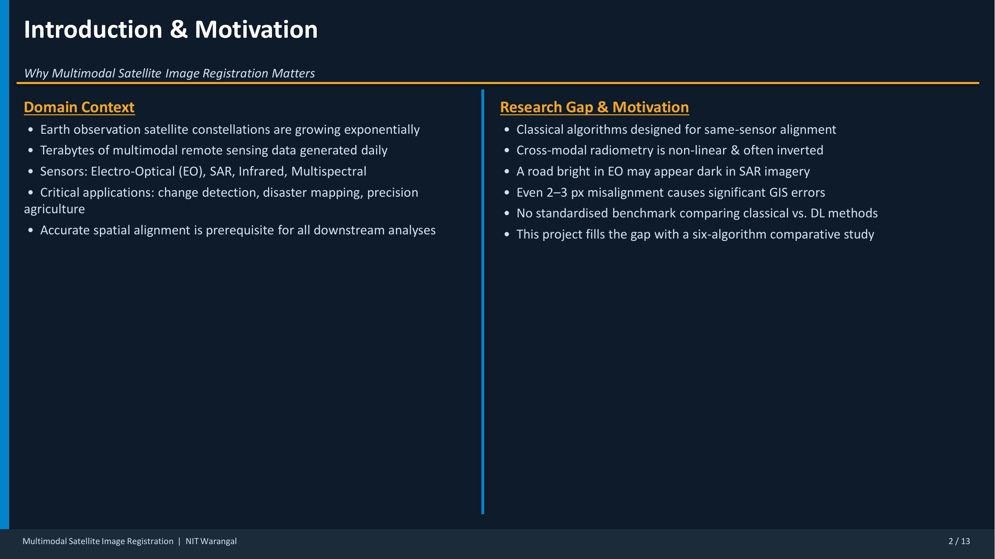
01 MOTIVATION
02 / 13
Why This Problem Matters
Accurate cross-modal registration is the prerequisite for reliable remote-sensing analysis.
Domain context
Why registration
Why multimodal is hard
Earth observation
constellations generate
terabytes of EO, SAR,
infrared, and multispectral
imagery every day for
mapping, agriculture, and
disaster response.
These downstream tasks
depend on precise spatial
alignment. Mis-registered
inputs create false changes,
noisy overlays, and poor GIS
decisions.
The same road can appear
bright in EO and dark in
SAR. Classical descriptors
built for same-sensor
imagery break under this
inversion.
Source visuals are preserved from the original project PDF; text hierarchy and layout are rebuilt for clearer presentation.
Notes:
Use this slide to motivate the project from an application viewpoint before going deep into the algorithms.
[Sources]
- Rhan final-year project PDF, NIT Warangal, Academic Year 2025-26.

Slide 3
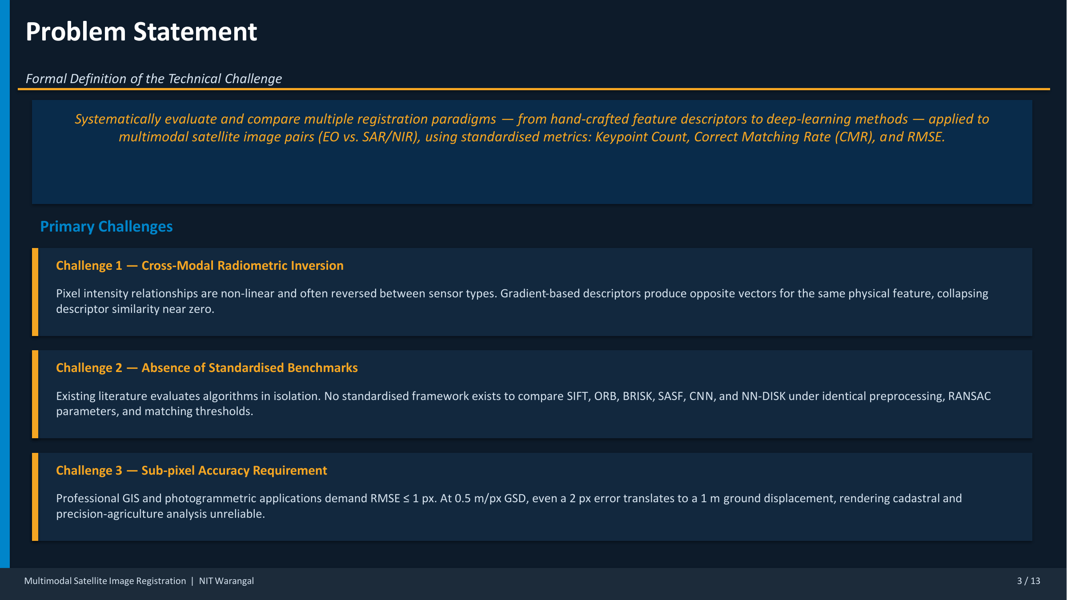
02 PROBLEM
03 / 13
Technical Challenge and Accuracy Target
The study compares multiple registration paradigms under one common evaluation pipeline.
2-3 px
<= 1 px
6 methods
Misalignment can already break GIS overlays
Professional photogrammetry target
Unified comparison setting
At 0.5 m per pixel, even small shifts are costly.
Sub-pixel error is the practical acceptance line.
Same preprocessing, matching logic, and RANSAC setup.
Source visuals are preserved from the original project PDF; text hierarchy and layout are rebuilt for clearer presentation.
Notes:
State the three core challenges: radiometric inversion, lack of standardized benchmarks, and sub-pixel accuracy needs.
[Sources]
- Rhan final-year project PDF, NIT Warangal, Academic Year 2025-26.

Slide 4
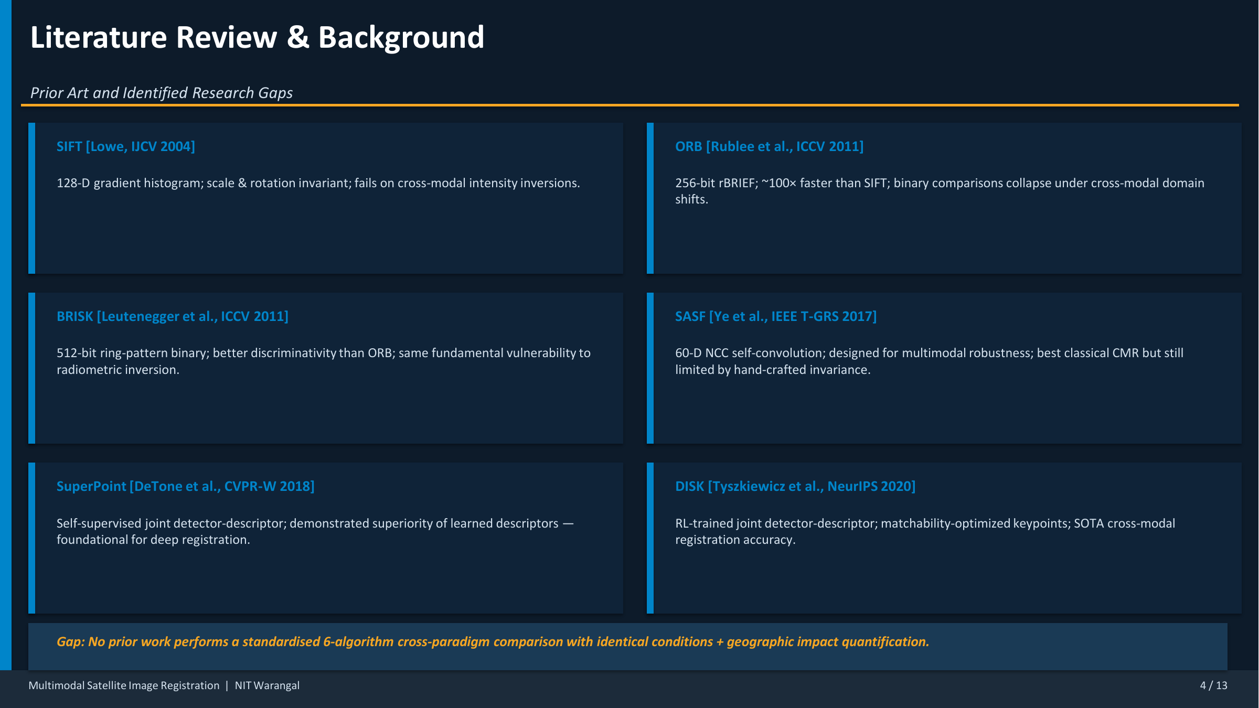
03 LITERATURE
04 / 13
What Earlier Work Gives Us
The project spans fast classical baselines, multimodal descriptors, and learned local features.
Classical baselines
Multimodal classical
Learned descriptors
SIFT, ORB, and BRISK provide
scale or speed advantages,
but their handcrafted
comparisons are vulnerable
when modality changes invert
intensities.
SASF improves robustness by
capturing structural
similarity through NCC-based
self-convolution instead of
relying only on raw pixel
intensity patterns.
SuperPoint and DISK show
that matchability can be
learned directly, making
deep methods the strongest
candidates for cross-modal
alignment.
Source visuals are preserved from the original project PDF; text hierarchy and layout are rebuilt for clearer presentation.
Notes:
Call out the research gap: fair cross-paradigm comparison under identical conditions is missing in much of the literature.
[Sources]
- Rhan final-year project PDF, NIT Warangal, Academic Year 2025-26.

Slide 5
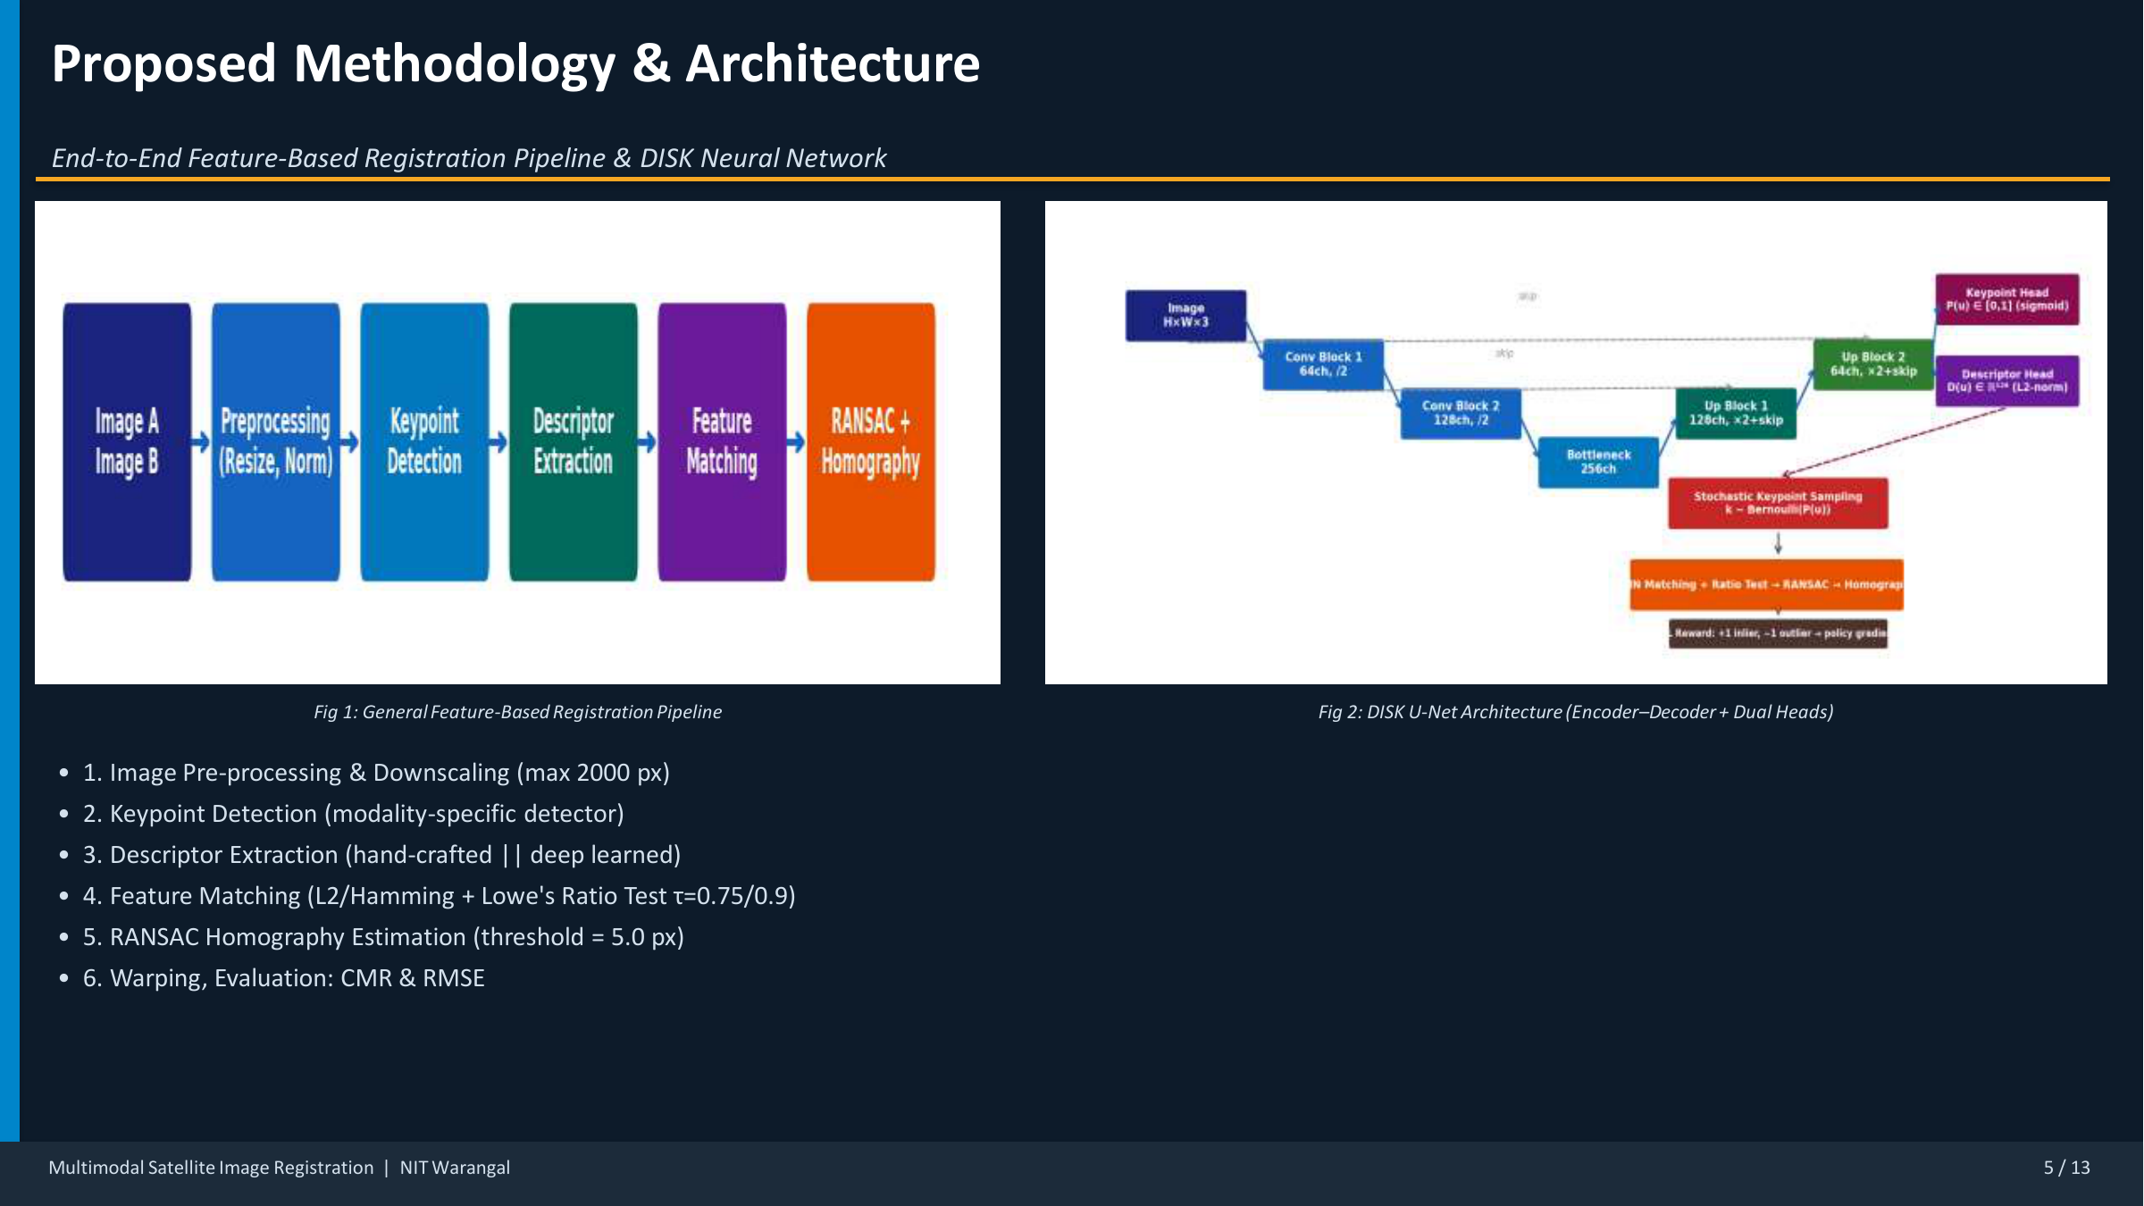
04 METHODOLOGY
05 / 13
Registration Pipeline and DISK Architecture
The PDF figures are preserved here because they capture both the generic pipeline and the deep network design.
Pipeline stages
Deep model choice
Fixed settings
Preprocess and downscale,
detect keypoints, extract
descriptors, match features,
reject outliers with Lowe
plus RANSAC, then estimate
homography and measure
error.
DISK uses a U-Net style
encoder-decoder with
detector and descriptor
heads trained to maximize
correct correspondences
instead of a proxy
objective.
Maximum image size is 2000
px, ratio test is 0.75 for
classical methods and 0.9
for DISK, and the RANSAC
reprojection threshold is
5.0 px.
Source visuals are preserved from the original project PDF; text hierarchy and layout are rebuilt for clearer presentation.
Notes:
Walk the audience through Fig. 1 first, then point to Fig. 2 to explain why the deep method can model cross-modal structure better.
[Sources]
- Rhan final-year project PDF, NIT Warangal, Academic Year 2025-26.

Slide 6
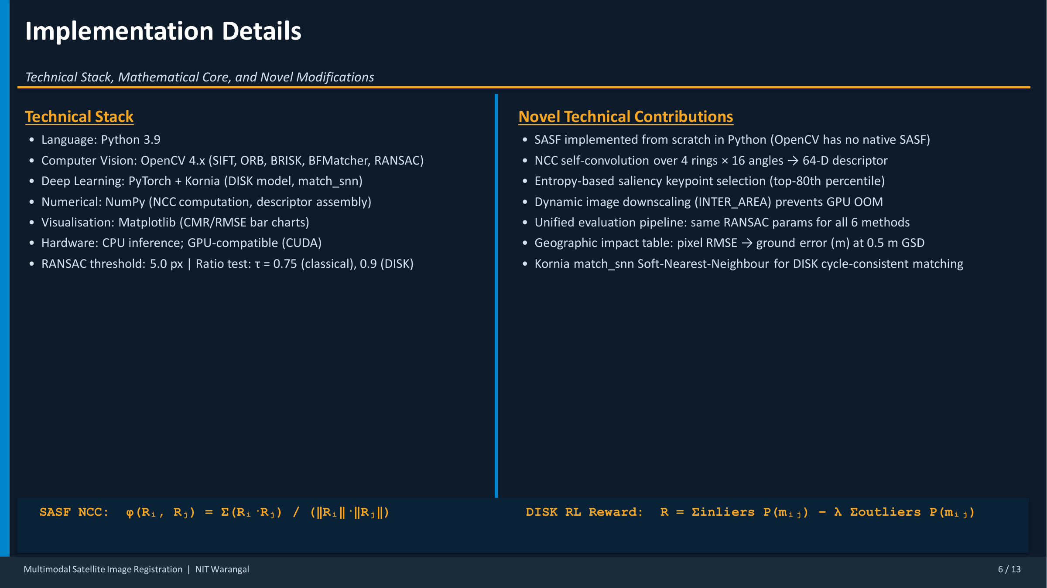
05 IMPLEMENTATION
06 / 13
Technical Stack and Main Contributions
The implementation combines OpenCV baselines with a custom SASF pipeline and PyTorch-based DISK inference.
Python 3.9
4 x 16
Top 80%
Core implementation language
SASF ring-angle descriptor structure
Entropy-based saliency filtering
OpenCV, NumPy, Matplotlib, PyTorch, and Kornia.
NCC over 4 rings and 16 angles drives the custom feature.
Keeps the most informative keypoints for SASF.
Source visuals are preserved from the original project PDF; text hierarchy and layout are rebuilt for clearer presentation.
Notes:
This is the place to mention the from-scratch SASF implementation and unified evaluation design across all compared methods.
[Sources]
- Rhan final-year project PDF, NIT Warangal, Academic Year 2025-26.

Slide 7
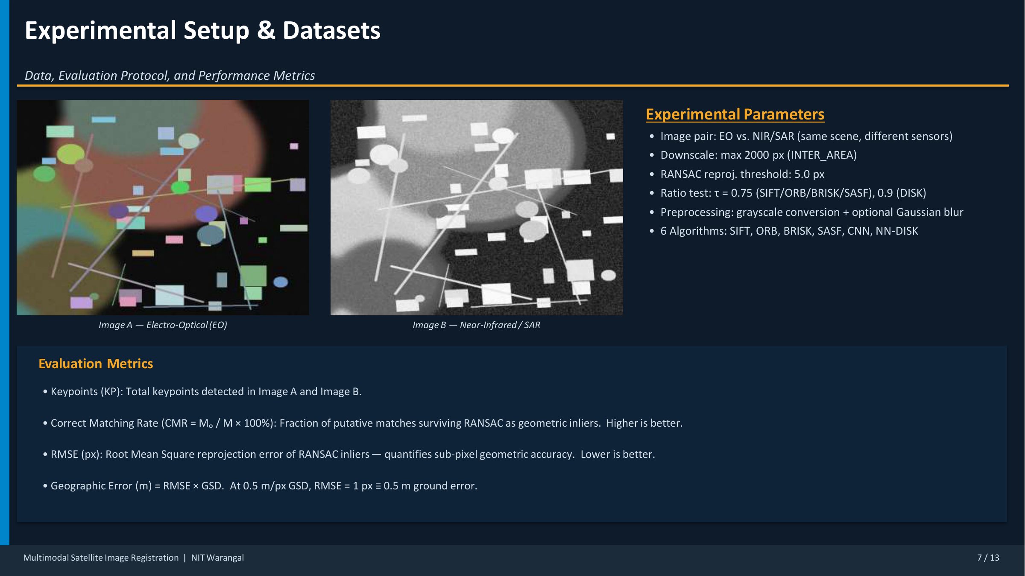
06 SETUP
07 / 13
Dataset and Evaluation Protocol
The same-scene EO and NIR or SAR pair makes the visual mismatch obvious while keeping geometry comparable.
Image pair
Compared methods
Metrics
One EO versus NIR or SAR
pair from the same scene is
used to test how each method
handles strong appearance
change with shared spatial
content.
SIFT, ORB, BRISK, SASF, CNN,
and NN-DISK are run inside
one standardized pipeline so
the comparison stays fair.
Keypoint count tracks
detections, CMR measures
inlier quality after RANSAC,
and RMSE captures the final
geometric accuracy in pixels
and meters.
Source visuals are preserved from the original project PDF; text hierarchy and layout are rebuilt for clearer presentation.
Notes:
Point directly to the EO and SAR or NIR visuals to show why intuitive same-image matching assumptions do not hold.
[Sources]
- Rhan final-year project PDF, NIT Warangal, Academic Year 2025-26.

Slide 8
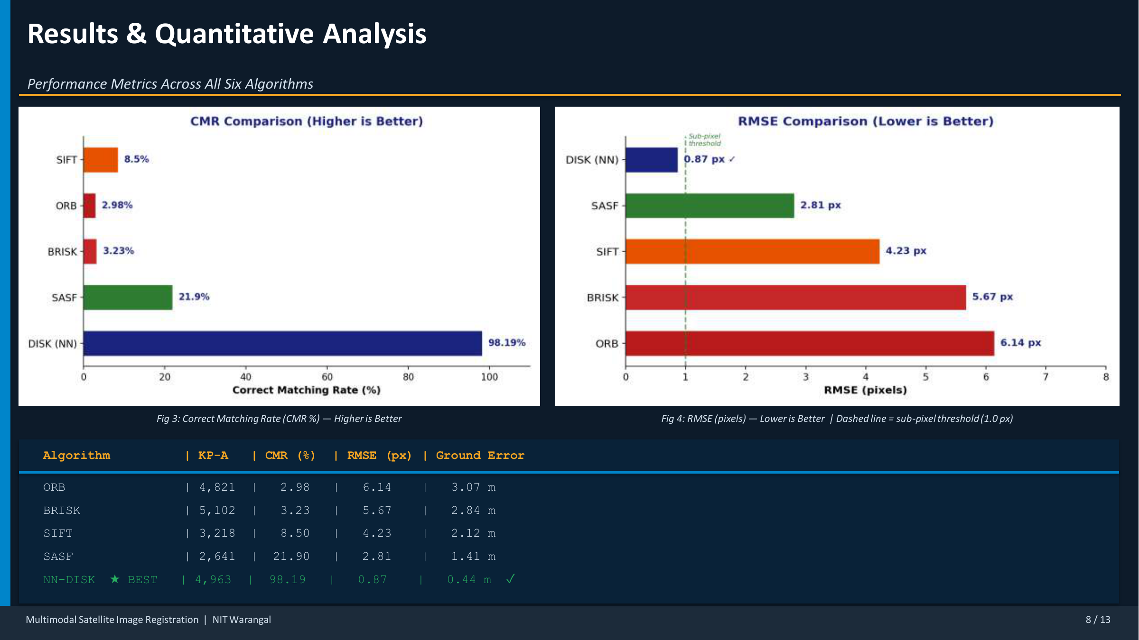
07 RESULTS
08 / 13
Quantitative Results Across Algorithms
This slide preserves the original charts because they are the strongest visual evidence in the presentation.
98.19%
0.87 px
0.44 m
Correct matching rate for NN-DISK
RMSE for NN-DISK
Ground error at 0.5 m per pixel
Highest by a very large margin.
Only method below the 1 px threshold.
Best practical outcome for mapping tasks.
Source visuals are preserved from the original project PDF; text hierarchy and layout are rebuilt for clearer presentation.
Notes:
Use the table and bar charts together: the bars show separation quickly, and the table gives the exact numbers the examiners may ask about.
[Sources]
- Rhan final-year project PDF, NIT Warangal, Academic Year 2025-26.

Slide 9
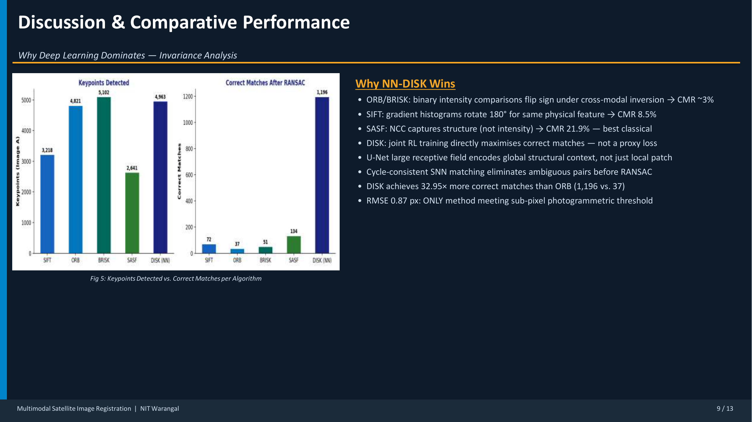
08 ANALYSIS
09 / 13
Why DISK Performs So Much Better
The chart and bullets together explain the gap between handcrafted descriptors and learned matchability.
Why ORB and BRISK fail
Why SASF improves
Why DISK wins
Binary intensity comparisons
flip sign under cross-modal
inversion, so they produce
many unstable matches even
when the physical scene is
the same.
SASF uses structural
similarity rather than
direct radiometric
agreement, so it becomes the
strongest classical option
in the experiment.
DISK learns detector and
descriptor behavior jointly,
uses broader context through
the network, and works with
cycle-consistent matching
before RANSAC.
Source visuals are preserved from the original project PDF; text hierarchy and layout are rebuilt for clearer presentation.
Notes:
Mention the standout comparison: DISK achieves 1,196 correct matches versus only 37 for ORB, which is roughly 32.95 times higher.
[Sources]
- Rhan final-year project PDF, NIT Warangal, Academic Year 2025-26.

Slide 10
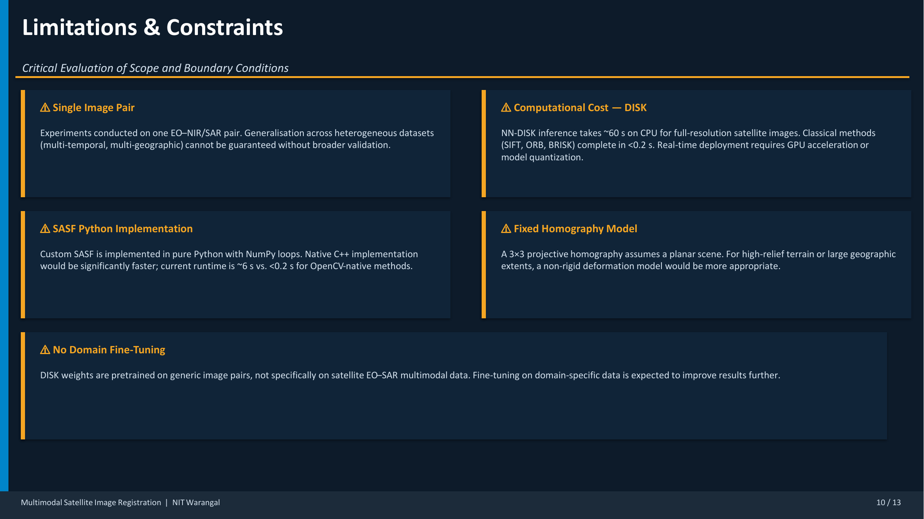
09 LIMITATIONS
10 / 13
Current Constraints of the Study
The result is strong, but the evaluation still has scope and deployment limitations that should be stated openly.
Limited data breadth
Runtime cost
Model assumption
Only one EO versus NIR or
SAR pair was evaluated, so
generalization to new
regions, seasons, and sensor
pairs still needs
validation.
NN-DISK takes about 60
seconds on CPU, while OpenCV
baselines finish in under
0.2 seconds and SASF takes
roughly 6 seconds.
Homography assumes a mostly
planar scene, and DISK was
not fine-tuned specifically
on satellite EO-SAR data.
Source visuals are preserved from the original project PDF; text hierarchy and layout are rebuilt for clearer presentation.
Notes:
Being explicit about limitations usually helps in viva discussions because it shows control over the scope of the work.
[Sources]
- Rhan final-year project PDF, NIT Warangal, Academic Year 2025-26.

Slide 11
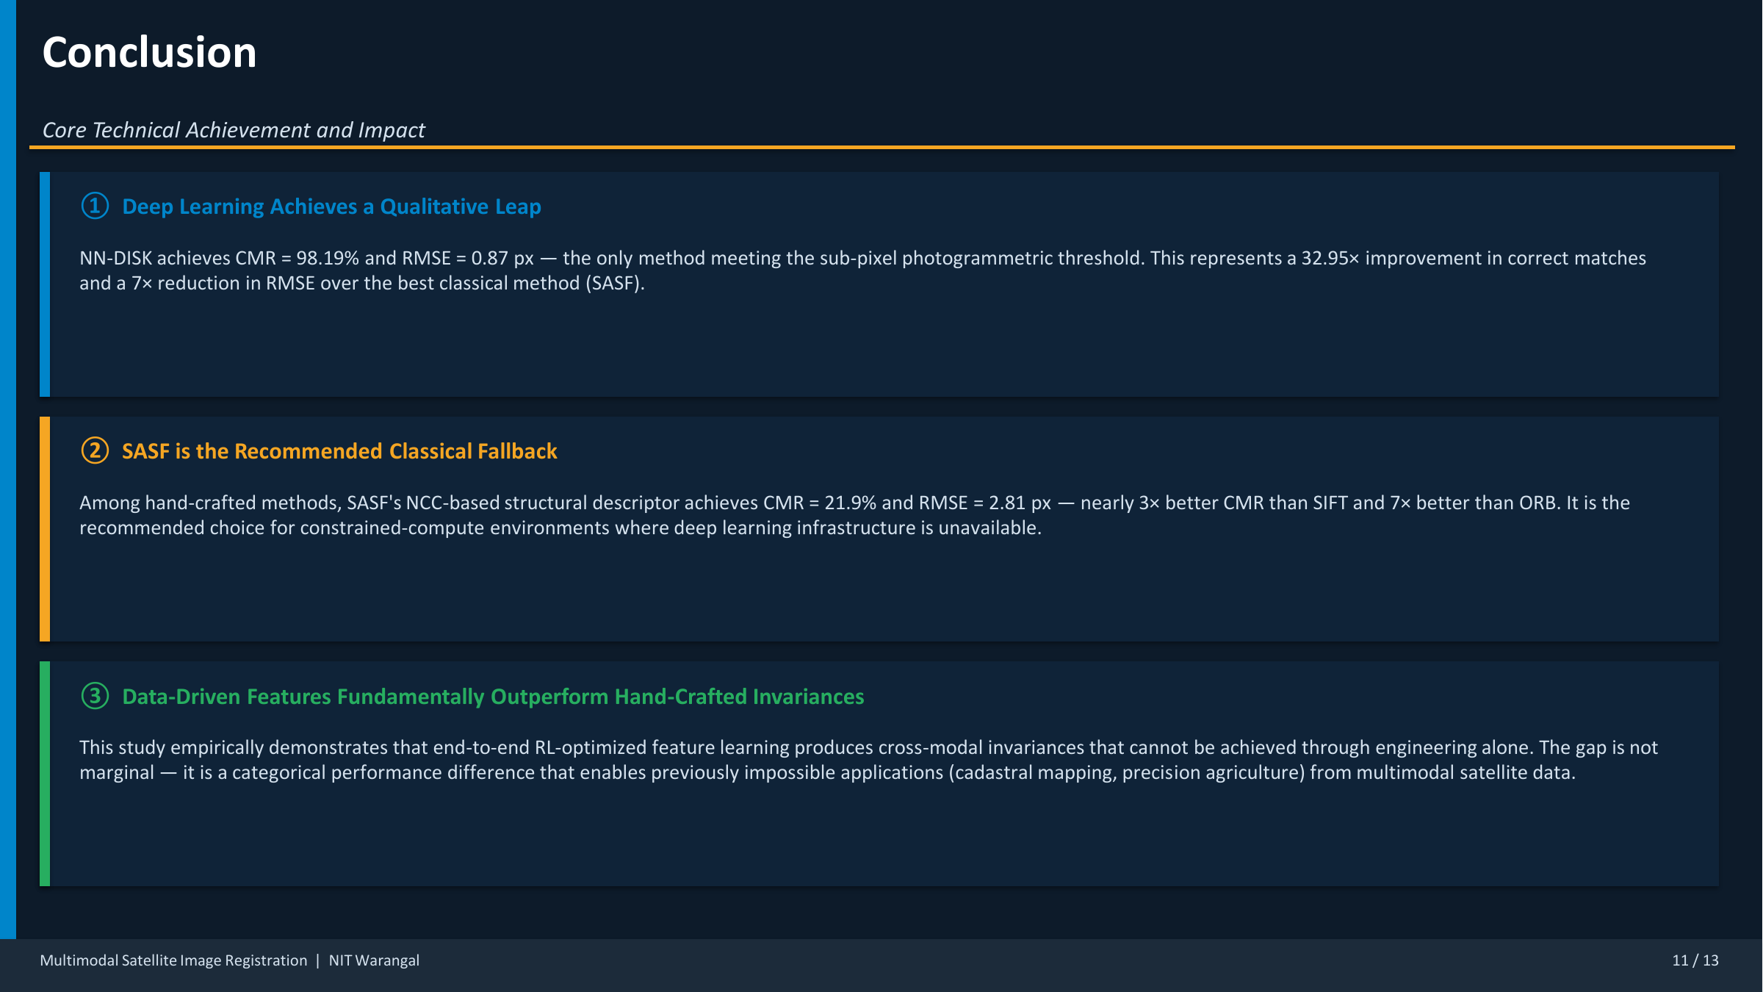
10 CONCLUSION
11 / 13
Core Takeaways
The deep-learning approach produces a categorical improvement rather than a small incremental gain.
32.95x
7x
21.9%
More correct matches than ORB
Lower RMSE than the best classical method
Best classical CMR from SASF
1,196 versus 37 after geometric verification.
NN-DISK versus SASF in the final comparison.
Useful fallback when deep infrastructure is unavailable.
Source visuals are preserved from the original project PDF; text hierarchy and layout are rebuilt for clearer presentation.
Notes:
End with a clear statement: learned features outperform handcrafted invariances for multimodal satellite registration.
[Sources]
- Rhan final-year project PDF, NIT Warangal, Academic Year 2025-26.

Slide 12
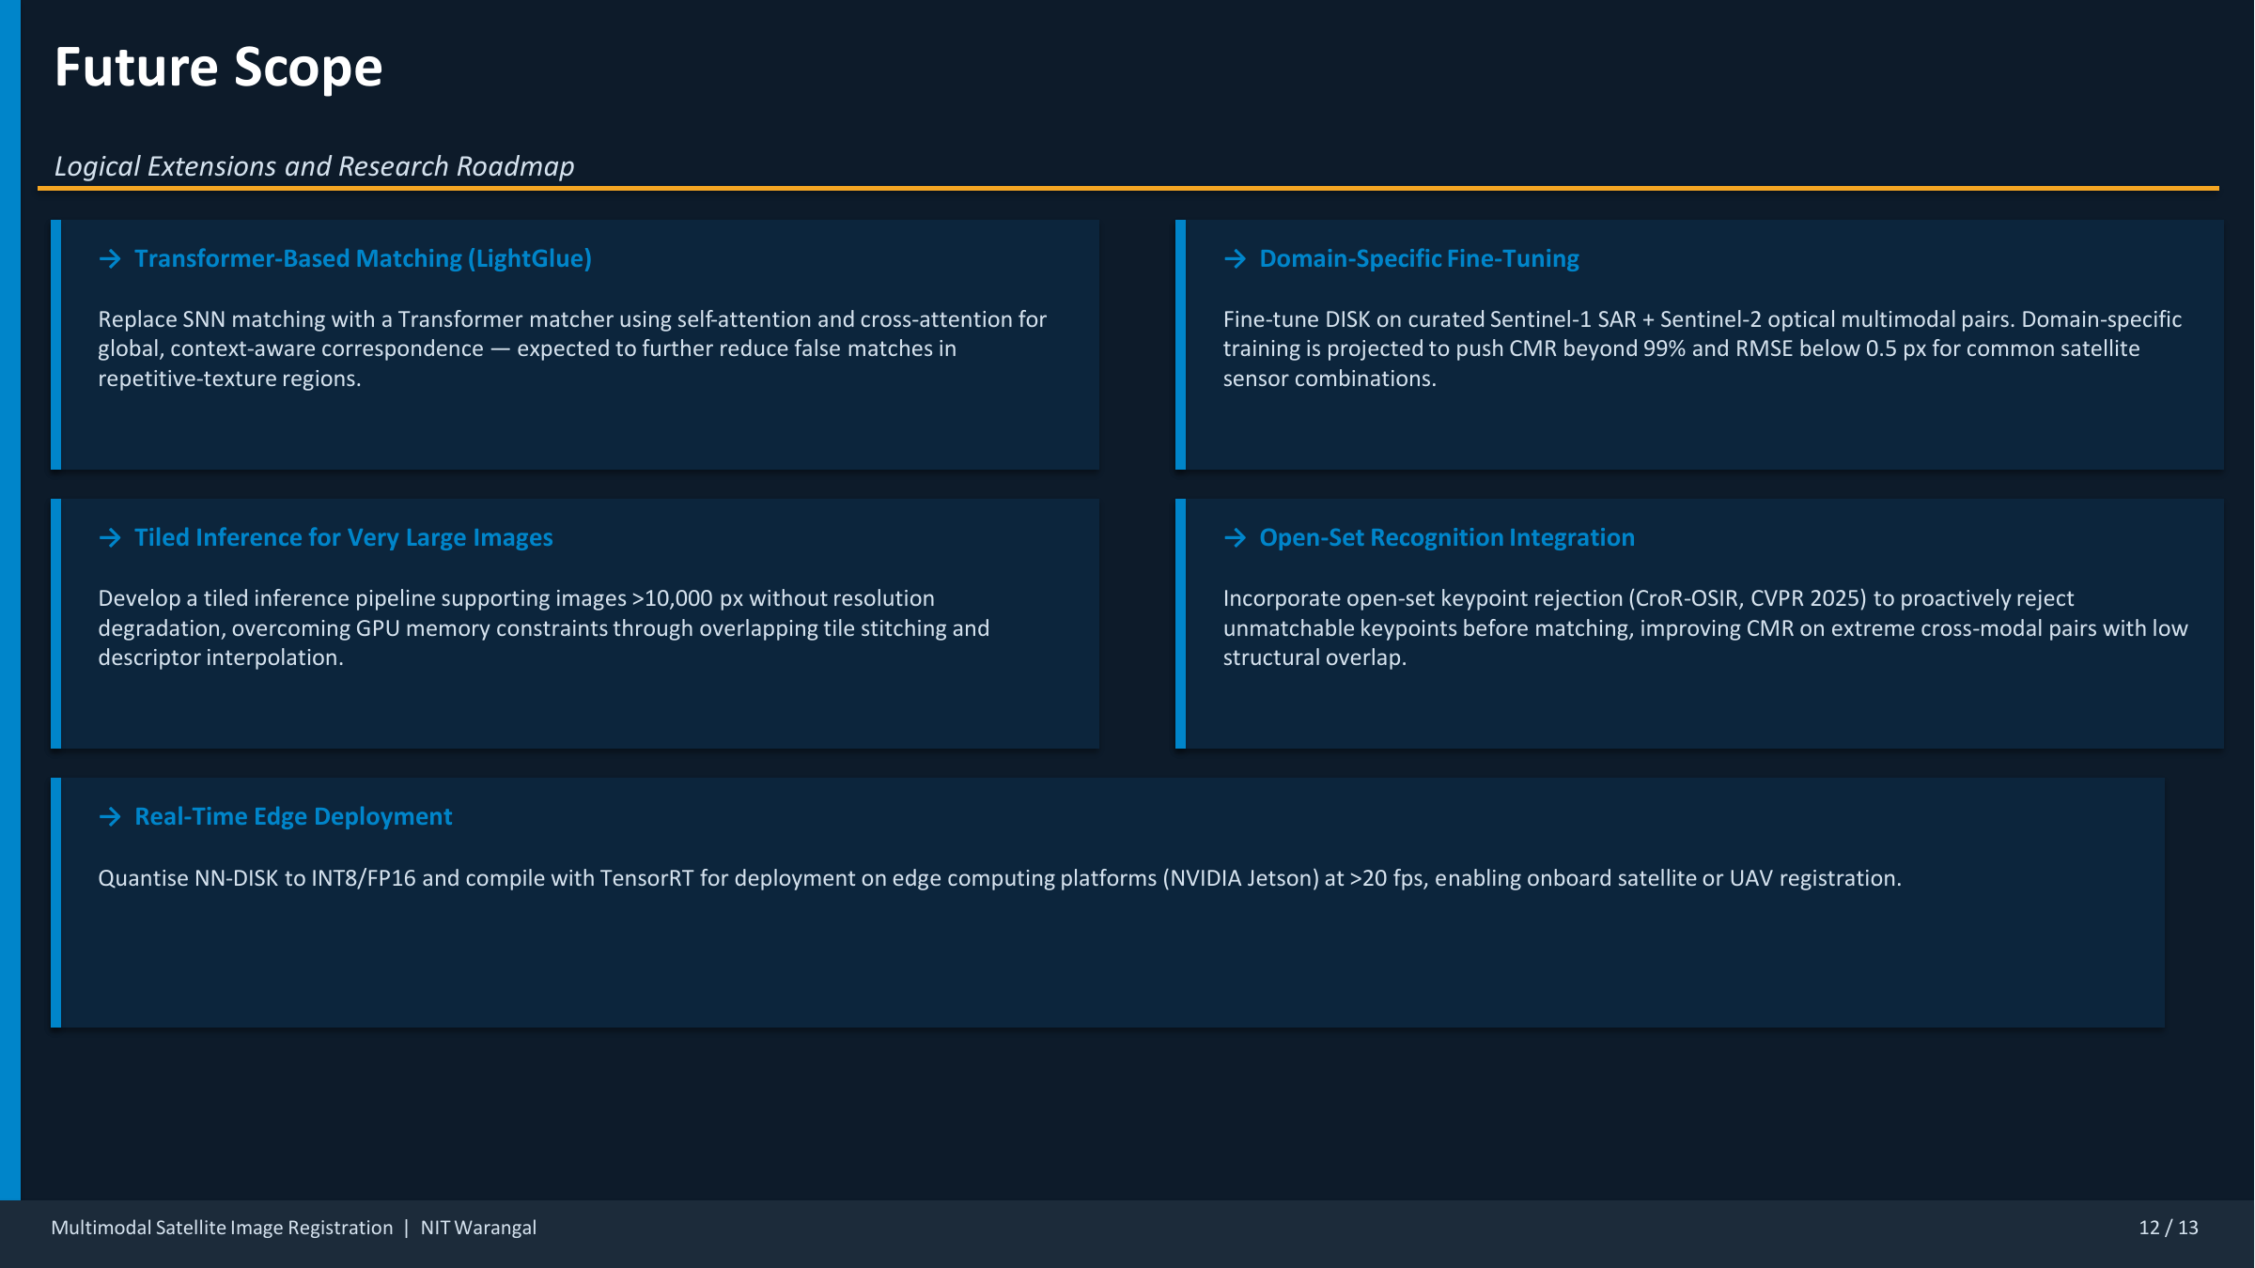
11 FUTURE SCOPE
12 / 13
Where This Can Go Next
The roadmap now is about better matchers, larger datasets, and deployment-ready inference.
Better matching
Better data
Better deployment
Replace soft
nearest-neighbour matching
with LightGlue-style
transformer matching for
stronger context-aware
correspondences.
Fine-tune on curated
Sentinel-1 and Sentinel-2
multimodal pairs to adapt
the learned features to
satellite-specific texture
and noise.
Use tiling, quantization,
and TensorRT or Jetson
deployment to push the
method toward real-time or
near-real-time use.
Source visuals are preserved from the original project PDF; text hierarchy and layout are rebuilt for clearer presentation.
Notes:
If asked for future scope, mention the target direction clearly: more than 99% CMR, below 0.5 px RMSE, and faster inference.
[Sources]
- Rhan final-year project PDF, NIT Warangal, Academic Year 2025-26.

Slide 13
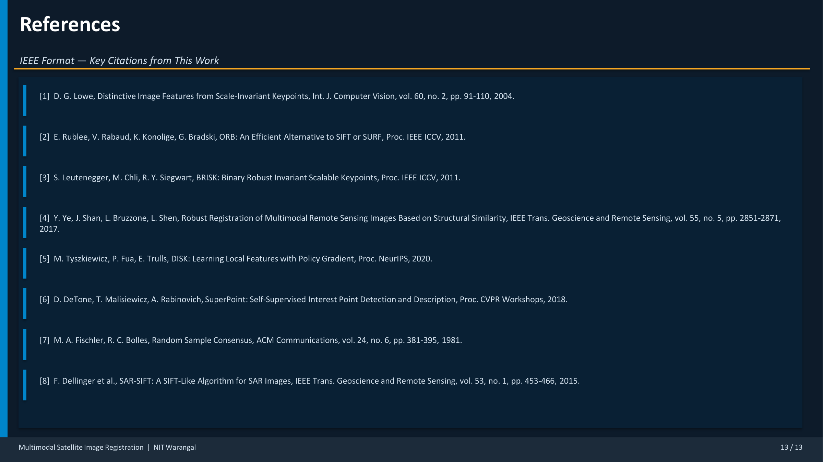
12 REFERENCES
13 / 13
Key References
The project is grounded in foundational local features, multimodal remote-sensing registration, and robust geometric fitting.
Foundations
Multimodal and learned features
Robust estimation
Lowe 2004 for SIFT, Rublee
et al. 2011 for ORB, and
Leutenegger et al. 2011 for
BRISK establish the
classical feature baseline.
Ye et al. 2017 motivates
SASF for multimodal sensing,
while DeTone et al. 2018 and
Tyszkiewicz et al. 2020
frame the learned feature
direction.
Fischler and Bolles 1981
remains the geometric
backbone through RANSAC,
which turns tentative
matches into valid
homography inliers.
Source visuals are preserved from the original project PDF; text hierarchy and layout are rebuilt for clearer presentation.
Notes:
Keep this slide visible if your department expects formal references in the main deck.
[Sources]
- Rhan final-year project PDF, NIT Warangal, Academic Year 2025-26.

