Slide 1
BIA
BOSTON
INSTITUTE OF ANALYTICS
HEART DISEASE PREDICTION
By Rehan Ali

Slide 2
OBJECTIVE
This project's main goal is to develop and assess machine learning models that can identify cardiac disease based on a variety of characteristics, including age, sex, blood pressure, cholesterol, and other pertinent medical information.
The objective is to limit the possibility of misdiagnosing patients with heart disease by achieving high accuracy while giving priority to sensitivity (recall).

Slide 3
Dataset Description
The dataset consists of 1025 entries with 14 columns. Here's a summary of the columns:
age: Age of the patient (int64)
sex: Sex of the patient (int64, 1 = male; 0 = female)
cp: Chest pain type (int64, 0-3)
trestbps: Resting blood pressure (int64)
Chol: Serum cholesterol in mg/dl (int64)
fbs: Fasting blood sugar > 120 mg/dl (int64, 1 = true; 0 = false)
restecg: Resting electrocardiographic results (int64, 0-2)
thalach: Maximum heart rate achieved (int64)
exang: Exercise induced angina (int64, 1 = yes; 0 = no)
oldpeak: ST depression induced by exercise relative to rest (float64)
slope: Slope of the peak exercise ST segment (int64, 0-2)
ca: Number of major vessels (0-3) colored by fluoroscopy (int64)
thal: Thalassemia (int64, 0 = normal; 1 = fixed defect; 2 = reversable defect)
target: Presence of heart disease (int64, 1 = yes; 0 = no

Slide 4
Exploratory Data Analysis (EDA)
There are no missing values present in the dataset
There are notable outliers in age, cholesterol, blood pressure, and heart rate, even though most people have average values for these parameters. When predicting cardiac disease, categorical variables should be carefully considered as they have varying distributions.

Slide 5
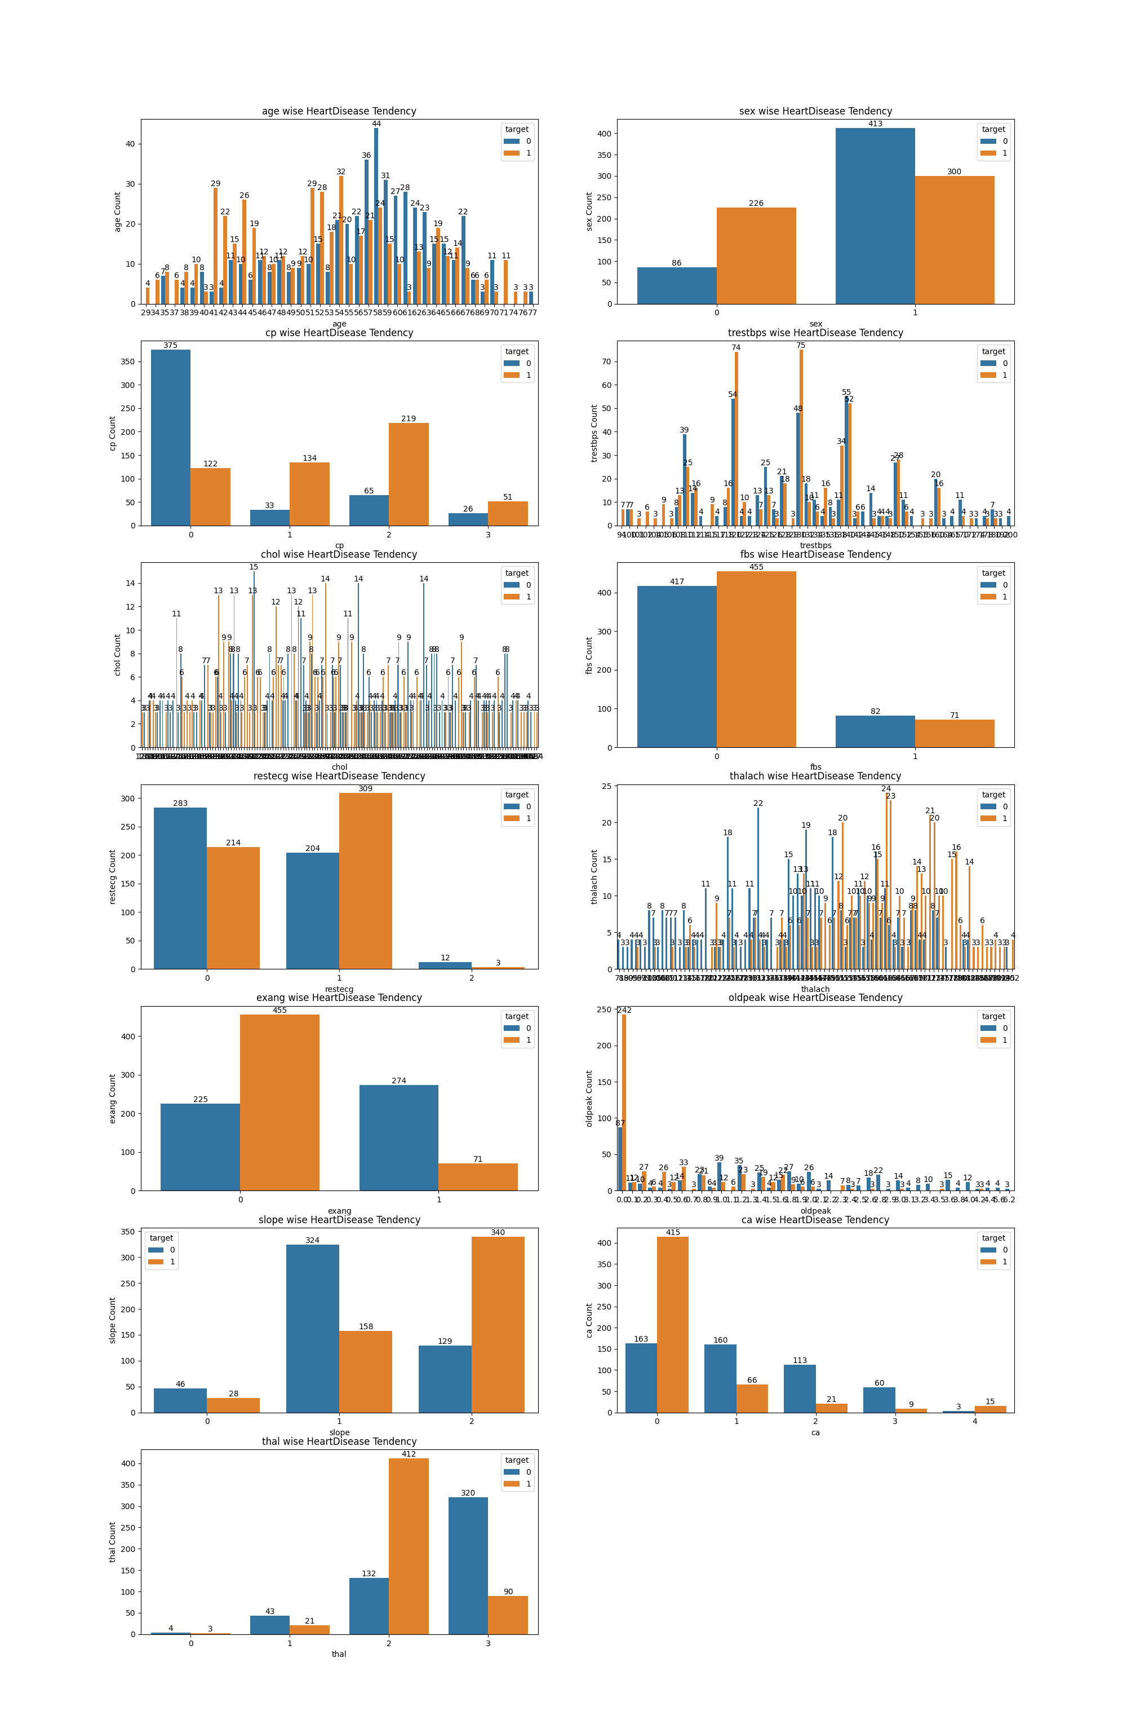

Slide 6
High Probability of Heart Disease
Out of 713 male candidates, 300 have heart disease.
Out of 312 female candidates, 226 have heart disease.
Who is more likely to have heart disease = Female Person
Chest pain type (CP) > Value 1: typical angina
The slope of the peak exercise ST segment (slp) > Value 2: downsloping
(thall) Dipyridamole-Thallium scan results > Value 2: Hemoglobin H Disease

Slide 7
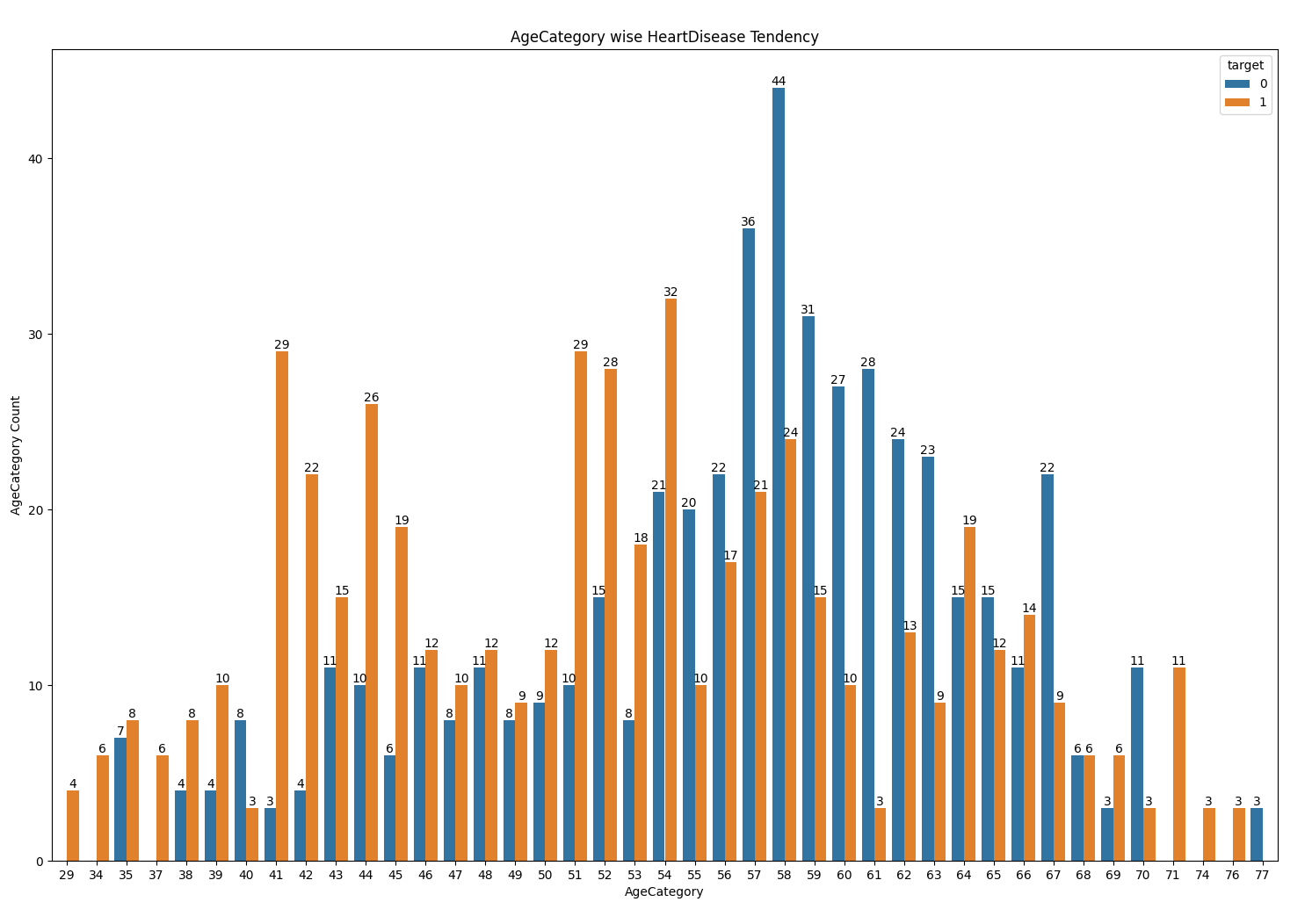
The below graph shows that heart disease prevalence varies with age, with a higher concentration of heart disease in certain age groups, particularly those between 40 and 60 years old.

Slide 8
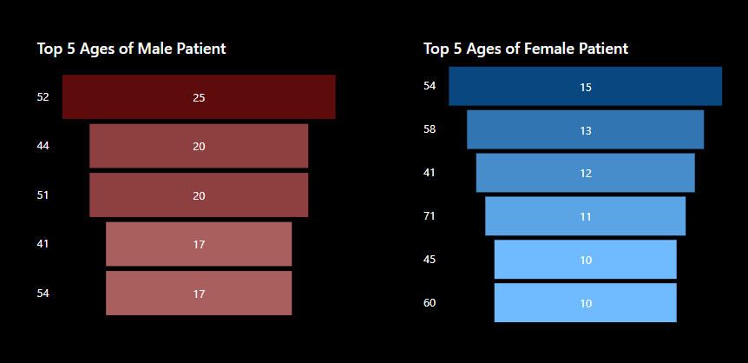
Ages with the most number of Heart Disease Presence

Slide 9
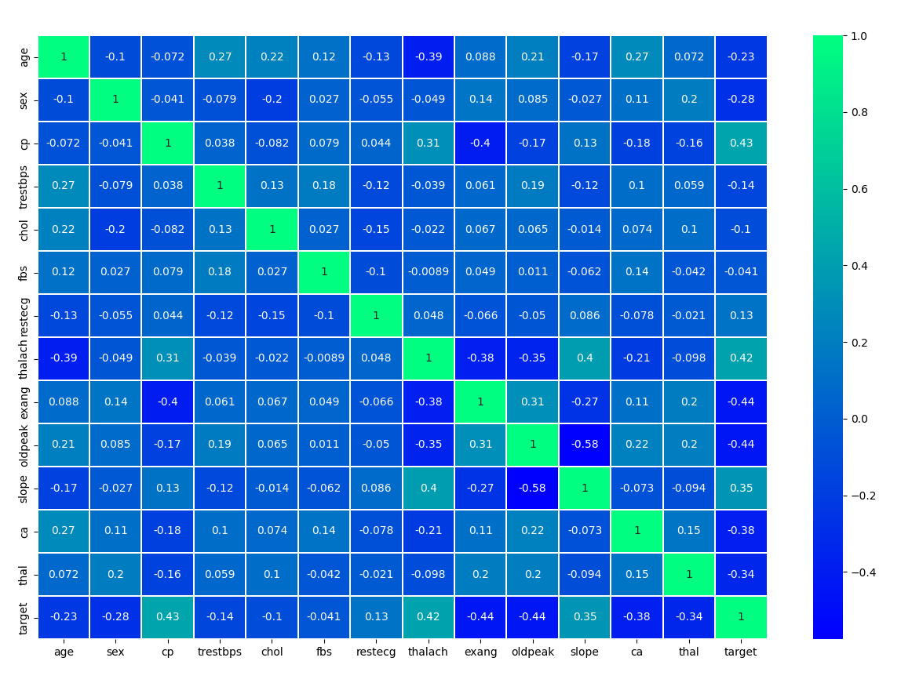
Correlation
Maximum heart rate and age have a negative correlation, but resting blood pressure and cholesterol have a minor positive correlation.
Heart disease is more common in men and in people who experience specific kinds of chest pain.
Increased ST depression during exercise, together with lower maximal heart rates and the presence of exercise-induced angina, are strong markers of cardiac disease.
Knowing these associations aids in the assessing the likelihood of cardiac disease and directs clinical judgments

Slide 10
Machine Learning
Model Training and Evaluation
Model Selection
Model Comparison
Confusion Matrix

Slide 11
Model Training and Evaluation
Data Splitting:
The dataset is divided into training, validation, and testing sets to ensure unbiased model evaluation.
Model Training:
Utilization of various machine learning models to identify the most fitting algorithm for the prediction task.
Evaluation Metrics:
Measuring model performance using metrics like accuracy, precision, recall, and F1 score.

Slide 12
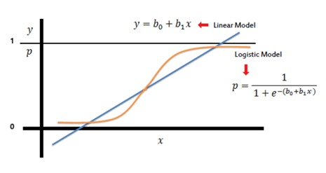
Logistic Regression
Logistic regression is a statistical model used for binary classification problems, where the outcome is a binary variable (0 or 1). It models the Probability that a given input point belongs to a particular class using the logistic function . The logistic function ensures that the output is between 0 and 1
‎With an accuracy of 0.84, the logistic regression model accurately predicts 84% of the cases. At 0.83, it is highly precise, meaning that 83% of the positive predictions are accurate. With a recall of 0.87, the model accurately detects 87% of real positive cases. The F1-Score of 0.85 strikes a compromise between precision and recall, offering a solitary indicator of the model's efficacy.

Slide 13
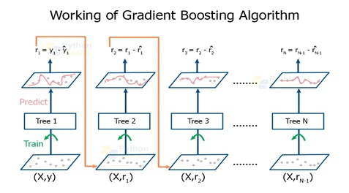
Gradient Boosting
Gradient Boosting is an ensemble technique that builds models sequentially, where each new model attempts to correct the errors made by the previous models.
With a 97% accuracy rate, the gradient boosting model accurately predicted 97 out of 100 situations. With a 98% accuracy rate, the majority of its optimistic forecasts came true. It correctly recognized 96% of all real positive cases with a 96% recall rate. With an F1-score of 97%, performance is generally solid and there is a strong balance between recall and precision.

Slide 14
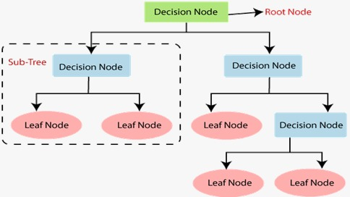
Decision Tree
Decision trees are non-parametric supervised learning methods used for classification and regression. They split the data into subsets based on the value of input features, creating a tree-like model of decisions.
With a 99% accuracy rate, the decision tree model predicts 99 out of 100 cases accurately. Its 100% precision means that all of its positive predictions came true. With a recall percentage of 98%, it successfully recognized 98% of all real positive cases. Precision and recall are balanced by the F1-score of 99%, which shows that the model works exceptionally well overall.

Slide 15
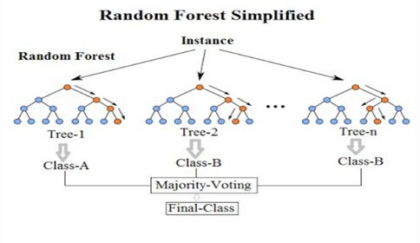
Random Forest
Random forests are an ensemble learning method that constructs multiple decision trees during training and merges them to improve accuracy and control overfitting.
With a flawless accuracy of 100%, the random forest model correctly predicted every scenario. Because of its 100% precision, each positive forecast came true. It detected all real positive instances with a 100% recall rate. Additionally, the model's F1-score of 100% indicates that it performs admirably by all measures.

Slide 16
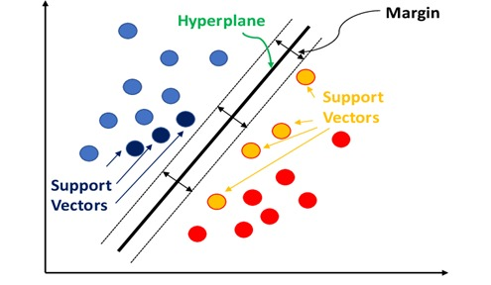
Support Vector Machine
Support Vector Machine (SVM) is a supervised machine learning algorithm used for classification and regression tasks. It works by finding the hyperplane that best separates the data into different classes.
With an accuracy of 95.1%, the SVM model did remarkably well, correctly classifying 95.1% of the examples. With 93.6% precision, it means that 93.6 % of the positive forecasts were accurate. It correctly detected 97.1% of the real positive instances, as evidenced by the recall rate of 97.1%. The 95.3% F1-score highlights the model's overall efficacy by striking a balance between recall and precision.

Slide 17
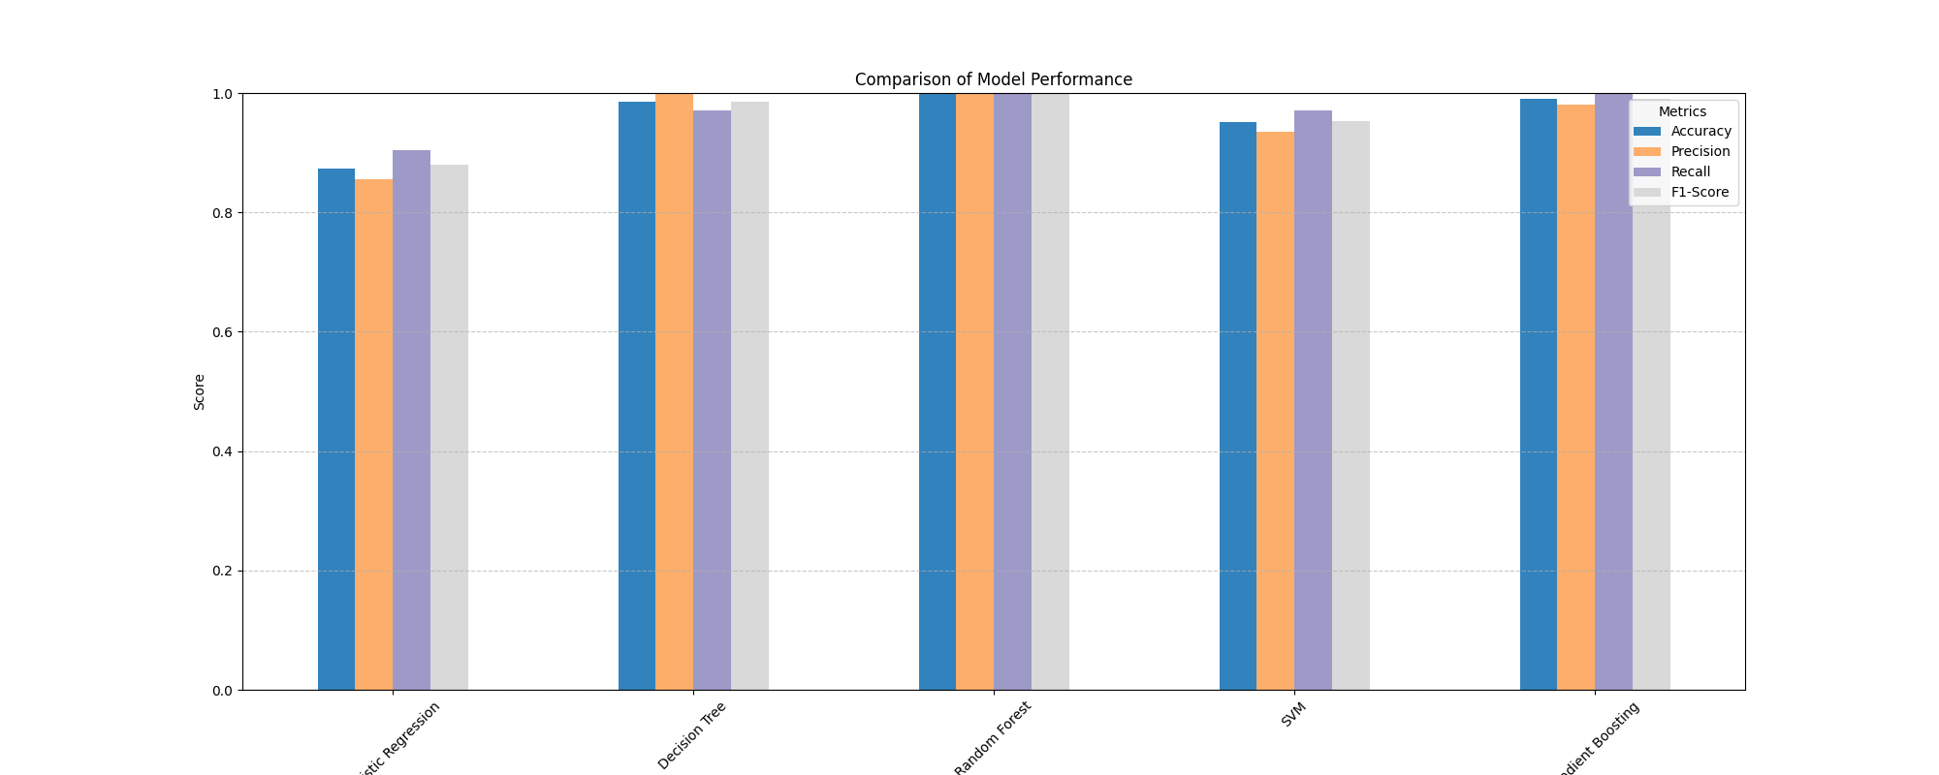
Model Comparison
Accuracy: Decision Tree and Random Forest models yielded the best results, while all models performed quite well overall.
Precision: The best models for predicting heart disease without producing a lot of false positives are Decision Tree and Random Forest, with the highest precision.
Recall: Random Forest is the best at recognizing real heart disease patients since it has the highest recall.
F1-Score: Random Forest has the highest F1-score among the models, suggesting that recall and precision are well-balanced.

Slide 18
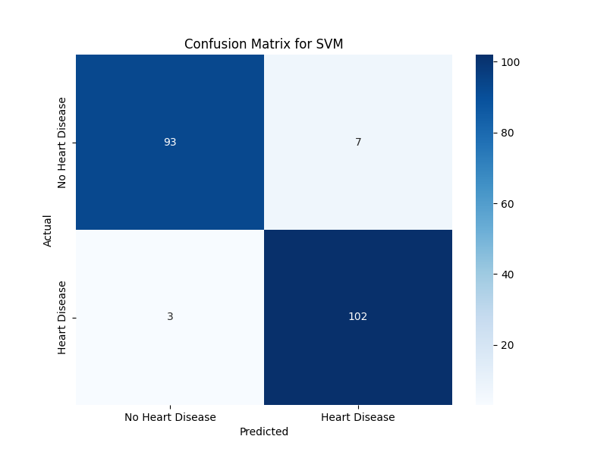
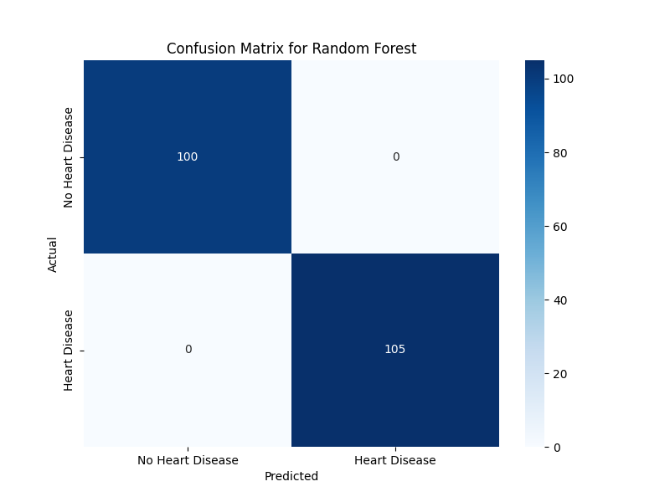
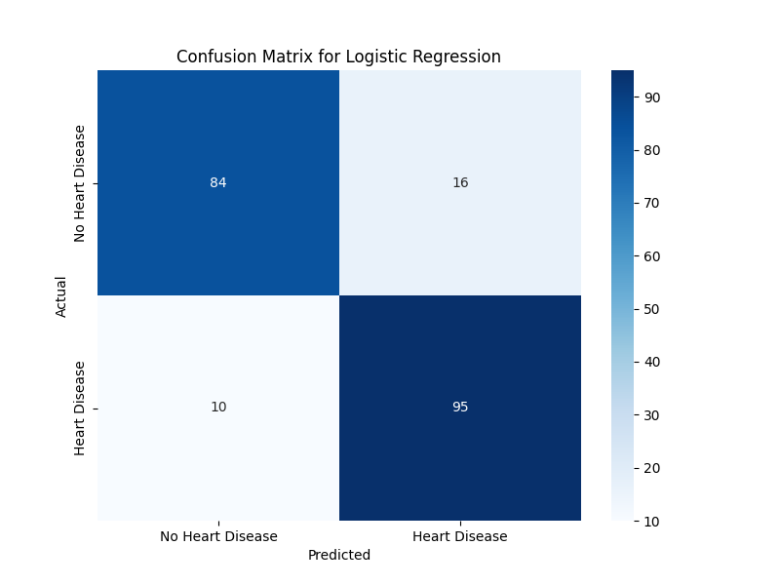


Confusion Matrix
Decision Tree , Random Forest, and Gradient Boosting show a well-balanced
confusion matrix with fewer misclassifications.
Logistic Regression has more false positives and false negatives compared to other models,
indicating potential overfitting or underfitting.
SVM performs slightly better than Logistic Regression

Slide 19
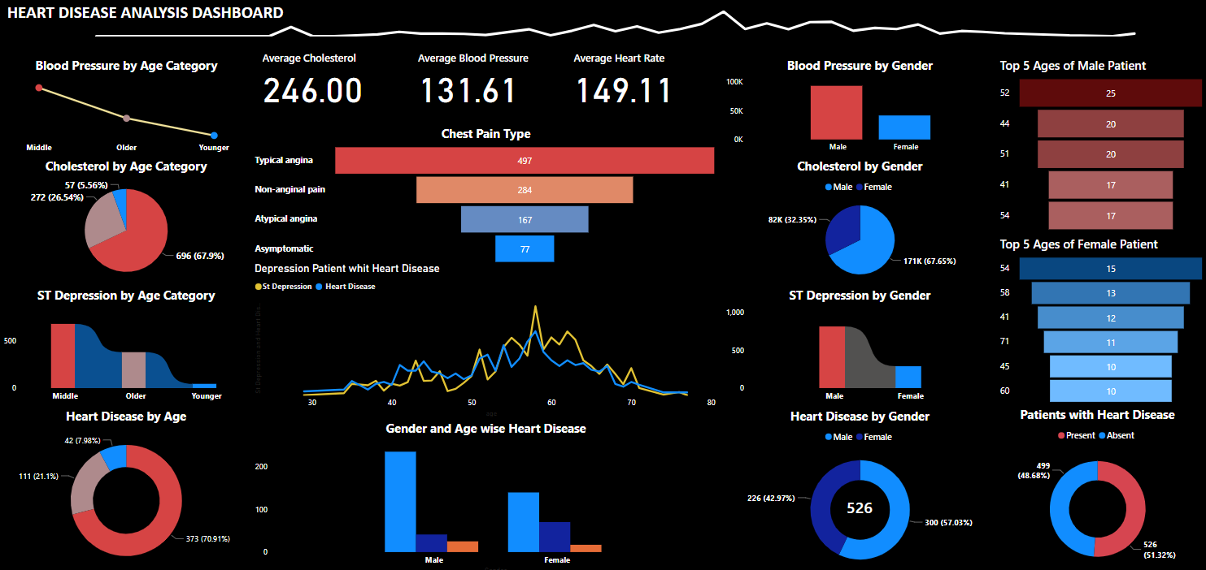
Overview Of Dashboard

Slide 20
Conclusion
Random Forest: With the best accuracy, recall, F1-score, and precision among the models tested, this one performed best overall and required the fewest trade-offs.
Gradient Boosting: If model simplicity and interpretability are important to you, it is a good substitute that performs similarly to Random Forest.
Decision Tree: Performed exceptionally well in recall, making it a good option when determining the majority of positive cases is essential.
Logistic Regression: Did not perform as well as other models, suggesting a less robust model in this situation.
SVM: While still useful, SVM's recall was marginally lower than that of Random Forest and Gradient Boosting, which made it less suitable for situations in which finding every case of heart disease is crucial.

Slide 21
Health Implication
It's critical to screen for heart disease on a regular basis, particularly for people between the ages of 40 and 60.
Effective preventative methods include blood pressure monitoring, cholesterol monitoring, and management of exercise-induced ST depression.
Heart disease can be detected early and treated promptly with the use of predictive models such as Random Forest and Decision Tree, which may lead to better patient outcomes.

Slide 22
Thank You!!!

