Slide 1
TRANSLATOR
TEAM 6
ANDY, MATT, MIG, ROHAN, SADMAN

Slide 2
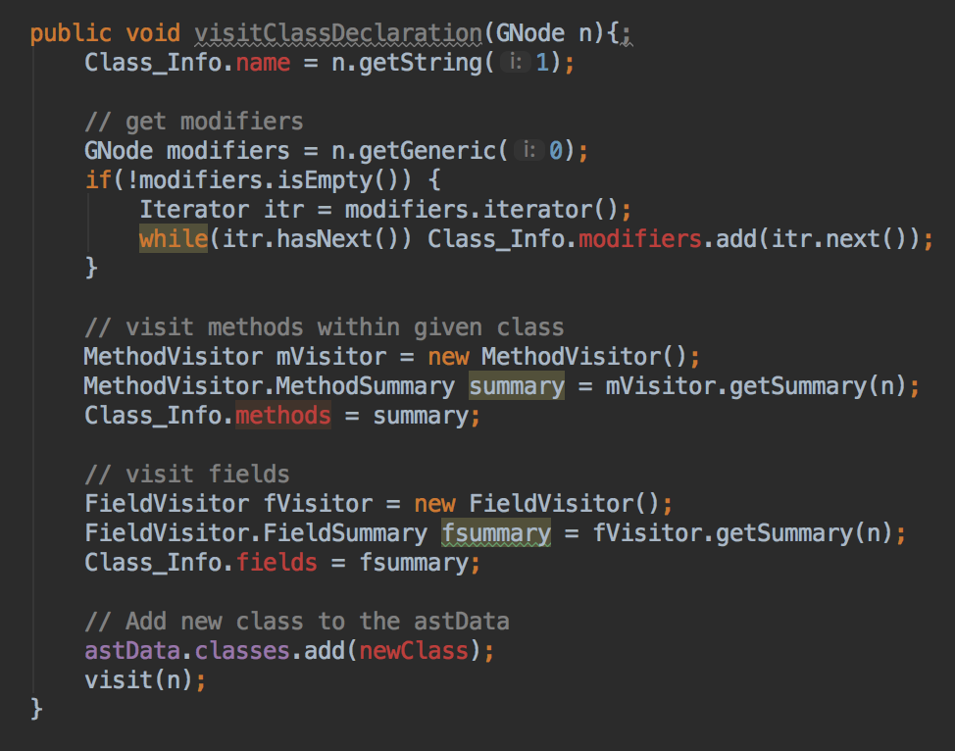
PHASE 1:
Input: Source java file
Output: Set of ASTs representing Java classes to be translated.
Steps:
Define our own classes MethodVisitor and FieldVisitor to cover functions and variables of each class.
Traverse them and summarize the data in a struct called Class_Info.

Slide 3
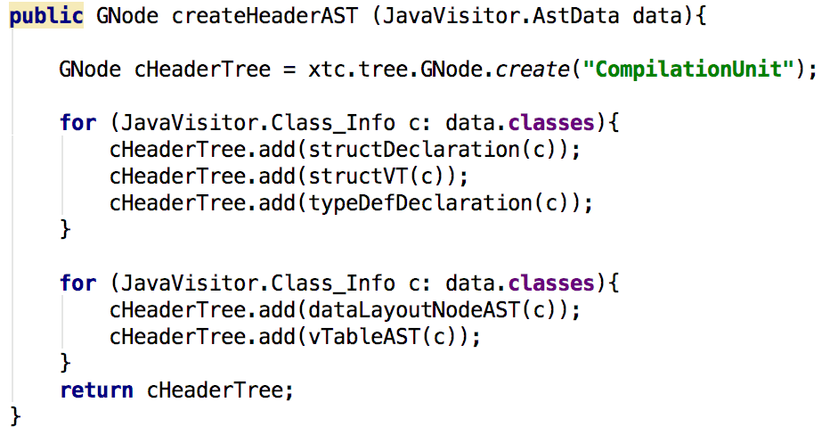
PHASE 2:
Input: Set of output ASTs from Phase 1.
Output: A set of ASTs representing the vtable and data layout for the C++ header file.
Steps:
Implement methods to create nodes for our declarations and the ASTs for our data layout node and vtable
Combine these into a single node for the header AST

Slide 4
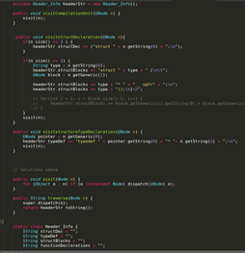
PHASE 3:
Input: Set of output ASTs from Phase 2.
Output: No output (Should print out the completed header file)
Steps: Take in the AST and implement unique Visitor Classes to traverse the AST and pull the necessary information.

Slide 5
QUESTIONS?

