Slide 1
Ryu Controller Homework
Speaker: Yi-Ta Chen
Advisor: Tsung-Nan Lin
Date: 20180515

Slide 2


Environment
Mininet-tree topology
  sudo mn --topo=tree,3 --switch=ovs,protocols=OpenFlow13 --mac --controller=remote
Ryu application
  cp simple_switch_13.py simplefirewalltask1.py
  cp simple_switch_13.py simplefirewalltask2.py
  Modify the code to observe two phenomenon
    h4 cannot ping h8, h8 cannot ping h4
    h4 cannot ping h8, h8 can ping h4
  Finish task1 get score:85
  Finish task2 get score:100
s1
s2
s5
s3
s4
s6
s7
h1
h2
h3
h4
h5
h6
h7
h8

Slide 3
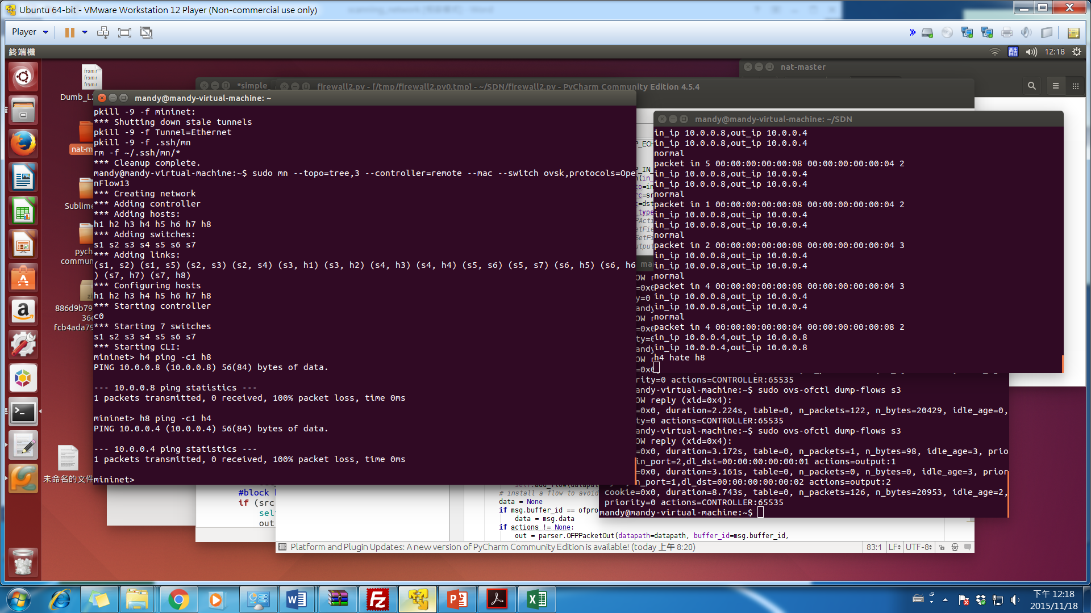
Demo Score:85 h4 cannot ping h8,and h8 cannot ping h4
h4 can’t ping h8
h8 can’t ping h4

Slide 4
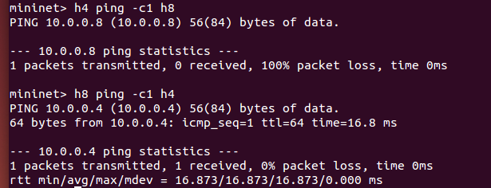
Demo score:100
-h4 cannot ping h8,but h8 can ping h4
h4 can not ping h8
h8 can ping h4

Slide 5
Submission Requirement
Report
  The result screenshot of task1 and task2.
  The simple discussion of the method you used in task2
Code
  Task1 Ryu controller code
  Task2 Ryu controller code
Deadline: 2018/05/22 24:00
Submission requirement
  Compress your dirctory into “ryu_學號.zip”
    +- ryu_學號/
    +- simplefirewalltask1.py
    +- simplefirewalltask2.py
    +-Report.pdf (pdf )

