Slide 1
Memory Devices on DE2-115
數位電路實驗
TA: 吳柏辰
Author: Trumen

Slide 2
Outline
SRAM
SDRAM
FLASH
EEPROM
SD Card

Slide 3
SRAM

Slide 5
Features
16M-bit (2MB) static RAMs organized as 1024K words by 16 bits.
High-speed access times:
speed = 20ns for VDD 1.65V to 2.2V
speed = 10ns for VDD 2.4V to 3.6V
speed = 8ns for VDD 3.3V + 5%
# of addresses
Maximum performance frequency: 125MHz

Slide 6
Schematic Diagram

Slide 7
SRAM Pin Assignments
Signal Name | FPGA Pin No. | Description
SRAM_ADDR[0]~ | PIN_AB7~ | SRAM Address[0]~
SRAM_DQ[0]~ | PIN_AH3~ | SRAM Data[0]~
SRAM_OE | PIN_AD5 | SRAM Output Enable
SRAM_WE | PIN_AE8 | SRAM Write Enable
SRAM_CE | PIN_AF8 | SRAM Chip Enable
SRAM_LB | PIN_AD4 | SRAM Lower Byte Control
SRAM_UB | PIN_AC4 | SRAM Upper Byte Control

Slide 8
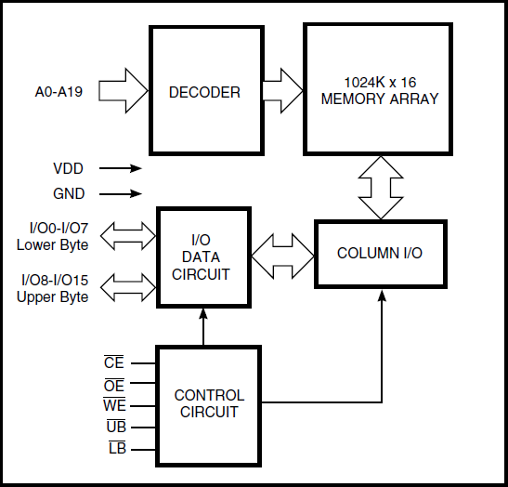
SRAM Block Diagram

Slide 9
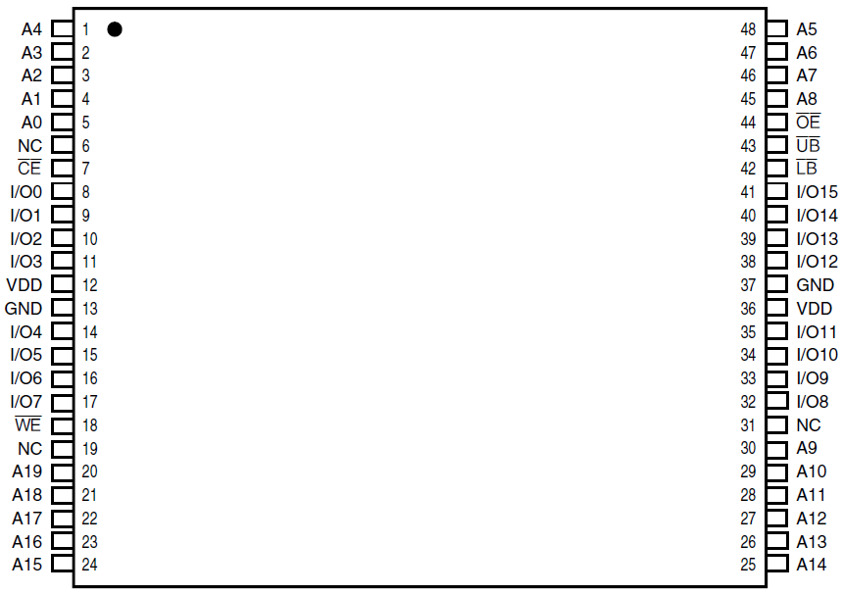
SRAM Pin Configuration
48-pin TSOP-1 (12mm x 20mm)

Slide 10
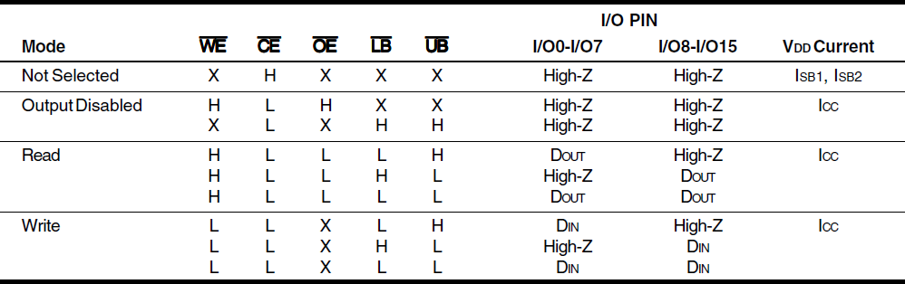
Truth Table

Slide 11
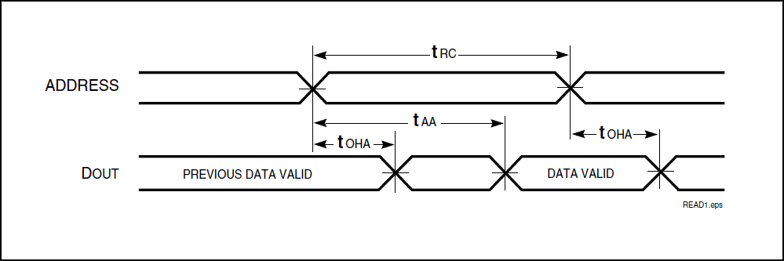
Read Cycle
Min. read cycle time t_{RC} = 8ns

Slide 12
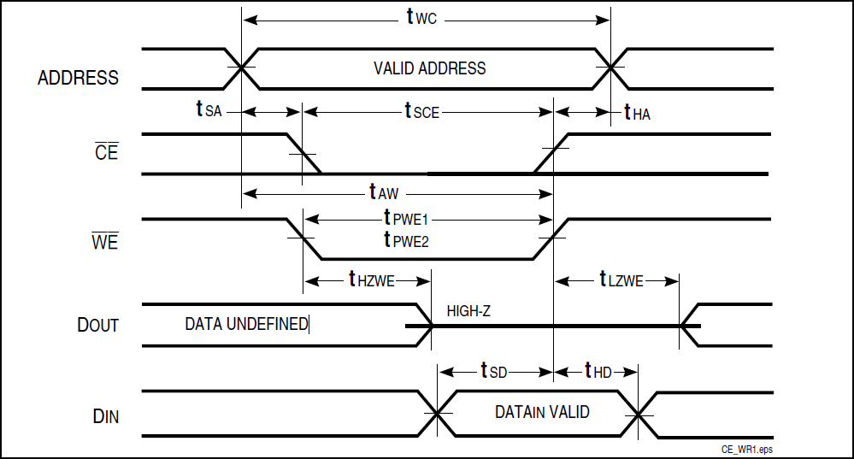
Write Cycle
Min. write cycle time t_{WC} = 8ns

Slide 13
The End.
Any question?

Slide 14
Reference
"DE2-115 User Manual" by Terasic.
"DE2-115_MB.pdf" by Terasic.
"61WV102416ALL(ISSI_1M x 16_SRAM).pdf" by ISSI.

